Slide 1


CPaaS Cloud PBX Solution
September, 2022

Slide 2
Problem Statement & Solution
Introduction
Key Features
Value Propositions
Comparison
Snapshots
Success Stories

Slide 3




Problem Statements & Solutions
1
2
Scaling Business
Business Communication
Organizations are bound to have business cycles with peak periods and increased call volumes in some season and and low times in others. To catch up with varying demand, an easily scalable solution is needed.
With the rapidly evolving world and change in global perspective, there’s an evenly growing need to make remote work-enabled solutions available. It’s becoming the necessity of the time.
Enjoy a complete CPaaS Cloud PBX solution on the go! Your staff can connect to the service from anywhere while maintaining an efficient and personalized customer service delivery with a user-friendly interface on any smart and internet-accessible device.
CPaaS Cloud PBX is the ultimate solution which can be effortlessly modified with just a few clicks. No matter the influx, CPaaS Cloud PBX allows you to scale up or down your workforce to match with the pace of business.

Slide 4


Introduction
The CPaaS Cloud PBX solution is a cloud-based, modular Call Management System designed to replace the traditional PABX systems of our customers. We provide a user-friendly, web-based complete telephony system for users to manage their workflows.
Our scalable solution involves Auto Attendant, Phone System components providing basic functions such as multi-layered call flows, call transfer, call forwarding, call-pickup, missed call notification, voicemail, BLF,... and integration with third party softwares using modern microservices architecture.

Slide 5


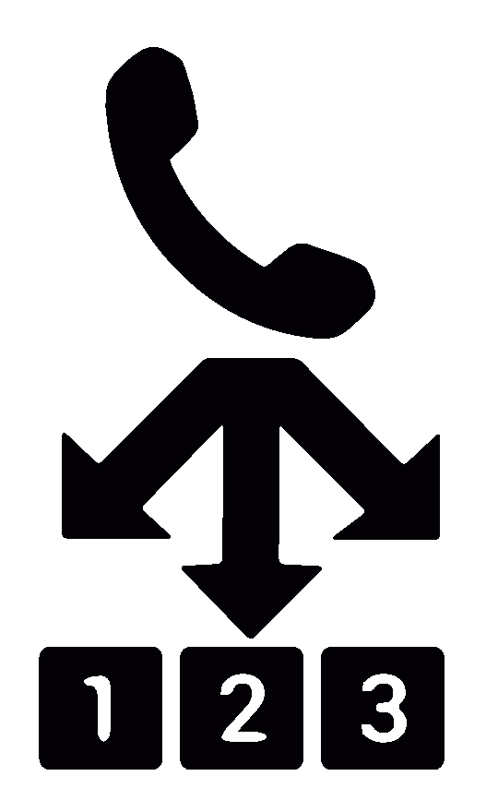











Key Features
Virtual Receptionist
Direct customers easily through your Virtual Receptionist
Auto Attendant
Unlimited layers of automated phone attendants with multiple supported languages and accents
Incoming Call Filter
Set advanced rules that provide special handling for calls with specific information
Time-dependant Call Handling
Set up different incoming call rules for different times of the day, including office hours, after office hours, or even public holidays
Simultaneous Ring
The work phone, mobile phone, and home phone can all ring simultaneously when you receive a call
Call Group
Allow calls to be forwarded to multiple users at once which will ring simultaneously
Caller ID Control
Support making anonymous calls or choosing any assigned numbers as a Caller ID
Call Recording
Allow automatically recording all incoming and outgoing calls - or doing it on demand
Team Chat
A clean and simple messaging service that brings all your communications to one place without the complexity and confusing features
Busy Lamp Field
Allow operators to view their users' status (e.g., busy or available) from their IP Phones
Music & Message On Hold
Create fun and interesting on-hold experiences for your callers by uploading your music or messages
3-way Conference Calls
By simply selecting a button on your phone you can quickly add another caller to the conversation
Integrable with third parties
We support integrating with MS Teams, Webhook
Role-based Access Control
Different roles will have different permissions to access configuration and organization data

Slide 6






Value Propositions
Flexibility
Cloud PBX empowers users to connect from anywhere and everywhere, using any VoIP device of their choice.
Compliance and Security
All calls are recorded for regulation and compliance purposes.
Cost & Time Efficient
Saves cost and time on server maintenance and equipment upgrades. Provisioning and setup is quick and simple via a user-friendly web interface.
Scalability
Allows businesses to easily scale up or down in proportion to business requirements.
Seamless Integration with Third Party Softwares
The system allows for customized or out-of-the-box integrations with third-party softwares to fulfill more advanced workflows as required.
Real-time Monitoring and Report Analysis
The system gives users access to real-time statistics and monitoring of all the activities in the PBX. Call logs & reports can easily be extracted, call recordings can be played back right away.

Slide 7









Comparison
Cloud PBX | VS | On-Premise Traditional PBX
No costs for initial installation or PBX maintenance |  | High upfront cost for hardware/software, set-up, and training
The ability to make additions or changes instantly |  | Require technicians on site to make changes
No need for capital outlay |  | High capital outlay
Free internal call no matter of geography |  | Incur call charges
Ability to manage calls and facilities as needed |  | Unable to manage calls and facilities
Support remote working with the freedom for staff to work wherever they want |  | Not flexible
Save up your operation cost |  | Cost has been paid even no one using
Integrate with most popular CRM parties |  | Limitation of Integration
Any sized business |  | Enterprise with available IT ressources

Slide 8
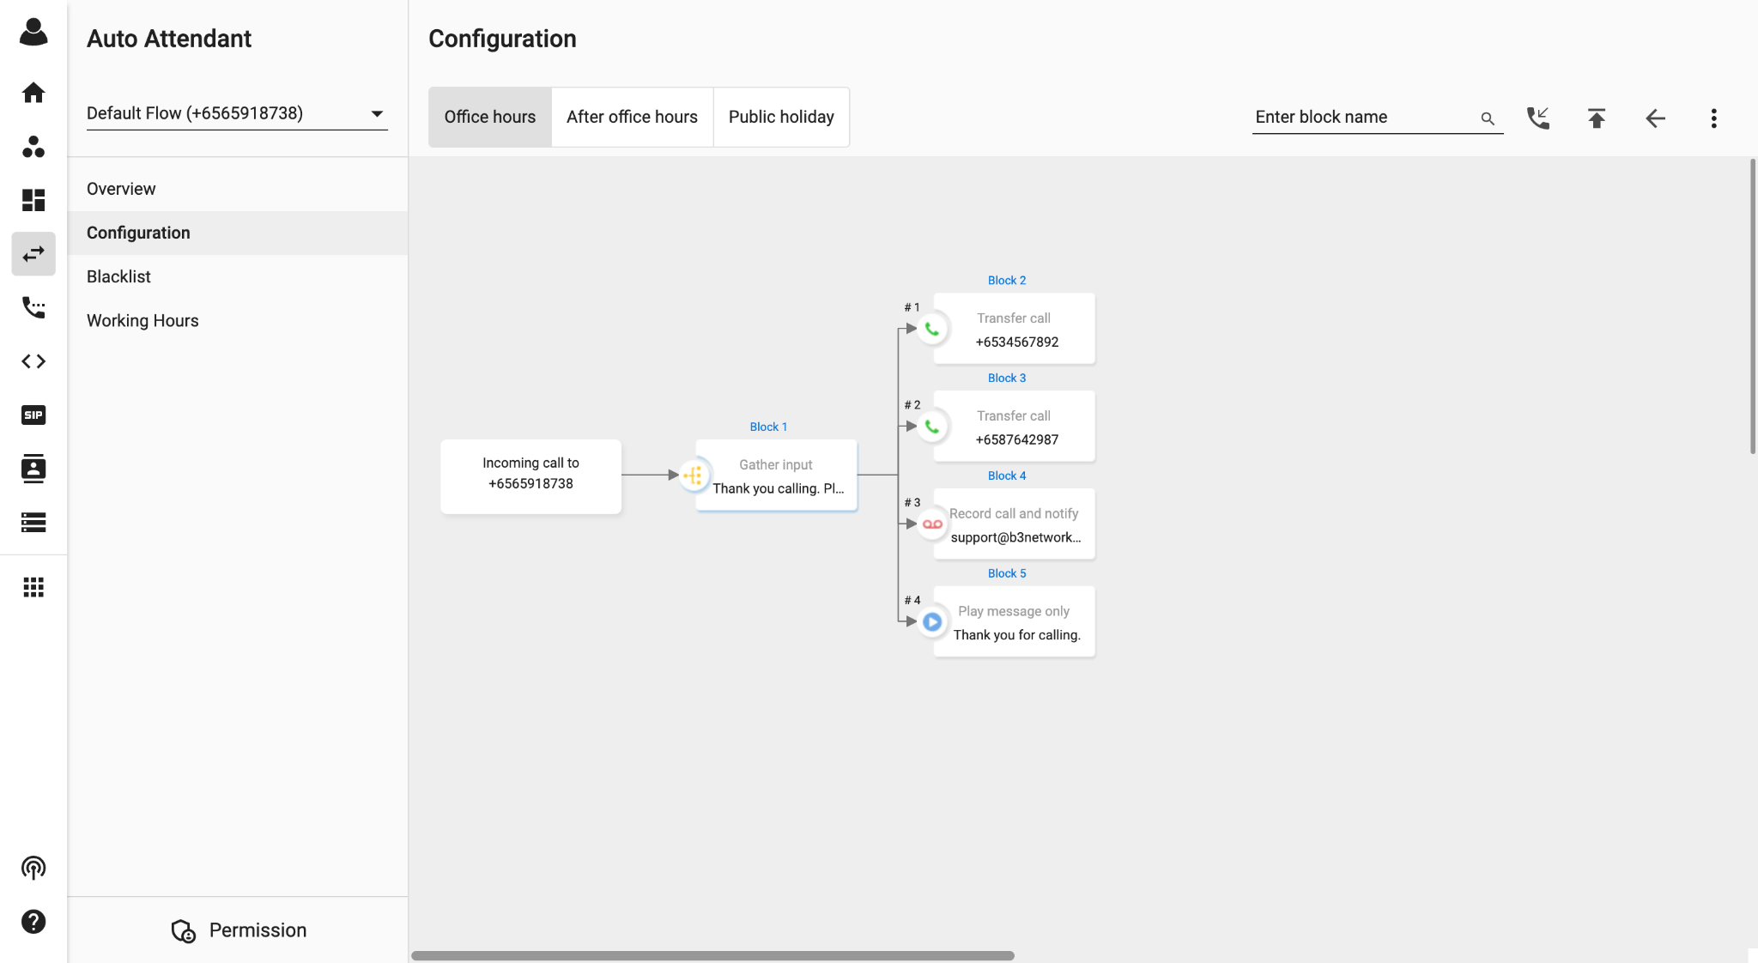
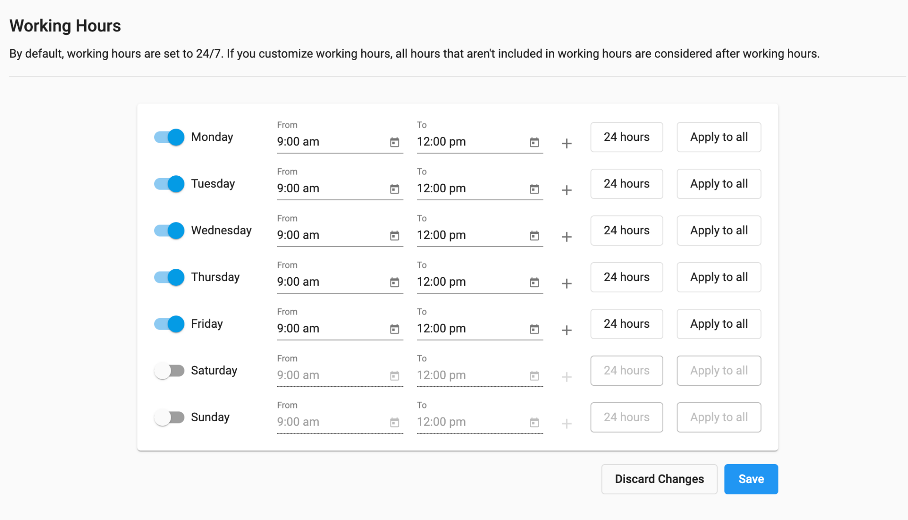
Snapshots <Auto Attendant>
Personalize customer journeys and offer self-service voice options with a graphic, flexible IVR solution. No coding or IT skills needed!

Slide 9
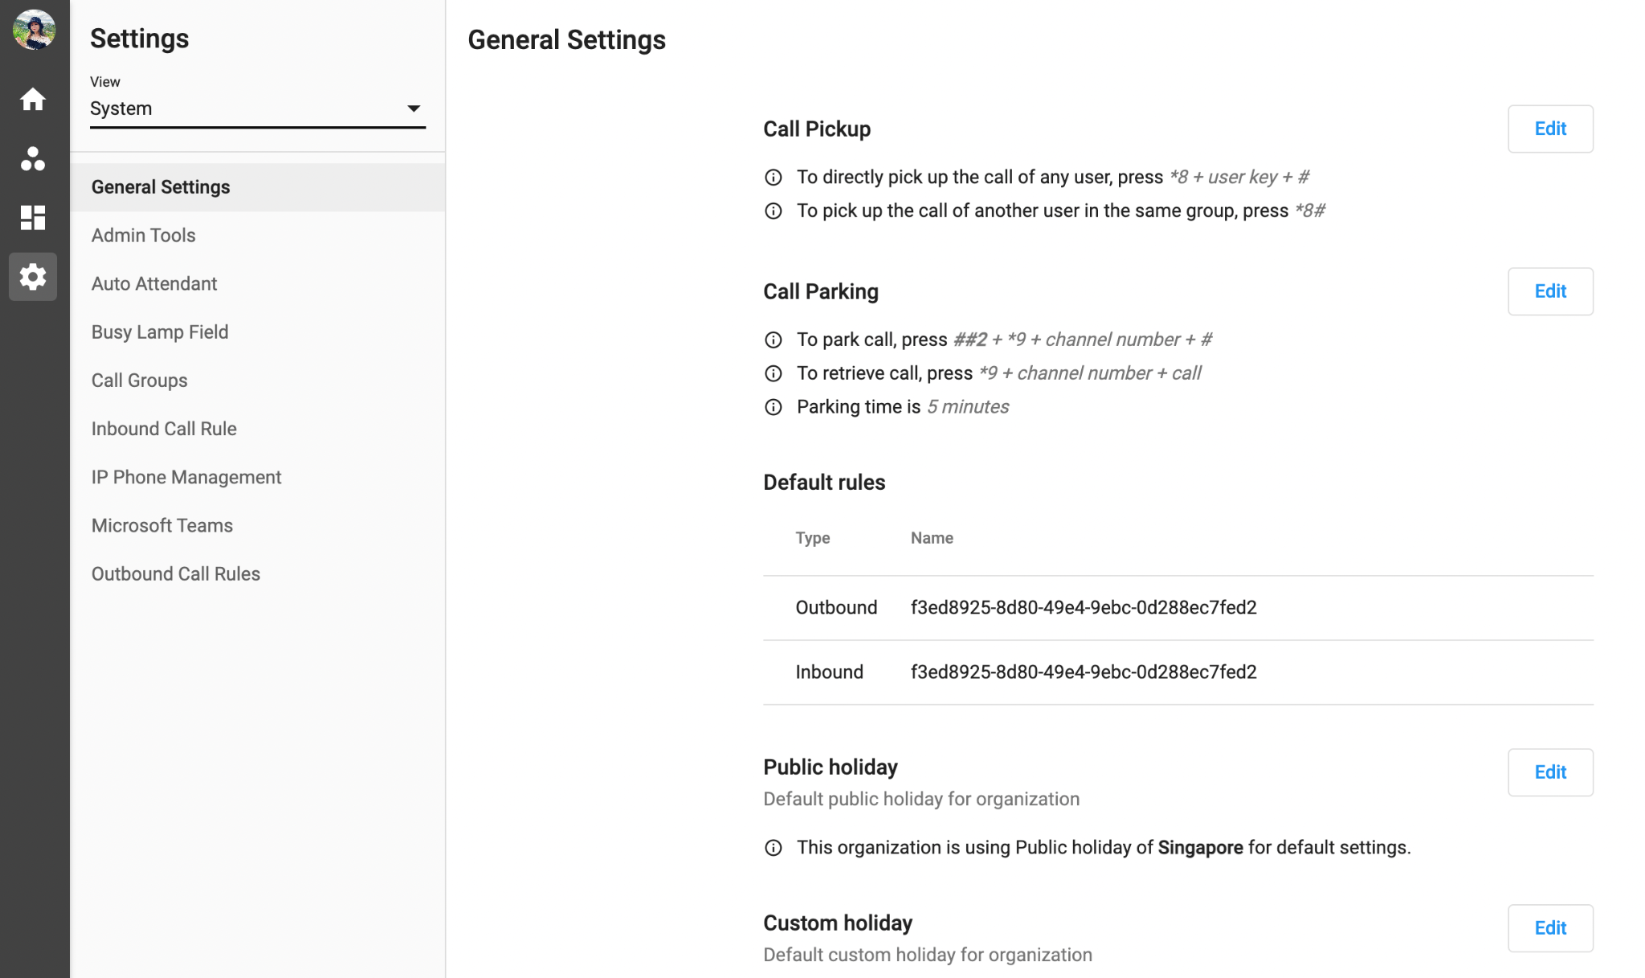
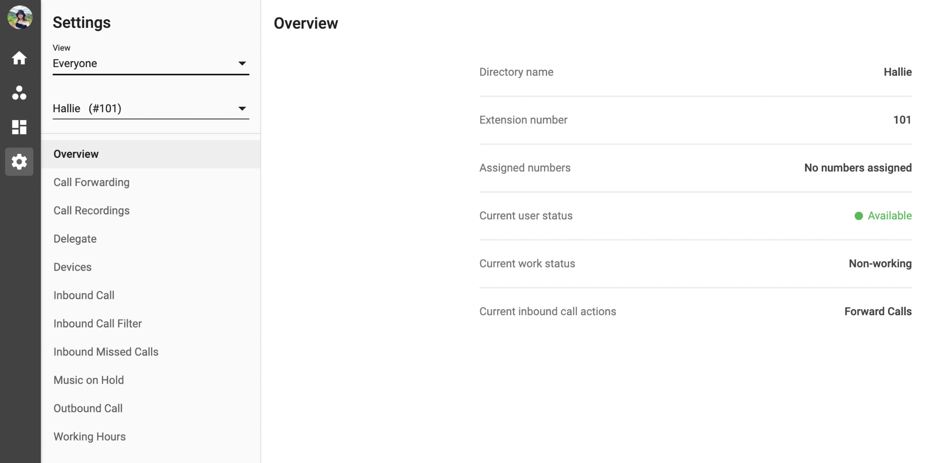
Snapshots <Phone System>
Personalize your VoIP devices, with advanced telephony features such as setting up personal phone extension, call transfer, call group, ringing a mobile phone/desktop simultaneously, recording voicemail, and notifying missed calls among many others.

Slide 10
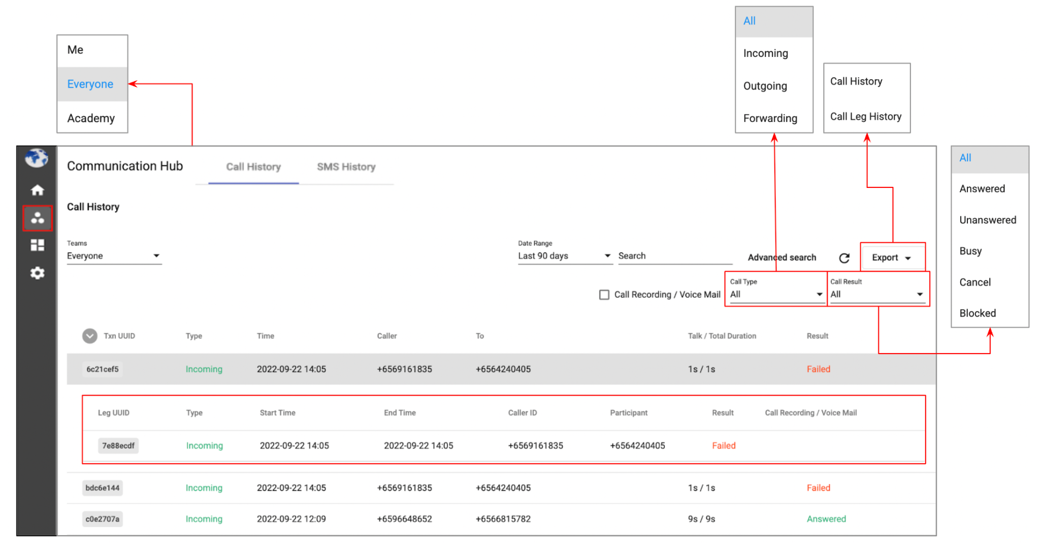
Snapshots <Communication Hub>
Monitor your Organization’s data in real-time to make quick decisions and improve your operating efficiency.

Slide 11
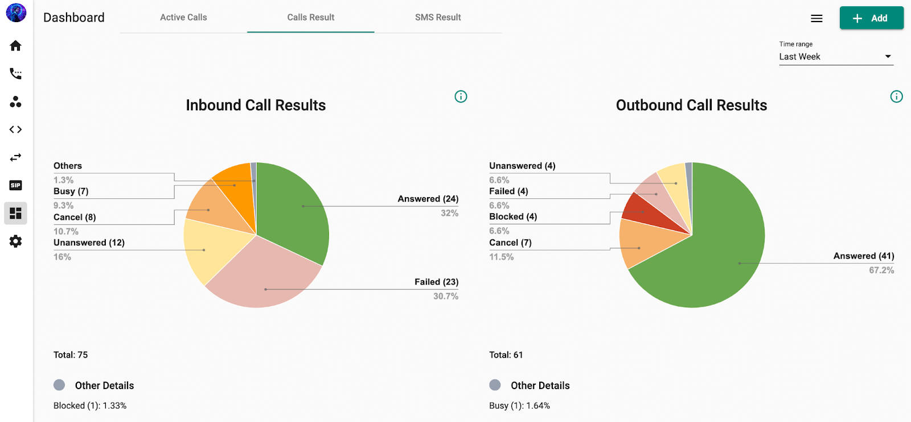
Snapshots <Dashboard>
Gain actionable insights to make the right decisions with Dashboard - a visual reporting tool that uses powerful analytics features to help you monitor your call data.

Slide 12






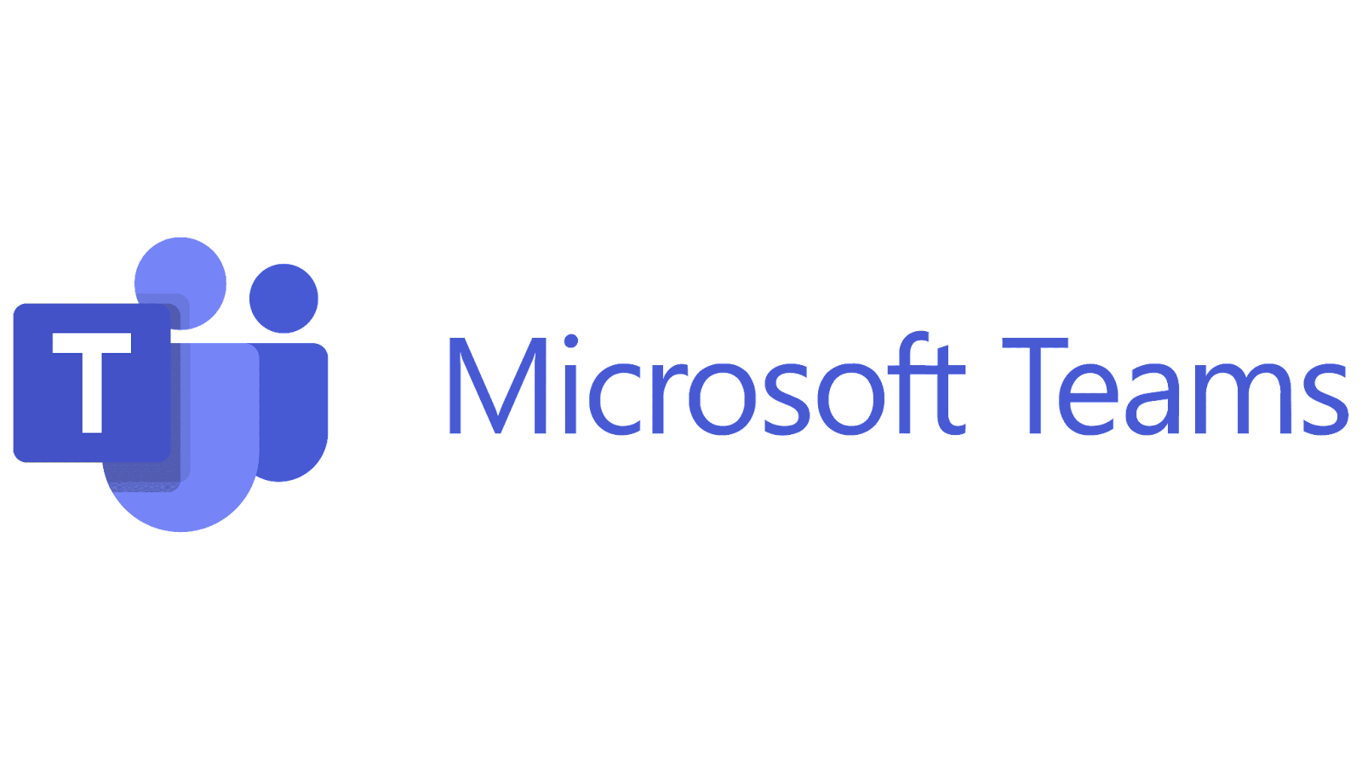
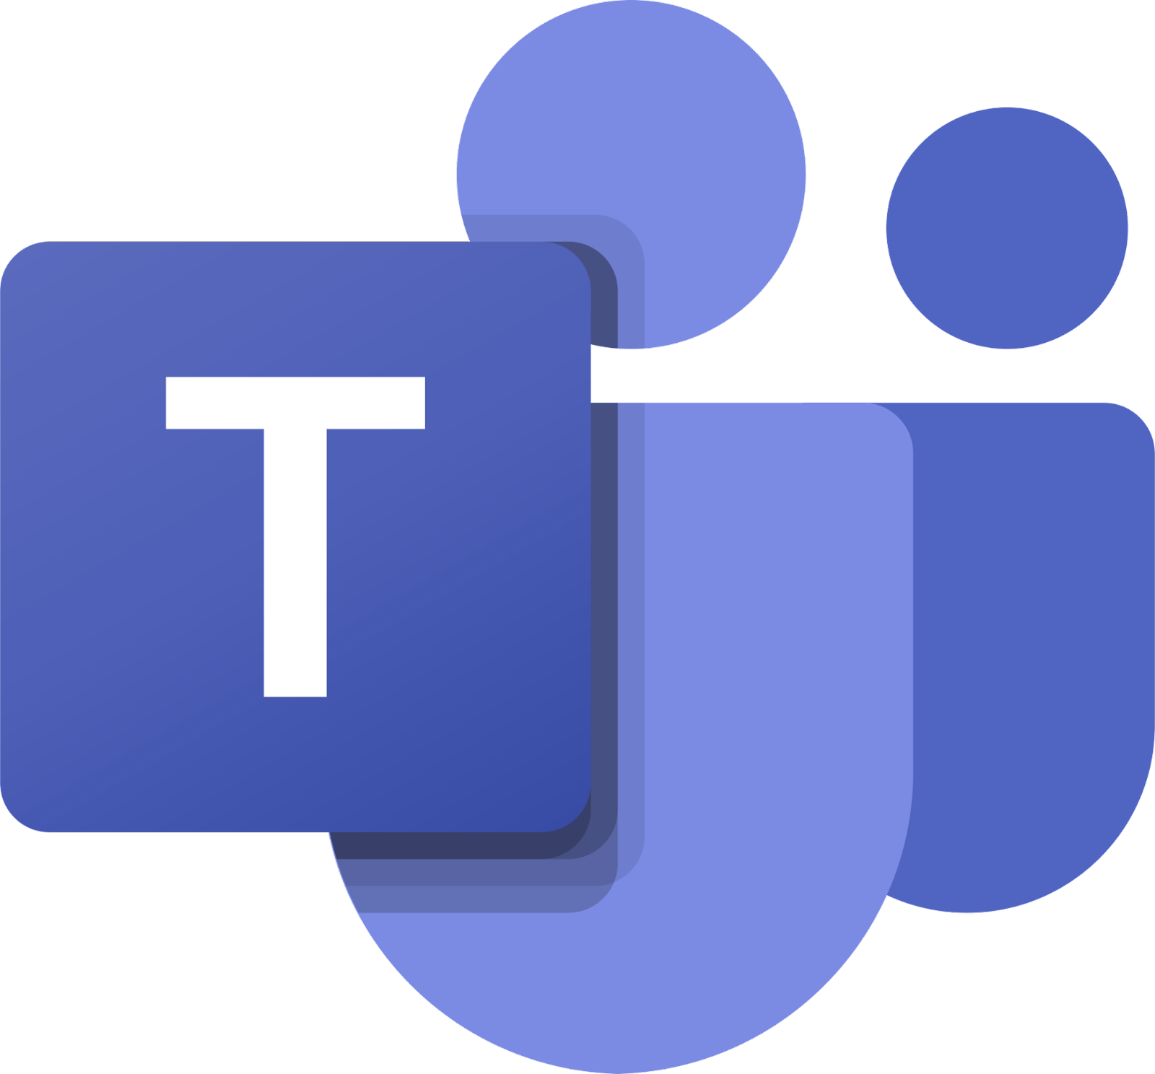
Integration
MS Teams
Auto-Attendant
CPaaS Phone System natively supports Microsoft Teams offering a cost-effective alternative to MS365’s Calling Plan. With Microsoft Teams phone system integration, users can call out via CPaaS SIP trunks, leveraging low cost domestic and international tariffs offered by regional SIP providers. CPaaS Phone System provides a seamless unified calling experience both for CPaaS Phone System users dialing Teams users and for Teams users who can dial out. Additionally, admins can benefit from a full-featured PBX that’s much easier to use and configure than Teams.
Uniform Greeting
Option Selection
Phone System Agents
Ext 101
Ext 102
Ext 103
Ext Group
By MS Teams App

Slide 13




Success Stories
“Please key in an extension”
Call will be transferred to the respective extension
A Leading Budget Airline Carrier is using our CPaaS Cloud PBX to connect their corporate office in Changi Airport with ground staff, pilots, check-in counter staff members and vendors. Each staff member will have access both an IP Phone, Mobile and desktop extension as they are running around the airport during their shift. This cloud PBX is only being used by over 200 internal staff members without getting disturbed with customer calls as they have an outsourced contact center.
Ext 101
Ext 102
Ext 103
Ext 104

Slide 14









Success Stories
Webhook verifies data
Plays “Approved” OR “Not approved” message
1
With Loan or Credit Card Application
Plays “Pending application result” message
Input Application Reference #
Plays “Reference number not found, please try again” message
“Thank you for calling ABC Bank. Please select from the following menu options.”
8am-5pm
Sales Hotline
Ext. Group 1
Prospective Customer
2
Send Online Shop URL via SMS
Otherwise
A Singapore Financial Institution is relying on our CPaaS Cloud PBX to make all transactions secure by creating separate extension groups for new and existing customers, and by requiring them to input their reference number or account number – which will be verified by the system to enhance customer journey experience.
1
Credit Card
Ext. Group 2
2
Savings/ Account
Ext. Group 3
Webhook verifies data
3
Account Holder
3
Loans
Ext. Group 3
Input Account #
4
Investment/ Insurance
Ext. Group 4

