Slide 1
THE SCLERA
This is also known as:
Fibrous
Outercoat
White of the eye
Greek – scleros
hard
The Sclera is continuous with:
Dura matter
Cornea
Origin: Mesoderm

Slide 2
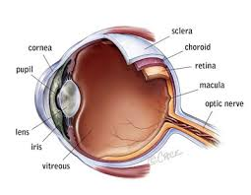

Slide 3
The sclera consist of the:
Posterior 5/6 of the outercoat
Cornea – consist of the anterior 1/6 of the outercoat
CHARACTERISTICS
Opaque
Dense collagen
Interspersed with elastic fibres
Thinnest at the equator and where it is pierced by the recti muscle.
Weakest at lamina cribrosa (sieve like).

Slide 4
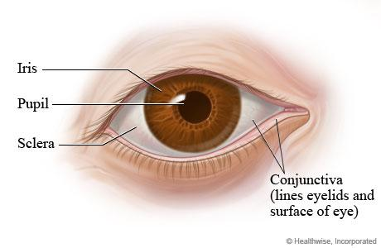

Slide 5
COVERINGS:
Richly vascular episclera
Fascia Bulbi (Tenon Capsule)
The conjunctiva
If a sustained increase of IOP occurs POAG, the lamina cribrosa:
yields
Bulges cupping (posteriorly at disc)
LAYERS OF SCLERA
Episclera
Scleral
Lamina fusca

Slide 6
EPISCLERA
Superficial aspect of sclera
Bundles of collagen circumferentially arranged
Rich blood supply anteriorly
Thickness to the rectus muscle insertions and becomes progressively thinner towards the back of the eye.

Slide 7
SCLERA STROMA
Bundles of collagen intermingled with fibroblasts, melanocytes, elastic fibres, proteoglycans and glycoproteins.
Variability in collagen fibres diameter, interlacing in bundles of collagen, and relative, deficiency in water – binding substances

Slide 8
accounts for the sclera dull – white colour.
The sclera stroma derives it’s nutrition from the episclera and choroidal vascular network
Anterior to the insertion of the recti muscle is the anterior ciliary arteries which forms dense episclera plexus.

Slide 9
These vessels become congested in ciliary injection
Small branches of the posterior ciliary arteries supply the sclera stroma posterior to the recti muscle

Slide 10
LAMINA FUSCA
Brown colour due to the melanocytes
Grooves for the passage of ciliary vessels, nerves (emissary canals)
Attached to the choroid by fine collagen fibres

Slide 11
BLOOD SUPPLY
Episclera – anterior and posterior ciliary arteries
Sclera stroma:
Relatively a vasculature structure

Slide 12
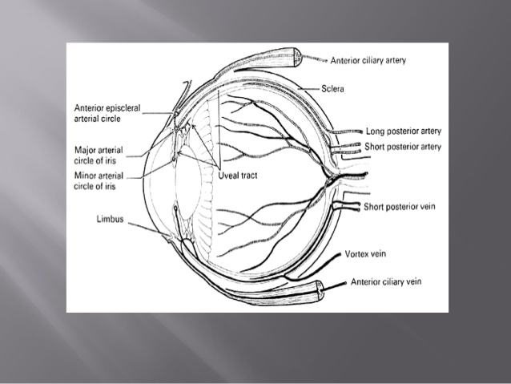

Slide 13
VENOUS DRAINAGE
Episclera/collecting vein
Anterior ciliary veins
Vortex veins

Slide 14
NERVE SUPPLY
Rich in nerve supply
Anterior sclera:
Long posterior ciliary nerves
Posterior sclera:
Short posterior ciliary nerves
Pain-
Inflammation, streching due to oedema and movement of the eye.

Slide 15
NB: The sclera is white because of:
Variable diameter
Irregular arrangement of the collagen fibres of the stroma
Because of the scathering of all wave length of light by dense irregular bundles of collagen in the sclera

