Slide 1


The “New Normal” | Brexit,
(More) Uncertainty and CEE Investment
Richard Needham
16 June 2017

Slide 2

Agenda
1
Overview
2
Where we are heading
3
M&A and CEE Investment
4
Trade and Customs
5
Tax
6
Competition
7
IT/Commercial, IP and Disputes
8
Financial Services
9
Product Regulation and Product Liability
10
Immigration
11
Questions

Slide 3
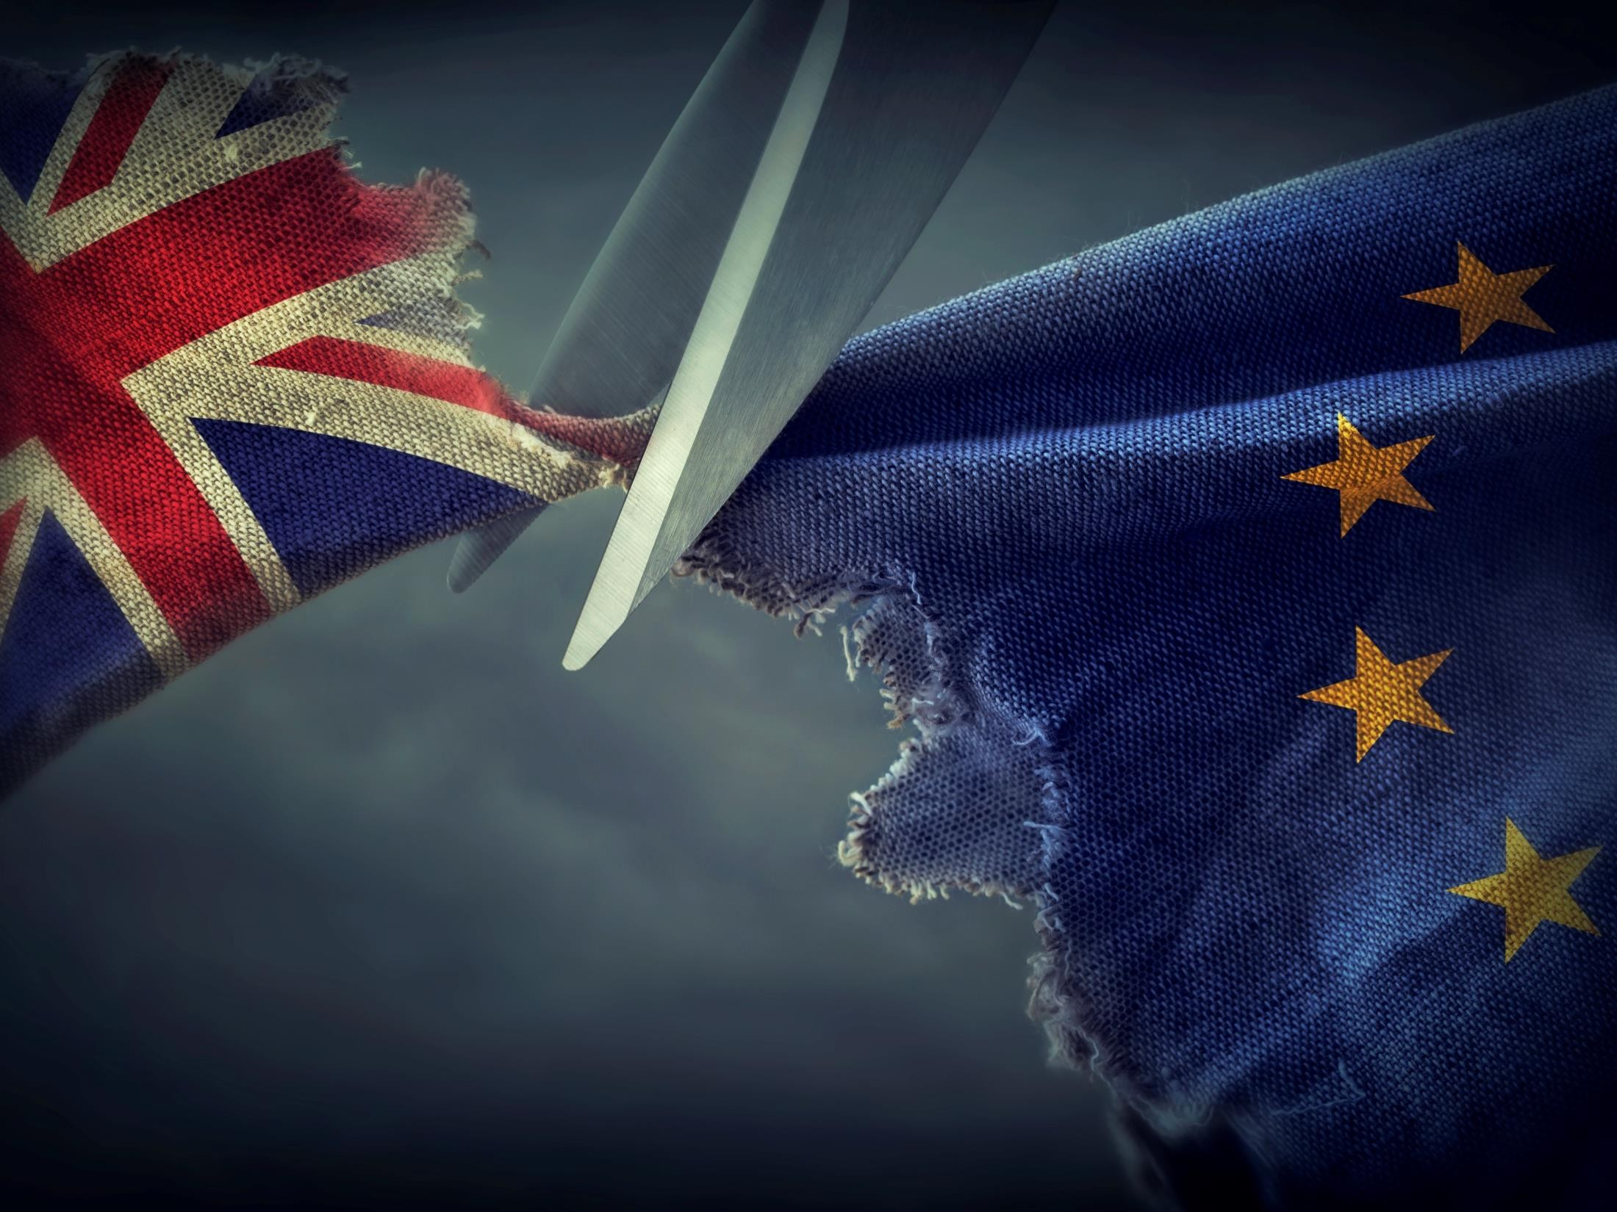
Overview
1

Slide 4




Brexit | Setting the scene
What happened, why, and effect?
▪
▪
▪
What: Non-binding vote (advisory) to leave the EU
Why: Immigration; economy; sovereignty
Result: Exit negotiations (Article 50) triggered 29 March 2017
Until
formal
“divorce”,
UK
remains
an
EU
Member
State
© 2017 Baker & McKenzie LLP
4

Slide 5

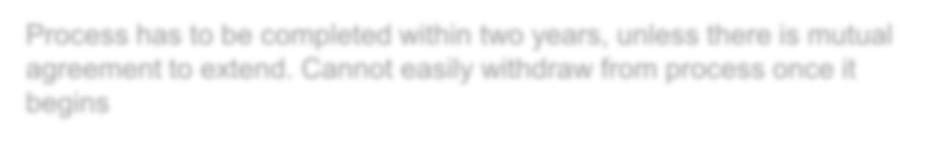






Article 50
|
Leaving
process
triggered
A R T I C L E
Process has to be completed within two years, unless there is mutual agreement to extend. Cannot easily withdraw from process once it begins
EU laws will continue to apply in the UK, and the UK will remain part of
Single Market until Brexit occurs
Extended period of uncertainty until negotiations finalised regarding
terms of future relationship between UK and EU and implications for third countries which trade with them
Results of UK elections will likely directly affect the path of negotiations
© 2017 Baker & McKenzie LLP
5

Slide 6
Where we are heading
2

Slide 7













A
bespoke model for the UK-EU relationship
UK joins the EEA and EFTA (the Norwegian
model)
Bilateral agreement between
EU-27 (the Swiss model)
the
UK
and
Customs Union with EU-27
(the Turkish model)
FTA
Fallback WTO Rules
for Trade
© 2017 Baker & McKenzie LLP
7

Slide 8
What are
the
models:
further
details
Summary:
Norway Turkey Switzerland Free trade WTO
model model model agreement approach
Access to EU market Yes Yes Yes Yes No for goods (limited) (limited) (limited)
Access to EU market Yes No (unless Yes Yes No
for services negotiated) (limited) (limited)
Common external Yes Yes No No No customs tariff
Contribution to EU Yes No No No No
budget
Free movement of Yes No Yes No No people (limited)
Influence over EU No No No No No legislation
© 2017 Baker & McKenzie LLP
8

Slide 9




Article 50 | Which Brexit model?
HARD BREXIT
▪ No access to Single Market
▪ No passporting for Financial
Services
▪ Limited free trade agreement with
EU27
▪ Control over immigration
▪ Unfettered control over rules/standards
▪ No contribution to EU budget
▪ Quick negotiations
SOFT BREXIT
▪ Access to Single Market
▪ Passporting for Financial Services
▪ Continuing free movement of people
▪ Continuing alignment with EU
rules/standards
▪ Contribution to EU budget
▪ Quick withdrawal but length
negotiations on the ‘what next’
The final deal will be a
negotiated settlement which addresses the concerns of the UK and EU27 (and every
member of the EU27)
UK Sovereignty is secured at the cost of market access
Market access is secured through adherence to EU principles
© 2017 Baker & McKenzie LLP
9

Slide 10



Brexit
|
UK
Election
8 June General Election resulted in a “hung parliament”
Lack of clear mandate over path Brexit should take,
with Brexit-related polling results showing narrow
margins of support to begin with
City senses softer Brexit as a result of election
© 2017 Baker & McKenzie LLP
10

Slide 11
M&A and CEE Investment
3

Slide 12


Brexit | Impact
on
M&A
activity
Immediate
aftermath
▪ General slow-down due to uncertainty and low investor confidence
▪ Tempered by creation of deal opportunities
Forecast
▪ Global uncertainty and apprehension until clarity emerges on new relationships
▪ UK activity expected to fall, particularly in financial and industrial sectors
▪ Eurozone recovery
▪ Positive outlook for technology and consumer goods
▪ Potential risk of a disorderly Brexit which could impact UK and Eurozone
© 2017 Baker & McKenzie LLP
12

Slide 13

Brexit | CEE Investment in Focus
Current economic picture of CEE stable (compared to rest of world)
and growing (faster than developed markets) - Poland leading
pack
▪ Opportunities: General growth fuels investment opportunities for lower- income goods / services while also pushing middle-class demand for premium goods
“In Poland,
decision.”
there are no bad feelings in relation to the British
-
Krzysztof
Szczerski,
top
foreign
policy adviser
to
Polish President
Brexit: Key question will be the ease and attractiveness of cross-border
investment between the UK and rest of EU (i.e., hard v soft), but:
• No immediate / direct impact, but uncertainty abounds and investors may be risk averse (but will focus on strong CEE fundamentals)
• Post-Brexit → Decreased regional stability possible around EU
© 2017 Baker & McKenzie LLP
13

Slide 14
Trade and Customs
4

Slide 15
Impact on
the customs framework
What
impact
will
Brexit
have
on:
Customs duties (internal and external tariffs)
Administrative and compliance costs
Product standards
UK’s competitiveness in the market
© 2017 Baker & McKenzie LLP
15

Slide 16





Challenges to assess
▪
▪
▪
Cost to business if UK no longer benefits from EU FTAs
Customs valuation implications
Challenges for movement of goods between UK and EU-27
▪ Customs controls (administrative burden and costs of import/ export declarations)
▪ Risk of delays
▪ Customs duties if no trade deal or if goods do not qualify under 'origin rules'
▪ Compliance burden of complying with 'origin' rules
Import VAT (cash flow impact)
▪
Could result in UK being unattractive
in the EU
as a hub for imports and distribution
UK Co.
German Co.
© 2017 Baker & McKenzie LLP
16

Slide 17




Mitigation and opportunities
Mitigation
Opportunities
Simplify Customs Warehouses in the UK
Introduction of Free Trade Zones
Import VAT deferment system
Relocation of distribution hubs
▪
Facilitate/simplify
customs
▪
▪
UK to negotiate new FTAs
Amending the UK customs framework to a more favourable customs regime, e.g.
▪
▪
▪
▪
▪
▪
Reintroduction of ‘earlier’ sale
Removal of
compulsory guarantees
© 2017 Baker & McKenzie LLP
17

Slide 18
Tax
5

Slide 19
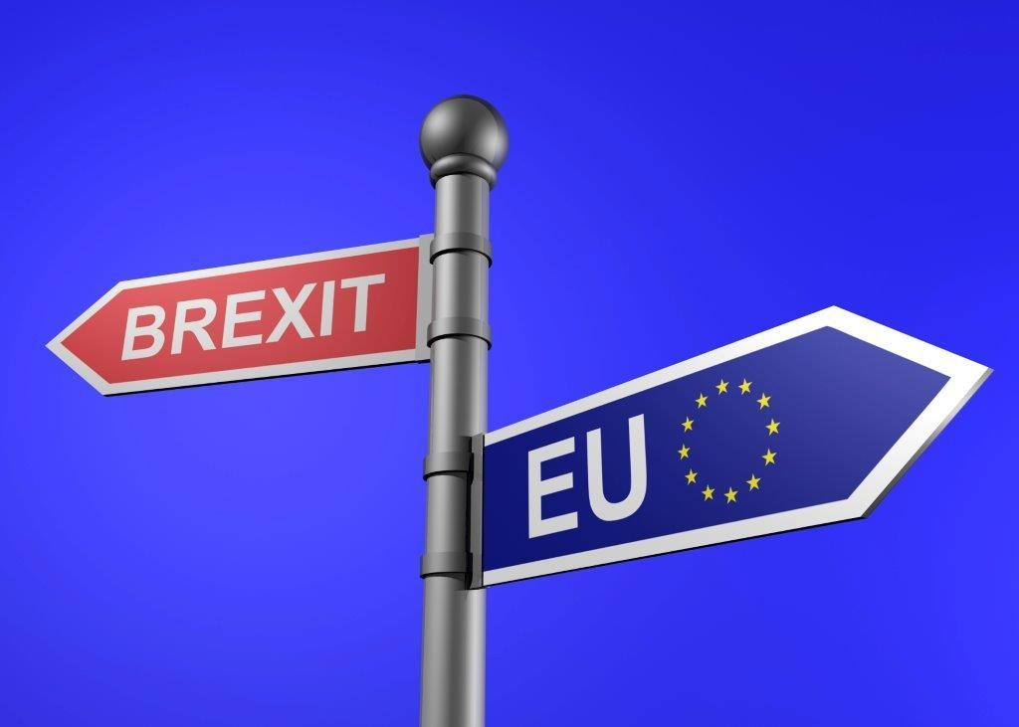
Tax
Primary impact
▪
UK indirect/direct tax no longer governed by EU Law
Some change to the impact of UK and overseas treaties
Distance from EU initiatives
▪
▪
Wider consequences
▪
What will the UK do to make the UK more attractive?
Possible extension of patent box to software copyright?
Lower headline rates?
Will the UK continue to play a leading role in BEPS?
▪
▪
▪
© 2017 Baker & McKenzie LLP
19

Slide 20






Practical implications
Referendum
Result
Article 50 triggered
Negotiations between UK and EU27
NO CHANGES TO UK LAW
FOR AT LEAST 2 YEARS
Afterward:
▪ Customs declarations and duties
▪ Corporate income tax may diverge from EU law
▪ VAT import and export rules for
supplies between the UK and EU27
▪ Abolition of EC Sales Lists and
Intrastat
▪ VAT registration in every EU27
Member State?
Minimum of
two years
BREXIT
© 2017 Baker & McKenzie LLP
20

Slide 21















Where
next
|
Future
direction of EU27 Tax Policy
aid cy
EU27 Transfer pricing guidelines?
Harmonisation of tax rates?
as g
Anti-tax Avoidance Directive
State poli
Tax haven blacklist?
Loss of UK
a liberalisin force
Financial
transactions tax
Common Consolidated Corporate Tax Base
WHT on profits leaving the EU27?
Protectionist policies to protect
Member States’ tax revenues?
Greater
integration of
Member States’ tax policies?
© 2017 Baker & McKenzie LLP
21

Slide 22
Competition
6

Slide 23



Competition
_{▪ No one stop sho}
Merger Control
▪ Possible UK parallel filings; risk of divergent outcomes
▪ CMA will have to grapple with larger, more complex deals
▪ Likely increase in Chapter 1 CA98 cases
Antitrust Investigations
and
Litigation
▪ Parallel investigation of international cartels
▪ Cannot rely on summary leniency applications
▪ Potential impact for follow-on damages actions in UK courts
_{▪ More relax}
Distribution
_{▪ Remember:}
Compliance
▪ Need to be EU and UK competition law-compliant
© 2017 Baker & McKenzie LLP
23

Slide 24
IT/Commercial, IP & Disputes
7

Slide 25




Commercial
Considerations
Governing law
▪ UK good choice of law for contracts as pro-business, flexible and established
▪ Recognised by EU courts. Rome I applies even if one party not a member state
▪ Laws more transparent than some CEE institutions (e.g., FCA rules)
Dispute resolution
▪ No impact on Arbitration
▪ Mutual recognition of jurisdiction clauses and judgments will depend on either the
‘Brexit model’ or treaty-based conventions that UK could join e.g. Hague
Intellectual Property
▪ EU Harmonisation at national level will remain mainly unchanged
▪ Uncertainty remains over unified EU rights (e.g., EU trade marks)
Commercial Litigation
▪ Increase in commercial litigation / triggering of material adverse change clauses?
© 2017 Baker & McKenzie LLP
25

Slide 26
Financial Services
8

Slide 27
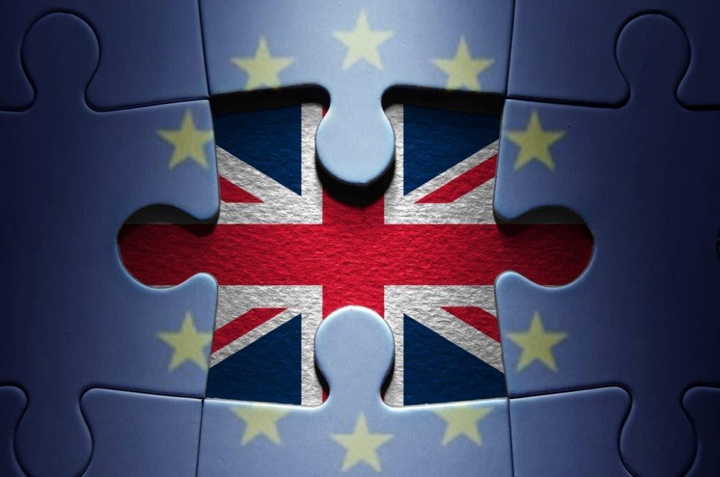
Brexit | Impact on Financial
Regulation
▪
Uncertainty as to exactly what
comes next (i.e. how the UK deals with EU-27 Member States and the rest of the world)
UK well positioned for ‘equivalence’?
Passporting implications
Will EU Directives / Regulations currently implemented in UK legislation be retained or replaced?
Currently, only one bank and the European Banking Authority have decided to relocate, but concern remains
▪
▪
▪
▪
© 2017 Baker & McKenzie LLP
27

Slide 28
Product Regulation and Product
Liability
9

Slide 29



Product Regulation
Product safety
/ environmental
requirements
▪ Substantive product safety requirements unlikely to change
▪ Some key issues will depend on how Brexit is implemented, e.g.
▪ Access to EU agencies (e.g. the European Chemicals Agency) and systems (e.g. RAPEX); and
▪ Producer responsibility legislation (e.g. on WEEE)
Product liability
▪ Strict liability for damage caused by defective products derives from EU law
(but is a well established cause of action in England)
Enforcement
▪ Regulatory enforcement takes place at a Member State rather than EU level.
Civil claims are brought in national courts
© 2017 Baker & McKenzie LLP
29

Slide 30
Immigration
10

Slide 31
Immigration
“[N]o change to the rights and status of EU nationals in the UK, and UK
nationals in the EU, as a result of the referendum” - Cabinet Office
announcement
“It’s not a single market a la carte” - Donald Tusk, European Council President
EU rights acquired automatically by exercising Treaty rights, but difficulties remain to protect right to remain and minimise uncertain
Restriction on ability of EU27 nationals to work in UK:
• Existing EU27 workers who have acquired right of permanent residence (5 years in
UK) very likely to be able to remain (and possibly others)
• UK Government has suggested EU27 nationals will be able to live and work in the
UK in future only if they have a “skilled” job waiting for them in the UK in the UK
© 2017 Baker & McKenzie LLP
31

Slide 32

Questions?
11

Slide 33


Brexit
|
Timeline
DECEMBER
Supreme Court hears appeal on High Court decision that government cannot trigger Article 50 without an act of Parliament
Italian Constitutional Referendum (Renzi resigns)
MARCH
UK triggers Article
50 and notifies EU Council of its intention to leave the EU
EU-27 discuss the UK's withdrawal
Negotiations between UK and EU-27
• Draft deal put to EU Council
• Approval required from at
65% of population
European Parliament
MARCH
• Negotiations can only be extended by unanimous consent of EU-27
• If no extension, UK leaves the EU
two years after triggering
Article 50
• EU treaties cease to apply to UK
by EU-27
least 20 member states with
OCTOBER JUNE
^{2-5 Oct:}
23 June: UK
^{voted in} _{Party}
^{favour of} conference
leaving EU
• If attained ratification by
JANUARY
17 Jan: PM
speech on
T W O Y E AR S O F U K / E U - 2 7 N E G O T I A T I O N S
Conservative
Brexit
Supreme Court decision
2
P E
APRIL
3 April: First
residential lection
JULY
7/8 July: G20 summit in Germany
AUTUMN
New European
Commission
round of French
appointed
2016
2017
2018
2019
2020
3 Nov: High Court ruled that government cannot trigger Article 50
Parliament
8 Nov: US Presidential Election
27 AUG –
22 OCT
Period in which German Federal Elections to be held
MAY
European Parliament
Elections
A R T I C L E
SEPTEMBER NOVEMBER
MAY
7 May: Second round of French Presidential Election
26/27 May: G7 summit in Italy
2017/18 EU presidency trio (Estonia, Bulgaria, Austria) meet in Bulgaria to discuss priorities
National Consensus Building: High level industry roundtables (FS, technology, retail, automotive) to inform Brexit negotiations of UK government support
16 Sept: Informal EU-27 leaders'
process of reflection for Europe's future
without an act of
June
8 June: UK General Election
results in “hung government”
13 June: Parliament convenes to discuss election
meeting in Bratislava to prepare
© 2017 Baker & McKenzie LLP
33

Slide 34
www.bakermckenzie.com
Baker & McKenzie LLP is a member firm of Baker & McKenzie International, a Swiss Verein with member law firms around the world. In accordance with the common terminology used in professional service organisations, reference to a "partner" means a person who is a partner, or equivalent, in such a law firm. Similarly, reference to an "office" means an office of any such law firm. This may qualify as “Attorney Advertising” requiring notice in some jurisdictions. Prior results do not guarantee a similar outcome.
© 2017 Baker & McKenzie LLP

