Slide 1

10 SLIDES TO AN
AWESOME PITCH!
freegoogleslidestemplates.com

Slide 2



Instructions
How to work with this template?
Open the presentation from the Google Slides Viewer (gear icon) or press the button below. In order to be able to edit the presentation in Google Slides, you must own a Google® Account and be logged in.
Open in Google Slides
Open in PowerPoint®
Please navigate to the File menu and select Make a copy.
A new Google Slides Editor will open with an editable copy of the template. This copy will be created in your Google Drive® account.
Navigate to the File menu and select Download as Microsoft PowerPoint. You will download a .pptx file that you can open in PowerPoint.
Note: You will need to install the fonts used in this presentation. Links to the fonts are provided at the end of this presentation.
Important: All our templates are free to use under Creative Commons Attribution License. If you use the graphic assets (photos, icons and typographies) included in this Google Slides Templates you must keep the Credits slide or add all attributions in the last slide notes.

Slide 3
10 SLIDES TO AN AWESOME PITCH
1
Elevator Pitch
6
Proprietary Tech
2
The Problem
7
Competition
3
The Solution
8
Marketing Plan
4
Market Size
9
Team
5
Business Model
10
Money

Slide 4
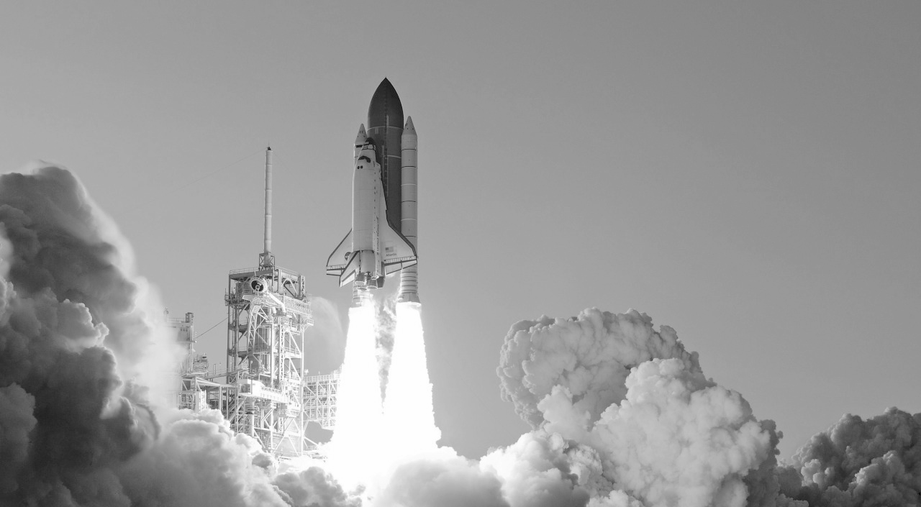
Create an Outstanding Teaser Slide That Is
MEMORABLE
freegoogleslidestemplates.com
Notes:
http://nos.twnsnd.co/

Slide 5

1
Elevator Pitch
freegoogleslidestemplates.com

Slide 6
In 30 Seconds.
Why You Do It?
How You Do It?
What You Do?
30
Seconds
Notes:
ATTRIBUTION
http://nos.twnsnd.co/

Slide 7
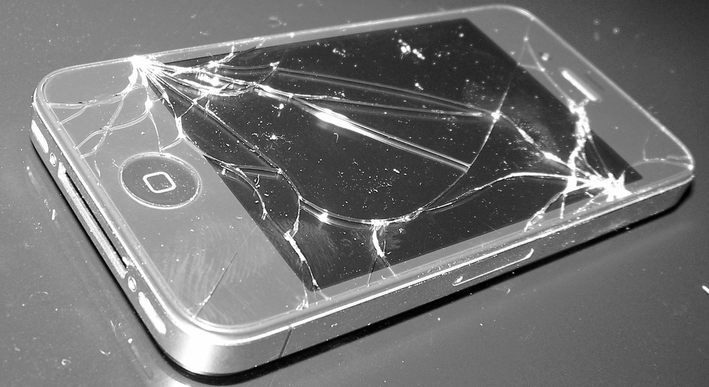
2
The Problem
freegoogleslidestemplates.com

Slide 8
My Phone Broke Again !
The Bigger The
Pain, The Better...
freegoogleslidestemplates.com

Slide 9
PROBLEM!
The problem ALWAYS comes
BEFORE the solution!
Explain The Pain Of Your Segment.

Slide 10
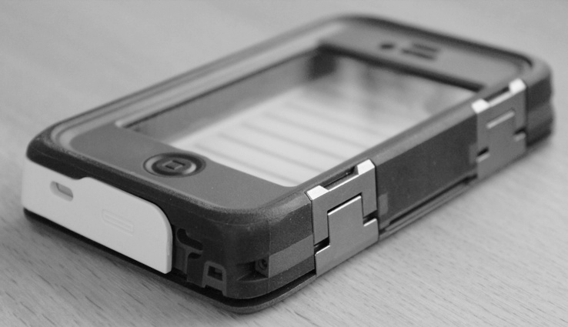
3
The Solution
freegoogleslidestemplates.com

Slide 11
How do you solve the problem ?
Describe how your solution makes your customers happy and does it better than others.

Slide 12

Show The Outstanding Features of Your Solution With A
DEMO
freegoogleslidestemplates.com

Slide 13

4
Market Size
freegoogleslidestemplates.com

Slide 14
Market Opportunities
Define Your Market
Total Market Size
4.45
Define Your Customers
Category 1
Category 2
Category 3
Trends And Insights
2013
2014
2015
2016
2017
2018
2018
2020
Series 1
Series 2
Series 3
freegoogleslidestemplates.com

Slide 15

5
Business Model
freegoogleslidestemplates.com

Slide 16
How will you make money ?
Retail
Online
Bundle
Describe 1-3 Revenue Sources

Slide 17
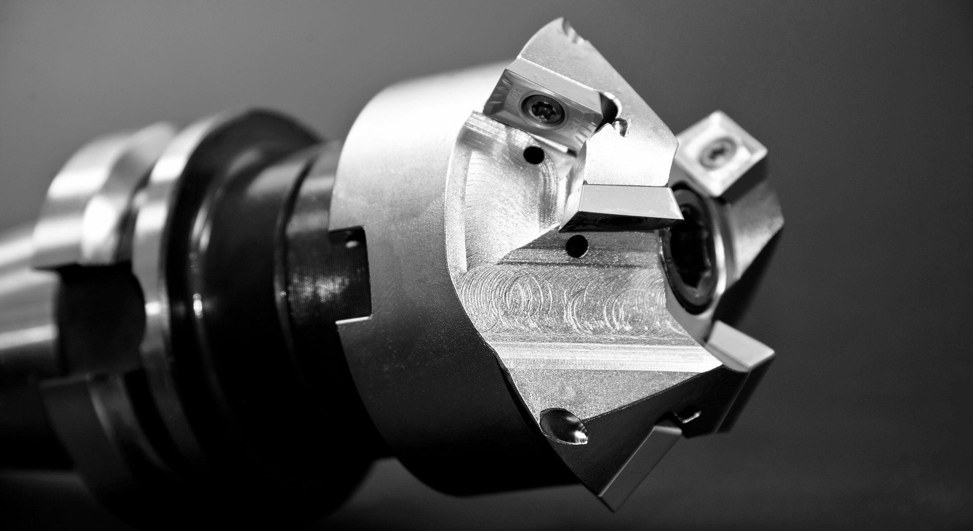
6
Proprietary Technology
freegoogleslidestemplates.com

Slide 18
What advantages do you have ?
Retail
Online
Bundle

Slide 19
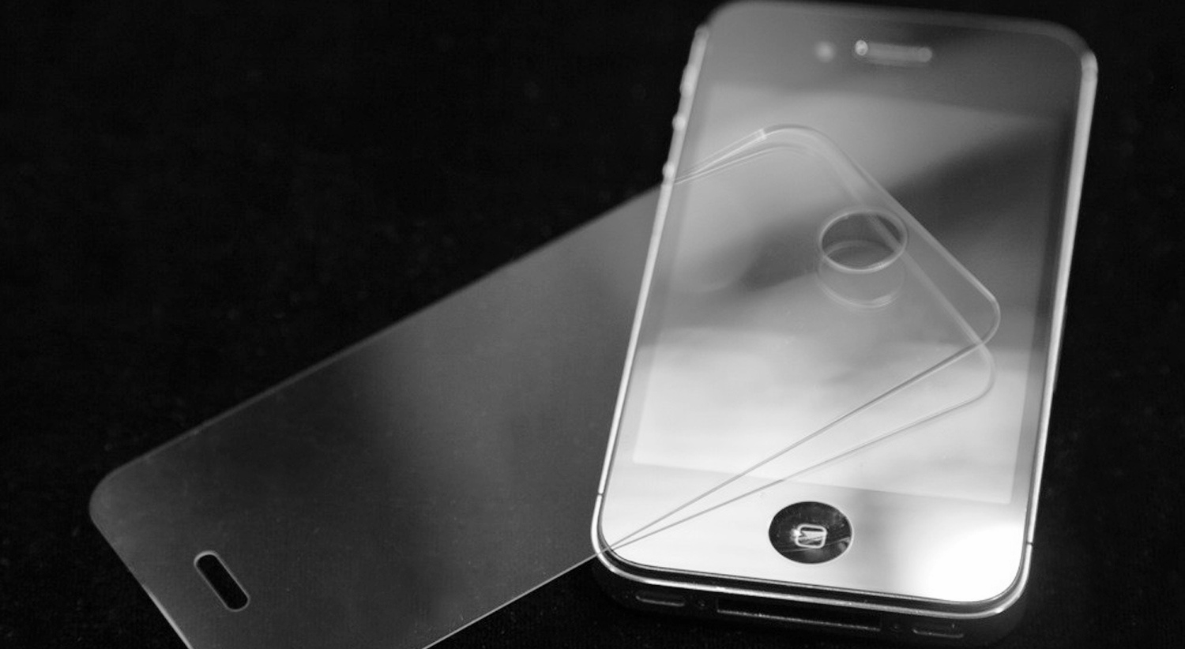
7
Competition
freegoogleslidestemplates.com

Slide 20
Performance
You
Competitor 2
2X2 MATRIX
Cost Efficiency
Competitor 1
freegoogleslidestemplates.com

Slide 21
Show you are
Better
1st.
freegoogleslidestemplates.com

Slide 22
or at least
Different
freegoogleslidestemplates.com

Slide 23

8
Marketing Plan
freegoogleslidestemplates.com

Slide 24
How do you get customers ?
Email
TV
SOCIAL
Describe your channels. Show your volume, cost and conversion!

Slide 25

9
The Team
freegoogleslidestemplates.com

Slide 26
Who is Your Team ?
Science
Business
SALES
Who drives
your Tech?
Who manages the
business?
Who brings the
customers?

Slide 27

10
The Money

Slide 28
What you achieved so far ?
Profits
Customers
Testimonials
Which is Your
Growth?
How Many Customers?
Which Customers love you?

Slide 29
What do you need ?
How much You need to Raise?
How Much Have you Raised?
How will you spend the money?

Slide 30
Thank You
freegoogleslidestemplates.com

Slide 31
Credits Slide
Shapes & Icons
Backgrounds
Images
Vectorial Shapes in this Template were created by Free Google Slides Templates and downloaded from FreePik.com.
Icons in this Template are part of Google® Material Icons and flaticons.com.
The backgrounds were created by Free Google Slides Templates
Photos in this template were downloaded from pixabay.com. Attribution is located in each slide notes and the Credits slide.
Fonts
Color Palette
Trademarks
The fonts used in this template are taken from Google fonts. ( Anton, Roboto Condensed )
You can download the fonts from the following url: https://www.google.com/fonts/
The Template provides a theme with the following basic colors:
Microsoft® and PowerPoint® are trademarks or registered trademarks of Microsoft Corporation.
© 2015 Google Inc, used with permission. Google and the Google logo are registered trademarks of Google Inc.
Google Drive® is a registered trademark of Google Inc.
#45bee8ff
#434343ff
#ecb883
#45bee864

Slide 32
Icons & Shapes
Vector Icons
Resize the Icons
Edit the colors
Free Google Slides Templates uses Vectorial Icons from the most popular Free Sources.
All Icons are resizable. Change the icons size without losing resolution.
All Icons are editable. Change the color fill and lines without affecting the shape.

Slide 33
Free Google Slides Templates
FGST
Notes:
You can safely remove this slide. This slide design was provided by Free Google Slides Templates – You can download more templates, shapes and elements for PowerPoint from http://freegoogleslidestemplates.com

