Slide 1
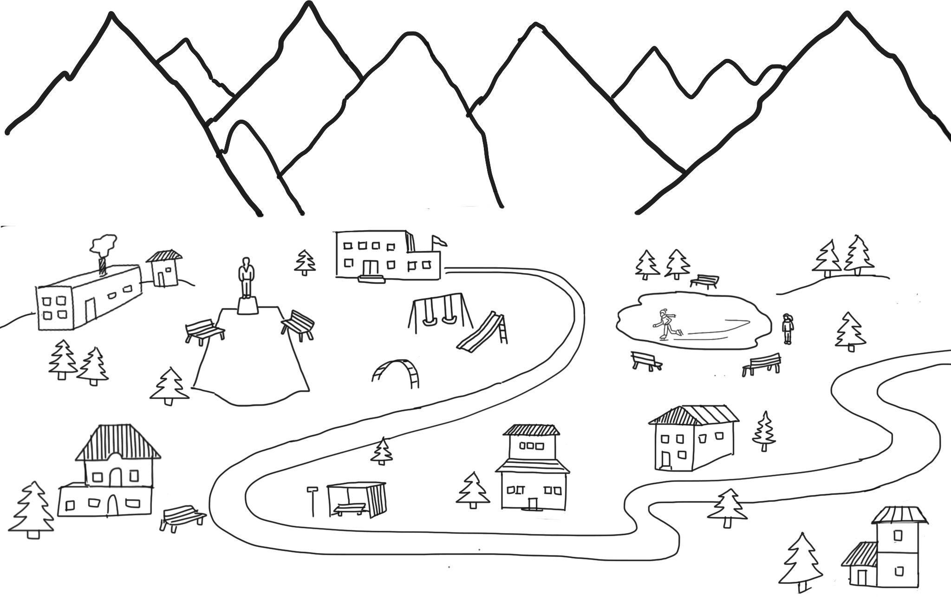
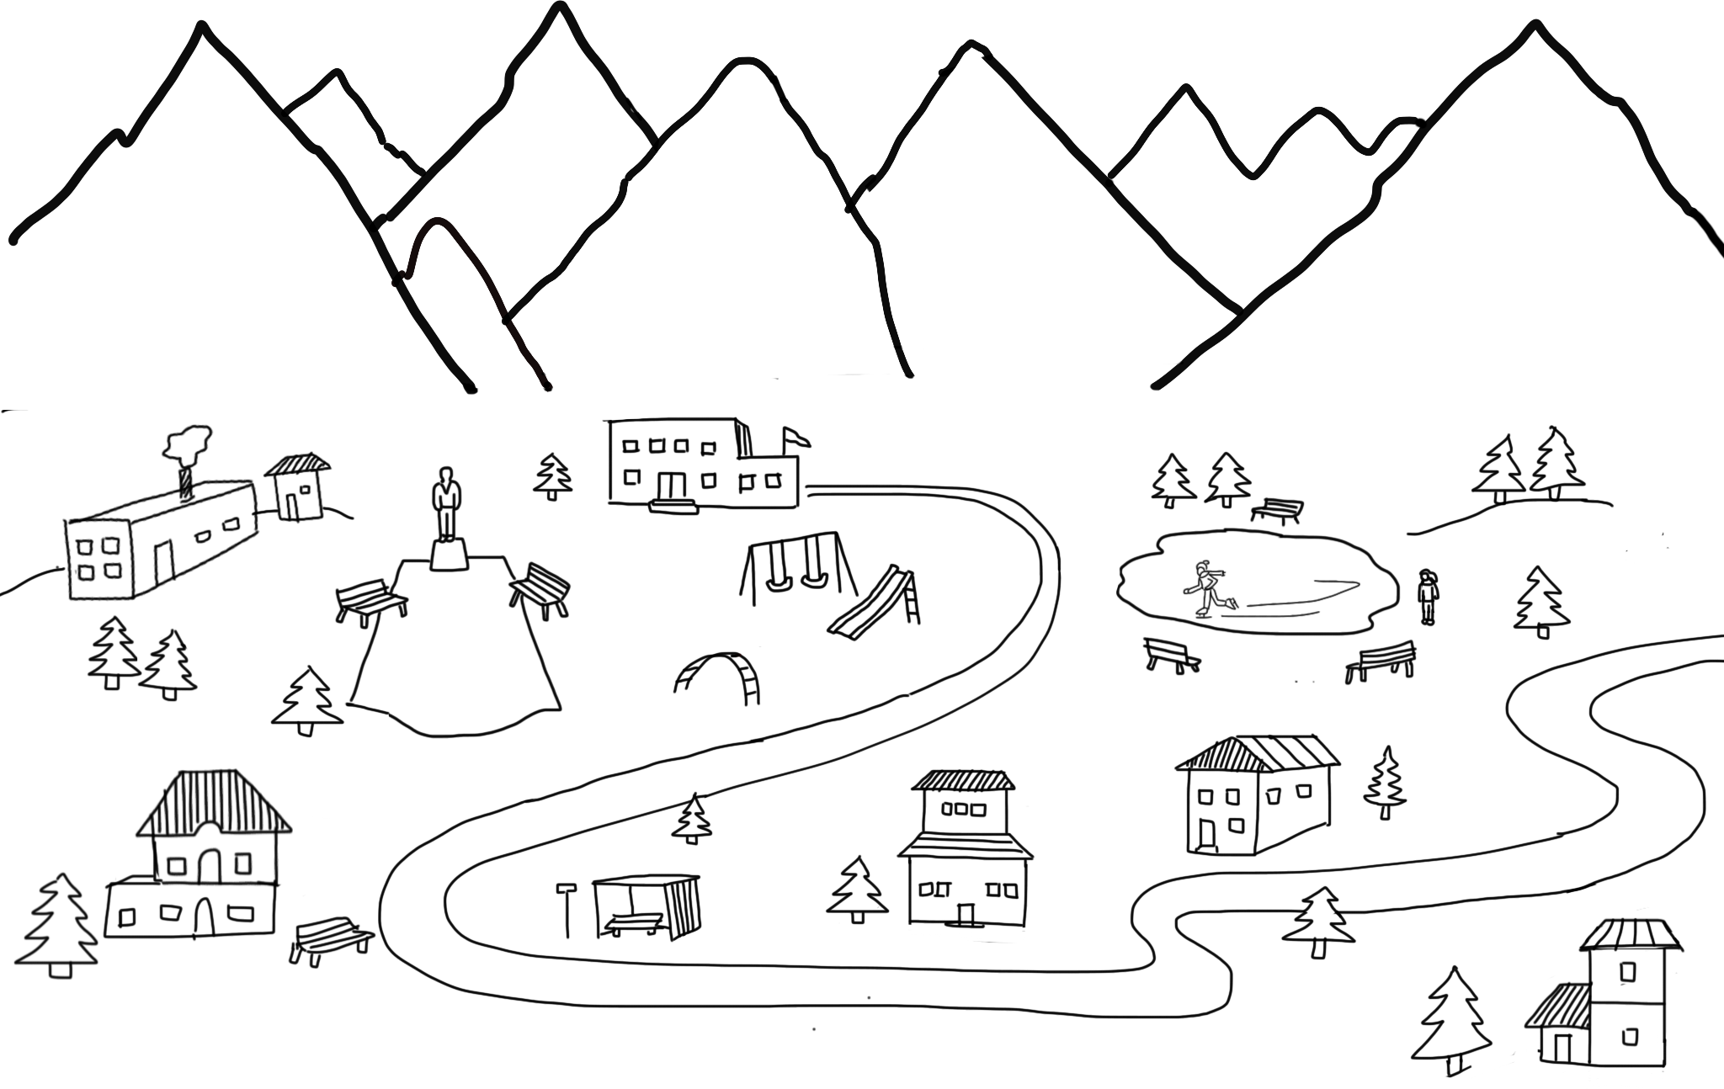

R
S
P
Chill City
How could you warm up a frozen playground?

