Slide 1
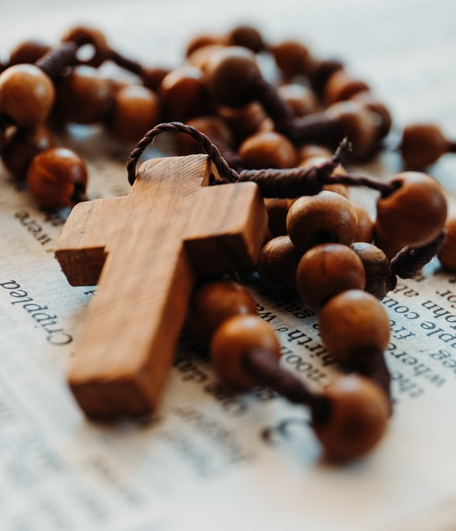
CATHOLIC ROSARY
Free Template

Slide 2
TABLE OF CONTENTS
01
INTRODUCTION
02
PRESENTATION
03
HISTORY
04
TRADITIONS
You can describe the topic of the section here
You can describe the topic of the section here
You can describe the topic of the section here
You can describe the topic of the section here

Slide 3
WHOA
This can be the part of the presentation where you introduce yourself, write your email…

Slide 4
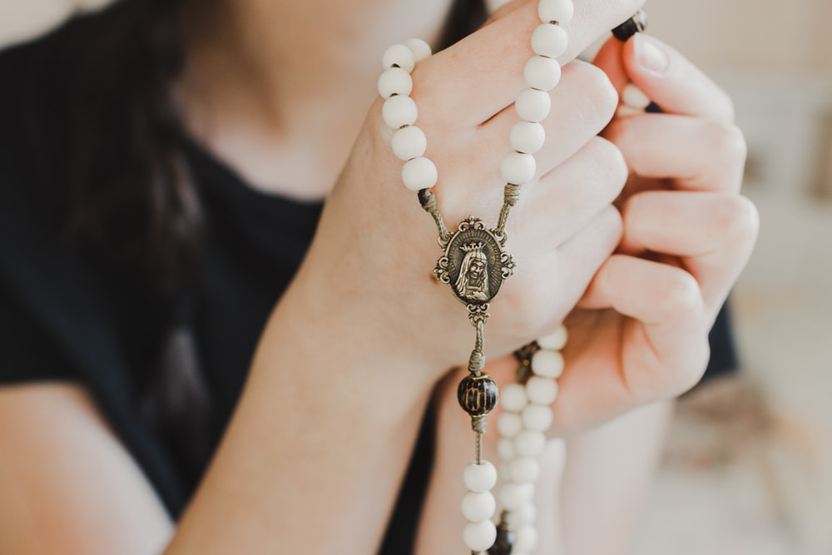
01.
NAME OF THE SECTION
You can enter a subtitle here if you need it

Slide 5
INTRODUCTION
Ash Wednesday is a Christian holy day. It is preceded by Shrove Tuesday and falls on the first day of Lent the six weeks of penitence. Christians usually fast and pray. Ash Wednesday is traditionally observed by Western Christians.
Ash Wednesday derives its name from the placing of repentance ashes on the foreheads of participants. It is often said: "Repent, and believe in the Gospel" or the dictum "Remember that you are dust, and to dust you shall return.” Each year’s ashes are made by burning the palms of the year prior.

Slide 6
THE SLIDE TITLE GOES HERE!
Do you know what helps you make your point clear? Lists like this one:
They’re simple
You can organize your ideas clearly
You’ll never forget to buy milk!
And the most important thing: the audience won’t miss the point of your presentation

Slide 7
—SOMEONE FAMOUS
“Remember that you are dust, and to dust you shall return”

Slide 8
TWO BASICS IN ASH WEDNESDAY
WHEN
WHY
Mercury is is the closest planet to the Sun and the smallest of them all. In fact, Mercury is only a bit larger than the Moon
Venus has a beautiful name and is the second planet from the Sun. It’s very hot and its atmosphere is extremely poisonous

Slide 9
THREE IMPORTANT CONCEPTS
FAST
ABSTINENCE
LENTEN
Mercury is the closest planet to the Sun and the smallest of them all
Venus has a beautiful name and is the second planet from the Sun
Despite being red, Mars is actually a cold place. It’s full of iron oxide dust

Slide 10
MAYBE YOU NEED SIX COLUMNS
MERCURY
VENUS
MARS
JUPITER
SATURN
NEPTUNE
It’s the closest planet to the Sun
Venus is the second planet from the Sun
Despite being red, Mars is a cold place
It’s the biggest planet of them all
Saturn is a gas giant and has rings
It’s the farthest planet from the Sun

Slide 11
HOW DOES IT WORK?
20%
50%
SATURN
MARS
Yes, this is the ringed one. It’s a gas giant
It’s a cold place full of iron oxide dust

Slide 12
THIS IS A GRAPH
MERCURY
It’s the closest planet to the Sun
JUPITER
It’s the biggest planet of them all
Follow the link in the graph to modify its data and then paste the new one here. For more info, click here

Slide 13
PLACES WITH BIG CELEBRATIONS
MALTA
Mercury the closest planet to the Sun
ROME
Venus has high temperatures
MADRID
Earth is the only planet with rings
BUCOVINA
Neptune is the farthest planet from the Sun

Slide 14
THIS IS A TIMELINE
TUESDAY OF CARNIVAL
ASH WEDNESDAY
HOLY THURSDAY
Venus has a beautiful name and it’s hot
Jupiter is the biggest planet of them all
Saturn is a gas giant and has several rings

Slide 15
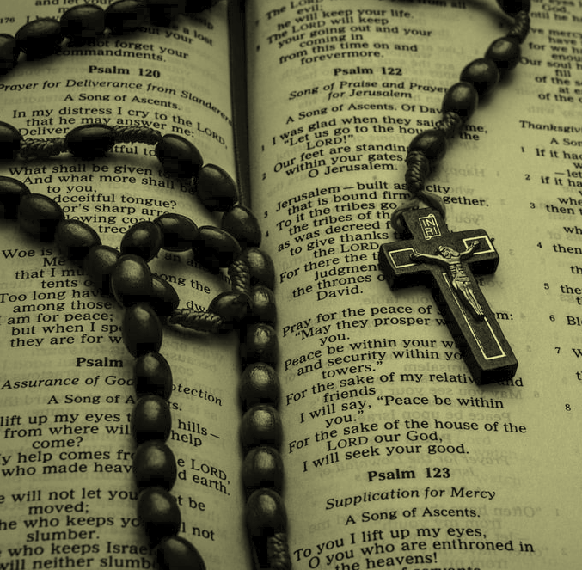
NAVY SUBMARINES
VENUS
JUPITER
It has a beautiful name, but it’s hot
It’s a gas giant and the biggest planet
MERCURY
NEPTUNE
Mercury is the closest planet to the Sun
It’s the farthest planet from the Sun

Slide 16
Roman empire
Latin language
Despite being red, Mars is actually a cold place. It’s full of iron oxide dust
Greek language
Mercury is the closest planet to the Sun and the smallest one

Slide 17
THIS IS A DIAGRAMM
ASH WEDNESDAY
MERCURY
VENUS
JUPITER
SATURN
Despite being red, Mars is actually a cold place full of iron oxide dust
Earth is the third planet from the Sun and the only one that harbors life

Slide 18
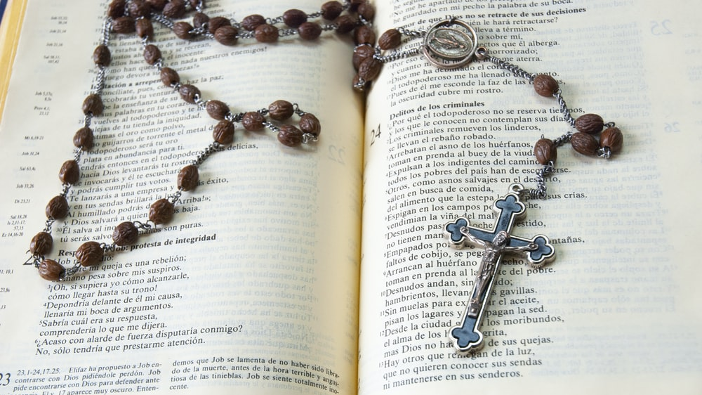
AWESOME
WORDS

Slide 19
Perhaps You Need More Infographics!
SATURN
NEPTUNE
Saturn is composed mostly of hydrogen and helium
Neptune is the farthest planet from the Sun
JUPITER
MARS
It’s the biggest planet in the Solar System
Despite being red, Mars is actually a cold place

Slide 20
AWESOME WORDS
Because key words are great for catching your audience’s attention

Slide 21
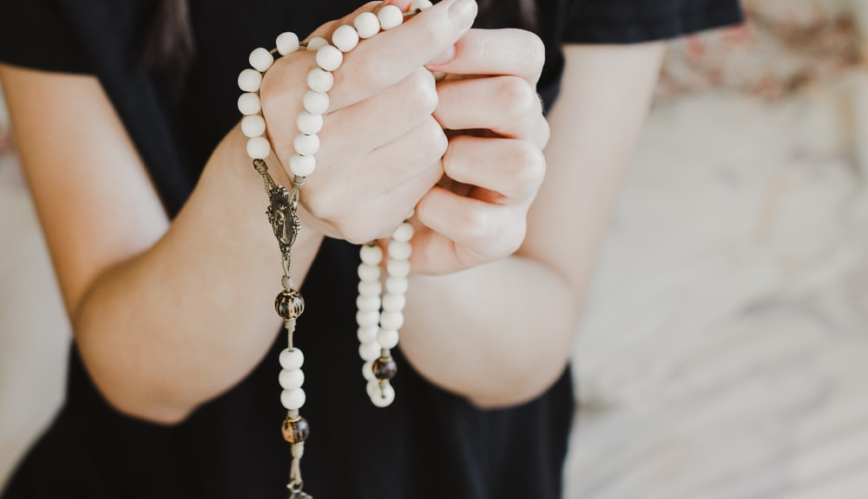
A PICTURE IS WORTH A
THOUSAND WORDS
This could be the part of the presentation where you can introduce yourself, write your email...

Slide 22
01
HISTORY
You can enter a subtitle here in case you need it

Slide 23
Saint
Mercury is the closest planet to the Sun and the smallest one in the Solar System—it’s only a bit larger than the Moon. The planet’s name has nothing to do with the liquid metal

Slide 24
SOME DETAILS
NEPTUNE
VENUS
Neptune is the farthest planet from the Sun
MERCURY
It has a beautiful name, but it’s terribly hot
Mercury is the closest planet to the Sun
SATURN
JUPITER
It’s composed mostly of hydrogen and helium
It’s a gas giant and the biggest planet

Slide 25
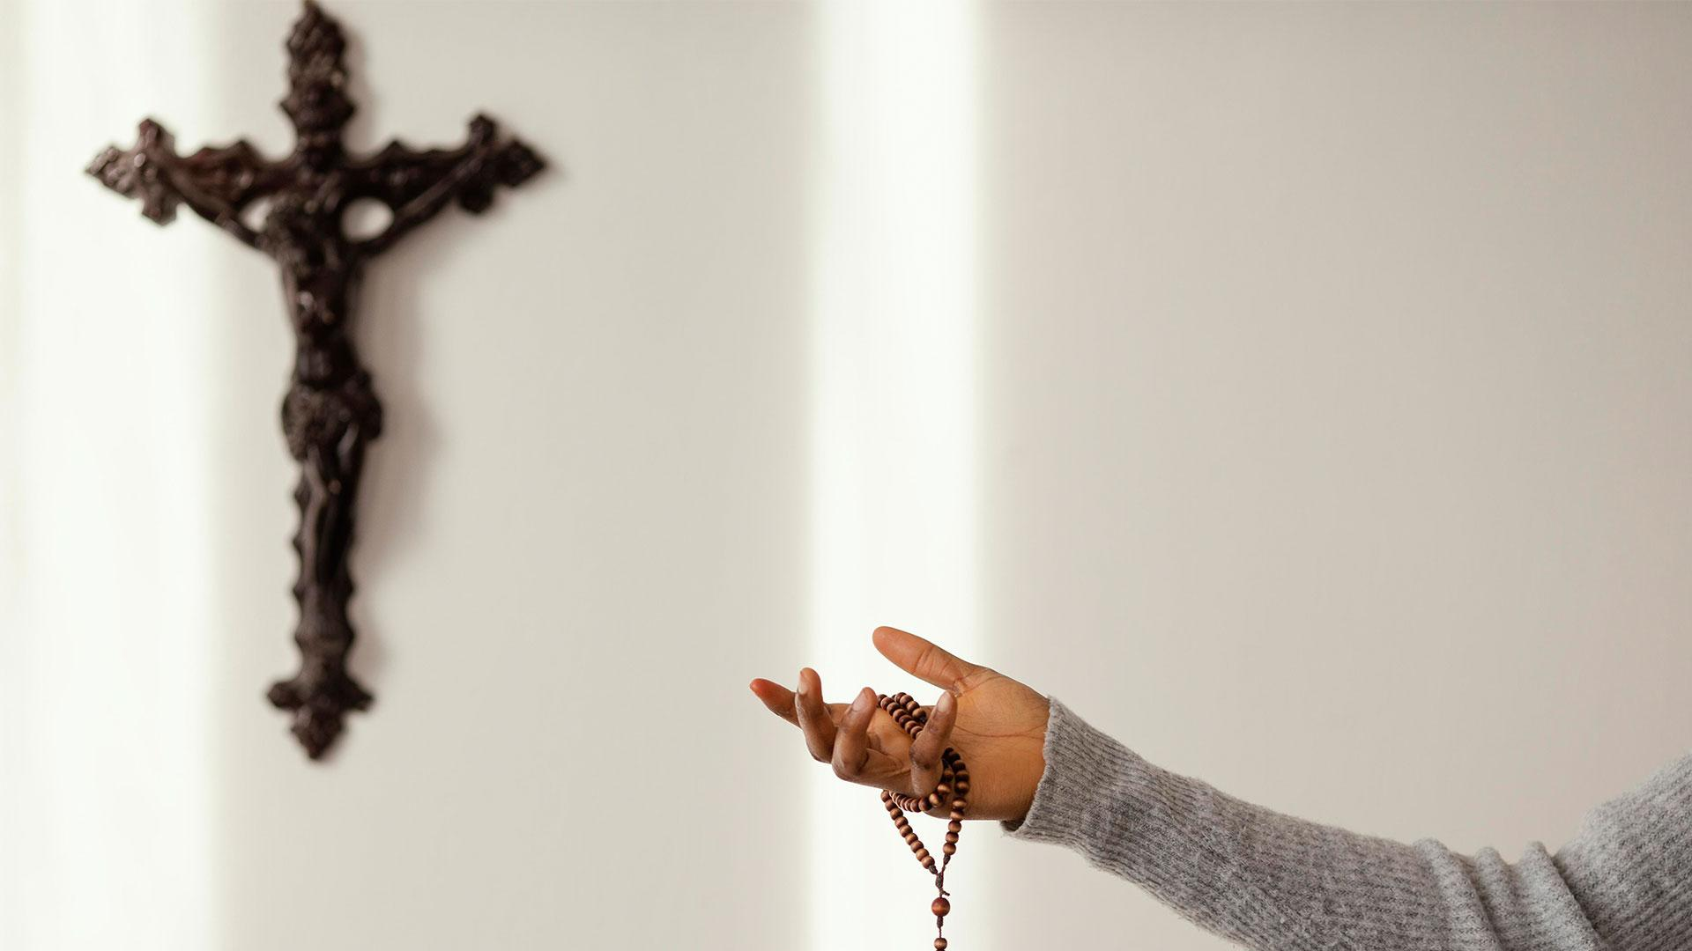
A PICTURE IS WORTH A THOUSAND WORDS

Slide 26
150,000
Big numbers catch your audience’s attention

Slide 27
OUR TEAM
JOHN DOE
JAY PATTERSON
You can replace the image on the screen with your own
You can replace the image on the screen with your own

Slide 28
25%
75%
500,000
Mercury is the closest planet to the Sun and the smallest of them all
Venus has a beautiful name and is the second planet from the Sun
Earth is the third planet from the Sun and the only one that harbors life in the Solar System—this is where we all live

Slide 29
THANKS!
Do you have any questions?
youremail@example.com
+91 620 421 838
Plantillaspowerpoint.org
Free Template

Slide 30
FUENTE
ELABORADO POR :
plantillaspowerpoint.org
IMAGES :
unsplash.com
FONTS :
Passion One
Open Sans

Slide 31
RESOURCES

Slide 32
RESOURCES

Slide 33
RESOURCES

Slide 34
Fully Editable Icon Sets: A

Slide 35
Fully Editable Icon Sets: B

Slide 36
Fully Editable Icon Sets: C

