Slide 1



Cute Anime
FREE PRESENTATION TEMPLATE

Slide 2

Welcome
Welcome to the world of fantasy! Join us on a journey to explore the mystical creatures, enchanted lands, and magical wonders that exist beyond our reality. Discover the wonders and secrets of this exciting realm and unlock the power of imagination.

Slide 3





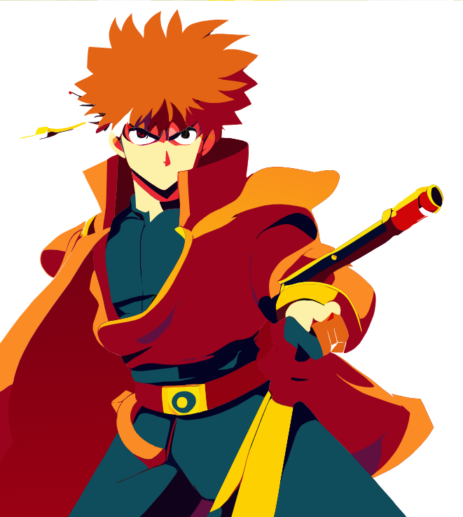















Table of Contents
Introduction
Encounters
The Extraordinary Realm
Unicorn Sightings
Wonders
Magic
Wishes Granted
Spellcasting
Adventure
Conclusion
Happily Ever After
Embrace the Fantasy

Slide 4




Introduction
The Fantasy Realm: Uncovering the Secrets of the Imagination and the Magic that Lies Within

Slide 5

The Realm of the Extraordinary
Welcome to the Fantasy World, a realm of wonder and enchantment where anything is possible. Here, dragons breathe fire, unicorns prance through meadows, and rainbows shine brightly. This world is a place where wishes come true, where potions can be cursed and spells are cast. It's a place of treasure and adventure, where the impossible becomes possible. But the greatest treasure of all is the one that lies within.
The world of fantasy is a reflection of our deepest desires, our fondest dreams, and our wildest imaginations. It's a place where we can let go of the constraints of reality and explore the boundless possibilities of the human mind. In this introduction, we will delve into the mysteries of this realm, uncovering the magic and wonder that lies within. So come with us and let's embark on a journey through the Fantasy World.

Slide 6







Unicorn Sightings
A record of the number of unicorns spotted in the fantasy realm and the beauty and mystery that surrounds these enchanting creatures.
Dragon Taming
A closer look at the art of taming dragons and the brave adventurers who dare to take on these fearsome creatures.

Slide 7

Fantasy is the gateway to the impossible, the land where the ordinary becomes extraordinary, and the impossible becomes possible. It is the realm of the imagination, where anything can happen and everything is possible.
The Dream Weaver

Slide 8


Taming Dragons and Sighting Unicorns: A Guide to the Realm of Magic and Adventure
In the Realm of Magic and Adventure, dragons are no longer fearsome beasts to be feared. They can be tamed and even become loyal companions to those brave enough to venture into the unknown. Similarly, unicorns, long considered to be mythical creatures, can now be sighted in this fantastical realm. The world is filled with endless possibilities and endless adventures.

Slide 9

Dragon Taming Technique
The Art of Unicorn Sighting
A guide to taming and caring for dragons in the realm of magic.
Tips and tricks for spotting the elusive unicorns.

Slide 10

The Elves: A Glimpse into Their World
Elegant inhabitants of enchanted forests, known for their mastery of magic and their close connection to nature. They possess an innate sense of harmony and balance, making them protectors of the natural world.
"The Art of Archery": Discover the intricacies of the Art of Archery as practiced by the graceful and precise elves.
"The Music of the Elves": Immerse yourself in the enchanting music of the elves, whose songs have the power to heal.

Slide 11
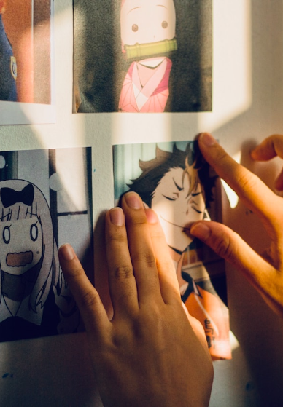


75%
Enchanted Creatures
possess the ability to cast spells.
60%
Magic-Wielding Individuals
practice the art of illusions.
90%
Spells Cast
are dark magic, foretelling danger.

Slide 12



234,567
UNICORN SIGHTINGS
A tally of the number of unicorns spotted in the fantasy realm.

Slide 13

233 Coins
85%
Treasure Found
Wished Granted
456 Hours
535 Km
Duration of Spell Casting
Journey Distance

Slide 14

1
Discover the secrets
Explore the lush, vibrant forest and uncover the mysteries that lie within.
2
Find your own path
Choose your own path through the forest, and see where it takes you.
3
Meet the creatures
Encounter the mythical creatures that call the forest home, from talking animals to mischievous fairies.
4
Uncover the magic
Learn about the powerful magic that pervades the forest and how it affects all who enter.

Slide 15





The information
Treasure
Hunt
Great
Adventure
A significant event in the history of the fantasy realm, in which a massive and awesome treasure hunt was organized.
A notable year in the history of the fantasy realm, in which a large number of adventurers set out to explore.

Slide 16







The Mystery
The Forbidden Forest: A place of mystery and wonder, where mystical creatures roam and enchanted flora flourishes.
The Crystal Caves: A network of glittering caves filled with precious gems and minerals, guarded by fierce beasts.
The Enchanted Garden: A place of pure beauty and tranquility, where the colors of the flowers are more vibrant.

Slide 17






The Enchanted Forest
A magical forest filled with talking animals and enchanted creatures.
The Crystal Caves
A network of underground caves filled with precious gems and crystals.
The Dragon's Lair
A dangerous and mysterious place where dragons reside.
Fantasy Realm at a Glance

Slide 18














Our Team
Elementalen
Lunaria
Eldruin
The Guardians of the Four Elements
The Moon Priestess
The Fire Mage

Slide 19







Thank you for choosing EaTemp
We offer free and high-quality slides templates for your presentations. We appreciate you choosing us and hope our templates have been helpful.
As a new website, we rely on your support to grow, so please help us by sharing our site with your friends and colleagues.
eatemp._
@eatemp
eatempofficial
@eatemp.official

