Slide 1
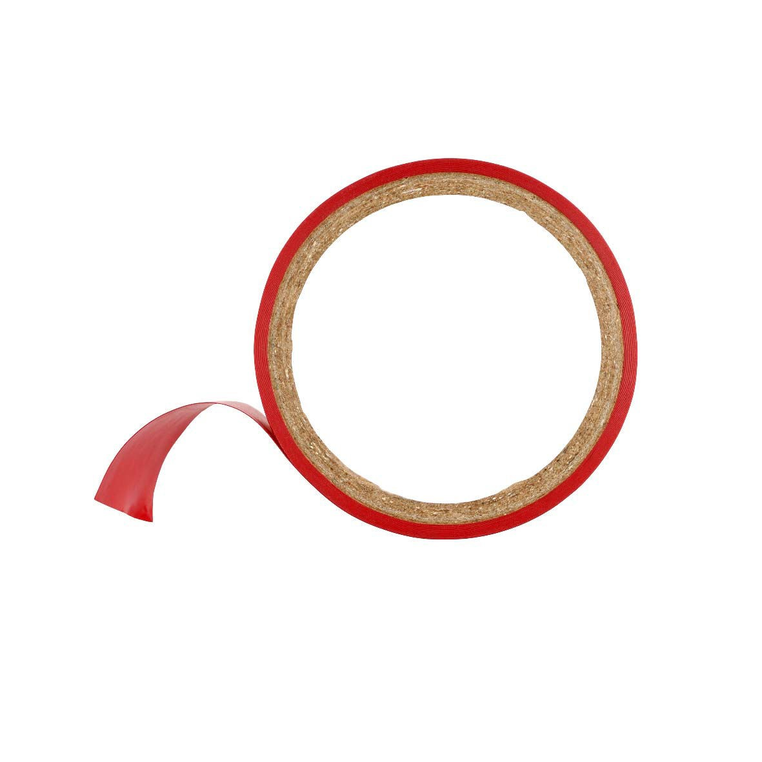
Modernizing compliance:
Moving from value protection to value creation
Deloitte Poll results from March 30, 2017

Slide 2
More than 5 8 0
Methodology
professionals in compliance (21.4
percent), internal audit (35.6 percent), risk management (17.7 percent), C-suite roles outside of compliance (22.6 percent) and corporate board members (2.7 percent) participated in a Deloitte Dbriefs webcast, titled “Modernizing compliance: Moving from value protection to value creation,” on March 30, 2017. Poll respondents largely work in the financial services (45.7 percent) and consumer and industrial products (23.2 percent) industries.
To replay the Deloitte Dbriefs webcast, visit the archive online.
Copyright © 2017 Deloitte Development LLC. All rights reserved.
‹#›

Slide 3
Do you expect regulatory enforcement activity to change in your sector in the next 12 months?
Votes received: 666
3 2 .4 % 4 8 .3 %
4 4 .1 %
3 7 % 2 2 .3 %
2 6 .1 %
1 7 .9 % 1 2 .8 %
1 4 .1 %
Yes - Increase
No
Yes - Decrease
Corporate leaders
Compliance
All
Don’t know/not applicable: Corporate leaders (12.7%); Compliance (16.6%); All (15.6%)
Copyright © 2017 Deloitte Development LLC. All rights reserved.
‹#›
Copyright © 2017 Deloitte Development LLC. All rights reserved.
3

Slide 4
How would you describe your organization’s current compliance and regulatory efforts?
Votes received: 681
Foundational:
Compliance team is focused on preventing, detecting, responding to and remediating risk, offering backward-looking analysis and reports, leveraging no analytics or RegTech tools
5 5 .5 %
5 2 .3 %
5 6 .6 %
Modernized:
Compliance team uses advanced analytics, and is involved/integrated in strategic decision-making
1 8 .6 %
All
1 9 .8 %
Corporate leaders
Compliance professionals
1 8 .3 %
Value- creating:
Compliance team is seen as a strategic advisor that offers predictive insights and greater efficiency through the use of RegTech (cognitive compliance, risk sensing, automation/robotics, etc.)
1 1 %
9 .9 %
1 1 .4 %
Don’t know/not applicable: Corporate leaders (18%); Compliance (13.8%); All (14.8%)
Copyright © 2017 Deloitte Development LLC. All rights reserved.
‹#›
Copyright © 2017 Deloitte Development LLC. All rights reserved.
4

Slide 5
What do you anticipate to be the biggest challenge to modernizing your organization’s Compliance function in the next 12 months?
Votes received: 673
Corporate leaders
Compliance
All
Lack of technological capabilities (cognitive compliance, risk sensing, automation/robotics, etc.)
Lack of talent with the required background, skills, and competencies
Lack of processes to support modernization efforts
Lack of board, C-suite, or business support
Lack of analytical capabilities (lack of data, data integrity issues, etc.)
 | 27% | 24.1% | 23.7%
 | 16.9% | 24.1% | 18.5%
 | 17.3% | 17.2% | 19.1%
 | 12.9% | 11.5% | 13.3%
 | 10.5% | 9.2% | 8.6%
Don’t know/not applicable: Corporate leaders (15.3%); Compliance (13.8%); All (16.5%)
Copyright © 2017 Deloitte Development LLC. All rights reserved.
‹#›
Copyright © 2017 Deloitte Development LLC. All rights reserved.
5

Slide 6
Which do you think would be the biggest benefit of modernizing your organization’s Compliance function in the next 12 months?
Votes received: 1,023
Corporate leaders
Compliance All
7.1% 8.2% 7.9%
Reduction in fines, penalties, corrective actions, or legal costs due to earlier detection of possible compliance violations
17.7% 27.2% 24.9%
20.6% 18.6% 19.1%
22% 18.6% 19.4%
Improved efficiency of
18.4% 18.6% 18.5%
Meaningful, often predictive, insights provided by compliance teams, in addition to backward-looking analysis and reports
Cultivation of a
Better integration of regulatory and compliance concepts in business strategy
consistent, organization- Compliance function and wide ethical culture that reduced costs related to makes compliance more it
of a built-in behavior
Don’t know/not applicable: Corporate leaders (14.2%); Compliance (8.8%); All (10.1%)
Copyright © 2017 Deloitte Development LLC. All rights reserved.
‹#›
Copyright © 2017 Deloitte Development LLC. All rights reserved.
6

Slide 7

Media contact
Shelley Pfaendler Public Relations Deloitte Services LP
spfaendler@deloitte.com
Full press release available on Deloitte.com
Copyright © 2017 Deloitte Development LLC. All rights reserved.
‹#›
Copyright © 2017 Deloitte Development LLC. All rights reserved.
7

Slide 8

The statements in this report reflect the aggregation of poll responses and are not intended to reflect facts or opinions of any entities. All data, charts and statistics referenced and presented, as well as the representations made and opinions expressed, unless specifically described otherwise, pertain only to the participants and their responses to the Deloitte poll. The information obtained during the poll was taken “as is” and was not validated or confirmed by Deloitte.
This presentation contains general information only and Deloitte is not, by means of this presentation, rendering accounting, business, financial, investment, legal, tax, or other professional advice or services. This presentation is not a substitute for such professional advice or services, nor should it be used as a basis for any decision or action that may affect your business. Before making any decision or taking any action that may affect your business, you should consult a qualified professional advisor.
Deloitte shall not be responsible for any loss sustained by any person who relies on this presentation.
About Deloitte
Deloitte refers to one or more of Deloitte Touche Tohmatsu Limited, a UK private company limited by guarantee (“DTTL”), its network of member firms, and their related entities. DTTL and each of its member firms are legally separate and independent entities. DTTL (also referred to as “Deloitte Global”) does not provide services to clients. In the United States, Deloitte refers to one or more of the US member firms of DTTL, their related entities that operate using the “Deloitte” name in the United States and their respective affiliates. Certain services may not be available to attest clients under the rules and regulations of public accounting. Please see www.deloitte.com/about to learn more about our global network of member firms.
Copyright © 2017 Deloitte Development LLC. All rights reserved.

