Slide 1
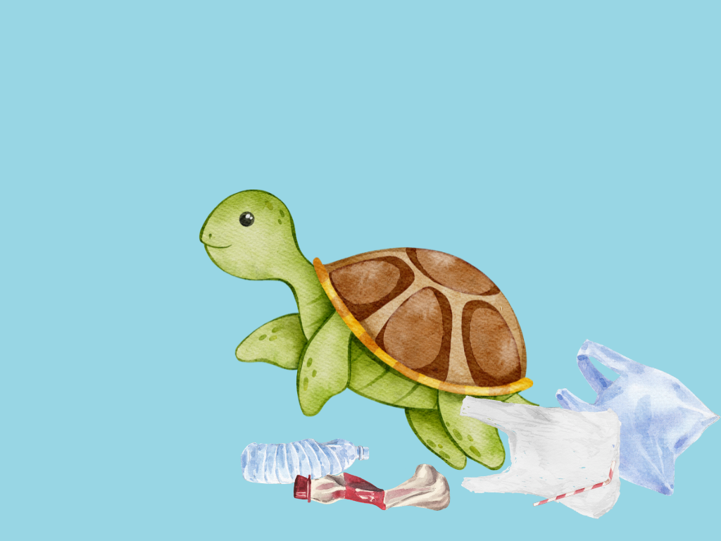

Tess and the Mess

Slide 2
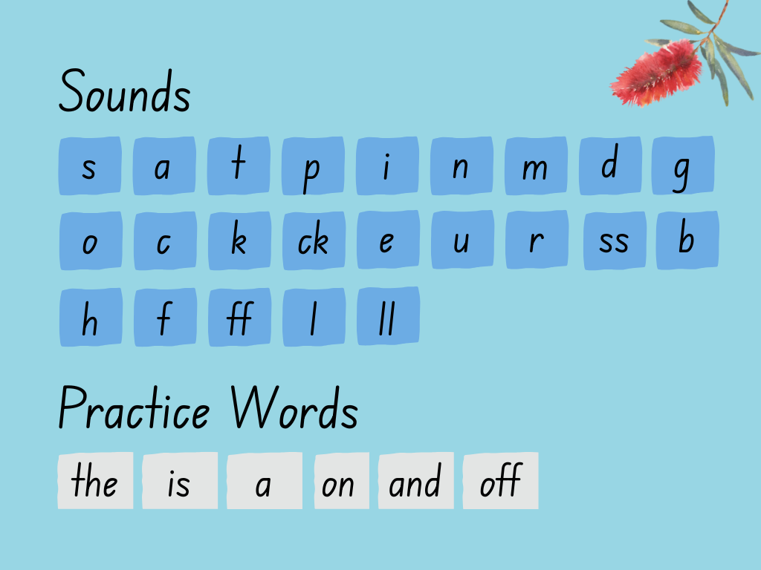

Slide 3
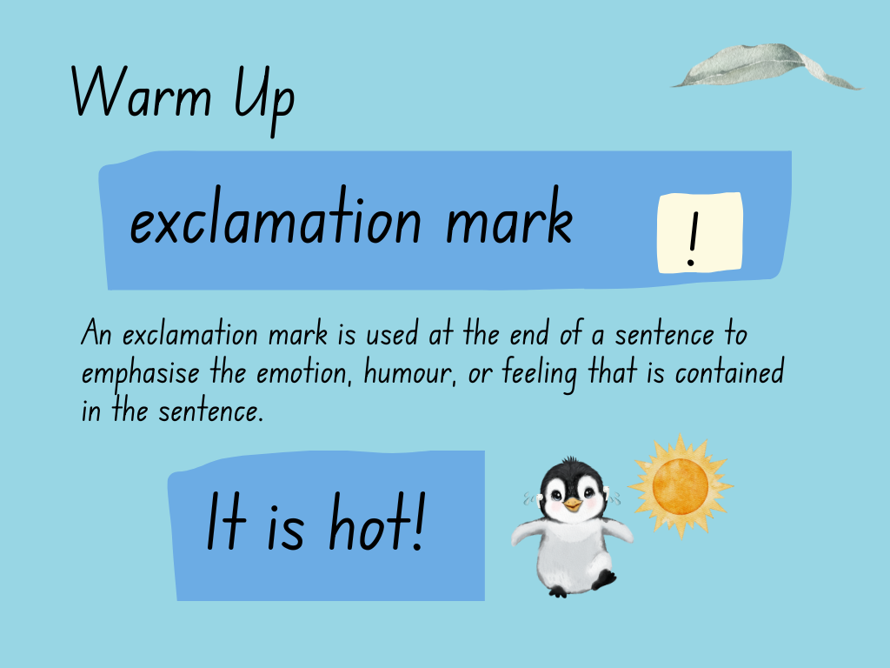

Slide 4
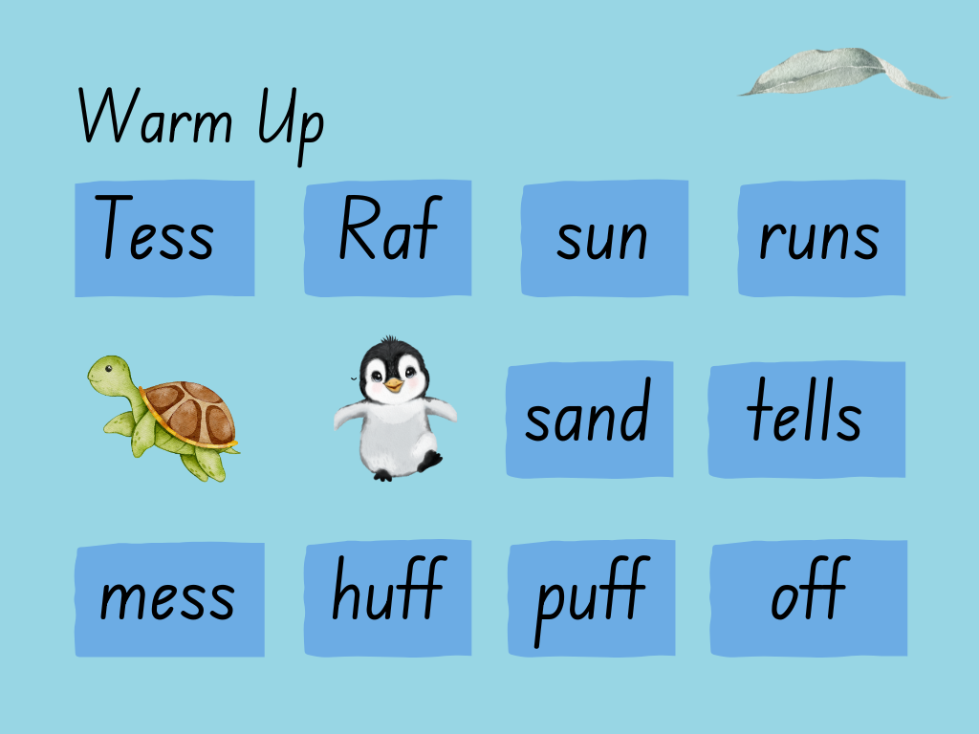

Slide 5

The sun is up.

Slide 6
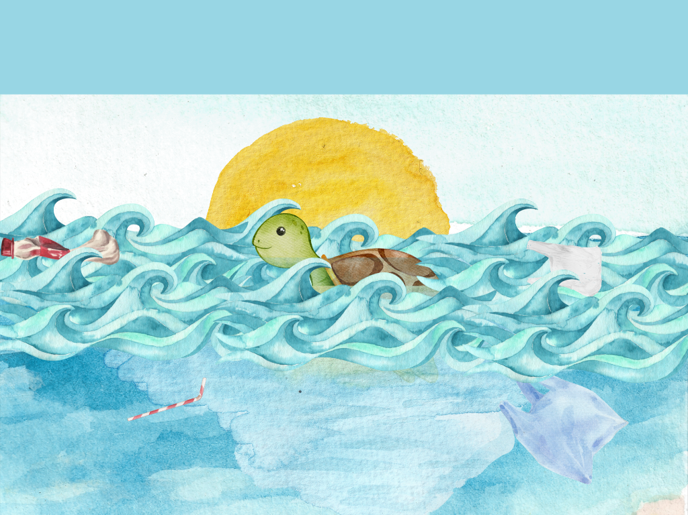
Tess is up. It is a mess!

Slide 7
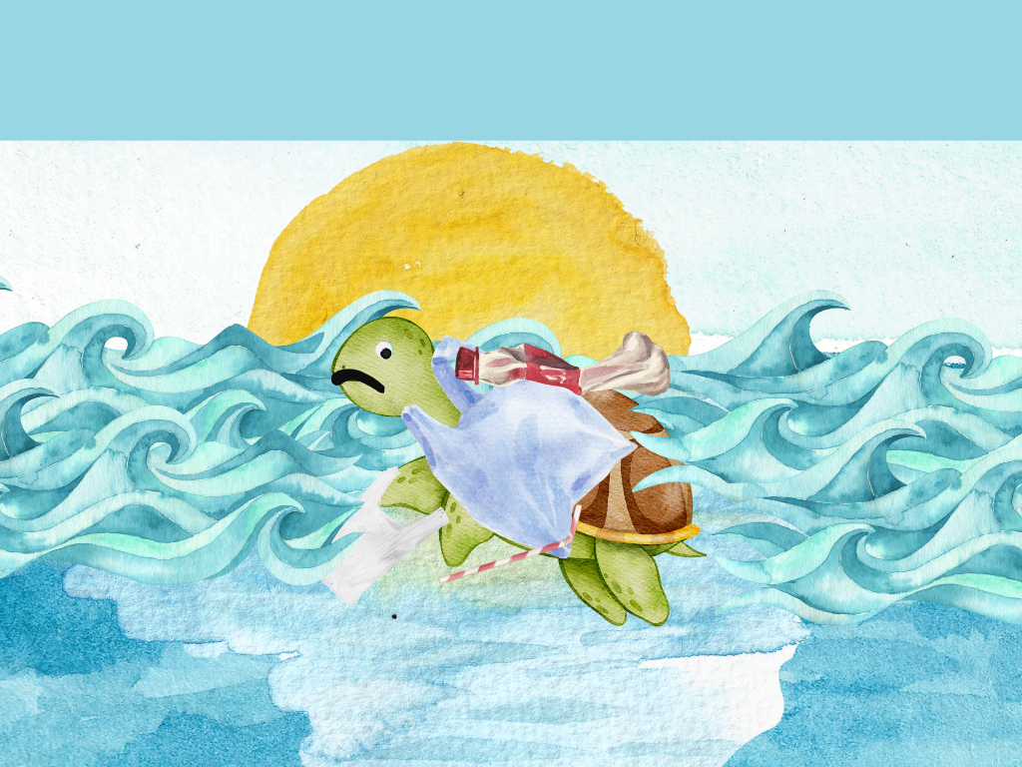
The mess is on Tess!

Slide 8

Raf is on the sand.

Slide 9
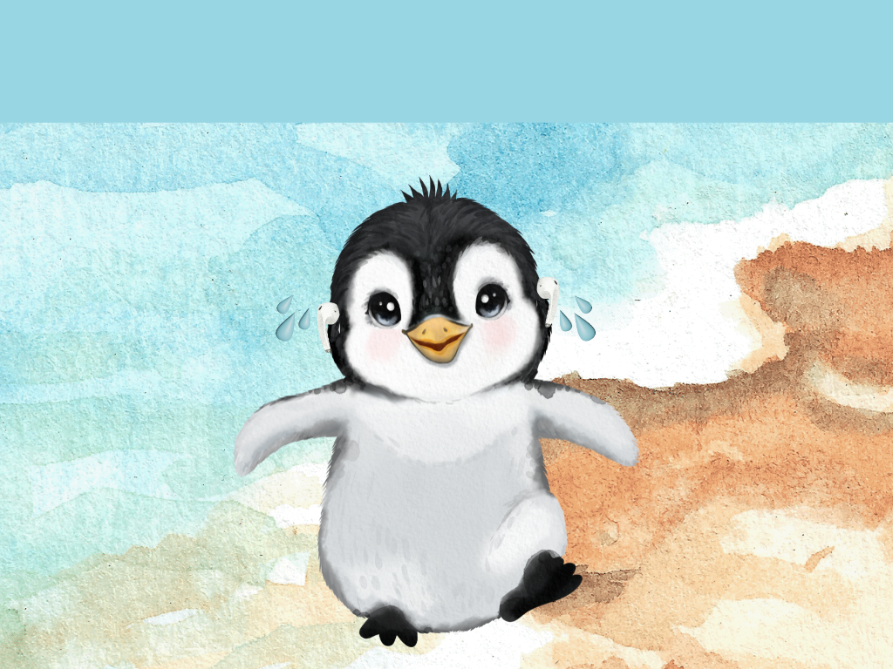
Raf runs. It is hot!

Slide 10
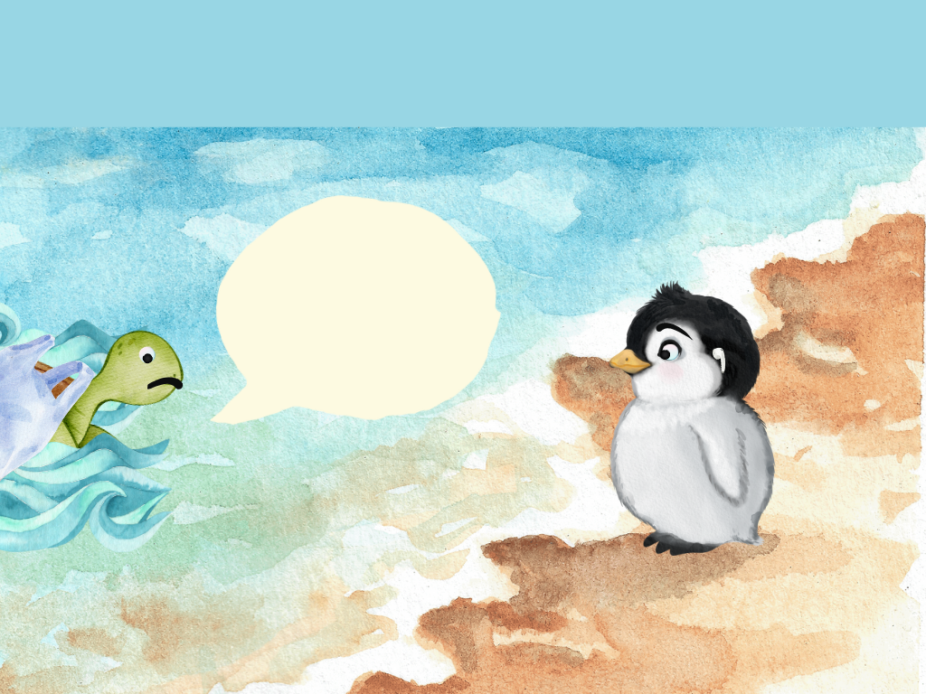
Tess tells Raf.
Get the mess off!

Slide 11
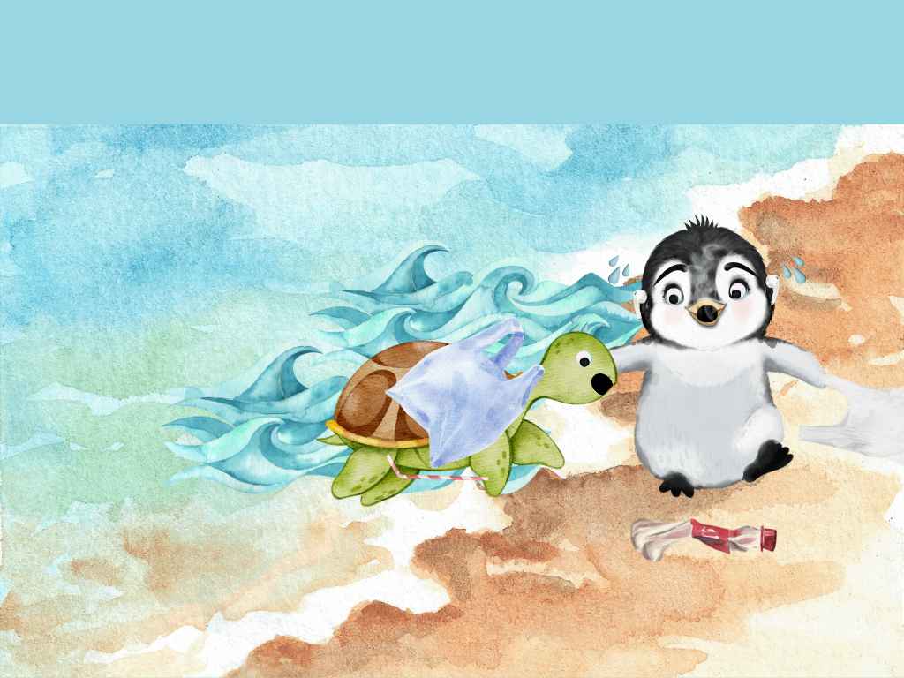
He huffs and puffs!

Slide 12
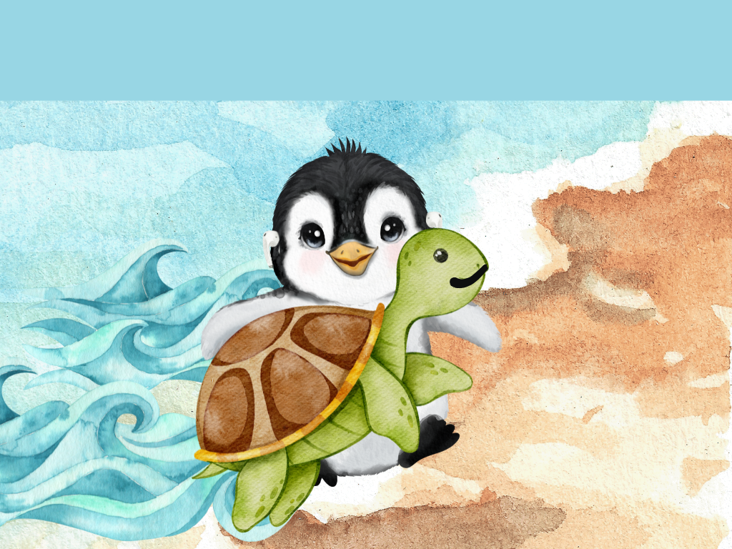
The mess is off.

Slide 13
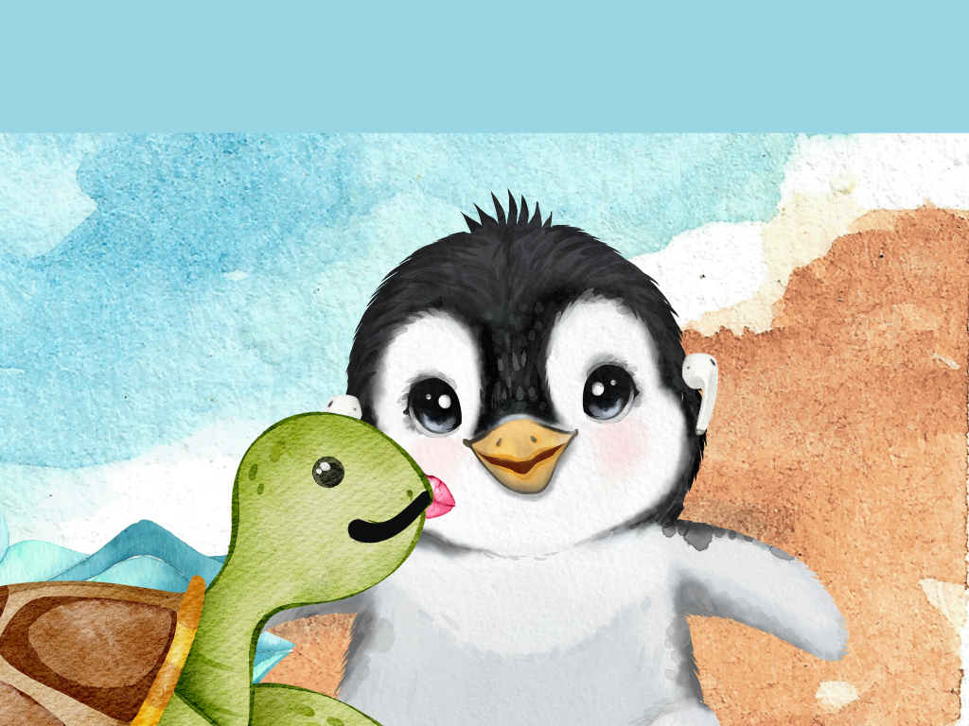
Raf gets a kiss.

Slide 14
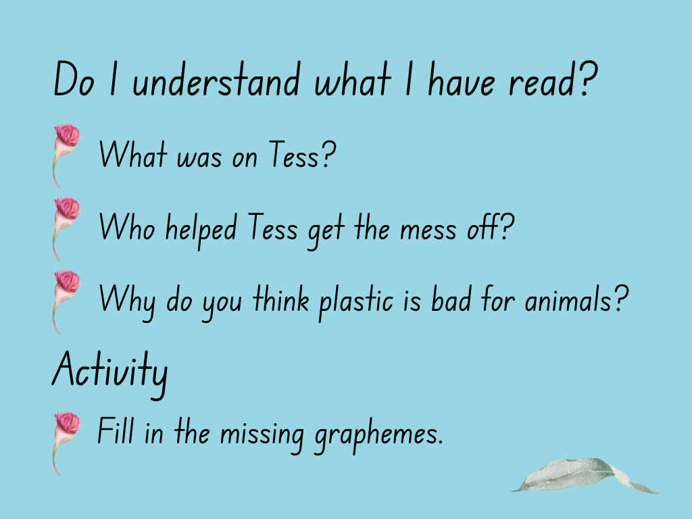

Slide 15
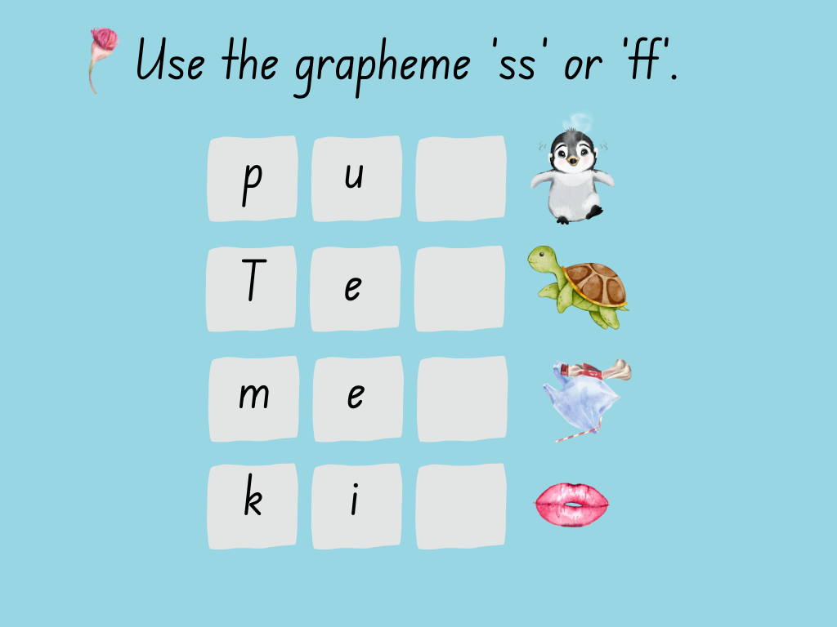

Slide 16
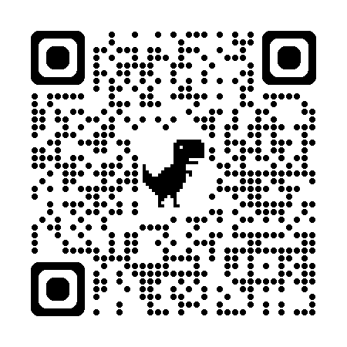
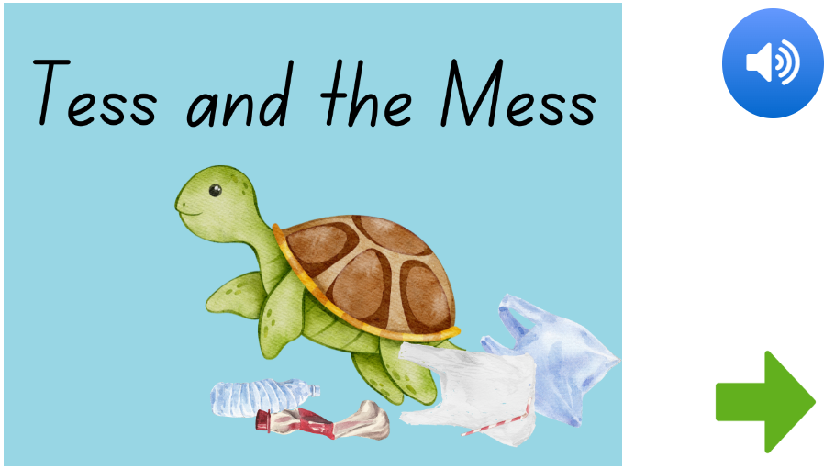

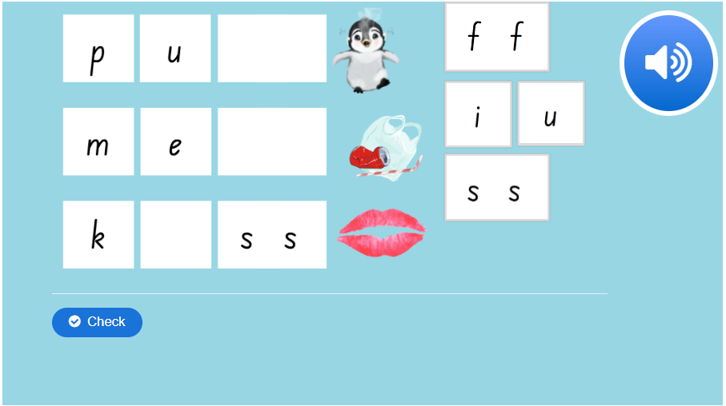
Digital decodable
This decodable text, and many other K-2 resources, can be found on the NSW Student learning library.
Follow this link to find digital resources associated with this decodable text, OR use the QR code.
Self paced read-aloud
Memory game
Spelling game

Slide 17
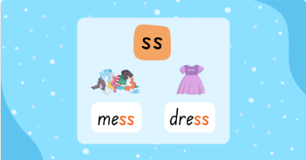
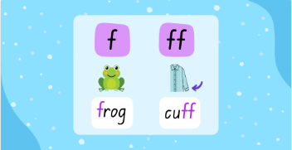
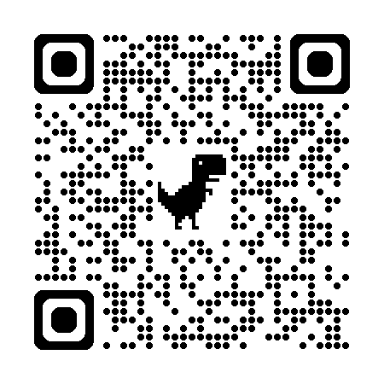
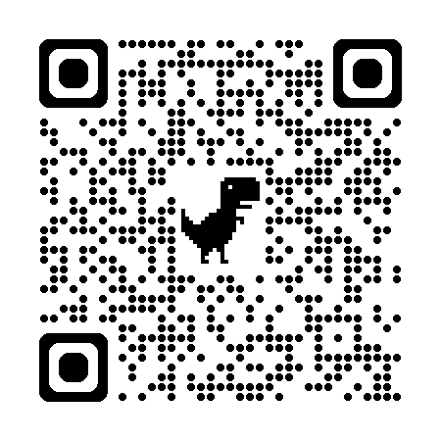
Relevant resources
Click on the titles below, or use the QR codes, to navigate to these resources.
Phonics – ss
Phonics – f, ff

Slide 18
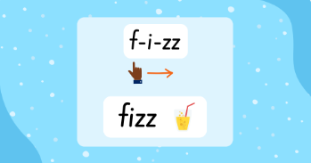
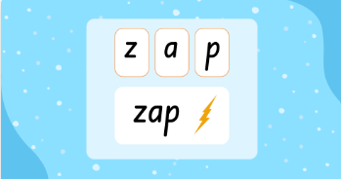
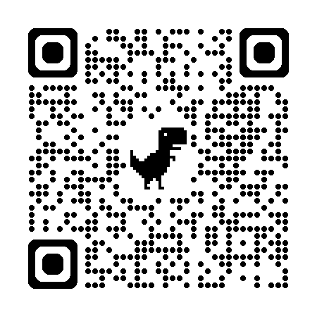
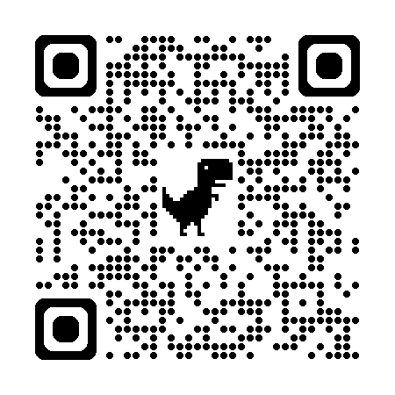
Relevant resources
Click on the titles below, or use the QR codes, to navigate to these resources.
Read words – ss, z, zz
Spell words – ss, z, zz

