Slide 1

Seventh Annual Summit on
Evidence-Based Education
Building and Sustaining an
Effective School Culture:
Supporting Educator and Student Success

Slide 2
30 years studying “research to practice” issues…
from the “practice” side

Slide 3
1978 - 2004
Operated a large non-profit organization in SF Bay Area
six spec. ed schools adult programs
residential programs employment supportive services
public school consultation teacher training campus
Deliberately implemented a organizational culture based on:
Evidence-based Clinical problem solving
research to practice data-based decision making
Performance feedback Positive reinforcement
student, staff, organization student, staff, organization
Notes:
How many worked for us ?

Slide 4
2004 - present
independent, non-profit operating foundation
promote evidence-based education policies and practices
act as a catalyst to facilitate communication, cooperation and collaboration between individuals and organizations currently engaged in evidence based education
engage in data-mining, gathering, analyzing and disseminating data

Slide 5
SUMMIT Participants: Organizations
60 different organizations
8 consumer / parent / advocacy / public policy
parent groups advocacy groups
service orgs Regional Centers
14 public school organizations
school districts SELPAs county office of ed
  17 private education organizations
  nonpublic schools nonpublic agencies private schools
19 universities
  education school psychology psychology pediatrics
  social welfare special education journalism disability services
4 research & policy organizations
4 private businesses

Slide 6


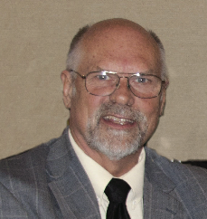
Presenters
Bill Redmon, Ph.D
Manager of Global Leadership and Development and Principal Vice President with the Bechtel Group, Inc.
Roger Addison, Ph.D
Chief Performance Officer of Addison Consultingq
Sam Redding, Ph.D
Director of the Center on Innovation & Improvement
Director of the Academic Development Institute

Slide 7
Summit Housekeeping
Resource Packet (Flash Drive)
Knowledge Network
Schedule
Breaks
Lunch
Time management (groups, report outs)
4:00 PM sharp!
Summit Feedback Survey

Slide 8
Building and Sustaining an
Effective School Culture:
Supporting Educator and Student Success
The Critical Role of Culture Change
in School Improvement…
What Did We Miss?

Slide 9

Successful Implementation and Culture Change
evidence-based and effective practices often fail due to ineffective implementation strategies
requires a systematic and deliberate cultural change process across all levels of an organization
changes in adult professional behavior (all stakeholders)
changes in organizational structures, systems, policies, contingencies, values, procedures, both formal and informal
changes in relationships to consumers, stakeholders, and systems partners
Evidence-based and produce desired outcomes over time
National Implementation Research Network (NIRN)

Slide 10
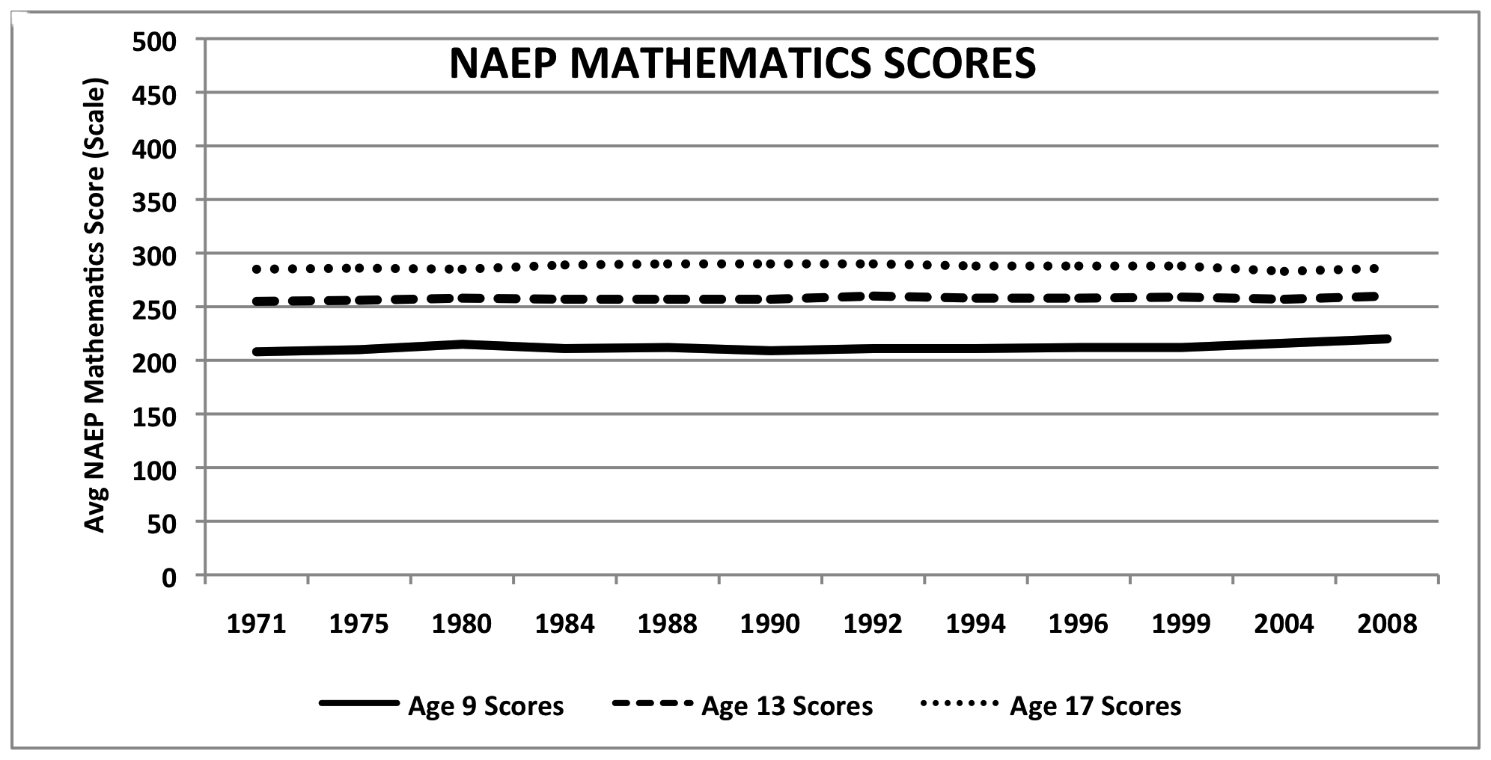
School Reform Track Record: NAEP
2011 NAEP Reading
At or above proficiency
4th Grade = 34%
8th Grade = 34%
12th Grade = 38%
2011 NAEP Math
At or above proficiency
4th Grade = 40%
8th Grade = 35%
12th Grade = 26%
National Assessment
of Educational
Progress (NAEP)
Notes:
NATIONAL ASSESSMENT OF EDUCATIONAL PROGRESS

Slide 11
School Reform Track Record: Graduation Rates

Slide 12
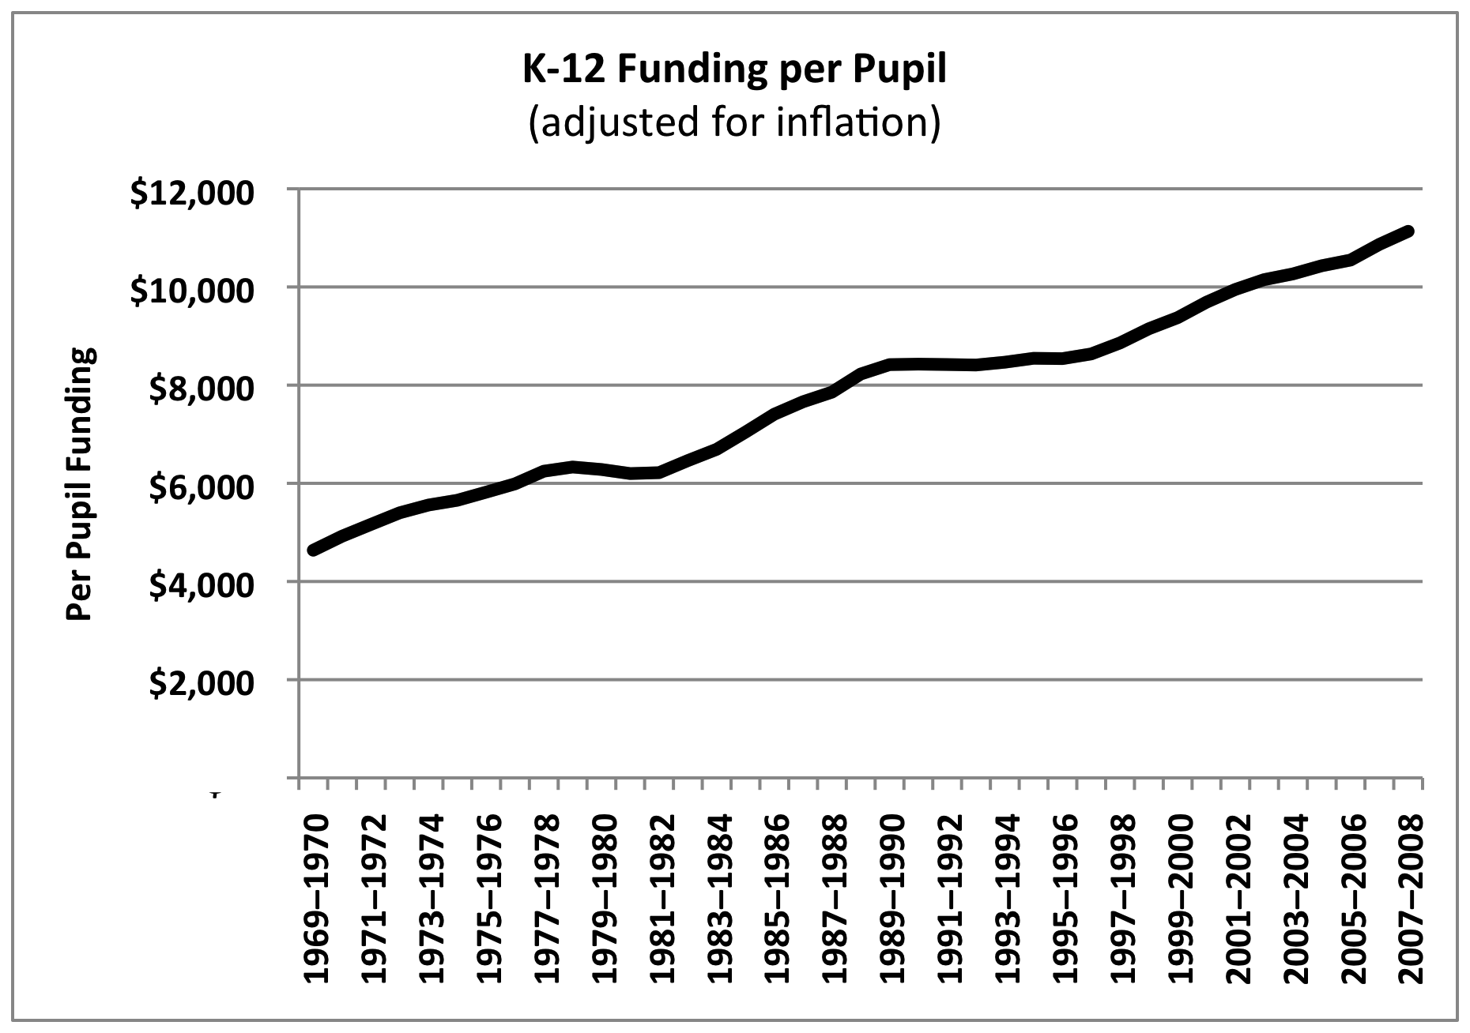
Education Structural Interventions
Increased Funding
1970-2008: Funding increased by 140%
1998-2007: Funding increased by 24%

Slide 13
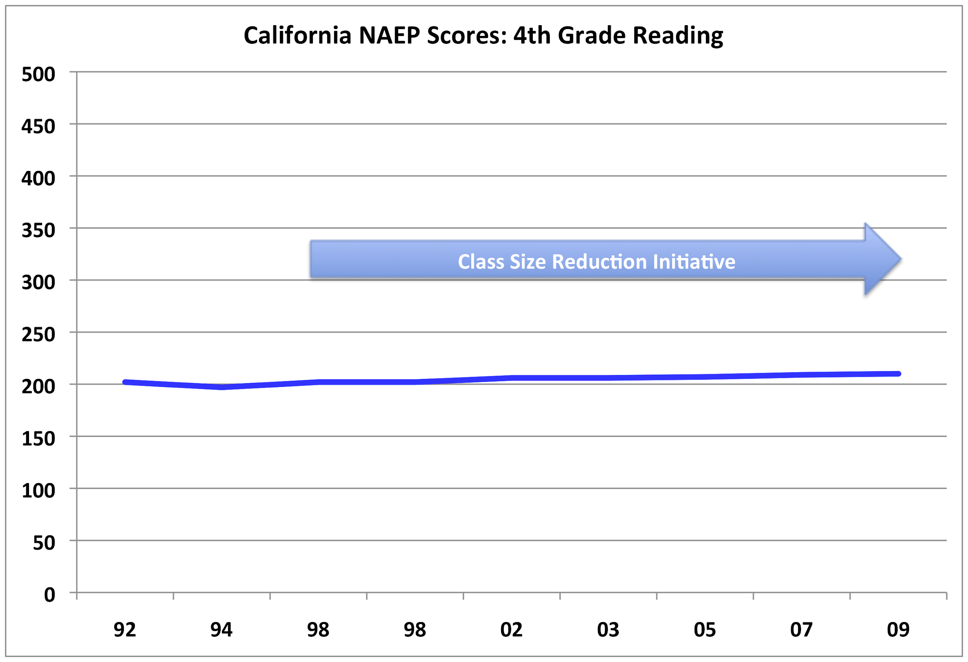
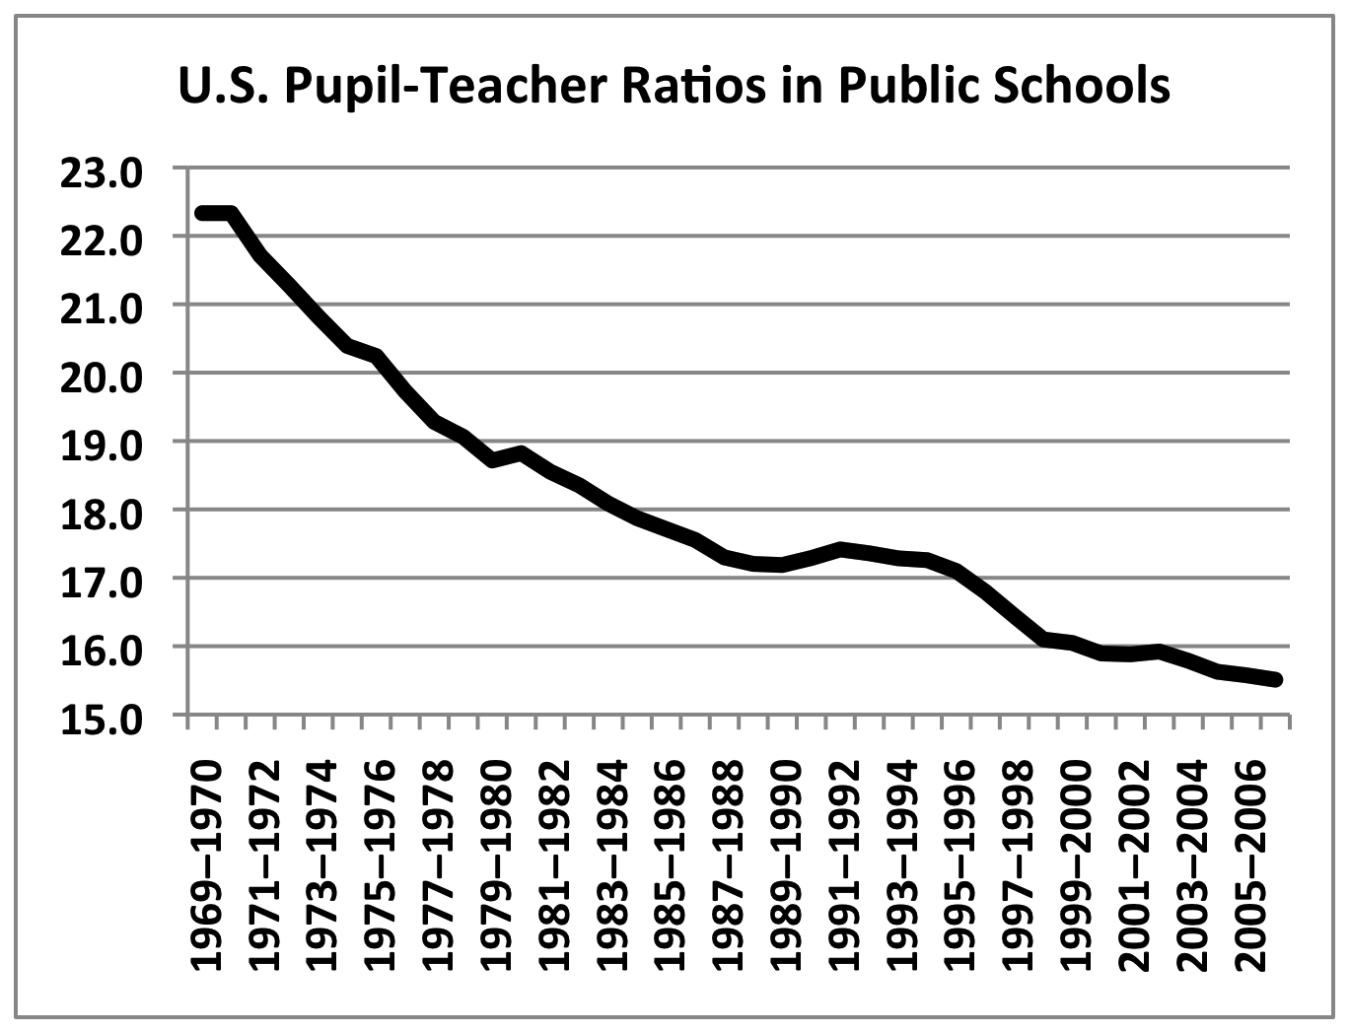
Education Structural Interventions
Class Size Reduction
CA spent over $20 billion from 1996–97 through 2009–10
on reduced K-3 class sizes,
averaging $ 1.75 billion per year for last five years.
As or 2010, 36 states have laws restricting the number of children in K-12 Classrooms
CAPSTONE REPORT (2002)
The relationship of CSR to student achievement was inconclusive…attribution to any gains in scores to CSR is unwarranted.
Students received more individual attention but similar instruction and curriculum…

Slide 14
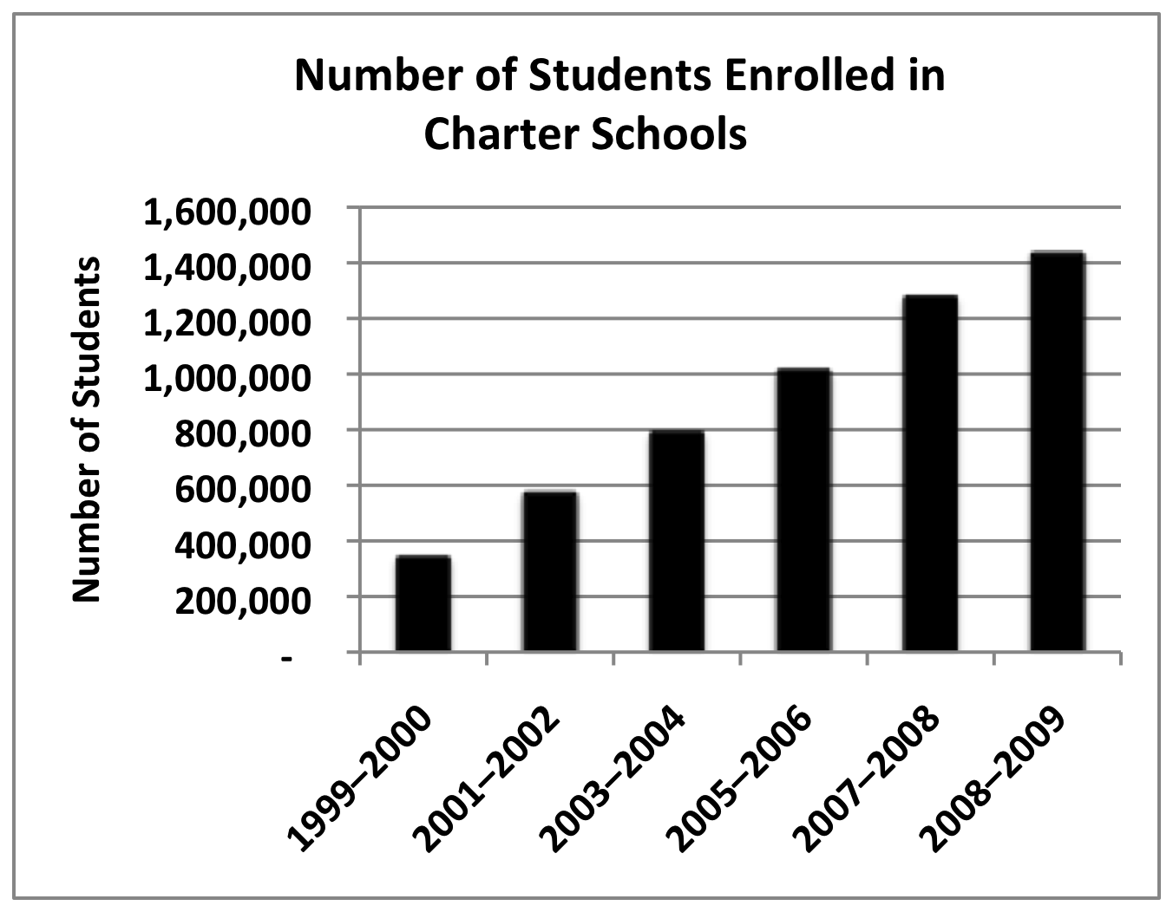
Education Structural Interventions
Charter Schools
The Evaluation of Charter Schools Final Report (June 2010)
“On average, charter middle schools that hold lotteries are neither more nor less successful than traditional public schools in improving achievement, behavior, and school progress.”
“The impact of charter middle schools on student achievement varies significantly across schools”

Slide 15
Education Structural Interventions
No Child Left Behind
Established Adequate Yearly Progress (AYP) metric:
test scores
graduation rates
Established criteria and “sanctions” to force school improvement
Schools that fail to make AYP for 2+ years are “in improvement”
Schools that fail to make AYP after 4 years are in “corrective action”
Schools that fail to make AYP after 5 years are “in restructuring planning”
Schools that fail to make AYP after 6 years are “in restructuring implementation”
Notes:
Close and reopen as charter
Contract with private management company
Replace all or most staff
State management, or
Other major governance restructuring that makes fundamental reforms

Slide 16
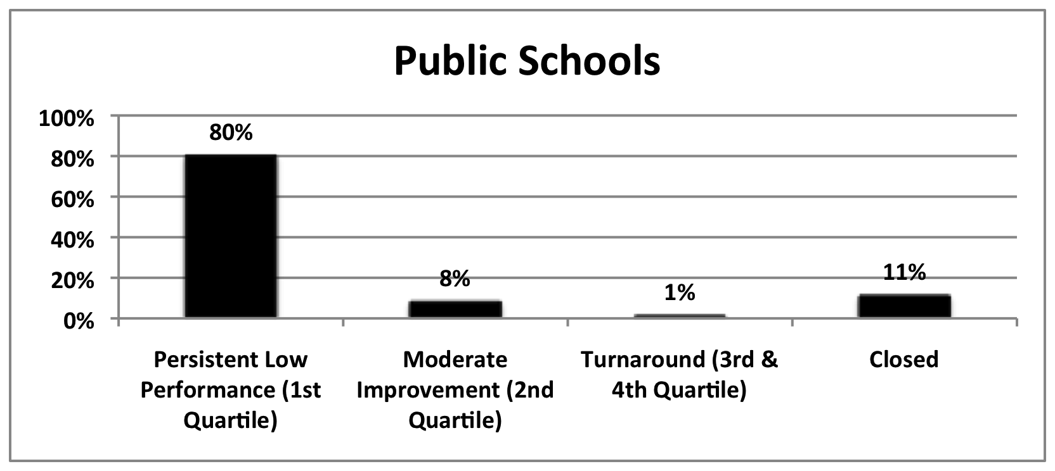
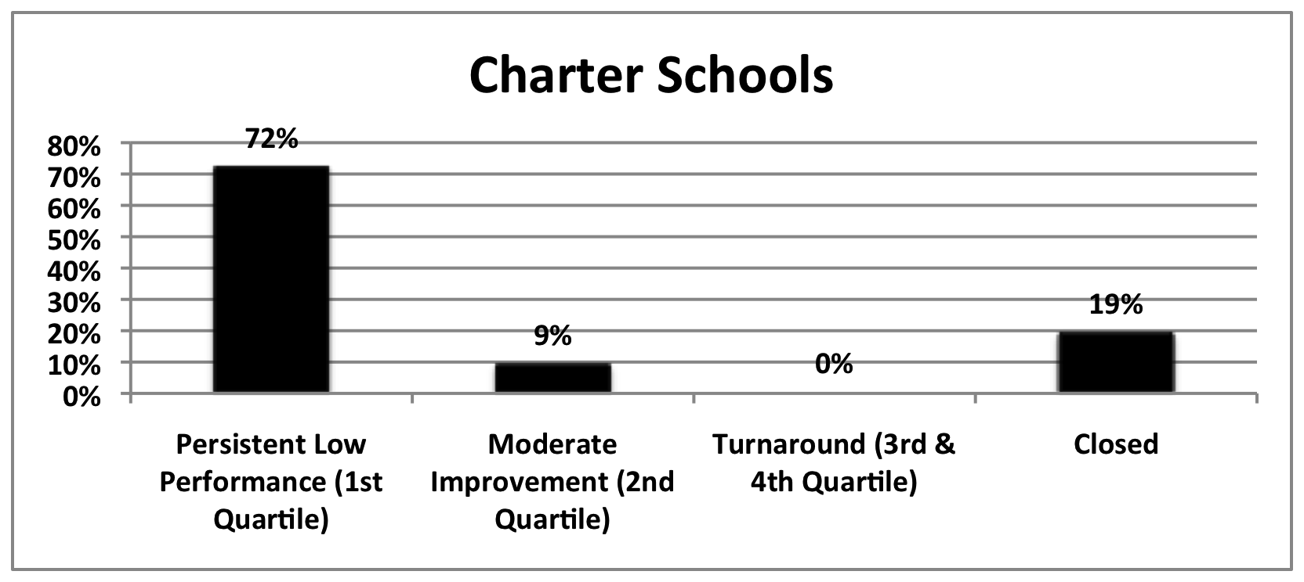
Education Structural Interventions
No Child Left Behind
Tracked progress of
2,025 low-performing
charter & district schools
across 10 states
(2003-04 TO 2008-09)
Thomas B. Fordham Institute,
Are Bad Schools Immortal? (2010)
    2005/06 was the first year
    for “restructuring sanction”
  Over the next three years
  (2006-07, 2007-08, 2008-09 )
  1521 more schools entered
  restructuring than exited restructuring.
    U.S. Department of Education
Notes:
Low performing schools = avg. combined 02/03, 03/04 reading and math proficiency in lowest 10%
= schools failed to meet AYP proficiency targets two years in a row
Turnaround = test scores above 50th percentile in last two years 07/08, 08/09

Slide 17
What did we miss?
Focused on “structural” interventions that don’t necessarily improve teaching effectiveness
    Increased funding Charter Schools
    Class size reduction No Child Left Behind
Not enough focus on interventions that do directly improve teaching effectiveness

Slide 18
2011 State Teacher Policy Yearbook
Analysis of state’s performance against a set of
36 specific, research-based teacher policy goals
in support of teacher effectiveness
Delivering Well-Prepared Teachers
Expanding the Teacher Pool
Identifying Effective Teachers
Retaining Effective Teachers
Exiting Ineffective Teachers
Average Overall Grade
  National Council on Teacher Quality (2011)
D
C-
D+
C-
D+
D+
Notes:
Very well to moderately well

Slide 19
“Evidenced-based” Teacher Training
Review of 1,206 Teacher Preparation Programs (1,434 in 2011)
(220,000 students)
Programs vary in every way imaginable
selectivity, design, duration, course and fieldwork requirements
2. Programs are driven by ideology and personal predilection
relativism is the rule
Programs have fundamental disagreements with scientific evidence and data
science vs. art
profession vs. craft
anti-science, anti-systematic instruction
(whole language, post modernism, constructivism)
Levine (2006)

Slide 20
“Evidenced-based” Teacher Training
DATA DRIVEN INSTRUCTION
using student & treatment integrity data to inform / improve instruction
estimated that teachers make 11,000 significant instructional decisions in any given year (Hosp 2010)
over $ 500 million of federal funding for developing states’ technology infrastructure to support data-driven decision making
TEACHER REQUISITE SKILLS
Assessment literacy: the taxonomy of assessment
(formative vs. summative, norm-referenced, criterion-referenced)
Analytic Skills: collect, dissect, describe and display data
Instructional Decision Making: using data to make effective decisions about teaching strategies National Council on Teacher Quality (2012)

Slide 21
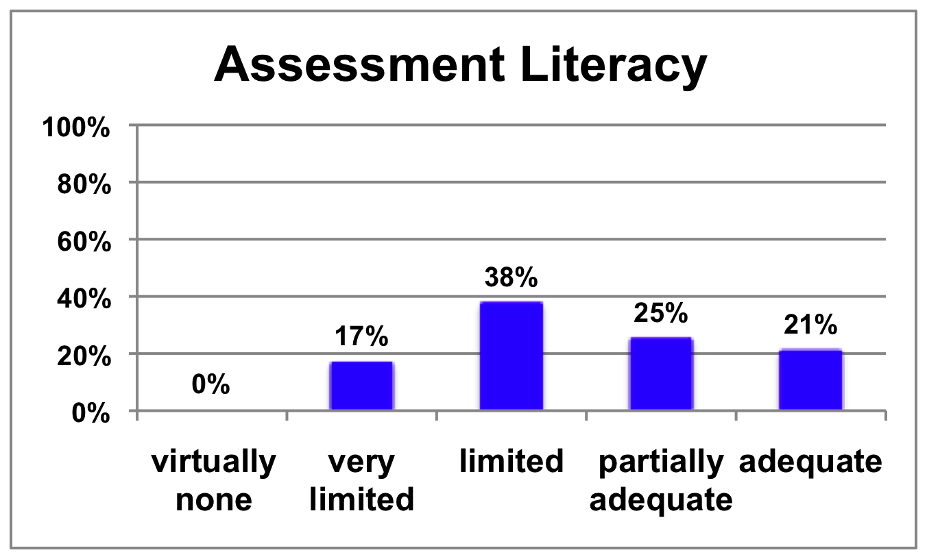
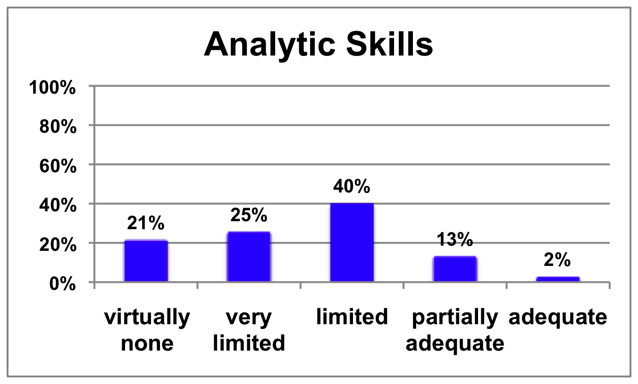
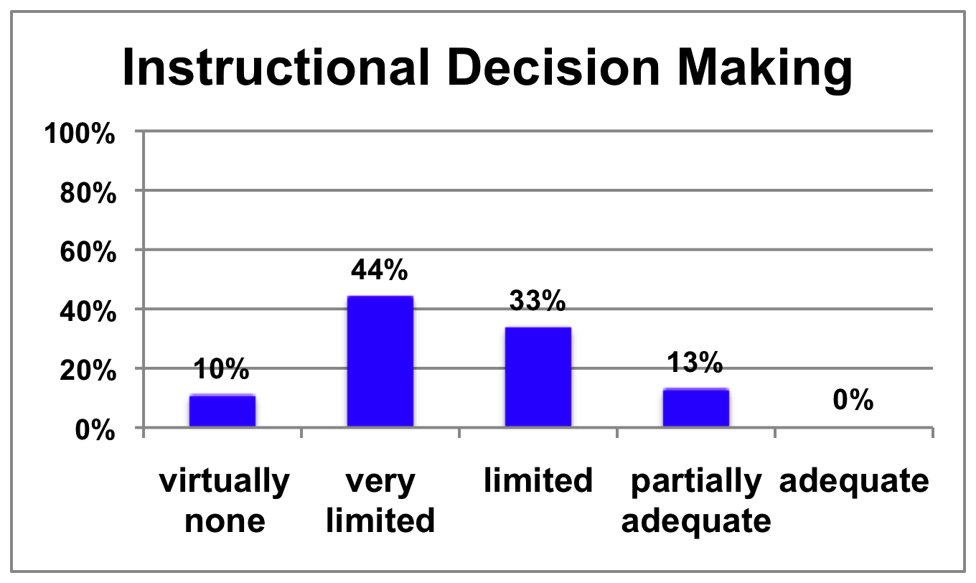
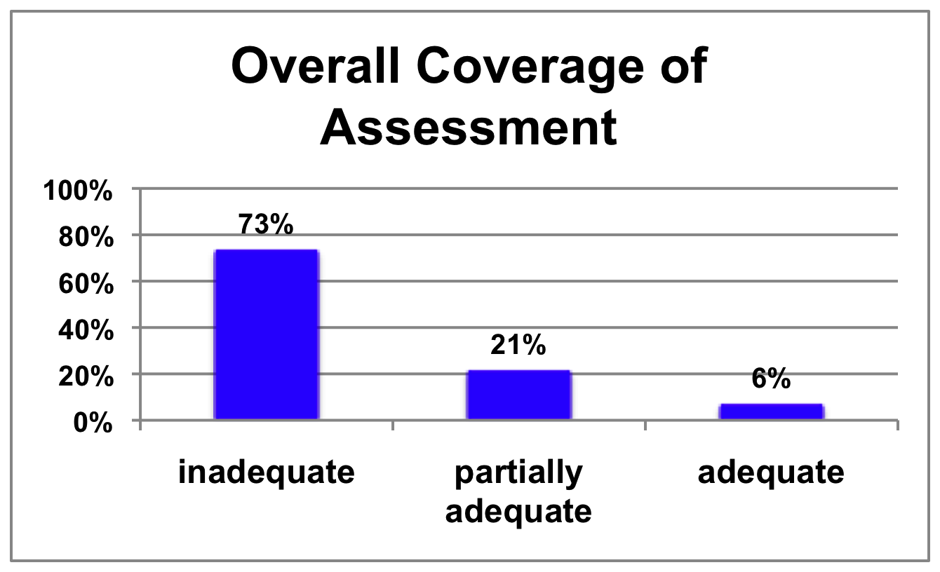
Teacher Preparation: Data Driven Instruction
National Council on Teacher Quality 2012

Slide 22
Evidence-based Teacher Training
National Reading Panel (2000)
overwhelming evidence that effective reading instruction includes explicit and systematic teaching of:
Phonemic awareness
Phonics
Fluency
Vocabulary
Comprehension
“whole language” instruction that ignores phonics and phonemic awareness was ineffective, especially for students with poor language skills and little exposure to print.”
National Council on Teacher Quality (2012)

Slide 23
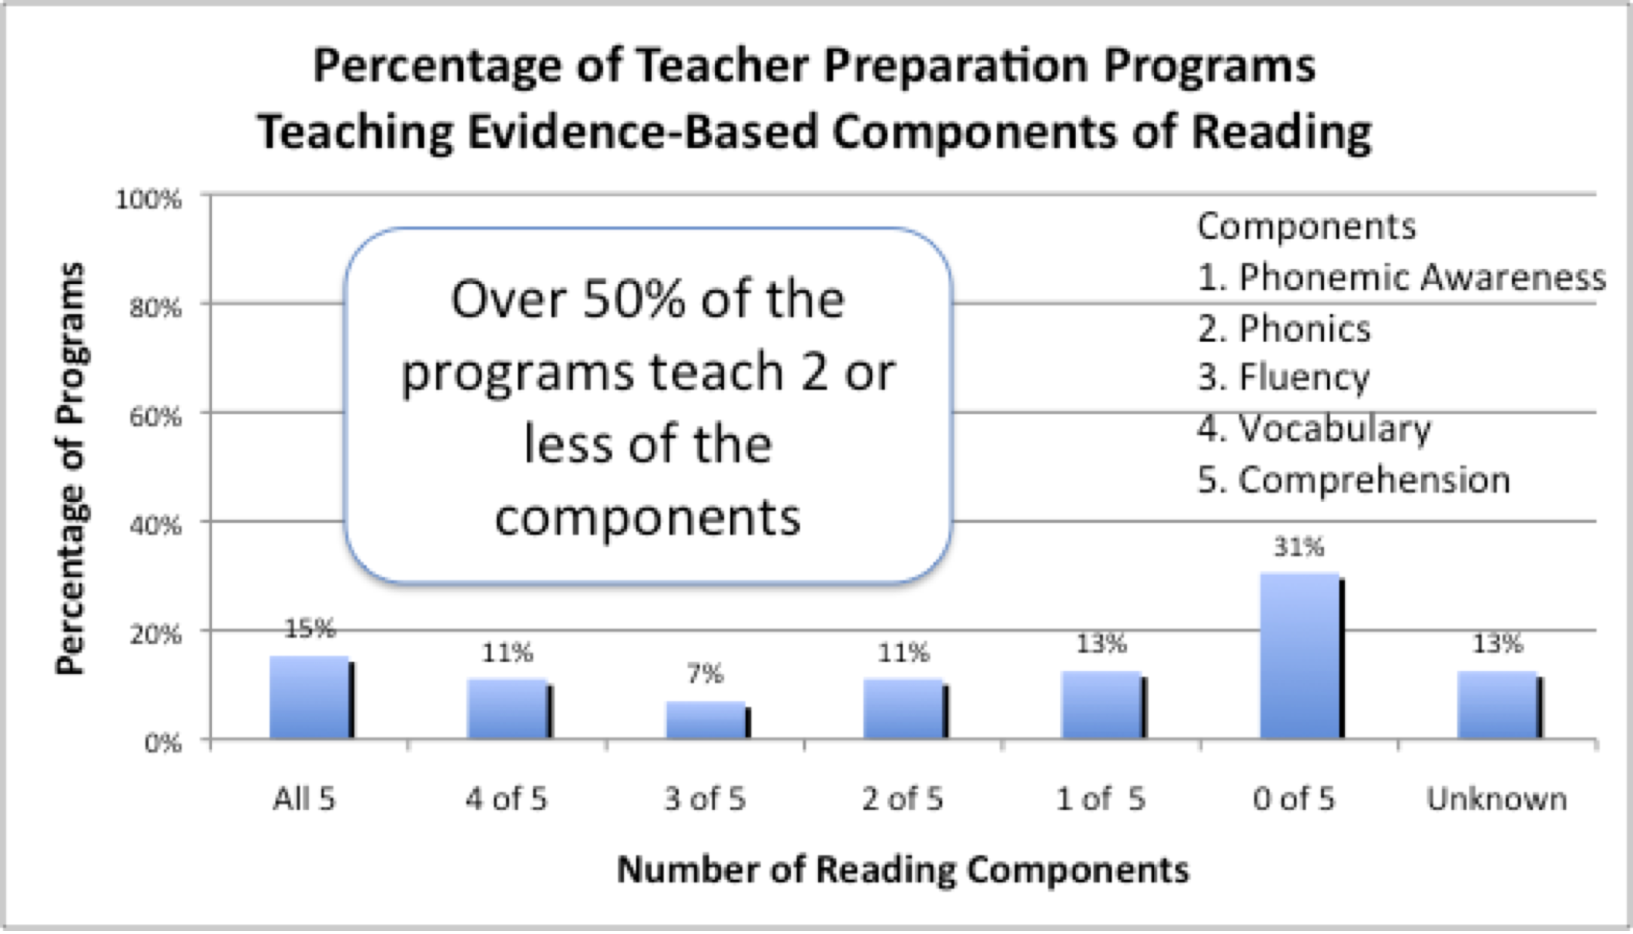
Teacher Preparation: The Science of Reading
Only 4 of 227 required reading text books met acceptable standards for reading science.
National Council on Teacher Quality (2006)
Notes:
Randomly sampled 72 programs, 223 reading courses
“Balanced Literacy”
Much of current reading instruction is incompatible with science.
organic process, reading develops naturally
kids learn to read as a result of life experience
you should dvelope your own theories of teaching reading and writing
only 4 of 227 text books met acceptable standards

Slide 24
Performance Feedback: TEACHERS
School districts fail to acknowledge or act on differences in teacher performance almost entirely.
recognize excellence among top performers
identify and provide support to the broad plurality of hard working teachers who operate in the middle of the performance spectrum
identify and dismiss consistently poor performers
New Teacher Project: The Widget Effect (2009)

Slide 25
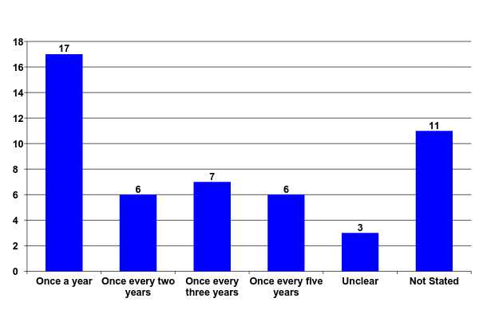
Performance Feedback: Staff Level
Evaluation Requirements of Tenured Teachers
in the 50 Largest U.S. School System
Hiring, Assignment, and Transfer in Chicago Public Schools Report from The New Teacher Project July 2007

Slide 26
Performance Feedback: TEACHERS
Review of multiple years of teacher evaluations from:
Large districts: Chicago, Denver, Cincinnati, Akron, Toledo
Smaller Districts: Jonesboro, Pueblo City, Springdale, Rockford
Out of 52,337 teacher evaluations,
only 233 were unsatisfactory or improvement needed,
99.6% of all teachers evaluated were satisfactory or above.
In the districts that gave “above satisfactory” ratings,
92.6% were rated as very good, distinguished, superior,
excellent, or outstanding.
New Teacher Project: The Widget Effect (2009)

Slide 27
Performance Feedback: TEACHERS
Irrespective of school performance…
In Denver schools that did not make adequate yearly
progress (AYP), more than 98 percent of tenured
teachers received the highest rating—satisfactory.
in Chicago 87 Schools met criteria for being identified
as “failing schools”, 79% of these schools did not
issue a single “unsatisfactory rating”
New Teacher Project: The Widget Effect (2009)

Slide 28

Will it make the boat go faster?
Will it improve teaching effectiveness?
Notes:
SHARED VISION, COMMON GOALS

