Slide 1

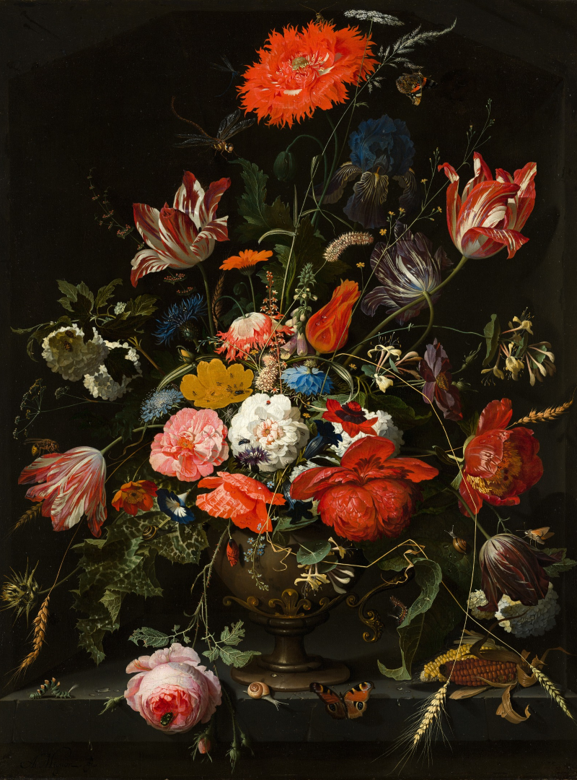



FREE PRESENTATION TEMPLATE
Art

Slide 2






Welcome
Welcome to the world of fantasy! Join us on a journey to explore the mystical creatures, enchanted lands, and magical wonders that exist beyond our reality. Discover the wonders and secrets of this exciting realm and unlock the power of imagination.

Slide 3

1
Introduction
Table of Contents
The Extraordinary Realm
2
Encounters
3
Wonders
Unicorn Sightings
Wishes Granted
4
Magic
5
Adventure
Spellcasting
Happily Ever After
6
Conclusion
Embrace the Fantasy

Slide 4


The Realm of the Extraordinary
Welcome to the Fantasy World, a realm of wonder and enchantment where anything is possible. Here, dragons breathe fire, unicorns prance through meadows, and rainbows shine brightly. This world is a place where wishes come true, where potions can be cursed and spells are cast. It's a place of treasure and adventure, where the impossible becomes possible. But the greatest treasure of all is the one that lies within.
The world of fantasy is a reflection of our deepest desires, our fondest dreams, and our wildest imaginations. It's a place where we can let go of the constraints of reality and explore the boundless possibilities of the human mind. In this introduction, we will delve into the mysteries of this realm, uncovering the magic and wonder that lies within. So come with us and let's embark on a journey through the Fantasy World.

Slide 5
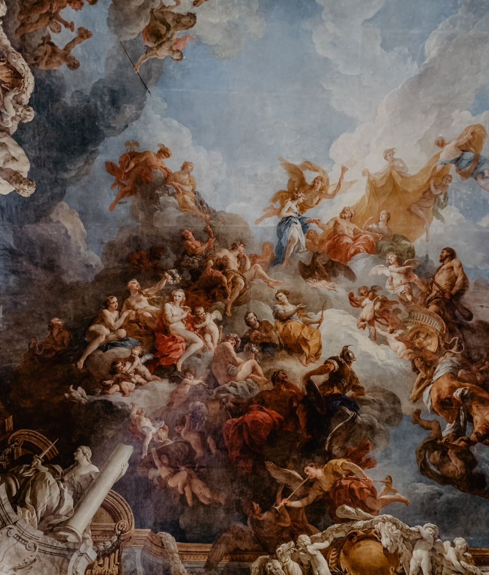




Unicorn Sightings
A record of the number of unicorns spotted in the fantasy realm and the beauty and mystery that surrounds these enchanting creatures.
Dragon Taming
A closer look at the art of taming dragons and the brave adventurers who dare to take on these fearsome creatures.

Slide 6



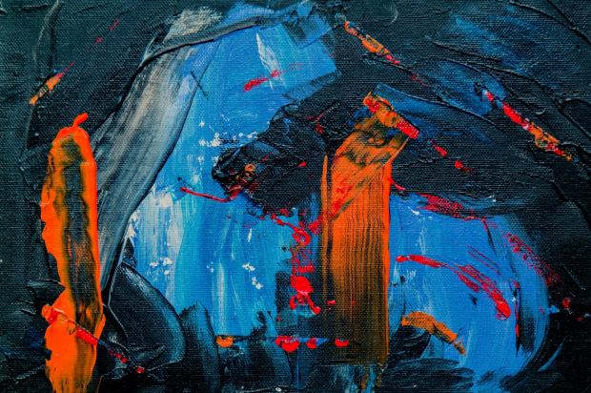

Unicorn Sightings
Dragon Taming
A record of the number of unicorns spotted in the fantasy realm and the beauty and mystery.
A closer look at the art of taming dragons and the brave adventurers who dare to take on these creatures.

Slide 7

Fantasy is the gateway to the impossible, the land where the ordinary becomes extraordinary, and the impossible becomes possible.
The Dream Weaver

Slide 8



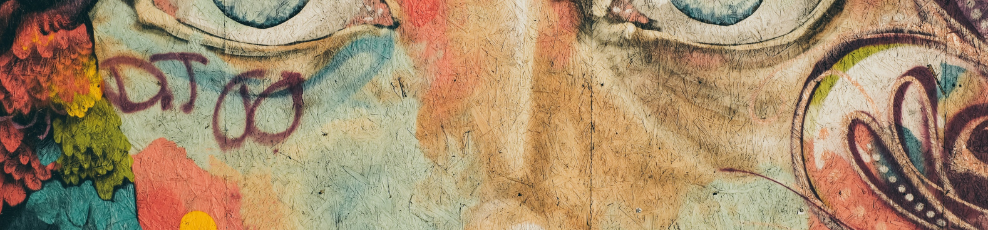

In the Realm of Magic and Adventure, dragons are no longer fearsome beasts to be feared. They can be tamed and even become loyal companions to those brave enough to venture into the unknown. Similarly, unicorns, long considered to be mythical creatures, can now be sighted in this fantastical realm. The world is filled with endless possibilities and endless adventures.
Taming Dragons and Unicorns

Slide 9

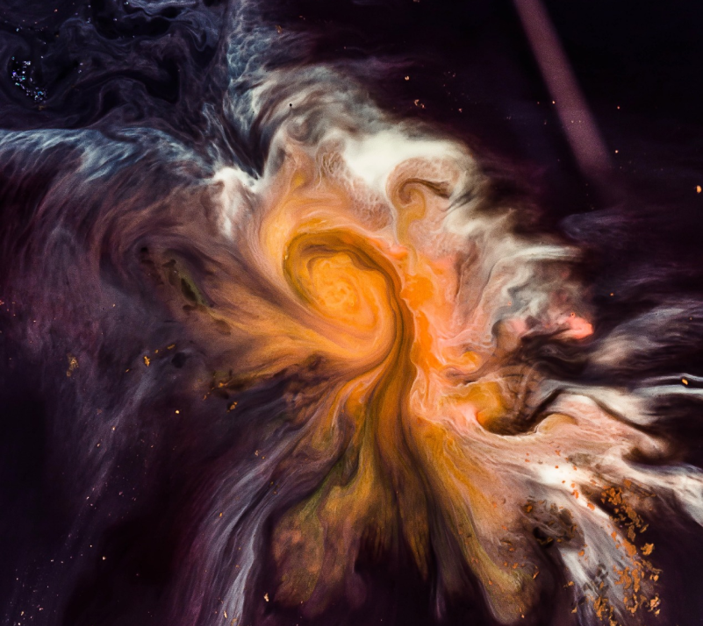
The journey of self-discovery and the exploration of the human imagination are just as important as the creatures and wonders that populate this realm. Here, you can reflect on your deepest desires and fulfill your fondest dreams. The realm is a place where you can let go of the constraints of reality and explore the boundless possibilities of the mind.

Slide 10


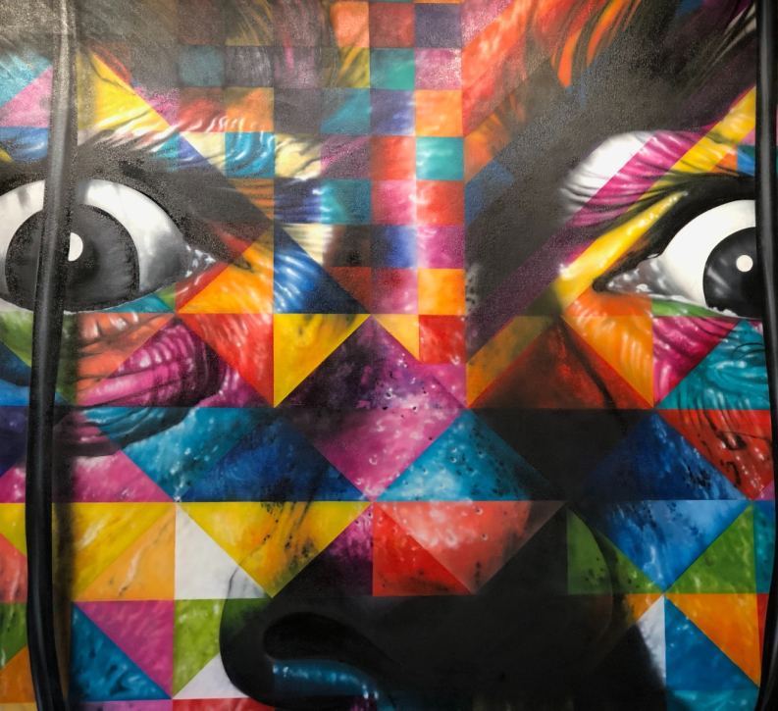
"The Evolution of the Unicorn" is a study exploring the historical, cultural, and mythical development of the iconic fantasy creature. From its ancient roots in Mediterranean mythology to its modern-day representation in popular culture, this research delves into the various interpretations and beliefs surrounding the mystical horse with a single horn. The goal is to understand the evolution of this captivating creature and its enduring place in human imagination.
The Evolution of the Unicorn

Slide 11
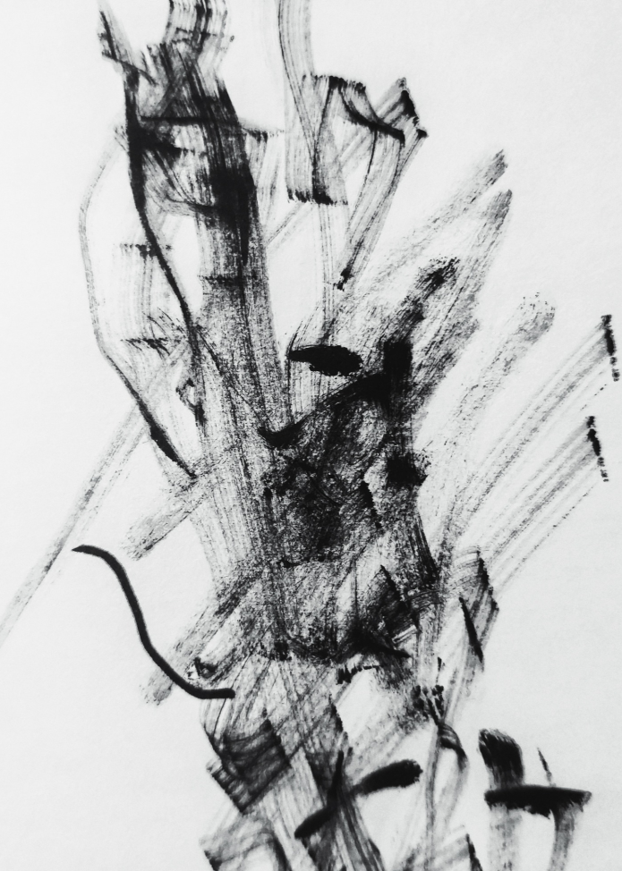
The Enchanter: Cast Spells, Create Illusions

Slide 12
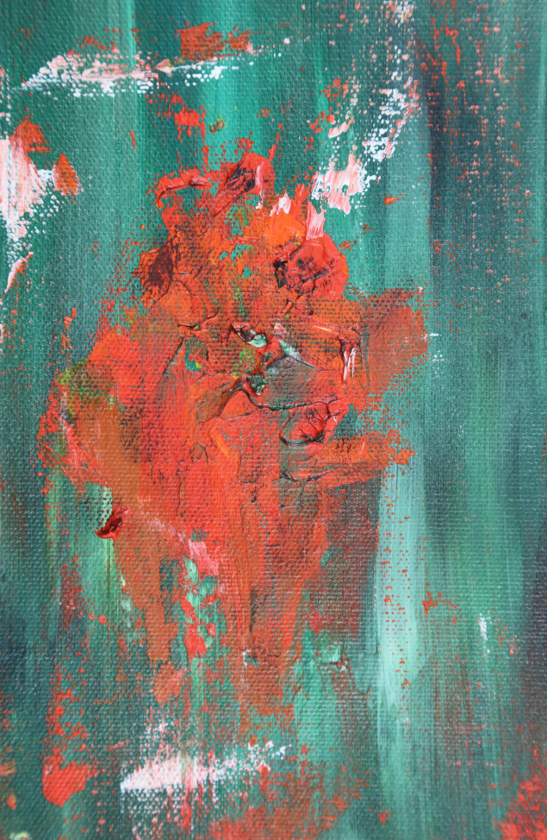
Some Data
75%
Enchanted Creatures
possess the ability to cast spells.
60%
Magic Individuals
practice the art of illusions.
90%
Spells Cast
are dark magic, foretelling danger.

Slide 13
234,567
UNICORN SIGHTINGS
A tally of the number of unicorns spotted in the fantasy realm.

Slide 14















































Some Graph
100
90
80
70
60
50
68%
40
30
20
10
0
1
2
3
4
5
6
7
8
Treasure Found
Spell Progress
A record of the amount of treasure found per month
A record of the number of spells cast per year

Slide 15
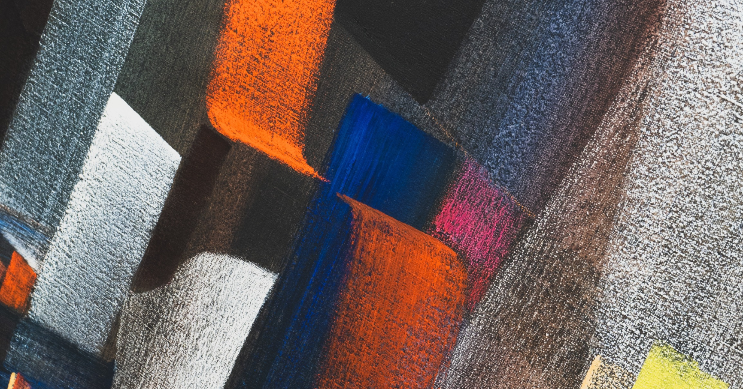

A Magic Picture

Slide 16

Another Magic Picture

Slide 17
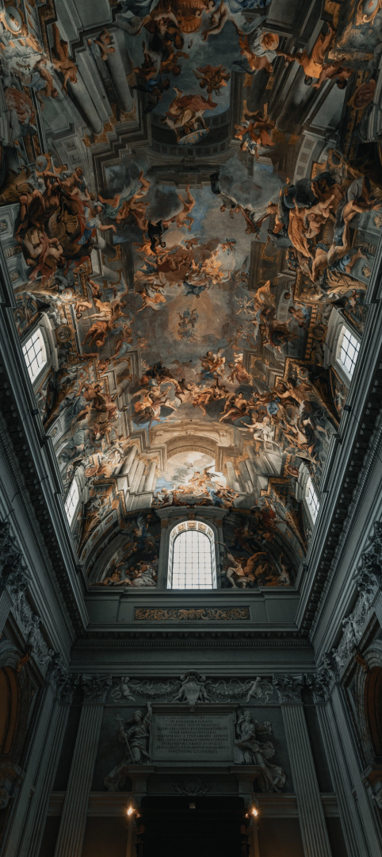
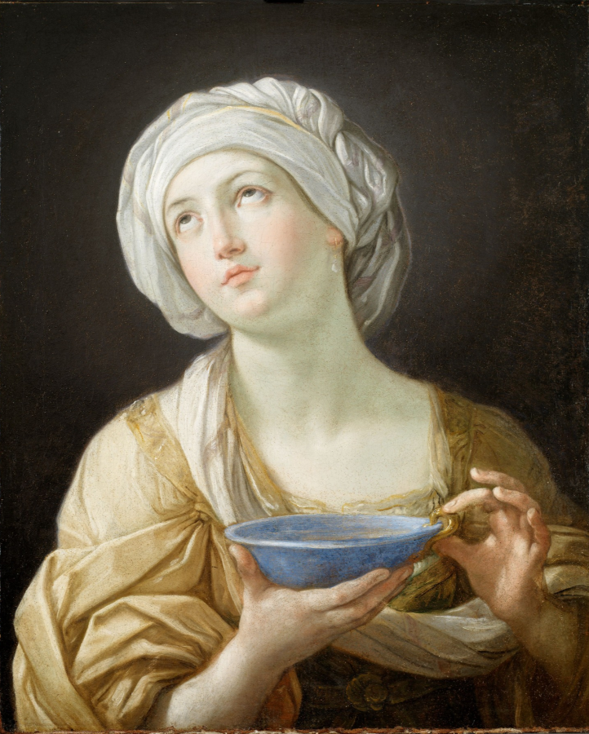
And Two Magic Pictures

Slide 18

The mythical horses
These mythical horses are said to have a single horn on their forehead and are often associated with purity, grace, and magic. Some legends suggest that unicorns can only be seen by the pure of heart.
The Unicorns

Slide 19
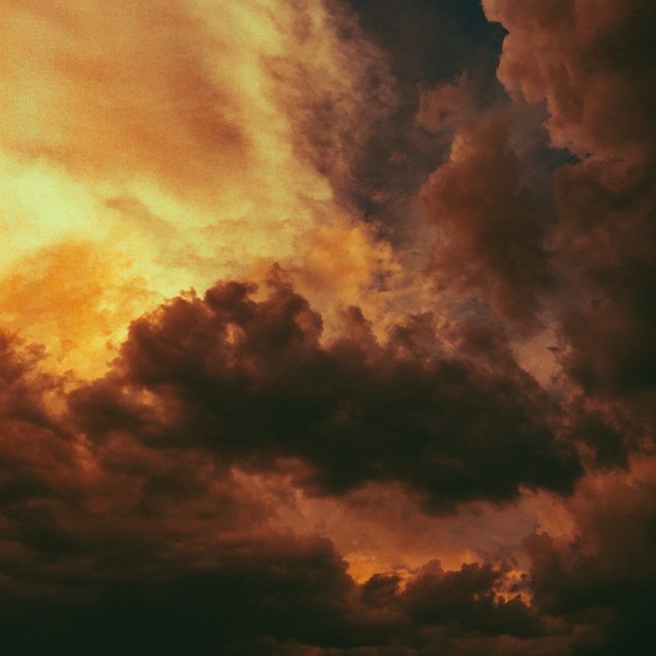
The Enchanted Forest
A Journey Through the Realm of Magic and Wonder
  A world of mystery and enchantment awaits
  Explore the secrets of the Enchanted Forest
  Meet the magical beings that call this place home
  From fairies to unicorns, discover their stories and powers

Slide 20
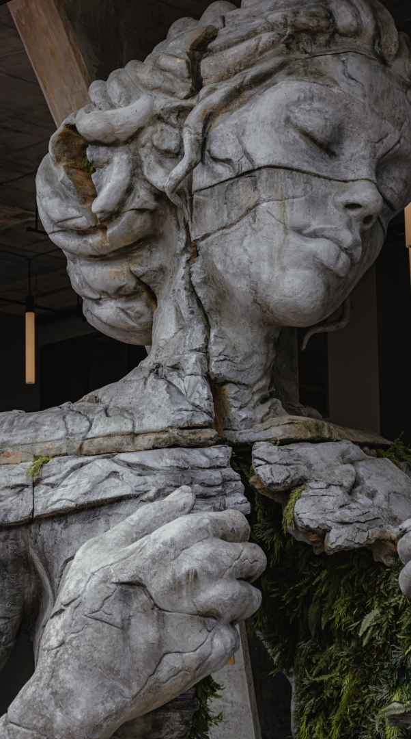
Discover the secrets
Find your own path
1
2
Explore the lush, vibrant forest and uncover the mysteries that lie within.
Choose your own path through the forest, and see where it takes you.
Meet the creatures
Uncover the magic
3
4
Encounter the mythical creatures that call the forest home, from talking animals to mischievous fairies.
Learn about the powerful magic that pervades the forest and how it affects all who enter.

Slide 21
The Castle of Shadows
The Crypt of the Forgotten
The Castle of Shadows is a mysterious and ominous place, shrouded in mystery and surrounded by darkness.
It is said to be the home of the evil witch, who uses her dark magic to terrorize the surrounding lands.
Despite the danger, many brave adventurers venture into the castle in search of treasure and adventure.
The Dungeon of Despair

Slide 22
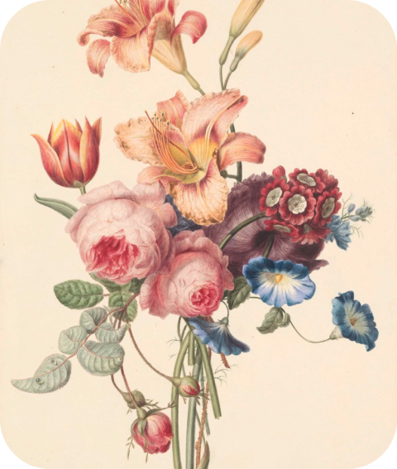
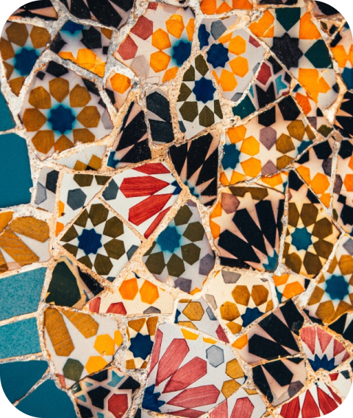
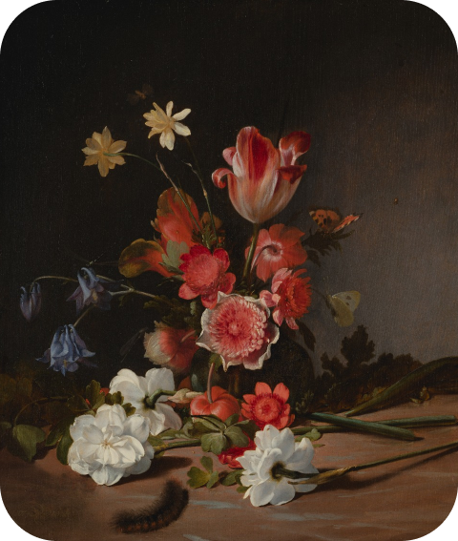
Our Team
Eldruin
Lunaria
Elementalen
The Fire Mage
The Moon Priestess
The Guardians

Slide 23
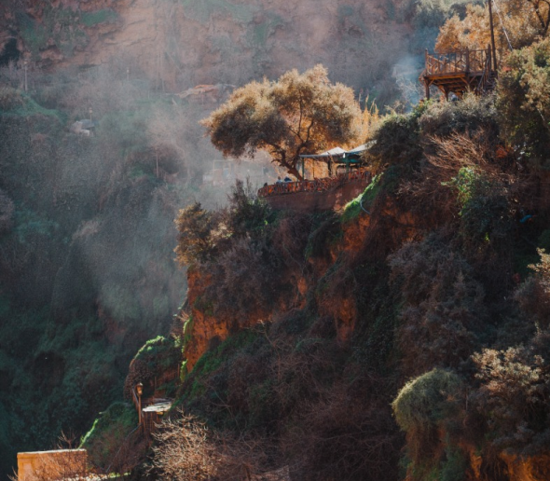
An Unforgettable Journey
An Adventure Awaits
Enter the mysterious world of the sea serpents, where danger and beauty intertwine.

Slide 24
We offer free and high-quality slides templates for your presentations. We appreciate you choosing us and hope our templates have been helpful.
As a new website, we rely on your support to grow, so please help us by sharing our site with your friends and colleagues.
Thank you for choosing EaTemp

