Slide 1

www.teachclever.it.com

Slide 2
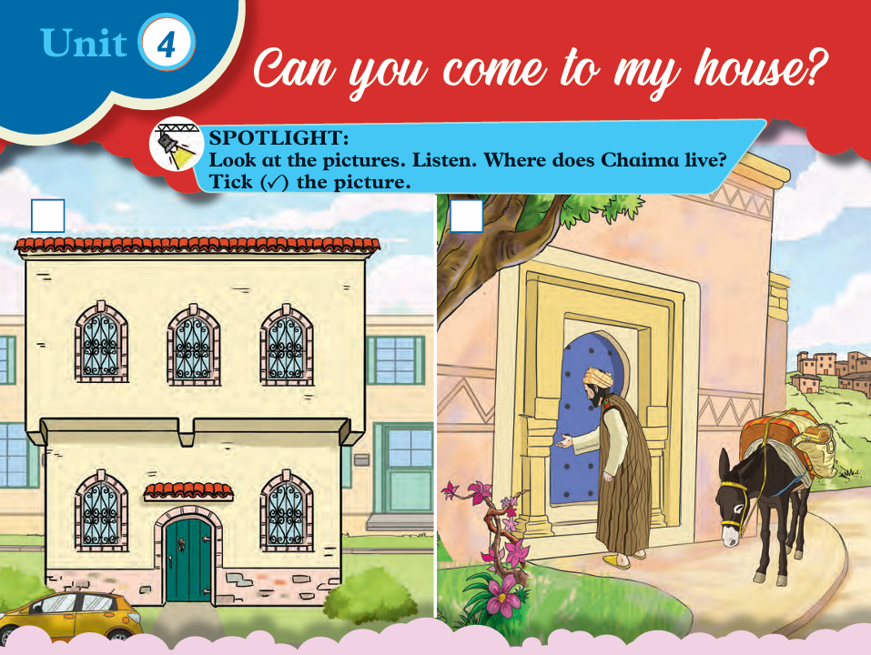

Slide 3

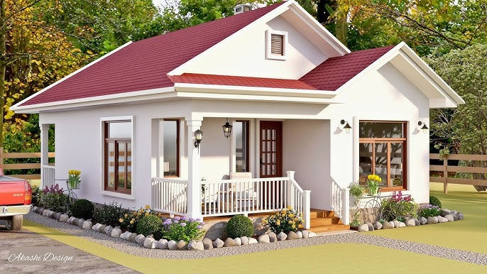
House

Slide 4
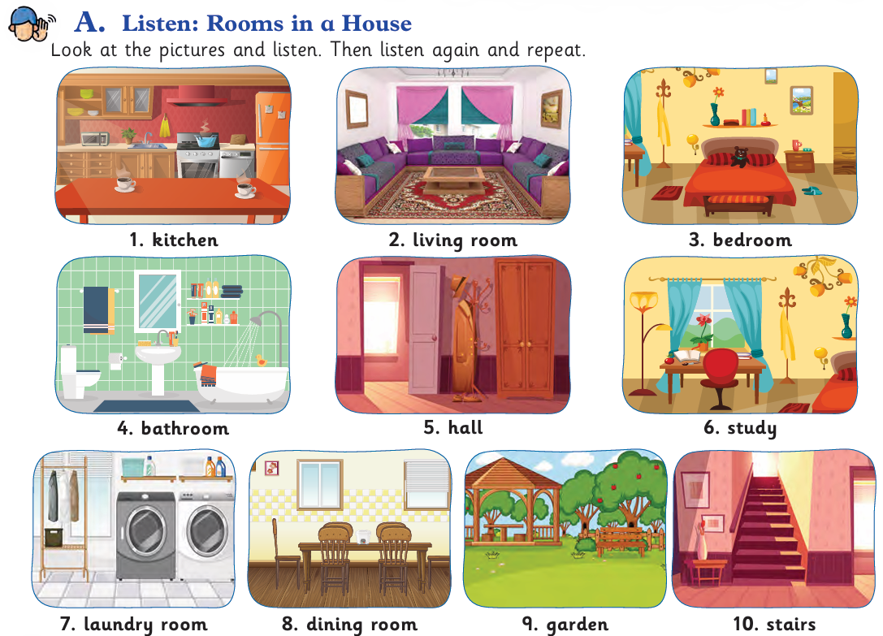

Slide 5

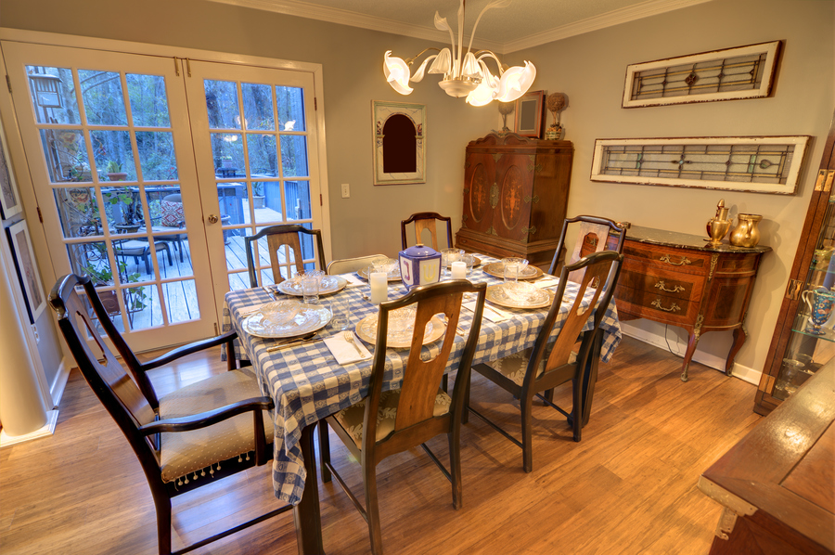
Dining room

Slide 6
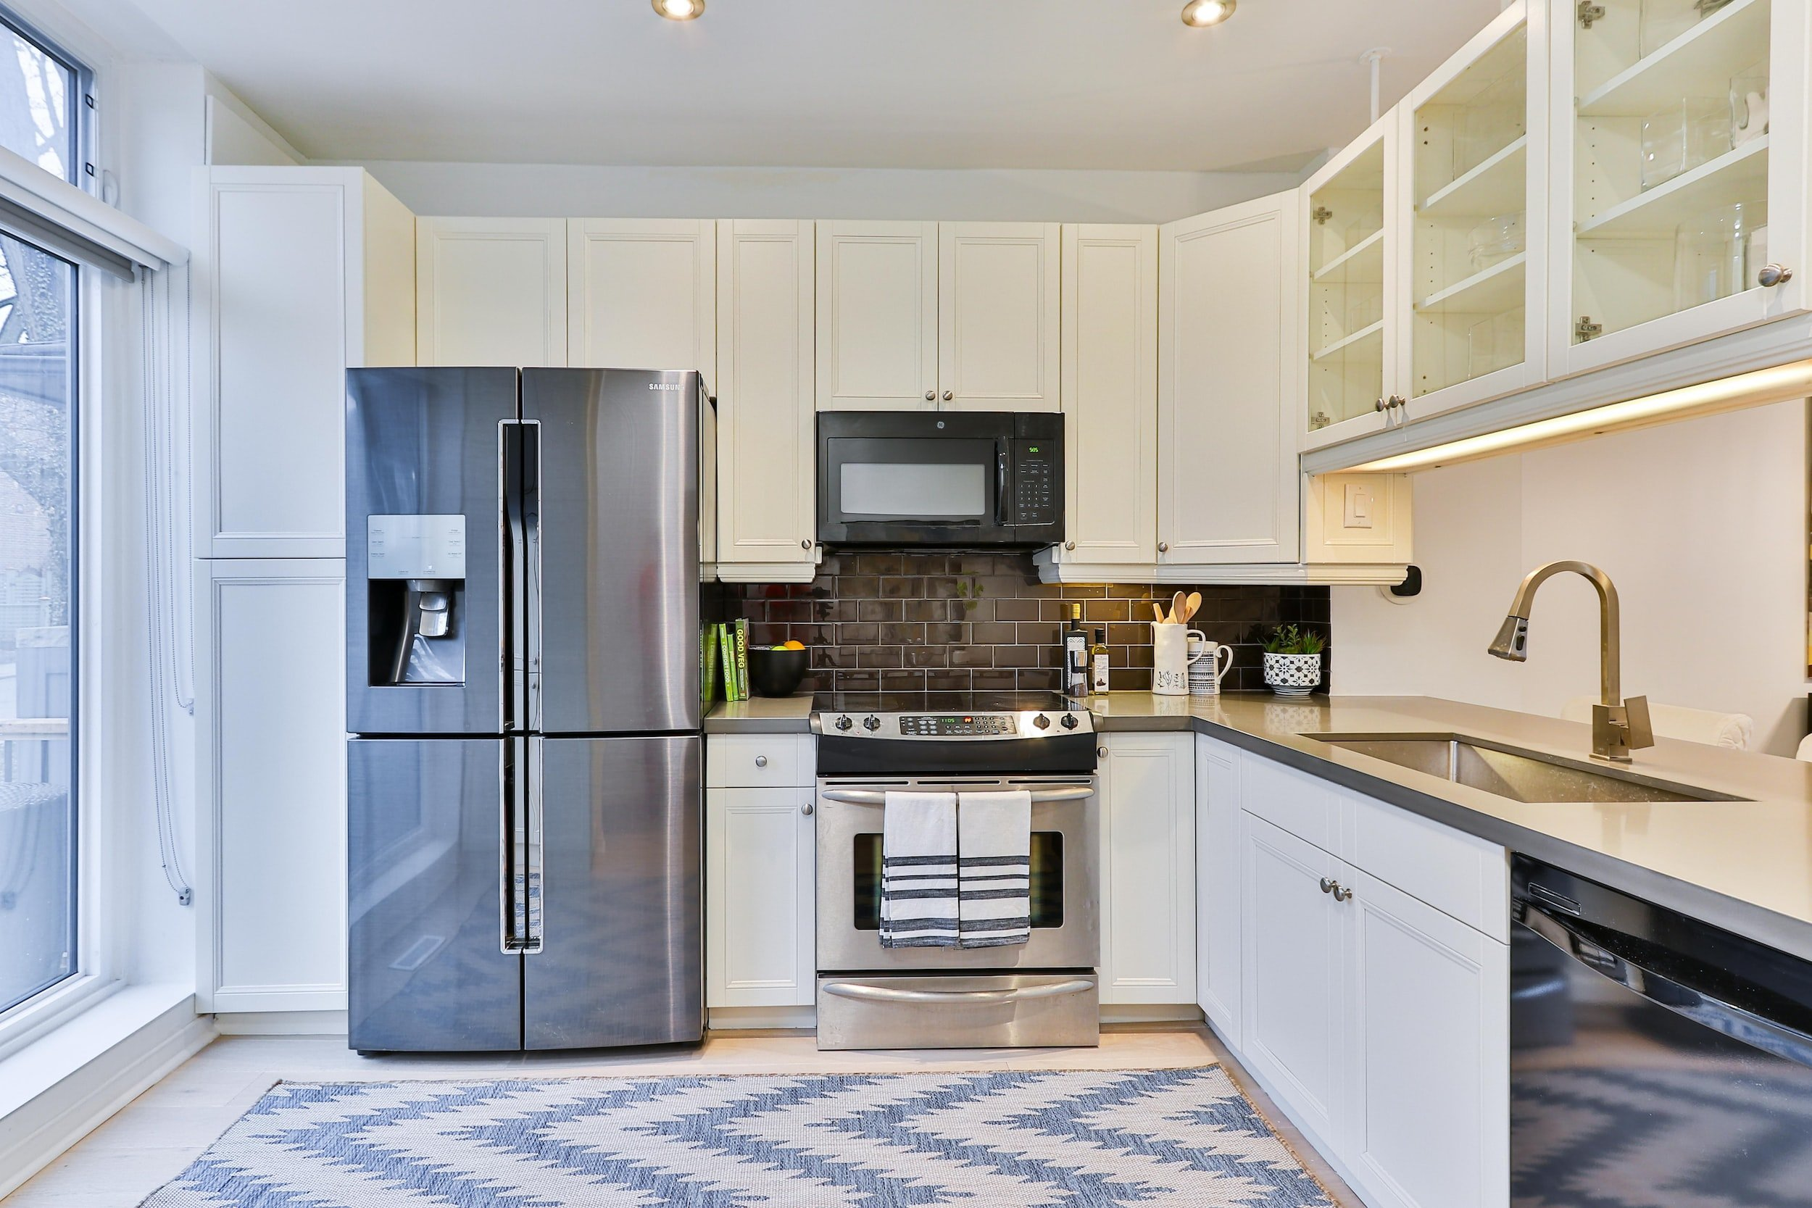
Kitchen

Slide 7
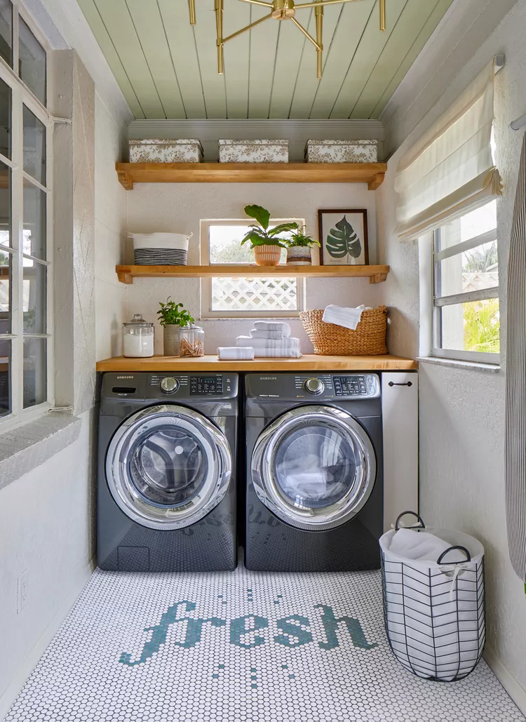
Laundry room

Slide 8
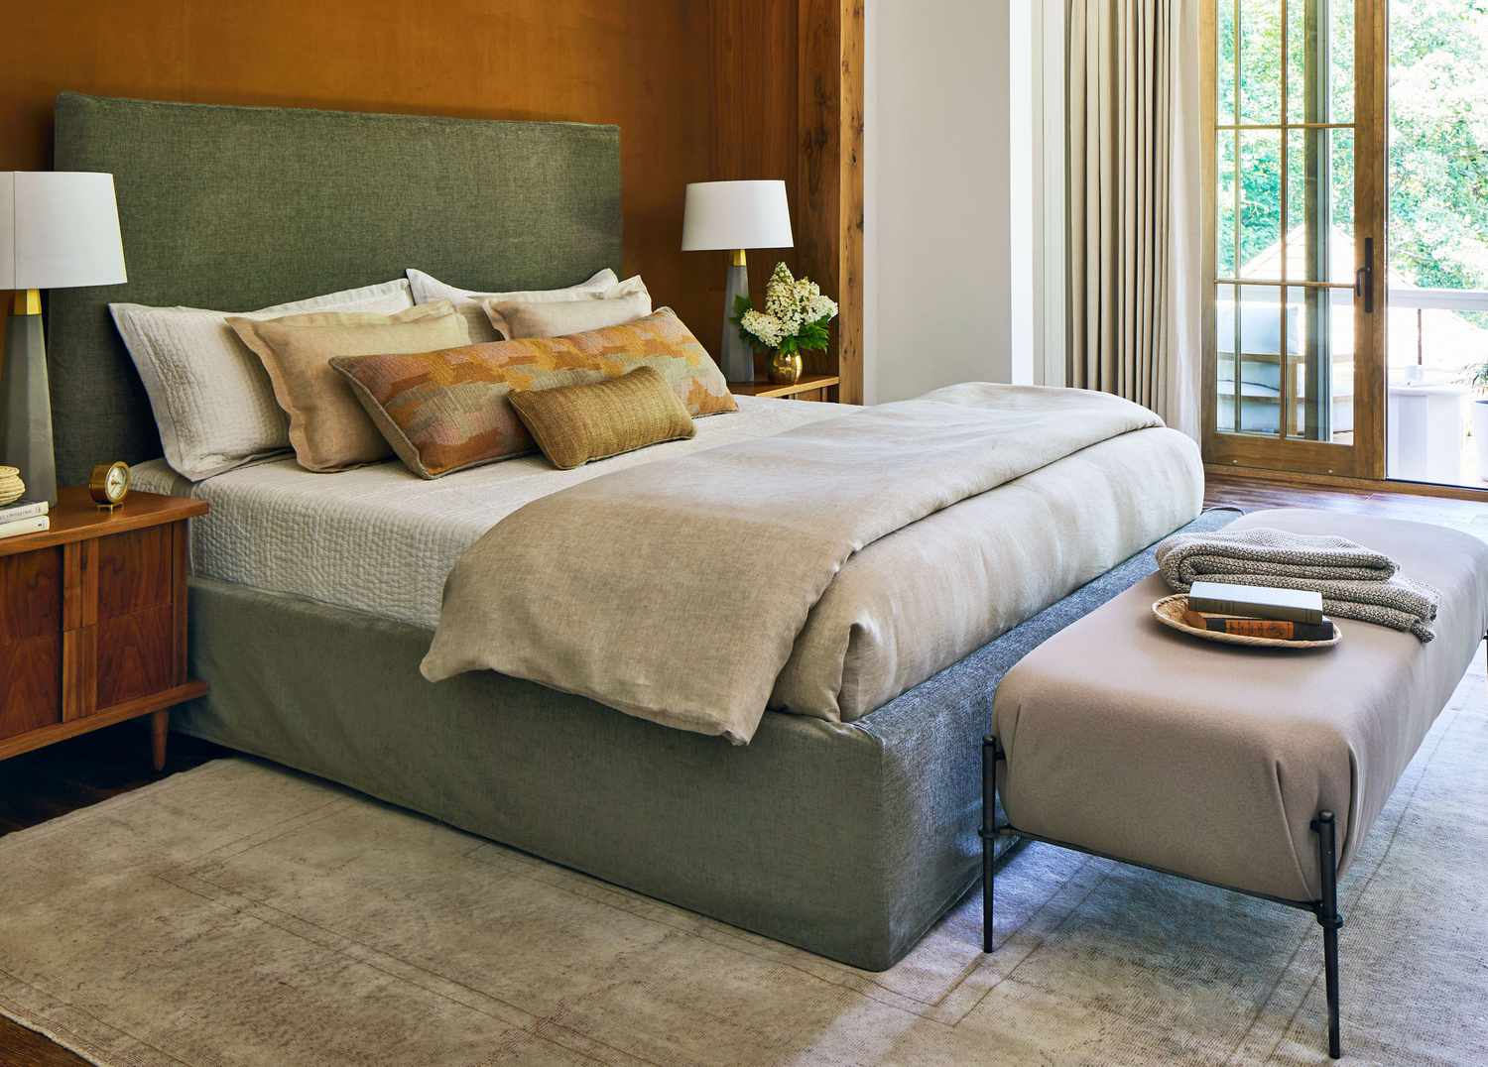
Bedroom

Slide 9
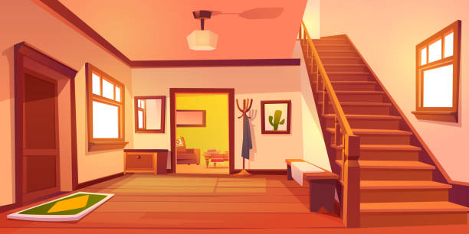
Hall

Slide 10
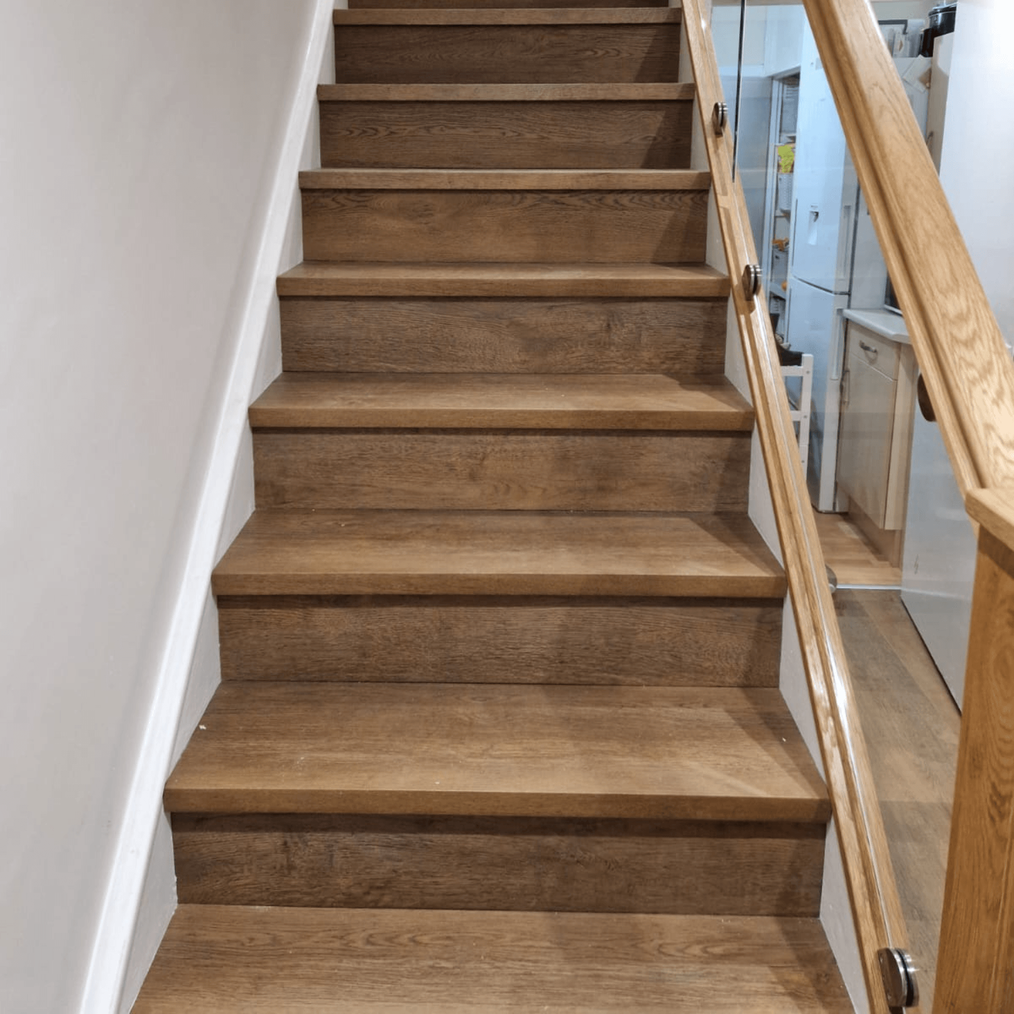
Stairs

Slide 11
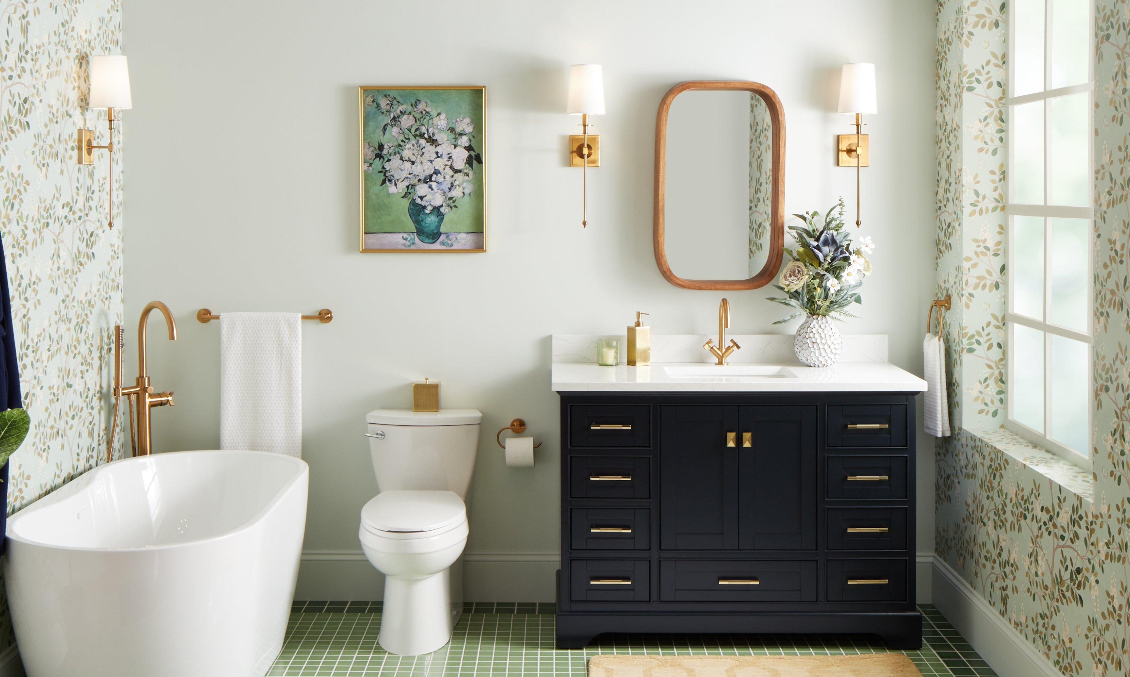
Bathroom

Slide 12
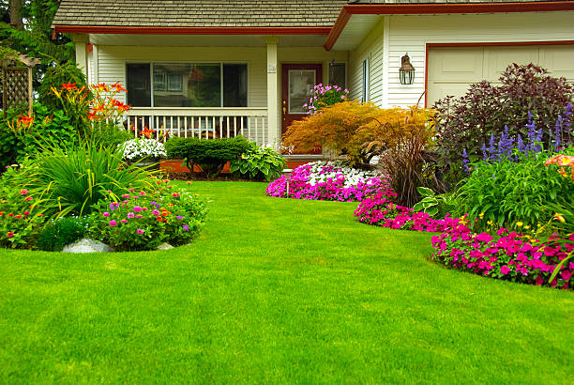
Garden

Slide 13
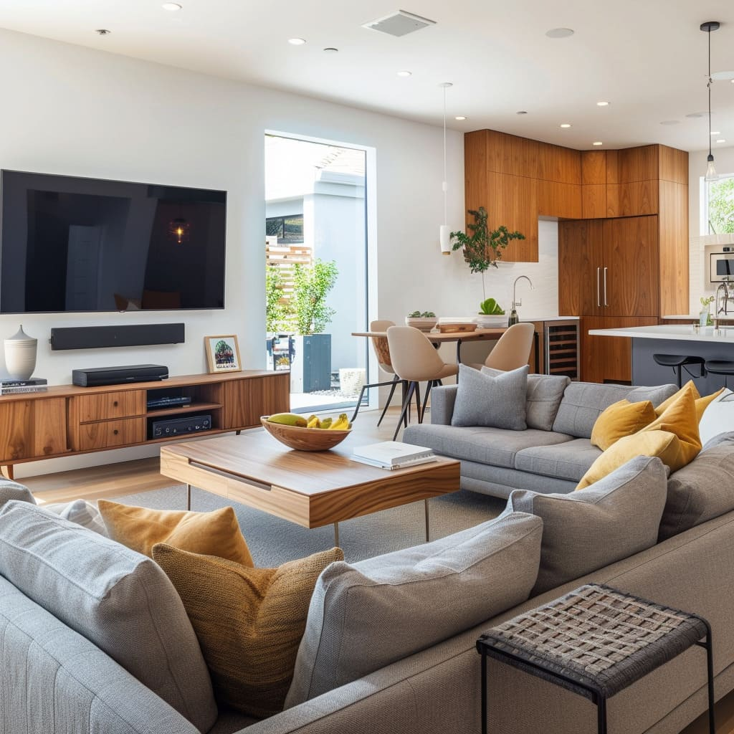
Living room

Slide 14
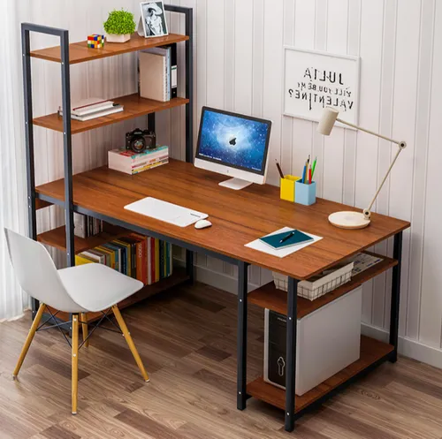
Study

Slide 15



Slide 16
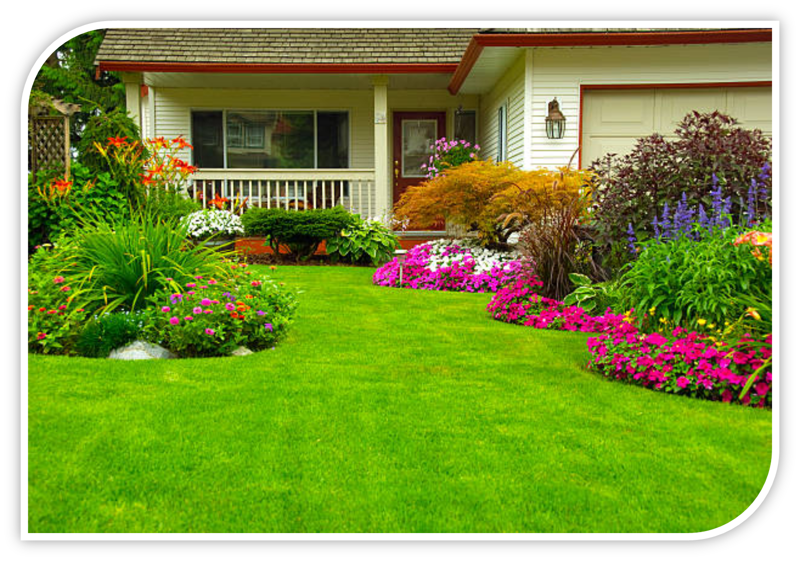
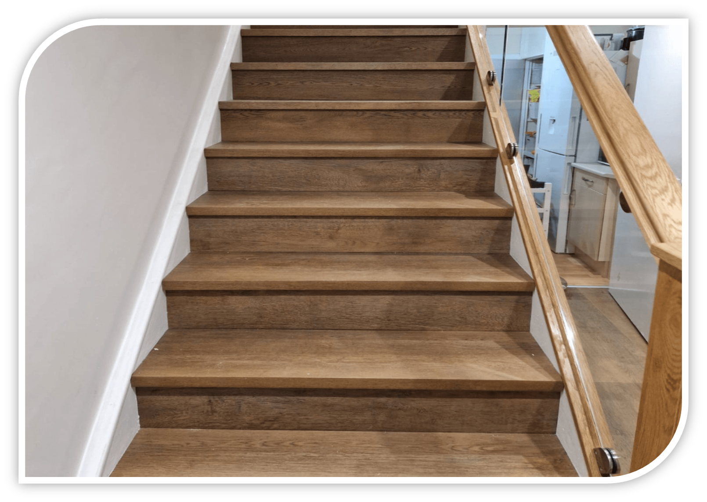
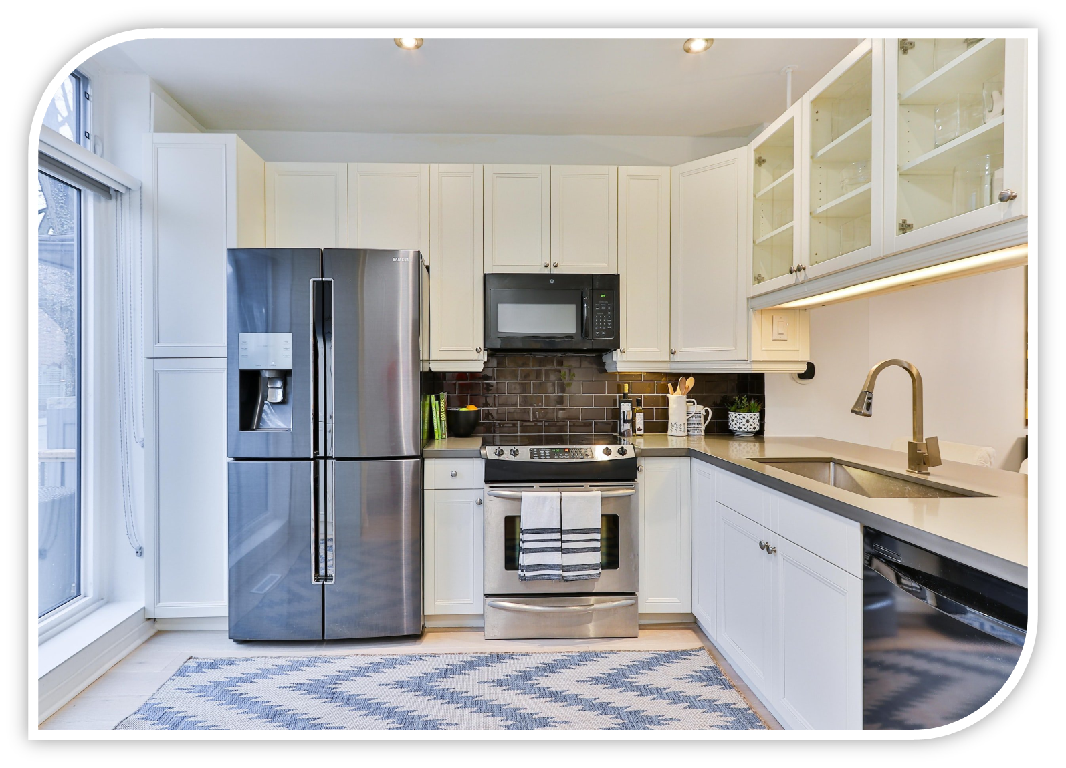
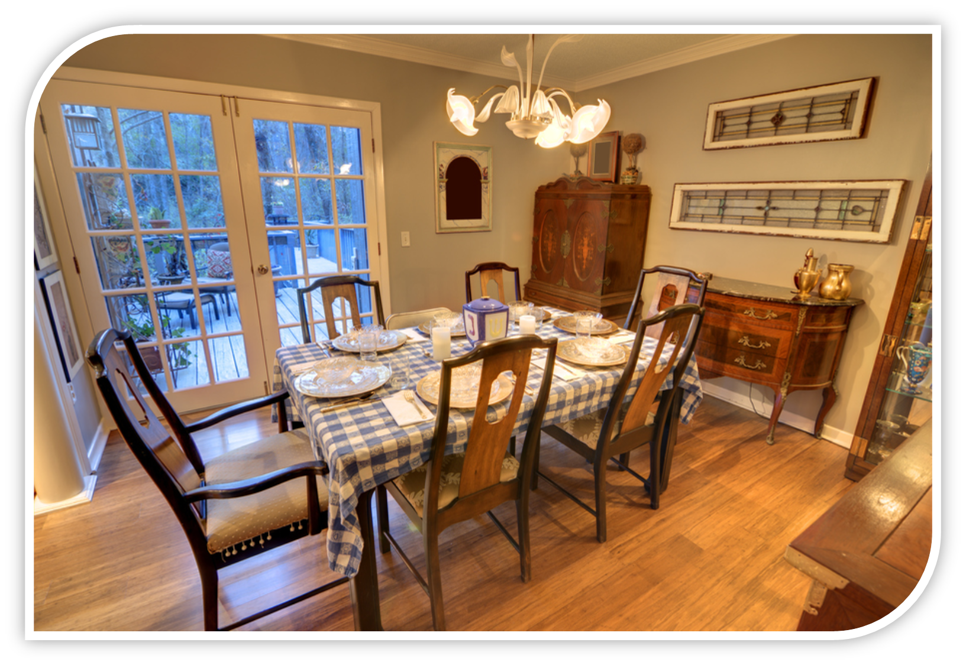
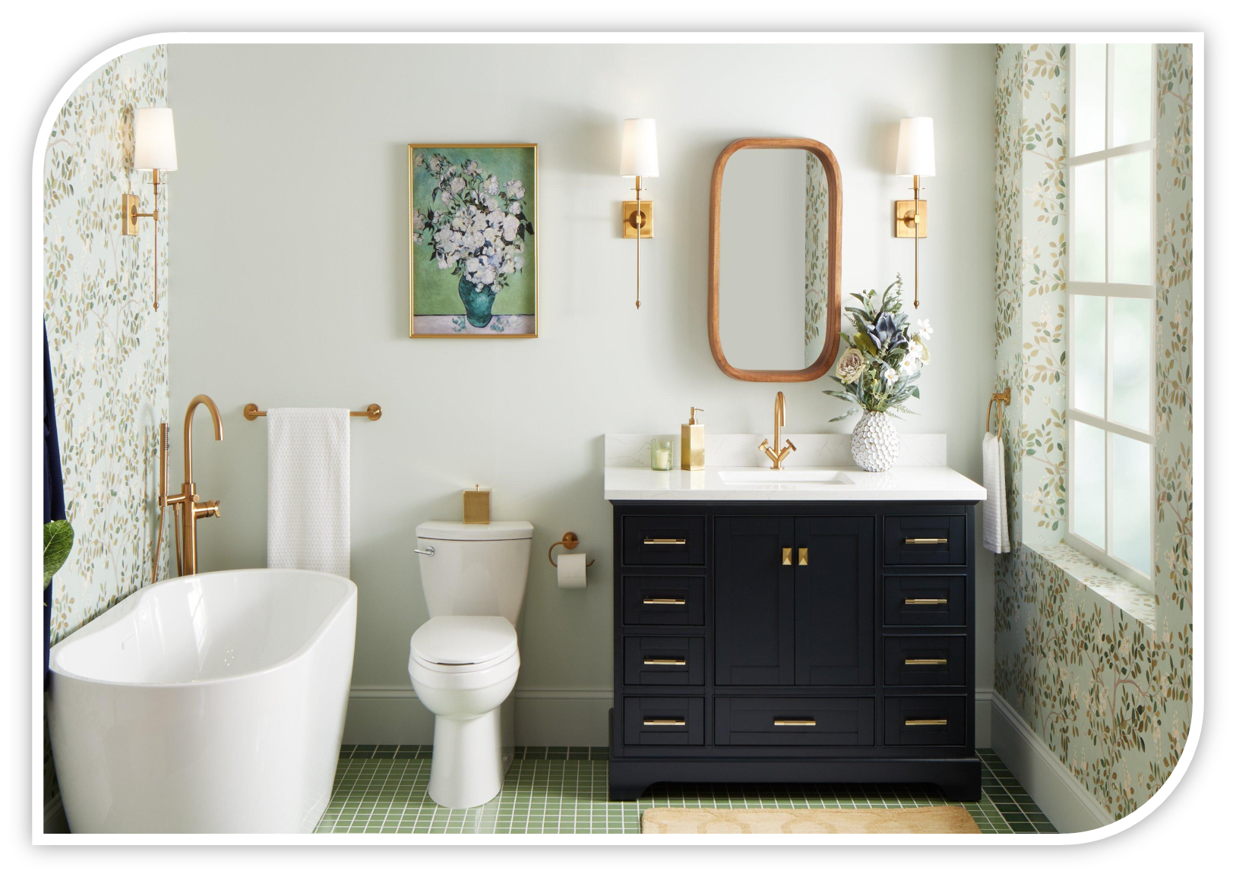

Slide 17
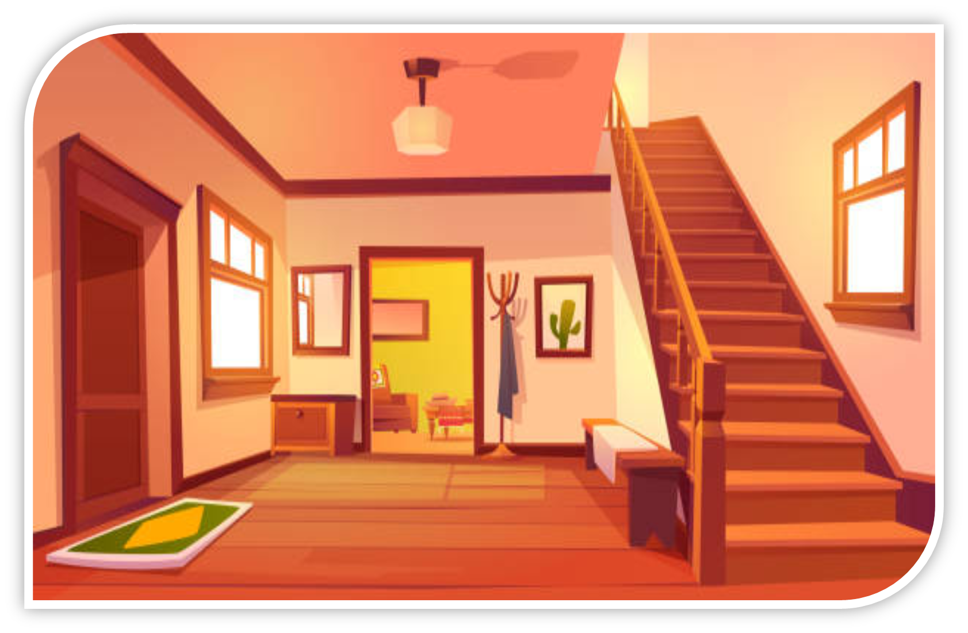
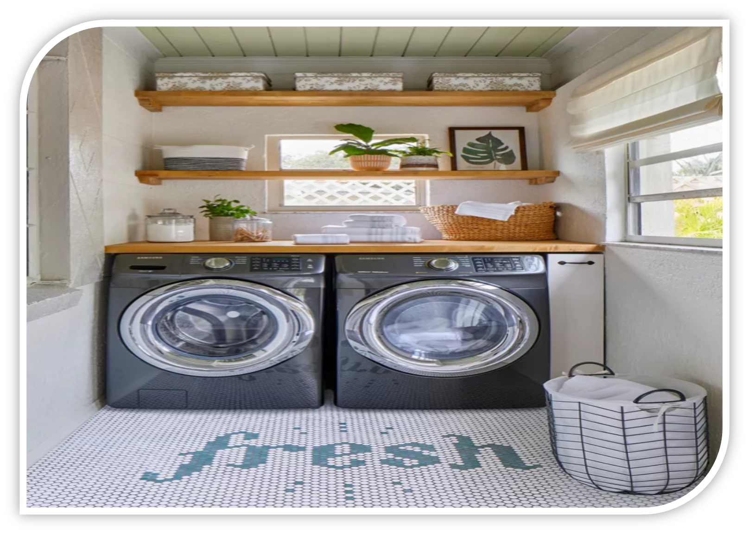
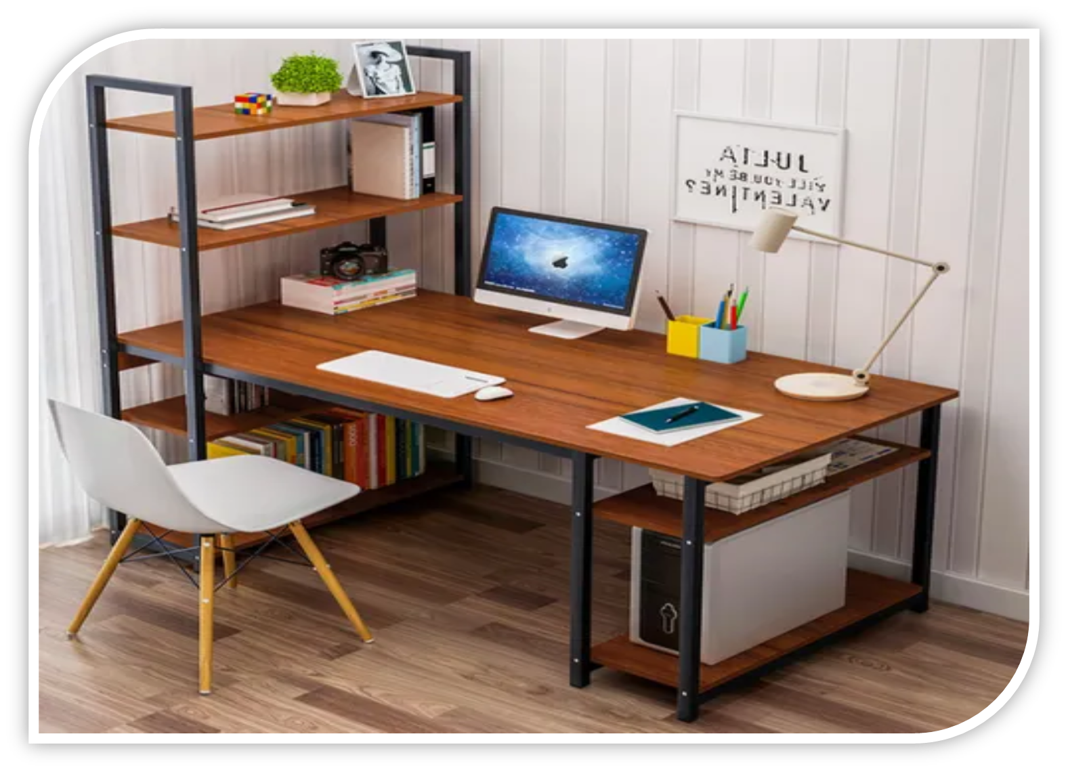
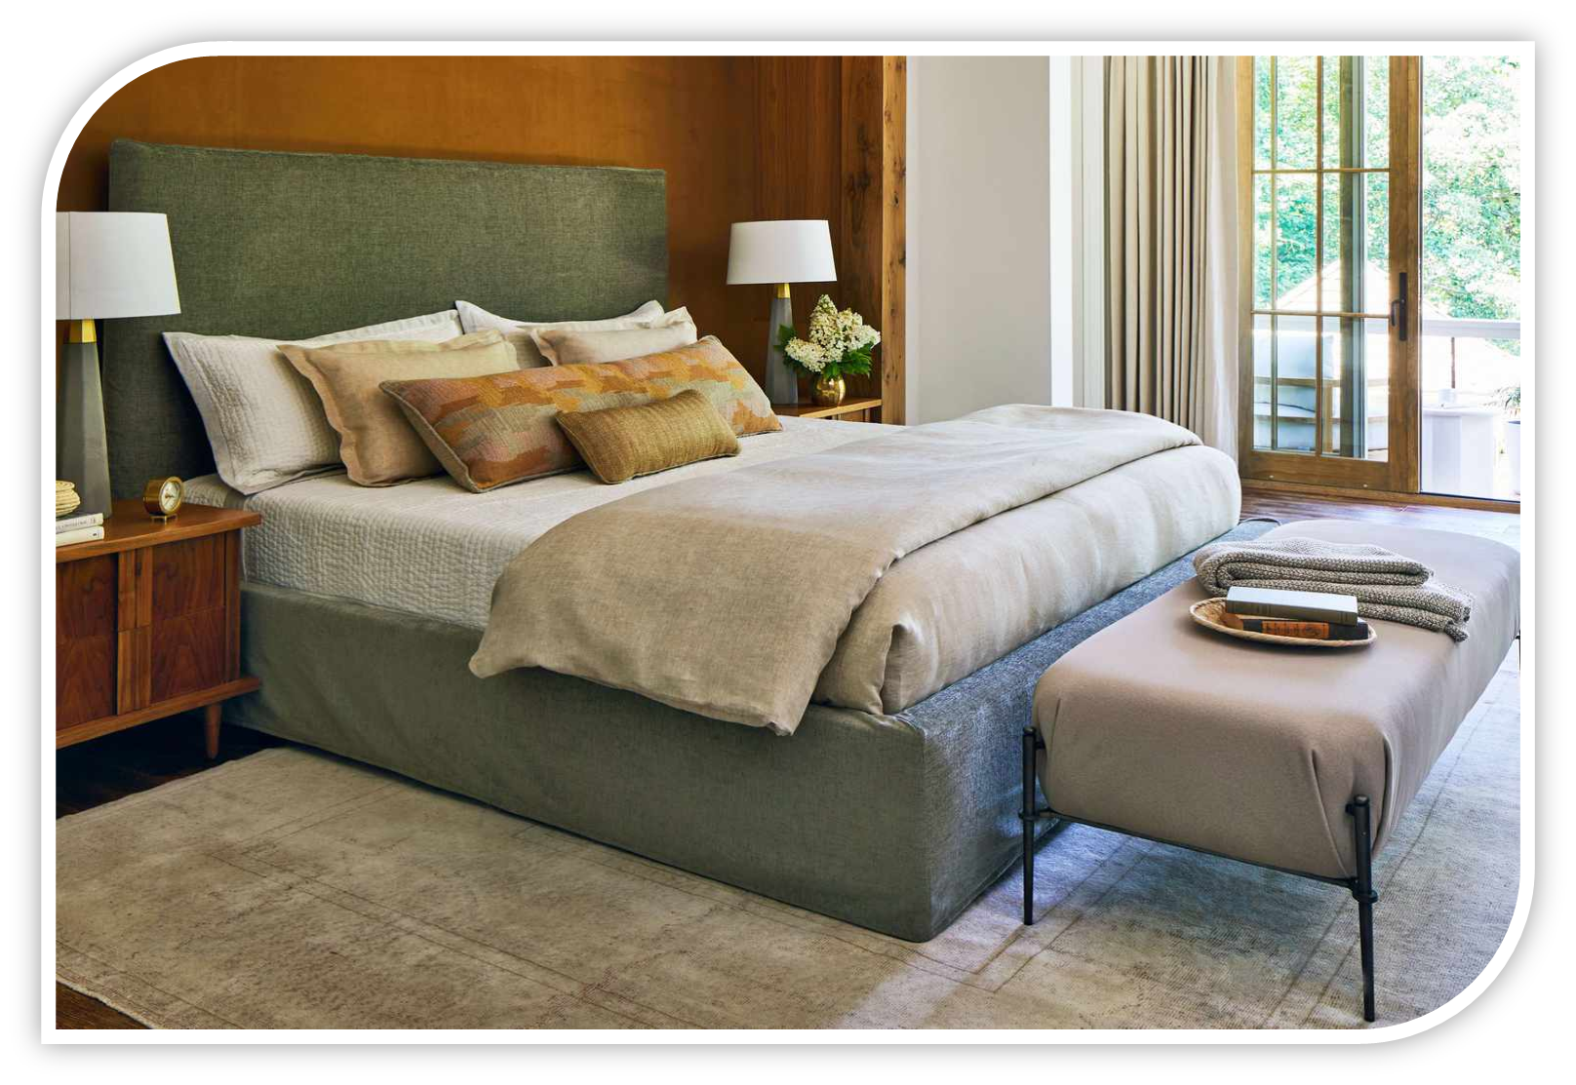
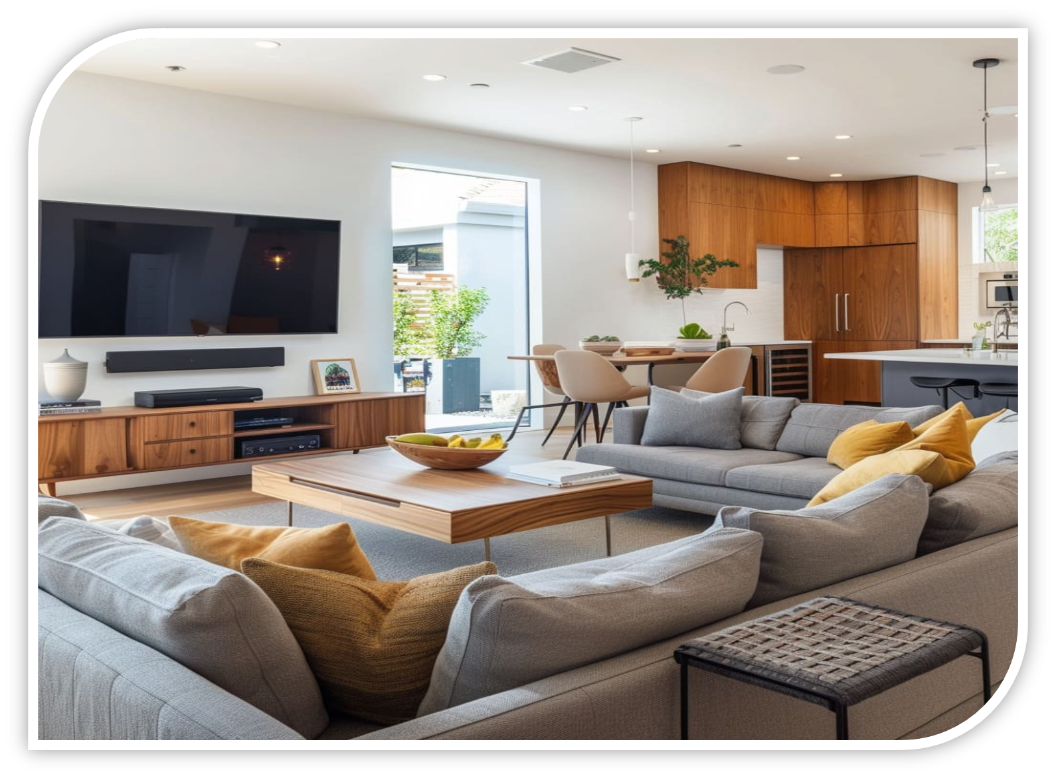

Slide 20
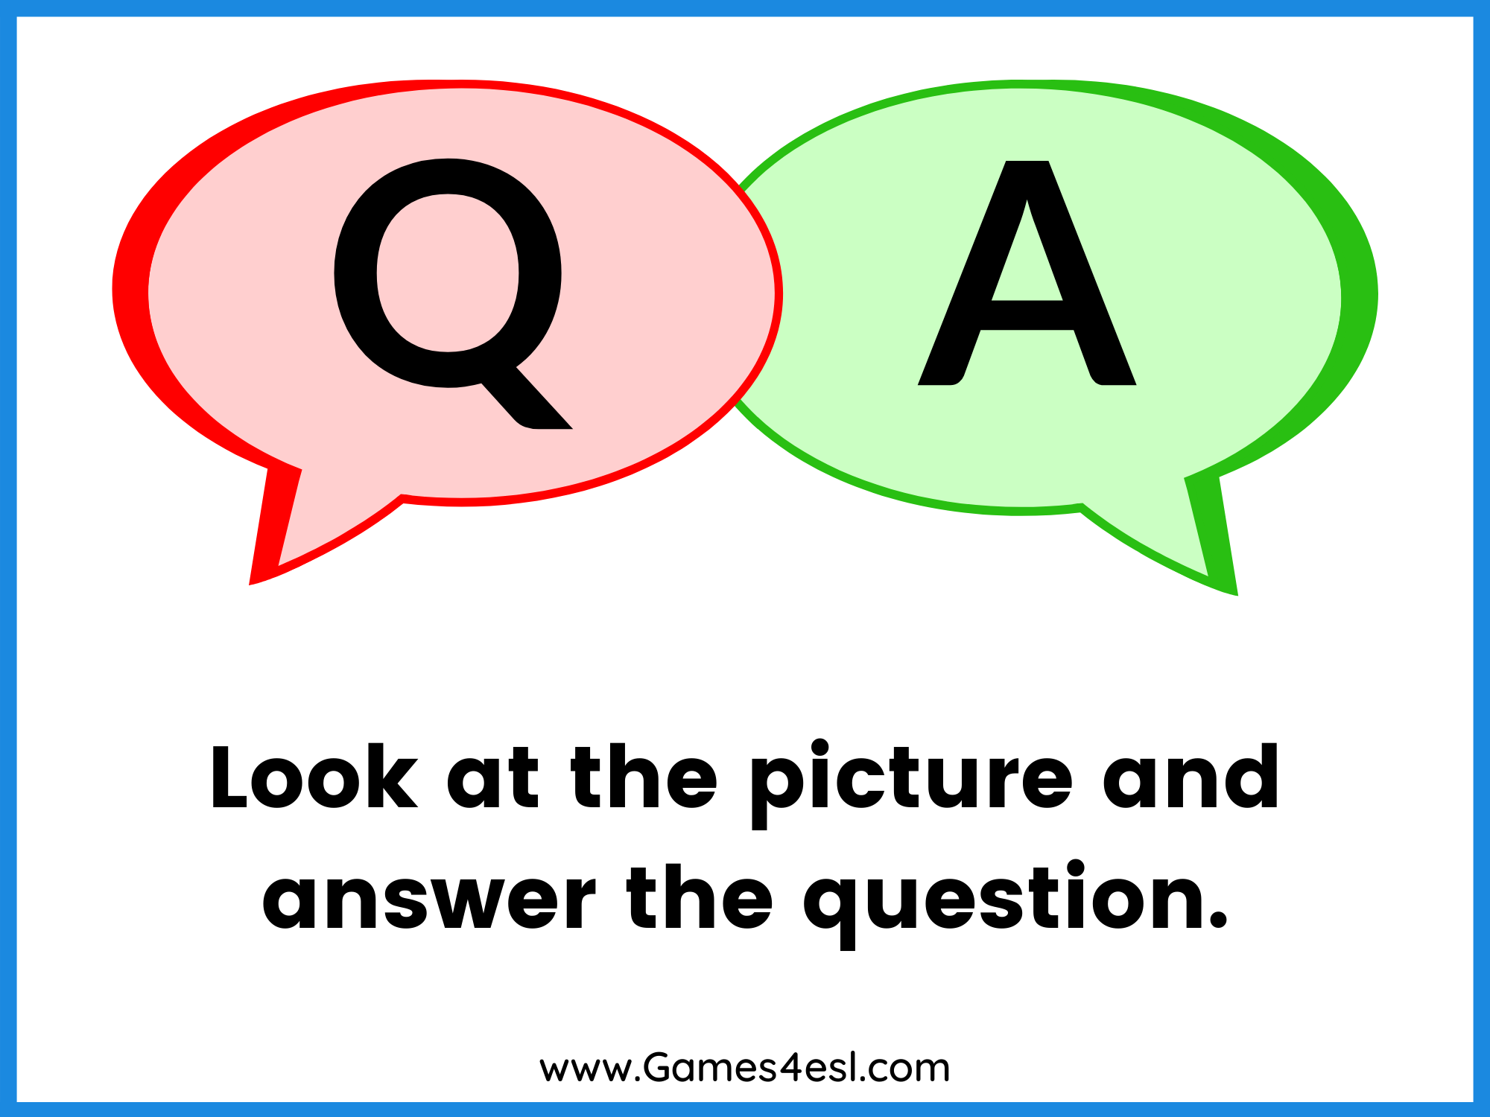

Slide 21
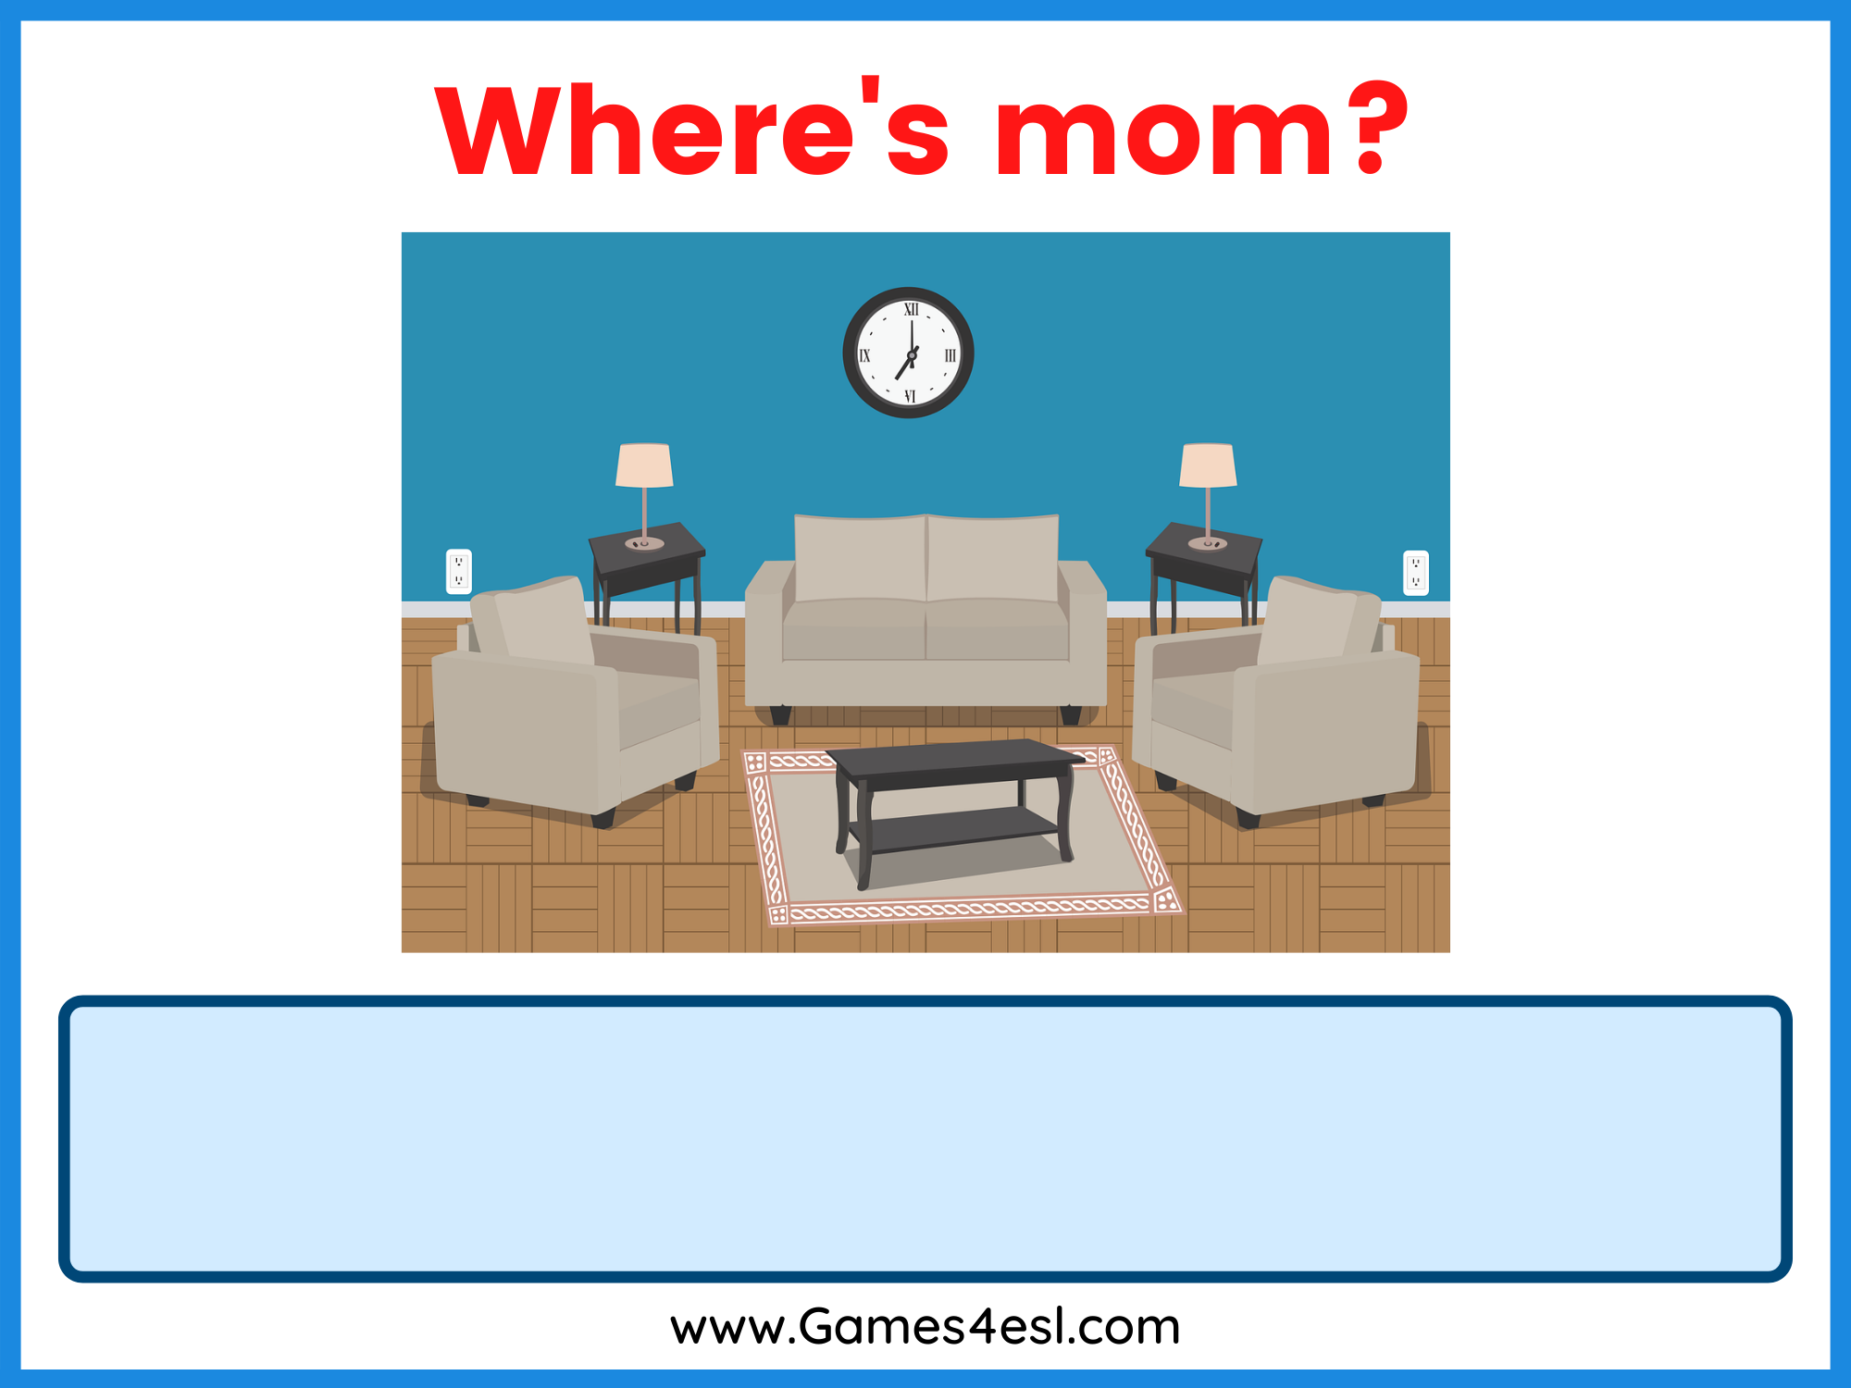
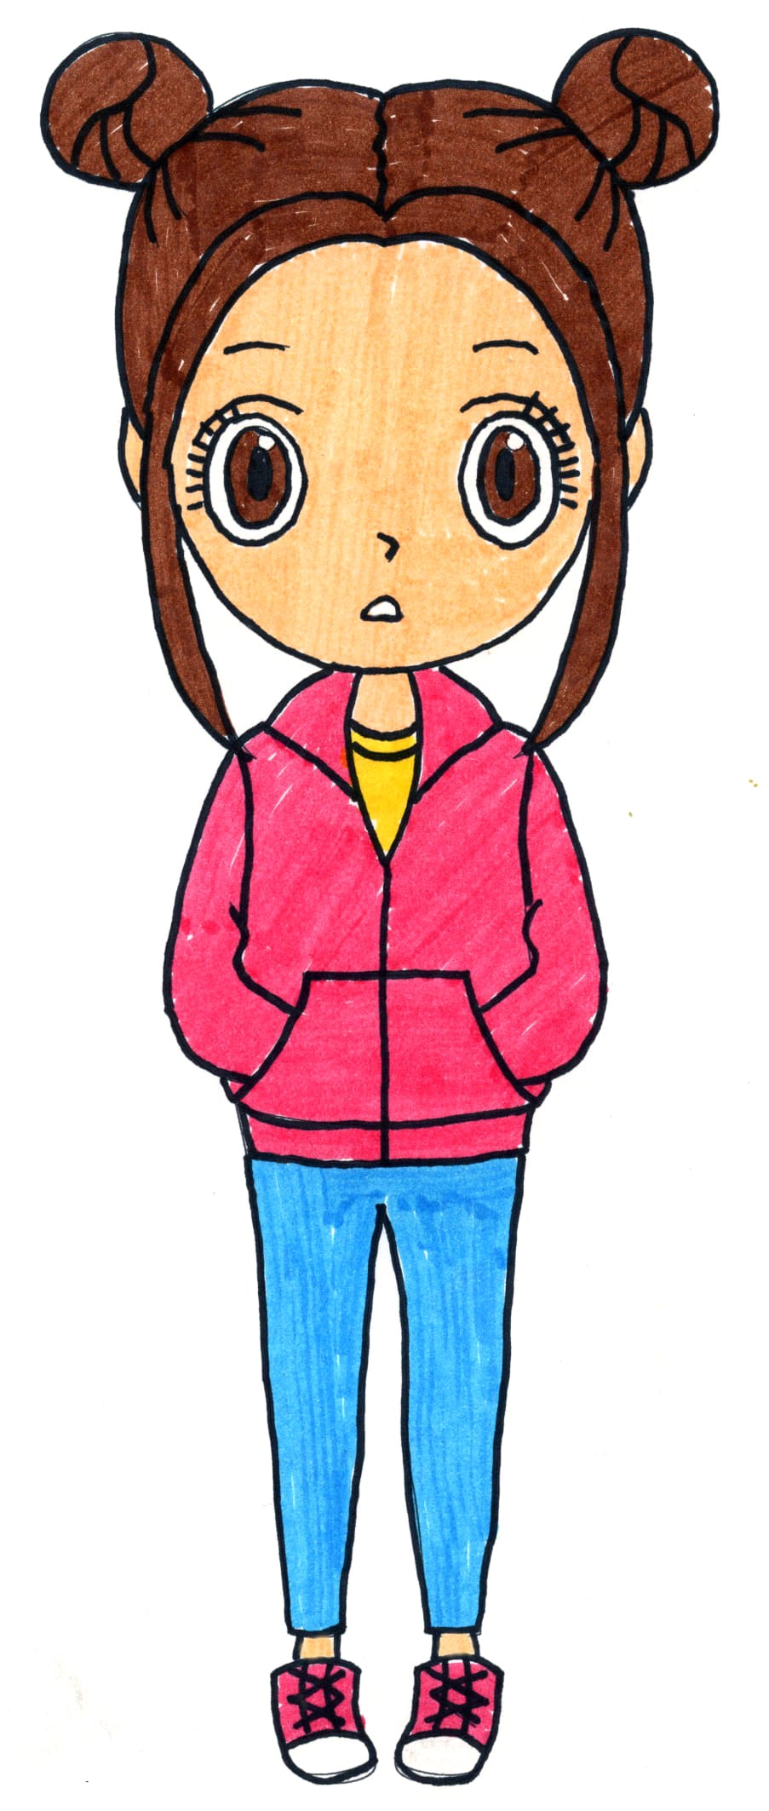
Where is Salima?

Slide 22
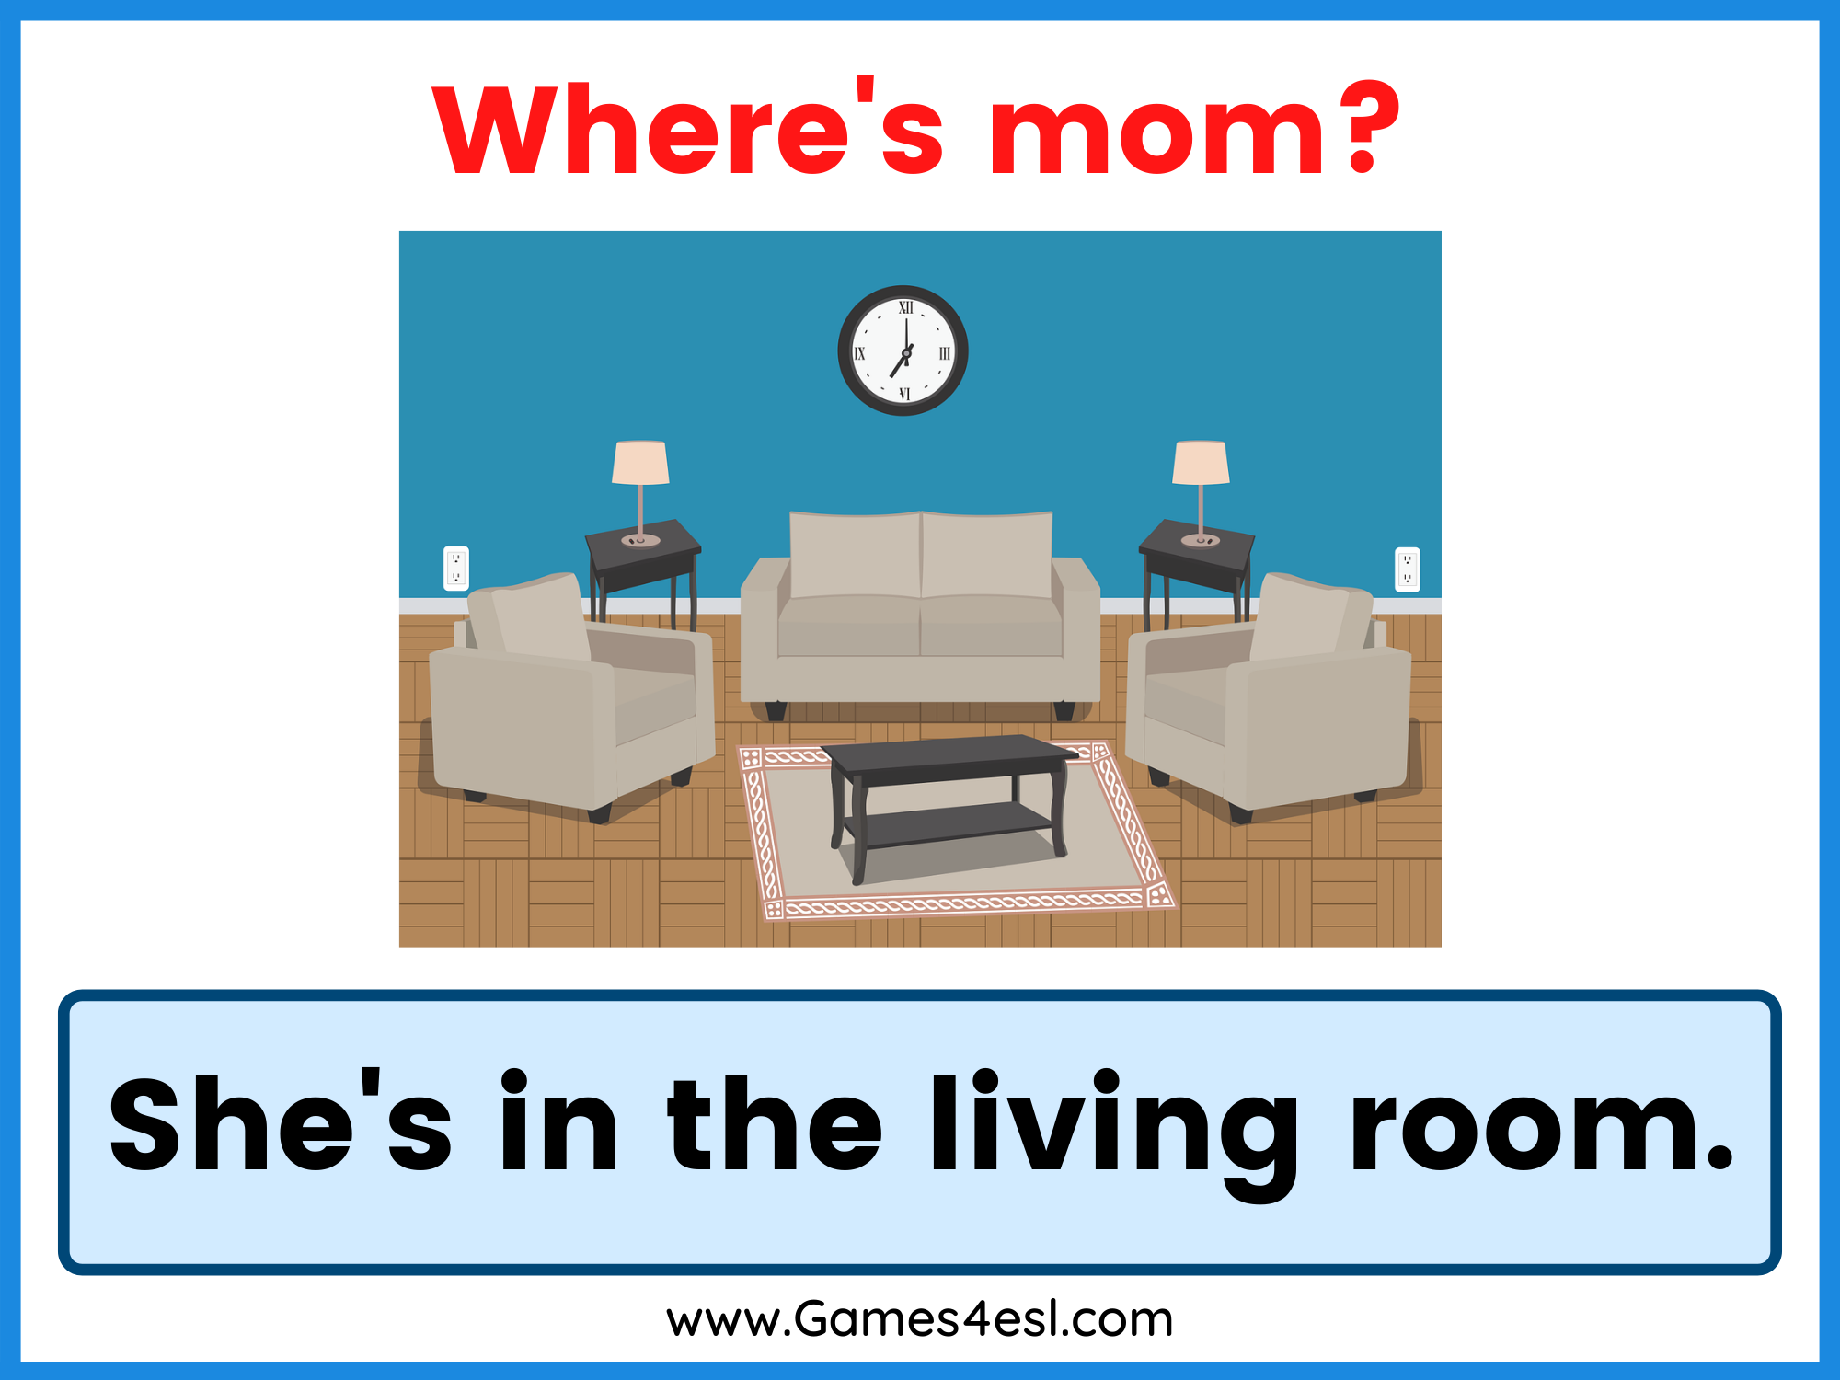
Where is Salima?

Slide 23
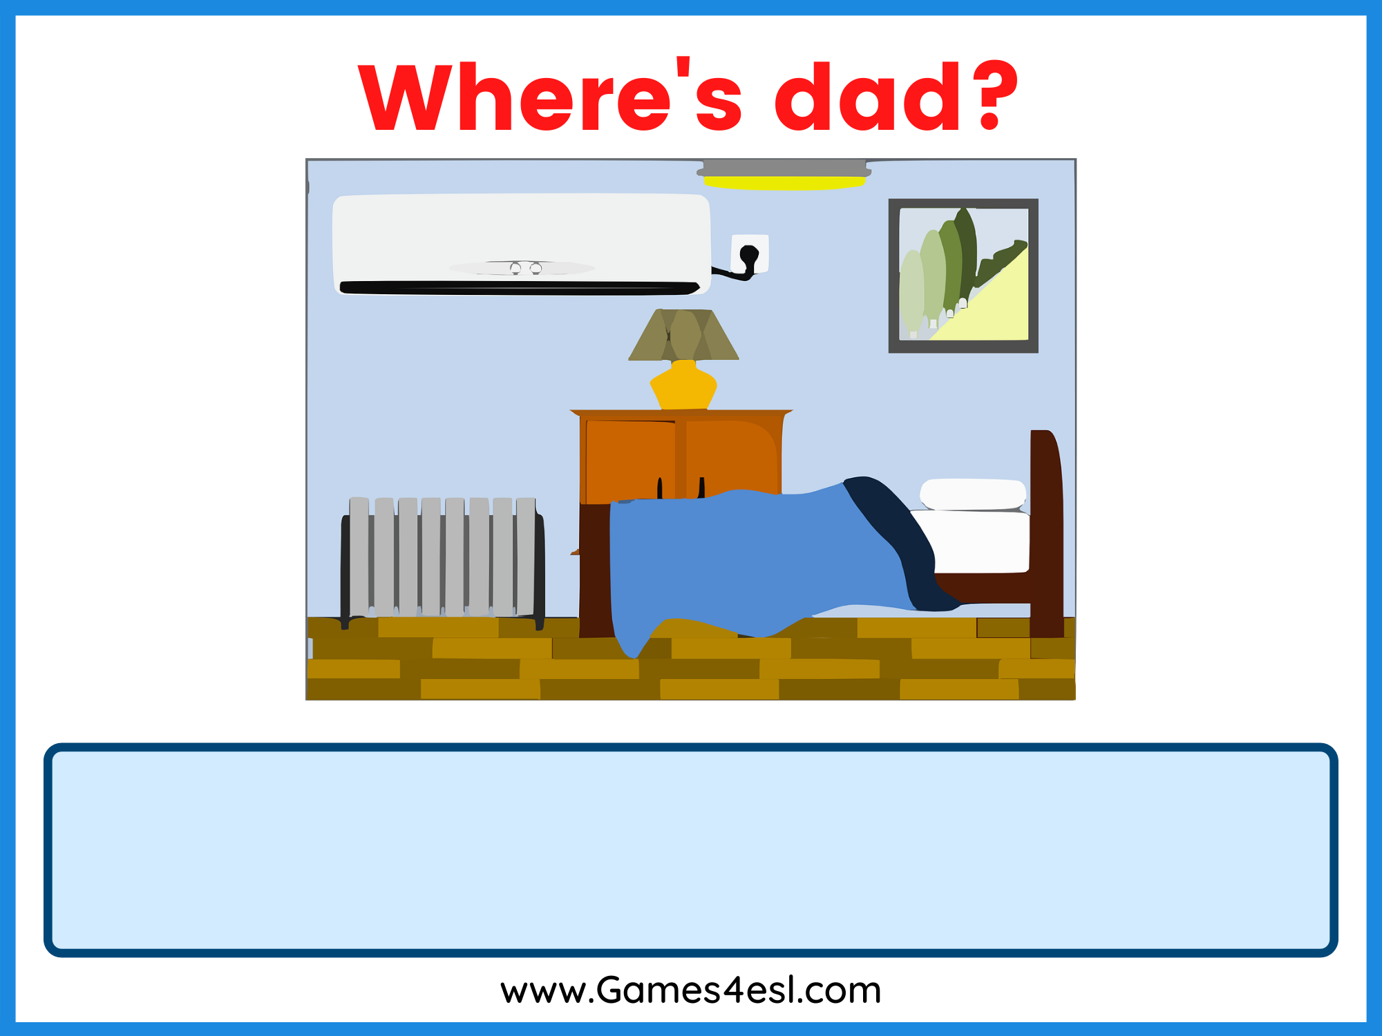
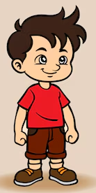
Where is Ahmed?

Slide 24
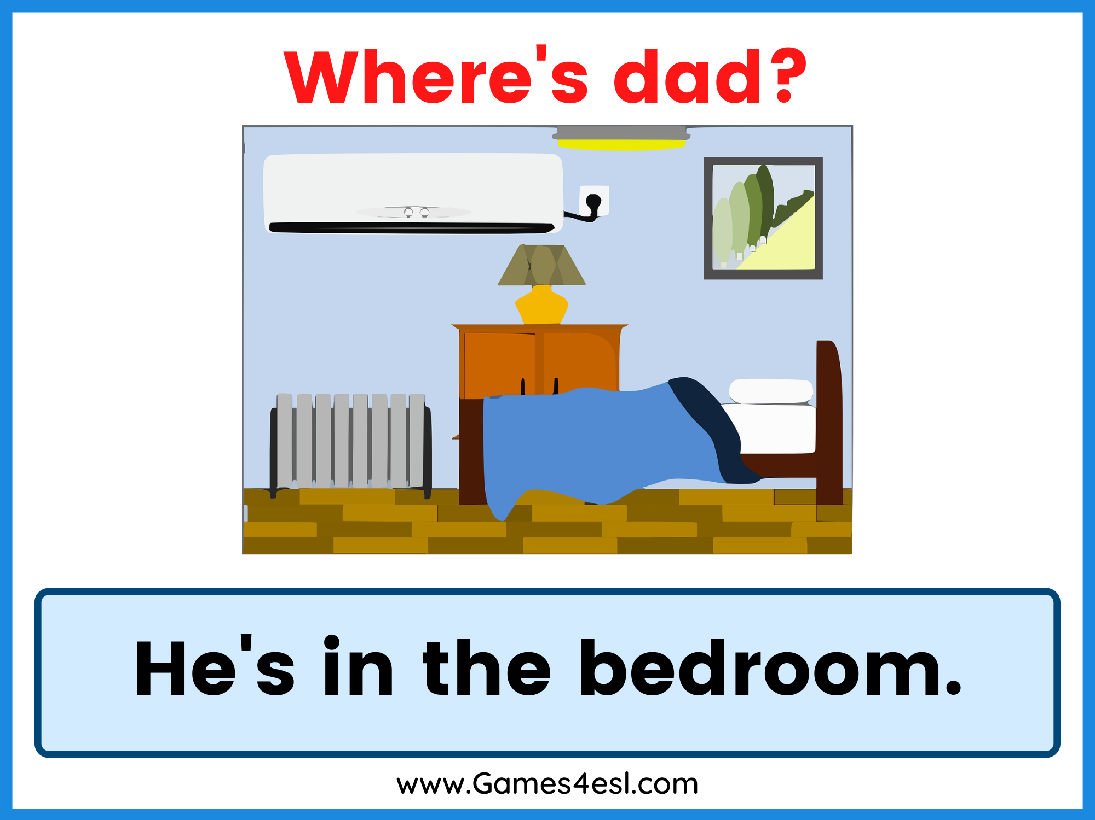
Where is Ahmed?

Slide 25
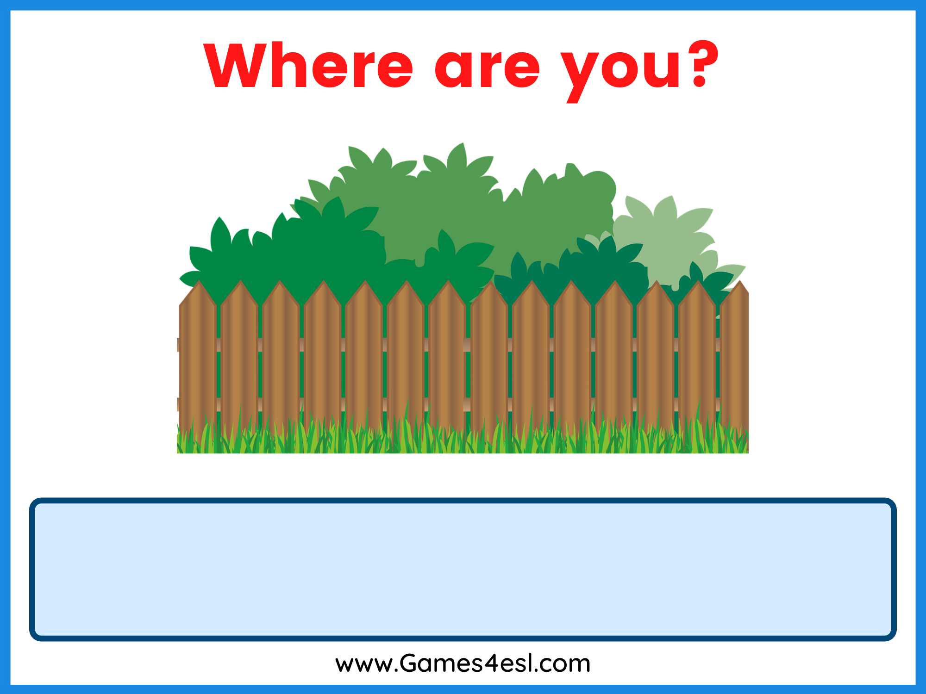
Where is Salima?

Slide 26
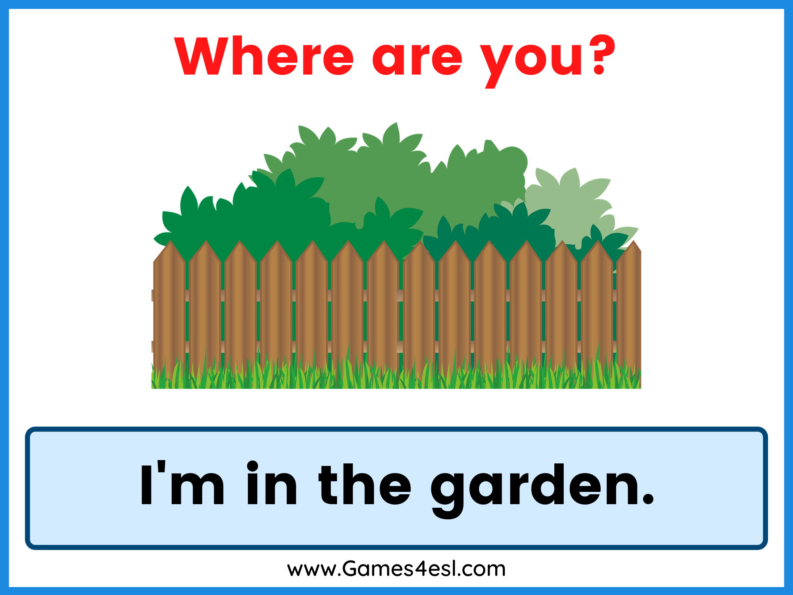
Where is Salima?
She’s in the garden..

Slide 27
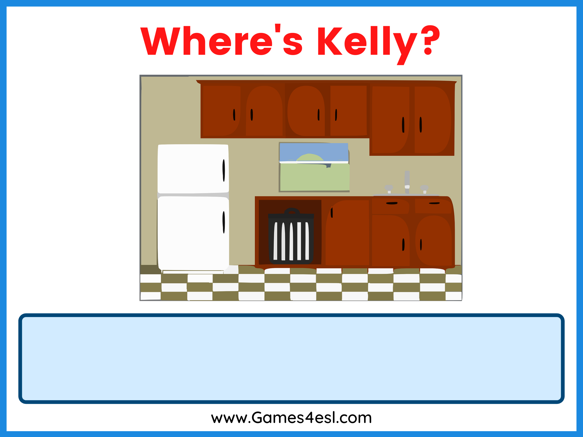
Where is Salima?

Slide 28
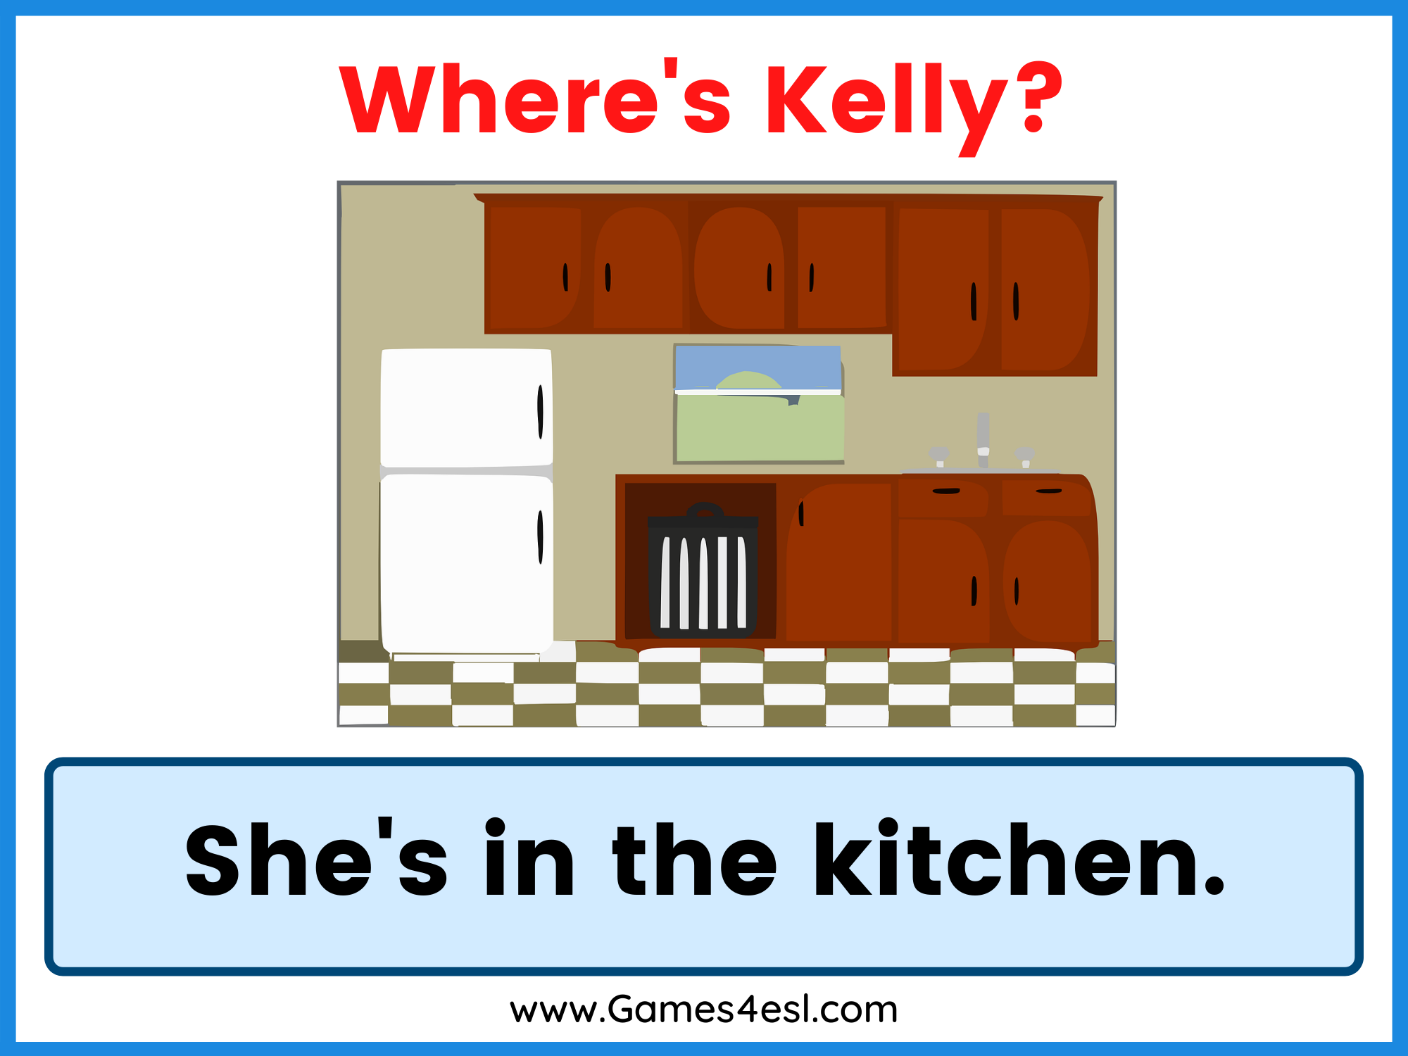
Where is Salima?

Slide 29
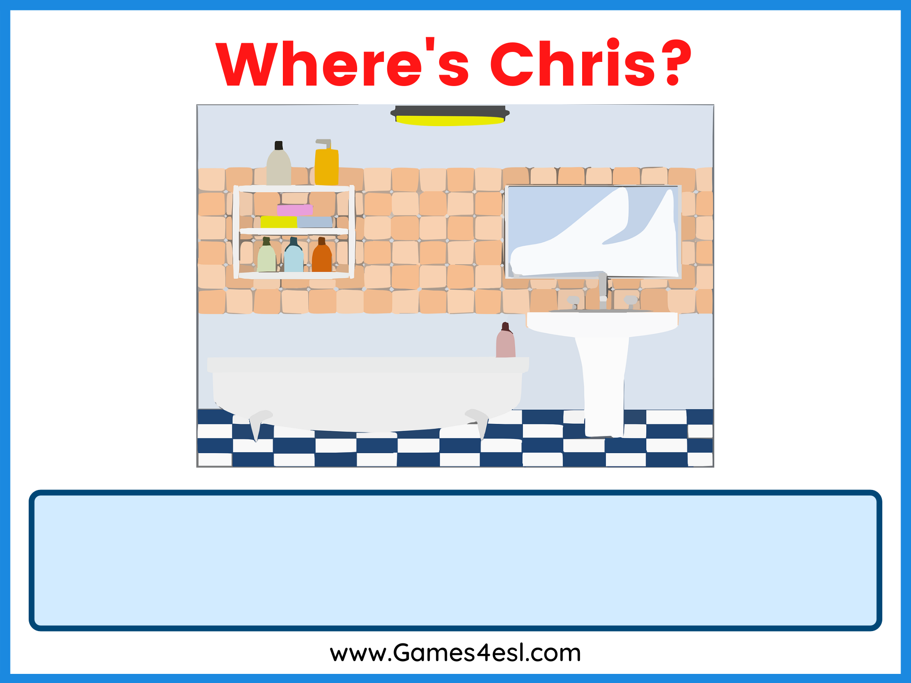
Where is Ahmed?

Slide 30
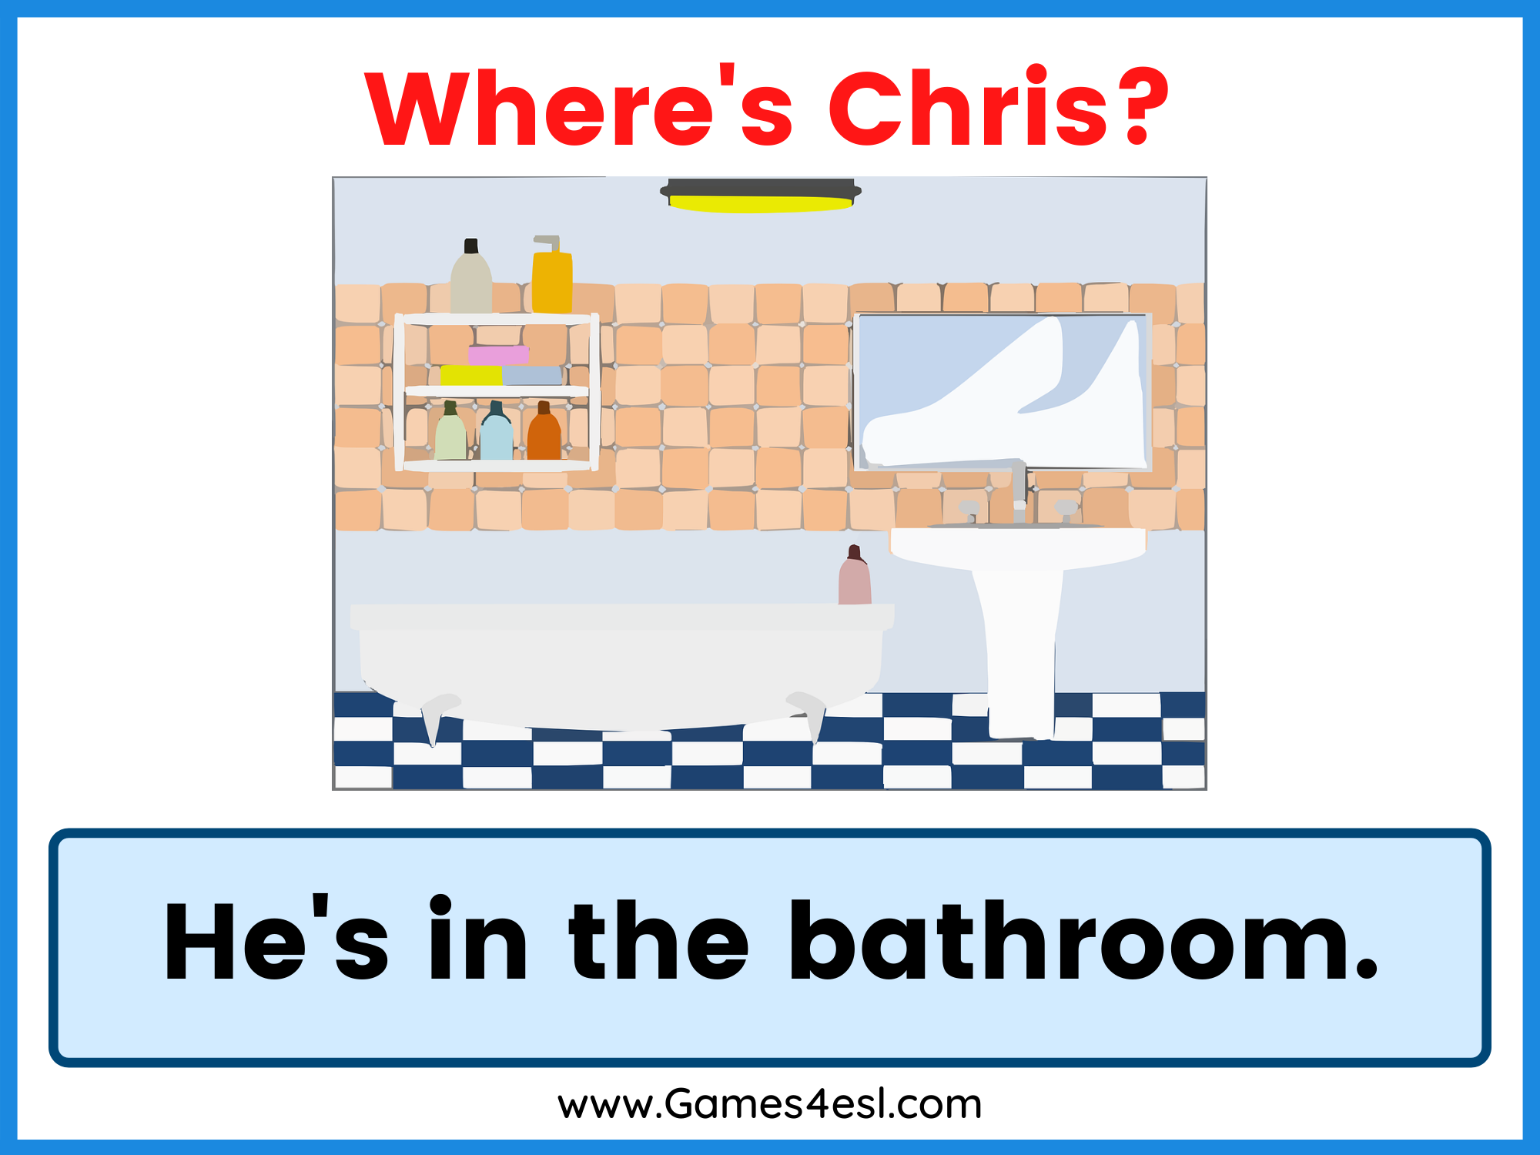
Where is Ahmed?

Slide 31


Slide 32
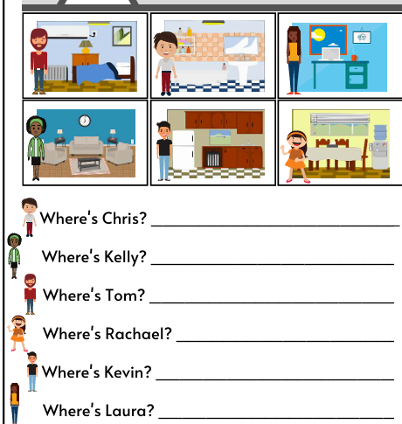

Slide 33
My name is Houda. I am from Morocco. I live in a big
house. It has five rooms: a bedroom, a kitchen, a living room, a bathroom, and a garden. I sleep in my bedroom. I help my mother cook in the kitchen. I watch TV and play in the living room. I take a shower in the bathroom. I play with my dog in the garden. I love my house because it is beautiful!
Exercise 1: Read the sentences and write True or False:
The house has six rooms.
Houda sleeps in the bedroom.
Houda cooks in the kitchen.
Houda watches TV in the garden.
Houda loves the house.

Slide 34

Speaking: answer these questions.
What is your full name?
Where are you from?
Do you live in a house or apartment ?
How many rooms are there ?
What’s your favourite room?
My full name is……….
I am from…….
I live in…..
There are….....rooms.
My favourite room is….

Slide 35
Bedroom – many - garden – study – two - apartment – live – yes -

Slide 36
Match the activities with the rooms. Activities | Rooms
1.We cook | A. In the bedroom.
2. We sleep | B. In the kitchen.
3. We watch TV | C. In the bathroom.
4. We take a shower | D. In the living room.
5. We eat | E. In the dining room.
6. We do homework | F. In garden
7. We play | G. In the study.

Slide 37
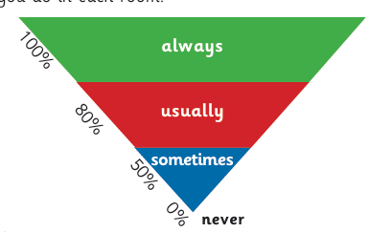
What do you do in the in the bathroom?
What do you do in the living room?
What do you do in the kitchen?
What do you do in the garden?
I usually take a shower in the bathroom.

Slide 38
Match the activities with the rooms. Activities | Rooms
1.We cook | A. In the bedroom.
2. We sleep | B. In the kitchen.
3. We watch TV | C. In the bathroom.
4. We take a shower | D. In the living room.
5. We eat | E. In the dining room.
6. We do homework | F. In the garden
7. We play | G. In the study.

