Slide 1




Messages in media
Changing the world > Media Analysis > Messages in media

Slide 2
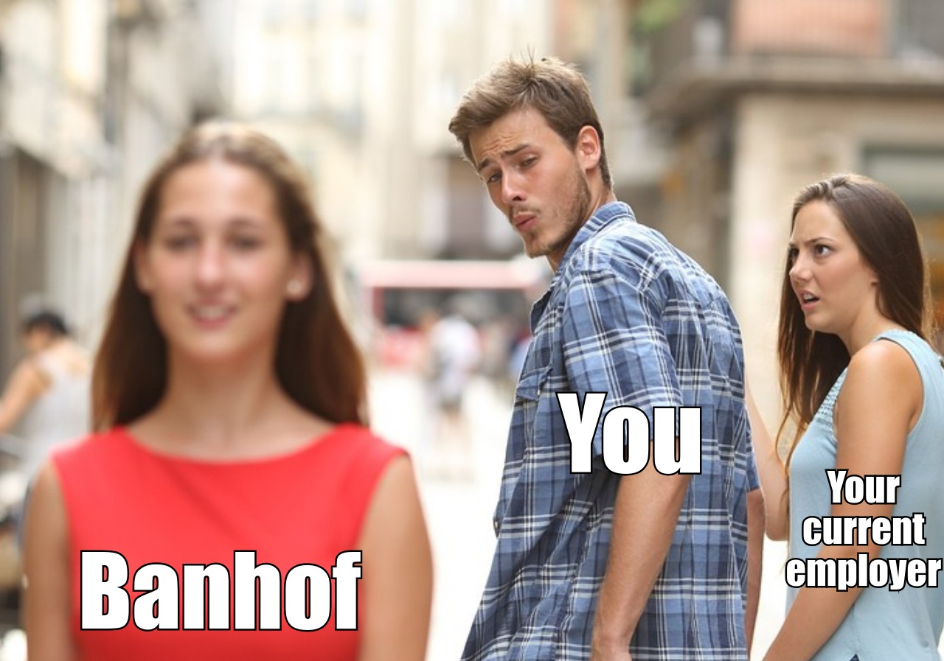
What do you think about this?

Slide 3
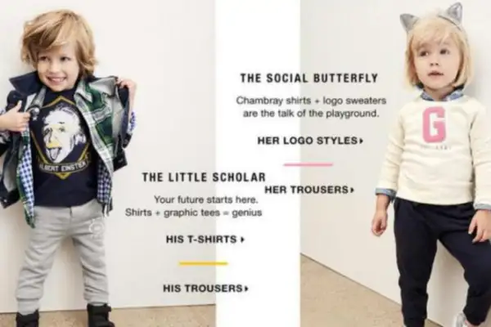

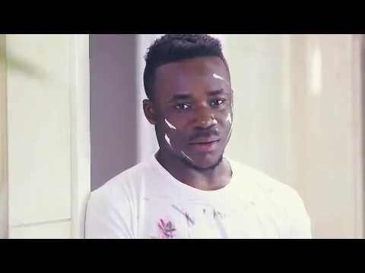
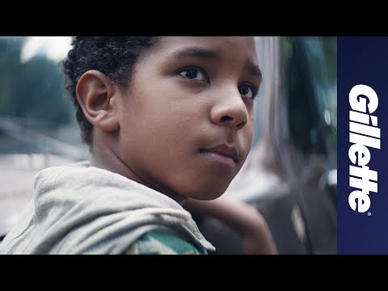
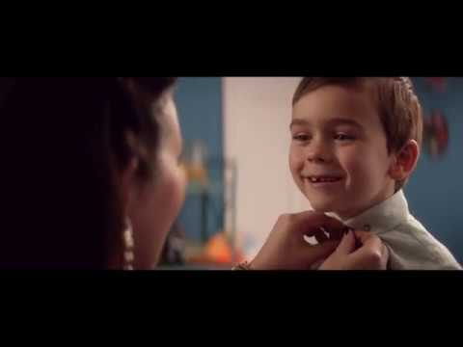
And these?

Slide 4
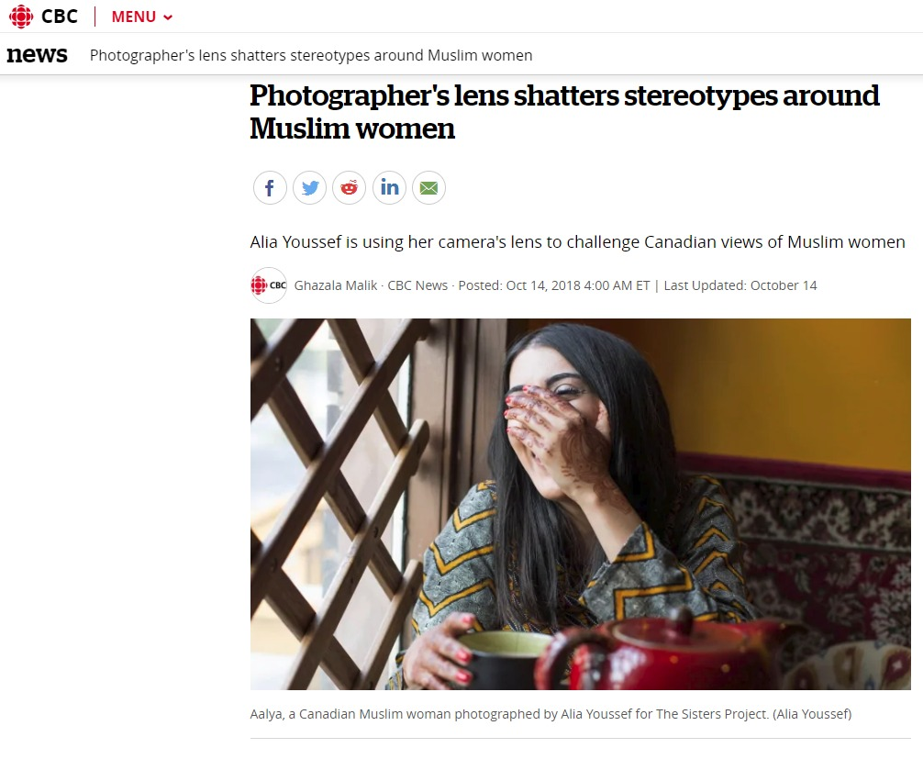


How about this?

Slide 5
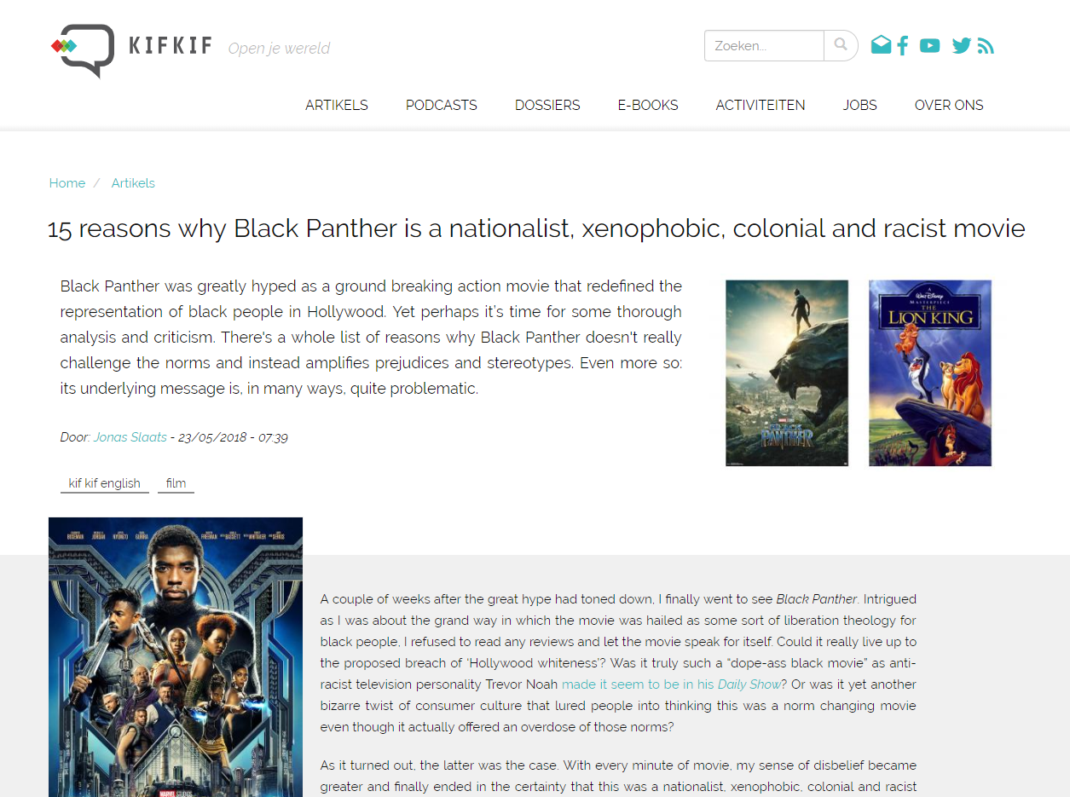
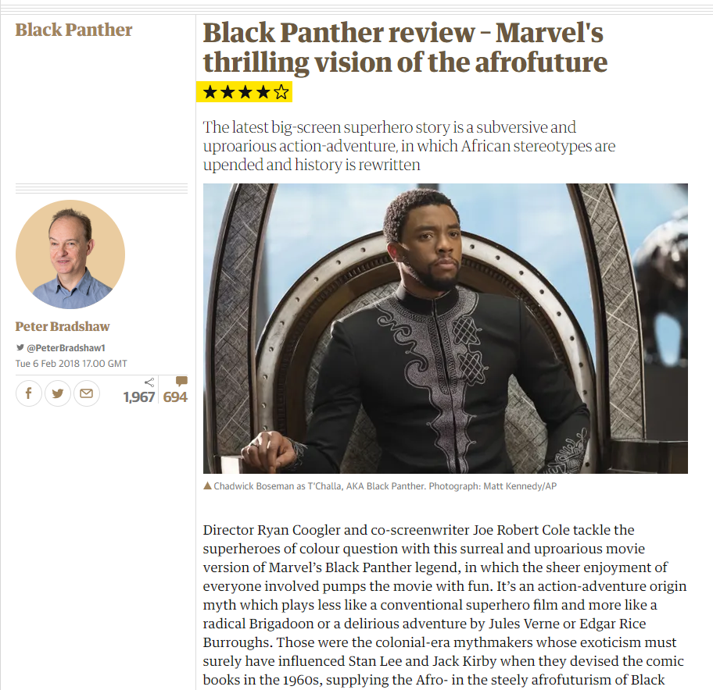

Contrasting views
‘...African stereotypes are upended and history is rewritten’
‘Nationalist, xenophobic, colonial and racist’

Slide 6

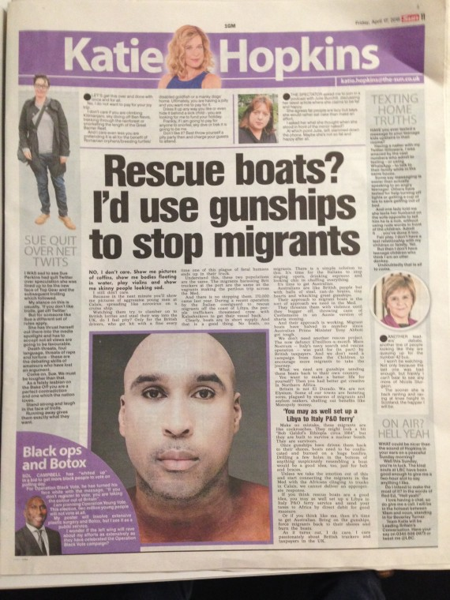
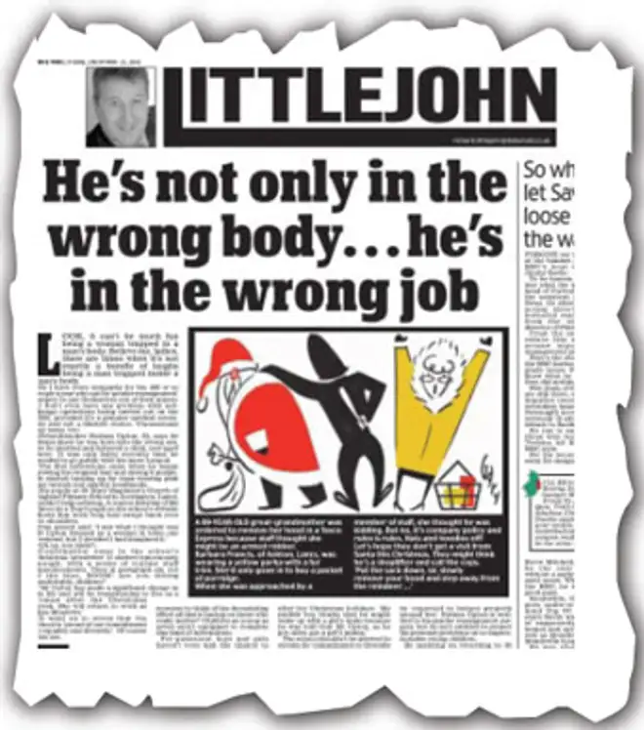
Opinions = news?

Slide 7
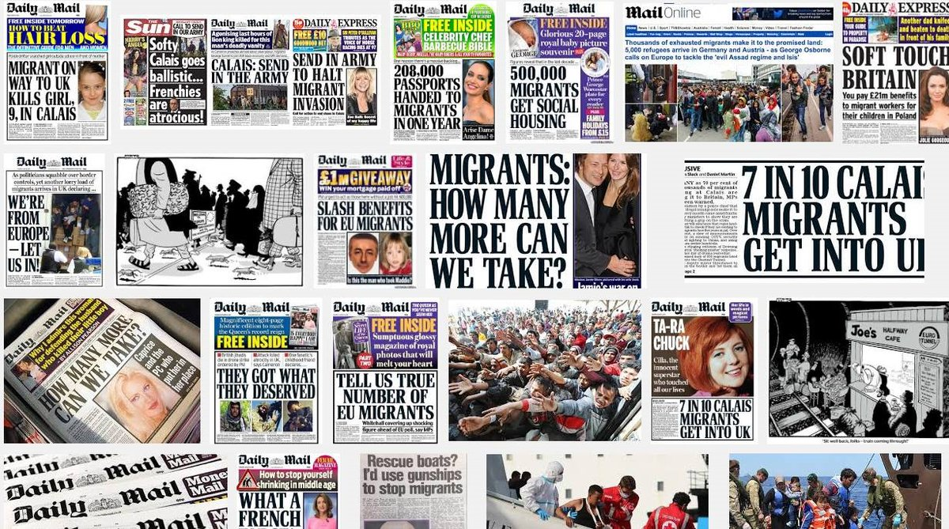
Headline news or an opportunity to sell more papers?

Slide 8

Successful campaigns?

Slide 9
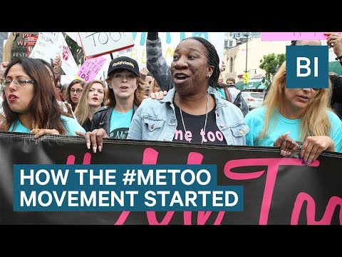

#metoo
Harvey Weinstein: Has his fall from grace and #MeToo changed anything?
https://news.sky.com/story/harvey-weinstein-has-his-fall-from-grace-and-metoo-changed-anything-11518273

Slide 10

#KONY2012
Was #Kony2012 a failure?
https://www.washingtonpost.com/news/worldviews/wp/2014/12/16/was-kony2012-a-failure/?noredirect=on&utm_term=.fa2404c4129a
The Lessons of Kony 2012
http://www.slate.com/articles/news_and_politics/the_next_20/2016/09/kony_2012_quickly_became_a_punch_line_but_what_if_it_did_more_good_than.html
Kony2012: The rise of online campaigning
https://www.bbc.co.uk/news/magazine-17306118

Slide 11
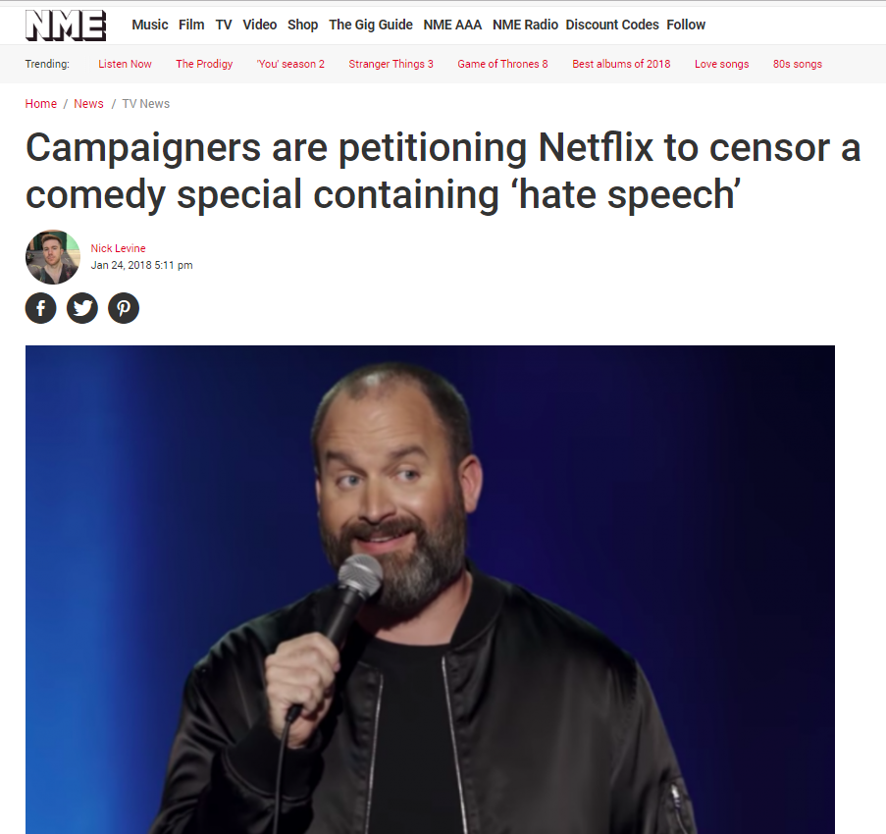
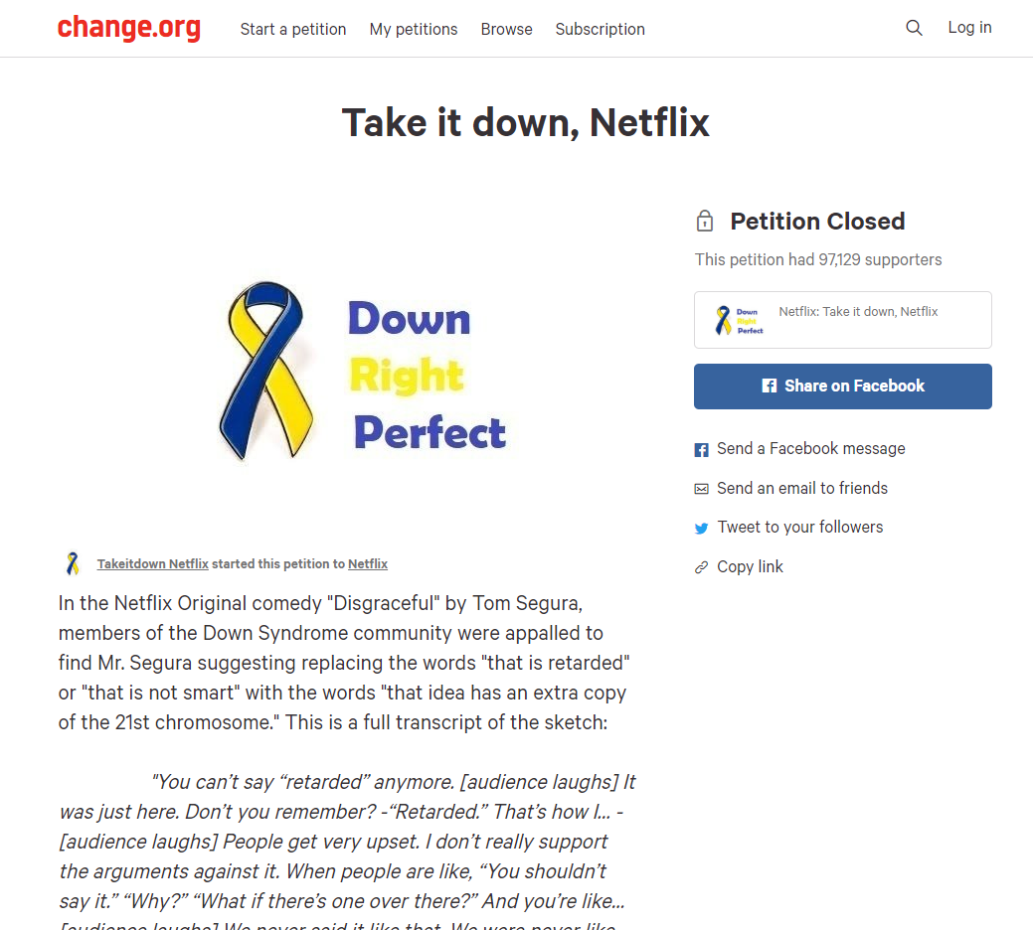
Tom Segura + Netflix

Slide 12
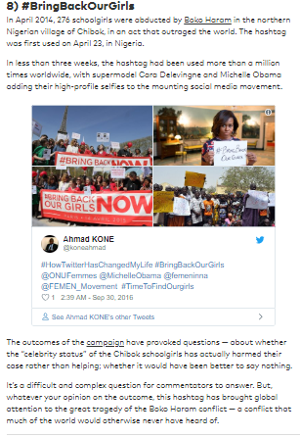
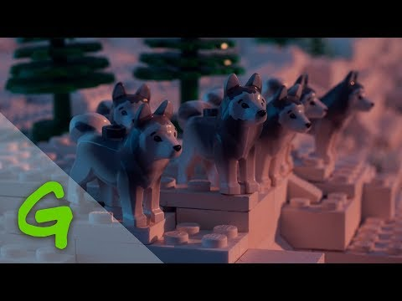
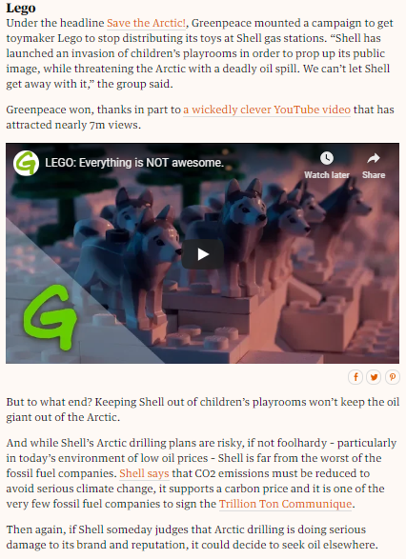
Successful Activism
8 Massive Moments Hashtag Activism Really, Really Worked
https://www.globalcitizen.org/en/content/hashtag-activism-hashtag10-twitter-trends-dresslik/
Under pressure: campaigns that persuaded companies to change the world
https://www.theguardian.com/sustainable-business/2015/feb/09/corporate-ngo-campaign-environment-climate-change

Slide 13
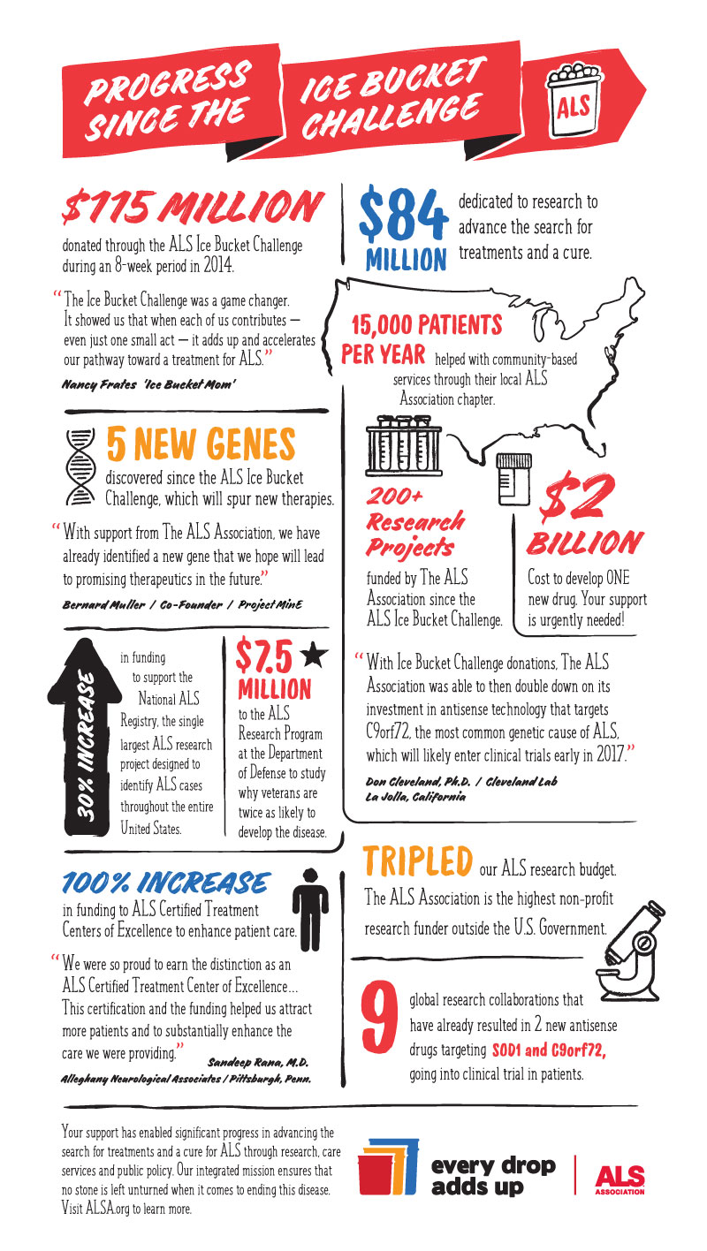
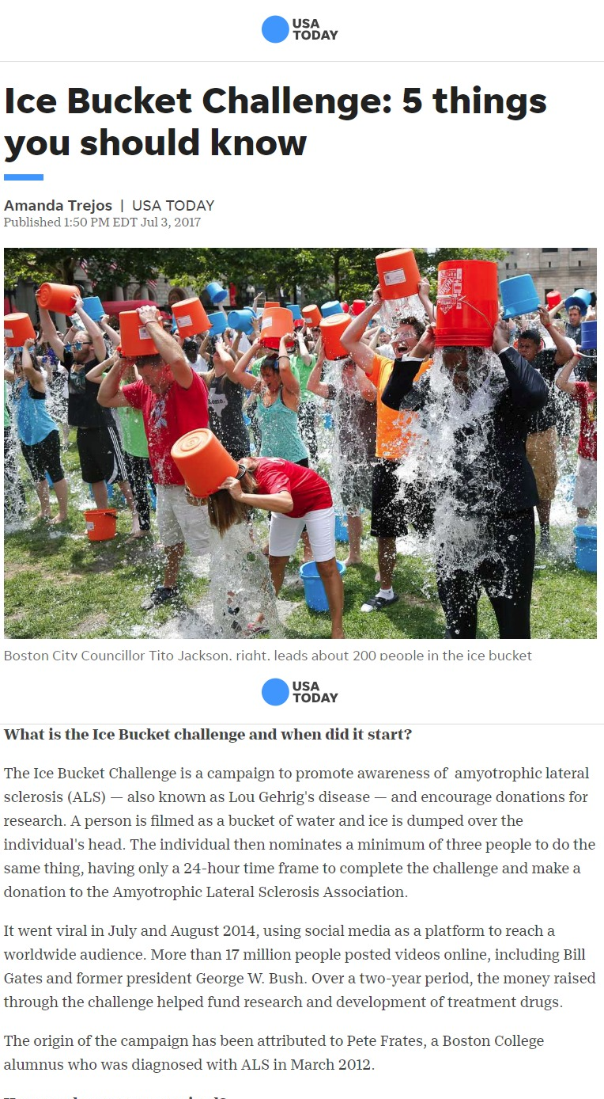
The #ALSIceBucketChallenge
Ice Bucket Challenge: 5 things you should know
https://eu.usatoday.com/story/news/2017/07/03/ice-bucket-challenge-5-things-you-should-know/448006001/
Progress since the Ice Bucket Challenge
http://www.alsa.org/fight-als/edau/ibc-progress-infographic.html

Slide 14
Features of a successful campaign
Organisation and mobilisation of your people
Inclusive - involving all, including marginalised communities
Being clear about the change you want to see
Responsive to real-time issues and events
Inspire others to generate their own campaigns
Hybridisation - both online and offline activities working together.

Slide 15








www.hackinghate.eu
#SELMA_eu

