Slide 1
CPaaS Microsoft Teams Operator Connect
September, 2023

Slide 2
Problem Statement & Solution
Overview
Key Features
Value Propositions
Benefits
Snapshot
Success Stories

Slide 3
Problem Statement & Solution
Integration of traditional voice systems with modern communications & collaborative tools can be expensive and complex.​
Businesses are starting to switch up. They would want seamless interaction with their customers.
Businesses are generally looking at cutting back their expenditures. ​
No need for on-premise equipment/hardware that may need maintenance or support, freeing up your IT department for more value adding work​.
Combining fixed line numbers with MS Teams makes business number accessible to the employees on any device no matter where they are​.
Monthly Subscription model with no upfront investment required. Enjoy unlimited local/international calls.
accessibility
Accessibility
Remote Work
Cost

Slide 4
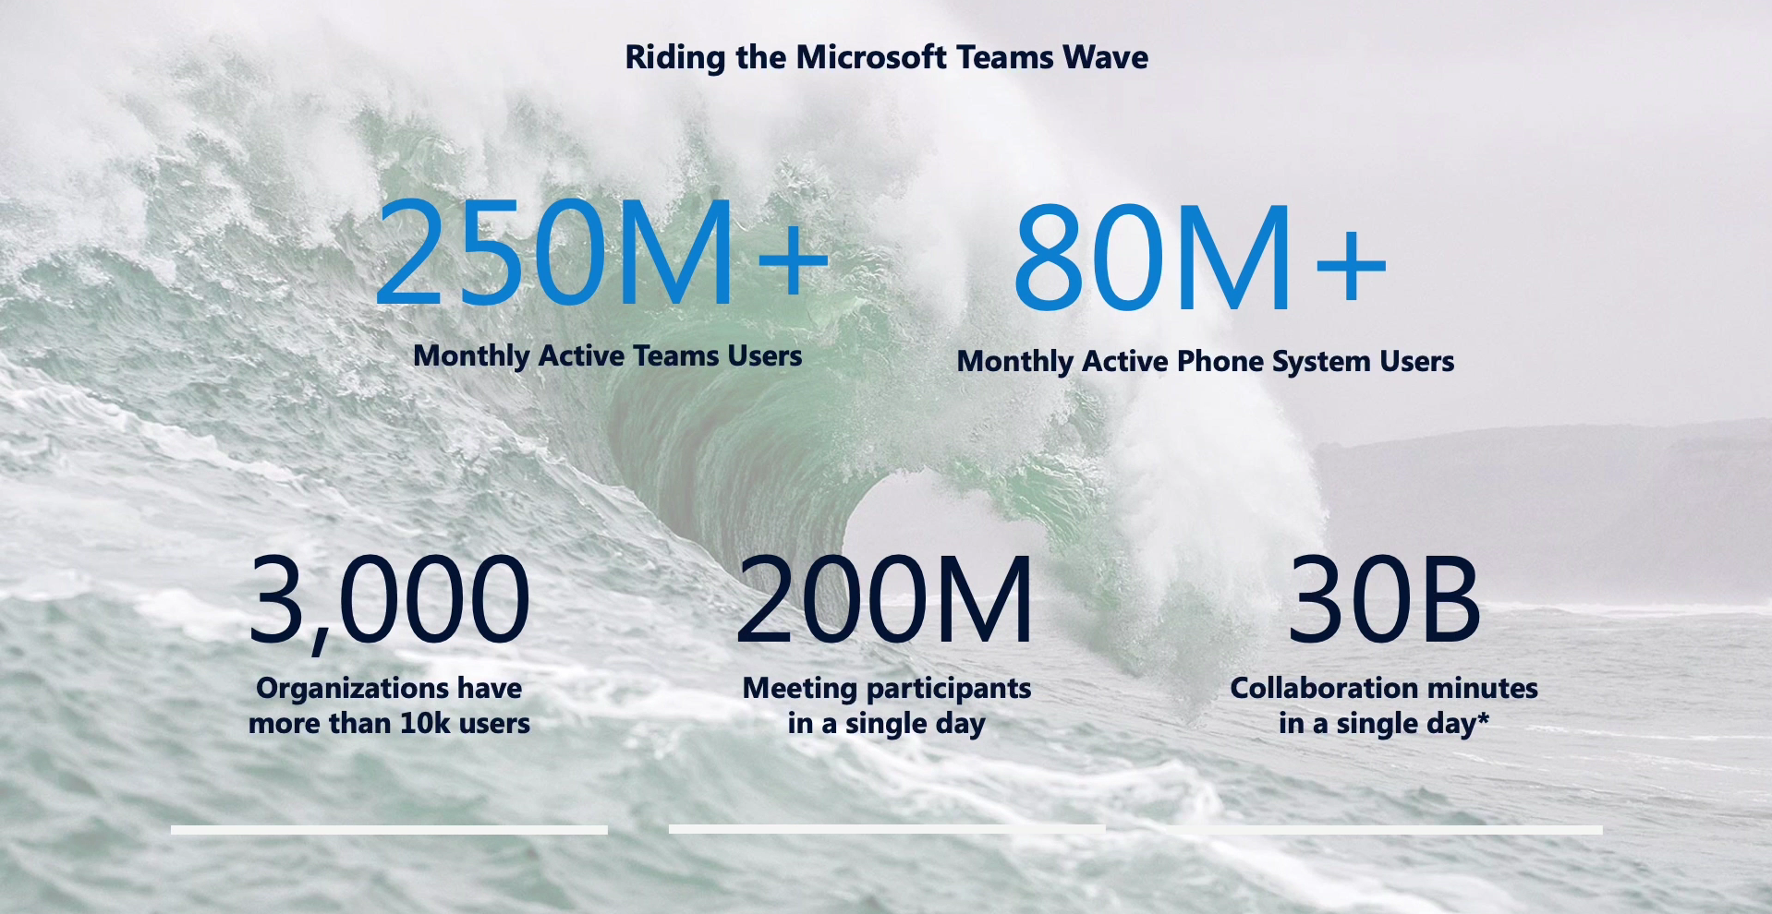

Slide 5
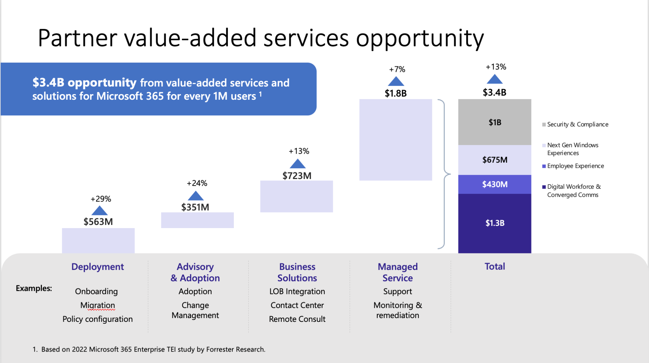
Notes:
Data as per Nov 2021

Slide 6
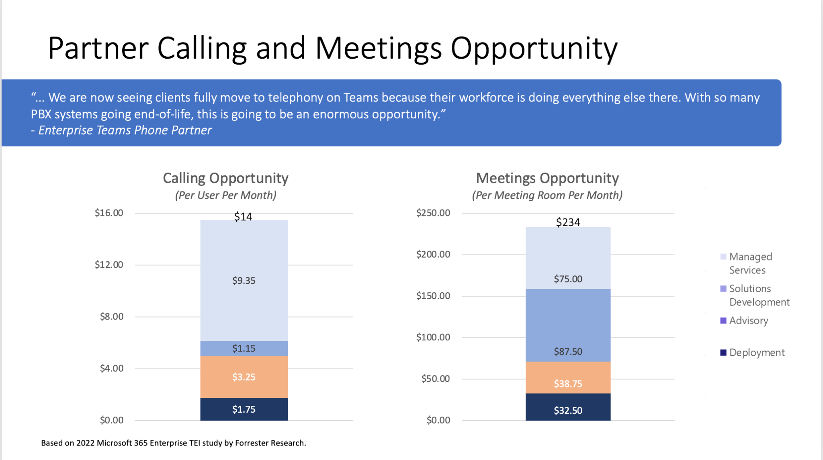
Notes:
Data as per Nov 2021

Slide 7
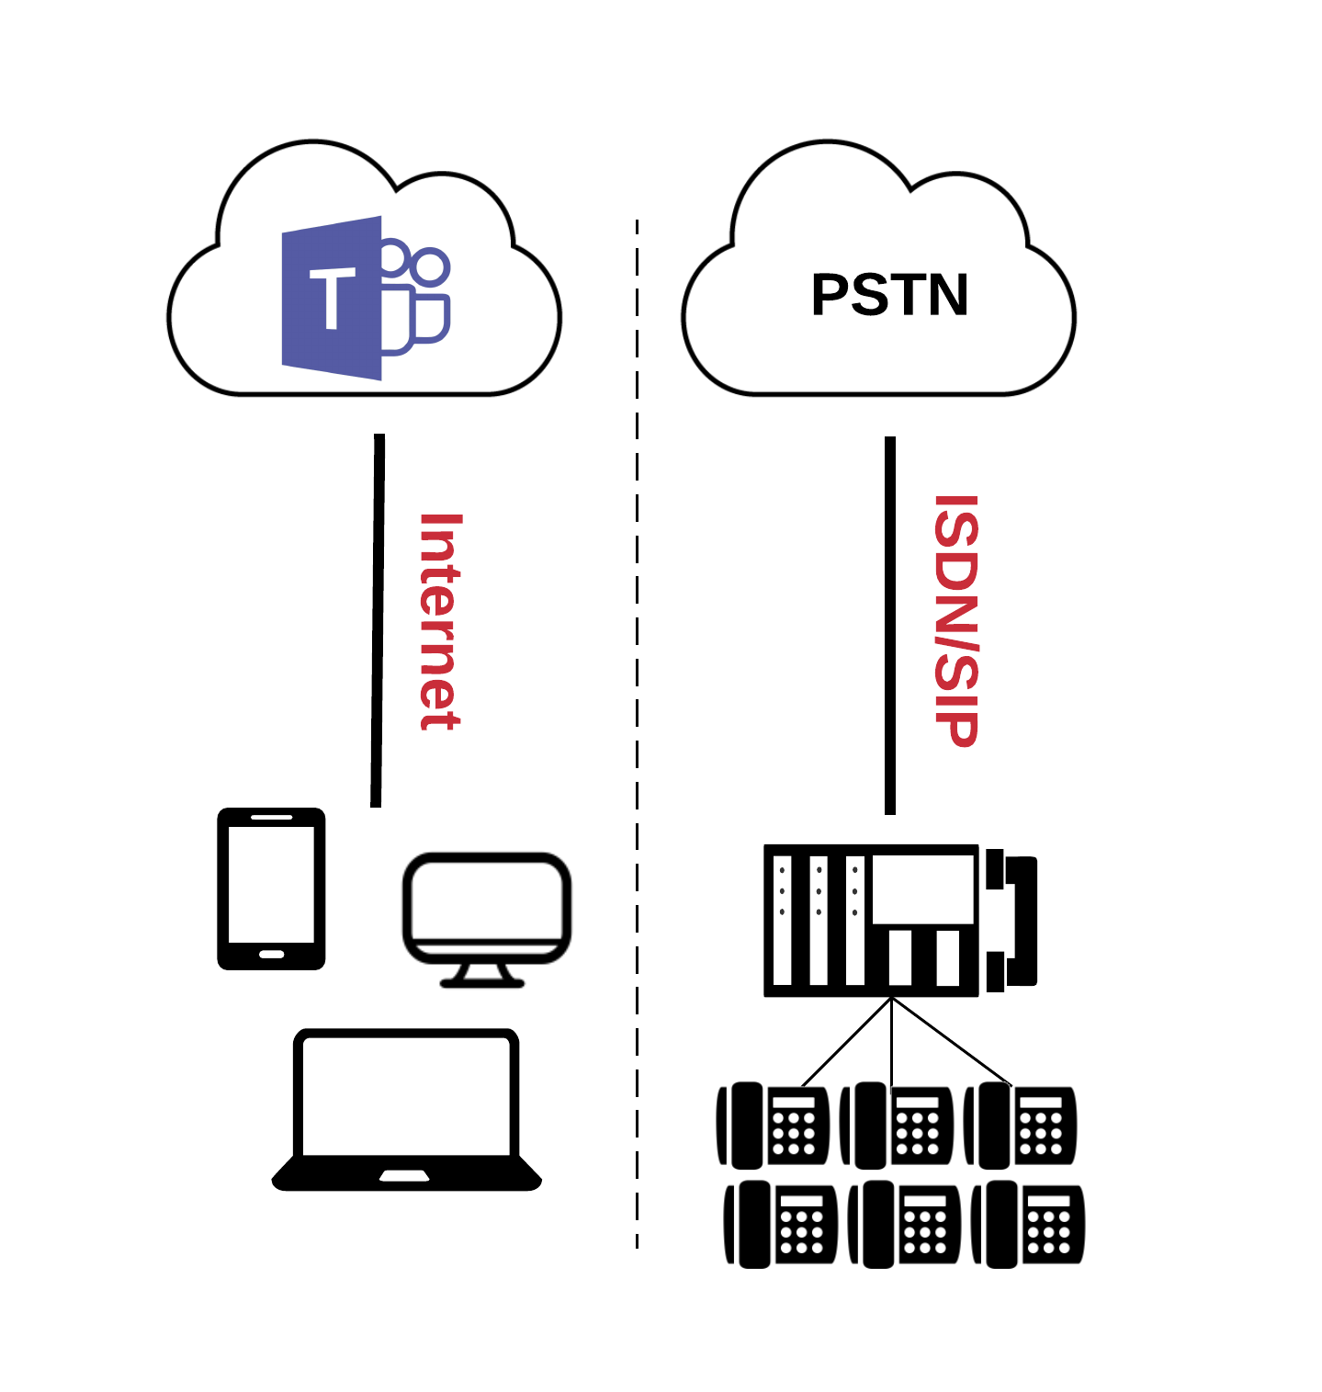
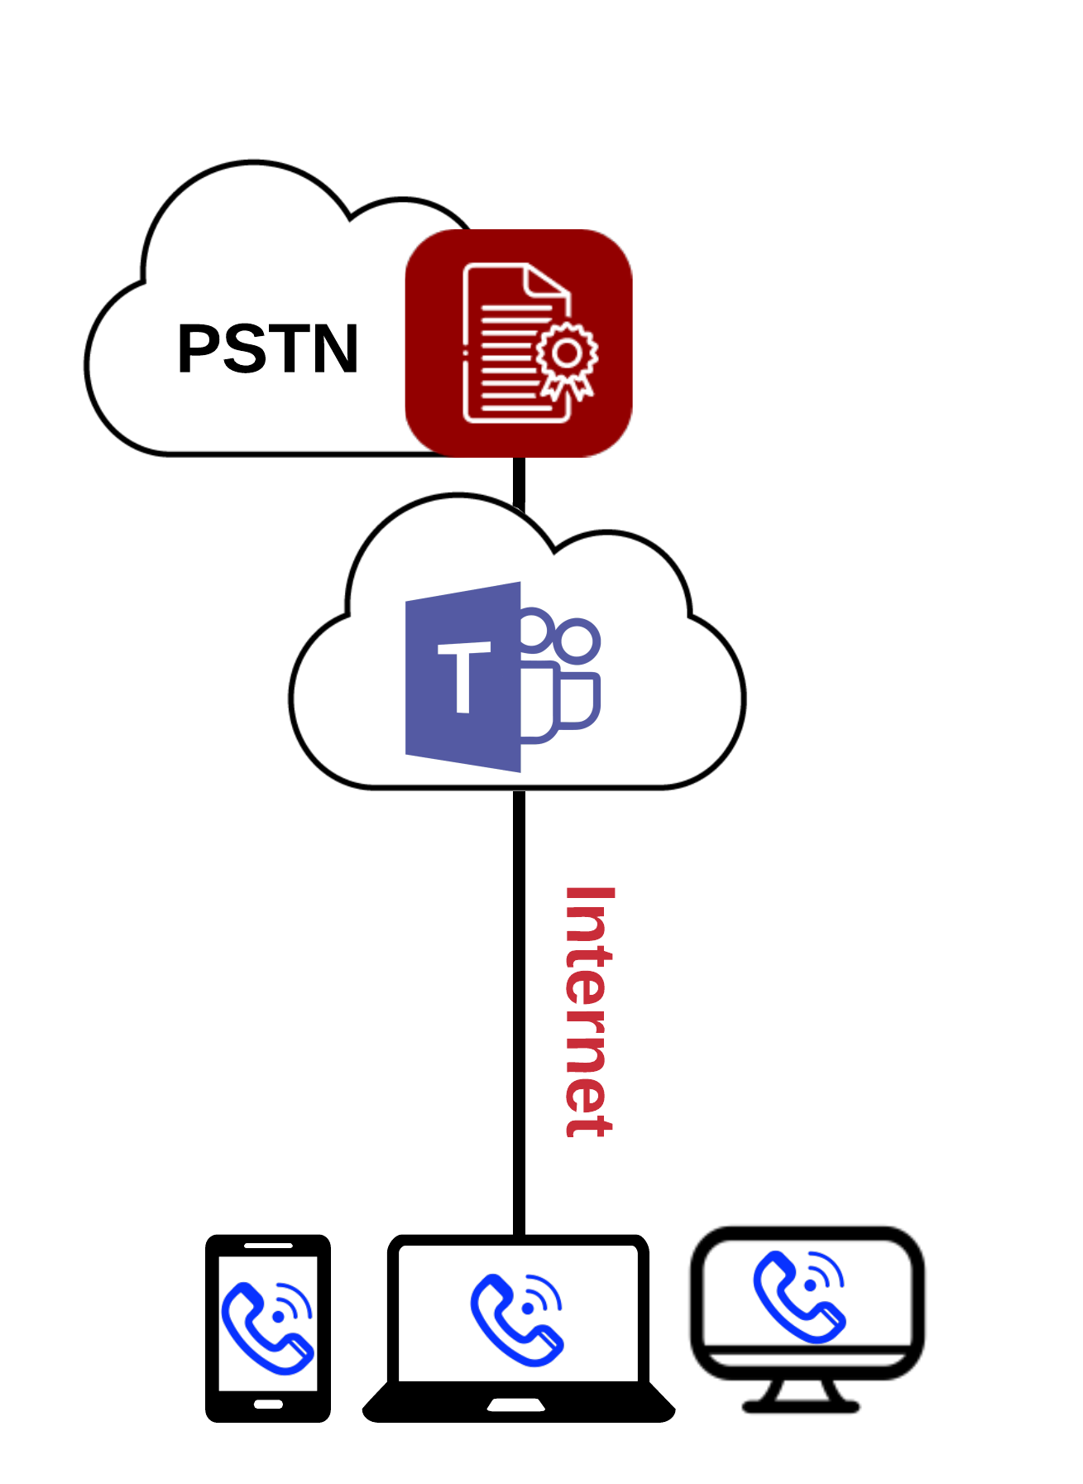
What is CPaaS MS Teams Operator Connect?
BEFORE
AFTER
MS Teams with Standalone IP-PBX Setup for PSTN Calls
MS Teams + CPaaS MS Teams Operator Connect
Internal
External
Calls to other Teams users are free.
But to make/receive telephone calls, a separate IP-PBX system is required
CPaaS
MS Teams Operator Connect enables businesses to make and receive PSTN calls to/from regular telephone number by simply using the MS Teams App.

Slide 8


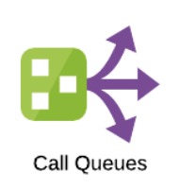
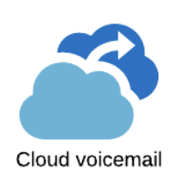
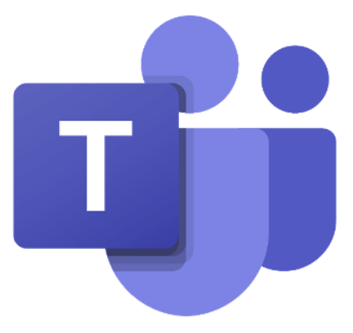



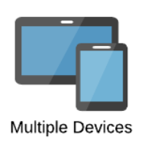

Key Features
As a cutting-edge communications solution, CPaaS MS Teams Operator Connect leverages advanced call features for businesses

Slide 9
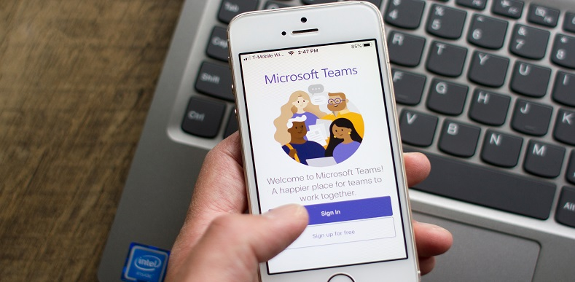



Value Propositions
01 | No Upfront hardware investment
02 | Supports Unified Call Recording
03 | Supports IDD Controls, Number Masking
04 | Supports for Hybrid Setup (MS Teams + PBX)
05 | 99.9% SLA (CPaaS Microsoft Teams Operator Connect)

Slide 10
Benefits of CPaaS MS Teams Operator Connect
Improve Business Continuity
Cost & Time Savings
Improve Productivity
Stay connected with your customers from home, office or anywhere.
Accessible via multiple devices of your choice on internet/mobile data.
Unlimited incoming & outgoing local calls and no new equipment required.
Save on new equipment and maintenance cost.
Modern Collaboration experience with PSTN calling & MS Teams features all in one app.
Better access to voice calling and Auto-attendant feature to route calls efficiently.

Slide 11
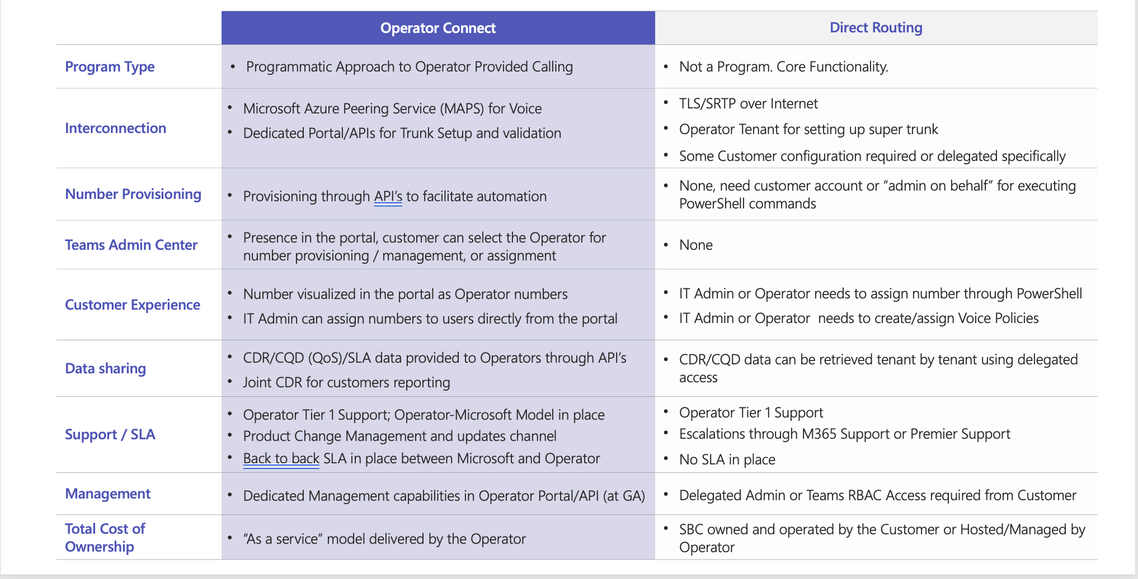
CPaaS MS Teams Operator Connect vs MS Teams Direct Routing

Slide 12
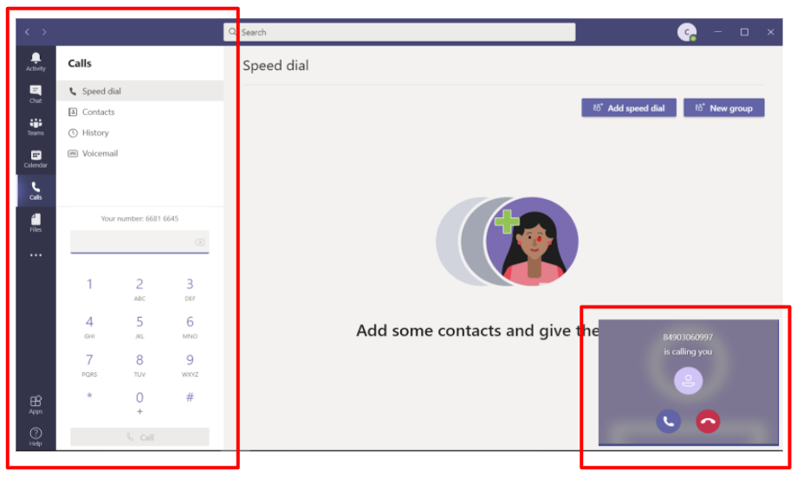
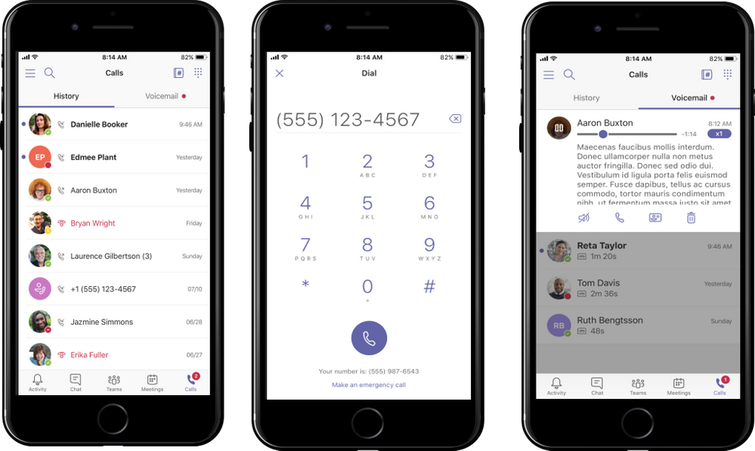
MS Teams User Interface
Computer/ Laptop
Smart Phone

Slide 13
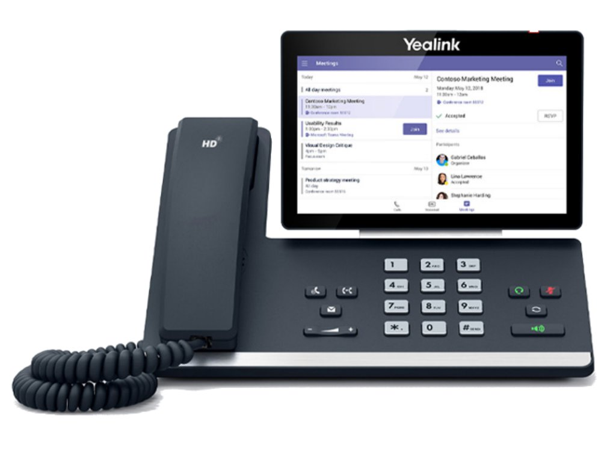
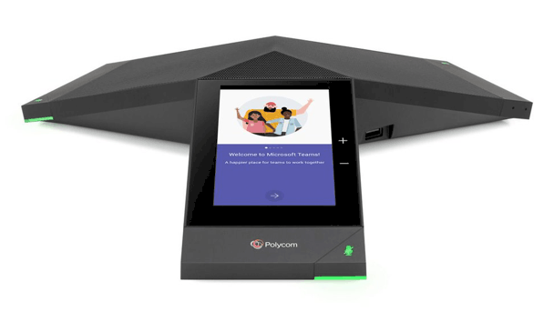
MS Teams User Interface (Cont’d)
IP Desk Phones

Slide 14
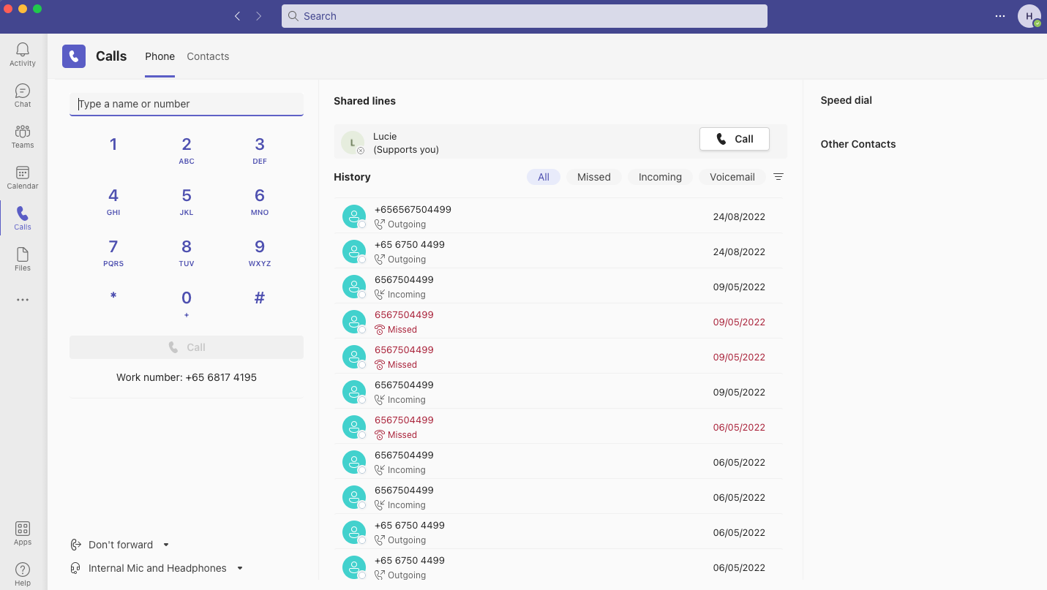
MS Teams User Interface (Cont’d)
Click on ‘Calls’ icon to access this calling screen
Your business phone number will be displayed here
You will be able to use this dial pad to make PSTN calls or you can also click on ‘Call contact’ on your user contacts​

Slide 15
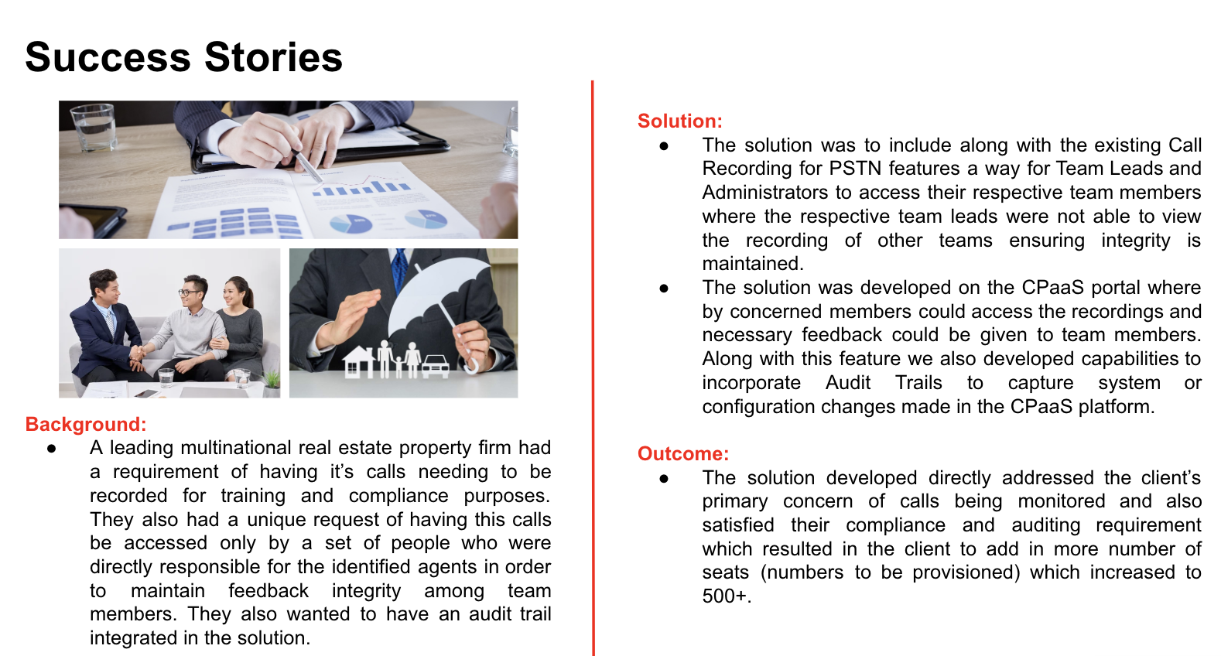
Background:
A leading multinational real estate property firm had a requirement for recording their calls for training and compliance purposes. They also wanted to customize this feature and wanted only those people to have access to these calls who are directly responsible for the identified agents in order to maintain feedback integrity among team members. They also wanted to have an audit trail integrated in the solution.

Slide 16
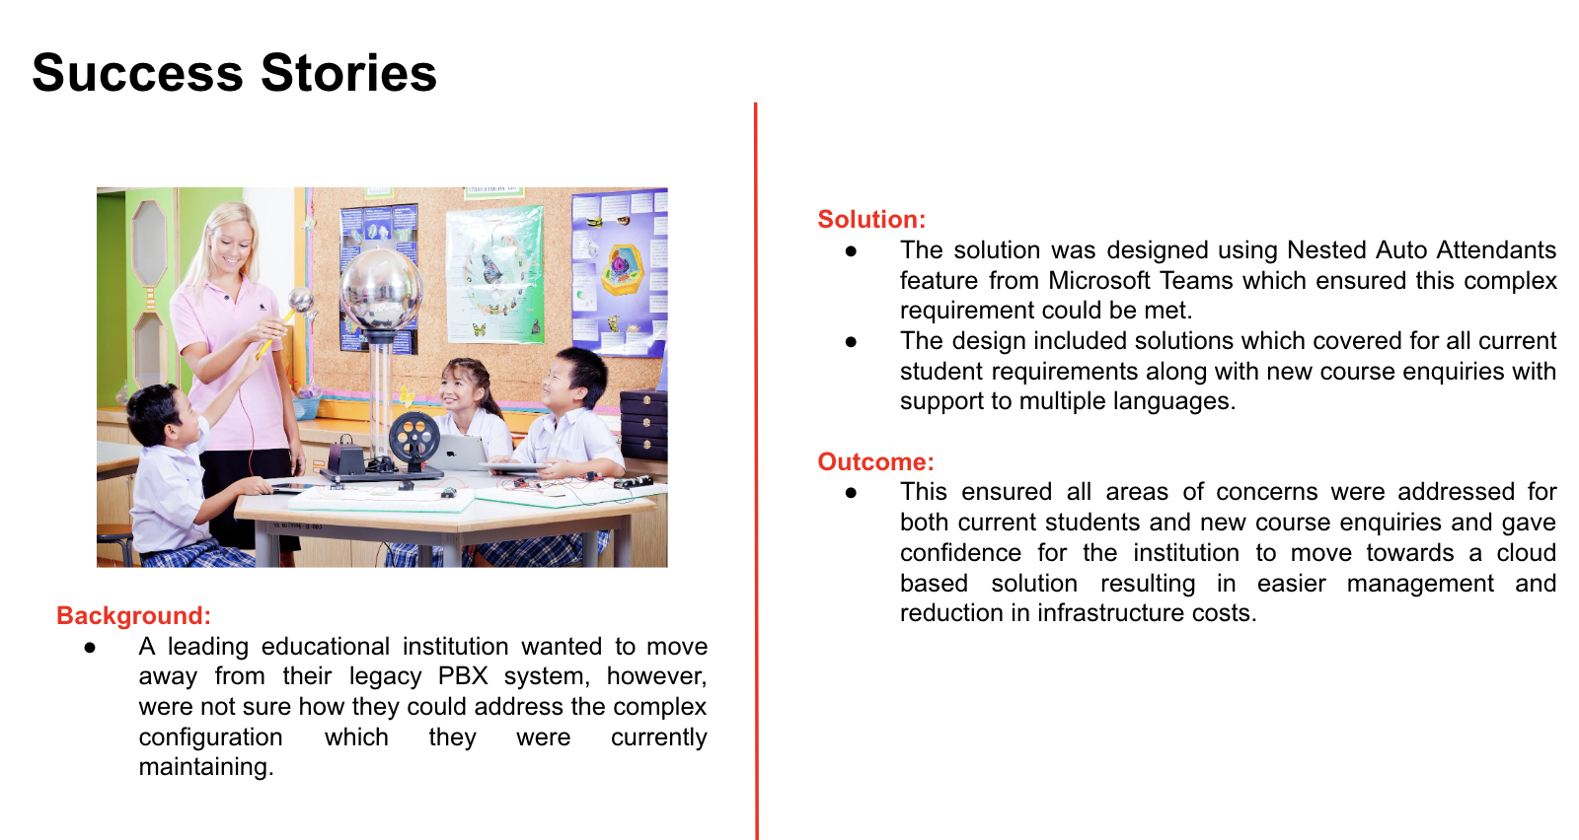

Slide 17
Success Stories
Customer Requirements
Authentication & Access in the CPaaS platform needs to be centralized with clear defined roles.
Have an Audit trail in the CPaaS platform which highlights changes made. (pending)
Call Recording
  Have an additional role created to manage and administer this feature to meet business needs. (pending)
  Restrict any end-user changes to enable/disable at end user level and retain this feature only at Admin level.
  Meet business Compliance requirements by announcing Call Recording message to the caller before recording the conversation.
Client needed to dial using Extension as used in the legacy systems (internal calling in Operator Connect)
Ability to call Satellite Services from ships or remote locations
Solutions & Results
The Solution resulted in the Owner to have Super-Admin access to CPaaS portal from where 2FA authorization & access was centralized and managed resulting in more control.
More control was provided to the Call Recording feature in CPaaS to the Admin by restricting configuration changes at user level to ensure all calls get monitored and recorded and this meeting internal compliance requirements.
Solution provided ensured that the caller is informed that the call is recorded by providing a prompt at the beginning of the call against where the person who was taking the call only had received this message earlier.
Solutioning resolved by accommodating a legacy feature of transferring/forwarding calls internally within the organization.
Solution ensured Business Connectivity is maintained for vessels in high seas by providing connectivity to Satellite services.

Slide 18
Success Stories
B3Networks CPaaS
Microsoft Certified SBC Setup has primary and secondary SBC on 1 single virtual IP on AWS Zone A and Zone B.
B3Networks CPaaS is connected to B3Networks West and Kim Chuan 1 Data Centers for connecting to the PSTN Calls
Customer Premise & Microsoft Cloud
Customer MS Teams Users
AWS Singapore Zone A & Zone B
Microsoft Certified SBC 1 & 2
Microsoft Teams
Azure Singapore
Singtel West DC
Singtel Kim Chuan 1 DC

