Slide 1
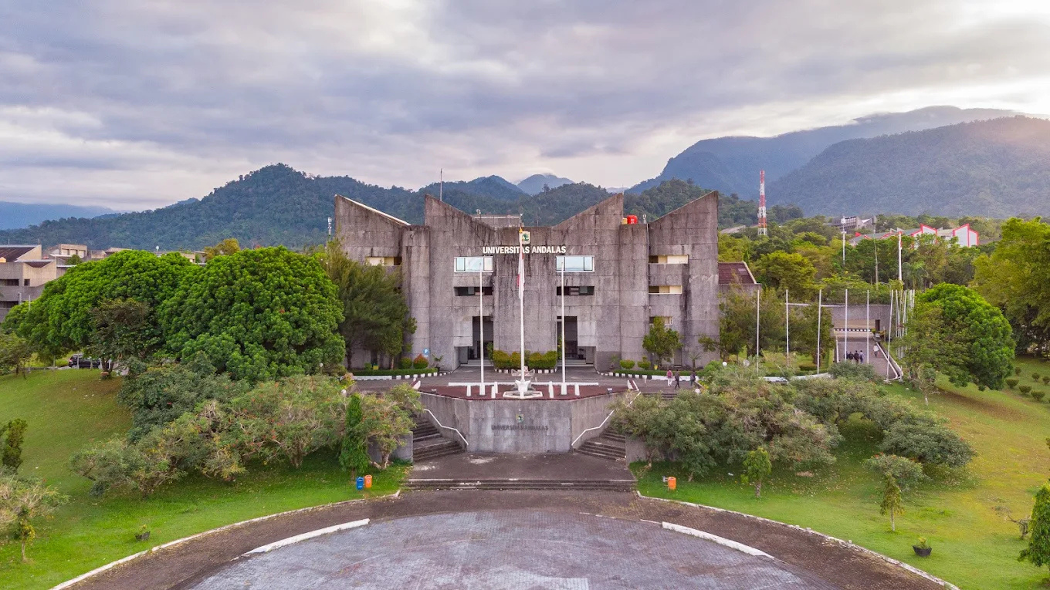










Presented by:
#Name of Presenter
The 5th ICDM 2026
29 - 30 SEPTEMBER 2026
Convention Hall, Universitas Andalas, Indonesia
Article Title
#Names of all authors
#Affiliation

Slide 2
Text
Text

Slide 3
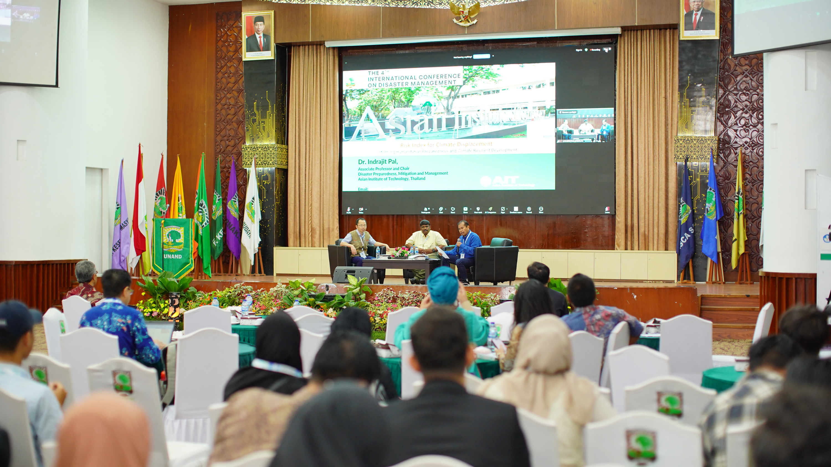

Thank You!
Contact Us
  icdm_icdmm@unand.ac.id
  icdm@unand.ac.id

