Slide 1


Public Health Research Methods: Research Study Designs in Injury & Violence Prevention
Johns Hopkins Center for Injury Research and Policy Diné College

Slide 2
How this lecture fits into the course
This lecture builds on a Research Methods course by providing an introduction to Injury Prevention as a Public Health discipline and giving specific examples of research study designs used in injury and violence prevention studies.

Slide 3
Part 1: Learning Objectives
In this lecture you will learn an introduction to injury prevention:
Describe injury using the medicine wheel public health model and distinguish intentional from unintentional injuries.
Identify key injury risk and protective factors in American Indian and Alaska Native communities.
Explain how Indigenous and Western approaches can support culturally grounded injury prevention and evaluation.
Notes:
Define injury and/or violence and describe the concepts of intentionality and mechanism as they relate to injury and/or violence.
Describe how injury and/or violence compare with other leading causes of morbidity and mortality and with regard to burdens on the population (e.g. incidence, cost, years of potential life lost, etc.)
Explain how injuries and/or violence are preventable.
Describe the disparity in the risks of injury and/or violence (e.g. differences by age, gender, race, ethnicity, education, location, access to economic resources, access to health care services, sexual orientation, creed, community norms, and the environment).
Describe the influence of a variety of factors (including age, gender, race, ethnicity, education, access to economic resources, sexual orientation, creed, community norms, access to health care services, and the environment) on injury and/or violence prevention.

Slide 4
What do you see in your surroundings right now that represents your interest in public health?
Notes:
Picture Posting or Word description Activity: The slide has the following question written out: “What do you see in your surroundings right now that represents your interest in public health?” Ask the students to either post a picture or write out a description in the chat. They are invited to describe why, if they choose, but they can leave the reason up to our imaginations, too. This activity will provide you with connection and interaction with the students. We encourage that you post a picture.

Slide 5

Part 1: Injury 101
Play Recorded Lecture

Slide 6
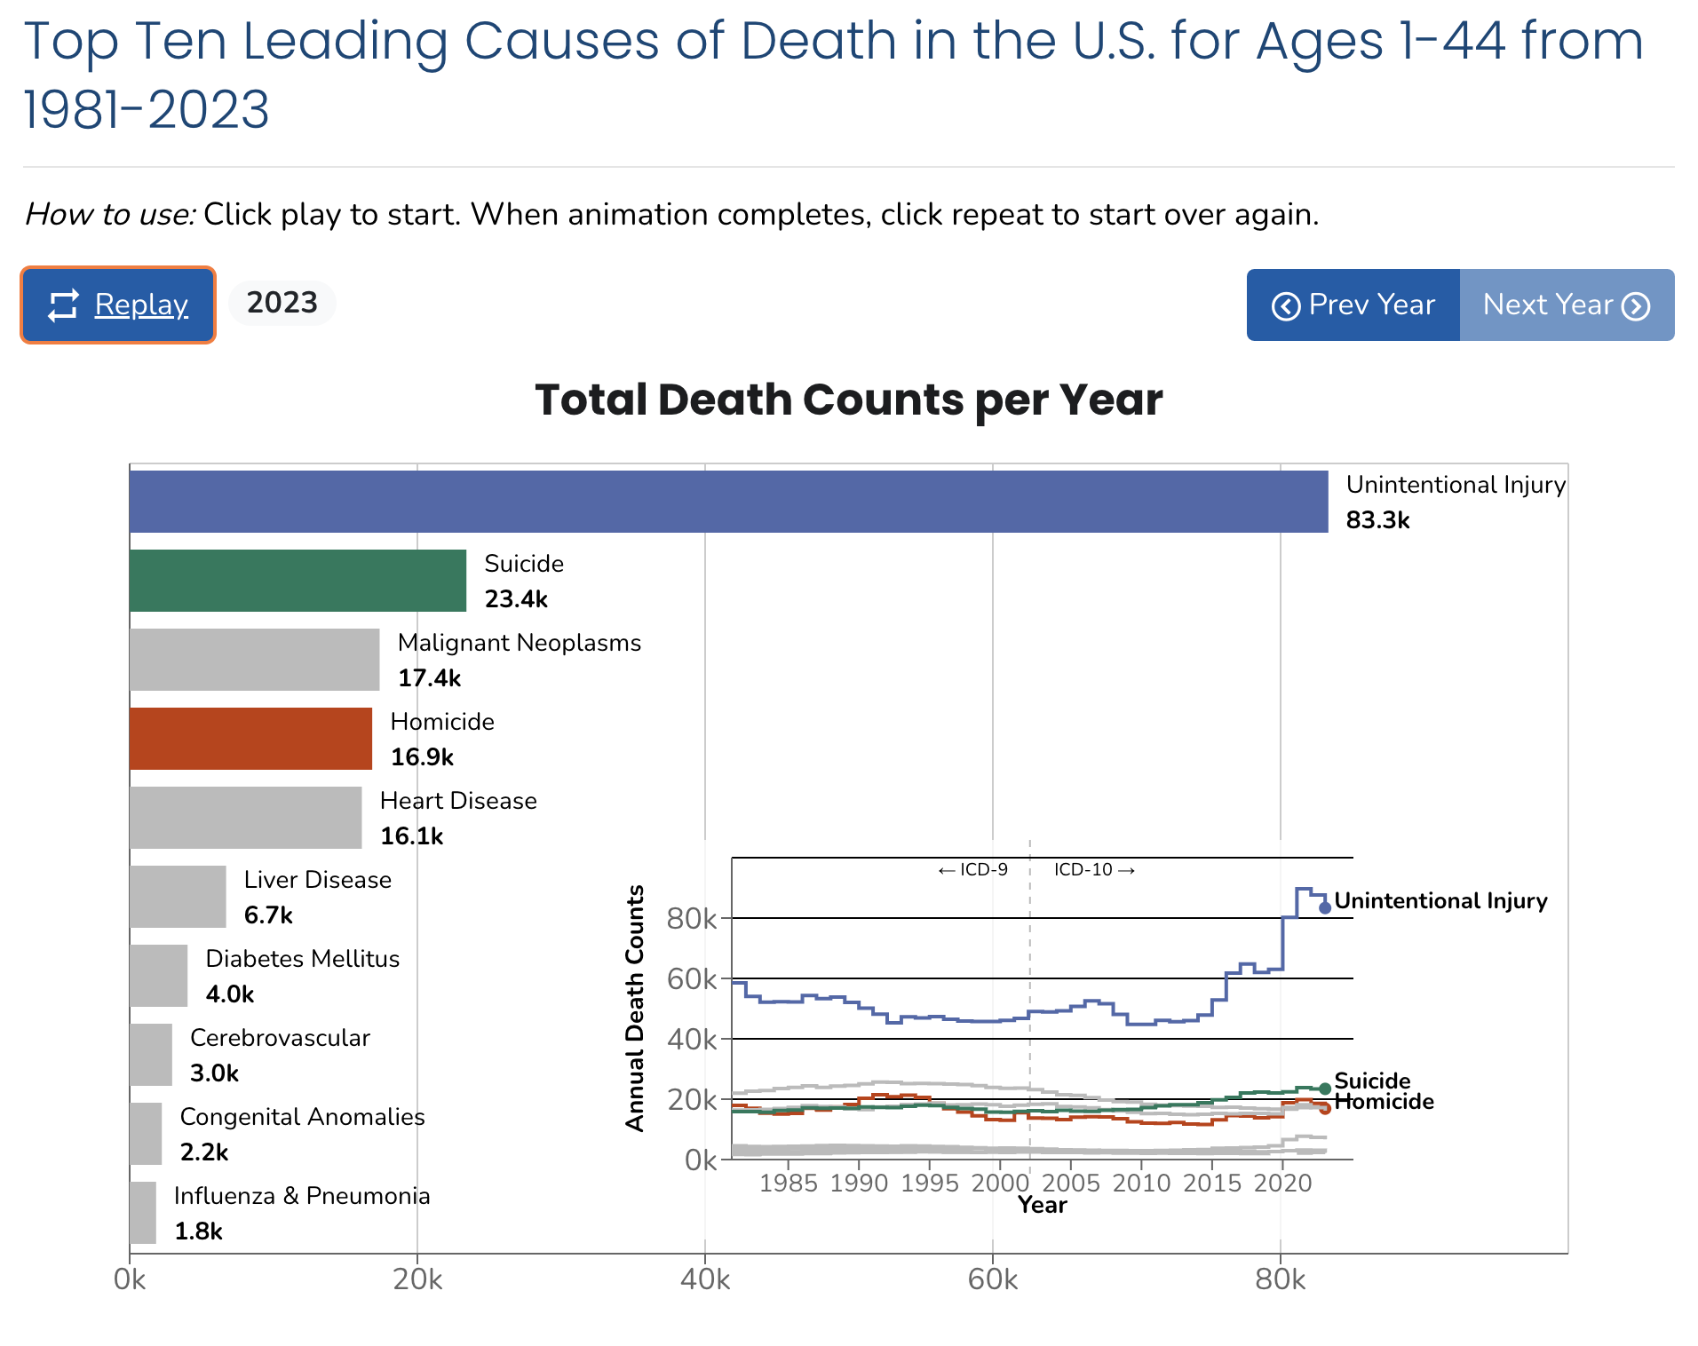
Link to animation:
https://wisqars.cdc.gov/animated-leading-causes/
Notes:
Optional activity if there is time. Description in Facilitator Guide.

Slide 7
Part 2: Research Study Designs in Injury and Violence Prevention Learning Objectives
After this lecture, you will be able to:
Describe how the following research study design types can be implemented in injury and violence prevention studies:
  case-control
  cohort
  qualitative

Slide 8
Part 2: Research Study Designs in Injury and Violence Prevention
Play Recorded Lecture
(youtube link)

Slide 9
DISCUSSION QUESTIONS
What caught your attention in today’s lesson?
How do the research study designs described today compare to what you are learning in class?
What research design would you use to address an injury issue in your community?
Notes:
If the class will be going into different break out rooms, post the questions in the chat before initiating the breakout rooms. Inform the facilitators the time allowed and if there will be a person to give a summary of the small group discussion.

