Slide 1
Project AIM: Assess, Improve & Maintain Effective Teaching Practices
Teri Lewis, Oregon State University
R. Kenton Denny, Louisiana State University

Slide 2
Purpose
Apply a three-tiered prevention model (e.g., PBIS, RtI) to assessing and intervening with classroom teachers
Develop a reliable and valid gated assessment of effective classroom management and instructional practices
Gate 1 – Screener
Gate 2 – Diagnostic
Gate 3 – Continuous monitoring?

Slide 3
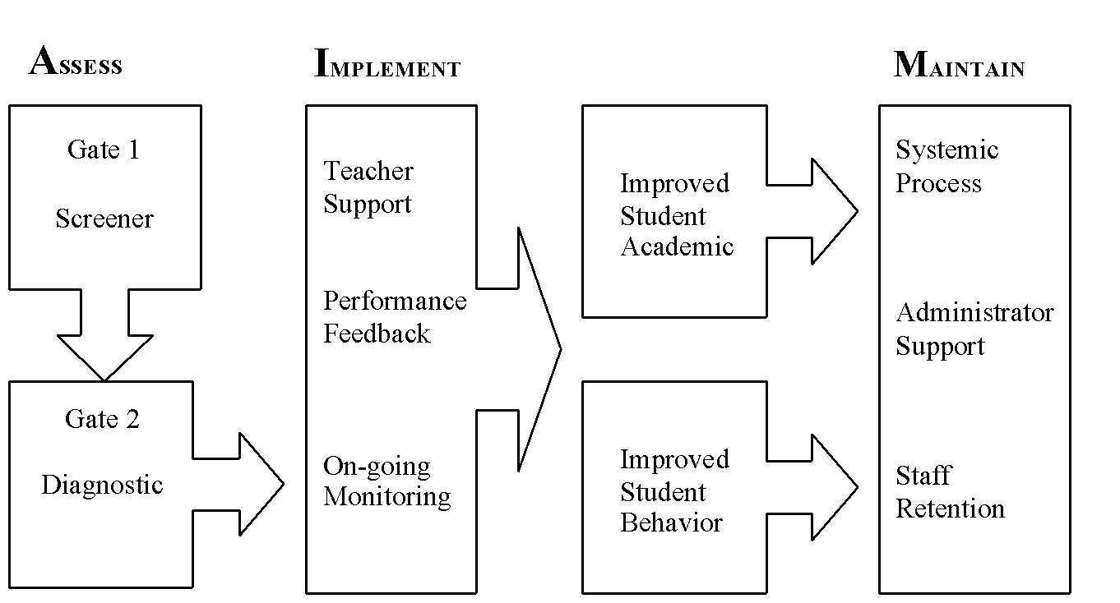
Conceptual Model

Slide 4
?
Not currently part of grant. Add?
Diagnostic
Diagnostic assessment of at-risk classrooms
Screener
Efficient screener in fall
- CAR (same logic as ORF)

Slide 5
Assessment Domains
Instructional Practices | Academic practices while presenting curriculum, responding to students correct and incorrect responses
Management Practices | Environmental arrangement, encouraging and reinforcing socially acceptable behavior of groups and individuals
Student-Teacher Interactions | Type, quality and distribution of academic and social interactions between the teacher and groups and individual students
Non-verbal Interactions | Measures of climate, warmth and overall perception of the teacher, student-teacher relationships and classroom environment

Slide 6
Effective Teaching Domains
Instructional Practices | Management Practices | Student-Teacher Interactions | Nonverbal Interactions
Opportunities to Respond Correct Academic Responding Error Correction Feedback | Reinforcement Reprimands Action getting signal Active Supervision | Active Engagement Compliance to Request Distribution of Teacher Attention | Psychological immediacy Rapport Climate Non-dogmatic Behaviors

Slide 7
Non-Verbal Interactions | Definition
Psychological Immediacy | Interpersonal warm and positive regard that a teacher can communicate to a student or class, both verbally and nonverbally
Rapport | Quality of human interaction where there exists mutual attention, high degrees of positive affect, and interpersonal coordination
Climate | Closeness and comfort individuals feel when they are with each other. It is characterized by and operationalized as high amounts of eye-contact, nonverbal proximity
Non-dogmatic Behaviors | Style of teaching that others perceive as warm, flexible, and democratic

Slide 8
Design Questions
What is a reasonable number of sites?
Schools
Classrooms within schools
Content area within and across teachers
Grade level(s) (4th – standardized assessment)
Representative Sample (i.e., diversity)
Urban/suburban/rural
SES (Free/reduced lunch/title)
Ethnicity/race
Educational Status
School and Classroom Size

Slide 9
Stability of Observations
Need for multiple observations to rely on conditional probabilities
Number of observations per classrooms
Distribution across academic year
Content (reading only, reading & math, ???)
Predictive Validity
What achievement scores should we use?
Standardized (state) or DIBELS, …
Treatment of outliers?
How should multiple data sources be treated?

