Slide 1

GRADE 5
Distance Learning Guide
Our recommendations for adapting Mystery Science lessons for socially distant classrooms and online distance learning.
We’ve assigned each lesson one of these labels:
Ready to Teach
These lessons have activities that only need minor modifications to eliminate partner work or shared supplies. For these activities, you can have students work solo without preparing extra supplies.
Adjust Supplies
Jump to a section:
Web of Life
6 lessons
Watery Planet
5 lessons
Spaceship Earth
8 lessons
Chemical Magic
5 lessons
Guide FAQs
Using Your Mystery Pack
These lessons also have activities that need small changes so students can work solo, but you’ll need to adjust the supply quantities. We suggest how to adjust the supplies.
Demo Activity
These lessons have activities that require coordinated partner work or messy materials, so we recommend demonstrating the activity for students. Students can make detailed observations.
Substitute Activity
These lessons have activities that require specialized materials or adult help. We suggest an alternative activity to do instead.
1

Slide 2

GRADE 5
UNIT Web of Life
View this unit here. | Teaching in the classroom | Teaching online
Lesson 1 Why would a hawk move to New York City? | Students need a partner to play the Eat or Be Eaten game, but you can try a modification where they make the longest food chains on their own. Look at the supply list and print 4x the number of Eat or Be Eaten Cards listed. You do not need to print the Rules of the Game. | Have students do the activity at home. Send each student home with the Eat or Be Eaten Cards (a digital copy will not work). Each student also needs the Score Card (or assign the digital version).
Lesson 2 What do plants eat? | Set up the Weighing Air activity for the class to observe. Give each student the Weighing Air worksheet so they can record their observations. | Set up the Weighing Air activity and demo over video conference. Send each student home with the Weighing Air worksheet (or assign the digital version) so they can record their observations.
Lesson 3 Where do fallen leaves go? | Set up a control Mold Terrarium and have students vote on a few variables to test. Set up a few other Mold Terrariums with those variables changed. Give each student the Mold Terrarium worksheet to record their observations. | Set up the activity with several Mold Terrariums and demo over video conference. Send each student home with the Mold Terrarium worksheet (or assign the digital version) to record their observations.
Lesson 4 Do worms really eat dirt? | Have students watch this sped up video of worms at work. Ask students to follow the instructions on the screen and answer the questions. | Have students watch this sped up video of worms at work. Ask students to follow the instructions on the screen and answer the questions.
Adjust Supplies
Demo Activity
Demo Activity
Substitute Activity
2

Slide 3
GRADE 5
UNIT Web of Life
View this unit here. | Teaching in the classroom | Teaching online
Lesson 5 Why do you have to clean a fish tank but not a pond? | Watch what’s happening below the water’s surface in this underwater video observation. Discuss the questions. Students will draw a pond and label organisms with their roles in the ecosystem. | Watch what’s happening below the water’s surface in this underwater video observation. Discuss the questions. Students will draw a pond and label organisms with their roles in the ecosystem.
Lesson 6 Why did the dinosaurs go extinct? | Have students do the activity solo. You will need 2x as much construction paper as the supply list indicates. Print 2x as many copies of the Dino Die-Off Cards so that each student has a set. | Send each student home with a set of the printed Dino Die-Off Cards, 35 strips of colored construction paper and 20 strips of black construction paper. Each student also needs the Dinosaur Food Web worksheet (or assign the digital version).
Substitute Activity
Adjust Supplies
3

Slide 4
GRADE 5
UNIT Watery Planet
View this unit here. | Teaching in the classroom | Teaching online
Lesson 1 How much water is in the world? | Give each student one part of the World Map. Instead of having students add stickers to the graph, we suggest you add the stickers to the class bar graph. | Send each student home with one part of the World Map (or assign the digital version). If you can meet with your class virtually, students can work together with you to create a class bar graph (with you putting stickers on the graph).
Lesson 2 How much salt is in the ocean? | Prepare the Tiny Ocean model for the entire class to observe. Give each student the Tiny Ocean worksheet so they can record their ideas and observations. | Prepare the Tiny Ocean model and demo over video conference. Send each student home with the Tiny Ocean worksheet (or assign the digital version) so they can record their ideas and observations.
Lesson 3 When you turn on the faucet, where does the water come from? | Print 4x as many copies of the Mapmaker’s Map, Plant & Soil Clues and Wanted A Well printouts. The activity is more fun in a group so we suggest supplying each student with their own printouts and collaborating in a group while maintaining distance. | Send each student home with a copy of the Mapmaker’s Map, Plant & Soil Clues and Wanted A Well printouts (or assign the digital versions). The activity is more fun if students can collaborate virtually.
Ready to Teach
Demo Activity
Demo Activity
4

Slide 5
GRADE 5
UNIT Watery Planet
View this unit here. | Teaching in the classroom | Teaching online
Lesson 4 Can we make it rain? | Prepare the 4 experimental set-ups (see the Rainmaker Experiments worksheet) for the entire class to observe. Give each student the Rainmaker Experiments worksheet so they can record their ideas and observations. | Prepare the 4 experimental set-ups (see the Rainmaker Experiments worksheet) and demo over video conference. Send each student home with the Rainmaker Experiments worksheet (or assign the digital version) so they can record their ideas and observations.
Lesson 5 How can you save a town from a hurricane? | Do this activity as a class (instead of in small groups). There are 4 engineer types, so divide the class into 4 groups. Assign one engineer type to each group, and give them the worksheet for their engineer type. Then work as a class on the Beachtown Final Plan, utilizing the expertise of the different engineer types. | Do this activity as a class (instead of in small groups). There are 4 engineer types, so divide the class into 4 groups and assign one engineer type to each group. Provide groups with the worksheet for their engineer type. Then work as a class on the Beachtown Final Plan over video conference, utilizing the expertise of the different engineer types.
Demo Activity
Demo Activity
5

Slide 6
GRADE 5
UNIT Spaceship Earth
View this unit here. | Teaching in the classroom | Teaching online
Lesson 1 How fast does the Earth spin? | Have students do the activity solo. No supply adjustments. To maintain distance, have students stand farther apart and use a lamp in the classroom instead of the paper Sun model. The teacher can also stand in the middle of the room and be the “Sun model.” | Have students do the activity at home. Send each student home with 4 stickers and the Earth Map template (a digital version will not work). Have students use a lamp at home instead of the paper Sun model.
Lesson 2 Who set the first clock? | Have students do the activity solo. You will need 2x as many flashlights as the supply list indicates. | Have students do the activity at home. Send each student home with 1 paper plate, 1 toothpick, 1 bit of sticky tack and the Shadow Clock template (digital version will not work). Students can use a flashlight or lamp at home to model the Sun.
Lesson 3 How can the Sun tell you the season? | Have students do the activity solo. No supply adjustments. | Have students do the activity solo. No supplies needed.
Lesson 4 Why do the stars change with the seasons? | Have students do the activity solo. No supply adjustments. | Have students do the activity at home. Send each student home with 1 paper fastener, the Constellation Guide, and the Universe-In-A-Box template (a digital version will not work).
Ready to Teach
Adjust Supplies
Ready to Teach
Ready to Teach
6

Slide 7
GRADE 5
UNIT Spaceship Earth
View this unit here. | Teaching in the classroom | Teaching online
Lesson 5 Why does the Moon change shape? | You will need one Styrofoam ball per student. Instead of having students work in pairs with flashlights, they can work solo and use a bright lamp as the light source. This video illustrates how to run the activity using a bright lamp. | Send each student home with a 2” Styrofoam ball (or have them use another round object at home, like an orange). We suggest that students use a bright lamp instead of a flashlight as the light source. This video illustrates how to run the activity using a bright lamp.
Lesson 6 What are the wandering stars? | Have your students watch this 7-minute video about building a scale model of the Solar System. Consider having students create a chalk scale model of the Solar System in their neighborhood. | Have your students watch this 7-minute video about building a scale model of the Solar System. Consider having students create a chalk scale model of the Solar System in their neighborhood.
Lesson 7 Why is gravity different on other planets? | Students can do the activity solo, but they will need to do both roles of Jumper and Ruler. Either project the Planet and Moon Exploration Stations to the whole class or provide individual copies to students. | Students can do the activity at home. Send each student home with 3 Post-Its. Students also need the Gravity Graph, Gravity Jump Data, and the Planet & Moon Exploration Stations worksheets (or assign the digital versions).
Lesson 8 Could there be life on other planets? | Have students do the activity on their own. You will need 2x as many printouts as the supply list indicates. This activity works best if students can engage in discussion with one another (from a distance). | Send each student home with the printouts or assign the digital versions. This activity works best if students can engage in a virtual discussion.
Adjust Supplies
Substitute Activity
Adjust Supplies
Adjust Supplies
7

Slide 8
GRADE 5
UNIT Chemical Magic
View this unit here. | Teaching in the classroom | Teaching online
Lesson 1 Are magic potions real? | Set up the 4 testing liquids and have your students make observations as you demo the activity. Provide each student with a copy of the Alchemist’s Potion, Part 1 worksheet so they can record their observations. | Set up the 4 testing liquids and demo the activity over video conference. Send each student home with a copy of the Alchemist’s Potion, Part 1 worksheet (or assign a digital version) so they can record their observations.
Lesson 2 Could you transform something worthless into gold? | Note: This activity requires that students have already completed the activity in Lesson 1. Set up a bag with: the pennies, the salt and vinegar liquid and a nail. Demo the activity. Give each student an Alchemist’s Potion, Part 2 worksheet to record their observations. | Set up a bag with: the pennies, the salt and vinegar liquid and a nail. Demo the activity over video conference. Send home the Alchemist’s Potion, Part 2 worksheet (or assign a digital version) to record their observations.
Lesson 3 What would happen if you drank a glass of acid? | Set up the activity and go through each step of the activity together. Give each student a copy of the Results worksheet so students can record their observations. | Set up the activity and go through each step of the activity together over video conference. Send home the Results worksheet (or assign a digital version) so students can record their observations.
Lesson 4 What do fireworks, rubber and Silly Putty have in common? | Do Part 1 of the activity (Steps 1 - 11) as a demo. Give each student the Goo Testing worksheet to record their observations. Students can do Part 2 of the activity solo. In Step 14, each student will need to hold the bag open and pour the substances in on their own. | Set up Part 1 of the activity as a demo and go through Steps 1 - 11 over video conference. Provide each student with the Goo Testing worksheet (or assign a digital version) so they can record their observations.
Demo Activity
Demo Activity
Demo Activity
Demo Activity
8

Slide 9
GRADE 5
UNIT Chemical Magic
View this unit here. | Teaching in the classroom | Teaching online
Lesson 5 Why do some things explode? | Set up the first part of the activity and have students make observations as you go through Step 1 - 13 together. Give each student the Capturing Chaos worksheet so they can record their observations. | Set up the first part of the activity and have students make observations as you go through Step 1 - 13 over video conference. Give each student the Capturing Chaos worksheet (or assign the digital version).
Demo Activity
9

Slide 10
GRADE 5
Guide FAQs
Additional recommendations for using this guide to adapt Mystery Science for socially distant classrooms and online distance learning.
Where should I start?
Spaceship Earth is the easiest Grade 5 unit to adapt for distance learning, so we recommend starting with that unit.
What does it mean when the guide says students can work “solo”?
Our lessons are designed to get students talking and working together, but group work and sharing supplies is not advised at present. So, when we mention students working “solo,” we mean that students can work independently at home or in the classroom, without partners or sharing supplies.
Where can I find all of the printouts for the Grade 5 units?
To easily make packets of printouts for students, you can find all the printouts for each grade level here.
What if I skip some of the lessons in a unit?
If you omit lessons, we recommend reviewing the Grade 5 Planning Guide to see the concepts and standards covered in those lessons.
Will students need any additional supplies for the activities?
This guide lists the specialized supplies students need for each activity, but general classroom supplies (such as pencils, scissors, crayons, markers, and rulers) are not listed. We suggest checking the lesson supply lists to know which general supplies students will need.
10

Slide 11
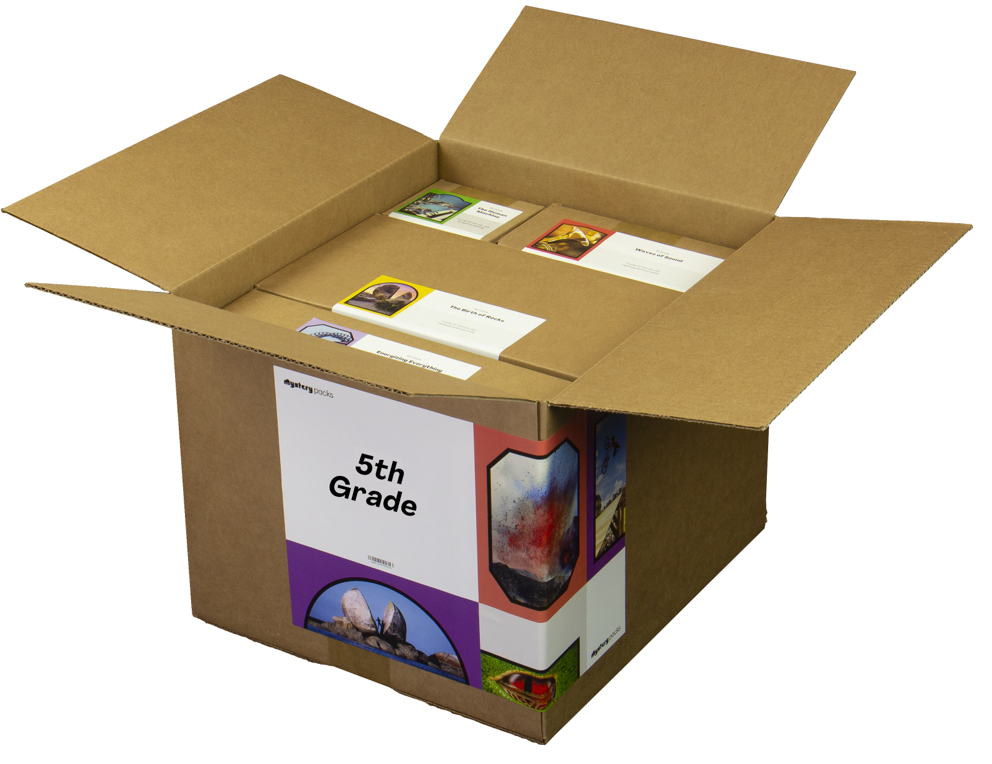
GRADE 5
Using Your Mystery Pack
Mystery Packs are supply kits that contain all the materials needed to teach Mystery Science for the entire year. Each box contains supplies for a class of 30 students.
Does my Mystery Pack contain enough supplies to send home?
For activities labeled Ready to Teach, there are enough supplies in your box for each student to have their own materials. For activities labeled Adjust Supplies, you’ll need some extra materials so that students can work on their own without sharing supplies.
What if I can’t send supplies home to students?
If students don’t have access to supplies, you can turn some activities into demonstrations and share via video conference. Students can participate by recording their observations.
What if I don’t use all of my supplies this year?
Don’t worry! You can still use your Mystery Pack next school year. You’ll just need to refill any supplies that you do use this year.
I don’t have a Mystery Pack. Can I still order one?
Yes! Packs are still available for purchase. You can learn more about Mystery Packs and how to get them here.
11

