Slide 1
How to take care of monthly money
This session is aimed at Key Stage Three (recommended for Year 7)

Slide 2
Unit outline
Session 1 | Session 2 | Session 3 | Session 4 | Session 5 | Session 6
Spending decisions | Budgeting | Getting a job | The impact of inflation | The critical consumer | Budgeting for a holiday

Slide 3
Having a respectful learning environment
We will listen to each other respectfully
We will avoid making judgements or assumptions about others
We will comment on what has been said, not the person who has said it
We won’t put anyone on the spot and we have the right to pass
We will not share personal stories or ask personal questions
If there is a question that you do not wish to ask aloud, you can write it on a Post-it Note which will be collected throughout the session and answered at the end
Notes:
Teacher delivery
Students should be invited to ask questions and they should be provided with an opportunity to ask questions anonymously. It is useful to have a question box or allocated space on the whiteboard for students to share questions.
It is suggested that students are provided with post-its or slips to write their questions on and as the teacher circulates throughout the lesson these questions can be collected and answers throughout the session or using an allocated ‘question time’ at the end of the session.
Students can be invited to respond to questions asked by their peers. If responses to questions are based on personal preference or opinion, the teacher should be clear to preface any answers with this.

Slide 4
Session 2:
Budgeting

Slide 5
By the end of the session, I will be able to:
Describe what a budget is and why it is important
Analyse budgets, looking at income and expenses
Set budgeting goals and ways to plan for the future

Slide 6
Starter | Needs vs Wants
Recap. Draw a Venn diagram and put the items below into the different categories. Which overlap?
Smart phone
Paying housing rent
Home heating
New pair of trainers
Stationary (pens, ruler, pencils)
Laptop
Holiday abroad
Cracked screen repair
Electricity bills
Netflix subscription
Needs
Wants
Home heating
Holiday abroad
Notes:
Teacher explanation
While some items might fit clearly into the needs and wants categories, others might sit in the middle of the Venn diagram. Needs and wants may also be different for different people based on their circumstances and values; what people consider to be needs and wants may also change over time depending on their circumstances, jobs and priorities.

Slide 7

Budgeting
Think - Pair - Share
I would love to go to the cinema with my sister. However, I’ve now factored in the bus price and the fact that I need to buy my best friend a birthday present, and I don’t have enough money in my budget.
What is a budget?
Why would Charlie budget?
How do people budget?
Charlie
Notes:
Delivery instruction
Suggested to allow 2 mins.

Slide 8
Budgeting
What is a budget?
A way of planning finances, taking into account income and expenses.
Why budget?
A person can feel more in control over their money
Understand spending better and where to cutback if needed
Allows us to save for the future
Provides financial security and safety
Can increase confidence and improve wellbeing
Notes:
Teacher explanation
What is a budget?
Budgeting is a way of planning your finances to ensure that you have enough money to purchase items you want. It’s a way of tracking money coming in and money going out.
Why budget?
There are numerous reasons for people to budget. Others may be mentioned that aren’t listed on the slide. This question may also bring up sensitivities so depersonalisation is key in the discussion.

Slide 9
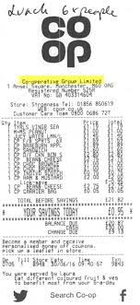
How do people budget?
There are 2 main things to consider when it comes to budgeting:
Income - how much money is available every month
Expenditures - payments that need to be made throughout the month. Some of these may be regular, others will vary
Then people can see how much left there is to spend on other needs and additional wants, taking into account money they will want to save for the future.
Receipts can a be useful way of tracking spending

Slide 10
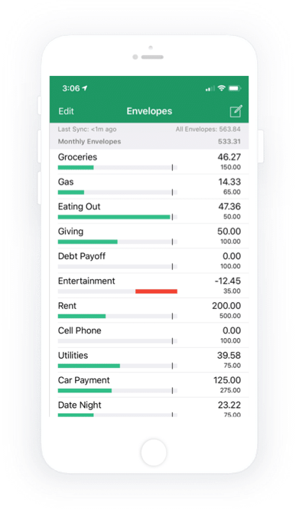
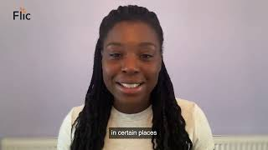
Digital budgeting tools
How might apps be able to help people with budgeting?
Watch the video explaining how digital budgeting tools can be used:
Write down 3 things digital apps allow you to do
Video: Digital Budgeting Tools
Terms to consider:
spending - saving - goal - awareness - categories - managing money - apps
Notes:
Teacher explanation
Different factors students may identify from the video:
Set up an emergency savings pot or holiday money. An emergency fund should enable someone to plan for 3 months of unexpected expenses, e.g. the the boiler breaks, unemployment, unforeseen medical expenses
Track how much money you’re really spending. This enables a person to make changes to their spending habits when they need to.
Set spending limits to help reach long term spending goals, and have money left to save or invest.
Set alerts for different categories of spending

Slide 11
Budgeting - Over to you!
I would love to go to the cinema with my sister. However, I’ve now factored in the bus price and the fact that I need to buy my best friend a birthday present, and I don’t have enough money in my budget.
Can you summarise why it’s important for Charlie to budget? (2-3 sentences)
Stretch: What can Charlie do to save money?
Charlie
Notes:
Delivery instruction
Students use learning to respond to these questions in their books.

Slide 12
By the end of the session, I will be able to:
Describe what a budget is and why it is important
Analyse budgets, looking at income and expenses
Set budgeting goals and ways to plan for the future
Notes:
Delivery instruction
Ask students to share via a show of hands how confident they feel with the learning objectives from 1-10. This can help guide the pace of lesson.

Slide 13


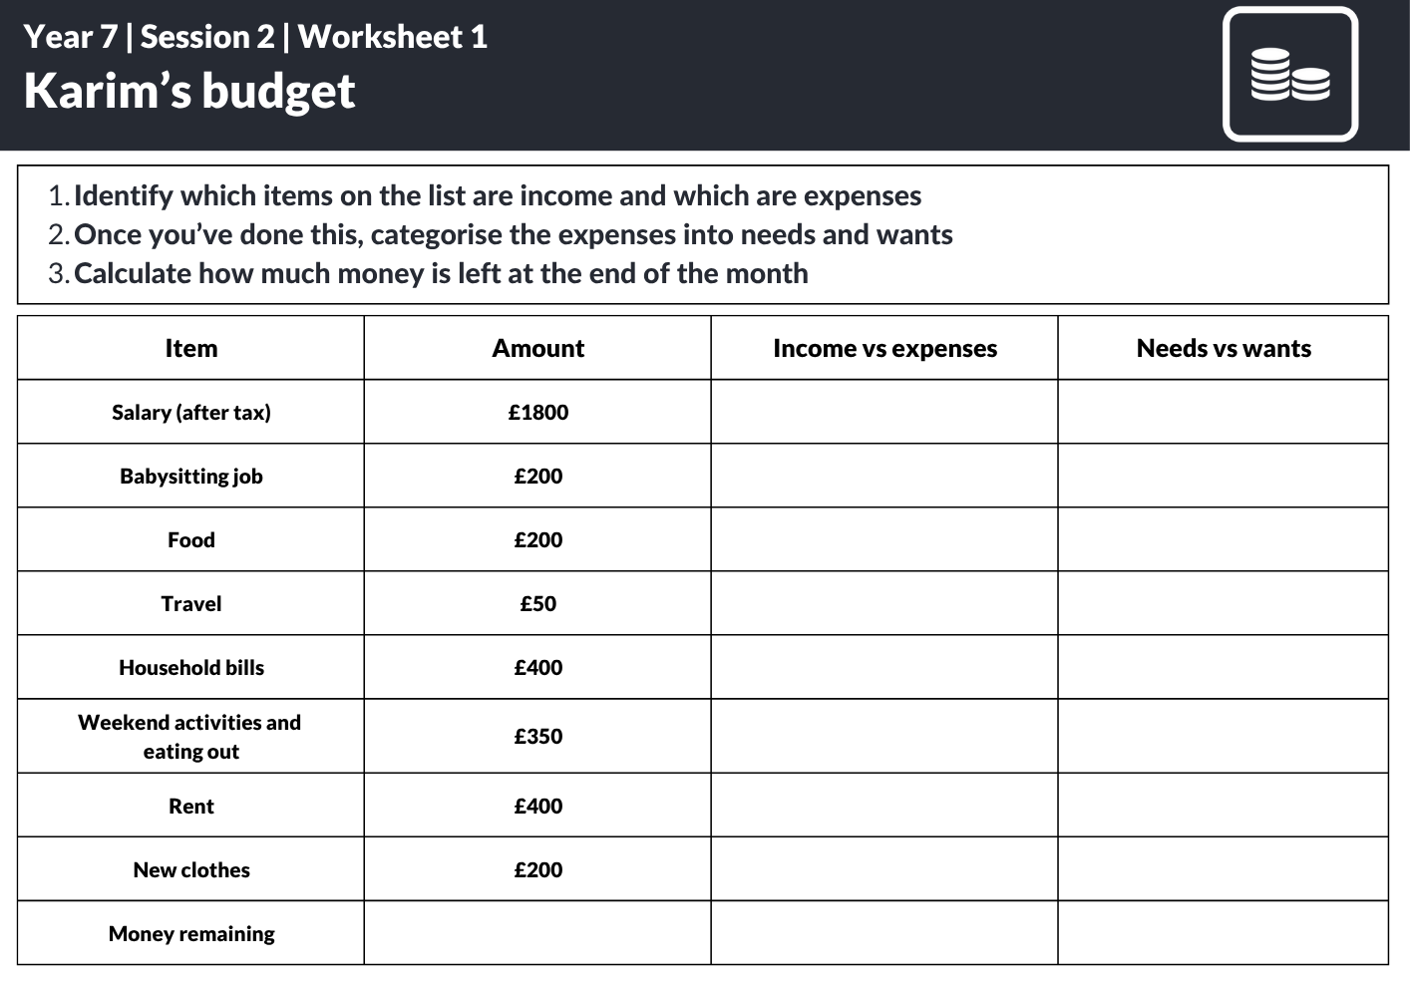
Karim’s budget
Meet Karim
Karim works part time and has put together a list of his income and expenses.
He now needs your help to work out whether his budget balances.

Slide 14


Karim’s budget
This is Karim’s income and spending for the month.
Item | Amount
Salary (after tax) | £1800
Babysitting job | £200
Food | £150
Travel | £50
Household bills | £400
Weekend activities and eating out | £300
Rent | £600
New clothes | £150
Money remaining
Meet Karim
Karim has put together a list of his income and expenses. He now needs your help to work out whether his budget balances.
Firstly, what do you think we mean by a balanced budget?
Resource 1: Karim’s budget worked example

Slide 15
Karim’s budget
This is Karim’s income and spending for the month.
Item | Amount
Salary (after tax) | £1800
Babysitting job | £200
Food | £150
Travel | £50
Household bills | £400
Weekend activities and eating out | £300
Rent | £600
New clothes | £150
Money remaining
Meet Karim
Karim has put together a list of his income and expenses. He now needs your help to work out whether his budget balances.
A balanced budget is when income (money coming in) is greater than expenses (money going out), with some extra money left over for savings.
Resource 1: Karim’s budget worked example

Slide 16
Karim’s budget
This is Karim’s income and spending for the month.
Item | Amount
Salary (after tax) | £1800
Babysitting job | £200
Food | £150
Travel | £50
Household bills | £400
Weekend activities and eating out | £300
Rent | £600
New clothes | £150
Money remaining
ACTIVITY
Identify which items on the list are income and which are expenses
Once you’ve done this, categorise the expenses into needs and wants
Calculate how much money is left at the end of the month
Resource 1: Karim’s budget worked example
Notes:
Delivery instruction
Ask students to answer question 1 and then ask for feedback. They can do this by completing column 3 in their print out worksheet. There is also the option for students to copy the table into their books and circle income and expenses in different colours.

Slide 17
Karim’s budget
This is Karim’s income and spending for the month.
ACTIVITY
Item | Amount
Salary (after tax) | £1800
Babysitting job | £200
Food | £150
Travel | £50
Household bills | £400
Weekend activities and eating out | £300
Rent | £600
New clothes | £150
Money remaining
Identify which items on the list are income and which are expenses
Once you’ve done this, categorise the expenses into needs and wants
Calculate how much money is left at the end of the month
Salary → income
Babysitting job → income
Food → expenditure
Travel → expenditure
Electricity bills → expenditure
Weekend activities → expenditure
Rent → expenditure
New clothes → expenditure
Resource 1: Karim’s budget worked example
Notes:
Delivery instruction
Self assessment - Ask students to answer question 1 and then ask for feedback. They can do this by completing column 3 in their print out worksheet. There is also the option for students to copy the table into their books and circle income and expenses in different colours.

Slide 18
Karim’s budget
This is Karim’s income and spending for the month.
ACTIVITY
Item | Amount
Salary (after tax) | £1800
Babysitting job | £200
Food | £150
Travel | £50
Household bills | £400
Weekend activities and eating out | £300
Rent | £600
New clothes | £150
Money remaining
Refer to the list of items on the worksheet and identify which items are income and which are expenses
Once you’ve done this, categorise the expenses into needs and wants
Calculate how much money is left at the end of the month
Salary → income
Babysitting job → income
Food → expenditure → needs
Travel → expenditure → needs
Electricity bills → expenditure → needs
Weekend activities → expenditure → wants
Rent → expenditure → needs
New clothes → expenditure → wants
Were yours categorised differently?
If so, what is your thinking?
Resource 1: Karim’s budget worked example
Notes:
Delivery instruction
Ask students to answer question 2 and then ask for feedback. Students can do this by completing column 4 in their print out worksheet. There is also the option for students to copy the table into their books and label needs and wants with arrows.
Teacher explanation
Discuss with students that not all of these needs and wants are clear cut. For example, new clothes may be considered a need if old school uniform doesn’t fit anymore. However, prompt questions could include ‘What are alternatives to buying brand new items? What different ways are there of getting the best deals and reducing expenses? Do people always want to get the cheapest price?”

Slide 19
Karim’s budget
This is Karim’s income and spending for the month.
ACTIVITY
Item | Amount
Salary (after tax) | £1800
Babysitting job | £200
Food | £150
Travel | £50
Household bills | £400
Weekend activities and eating out | £300
Rent | £600
New clothes | £150
Money remaining | £400
Refer to the list of items on the worksheet and identify which items are income and which are expenses
Once you’ve done this, categorise the expenses into needs and wants
Calculate how much money is left at the end of the month
= Total income - Total expenditures
= (£1800+£200) - (£150+£50+£400+£300+£600+£150)
= £2000 - £1650
= £350
Total money
remaining
Resource 1: Karim’s budget worked example

Slide 20
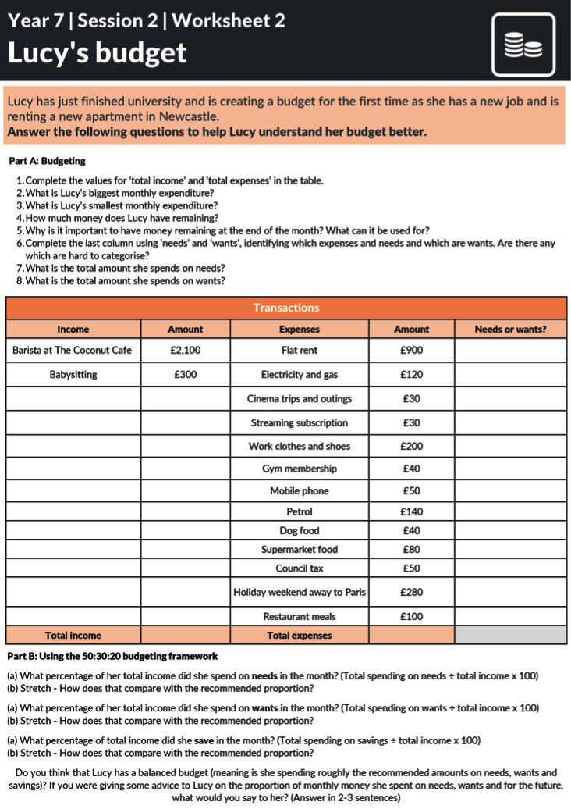

Budgeting deep dive: Lucy’s budget
Read through Part A and answer the questions on your worksheet 5 mins)
As you are working through, write down any questions you have and put them in the classroom anonymous box.
Stretch - are some items more difficult to categorise into needs and wants than others? If so, why?
Resource 2: Lucy’s Budget
Notes:
Delivery instruction
It’s important that students have an opportunity to answer Part A of the worksheet. If students need more time than allocated to do this, that’s fine and Part B can used as stretch material for more confident students.

Slide 21
Lucy’s Budget
Read through Part A and answer the questions on your worksheet (5 mins).
Complete the values for ‘total income’ and ‘total expenses’ in the table.
What is Lucy’s biggest monthly expenditure?
What is Lucy’s smallest monthly expenditure?
How much money does Lucy have remaining?
Why is it important to have money remaining at the end of the month? What can it be used for?
Complete the last column using ‘needs’ and ‘wants’, identifying which expenses and needs and
  which are wants.
What is the total amount she spends on needs?
What is the total amount she spends on wants?
Stretch - are some items more difficult to categorise into needs and wants than others
As you are working through, write down any questions
you have and put them in the classroom anonymous box.
Resource 2: Lucy’s Budget
Notes:
Delivery instruction
It’s important that students have an opportunity to answer Part A of the worksheet. If students need more time than allocated to do this, that’s fine and Part B can used as stretch material for more confident students.

Slide 22
Lucy’s Budget ANSWERS
Read through Part A and answer the questions on your worksheet (5 mins).
Complete the values for ‘total income’ and ‘total expenses’ in the table Please see table on next slide
What is Lucy’s biggest monthly expenditure? Flat rental
What are Lucy’s smallest monthly expenditures? Cinema trips and other outings AND Streaming subscription
How much money does Lucy have remaining at the end of the month?
£2,400 - £2,060 = £340
5. Why is it important to have money remaining at the end of the month? What can it be used for?
It can be used to save for the future, e.g. a bigger life goal such as expenses for university, a car or mortgage for a home. It can also be used to invest to try and make the money grow further. The money could also be used if there is an unexpected event such as a house leak, which needs fixing.
6. Complete the last column using ‘needs’ and ‘wants’, identifying which expenses and needs and which are wants. Are there any which
are hard to categorise?
Examples include gym membership or mobile phone. Gym membership - may be important for staying healthy but could Lucy workout outdoors instead which doesn’t cost? Mobile phone - the latest smartphone may be a want but a more basic phone may be a need. These will depend on people's’ values and priorities.
7. What is the total amount she spends on needs? £1,380
8. What is the total amount she spends on wants? £680
Resource 2: Lucy’s Budget
Notes:
Delivery instruction
It’s important that students have an opportunity to answer Part A of the worksheet. If students need more time than allocated to do this, that’s fine and Part B can used as stretch material for more confident students.

Slide 23
Transactions
Income | Amount | Expenses | Expenses | Needs or wants?
Graphic designer | £2,100 | Flat rent | £900 | N
Saturday job - waitressing in a cafe | £300 | Electricity and gas | £120 | N
 |  | Cinema trips and other outings | £30 | W
 |  | Streaming subscription | £30 | W
 |  | New work clothes and shoes | £200 | W
 |  | Gym membership | £40 | W
 |  | Mobile phone | £50 | N
 |  | Petrol | £140 | N
 |  | Dog food | £40 | N
 |  | Supermarket food | £80 | N
 |  | Council tax | £50 | N
 |  | Holiday weekend away to Paris | £280 | W
 |  | Restaurants | £100 | W
Total income | £2,400 | Total expenses | £2,060

Slide 24
Optional | Stretch material (15 mins)
Notes:
Delivery instruction
Students use learning to respond to these questions in their books.

Slide 25

Budgeting: A guide
Needs
20%
Wants
Future (savings, investments and rainy day fund)
50%
30%
Notes:
This is what we call a budgeting framework - a method to use to support people to budget effectively.
It’s perhaps an ideal method to use but we need to appreciate that it’s not always easy to stick to - and that’s okay. At times, e.g, when inflation is high, our needs and wants segments may creep up and get bigger because prices are rising leaving less money to save. If that’s the current situation that’s okay, but we can use this to guide us so we can see how close we are and at least begin to understand how we’re spending on needs vs wants

Slide 26
Applying the 50:30:20 rule
This is Karim’s income and spending for the month.
Item | Amount
Salary | £1800
Babysitting job | £200
Food | £200
Travel | £50
Household bills | £400
Weekend activities and eating out | £350
Rent | £400
New clothes | £200
Money remaining | £400
Revisiting our budget, can we apply the 50:30:20 rule to work out how balanced Karim’s budget is?
How could we do this?
Think - Pair - Share
Reminder: 50:30:20 rule for income
50% on needs
30% on wants
20% on savings

Slide 27
Applying the 50:30:20 rule
This is Karim’s income and spending for the month.
Item | Amount
Salary | £1800
Babysitting job | £200
Food | £200
Travel | £50
Household bills | £400
Weekend activities and eating out | £350
Rent | £400
New clothes | £200
Money remaining | £400
Revisiting our budget, can we apply the 50:30:20 rule to work out how balanced Karim’s budget is?
To do this, we need to calculate the percentage of his expenses that are spent on wants, needs and the percentage of money remaining for the future.

Slide 28
Applying the 50:30:20 rule
This is Karim’s income and spending for the month.
Item | Amount
Salary | £1800
Babysitting job | £200
Food | £200
Travel | £50
Household bills | £400
Weekend activities and eating out | £350
Rent | £400
New clothes | £200
Money remaining | £400
Revisiting our budget, can we apply the 50:30:20 rule to work out how balanced Karim’s budget is?
To do this, we need to:
Step 1: Calculate 50%, 30% and 20% of Karim’s income to calculate the ideal amount he should spend on needs, wants and save for the future
Step 2: Compare how much he should with how much he actually did spend on needs, wants and the future
Notes:
Delivery instruction
Stretch opportunity - ask students to work out the 'actual' spending on needs, wants and savings as a percentage of Karim’s total income to get a more accurate idea of how close/ far they are from the ideal 50:30:20

Slide 29
Applying the 50:30:20 rule
This is Karim’s income and spending for the month.
Step 1: NEEDS - 50%
Item | Amount | Needs vs Wants
Salary | £1800 | Income
Babysitting job | £200 | Income
Food | £200 | Needs
Travel | £50 | Needs
Household bills | £400 | Needs
Weekend activities and eating out | £350 | Wants
Rent | £400 | Needs
New clothes | £200 | Wants
Money remaining | £400
We are going to compare the ideal amount with the actual amount.
Step 1: Calculate ideal amount spent on needs
50% of his total income is 0.50 x £2,000 = £1,000
To find 50%, we can also find 10% and multiply that by 5.
10% of £2,000 = £200
£200 x 5 = £1,000
Step 2: Compare actual amount spent on needs
He actually spent £200+£50+400+£400 = £1,050
What do you notice?
Stretch - what percentage of Karim’s budget was actually spent on needs?
Resource 1: Karim’s Budget Worked Example
Notes:
Teacher explanation
Actual amount spent on needs is greater by £50 than the ideal 50% amount. This is an opportunity to explain that during a cost of living crisis, where inflation (prices of goods and services) is rising at a high level, it is easier for spending on needs to exceed 50%. In this case, Karim hasn’t spent so much over the £1,000.
Stretch - what percentage of his budget did Karim actually spend on needs? £1050/£2000 = 52.5%

Slide 30
Applying the 50:30:20 rule
This is Karim’s income and spending for the month.
Step 2: WANTS - 30%
Item | Amount | Needs vs Wants
Salary | £1800 | Income
Babysitting job | £200 | Income
Food | £200 | Needs
Travel | £50 | Needs
Household bills | £400 | Needs
Weekend activities and eating out | £350 | Wants
Rent | £400 | Needs
New clothes | £200 | Wants
Money remaining | £400
We are going to compare the ideal amount with the actual amount.
Step 1: Calculate ideal amount spent on wants
30% of his total income is 0.30 x £2,000 = £600
To find 30%, we can also find 10% and multiply that by 3.
10% of £2,000 = £200
£200 x 2 = £600
Step 2: Calculate actual amount spent on wants
He actually spent £350 + £200 = £550
What do you notice?
Stretch - what percentage of Karim’s budget was actually spent on needs?
Resource 1: Karim’s Budget Worked Example
Notes:
Teacher explanation
Actual amount spent on needs is greater by £50 than the ideal 50% amount. This is an opportunity to explain that during a cost of living crisis, where inflation (prices of goods and services) is rising at a high level, it is easier for spending on needs to exceed 50%. In this case, Karim hasn’t spent so much over the £1,000.
Stretch - what percentage of his budget did Karim actually spend on needs? £1050/£2000 = 52.5%

Slide 31
Applying the 50:30:20 rule
This is Karim’s income and spending for the month.
Step 3: FUTURE - 20%
Item | Amount | Needs vs Wants
Salary | £1800 | Income
Babysitting job | £200 | Income
Food | £200 | Needs
Travel | £50 | Needs
Household bills | £400 | Needs
Weekend activities and eating out | £350 | Wants
rent | £400 | Needs
New clothes | £200 | Wants
Money remaining | £400
We are going to compare the ideal amount with the actual amount.
Step 1: Calculate ideal amount spent on future
20% of his total income is 0.20 x £2,000 = £400
To find 20%, we can also find 10% and multiply that by 2.
10% of £2,000 = £200
£200 x 2 = £40
Step 2: Calculate actual amount of money remaining for the future
£400
What do you notice?
Stretch - what percentage of Karim’s budget was actually spent on needs?
Resource 1: Karim’s Budget Worked Example
Notes:
Teacher explanation
Actual amount spent on needs is greater by £50 than the ideal 50% amount. This is an opportunity to explain that during a cost of living crisis, where inflation (prices of goods and services) is rising at a high level, it is easier for spending on needs to exceed 50%. In this case, Karim hasn’t spent so much over the £1,000.
Stretch - what percentage of his budget did Karim actually spend on needs? £1050/£2000 = 52.5%

Slide 32

Do you think Karim has a
balanced budget?
Notes:
Delivery instruction
Ask for thumbs up, thumbs down. Then ask students to explain their opinion.
Overall, share with the class that Karim’s budget is pretty balanced. He has 20% of his money which can be used for saving, and spending on needs and wants is close to 50% and 30% respectively.

Slide 33
Budgeting deep dive
Read through Part B and answer the questions on your worksheet.
As you are working through, write down any questions you have and put them in the classroom anonymous box.
Resource 2: Lucy’s Budget

Slide 34
Budgeting deep dive
Read through Part B and answer the questions on your worksheet.
Using the 50:30:20 budgeting framework
(a) What percentage of her total income did she spend on needs in the month?
(Total spending on needs ÷ total income x 100)
(b) Stretch - How does that compare with the recommended proportion?
2. (a) What percentage of her total income did she spend on wants in the month?
(Total spending on wants ÷ total income x 100)
(b) Stretch - How does that compare with the recommended proportion?
3. (a) What percentage of total income did she save in the month?
(Total spending on savings ÷ total income x 100)
(b) Stretch - How does that compare with the recommended proportion?
4. Do you think that Lucy has a balanced budget (meaning is she spending roughly the recommended
amounts on needs, wants and savings)? If you were giving some advice to Lucy on the proportion of monthly
money she spent on needs, wants and for the future, what would you say to her? (Answer in 2-3 sentences)
Resource 2: Lucy’s Budget

Slide 35
Lucy’s budget - Answers | Part B
Part B:
(a) What percentage of her total income did Lucy spend on needs in the month?
(Total spending on needs ÷ total income x 100)
£1,380 x 100 = 57%
£2,400
(b) How does that compare with the recommended proportion?
The recommended proportion is 50% so this is close. Perhaps she could look at cutting back slightly on needs or the costs of those needs, e.g. switching supermarkets to get a better deal on her weekly food shop.
2. (a) What percentage of her total income did Lucy spend on wants in the month?
(Total spending on wants ÷ total income x 100)
£680 x 100 = 28%
£2,400
(b) How does that compare with the recommended proportion?
The recommended proportion is 30% so this is very close. Perhaps she could look at cutting back slightly.

Slide 36
Lucy’s budget - Answers | Part B
3. (a) What percentage of total income did Lucy save? (Total spending on savings ÷ total income x 100)
£340 x 100 = 14%
£2,400
(b) How does that compare with the recommended proportion?
The recommended proportion is 20% so this is not too far off. However, if she can reduce her spending on needs then she can put away more for savings.
4. Do you think that Lucy has a balanced budget (meaning is she spending roughly the recommended amounts on needs, wants and savings)? If you were giving some advice to Lucy on the proportion of monthly money she spent on needs, wants and for the future, what would you say to her?
Lucy’s budget is well balanced, but there are tweaks that she can make to get closer to the 50:30:20 guidance. Nevertheless, in normal life it is hard to get to these percentages exactly so she has a well balanced budget, where she can cover all of her spending costs and has some money left for savings. Students may wish to explore tweaks that she can make to get even closer to the 50:30:20 rule. Please see some suggestions above.

Slide 37
Discussion
How helpful do you think the 50:30:20 rule is?
How realistic do you think it is to apply the 50:30:20 rule in everyday life?
Budgeting goals are really important to help us plan and feel confident when it comes to how we use our money and being able to afford our needs.
However, sometimes people's finances can suddenly change e.g. energy and petrol prices go up, so there is not the desired amount of money left for needs and wants and budgets may need to be adjusted.
We want to be sensitive when it comes to money issues as everyone's circumstances are different.

Slide 38
End: Optional | Stretch material (15 mins)
Notes:
Delivery instruction
Students use learning to respond to these questions in their books.

Slide 39
By the end of the session, I will be able to:
Describe what a budget is and why it is important
Analyse budgets, looking at income and expenses
Set budgeting goals and ways to plan for the future
Notes:
Delivery instruction
Ask students to share on a show of their hands how confident they feel with the success criteria from 1-10. This can help guide pace of lesson.

Slide 40



Planning your future
How can a person use their savings to plan for the future?
Discuss: What do these make you think about? 2 minutes.
Notes:
Delivery instruction
Elicit student feedback before sharing image descriptions on following slide

Slide 41
Planning your future
How can a person use their savings to plan for the future?
Savings can be kept in a bank to earn interest*
Money can be invested in the hope that it will grow in the future
Extra money may need to be spent on unplanned for events. This is known as an emergency fund.
*Interest is the cost of borrowing or reward for saving. It is the amount of money that is regularly added to a person’s savings account.
Notes:
Teacher explanation
As individuals, we need to be savvy when it comes to how we split our remaining money across saving money in a bank, investing in stocks and shares (or other investments) and leaving some money in an emergency fund. General guidance is that an emergency fund should cover a minimum of 3 months of expenses.
More on savings and investments will be covered in later year group units.

Slide 42

Planning your future
Think carefully about a personal goal you have e.g. going to university, supporting a family member, owning a car one day or starting your own business.
Write your personal goal
Stretch - below your goal, write down the main steps you’ll need to take to reach it
I am going to…
Notes:
Use the handout cards - as demonstrated in next slide.

Slide 43
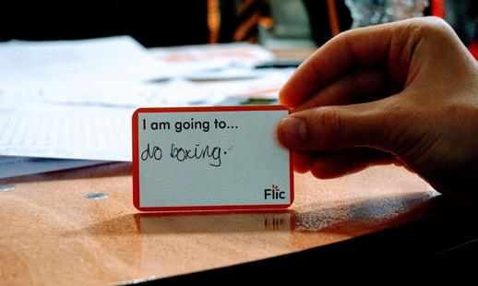

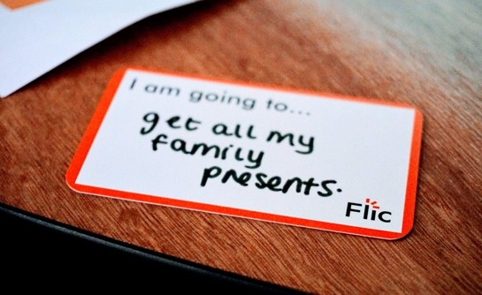
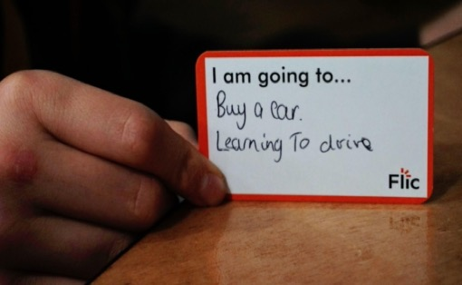
Planning your future
Notes:
no expectation for pupils to share these with the class.

Slide 44
Learning Review
1. What is meant by the term ‘budget’?
2.What might be included in a person’s budget?
3. What are some top tips to budget well?
How will you use what you have learnt in your daily life?
Notes:
Delivery instruction
Students to write down answers in notebooks for teacher review. Possible responses for Q3 include:
- setting clear goals and timelines
- considering needs vs wants
- understanding priorities
- saving regularly
- using digital tools if they have a bank account

Slide 45
By the end of the session, I will be able to:
Describe what a budget is and why a budget is important
Analyse budgets, looking at income and expenses and the 50:30:20 rule of budgeting
Set budgeting goals and plan for the future
Notes:
Delivery instruction
Ask students to share on a show of their hands how confident they feel with the success criteria from 1-10.

Slide 46
Any questions?
?

Slide 47



Services available for people who have concerns about their personal finances
Citizens Advice – Debt and Money – This resource contains links to advice on a number of topics, including financial difficulties, cost of living and communicating with creditors.
National Debtline – Debt and Money – a debt advice charity run by the Money Advice Trust, offering a free and confidential debt advice service.
Childline Helpline
0800 1111
At school, you can speak with an adult you trust.
This could be your form tutor, head of year or the school’s safeguarding officer.

Slide 48
Links to learn more!
Articles to extend learning
Please visit the FLIC Learning Hub for further resources
NatWest Thrive: Become a Budgeting Master (game)
Budgeting (BBC Bitesize)
Cost of Living Crisis: What is it and when will it end? (2024)

