Slide 1

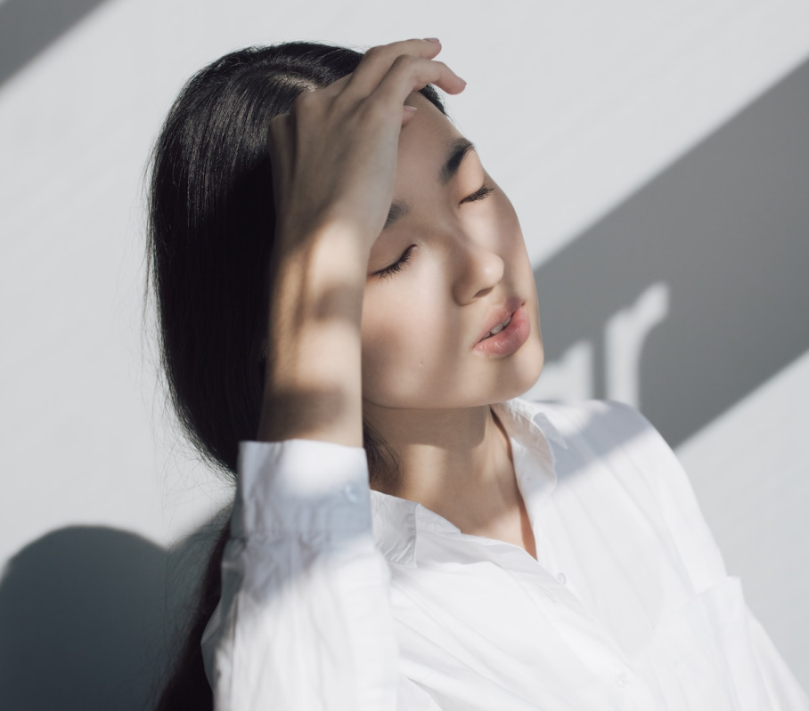
Free Resume Presentation Template
Chloe Ng
Marketing Manager

Slide 2
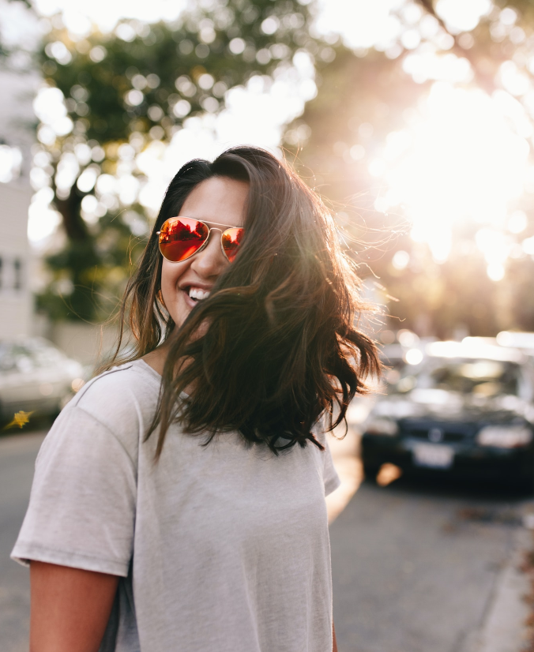





Hello There
Chloe Ng
2344 Fairy Forest, Enchanted Kingdom
chloe@ek.com
+1 (555) 555-1234

Slide 3

I am Chloe Ng, a marketing manager with a passion for creating enchanting experiences for customers.
With over 8 years of experience in marketing, I specialize in digital marketing, social media, and brand management for various magical industries such as fairy gardens, unicorn stables, and enchanted forests.
About me

Slide 4
Marketing Manager
Marketing Coordinator
Marketing Intern
Unicorn Stables | 2020-2023
Dragon's Lair Resort | 2019-2020
Mermaid Cove | 2020-2023
  Develop and execute digital marketing campaigns, manage social media platforms, and coordinate events for unicorn enthusiasts.
  Achieve 30% increase in website traffic and 25% increase in social media engagement through targeted campaigns and influencer partnerships.
  Assist in development and execution of marketing campaigns for a luxury resort in Mystic Kingdom.
  Manage social media platforms and collaborate with influencers.
  Lead development and execution of marketing strategies., resulting in 40% increase in bookings and revenue.
  Assisted in the development and execution of marketing strategies for a popular mermaid attraction in the Enchanted Kingdom.
  Conducted market research and competitor analysis to identify new opportunities
  Assisted in the management of social media platforms and contributed to a 10% increase in followers.
Experience

Slide 5





Digital Marketing
Content Marketing
Develop and execute targeted digital marketing campaigns, including social media advertising, email marketing, and PPC campaigns.
Develop and execute content marketing strategies to engage customers and build brand awareness. Launched a successful blog.
Skills
Brand management
Event planning
Manage brand identity and messaging across all marketing channels, including social media, website, and print materials.
Plan and execute successful events, including product launches, conferences, and experiential marketing campaigns

Slide 6
Market Research
Skills
Event Planning
Project Management
Leadership

Slide 7
Education and Certifications
2018-2023
2017
Fairy Tale University
Marketing Association
Bachelor of Business Administration
Certified Marketing Professional
2016
2015
Mystic Kingdom College
Dragon's Lair Academy
Social Media Marketing Course
Marketing Analytics Course

Slide 8
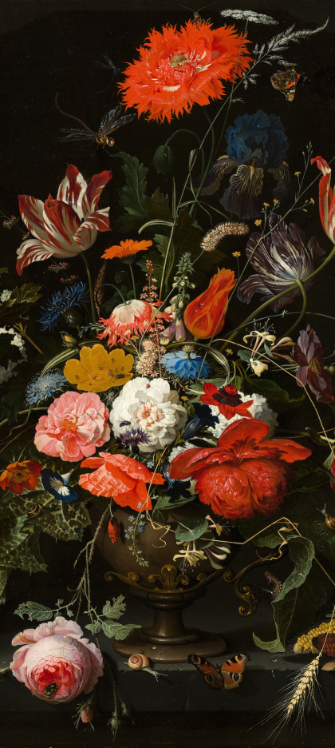
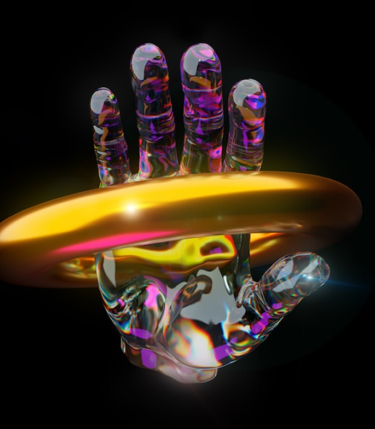
Campaigns
Campaign slides showcase successful marketing campaigns. Each slide summarizes the campaign's objectives, strategies, and results using visuals. Highlight unique or creative aspects of the campaign. Keep the slides concise and visually appealing.

Slide 9


Unicorn Dreams Social Media Campaign
Objective
A record of the number of unicorns spotted in the fantasy realm and the beauty and mystery that surrounds these enchanting creatures.
Strategy
Develop and execute a social media campaign featuring user-generated content, influencer partnerships, and targeted Facebook ads.
Results
Achieved a 40% increase in social media engagement and a 25% increase in bookings.

Slide 10
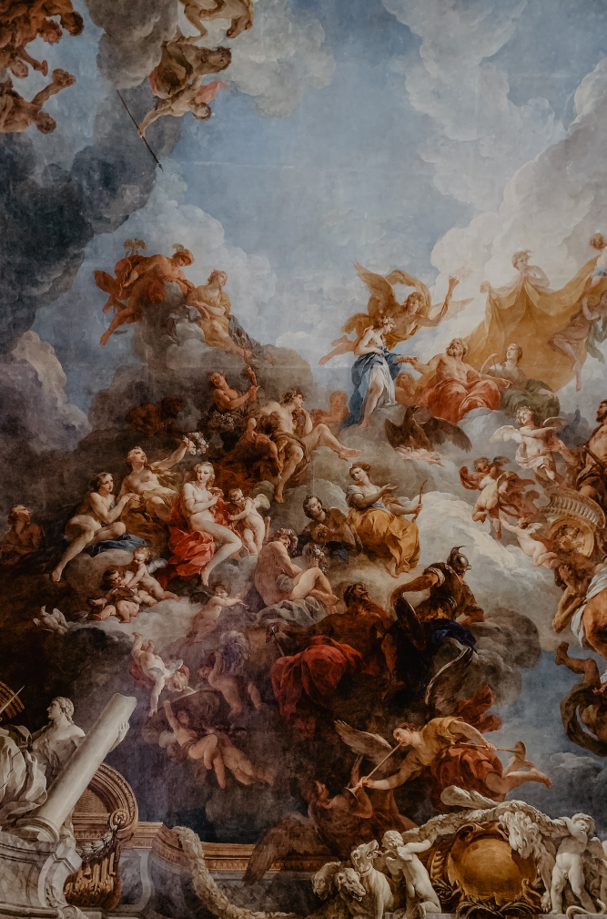
Enchanted Forest Festival
10,000
Attendees
Objective
Strategy
Increase brand awareness and attendance for an enchanted forest festival.
Develop and execute a multi-channel marketing campaign featuring social media, email marketing, and influencer partnerships.

Slide 11
Awards and Honors
Most Creative Marketing Idea
Fairy Tale University Marketing Club, 2021
Outstanding Performance Award
Fairy Tale Marketing Agency, 2020
Marketing Excellence Award
Mystic Kingdom College, 2019
Dean's List
Fairy Tale University, 2016-2020

Slide 12





Thank you for choosing EaTemp
We offer free and high-quality slides templates for your presentations. We appreciate you choosing us and hope our templates have been helpful.
As a new website, we rely on your support to grow, so please help us by sharing our site with your friends and colleagues.
eatemp._
@eatemp
eatempofficial
@eatemp.official

