Slide 1

What Makes an Effective School Principal?
Jack States, The Wing Institute
The Current State of Principal
Preparation, Evaluation, and Support
Randy Keyworth, The Wing Institute

Slide 2

independent, 501(c)(3) non-profit operating foundation
promote evidence-based education policies and practices
act as a catalyst to facilitate communication, cooperation and collaboration between individuals and organizations currently engaged in evidence based education
engage in data-mining, gathering, analyzing and disseminating data
www.winginstitute.org

Slide 3
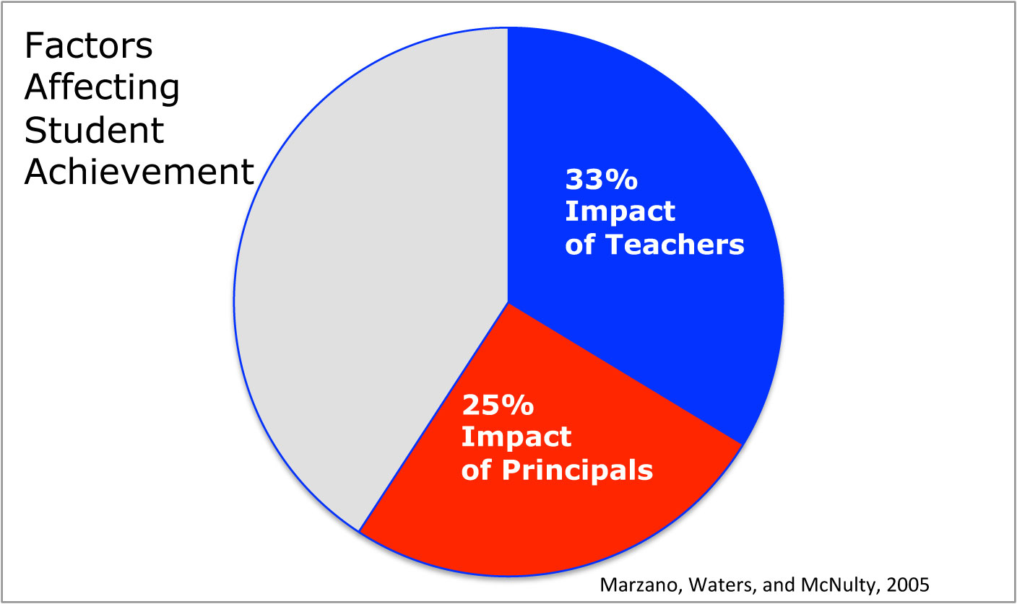
Highly effective Principals have significant impact
on student achievement.

Slide 4
Highly effective Principals have significant impact on student achievement.
HIGHLY EFFECTIVE PRINCIPALS:
• improve student outcomes (Waters, et al. 2003, Branch et al. 2012, Rivkin et al. 2005)
• reduce student absences and suspensions, and improve graduation rates (Leithwood, et al. 2004, Seashore-Louis, et al. 2010)
• retain and recruit effective teachers
(Beteille, et al. 2011, Branch, et al. 2012, Portin et al. 2003)
• have greater impact on the most challenging schools (Branch, et al. 2012, Clark, et al. 2010, Loeb et al. 2010)

Slide 5
The job of Principal has changed dramatically.
“Principals are now more than ever focused on student achievement while still retaining their traditional administrative and building manager duties.”
Hull, Center for Public Education (2012)
Principal Responsibilities
Community relations | Fiscal management and budgeting
Liaison with school board | Student records keeping
Student intake and enrollment | Attendance
Parent relations | Testing
Conflict resolution | Technology
School safety and security | Data analysis
Student discipline | Regulatory compliance
Facilities | Implementation of new initiatives
Personnel management | Resource management
Notes:
The number of new initiatives is staggering: class size reduction, technology, drug prevention, school discipline, professional development. Principals typically work 10 hour days and many believe the job is just not “doable” as it is configured now (Usdan, McCloud and Podmostko 2000).

Slide 6
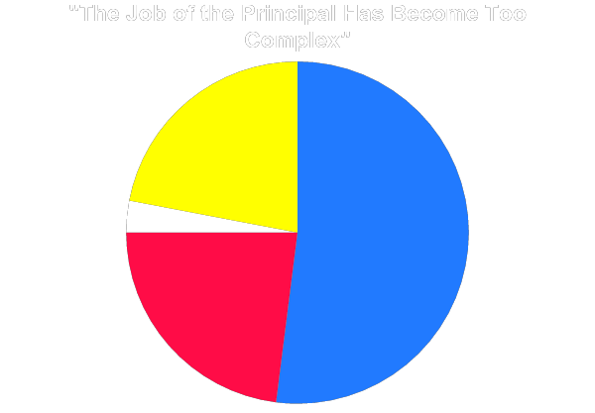
Principal’s jobs are extremely demanding.
Somewhat Disagree
22%
Strongly Disagree
3%
Somewhat Agree
52%
Strongly Agree
23%
MetLife Survey, 2012
The average principal now pus in over 10 hours a day.
(Udon, et al. 2000)

Slide 7
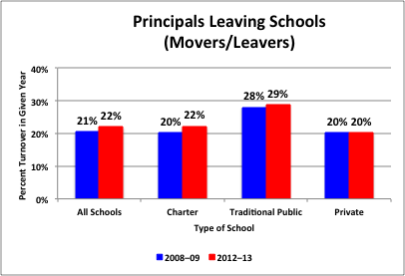
A Significant Percentage of Principals Change Schools Each Year
Principal Attrition and Mobility, National Center for Education Statistics (2014)
Notes:
The average tenure for a high school principal in Texas is just over three years—the average high school principal will not see her/his first freshman class graduate

Slide 8
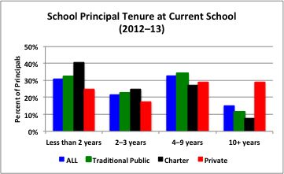
Principal Tenure at School Level
Over 30% of school principals have been at their site for less than 2 years!
Over 50% of school principals have been at their site for 3 years or less!
Principal Attrition and Mobility, National Center for Education Statistics (2014)
Notes:
The average tenure for a high school principal in Texas is just over three years—the average high school principal will not see her/his first freshman class graduate

Slide 9
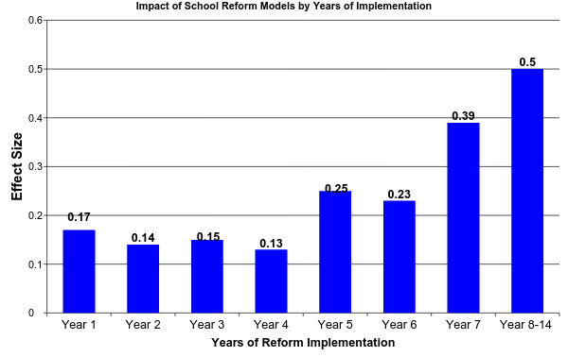
Impact of Principal Turnover: School Iniatives
(Borman, Hewes, Overman, and Brown, 2003)
Notes:
National Implementation Research Karen Blasé and Dean Fixsen

Slide 10
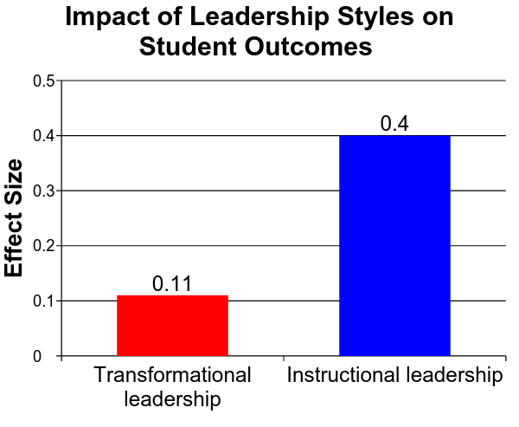
What Does Research Tell Us About Leadership Styles?
Transformational Leadership:
focus on motivation through inspiration
Instructional Leadership:
systematic focus on instructional quality and educational achievement
Robinson, Lloyd, and Rowe, 2008
Notes:
How does our research match up to this notion that instructional leadership is the key to effective principals
Instructional leadership: an approach in which the principal encourages educational achievement by making instructional quality the top priority of the school.
Transformational leadership: an approach in which the principal provides motivation through inspiration

Slide 11
Which leadership practices have the greatest impact on student outcomes?
1. Leading teacher learning and development: promoting and participating in informal and formal development
2. Establishing goals and expectations: communicating expectations, sustaining expectations over time, monitoring learning goals, and involve staff in the process
3. Ensuring quality teaching: ongoing support and evaluation of teaching, direct oversight of curriculum, coordination across classrooms and levels, and aligning goals to curriculum and teaching
4. Resourcing Strategically: aligning and allocating resources to teaching goals, and maintaining recruitment and hiring
5. Ensuring an orderly and safe environment: assuring and protecting time for teaching by reducing external pressures and interruptions, and establishing and supporting orderly classroom / school environments
Robinson (2011)
Notes:
Setting the standards and goals, communicating expectations, sustain expectations over time, monitoring learning goals, and involve staff in the process
Strategic Resourcing: Aligning and allocating resources to teaching goals, and maintaining recruitment and hiring.
Teaching and Curriculum: Having a direct role in the support and evaluation of teaching, regular visits, on-going formative and summative feedback, direct oversight of curriculum, coordination across classrooms and levels, and aligning goals to curriculum and teaching.
Teacher Development: Promoting and participating in informal and formal development
Supportive Environment: Assuring and protecting time for teaching by reducing external pressures and interruptions, and establishing and supporting orderly classroom environments (classroom management and climate).

Slide 12
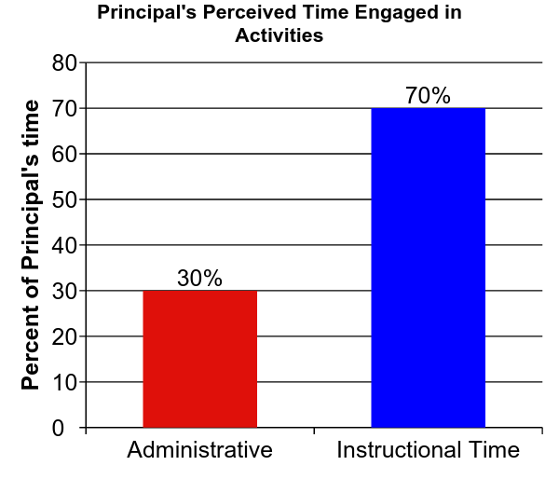
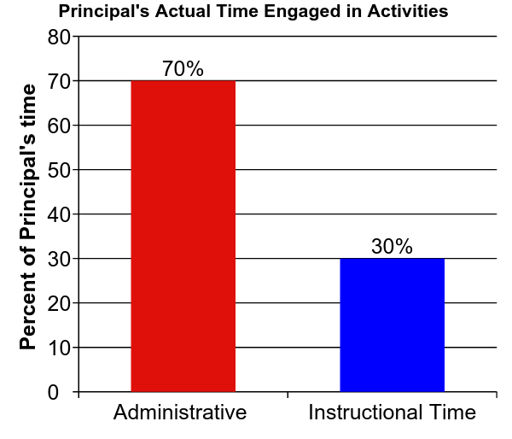
How Principals Spend Their Time
Turnbull et al., 2009

Slide 13
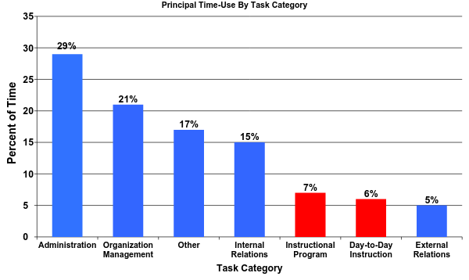
How Principals Use Their Time
Principals were directly engaged in classrooms improving teacher instruction only 13% of the time
Horng, E. L., Klasik, D., & Loeb, S. (2010)
Notes:
This is not a surprise as Randy will present; Principals aren’t trained in the area that make a difference and are not comfortable, find the other roles more reinforcing, and they are often redirected away from instructional roles into crisis intervention.

Slide 14
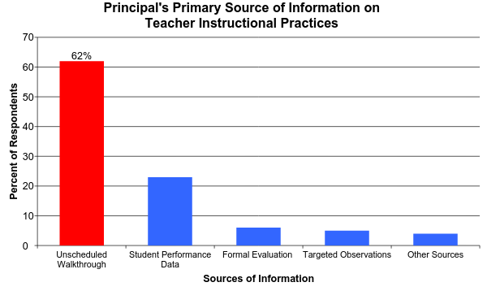
How Principals Engage with Instructional Activities?
Grissom, Jason A., Susanna Loeb, and Ben Master. (2012)
Notes:
Observation data - Overall Instructional Time = 12.7
Walk-through: the most popular method of sampling can function for error detection, but not effective for improving performance
Coaching: Joyce and Showers and Jim Knight
Where does that leave us? Change what the principal does or change the model

Slide 15
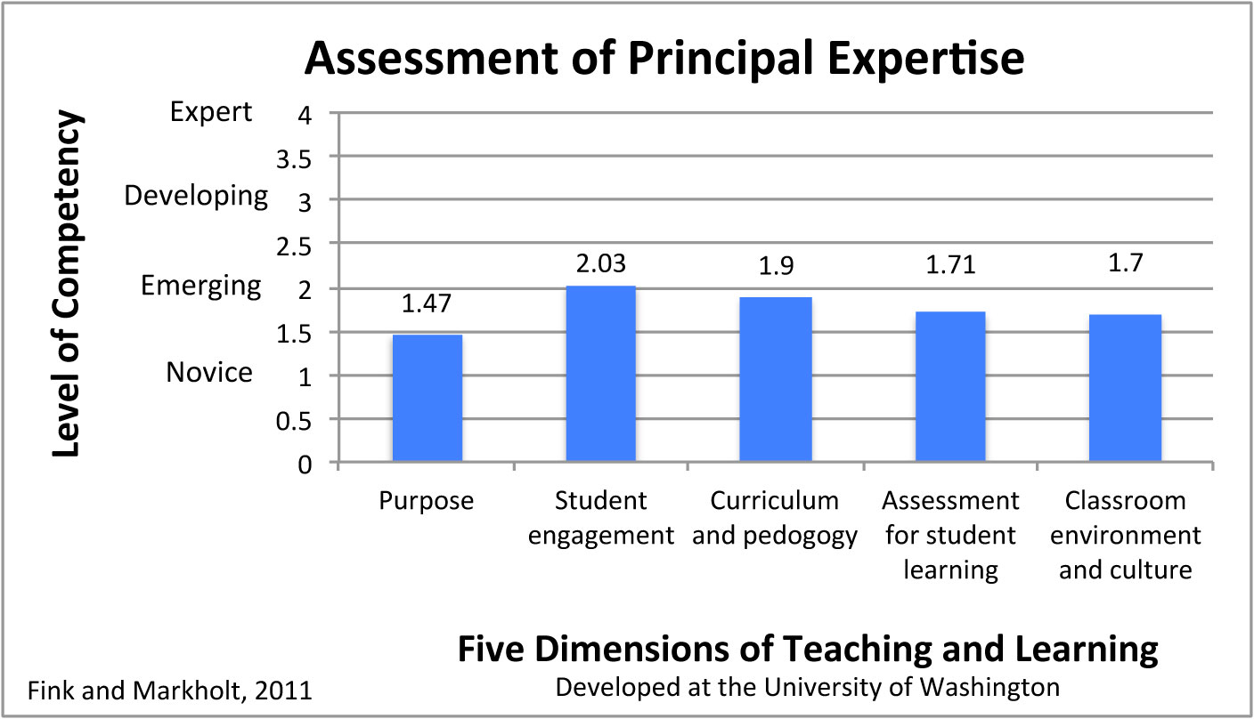
How Effective Are Principals at Identifying Valued Teachers
Notes:
Purpose: How lessons connect with external standards and The learning goals that are expected of a lesson
New Teachers Project, 2009 - 98% of teachers evaluations satisfactory or better (12 districts)
Principals 80% reported at least one teacher should not be teaching

Slide 16
The Current State of Principal
Preparation, Evaluation, and Support

Slide 17
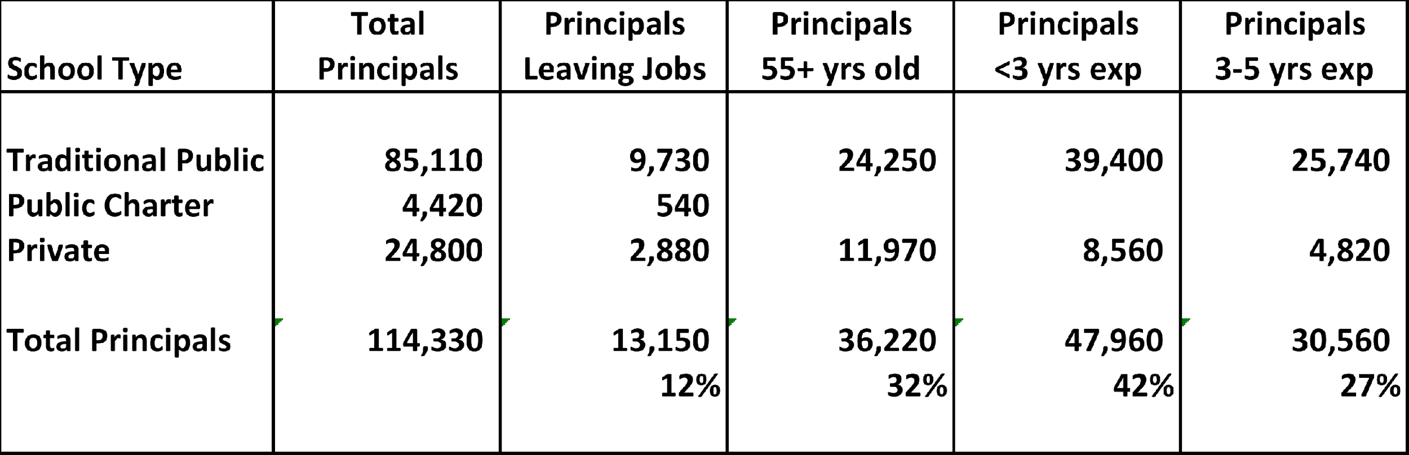
The Challenge: Developing Effective Principals “At SCALE”
SY 2012-13
Principal Attrition and Mobility, National Center for Education Statistics (2014)

Slide 18
Principal Development Universe: Programs
University-based preparation program 825 (84%)
Non-University-based preparation program 153 (16%)
Private Organizations (nonprofit)
New Leaders for New Schools
NYC Aspiring Principal Program
District-based Programs
Ohio Advisory Leadership Council
Charter School Programs
KIPP
Over 95% of America’s …K-12 principals graduate from a university-based preparation program. Levine (2005)
27,289 M.A degrees 4,676 Ph.D. degrees NCES (2013)
1600 leaders over 10 years
500 leaders over 11 years
Notes:
2011-12

Slide 19
Critical Core Components of Principal Preparation
Principal competency framework
Strategic and and proactive recruiting
Rigorous selection process
4. Relevant and practical coursework
5. Experiential, clinical school-based opportunities
6. Placement and on-the-job support
7. Robust data collection and continuous learning
Rainwater Leadership Alliance Cheney, et.al. (2010)
Notes:
set of skills, knowledge, and dispositions that a principal must have in order to drive high levels of student achievement
it guides ALL aspects of the system
Leadership-Centered

Slide 20
Principal competency framework: University Programs
‘’The typical course of study…
…has nothing to do with the job of being a principal
…a nearly random collection of courses…
…little more than a grab bag of survey courses”
Levine 2005
“Programs offer a …
…disparate array of courses and program elements
…without a governing set of competencies”
Cheney & Davis 2011

Slide 21
Strategic and and proactive recruiting
&
3. Rigorous selection process
Recruitment / Selection “Gateways”:
admission to UNIVERSITY GRADUATE PROGRAMS
selection via district PIPELINE
acquisition & renewal of ADMINISTRATIVE LICENSES

Slide 22
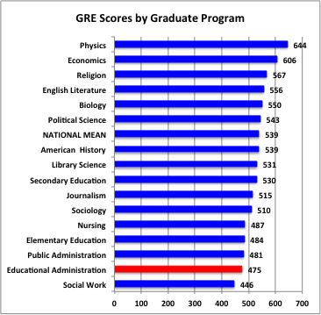
Recruitment / Selection: UNIVERSITY
ADMISSION AND GRADUATION STANDARDS
For all intents and purposes, the majority of educational administration programs admit nearly everyone who applies.
Levine 2005
Most programs are open enrollment programs and do not target or cultivate relationships with high-potential candidates. Instead, these programs passively accept who comes to them through their applicant pool.
Cheney & Davis 2011
Education Testing Service 2004

Slide 23
Recruitment / Selection: PIPELINE
Most recruiting and selection of principals is done internally…tends to be a very laissez-faire process…often valuing the following traditional qualifications…
Years of experience as a teacher
Years of experience as an Assistant Principal
Having a M.A. degree
Selectivity of principal’s college
Traditional principal training programs
Job-embedded principal training programs
Research on relationship between qualifications and effect on student performance.
(NYC, 1987 – 2007, employs well over 1,000 school principals)
(student test scores, absences and suspensions) Clark, Martorell, Rockoff (2009)
no effect
no effect *
no effect
no effect
no effect
small effect

Slide 24
Recruitment / Selection: ADMINISTRATIVE LICENSES
7 states could not report how many principal licenses are granted annually
Only 6 states require principals to demonstrate effectiveness to renew their licenses.
In the 7 states where tenure is granted at the state level, leaders only need to serve for 2.5 years on average before being granted life tenure.
Cheney & Davis (2012)

Slide 25
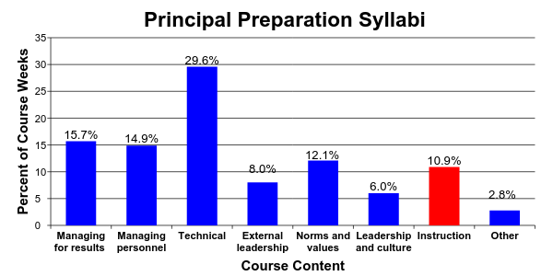
4. Relevant and practical coursework: University Programs
31 Preparation Programs
Hess and Kelly, 2007

Slide 26
4. Relevant and practical coursework: University Programs
Managing for results
• 2% of curricula addressed accountability as it relates to school management
• 5% addressed use of data, research, or technology as it relates to managing school improvement
Managing personnel
• 1% of curricula focused on systematic and “assertive” efforts to identify, enhance and reward teacher quality…the majority failed to mention termination or compensation at all.
Technical knowledge
• 7.4% data management and utilization
• 10% research skills
• 4.7% technology
Hess & Kelly (2007)
Notes:
If equal each 14%
Technical: law, finance, facilities, data, and research

Slide 27
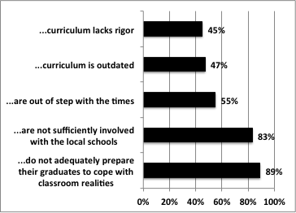
4. Relevant and practical coursework: University Programs
Schools of education…
Levine (2005)

Slide 28
4. Relevant and practical coursework: University Programs
PEDAGOGY
classes are predominately:
teacher-centered and lecture-styled
from a theoretical context
with little opportunity to practice critical leadership skills
and no content involving the real-life situations they are likely to confront on the job.
Cheney & Davis 2011

Slide 29
4. Relevant and practical coursework: University Programs
FACULTY
• the field depends too heavily on practitioners serving as part-time faculty
lack of instructional experience, knowledge of research, and rely on anecdotal “war stories”
• it employs too many full time professors who have minimal, if any, recent experience in the practice of school administration
only 8% of faculty who have had experience as school administrators
only 22% of deans who have had experience as school administrators
Levine (2005)

Slide 30
5. Experiential, clinical school-based opportunities: University Programs
Internship Mentors
• vague or unclear goals
• insufficient focus on instructional leadership and / or overemphasis on managerial role
• weak or non-existent training for mentors
• insufficient mentoring time or duration
The Wallace Foundation (2007)
• weak or non-existent evaluation of mentors
• weak or non-existent evaluation of principal interns
Southern Regional Education Board (2007)

Slide 31
6. Placement and on-the-job support
Principal Supervisors
Professional Development
Principal Feedback & Evaluation

Slide 32
6. Placement and on-the-job support: Supervision
Principal Supervisors
• Principal supervisors oversee an average of 24 schools, ranging from 6 to 67
• Districts by and large have not articulated an explicit set of principal supervisory competencies on which to base evaluations.
• Few districts select principal supervisors on the basis of their explicit results and measurable student achievement gains.
The Wallace Foundation and Council of the Great City Schools
Survey of 41 urban public school districts Corcoran. et al. (2012)

Slide 33
6. Placement and on-the-job support: Evaluation
INSTRUMENT CONTENT ANALYSIS
Learning Centered Leadership: A Behavior-Anchored Framework
(Vanderbilt Assessment of Leadership in Education)
high standards for student learning culture of learning
rigorous curriculum connections to external communities
quality instruction performance accountability
INSTRUMENT USAGE ANALYSIS
UTILITY: information is used to improvement performance
ACCURACY: instrument produces sound information about the principal’s performance (e.g. sound psychometric development)
The Wallace Foundation and Council of the Great City Schools. Survey of 65 Principal Assessment Instruments from 65 districts (43 states and DC)
Goldring, et.al. (2012)

Slide 34
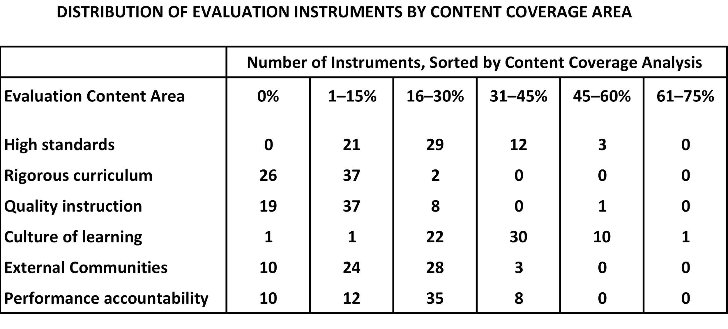
6. Placement and on-the-job support: Evaluation
CONTENT: Principal evaluation systems do not focus on the most critical items: student outcomes and teacher effectiveness
• only 25 instruments (38%) touched on all six core components
Goldring, et.al. (2012)

Slide 35
6. Placement and on-the-job support: Evaluation
UTILITY: Principal evaluation systems are not used effectively to improve principal performance
• 43% of the reviewed instruments failed to give leaders clear feedback on what they could be doing more or better to improve teaching and learning
• there are often inconsistent (or nonexistent) connections between evaluation and professional development plans
ACCURACY: Principal evaluation systems are not used effectively to improve principal performance
• evaluation systems are seldom based on clear performance standards
• there is little attention paid to the skills, qualifications, or authority of the reviewer
• few have been tested for important psychometric properties for validity and reliability
Goldring, et.al. (2012)

Slide 36
6. Placement and on-the-job support: Supervision
Professional Development
Professional development is generally not seen as sufficient to support school principals as instructional leaders.
The Wallace Foundation and Council of the Great City Schools , Corcoran. et.al. (2012)
Principal development opportunities are based more on “whims, fads, opportunism and ideology” than sound research and that while participation rates were high, it rarely lead to any changes in practice that had an impact on student achievement.
National Association of State Boards of Education, Sun (2011)

Slide 37
7. Robust data collection and continuous learning: State Oversight
Performance data
• 19 states were unable to report how many people graduate from state-approved principal preparation programs in their state on an annual basis
• 28 states report than neither the state nor principal preparation programs are required to collect any outcome data on principal preparation program graduates to know if they secure jobs, retain them, show impact on student achievement, or earn effective ratings on principal evaluations program
• Universities typically do not track performance outcomes

Slide 38
Critical Core Components of Principal Preparation
Principal competency framework
Strategic and and proactive recruiting
Rigorous selection process
4. Relevant and practical coursework
5. Experiential, clinical school-based opportunities
6. Placement and on-the-job support
7. Robust data collection and continuous learning
Rainwater Leadership Alliance Cheney, et.al. (2010)
Poor
Poor
Poor
Poor
Poor
Poor
Poor
Notes:
set of skills, knowledge, and dispositions that a principal must have in order to drive high levels of student achievement
it guides ALL aspects of the system
Leadership-Centered

Slide 39
What’s next?
1. There is movement in the public policy level to recognize the changing role of school principal and the need to strengthen principal effectiveness standards, preparation program oversight, licensure and outcome data.
U.S. Department of Education
National Association of State Boards of Education
National Conference of State Legislators
Education Commission of the States
Council of State Chief School Officers
National Association of Elementary School Principals
National Association of Secondary School Principals

Slide 40
What’s next?
1. There is movement in the public policy level to recognize the changing role of school principal and the need to strengthen principal effectiveness standards, preparation program oversight, licensure and outcome data.
2. There is an increasing amount of research on principal competencies and principal preparation systems.
U.S. Department of Education is funding a large-scale randomized control trial evaluation of principal professional development beginning in 2015.
Rand studies on New Leaders performance outcomes

Slide 41
What’s next?
1. There is movement in the public policy level to recognize the changing role of school principal and the need to strengthen principal effectiveness standards, preparation program oversight, licensure and outcome data.
2. There is an increasing amount of research on principal competencies and principal preparation systems.
There are an increasing number of “exemplar” principal preparation programs and research organizations:
New Leaders, etc.
The Wallace Foundation Pipeline
Southern Regional Education Board

Slide 42
Thank You

Slide 43
Lack of Research on Principal Preparation
https://docs.google.com/presentation/d/1RN0Ih-zPypstDN-I8k5eWD-lunb2Yk4d8fg5YgcGvHk
The field of educational leadership has suffered from a general dearth of systematic scholarly inquiry…bleak, scant…no systematic data regarding what principal preparations do or teach
Hess & Kelly (20??)
“From the extant research, we know almost nothing about the traditional curricular domains of preparation programs…nor…the shape of curriculum in a post-theory era where issues around teaching and learning and community are reshaping the profession.”
(Murphy & Vriesenda (2004)
The level and extend of scholarship is weak. There is a lack of rigorous scholarship
It doesn’t do research that matters;
it doesn’t have visible researchers and lacks an intellectual center
There is no substantial, meaningful body of theory and research to expose students to.
(Levine 2005)

Slide 44
Summation
What We Know
Principals make a major contribution
What principal practices that make the greatest difference
Principals are struggling and are departing all too often
Where We Go From Here
Better training
On-going coaching and feedback on the practices that make a difference
Finding ways to buffer principals from distractions that take them away from what matters
Notes:
Where does that leave us? Change what the principal does or change the model. I believe we can discount the The Heroic Leader model is flawed. We need research to tell us how many of the pieces need to be in place for significant change.

Slide 45
LACK OF COMPETENCY FRAMEWORK
University Based School Leadership Programs:
The majority of programs range from inadequate to appalling, even at some of the country’s leading universities.
They do not engage in systematic self assessment.
Their curricula are disconnected from the needs of leaders and their schools
Their admission standards are among the lowest in American graduate schools.
Their professoriate is ill equipped to educate school leaders.
Their programs pay insufficient attention to clinical education and mentorship by successful practitioners.
The degrees they award are inappropriate to the needs of today’s schools and school leaders.
Their research is detached from practice.
Their programs receive insufficient resources.
Levine 2005

Slide 46
PRE-SERVICE PEDAGOGY
Precepts of adult learning:
Clear focus and values about leadership and learning around which the program is coherently organized;
Standards-based curriculum emphasizing instructional leadership, organizational development, and change management;
Field-based internships with skilled supervision;
Cohort groups that create opportunities for collaboration and teamwork in practice oriented situations;
Active instructional strategies that link theory and practice, such as problem solving learning;
Rigorous recruitment and selection of both candidates and faculty; and
Strong partnerships with schools and districts to support quality, field-based learning
(Davis, Darling-Hammond, Meyerson & La Pointe, 2005)

Slide 47
5. Experiential, clinical school-based opportunities: University Programs
Internships generally are not planned and structured to provide a continuum of observing, participating in, and leading activities that develop competency in improving schools and increasing student achievement.
• About one-third of the programs require interns to actually lead the kinds of school-based activities successful principals engage in to improve schools and raise student achievement.
• only 52% of departments reported regular interactions with districts
Southern Regional Education Board (2007)

Slide 48
5. Experiential, clinical school-based opportunities: University Programs
Clinical experience tends to be squeezed in while students work full time and generally occurs in the school where the student is employed:
• whether the principal or superintendent there was successful or unsuccessful was immaterial.
• school leadership programs offer little in the way of clinical or field-based education. When offered, it tends to be disconnected from academic instruction.
Levine 2005

Slide 49
5. Experiential, clinical school-based opportunities: University Programs
• Most programs provide “shadowing” opportunities or limited internships where individuals remain in the same job.
• These internships often amount to less than one or two months of school-based opportunities.
• Few programs offer strong clinical training experiences of significant length to enable aspiring principals to assume leadership positions that give them real responsibility and develop the skills to make changes in culture, manage and develop teachers, and impact student learning.
• Few programs provide opportunities for aspiring principals to work directly with effective principals in school contexts similar to ones they will lead and receive meaningful feedback.
Cheney & Davis (2011)

Slide 50
Educating School Leaders, Levine (2005)
Schools Can’t Wait: Accelerating the Redesign of University Principal Preparation Programs, Southern Regional Education Board (2006)
Learning to Lead: What Gets Taught in Principal-Preparation Programs, Hess & Kelly (2007)
The Evaluation of Principals: What and How Do States and Districts Assess Leadership?Goldring, et al. (2008)
Preparing School Leaders for a Changing World: Lessons from Exemplary Leadership Programs, Darling-Hammond, et al. (2009)
Learning from Leadership Project: Investigating the Links to Improved Learning Louis, et al. (2010)
A New Approach to Principal Preparation: Innovative Programs Share Their Practices and Lessons Learned, Cheney et al., (2010)
Gateways to the Principalship: State Power to Improve the Quality of School Leaders
Cheney, et al. (2011)
Rethinking Leadership: The Changing Role of Principal Supervisors
The Wallace Foundation, Corcoran, et al., (2012)
Operating in the Dark: What Outdated State Policies and Data Gaps Mean for Effective School Leadership, Briggs et al., (2013)
Districts Taking Charge of the Principal Pipeline, Wallace Foundation, Turnbull, et al., (2015)

Slide 51
6. Placement and on-the-job support
Principal Supervisor competency frameworks
Strategic and and proactive recruiting
Rigorous selection process
4. Relevant and practical coursework
5. Experiential, clinical school-based opportunities
6. Placement and on-the-job support
7. Robust data collection and continuous learning
Rainwater Leadership Alliance Cheney, et.al. (2010)
X

Slide 52
4. Relevant and practical coursework: University Programs
PEDAGOGY
In far too many programs material is presented from a theoretical context with students rarely being given the opportunity to practice what they have learned through role play, simulations, and case studies that approximate the real-life situations they are likely to confront on the job.
Classes are often teacher-centered and lecture-styled, with students simply being passive recipients of knowledge. What we know from adult leadership development is that skills must be practiced to be internalized. Leadership skills cannot be mastered through reading textbooks—they must be practiced.
Cheney & Davis 2011

Slide 53
4. Relevant and practical coursework: University Programs
Managing for results: principal’s role as “driver for results, quality control, performance, crucial role of research, data and technology for setting goals, monitoring progress, allocating resources and managing the school
Managing personnel: hiring, induct, evaluate personnel to improve teacher quality
Technical knowledge: school law, school finance, facilities management
External leadership: dealing with external contingencies, relationships and politics
Norms & values: promoting equitable and effective schooling
Leadership / culture: overall school values, beliefs, institutional character
Managing Classroom: Instruction pedagogy, curriculum, classroom management
Hess & Kelly (2007)

Slide 54
Principal competency framework: University Programs
State Performance Oversight of Program Performance
• Only 27 states report including in their standards all 5 key elements that research shows are critical to effectiveness:
recruiting and selecting teachers,
developing and supporting teachers,
assessing and rewarding teachers,
implementing data-driven instruction, and
(5) developing a positive school culture. Briggs, et. al. (2013)
• Principal training programs, professional development programs, and principal evaluation systems vary significantly in their alignment with state leadership standards.
Sun (2011)

Slide 55
5. Experiential, clinical school-based opportunities: University Programs
Internship Mentors
TRAINING: 38% of mentors received any training, tools, or resources in mentoring.
EVALUATION: 79% percent of mentors either were not evaluated at all or did not know who evaluated their performance
FOCUS: 61% indicated that their responsibility was to help interns complete a list of tasks determined by the university
42% for providing quality professional development
36% for developing high expectations for learning
25% for understanding the change process
FEEDBACK: 64% provided feedback to interns
55% completed a formal evaluation for the university or district
15% of mentors discussed interns strengths and weaknesses with districts
Southern Regional Education Board (2007)

Slide 56
7. Robust data collection and continuous learning
Inputs
Participant Characteristics
Processes
Program Implementation
Participant Learning and Program Completion
Participant Job Placement and Career Advancement
Outputs
Leadership Practices
School and Teacher Outcomes
Outcomes
Student Outcomes

Slide 57
State Oversight Responsibilities
Principal Competency Standards
Principal Preparation Program Approval
Set requirements School-based learning experiences
Specific coursework Faculty qualifications
Track performance outcomes
Principal Licensure
Initial licensure Renewal licensure
Principal outcome data
Briggs, et. al. (2013)

Slide 58
LACK OF PERFORMANCE DATA ON PRINCIPAL PREPARATION
STATE OUTCOME DATA
19 states were unable to report how many people graduate from state-approved principal preparation programs in their state on an annual basis
7 states could not report how many principal licenses are granted on an annual basis
Briggs et al., (2013)

Slide 59
LACK OF PERFORMANCE DATA ON PRINCIPAL PREPARATION
STATE OUTCOME DATA
28 states report than neither the state nor principal preparation programs are required to collect any outcome data on principal preparation program graduates
33 states do not have data on principal job placement rates
39 states do not have data on principal job retention rates
36 states do not have data on principal job effectiveness (by evaluation)
37 states do not have data on principal job effectiveness (as measured by student achievement data)
Briggs et al., (2013)

Slide 60
LACK OF PERFORMANCE DATA ON PRINCIPAL PREPARATION
UNIVERSITIES
Self-assessment is largely absent.
Levine, (2015)

Slide 61
Punch Lines
“Traditionally, the processes and standards by which many principal preparation programs screen, select, and graduate candidates often lack rigor and do not adequately equip principals for the multi-faceted role of effective instructional leader.” Cheney, et. al. (2010)
“it is distressing that inappropriate content ineffectively packaged should also be so poorly delivered…” Murphy (1992)
“The majority of programs range from inadequate to appalling, even at some of the country’s leading universities.” Levine (2005)

Slide 62
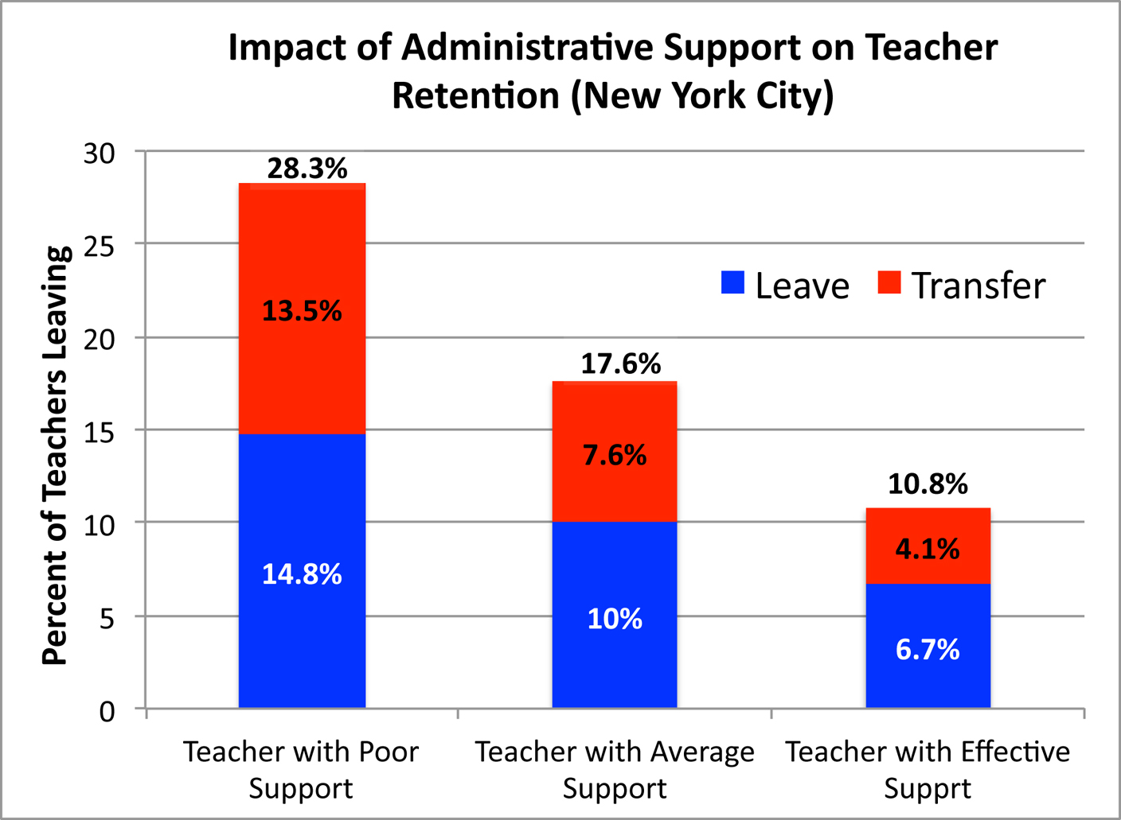
Impact of Principal Turnover: Teacher Turnover
Boyd, D., Grossman, P., Ing, M., Lankford, H., Loeb, S., & Wyckoff, J. (2011)
Notes:
Ineffective leadership is primary reason for teachers leaving, North Carolina Teacher Working Conditions Survey, (2008)
Less effective teachers tend to leave under an effective principal, while more effective teachers tend to leave when the school is taken over by an ineffective principal.
Furthermore, effective principals are more likely to replace teachers who leave with more effective teachers (Beteille, Kalogrides and Loeb 2011, Branch, Hanushek and Rivkin 2012, Portin, et al. 2003).

Slide 63
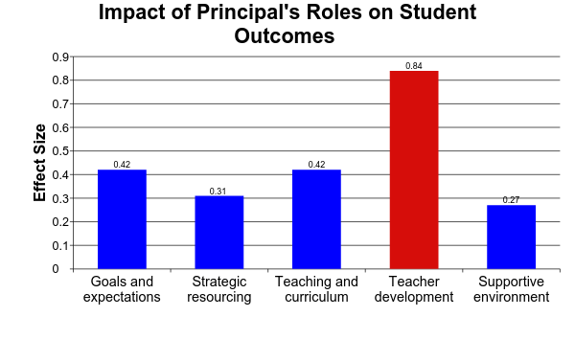
What Principals Do Makes a Difference
Robinson, Lloyd, and Rowe, 2008
Notes:
Setting the standards and goals, communicating expectations, sustain expectations over time, monitoring learning goals, and involve staff in the process
Strategic Resourcing: Aligning and allocating resources to teaching goals, and maintaining recruitment and hiring.
Teaching and Curriculum: Having a direct role in the support and evaluation of teaching, regular visits, on-going formative and summative feedback, direct oversight of curriculum, coordination across classrooms and levels, and aligning goals to curriculum and teaching.
Teacher Development: Promoting and participating in informal and formal development
Supportive Environment: Assuring and protecting time for teaching by reducing external pressures and interruptions, and establishing and supporting orderly classroom environments (classroom management and climate).

Slide 64
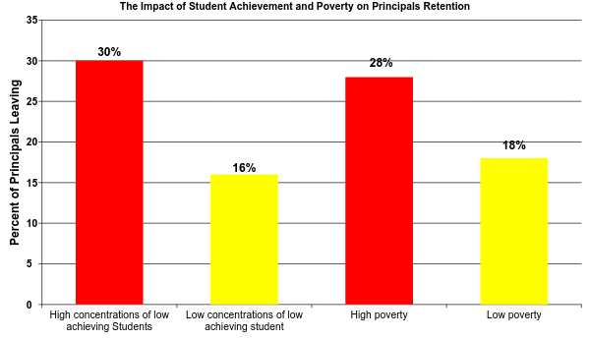
What is the Impact of Student Achievement and Poverty on Principal Retention?
Béteille, T., Kalogrides, D., & Loeb, S. (2012)
Notes:
Higher principal turnover in schools with low achieving student
Higher principal turnover in schools of high poverty
Unfortunately, these are the schools that require stable leadership

