Slide 1








VR Technology
FREE PRESENTATION TEMPLATE

Slide 2




Welcome
Welcome to the world of fantasy! Join us on a journey to explore the mystical creatures, enchanted lands, and magical wonders that exist beyond our reality. Discover the wonders and secrets of this exciting realm and unlock the power of imagination.

Slide 3






Table of Contents
01
Introduction
02
Encounters
The Extraordinary Realm
Unicorn Sightings
03
Wonders
04
Magic
Wishes Granted
Spellcasting
05
Adventure
06
Conclusion
Happily Ever After
Embrace the Fantasy

Slide 4







The Realm of the Extraordinary
Welcome to the Fantasy World, a realm of wonder and enchantment where anything is possible. Here, dragons breathe fire, unicorns prance through meadows, and rainbows shine brightly. This world is a place where wishes come true, where potions can be cursed and spells are cast. It's a place of treasure and adventure, where the impossible becomes possible. But the greatest treasure of all is the one that lies within.
The world of fantasy is a reflection of our deepest desires, our fondest dreams, and our wildest imaginations. It's a place where we can let go of the constraints of reality and explore the boundless possibilities of the human mind. In this introduction, we will delve into the mysteries of this realm, uncovering the magic and wonder that lies within. So come with us and let's embark on a journey through the Fantasy World.

Slide 5




Unicorn Sightings
A record of the number of unicorns spotted in the fantasy realm and the beauty and mystery that surrounds these enchanting creatures.
Dragon Taming
A closer look at the art of taming dragons and the brave adventurers who dare to take on these fearsome creatures.

Slide 6



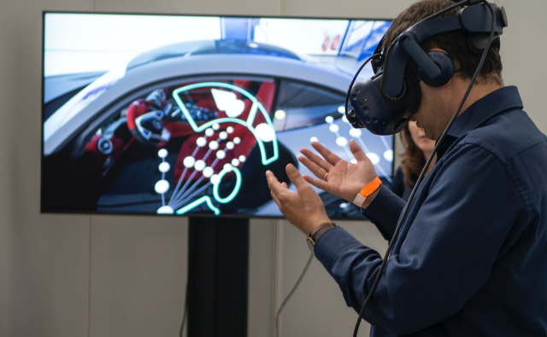
Unicorn Sightings
Dragon Taming
A record of the number of unicorns spotted in the fantasy realm and the beauty and mystery.
A closer look at the art of taming dragons and the brave adventurers who take on these creatures.

Slide 7


Fantasy is the gateway to the impossible, the land where the ordinary becomes extraordinary, and the impossible becomes possible. It is the realm of the imagination, where anything can happen and everything is possible.
The Dream Weaver

Slide 8


Dragon Taming Technique
A guide to taming and caring for dragons in the realm of magic.
The Art of Unicorn Sighting
Tips and tricks for spotting the elusive unicorns in their natural habitat.

Slide 9



The Magic of Dragons: A Research
6.7M
"The Art of Archery": Discover the intricacies of the Art of Archery .
4.4M
"The Music of the Elves": Immerse yourself in the enchanting music of the elves.
2.3M
"The Life of an Elf": Learn about the customs and daily life of the elves.

Slide 10



Pricing Plan
Basic
Elite
Legendary
  Access to the entry-level dungeons.
  A limited number of quests and battles per month.
  Ability to form a small party with fellow adventurers.
  Access to the intermediate and advanced dungeons.
  A greater number of quests and battles
  Ability to form larger parties with fellow adventurers.
  Access to the most challenging dungeons and encounters.
  Unlimited quests and battles per month.
  The ability to form the largest parties with fellow adventurers.
$10/month
$50/month
$100/month

Slide 11










Strengths
Weaknesses
Rare event causes unpredictable magic.
S
W
Rare event causes unpredictable magic.
O
T
Opportunities
Threats
Rare event causes unpredictable magic.
Rare event causes unpredictable magic.

Slide 12

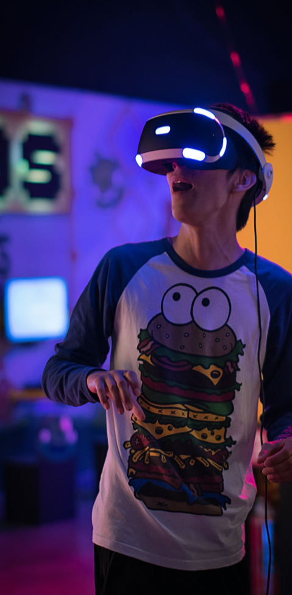
Some Data
75%
Enchanted Creatures
possess the ability to cast spells.
Magic-Wielding Individuals
60%
practice the art of illusions.
90%
Spells Cast
are dark magic, foretelling danger.

Slide 13

234,567
UNICORN SIGHTINGS
A tally of the number of unicorns spotted in the fantasy realm.

Slide 14
233 Coins
85%
Treasure Found
Wished Granted
456 Hours
535 Km
Duration of Spell Casting
Journey Distance

Slide 15



Portal to Adventure
A web application
A web application designed for discovering the world of fantasy

Slide 16


The Future of Fantasy
An mobile app
An app designed for exploring and experiencing the enchanting realm of fantasy
  Explore a magical world
  Experience fantasy firsthand
  Immerse in a realm of magic
  Discover untold wonders
  Live your fantasy dreams

Slide 17

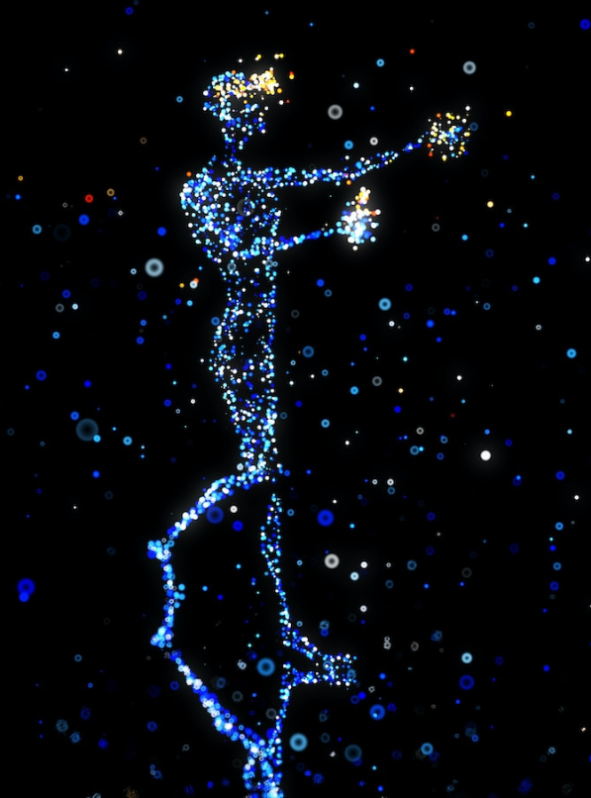
A Gateway to a World of Fantasy and Wonder
  Immerse yourself in the world of magic and mystery
  Explore uncharted territories and fantastical lands
  Meet mythical creatures and legendary beings
  Uncover hidden treasures and secret treasures
A web application
A web application designed for discovering the world of fantasy

Slide 18

A Magic Picture

Slide 19

Discover the secrets
Find your own path
1
2
Explore the lush, vibrant forest and uncover the mysteries that lie within.
Choose your own path through the forest, and see where it takes you.
Meet the creatures
Uncover the magic
3
4
Encounter the mythical creatures that call the forest home, from talking animals to fairies.
Learn about the powerful magic that pervades the forest and how it affects all who enter.

Slide 20
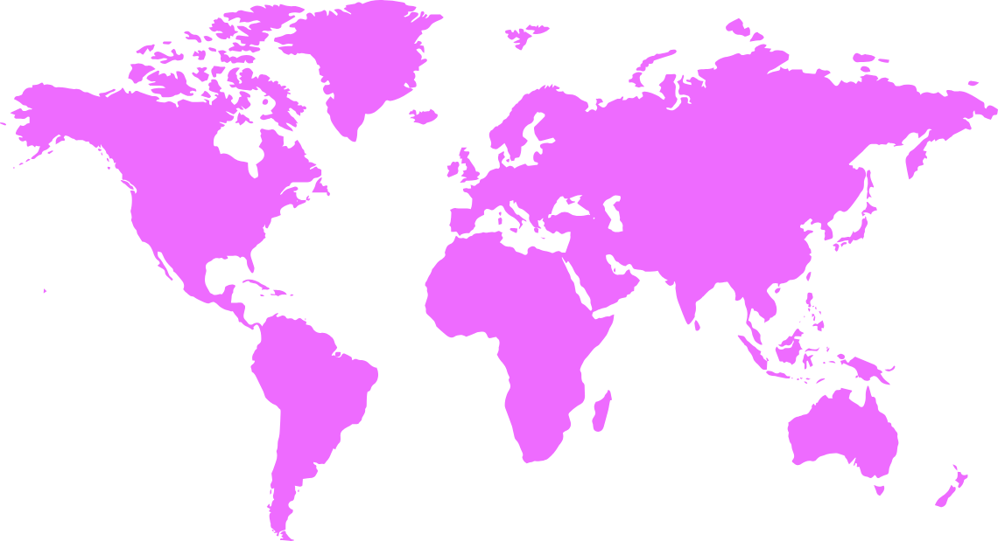
The Enchanted Forest
A magical forest filled with talking animals and enchanted creatures.
The Crystal Caves
A network of underground caves filled with precious gems and crystals.
The Dragon's Lair
A dangerous and mysterious place where dragons reside.
Fantasy Realm at a Glance

Slide 21

The Timeline
Dragon Taming
Unicorn Migration
First dragon was successfully tamed
Large herd of unicorns migrated to the realm
2022
2023
2024
2025
Enchanted Pool
Rainbow Sightings
A magical pool with power to grant wishes
Unusually large number of rainbows were sighted

Slide 22



Our Team
Eldruin
Elementalen
Lunaria
The Fire Mage
The Guardian
The Moon Priestess

Slide 23
The List
Dragons
Fire-breathing creatures that are often powerful and dangerous
Medieval-like Settings
Worlds with castles, knights, and feudal systems
Chosen One Trope
A hero chosen by destiny to save the world
Magic
An integral part of fantasy stories, can take many forms
The Best Curse
A curse that is unique, creative, and fits within the story
Unique Creatures
A variety of fantastical beings that inhabit the world

Slide 24









The Organization
Chloe Ng
The Mage
Valtorin
Aurielle
Theronis
Dariana
The Assassin
The Priestess
The Warrior
The Shaman
Lucian
Elvina
The Conjurer
The Oracle
Cedric
Seraphina
The Timekeeper
The Lightbringer
To download more editable chart, click here

Slide 25

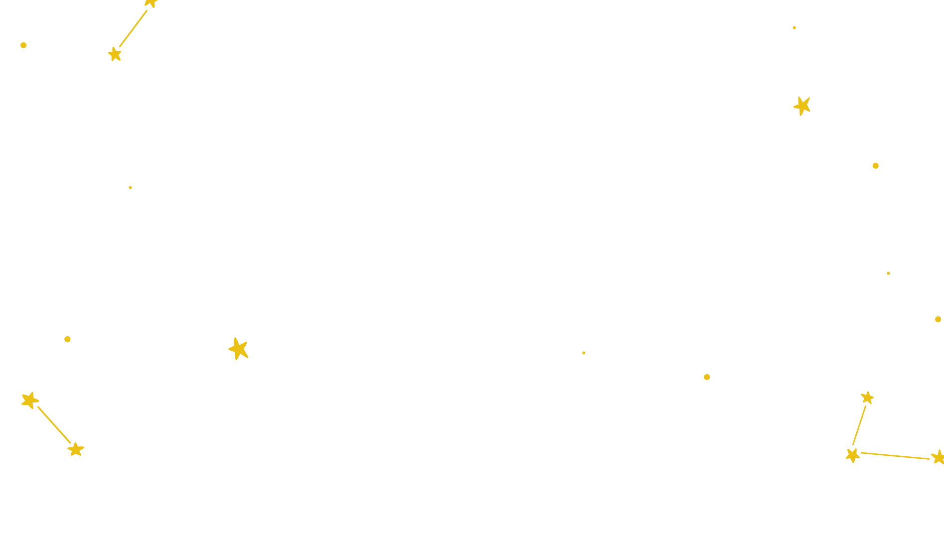



Thank you for choosing EaTemp
We offer free and high-quality slides templates for your presentations. We appreciate you choosing us and hope our templates have been helpful.
As a new website, we rely on your support to grow, so please help us by sharing our site with your friends and colleagues.
Credit | Image: Unsplash

