Slide 1


Mental Health Issues in Public Health: Alcohol and Drug Use
Johns Hopkins Center for Injury Research and Policy Diné College

Slide 2
How this lecture fits into the course
This lecture adds to a Mental Health course discussion by looking at alcohol and drug use from an injury prevention perspective after an introduction to injury prevention as a public health discipline.

Slide 3
Part 1: Learning Objectives
In this lecture you will learn an introduction to injury prevention:
Describe injury using the medicine wheel public health model and distinguish intentional from unintentional injuries.
Identify key injury risk and protective factors in American Indian and Alaska Native communities.
Explain how Indigenous and Western approaches can support culturally grounded injury prevention and evaluation.
Notes:
Define injury and/or violence and describe the concepts of intentionality and mechanism as they relate to injury and/or violence.
Describe how injury and/or violence compare with other leading causes of morbidity and mortality and with regard to burdens on the population (e.g. incidence, cost, years of potential life lost, etc.)
Explain how injuries and/or violence are preventable.
Describe the disparity in the risks of injury and/or violence (e.g. differences by age, gender, race, ethnicity, education, location, access to economic resources, access to health care services, sexual orientation, creed, community norms, and the environment).
Describe the influence of a variety of factors (including age, gender, race, ethnicity, education, access to economic resources, sexual orientation, creed, community norms, access to health care services, and the environment) on injury and/or violence prevention.

Slide 4
How are you feeling about today’s topic? Put an emoji in the chat.
Notes:
Emoji Response Activity: Understanding that mental health and substance use disorders can be difficult subjects to talk about based on personal experiences, this activity allows these feelings to be shared, in a fun way. The question “How are you feeling about today’s topic?” and the direction “Put an emoji in the chat.” are on the slide. Invite participation, allow for multiple emoji’s to be shared, and share your own emoji representing your feelings about today’s topic.

Slide 5
Part 1: Injury 101
Play Recorded Lecture
(youtube link)

Slide 6
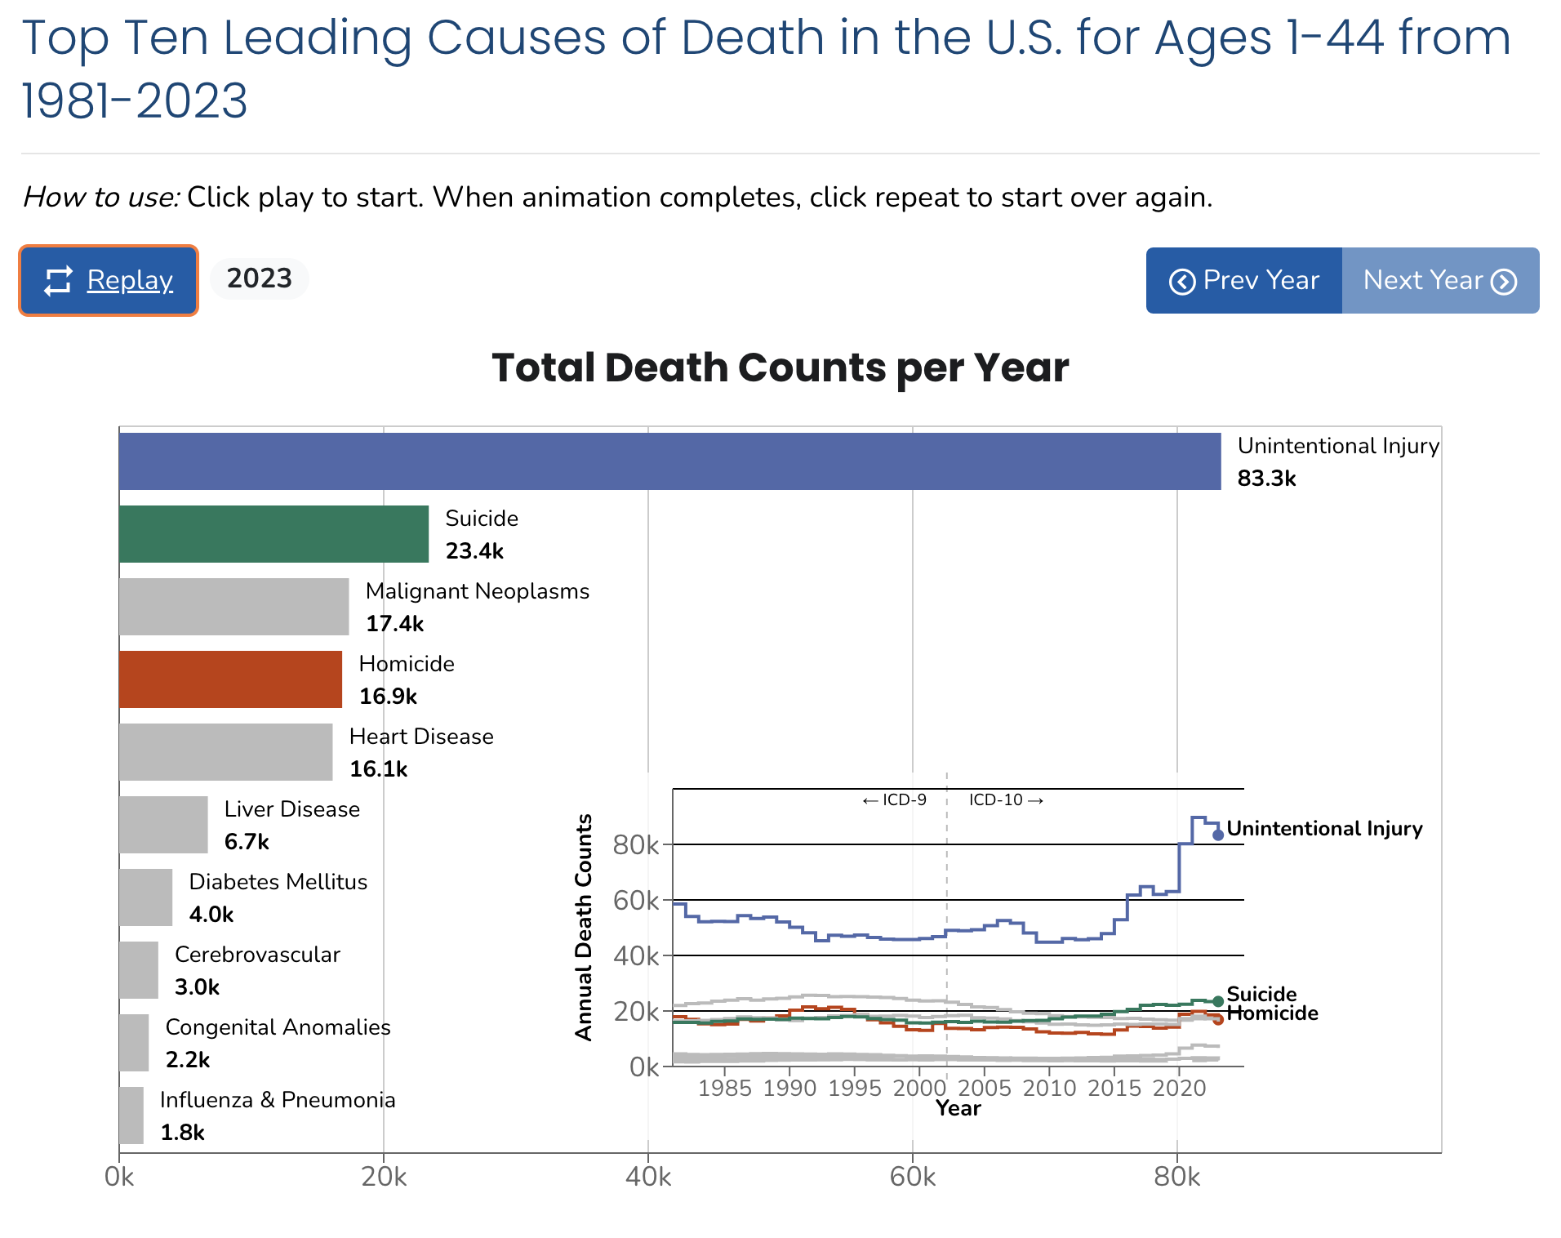
Link to animation:
https://wisqars.cdc.gov/animated-leading-causes/
Notes:
Optional activity if there is time. Description in Facilitator Guide.

Slide 7
Part 2: Learning Objectives for Alcohol and Drug use: A Public Health Perspective
After this lecture, you will be able to:
Describe the Addiction Cycle including the terms tolerance, withdrawal, and behavioral conditioning.
Identify risk factors of substance use disorders.
Describe the prevalence of several substance use disorders.
Identify several evaluated treatments for substance use disorders.

Slide 8
Part 2: Alcohol and Drug Use: A Public Health Perspective
Play Recorded Lecture
(youtube link)

Slide 9
DISCUSSION QUESTIONS
Was there anything in the lecture that surprised you about alcohol and drug use?
What connections do you see in this lecture to the content you are covering in your current coursework?
What interventions do you think would be most effective in your community for the prevention of substance use? Why?
Notes:
If the class will be going into different break out rooms, post the questions in the chat before initiating the breakout rooms. Inform the facilitators the time allowed and if there will be a person to give a summary of the small group discussion.

