Slide 1


Vendor Edge Server
Document Version - 16th November 2020

Slide 2
What’s in it for me?
This product document will cover:
Introduction to the Edge Server
User Personas & Use cases
User guide

Slide 3
Who should attend this training session?
This product document is catered for Enterprises - Partners that are keen on understanding what and how the Vendor Edge Server works.

Slide 4
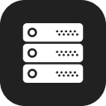
Product Introduction

Slide 5
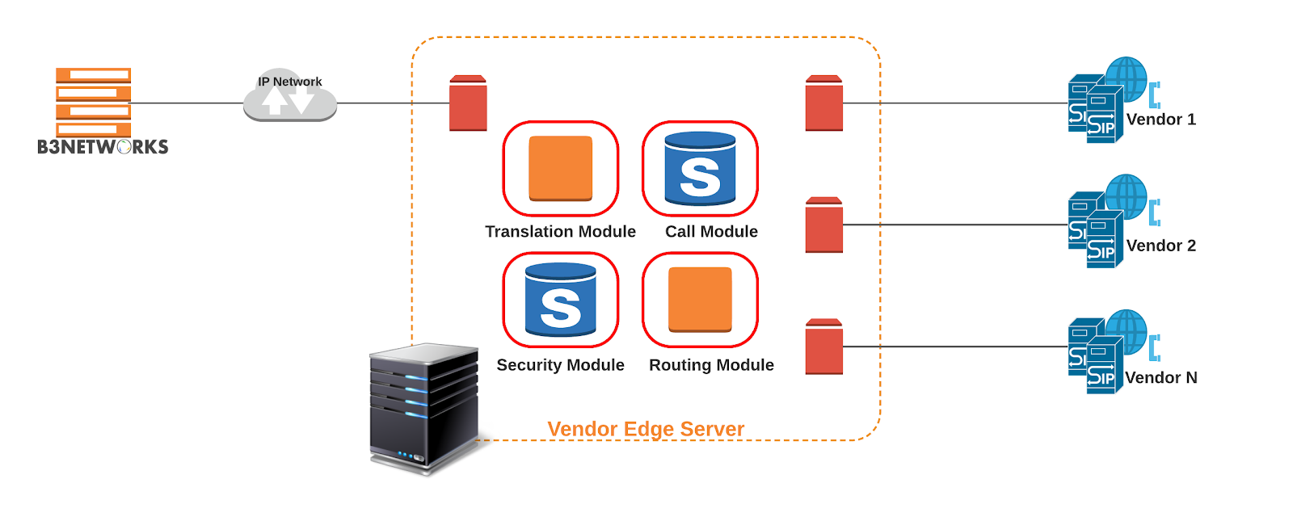
What is the Vendor Edge Server?
It controls how calls are started, conducted, and terminated – and all the necessary media streams to allow calls to occur. The Edge Server will act as a firewall ensuring every call occurs properly and is protected along the way to its destination. Vendor Edge Server is like the Session Border Controller that manages the call routing from the vendors to the B3’s network at the border.

Slide 6
Why choose Vendor Edge Server?
Reduce maintenance cost
Easy to manage
All products - 1 provider
Quickly support
The initiative in all situations

Slide 7
Functional Spec
Voice Vendor Interconnections
  Trunk Type
    Inbound
    Outbound
  Trunk Setting
    Support SIP
    IP Authentication (Peering)
    Supports CLID and DNIS Transformation
    Supports G729, G711U, G711A.
    Supports DTMF RFC2833
    Concurrent calls limit by Routes.
  Routing is using existing B3 Routing logic & based on 2 factors:
    DNIS: Dialed Number Identification Service
    CLID: Calling Line Identification
  Manipulation - Translation
  Load Balancing: distribute the call 50% to the primary peer and 50% for the secondary peer.
  Audit history
  Able to support vendor reconciliation.
  SIP logs for the calls

Slide 8
User Guide

Slide 9
Connect B3Networks - Edge Server - Vendors
Step 1: Get some basic settings ready before creating a trunk:
  Codec: G711A (PCMA) / G711U (PCMU) / G729
  Capacity: number of CPS, concurrent call
  Translation Rule (optional)
  Manipulation (optional)
Step 2: Create 2 Trunks (Inbound & Outbound) for your vendors based on their interconnection form
Step 3: Configure routing plan for your Edge Server:
  DNIS routing (required)
  CLID routing (optional)

Slide 10
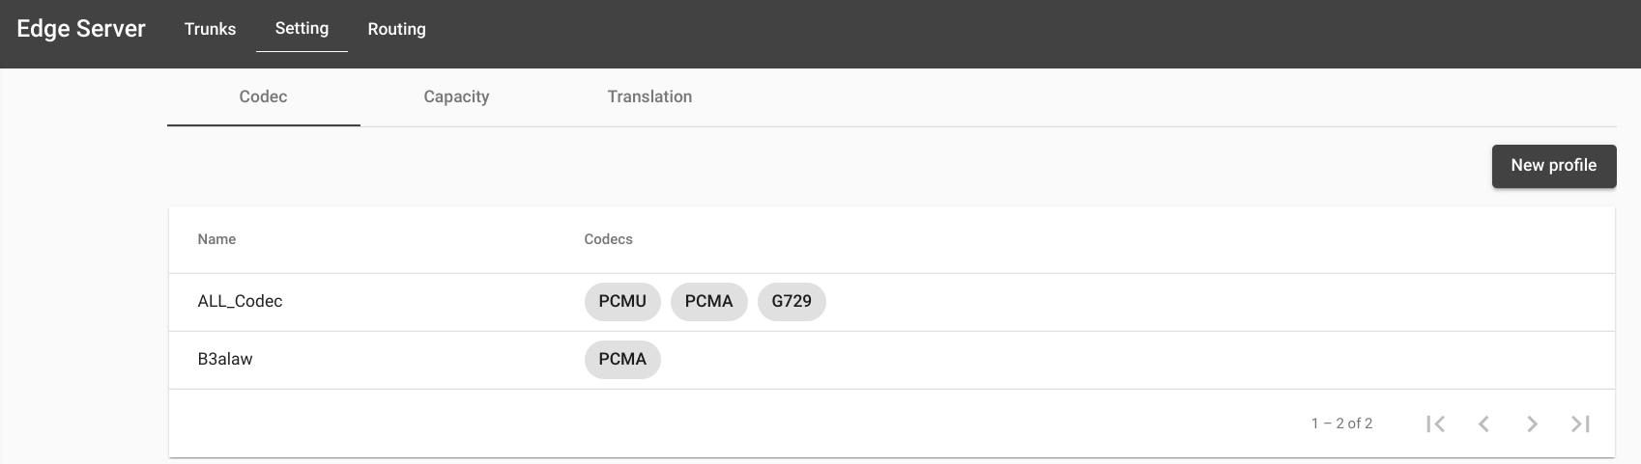
Step 1: Get some basic settings ready before creating a trunk
Configure codec profile

Slide 11
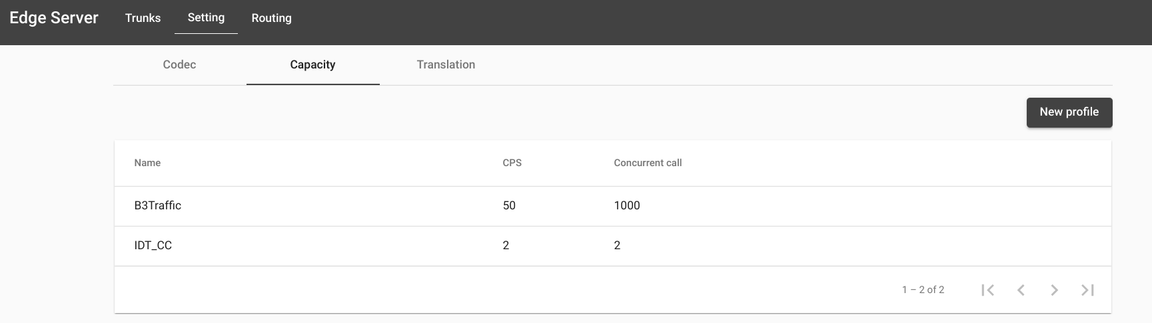
Step 1: Get some basic settings ready before creating a trunk
2. Configure capacity profile (Number of Call Per Second and Concurrent Calls)
Call per second (cps) - Max: 50: the amount of calls you can initiate in a single second.
Concurrent Call - Max: 1000: the total amount of live calls (including calls in calling state) you can have at the same time.

Slide 12
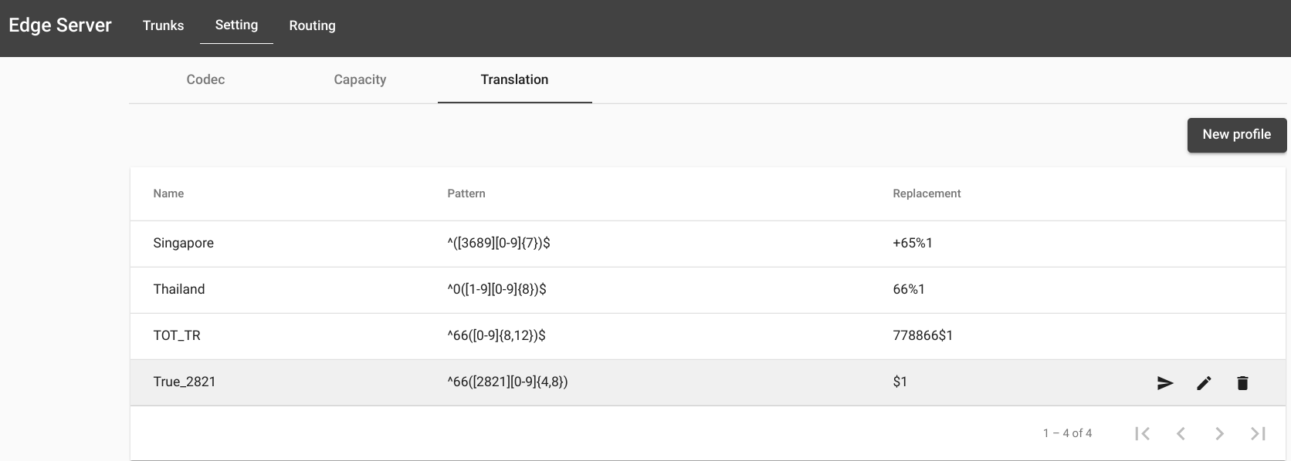
Step 1: Get some basic settings ready before creating a trunk
3. Configure translation rules
This tab is to convert the prefix of DNIS and CLID as vendors’ requirement.

Slide 13
3. Configure the translation (cont’d)
028215999 Pattern: ^0({[1-9]{8})$ Replacement: 66$1 Translated to: 6628215999 Start with 0 length = 9 remove = 1 add prefix 66 6620385 Pattern: ^66([0-9]{8})$ Replacement: 0$1 Translated to: 02038567 Start with 66 length = 10 remove = 2 add prefix 0
^ : indicates the beginning of a regular expression (required)
( : starts a regular expression block.
) : closes the block
[0-9] : matches one digit in the range from 0 to 9 (0,1, 2, 3, 4, 5, 6, 7, 8 and 9)
{8} : defines the number of occurrences for the previous expression, i.e. exactly 8 digits in the range 0-9.
$ : indicates the end of the regular expression (required)

Slide 14
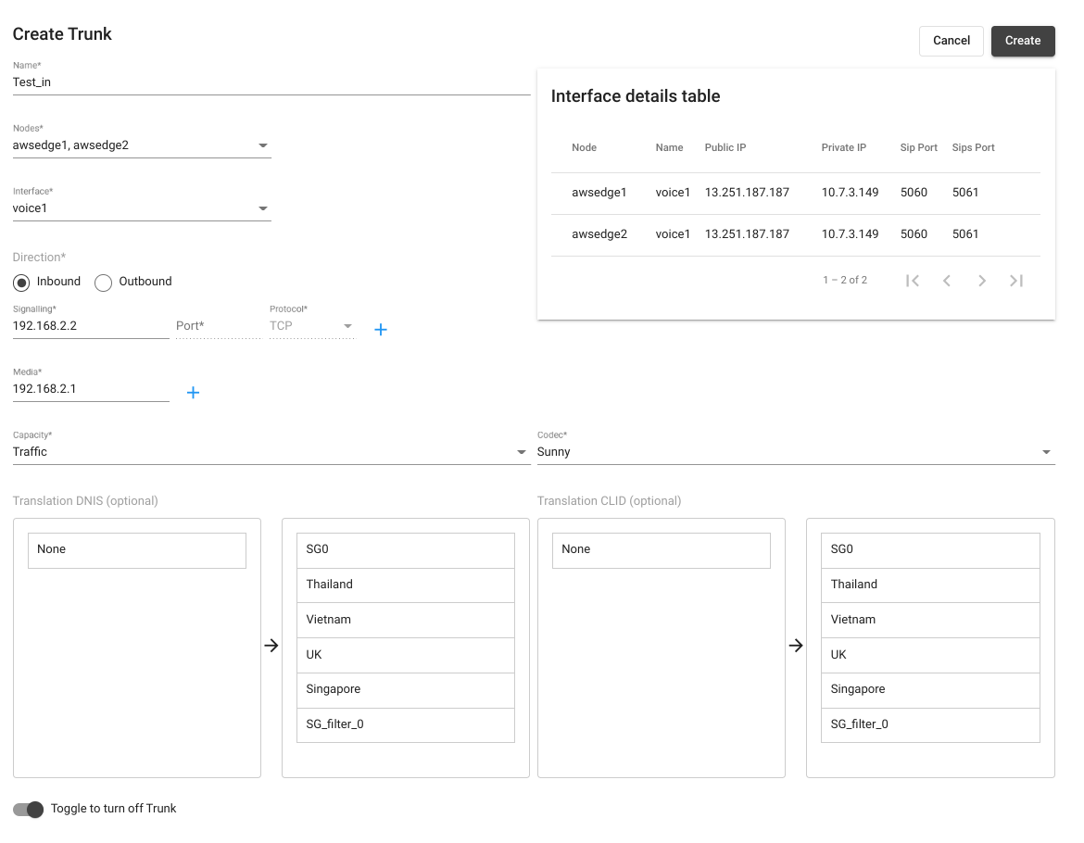
Step 2: Create Trunk
4. Create outgoing and incoming trunk (based on set codec, capacity, translation)
Signaling
Port
Protocol
Media
=> Based on vendor’s interconnection form.
NOTES:
The media port allows 10000-65000
The Trunk’s name should be a unique capital name
The profile‘s name should be a unique non-capital name

Slide 15
Step 2: Create Trunk
4. Create outgoing and incoming trunk (based on set codec, capacity, translation)
Interface details table: Provide the detail IP Addresses of the Edge Server

Slide 16
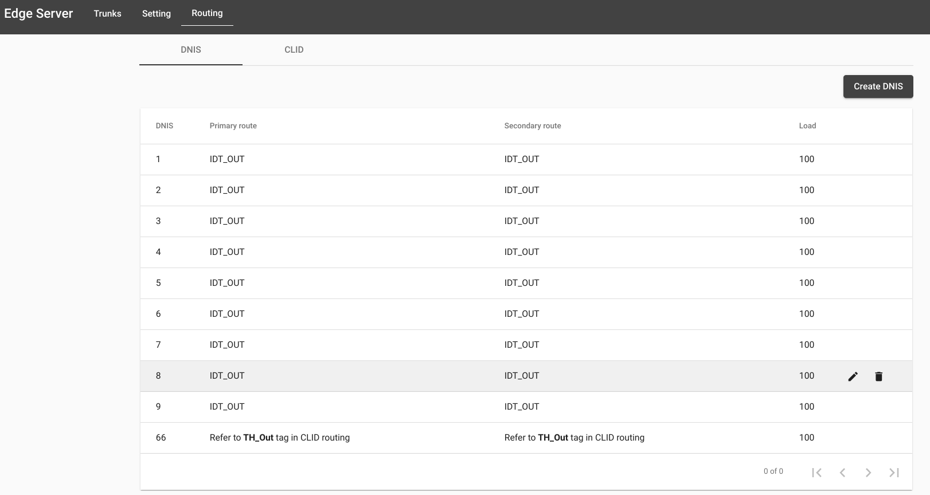
Step 3: Configure routing rule for Edge Server
DNIS: as always
CLID: optional

Slide 17
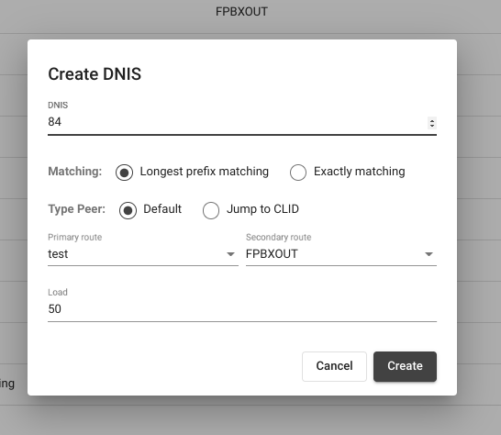
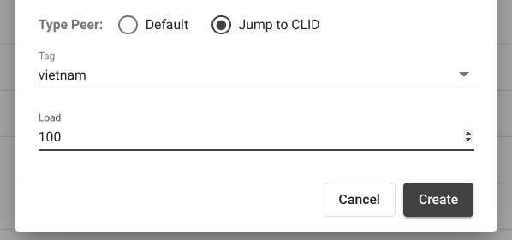
Step 3: Configure routing rule for Edge Server
Routing rule for DNIS
DNIS: prefix that will be applied for this rule.
Matching:
Longest prefix matching: The longest prefix matching criteria applies while each step is performed. At each step, if multiple matches are found, the one with the longest explicit match is chosen.
(e.g, DNIS: 84 234xx -> match)
Exactly matching: The server will look up the exact pattern.
(e.g, DNIS: 84 234xx -> not match ; DNIS: 84 -> match)
Type Peer:
Default: after the DNIS matched, the call will be distributed to the relevant trunks based on configured load balancing.
Jump to CLID: after the DNIS matched, system will go to the routing rule of CLID to continue checking.
Primary route/secondary route: the call will be routed randomly to the assigned outgoing trunks.
Load: distribute the call to the primary peer and the secondary peer based on the set percentage.
    100 > 100% Primary - 0% Secondary
    50 > 50% Primary - 50% Secondary
    0 > 0% Primary - 100% Secondary

Slide 18
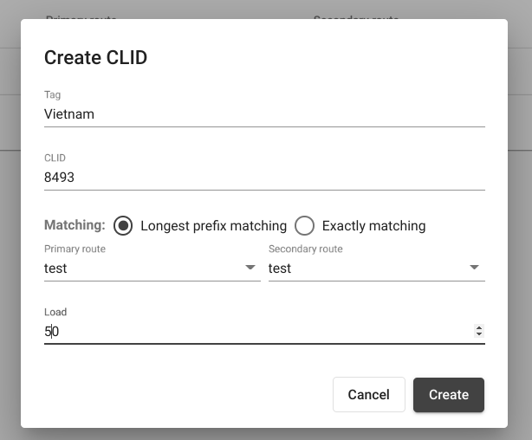
Step 3: Configure routing rule for Edge Server
Routing rule for CLID
Tag: Name for the rule. It is used when we want to filer route
CLID: the prefix that will be applied for this rule
Matching:
Longest prefix matching: The longest prefix matching criteria apply while each step is performed. At each step, if multiple matches are found, the one with the longest explicit match is chosen. (e.g, CLID: 84 93xxx -> match)
Exactly matching: The server will lookup the exact pattern.
(e.g, CLID: 84 93xxx -> not match ; CLID: 8493 -> match)
Primary route/secondary route: the call will be routed randomly to the assigned trunks.
Load: distribute the call to the primary peer and the secondary peer based on the set percentage.
  100 > 100% Primary - 0% Secondary
  50 > 50% Primary - 50% Secondary
  0 > 0% Primary - 100% Secondary

Slide 19
Thank You
For comments and feedbacks please contact academy@b3networks.com.

