Slide 1

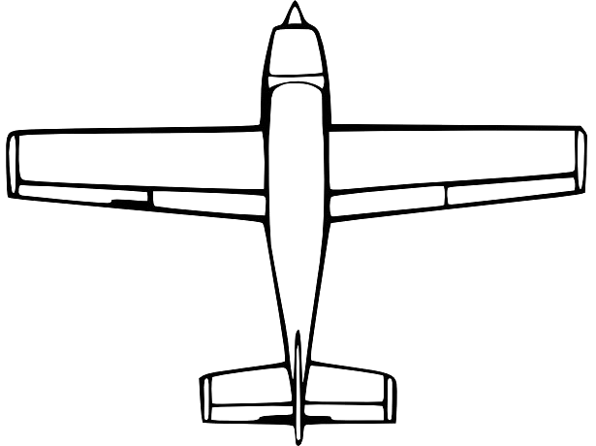



A
B
C
D
E
E
How do magicians trick people?
Notes:
GLIDER K-1 VERSION

