Slide 1


Travel
FREE PRESENTATION TEMPLATE

Slide 2


Welcome
Welcome to the world of fantasy! Join us on a journey to explore the mystical creatures, enchanted lands, and magical wonders that exist beyond our reality. Discover the wonders and secrets of this exciting realm and unlock the power of imagination.

Slide 3

Table of Contents
01
02
Introduction
Encounters
The Extraordinary Realm
Unicorn Sightings
03
04
Wonders
Magic
Wishes Granted
Spellcasting

Slide 4
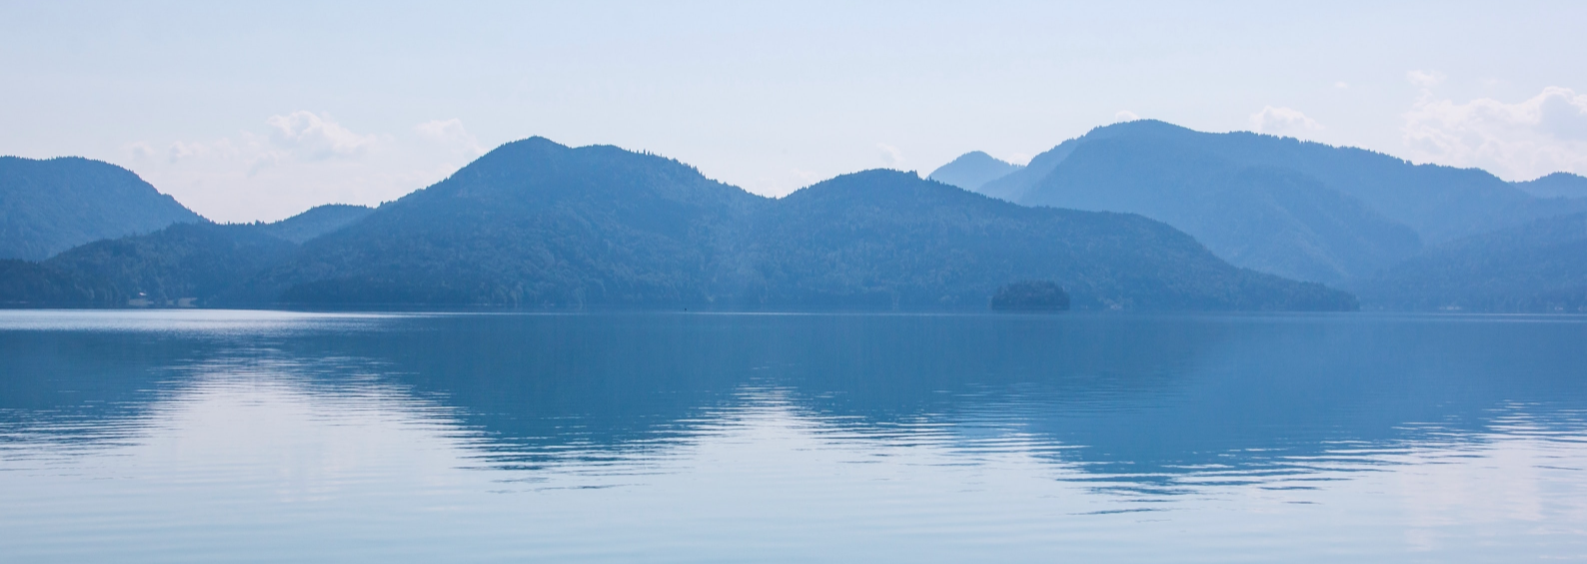
Introduction
The Fantasy Realm: Uncovering the Secrets of the Imagination and the Magic that Lies Within

Slide 5
The Realm of the Extraordinary
Welcome to the Fantasy World, a realm of wonder and enchantment where anything is possible. Here, dragons breathe fire, unicorns prance through meadows, and rainbows shine brightly. This world is a place where wishes come true, where potions can be cursed and spells are cast. It's a place of treasure and adventure, where the impossible becomes possible. But the greatest treasure of all is the one that lies within.
The world of fantasy is a reflection of our deepest desires, our fondest dreams, and our wildest imaginations. It's a place where we can let go of the constraints of reality and explore the boundless possibilities of the human mind. In this introduction, we will delve into the mysteries of this realm, uncovering the magic and wonder that lies within. So come with us and let's embark on a journey through the Fantasy World.

Slide 6



Unicorn Sightings
Dragon Taming
A record of the number of unicorns spotted in the fantasy realm and the beauty and mystery that surrounds these enchanting creatures.
A closer look at the art of taming dragons and the brave adventurers who dare to take on these fearsome creatures.

Slide 7




01
02
03
04

Slide 8

Fantasy is the gateway to the impossible, the land where the ordinary becomes extraordinary, and the impossible becomes possible. It is the realm of the imagination, where anything can happen and everything is possible.
The Dream Weaver

Slide 9

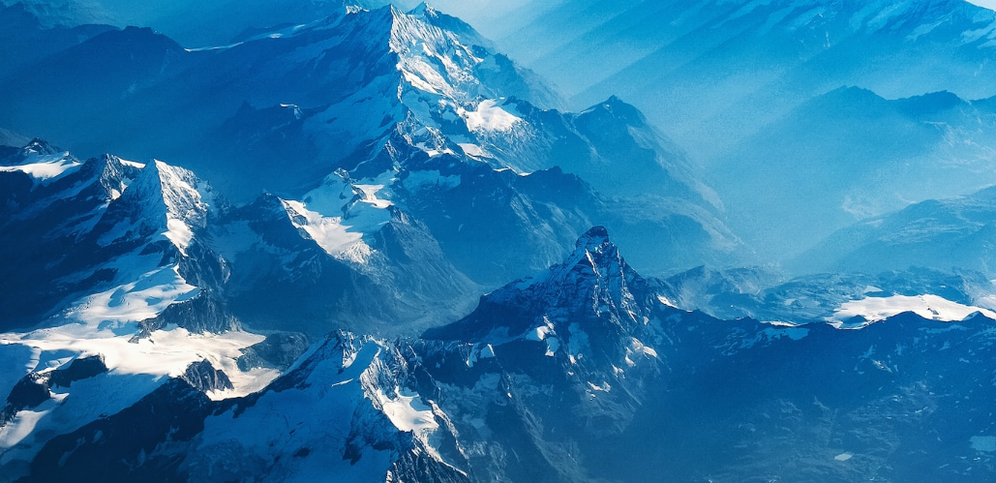
Dragon Taming Technique
A guide to taming and caring for dragons in the realm of magic.
The Art of Unicorn Sighting
Tips and tricks for spotting the elusive unicorns in their natural habitat.

Slide 10


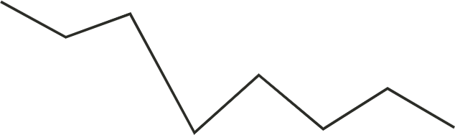

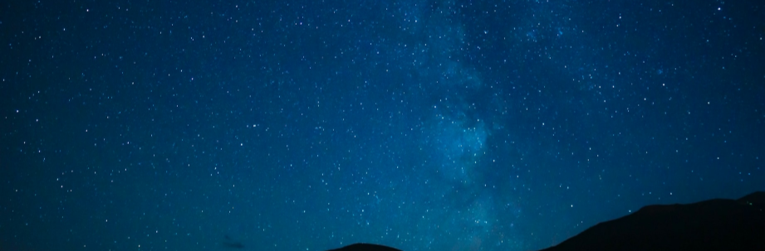
The Magic of Dragons: A Research
100
90
80
70
60
50
40
30
20
10
0
1
2
3
4
5
6
7
8
Spellcasting Progress
A record of the number of spells cast per year

Slide 11

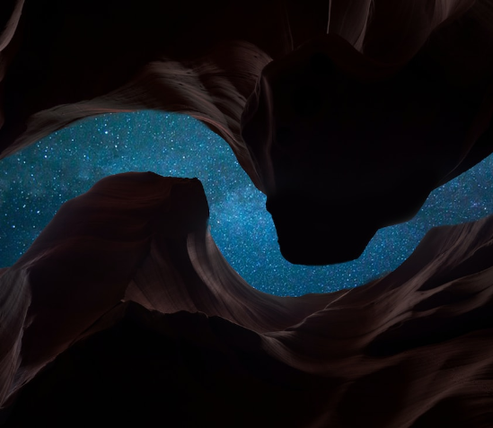



The Elves: A Glimpse into Their World
"The Art of Archery": Discover the intricacies of the Art of Archery as practiced by the graceful and precise elves.
"The Music of the Elves": Immerse yourself in the enchanting music of the elves, whose songs have the power to heal.
"The Life of an Elf": Learn about the customs and daily life of the elves, from their familial structure to their religious beliefs.

Slide 12


Some Data
75%
Enchanted Creatures
possess the ability to cast spells.
60%
Magic-Wielding Individuals
practice the art of illusions.
90%
Spells Cast
are dark magic, foretelling danger.

Slide 13

234,567
UNICORN SIGHTINGS
A tally of the number of unicorns spotted in the fantasy realm.

Slide 14
233 Coins
85%
Treasure Found
Wished Granted
456 Hours
535 Km
Duration of Spell Casting
Journey Distance

Slide 15

A Magic Picture

Slide 16
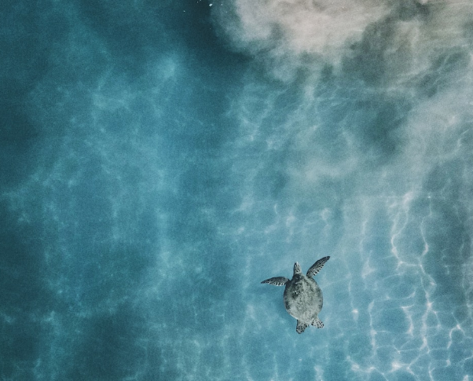
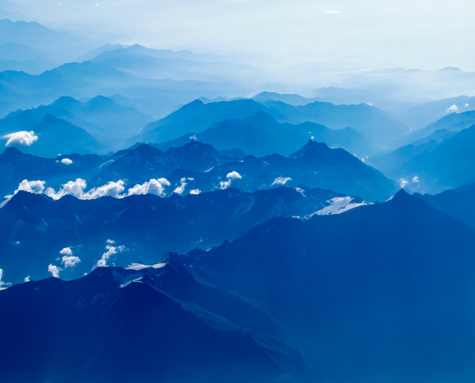
Discover the secrets
Find your own path
1
2
Explore the lush, vibrant forest and uncover the mysteries that lie within.
Choose your own path through the forest, and see where it takes you.
Meet the creatures
Uncover the magic
3
4
Encounter the mythical creatures that call the forest home, from talking animals to fairies.
Learn about the powerful magic that pervades the forest and how it affects all who enter.

Slide 17

Fantasy Realm at a Glance
The Enchanted Forest
A magical forest filled with talking animals and enchanted creatures.
The Crystal Caves
A network of underground caves filled with precious gems and crystals.
The Dragon's Lair
A dangerous and mysterious place where dragons reside.

Slide 18

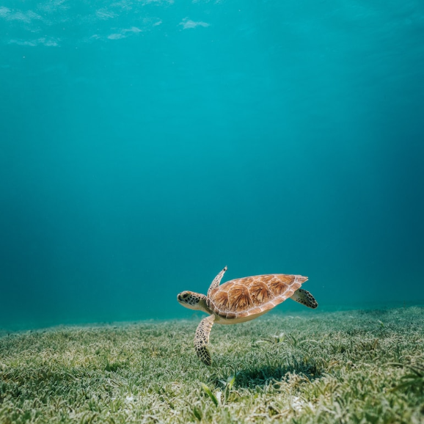

The Information
Spellcasting Competition
Treasure
Hunt
A significant event in the history of the fantasy realm, in which the greatest spellcasters of the realm.
A significant event in the history of the fantasy realm, in which a massive and awesome treasure hunt was organized.

Slide 19



Our Team
Eldruin
Elementalen
Lunaria
The Fire Mage
The Guardian
The Moon Priestess

Slide 20





The Mystery
The Forbidden Forest: A place of mystery and wonder, where mystical creatures roam and flora flourishes.
The Crystal Caves: A network of glittering caves filled with precious gems and minerals, guarded by fierce beasts.
The Enchanted Garden: A place of pure beauty and tranquility, where the colors of the flowers are vibrant.

Slide 21












The Organization
Chloe Ng
The Mage
Valtorin
Aurielle
Theronis
Dariana
The Assassin
The Priestess
The Warrior
The Shaman
Lyrisa
Lucian
Elvina
Kaelen
The Dreamer
The Conjurer
The Oracle
The Sentinel
Cedric
Seraphina
The Timekeeper
The Lightbringer
To download more editable chart, click here

Slide 22


Thank you for choosing EaTemp
Credit | Image: Unsplash
We offer free and high-quality slides templates for your presentations. We appreciate you choosing us and hope our templates have been helpful.
As a new website, we rely on your support to grow, so please help us by sharing our site with your friends and colleagues.

