Slide 1
SIP Trunk
- Admin Guide -
January, 2025

Slide 2

Table of Contents
Prerequisites
Configuration
Call History

Slide 3
Prerequisites

Slide 4
Prerequisites <Licenses>
The following licenses are required to enable the SIP Trunk feature.
Type | License | Mandatory | Optional
Base | SIP Trunk | ✅
Add-on | Concurrent Call | ✅
 | Number | ✅

Slide 5
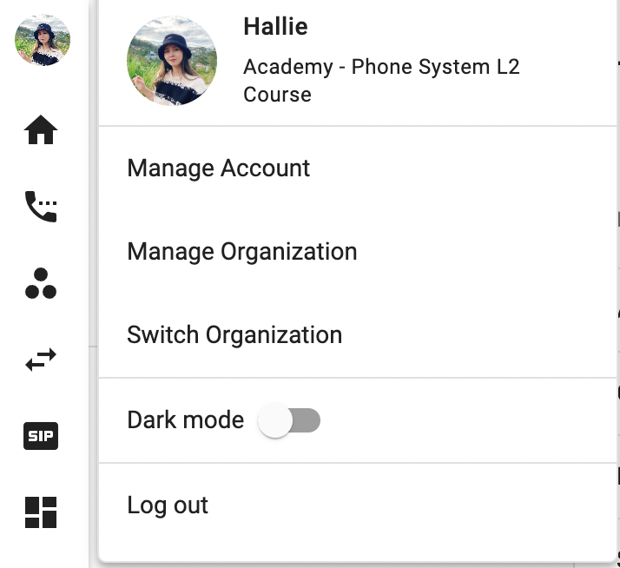
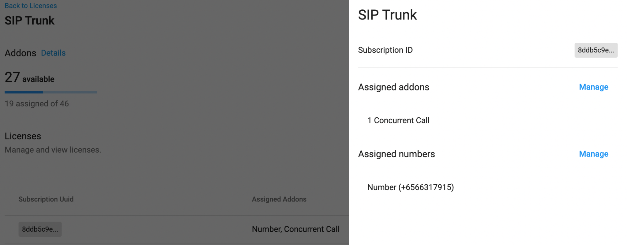
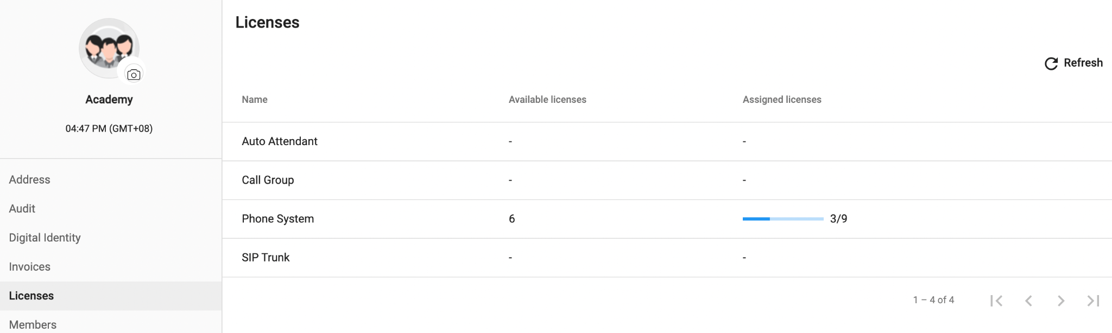
Prerequisites <Assign Licenses>
To assign the Licenses, please follow the steps below:
Click on the profile icon > go to Manage Organization
Go to the License, choose SIP Trunk
Select a Subscription that you want to configure
At Assigned addons and numbers, choose:
  Concurrent Call
  Number Addon
Save

Slide 6
Prerequisites <Assign Licenses>
Access Rules
Actions | Admin with Permission | Member with Access
See SIP Icon on the Sidebar | ✅ | ✅
Access SIP | ✅ | ✅
Access all SIP accounts | ✅ | ❌
Access a specific SIP account | ✅ | ✅ (Granted resource)
See Overview tab | ✅ | ✅
Edit Label | ✅ | ❌
Get certificate | ✅ | ✅
Assign Members | ✅ | ❌
See Configuration tab | ✅ | ✅
Configure the SIP Settings | ✅ | ✅
See Networking Info tab | ✅ | ✅
See Security tab | ✅ | ❌
Add IP Whitelist | ✅ | ❌
Total number of Members that can be assigned access = 50 Members / SIP account.

Slide 7
Configuration

Slide 8
Account

Slide 9
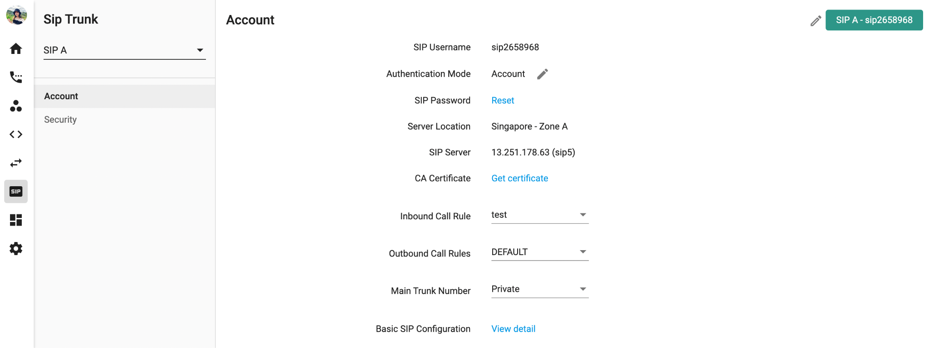
Label your SIP Account
Edit SIP Label

Slide 10
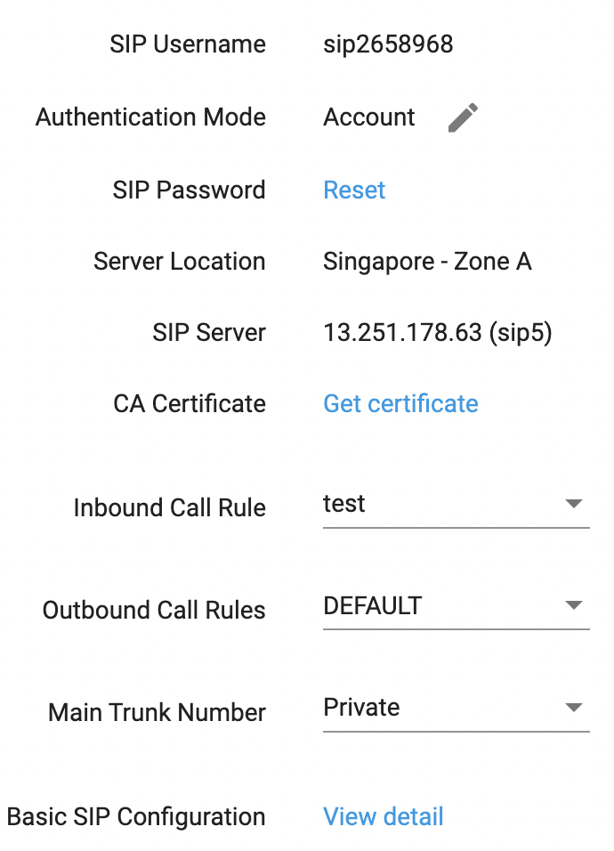
SIP Credentials
There are 2 types of SIP:
Account: these information are required to register a SIP account:
  Username
  Password: There are two ways to reset and get the SIP password:
    Automatically generate a password
    Create a password:
      Password policy:
        Length = 14
        Requires at least one uppercase letter
        Requires at least one lowercase letter
        Requires at least one number
        No reusing of last ten passwords
  Server Domain: Use sip<x>.b3networks.com (e.g: sip5.b3networks.com)
IP

Slide 11
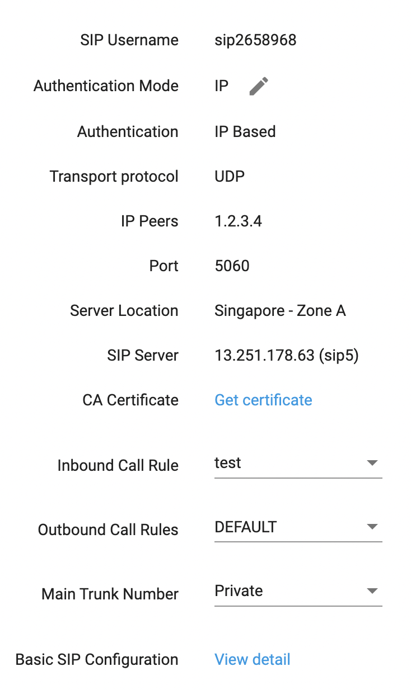
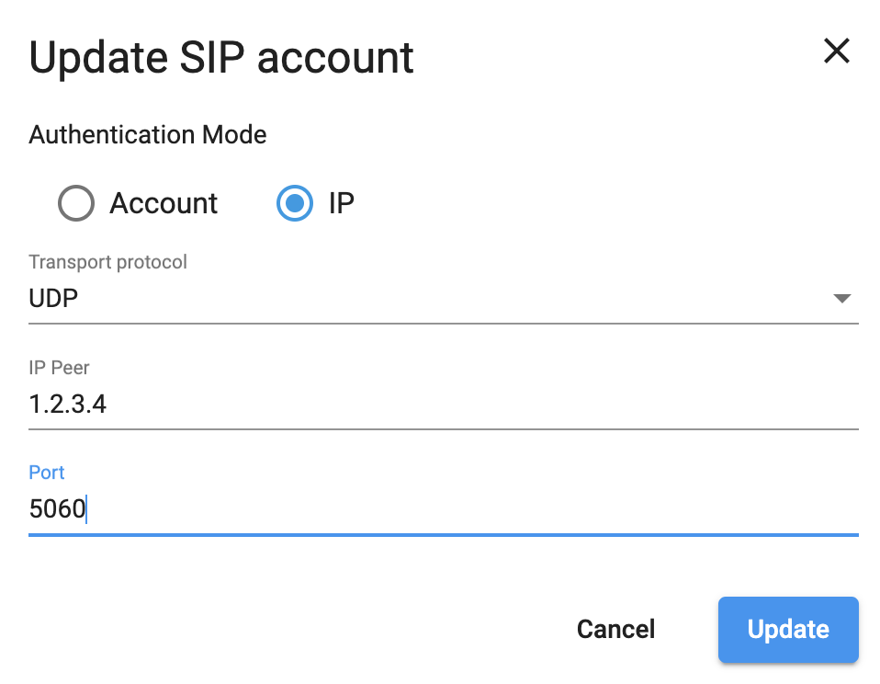
SIP Credentials
There are 2 types of SIP:
Account
IP:
  Fill in the Transport Protocol, IP Peer, and Port to register the SIP account.
    Transport Protocol: choose the protocol you would like us to send to you:
      UDP
      TCP
      TLS
    IP Peer: fill in your IP Address. We will only send the voice to and charge the usage of this IP address.
    Port number: Ports are standardized across all network-connected devices, with each port assigned a number. Most ports are reserved for certain protocols — for example, all Hypertext Transfer Protocol (HTTP) messages go to port 80. While IP addresses enable messages to go to and from specific devices, port numbers allow targeting of specific services or applications within those devices.
  Use our IP Address add the SIP Server to send your calls to

Slide 12
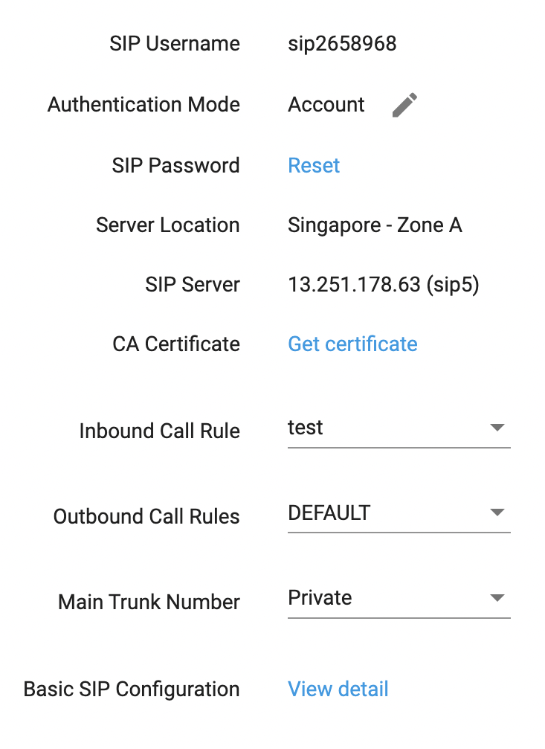
Server Location - CA Certificate
Let you know where our server is located
You can download our Certificate Authority from here when needed

Slide 13
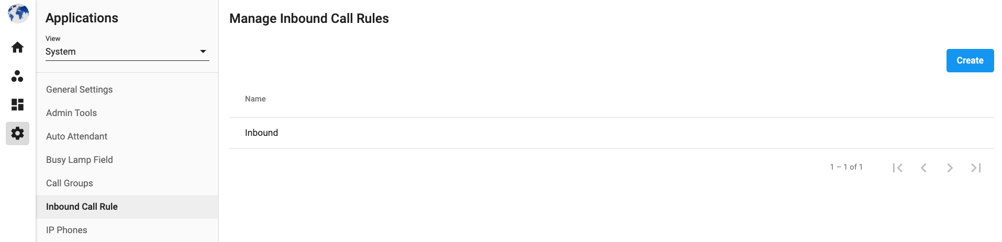



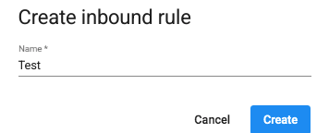
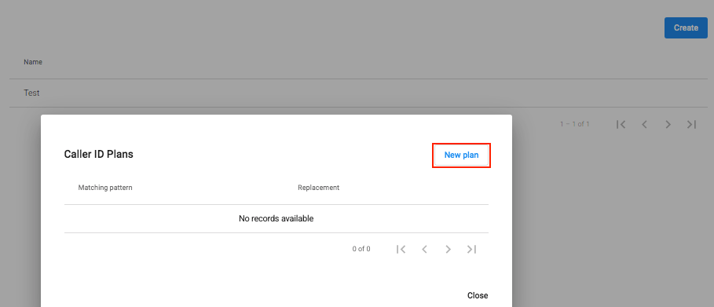
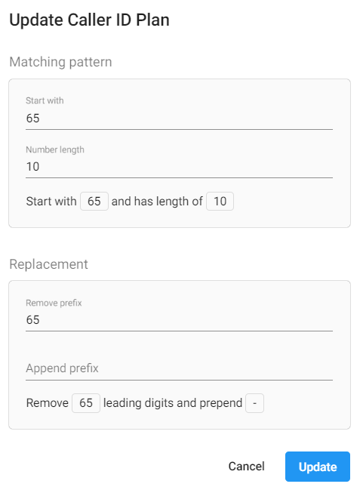
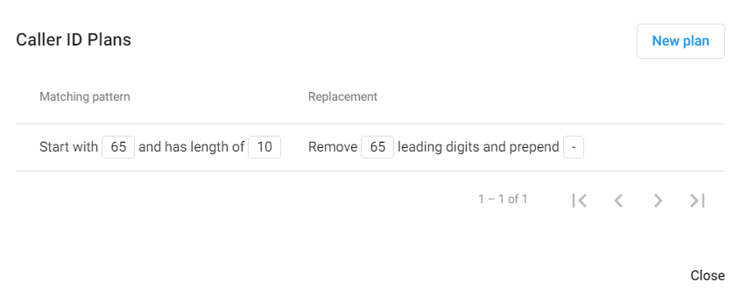
Inbound Call Rule
As a default, the system will display this standard Caller ID on the recipient's side when users make outgoing calls:
<country code> + <area code> + <destination>
It is possible for Owner/Admins to create an Inbound Call Rule that will override the way the recipients see the Caller ID.
To create an Inbound Call Rule, follow the steps below:
Go to Settings
View System > Inbound Call Rule
Click Create
Give the rule a name > Create
Click on the pencil icon next to the created rule > click New plan
At the plan as you wish > Update

Slide 14
Inbound Call Rule
Once the Inbound Call Rule has been created, the user can:
Go back to the SIP Trunk Settings page
Choose the SIP Account to configure
Go to Account > At the Inbound Call Rule part, select the created Inbound Call Rule

Slide 15
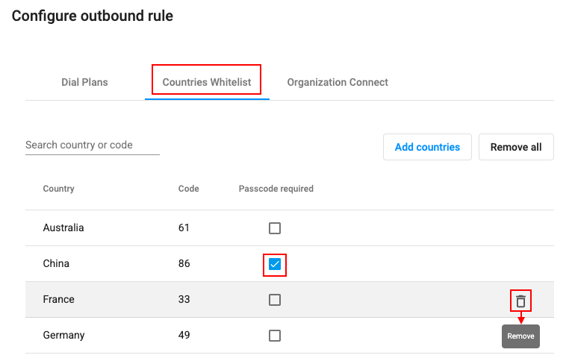
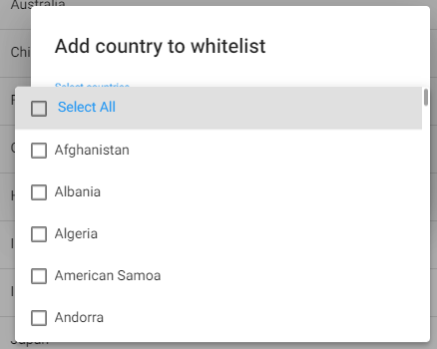
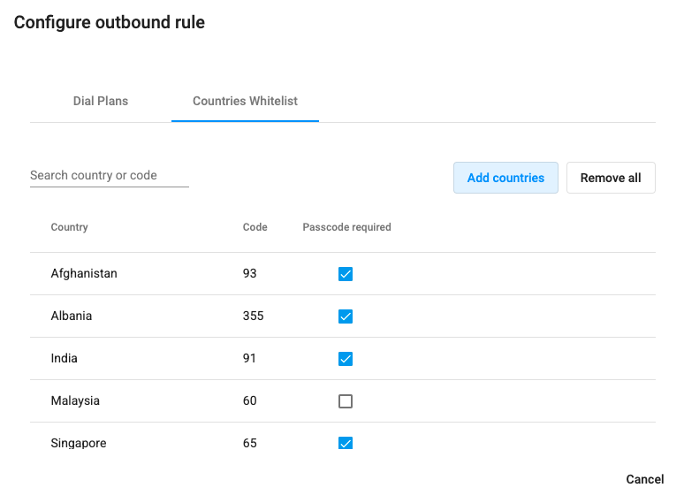
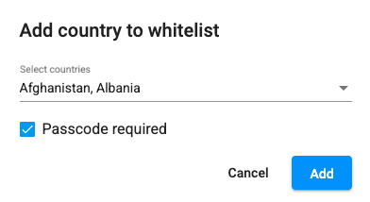
Outbound Call Rule
Outbound Rules are composed of the rules for:
Dial plan: By default, if users want to make an outbound call from our system, they will need to follow this standard:
  <country code> + <area code> + <destination>
However, to reduce the steps, owner/admins can set up a dial plan for users’ calls. By setting this up, users will not have to key in the country code every time they call out.
Country whitelist: the list of countries users can call to.
  Passcode required: users need to key in their passcode in order to call to these countries.

Slide 16
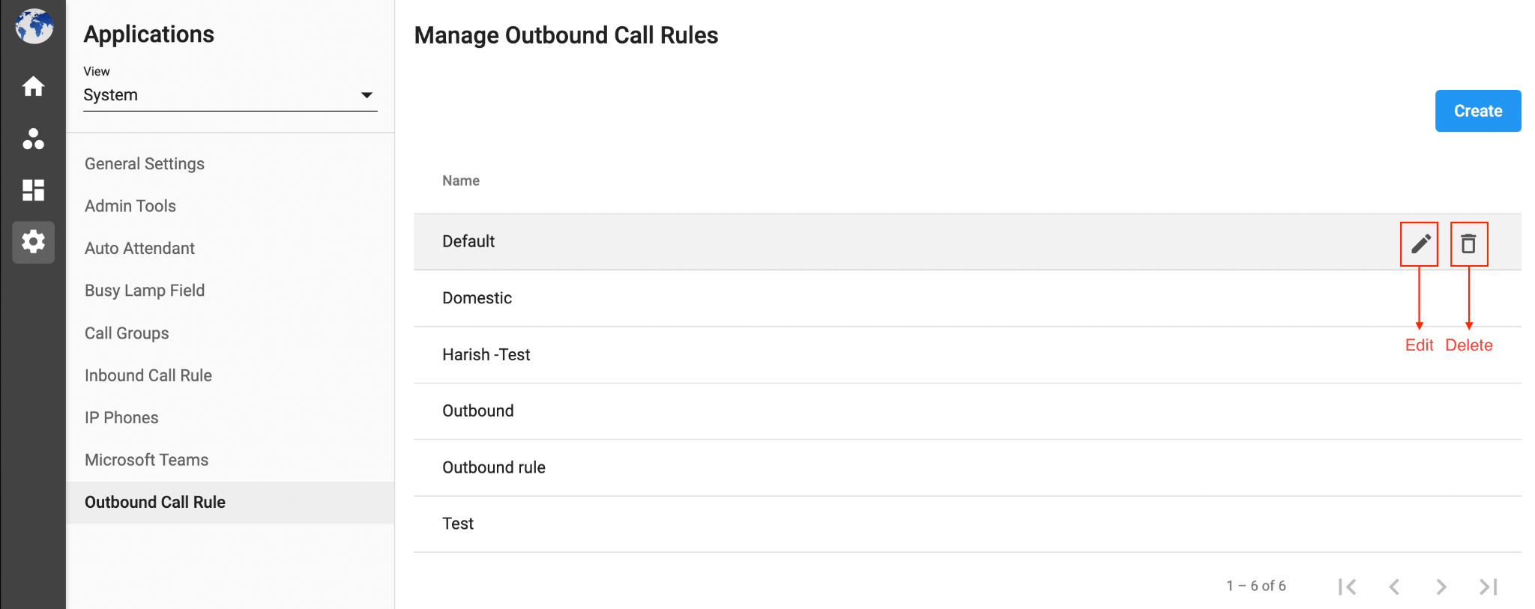

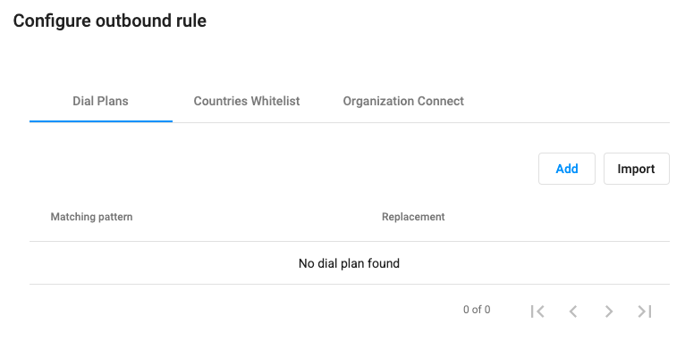
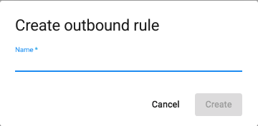
Outbound Call Rule
A SIP account needs to be assigned to an Outbound Call Rule in order to make outbound calls.
To create an Outbound Call Rule, follow the steps below:
Go to Settings
View System > Outbound Call Rule
Click Create
Give the rule a name > Create
Click on the pencil icon next to the created rule
At the plan as you wish > Update

Slide 17
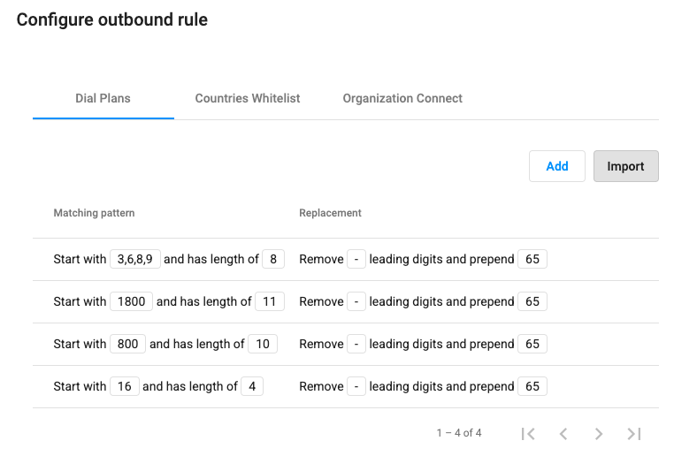
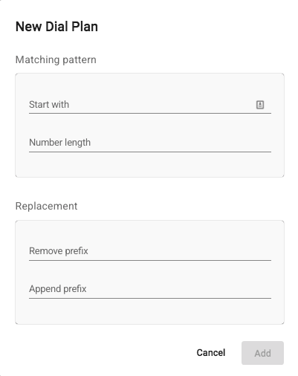
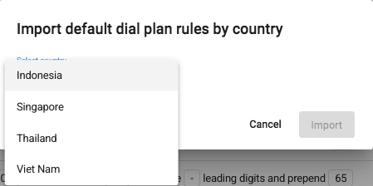
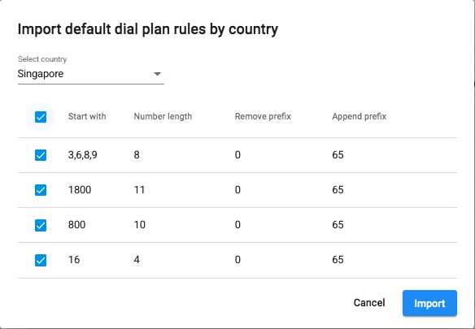
Outbound Call Rule
Outbound Call Rule is composed of the rules for:
Dial plan: By default, if users want to make an outbound call from our system, they will need to follow this standard:
  <country code> + <area code> + <destination>
However, to reduce the steps, owner/admins can set up a dial plan for users’ calls. By setting this up, users will not have to key in the country code every time they call out.
Country whitelist: the list of countries users can call to.

Slide 18
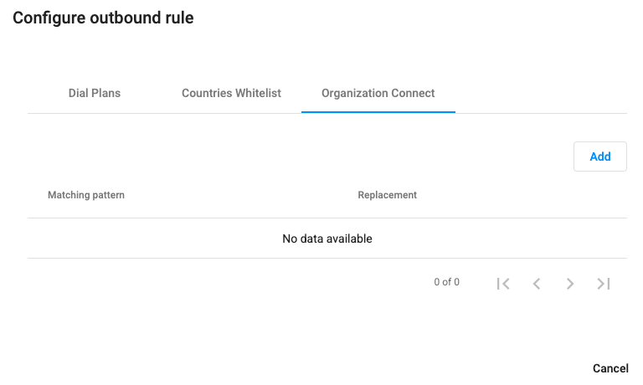
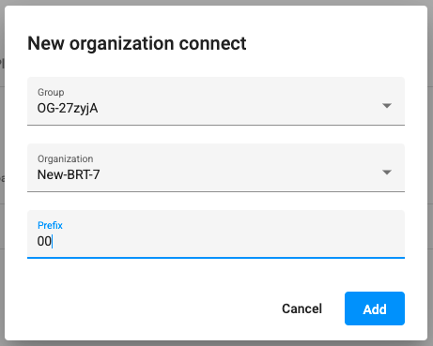
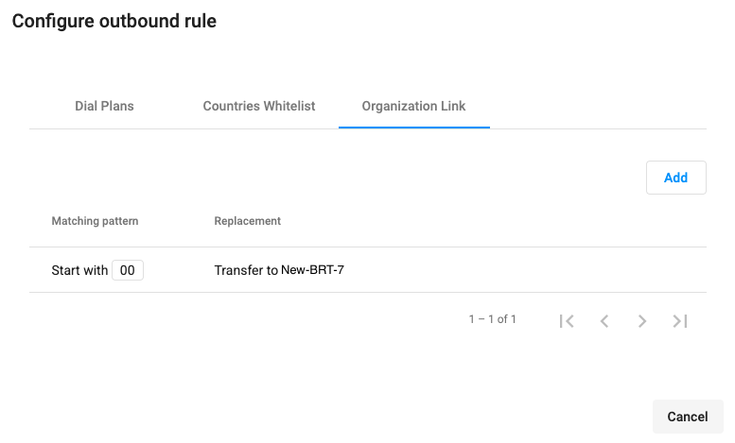
Outbound Call Rule
Outbound Rules are composed of the rules for:
Country whitelist: the list of countries users can call to.
  Passcode required: users need to key in their passcode in order to call to these countries.
Organization Connect: After the 2 organizations are connected, they need to define a Prefix to call the other side.
  The code is per direction per connection
  Limit 3 digits
*Note: Make sure the Matching Rules do not conflict with the Dial Plan
  Inter-organization Call:
  Prefix + Ext Number

Slide 19
Outbound Call Rule
Choose a created Outbound Call Rule. Click here to know how to create an Outbound Call Rule

Slide 20
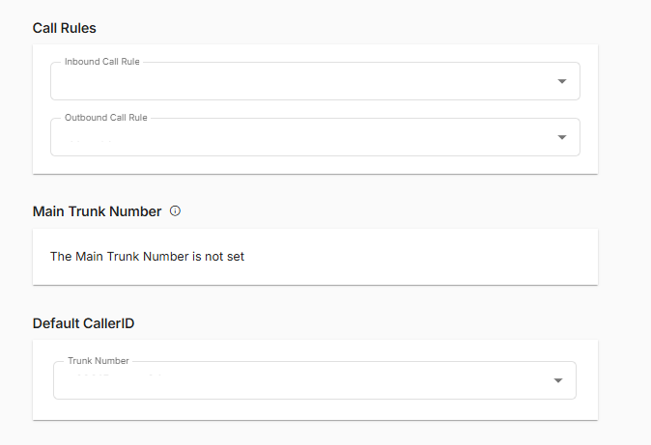
Main Trunk Number
The Main Trunk Number is used to identify outgoing calls when the caller ID is set to private.
It will be configured by your administrator and is used for billing reconciliation, as well as when the customer chooses a private caller ID.
If SIP Trunk account is assigned multiple numbers, the system will detect the 1st assigned number to be the Main Trunk Number.

Slide 21
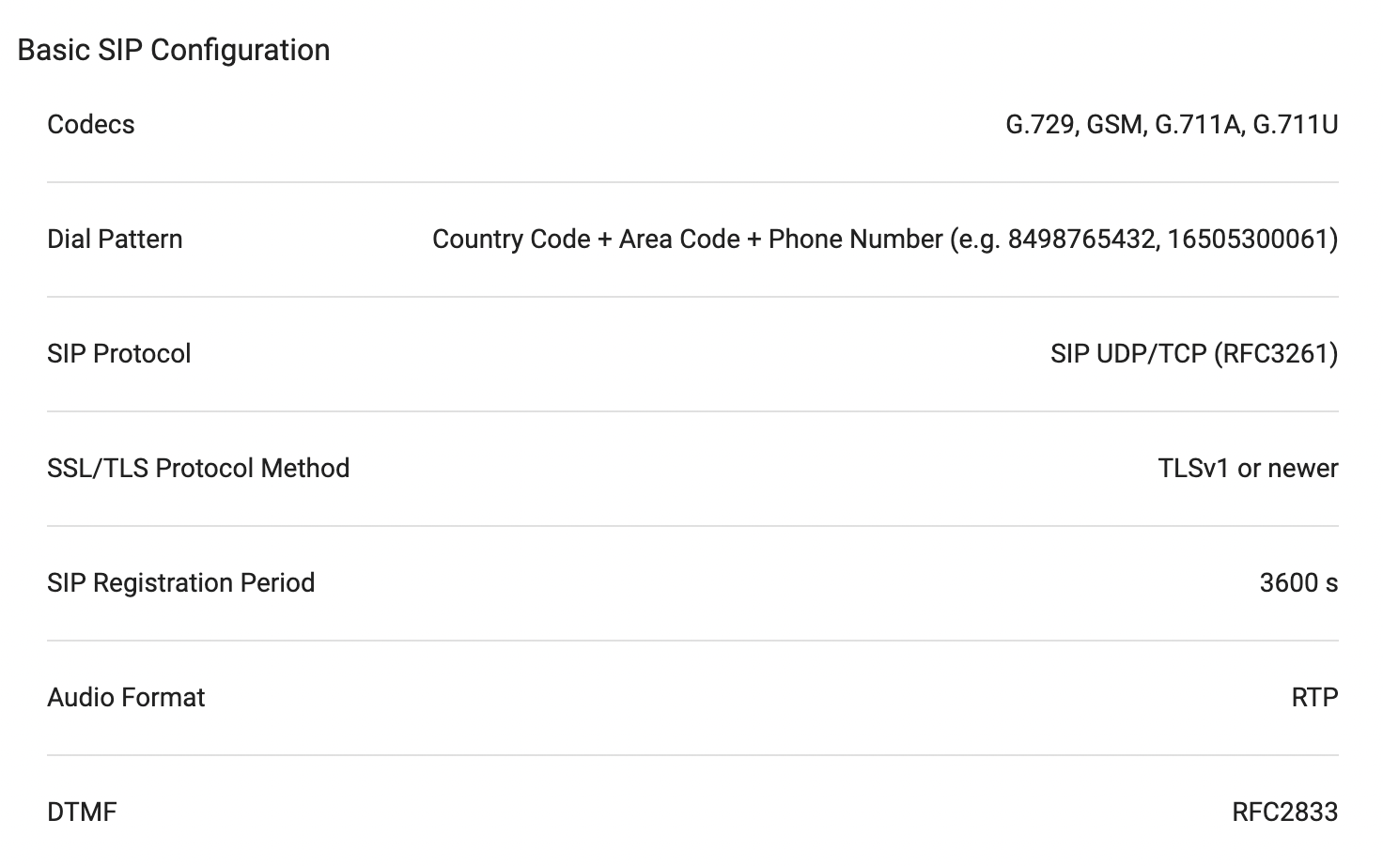
Basic Configuration
General information
Supported Codecs
How to dial a number/make a call
Transport protocol: TCP vs UDP
TCP gives more control
UDP lighter
TLS (secure)
DTMF mode supports only RFC2833. (IVR)

Slide 22
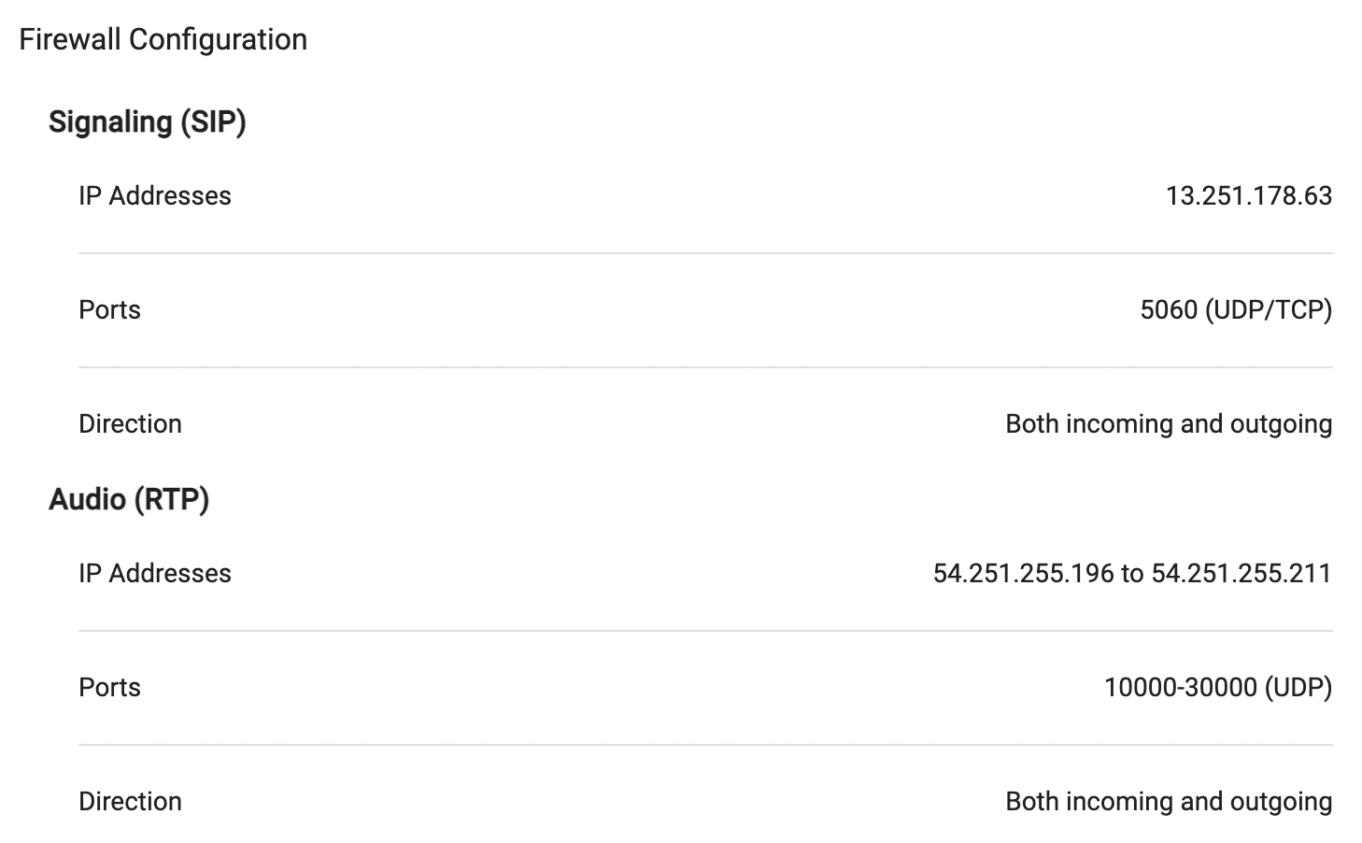
Basic Configuration
Firewall configuration
FIREWALL is a network security system that monitors and controls the incoming and outgoing network traffic based on predetermined security rules
Voice call = Audio + Signaling
*Make sure Firewall allows traffic following the rules mentioned in the SIP App

Slide 23
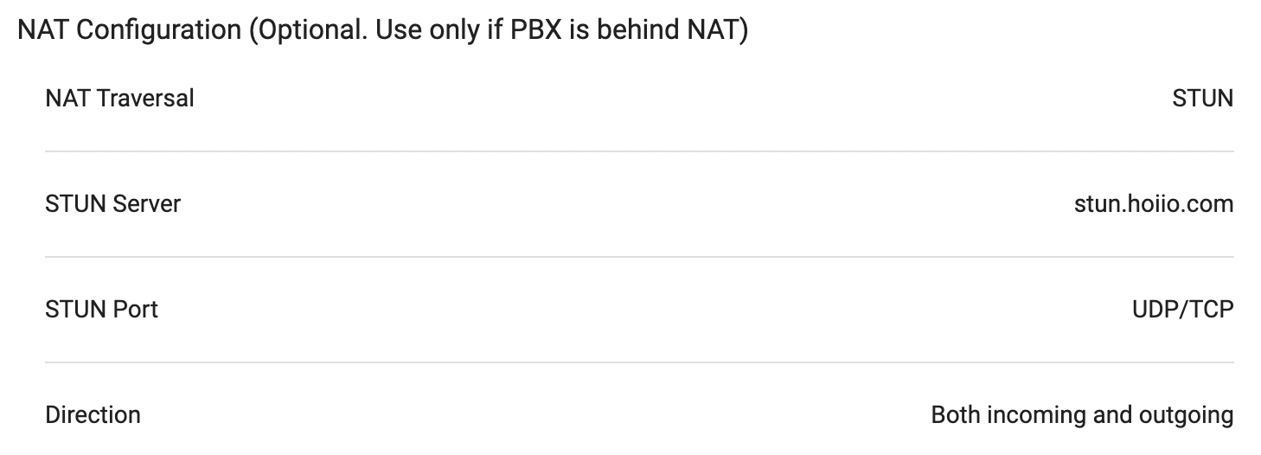
Basic Configuration
NAT configuration (Optional. Use only if PBX is behind NAT)

Slide 24
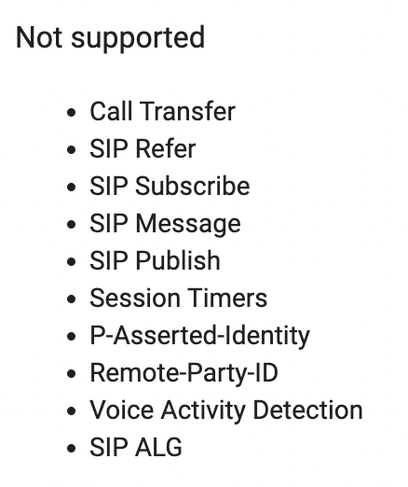
Basic Configuration
None-Supported Features
Call Transfer
SIP Refer
SIP Subscribe
SIP Message
SIP Publish
Session Timers
P-Asserted-Identity
Remote-Party-ID
Voice Activity Detection
SIP ALG

Slide 25
Security

Slide 26
Security
Customer SIP devices
B3Networks
Destination
IP
Country Code
 | IP White List | Country White List (configured in Outbound Call Rule)
Direction | Outgoing | Outgoing
Based on Information | Device’s Source IP | Destination (Dialed Number)
Failure message | “The number you are calling is currently unavailable, please try again later” | “Destination country is blocked”

Slide 27
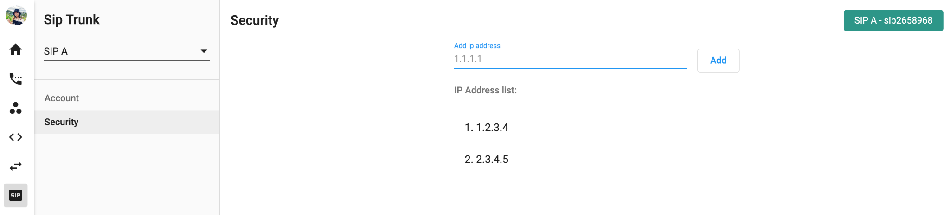
Security
IP address:
  Internet Protocol address is a numerical label assigned to each device participating in a computer network for communication.
  IPv4 Address: AAA.BBB.CCC.DDD (start 0.0.0.0 to 255.255.255.255)
  By Default SIP trunk allows all IP source.

Slide 28
Configuration

Slide 29
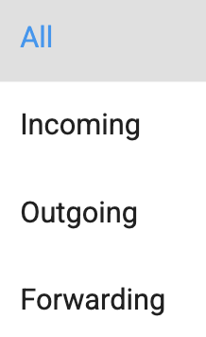
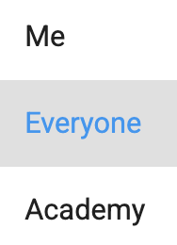
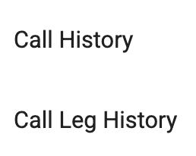
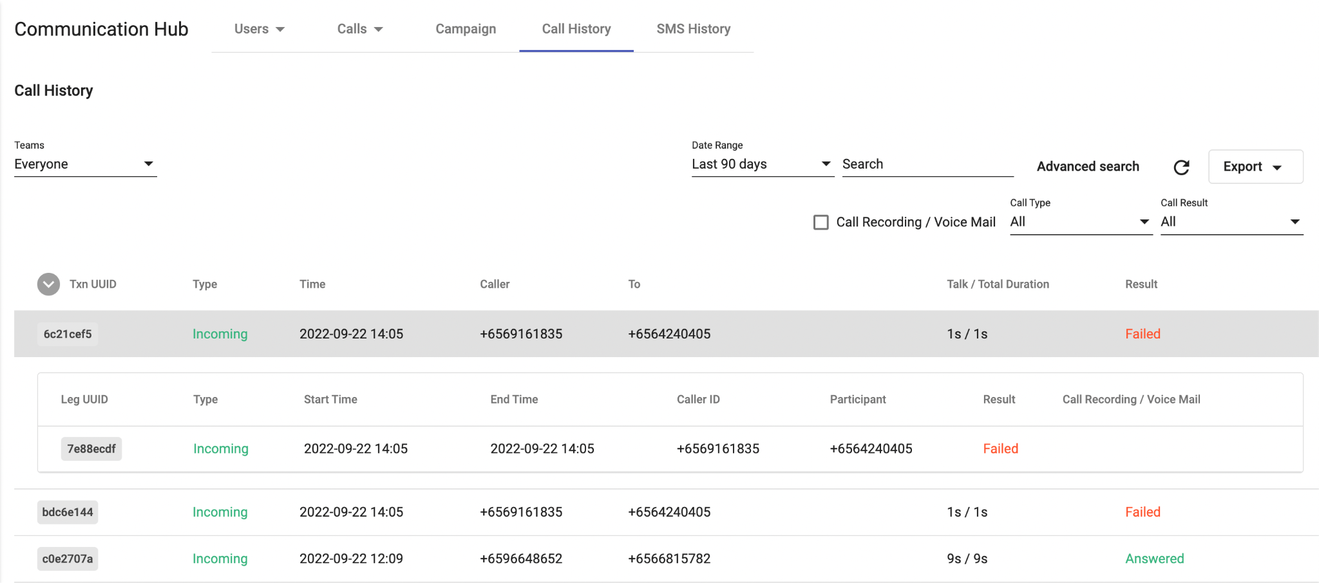
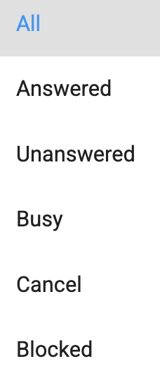

Robocall History
The Call History in Communication Hub is a place where keeps the records of all call transactions within the Organization. It will provide:
  Basic details - Call Directions (Incoming/Outgoing calls), Phone Numbers, Extension Numbers, Date & Time, etc.
  Advanced details - Call Result, Call Metadata, etc.
Data in Call History will be stored up to 1 year since the date the call is created.
It takes a few mins (max: 5 mins) for the data to appear on the portal after the call ends. Longer call duration will require longer processing time.
The SLA of call recording uploading on Unified History is 24 hours.

