Slide 1


Setting Instructional Goals and Decisions Based on Multiple Data Sources
Principal Professional Learning
September, 2023
Notes:
R Remind to bring device in our reminders about the PPL

Slide 2

Shared Norms
Be on time and prepared
Stay engaged - Signal for coming back
Respect all voices
Assume best intent
Notes:
R Under 1 min

Slide 3
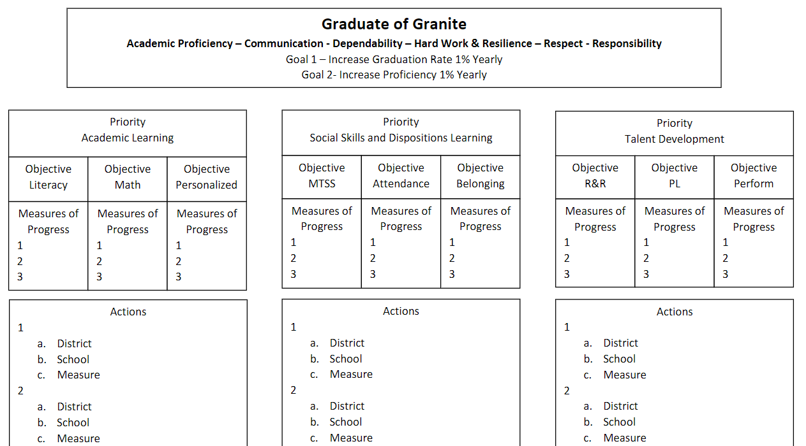
Notes:
R Under 1 min

Slide 4

Quick Review of our Principal Professional Learning (PPL) 3-Year Cycle
Year 1- “The What” is good/great in Instruction
Year 2- “The What” is good/great in Learning Environment
Year 3- The “How” to Build Principal Capacity based on your
understanding of what is good/great
Notes:
R

Slide 5
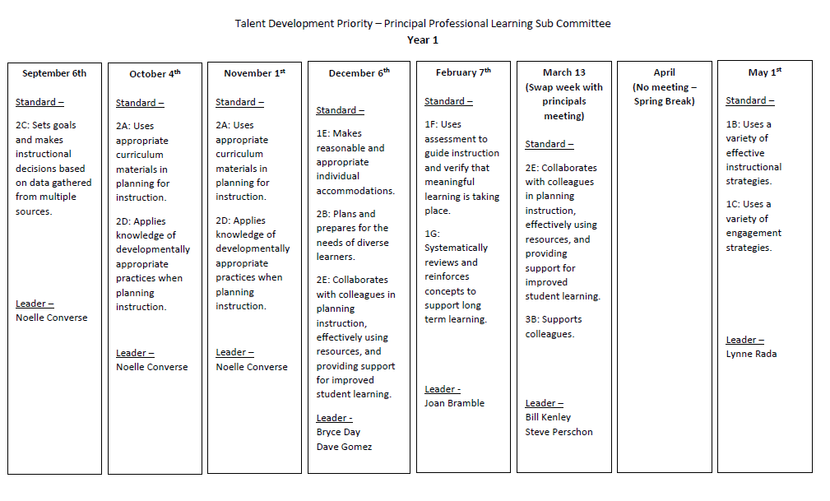
Notes:
R Under 1 min

Slide 6
Domain 2: Collective Commitment to Learning
Domain 2: An educational leader promotes and is accountable for student success by advocating, nurturing, assessing and sustaining a school focused on teaching the Utah Core Curriculum. An educational leader provides a learning environment conducive to student, faculty, and staff growth through collaboration within a culture of learning.
2C. Instructional Practice
Works with individuals and a variety of groups to ensure the use of Utah Core Standards, the district provided tools, data in assessing student learning, collaborative problem solving, and adjustment to evidence-based instruction to meet student learning needs.
2D. Differentiated Instruction
Assists and monitors the effective use of the district’s framework for instruction and system of support for providing differentiated instructional strategies and appropriate resources to address a variety of student learning needs.
Leadership Standards
Click Here
Notes:
R I min

Slide 7
Connection to Granite Educator Standards
Domain 2- Planning and Preparation
Educator Standard 2.C.
The educator sets goals and makes instructional decisions based on data gathered from multiple sources. Includes, but not limited to:
•Utilizing data from standardized tests to make
adjustments to lesson design and instructional
strategies;
•Using data from formal and informal measures to select instructional strategies, materials, and
opportunities for review and practice.
Notes:
R 1 min

Slide 8
Connection to Granite Educator Standards
Domain 2- Planning and Preparation
Highly Effective
•Utilizes data from standardized tests to differentiate instruction for individual students.
•Uses data from formal and informal measures to select instructional strategies,materials, and opportunities for students to apply their knowledge and skills.
Effective
•Utilizes data from standardized tests to make adjustments to lesson design and instructional strategies.
•Uses data from formal and informal measures to select instructional strategies, materials, and opportunities for review and practice.
Notes:
R 1 min

Slide 9
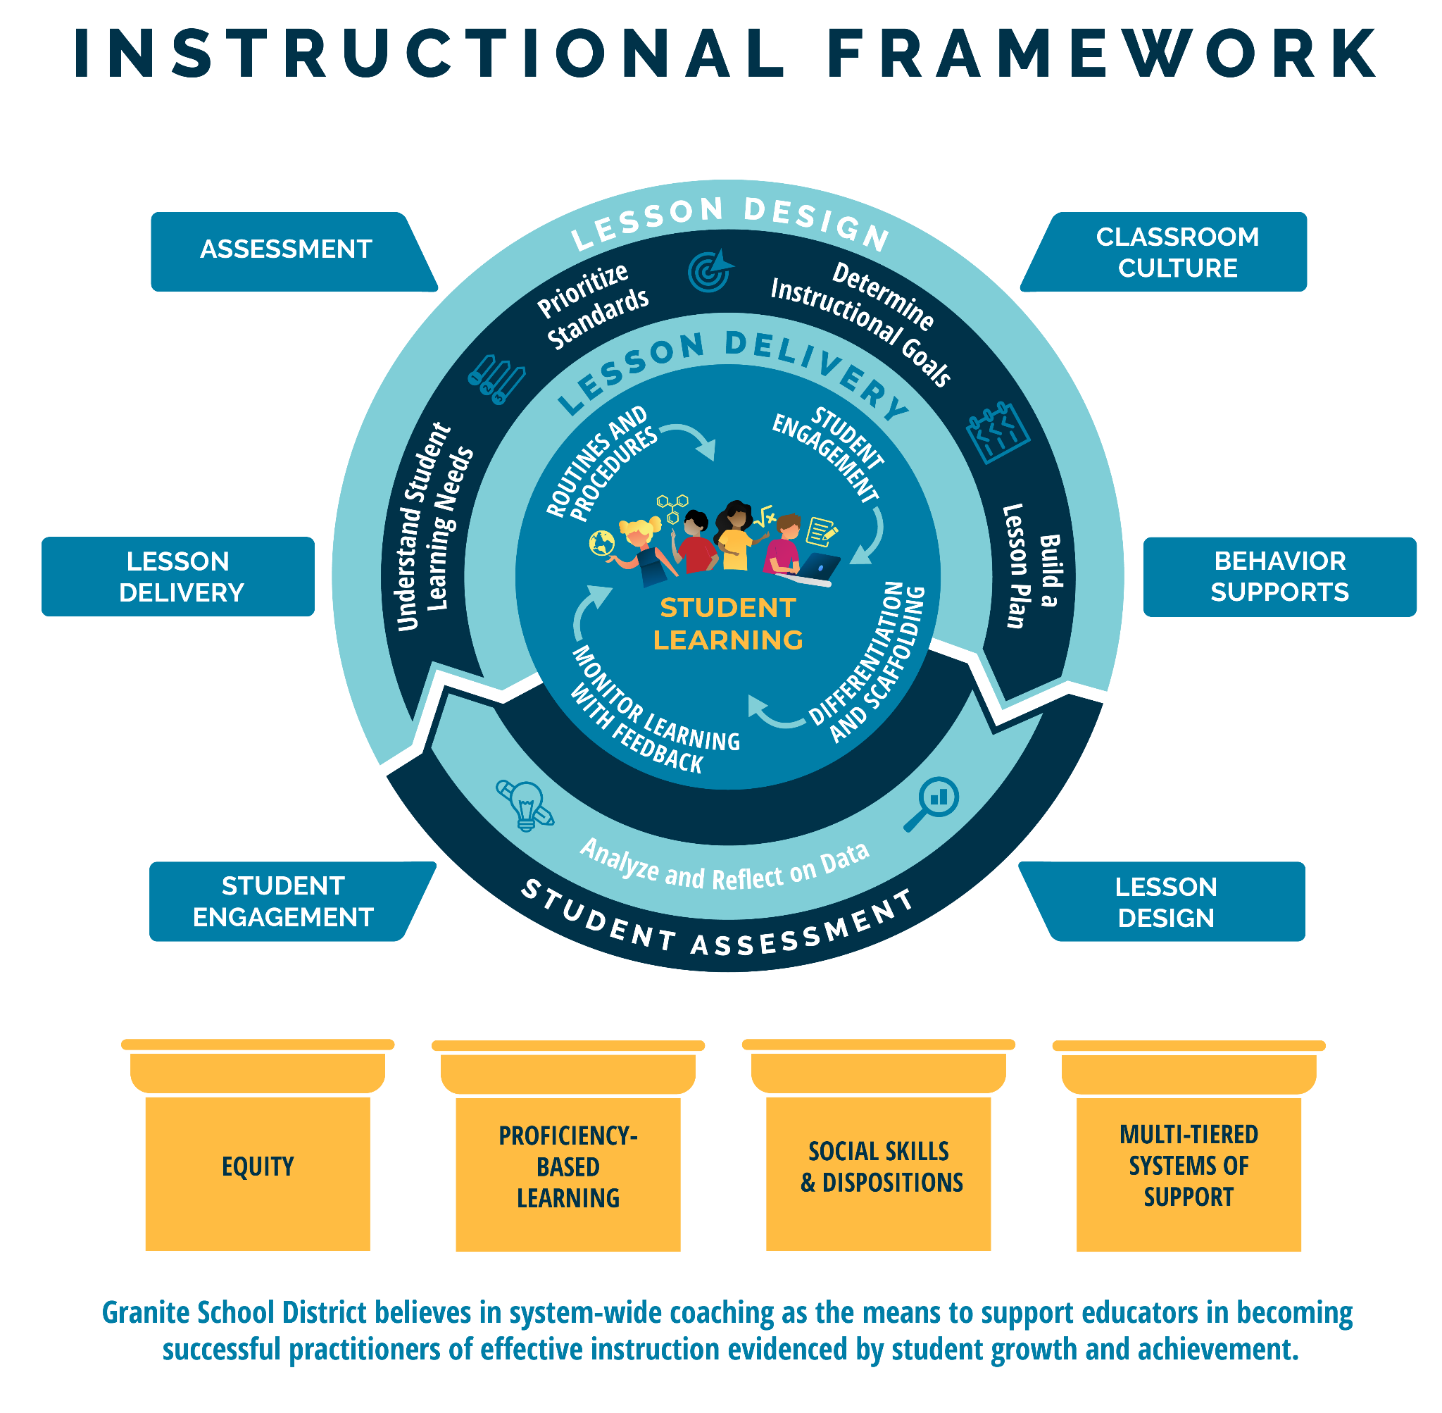
Notes:
JB 2 min This is the Granite School District Instructional Framework. This framework is based on the evidence-based instructional practices embedded in the GSD Strategic Plan and represents all of Granite School District’s priorities. You will notice student learning is at the heart of the framework as it represents our commitment to student learning around which everything else is built. The framework features the basic elements of a high quality instructional cycle including Lesson Design, Lesson Delivery, and Student Assessment. You will notice the evidence-based practices at the lesson delivery level that we expect to see in what the teacher and the student are doing during the lesson. The high quality instructional cycle components are reinforced through ongoing, job-embedded coaching in: lesson design, student engagement, lesson delivery, assessment classroom culture and behavior supports, all of which contribute to meaningful learning and career and college readiness. The framework rests on the foundational pillars of Granite School District’s commitment to Equity, Proficiency-Based Learning, Social Skills and Dispositions and Multi-Tiered Systems of Support. Today we will be learning about the tools and resources in alignment with the instructional framework that will help you in your specific content areas.

Slide 10
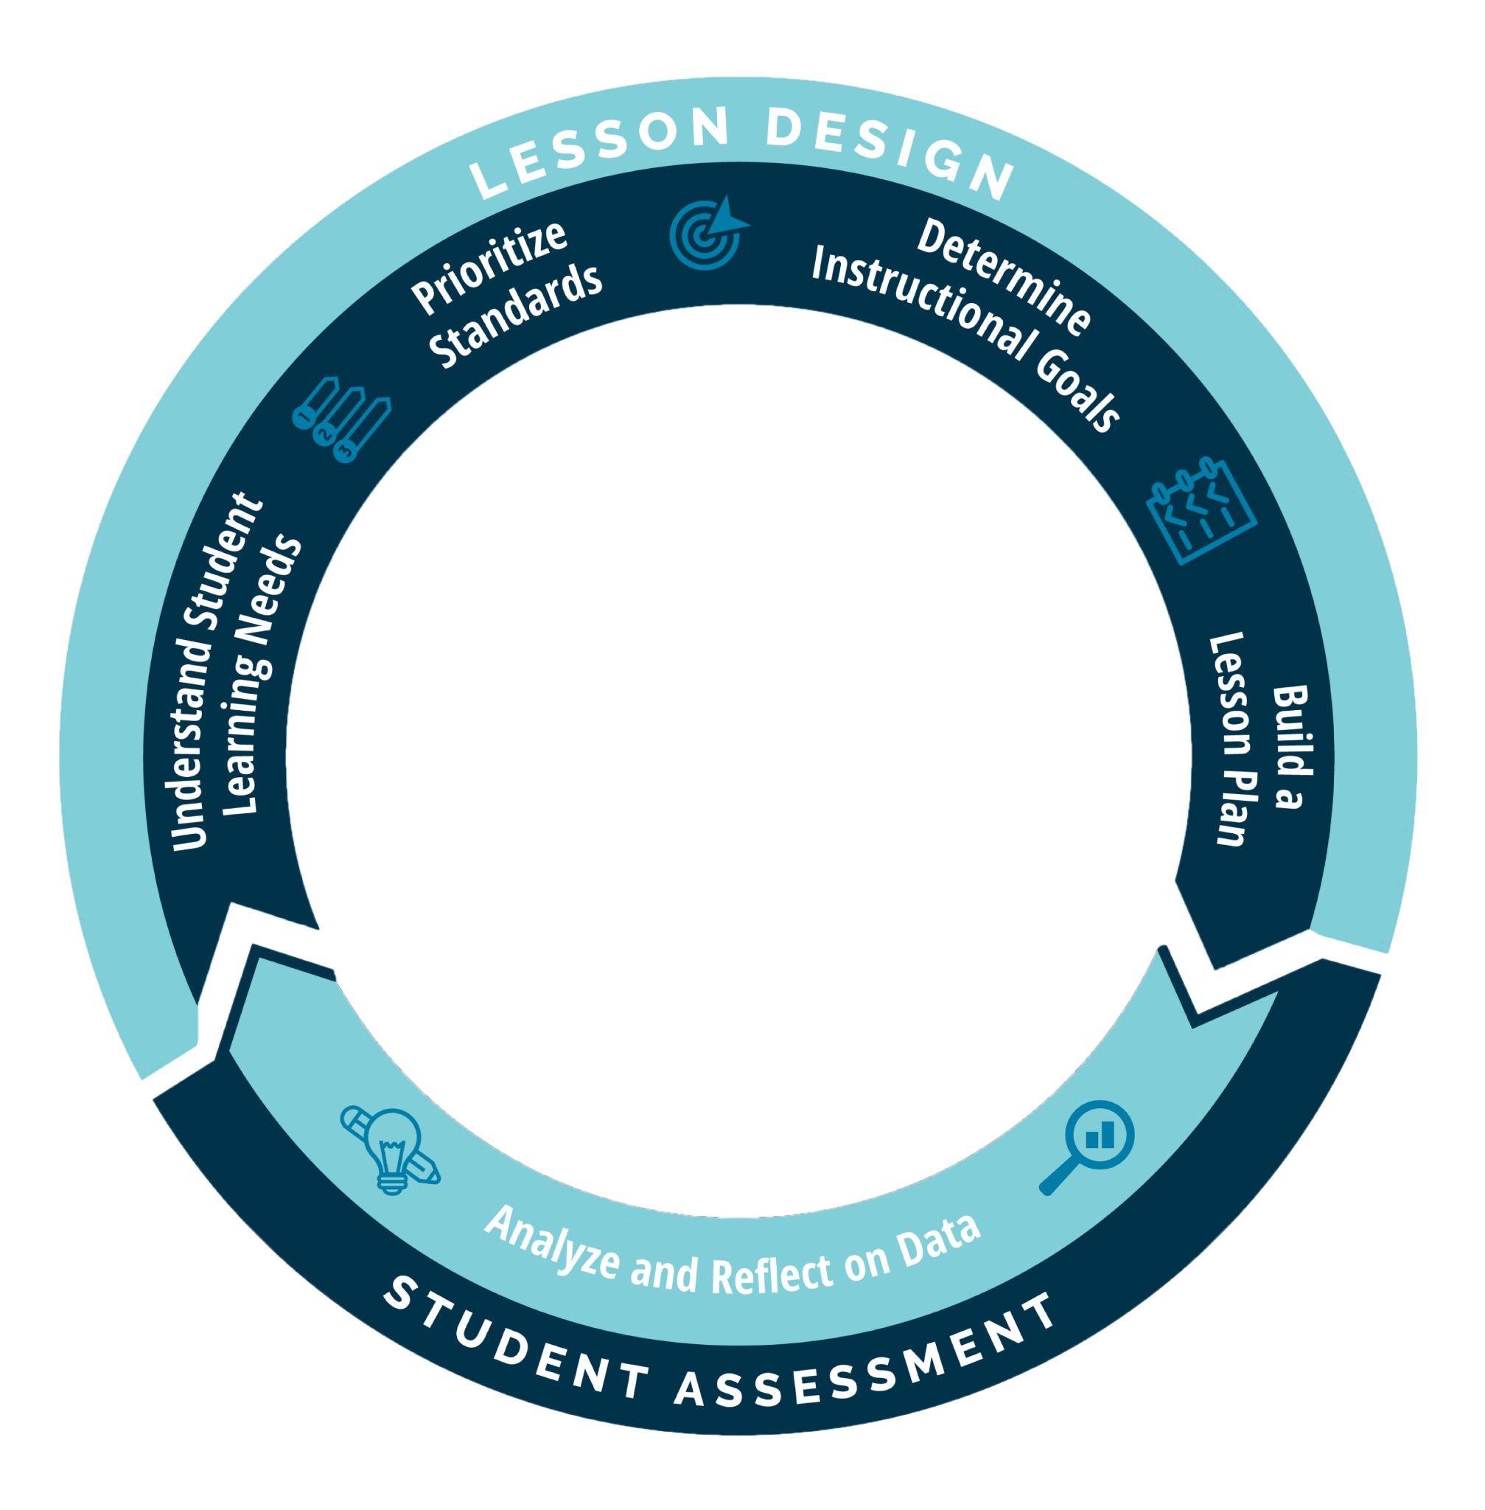
Notes:
1 min For the purpose of this presentation, we will be focusing primarily on the Lesson Design and Student Assessment components, and specifically within those, we will discuss Understand Student (and School) Learning Needs and Analyze and Reflect on Data

Slide 11

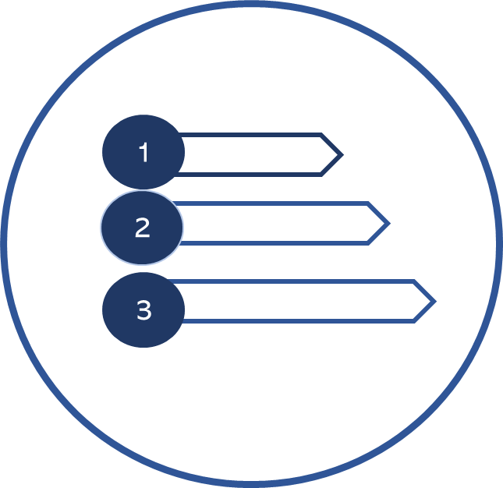


Determine
Instructional
Goals
Understand Student
Learning Needs
Prioritize
Standards
Build a
Lesson
Review student and school data
Scan the year’s curriculum maps to orient lesson(s) within the year’s scope and sequence
Review curricular resources from the learners’ perspective
Understand essential standards
Access proficiency scales
Organize concepts and skills from the standard into lesson(s)
Identify learning intentions
Identify success criteria
Identify the relevance of the learning
Determine design approach
Determine evidence to support learning
Develop learning tasks
Organize the components of the lesson
Lesson Design Guide
Curriculum and Instruction 2023
Notes:
JB I min Here you see the components of lesson design. Lesson design is more than just facilitating a learning activity, It starts with a strong understanding of student and school data, followed by prioritizing core standards and determining instructional goals before the actual building of the lesson occurs. Following all of the steps allows teachers to be sure they establish clarity about the “Why, What and How” of the lessons they facilitate. It is important to know that knowledge and skill of evidence based lesson design comes with time, practice, reflection and collaboration in PLCs.

Slide 12


Objectives
Administrators will be able to self-assess where their teachers and PLCs are relative to Educator Standard 2C.
Administrators will increase their ability to coach teachers and PLCs at different implementation levels in their use of data sources to set instructional goals.
Administrators will increase their ability to support teachers in their use of GSD instructional tools and resources.
Notes:
JB 1-2 min

Slide 13
Framing Your Professional Learning for the Year
Throughout this year’s Principal Professional Learning (PPL) each administrator will bridge learning to their everyday practice.
The goal for the PPL is to build every administrator’s capacity in coaching teachers and teacher PLCs regardless of the skill level or experience of you as the coach and your teachers as the coachees.
Notes:
1 min

Slide 14
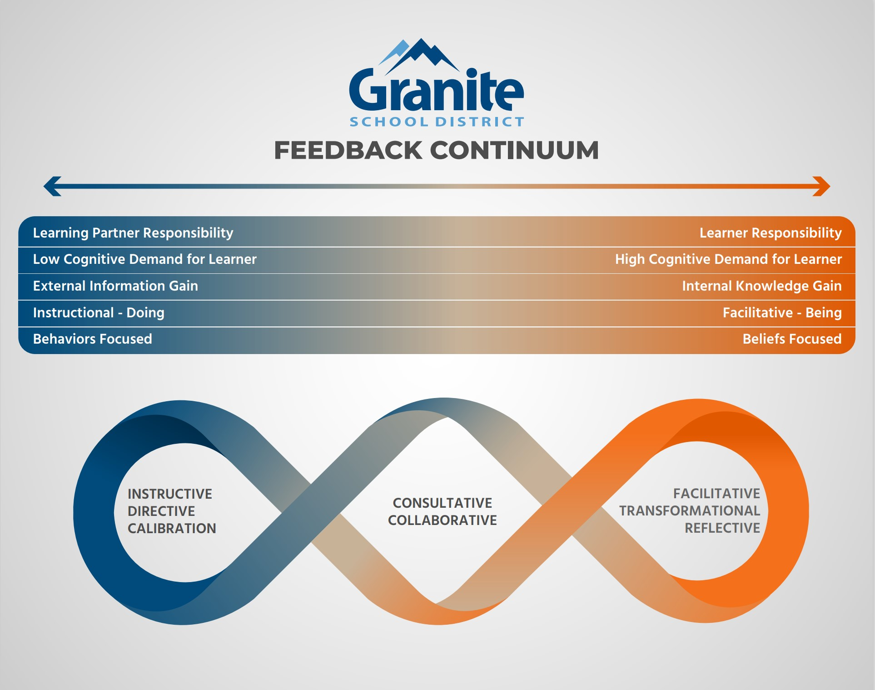
Considerations for Coaching and Evaluating Lesson Design
Notes:
R Under 1 minute

Slide 15
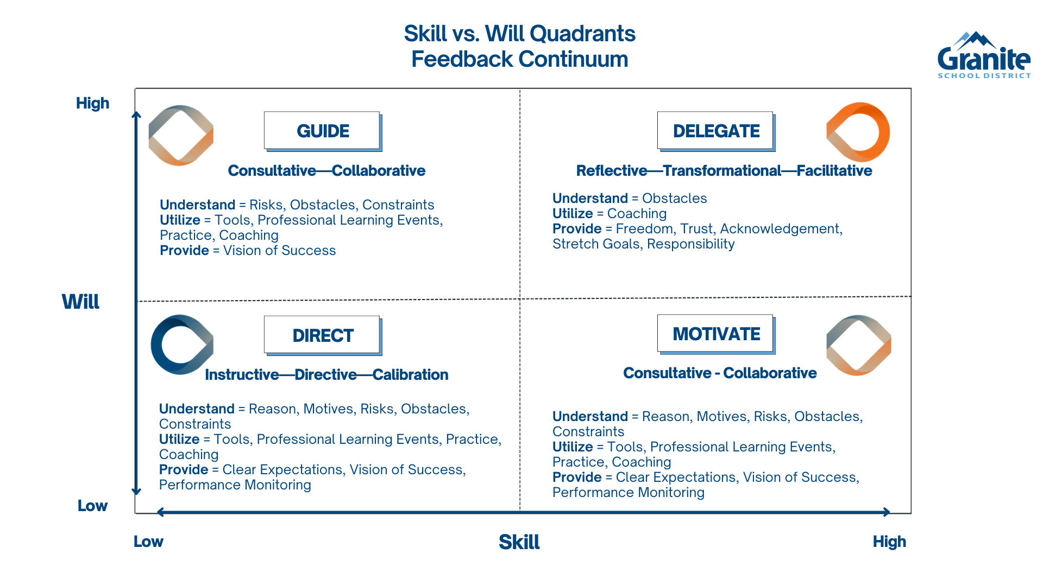
Considerations for Coaching and Evaluating Lesson Design
Notes:
R Under a min

Slide 16
Anchor Activity
Think about a teacher and/or a PLC that is an exemplar in the use of data to inform their instruction.
What are the characteristics/evidence that help you know that the teacher and/or PLC uses data well to inform instruction?
Share with each other…
Notes:
R 5 min Talk a little about the goal of reflecting on both the teacher level and the PLC level but allow for flexibility if principals feel like they can only focus on one for the sake of time, etc

Slide 17
Anchor Activity Cont’d
Think about a teacher and/or a PLC that
struggles in their use of data to inform their instruction.
What are the characteristics/evidence that help you know that the teacher and/or PLC does not use data well to inform instruction?
Notes:
R 2 min Keep this teacher and PLC in mind as we move forward…

Slide 18
Structured Reflection Journal
Click Here…Principal Reflection Journals
Click on the link and find your school folder
Click on the folder with your name.
Open the reflection journal and scroll the September reflection.
**You will add to this reflection journal throughout the year.
Notes:
JB 2 min As part of each month’s learning, you are going to engage in reflecting on teachers and teacher teams and record using your own reflection journal. Point out, for the purpose of the journaling you need to use current staff so if you are not sure, you will have time between now and next session to complete the journal….Logistics around the structured journal; only the admin assigned to the school and the PPL team have access. The info is completely confidential but if you are concerned about the use of the info feel free to use a pseudonym. We access the info only to manage the content.
If you are new to your school, you may need to think a little about the teacher/PLC you will be targeting. Take some initial notes and then complete between now and October session

Slide 19
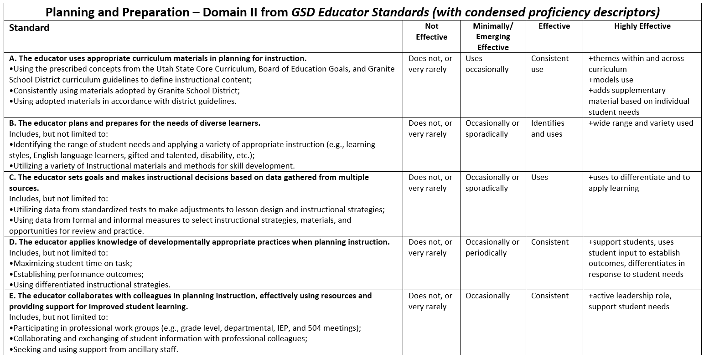
What does it look like when a teacher uses data?
Notes:
JB As you considered the characteristics of a teacher who uses data, these are likely reflected in this rubric as it appears here in the Planning and Preparation Domain. Today’s learning will focus on the data use standard, but over this year we will also highlight the what parts of the other standards in this domain.

Slide 20
What does it look like when a PLC uses data?
Data is prepared in advance of the meeting to allow time to discuss instruction and necessary changes.
Data is disaggregated by groups for differentiation or response to intervention
Other data includes student work that provides valid and reliable evidence of learning (not just numbers)
Time is allowed for analysis of data
Time Frame for Action with relevant data based on student’s most current needs acted on in a few days
* Adapted from 100-Day Leaders © 2019 Solution Tree Press • SolutionTree.com.
Notes:
JB 1 min Your exemplar PLCs likely have several of these present as they effectively use data. These were adapted from some of the work of Solution Tree to describe what using data looks like in a PLC.

Slide 21
Structured Reflection Journal
Considering the specific teacher and/or the specific PLC that you identified, reflect on the current characteristics of those you identified in relation to the data questions (Prompt 1)
As a reminder this bridge activity is intended to help you continue to build your capacity as an instructional leader.
Principal Reflection Journals
Notes:
JB 15 minutes…Reminder Logistics around the structured journal; only the admins assigned to the school and the PPL team (to add new components) have access-the data/contents are not used for anything else. Just for you. The info is completely confidential but if you are concerned about the use of the info feel free to use a pseudonym. We access the info only to manage the content. Once we are done adding new components, we will completely transfer ownership to you.

Slide 22
Academic Data Sources for
Instructional Decision-making
Math Data
SCI Data
OCT
SEPT
NOV
ELA Data
Notes:
JB 1 min Rationale for starting with math…Our goal is to coach teachers PLCs at a variety of levels to make good instructional decisions based on their data and the core standards (all four DuFour questions). We will use the three RISE tested subjects as our content focus for the next three sessions to allow you to interact with the different data sources and instructional tools associated with each content area and to be able to reflect on your teachers’ use of them. We chose to begin with math because every grade level is experiencing something new in math this year.

Slide 23
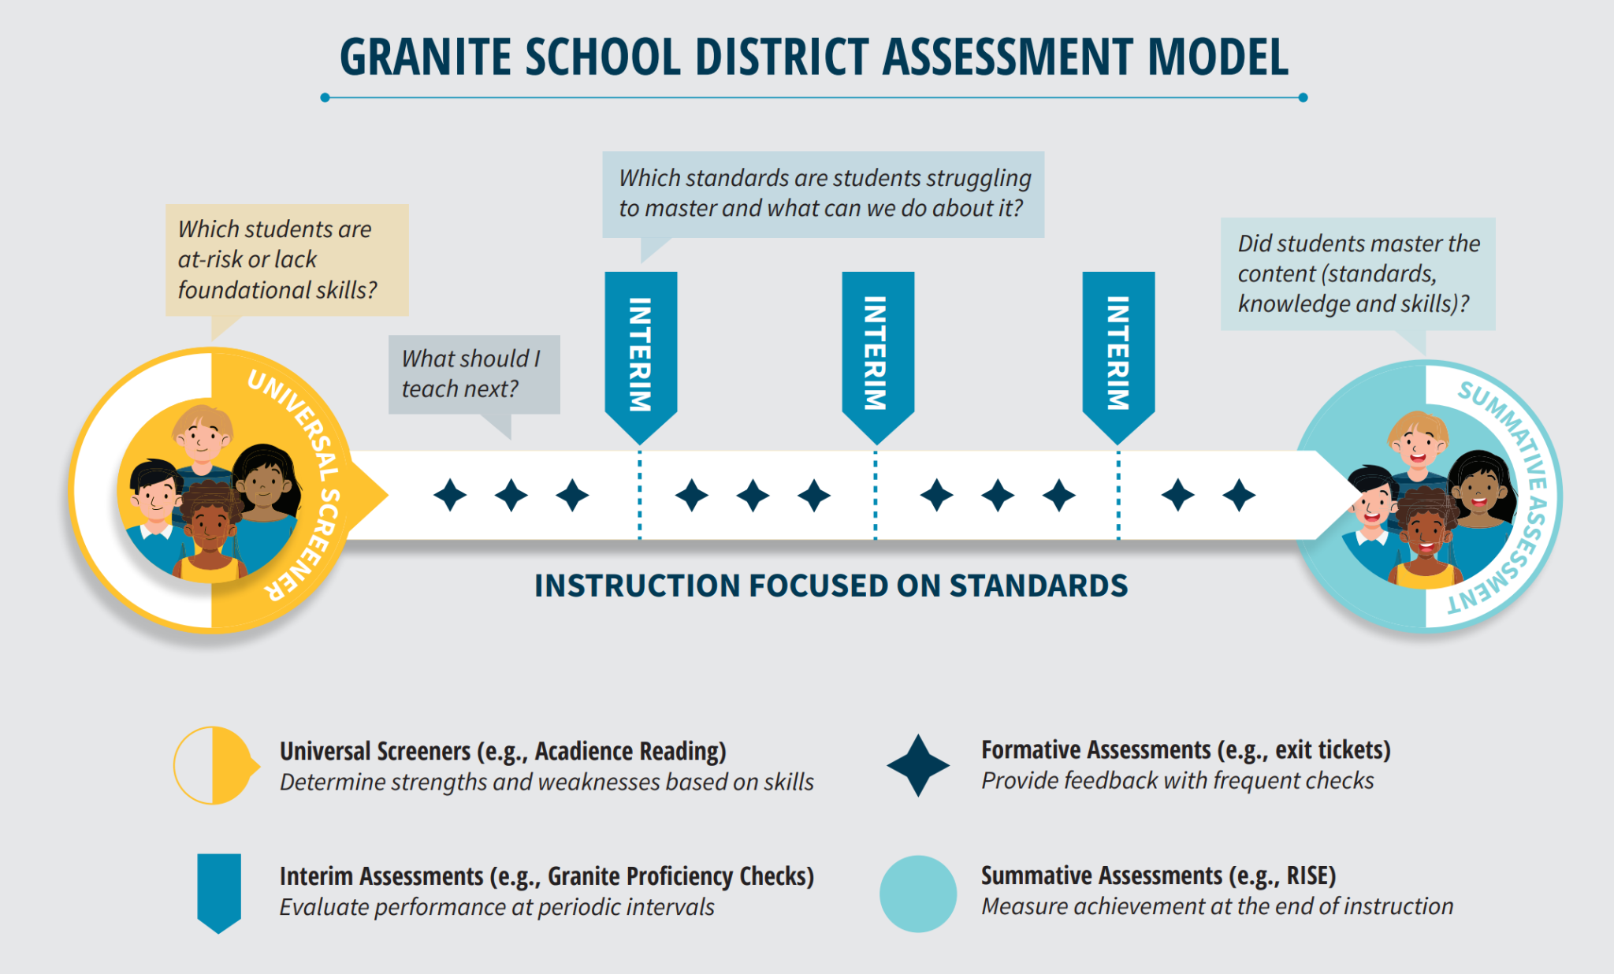
Teacher Observations
HS Benchmarks on UTIPs
School City Proficiency Checks
Derivita Assessments
Utah Aspire Plus Math
Course Grades
Notes:
JB 2 min
This graphic should look familiar. The Assessment Model includes a variety of assessments that are used for different purposes. One of our goals today is to connect how these different assessments are used together to improve learning.
Because we have selected math for this month, we will take some time to look at the math assessments that are used in our overall plan and how they become a way to consider multiple data sources. We have HS Benchmarks (that will be available on the UTIPs platform, School City Proficiency Checks and Derivita Assessments that are used as Interim Assessments (click) and Utah Aspire Plus Math as well as Course Grades that are used as a Summative Assessments (click). Remember not all data comes from an assessment however! Teacher observations and other evidence of learning in a classroom provide data for a teacher that ought to inform instruction and are an important part of formative assessments (click).

Slide 24
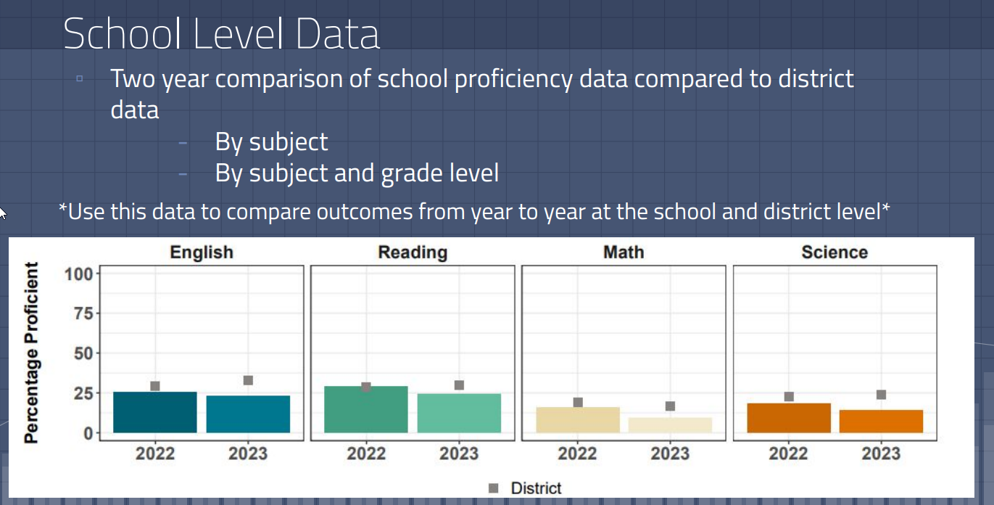
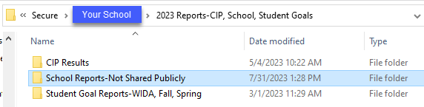
Summative Measure: Utah Aspire Plus Proficiency
Report available in Secure Folder
“2023 Preliminary Utah Aspire Plus {Your School}”
Notes:
JB 2 min The intention over the next several slides is to introduce/ or remind you of reports that are available with a brief overview. After presenting these, you will have some time to explore and discuss with your colleagues how these types of reports and visible data might be used in your specifics settings.

Slide 25
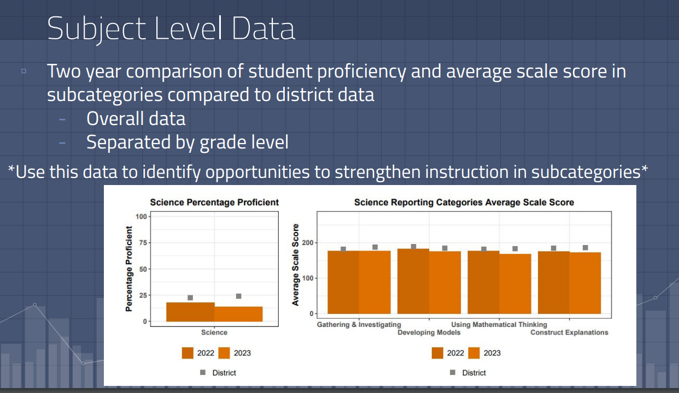
Summative Measure: Utah Aspire Plus Math Data
Additional Slides to walk through Utah Aspire Plus Results
Notes:
JB 2 min - In this same folder you will find a report that shows scaled score results by standard. This may be helpful in drilling into data. There is also a slide deck linked on this slide that can walk you through looking at this report or sharing it with teachers.

Slide 26
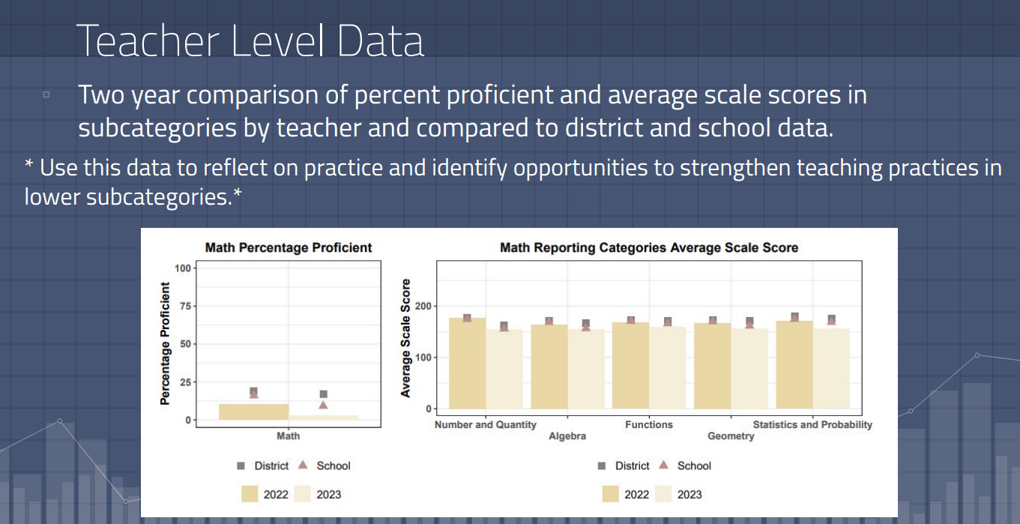
Summative Measure: Utah Aspire Plus Teacher Data
Notes:
JB This report also drills down to Teacher level data
Explore and share ideas for uses

Slide 27
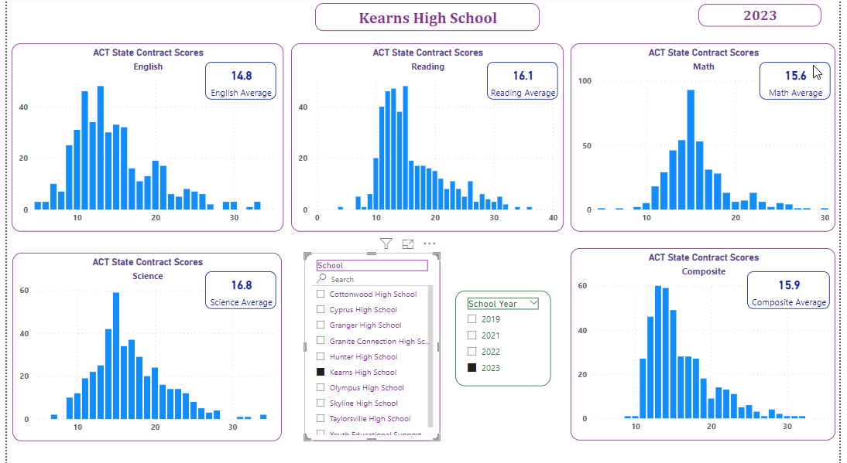
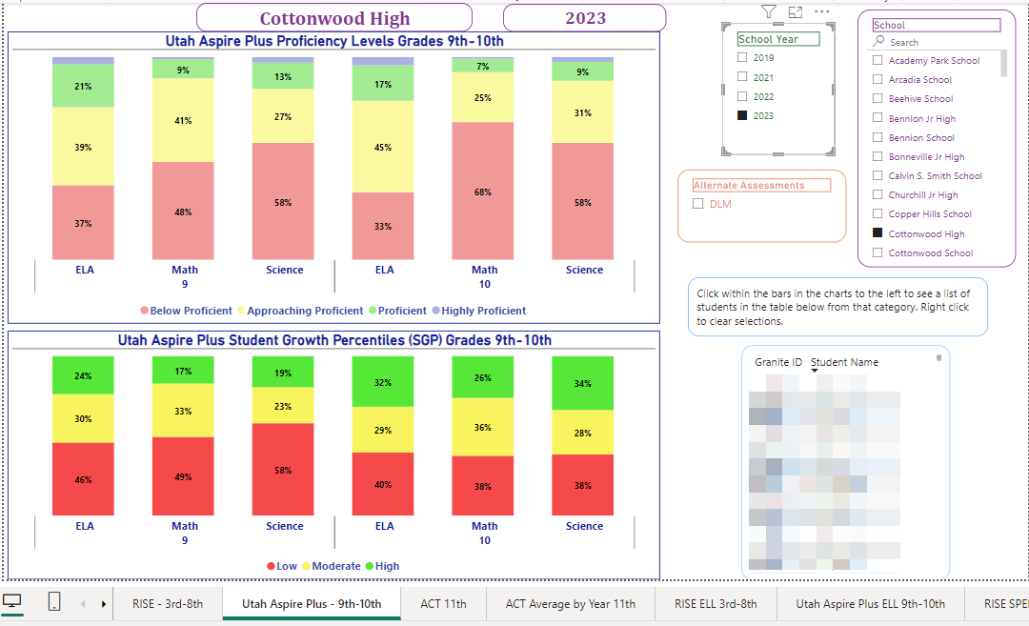
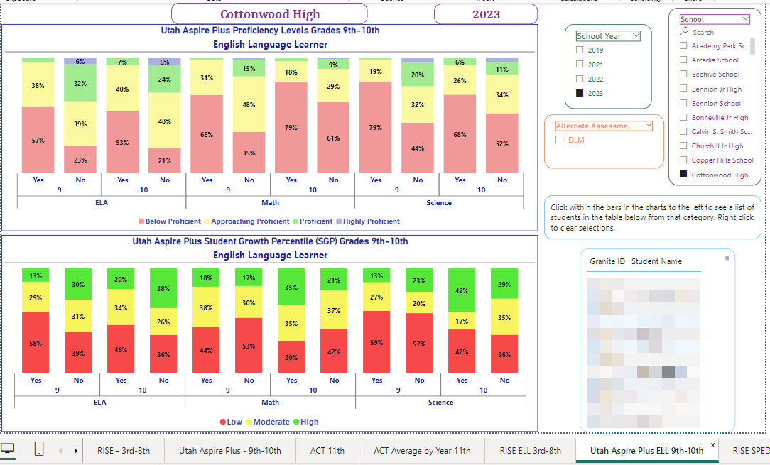
PowerBi Report on Utah Aspire Plus and ACT outcomes
ACT distribution
Link to Report
Drill into subgroups
Notes:
JB Present how to look at these, explore, discuss what works and what types of reporting that would be helpful
How might these report be used?

Slide 28
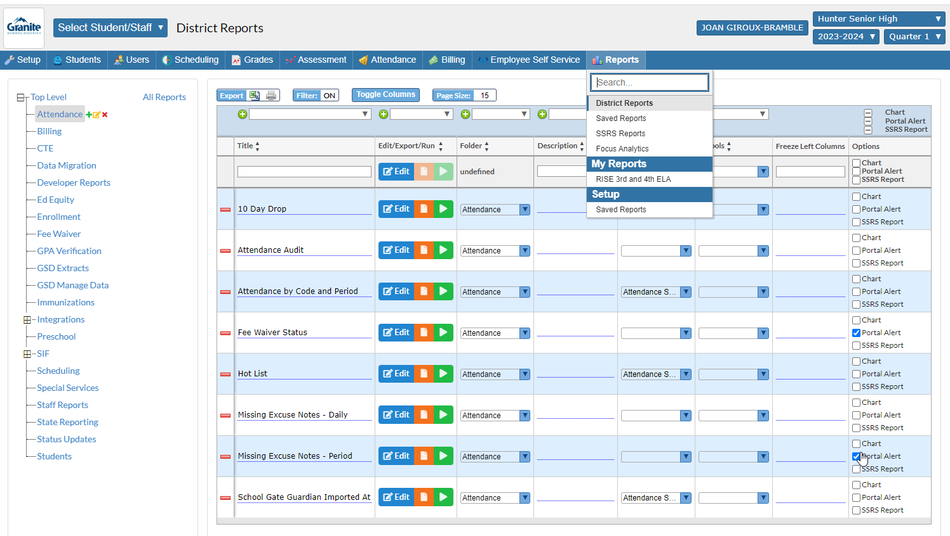
Focus Reports
What types of reports would be most useful for using data?
What data do you need?
What data do your teachers need?
Notes:
JB As we work toward building out reports in Focus, what do you need?

Slide 29
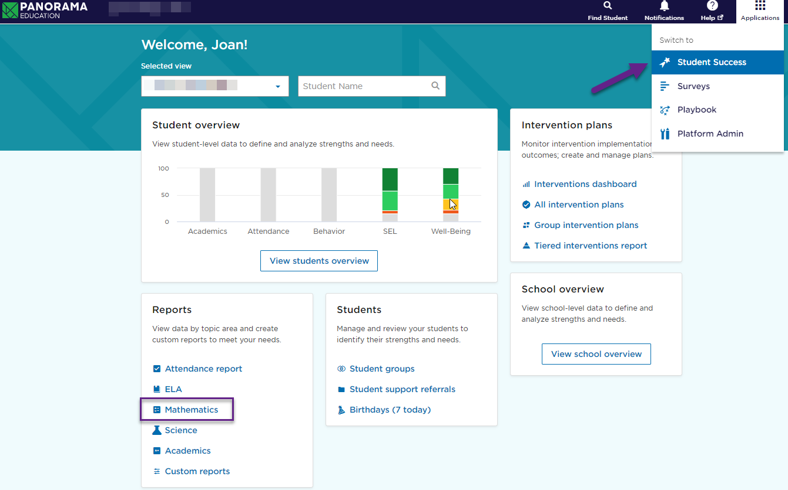
Looking at Multiple Measures: Utah Aspire Plus and PBL grades from 2023
Use Panorama to put it all together for a combined look at multiple math measures:
Coursework = Grades
Utah Aspire Plus
Notes:
2 min 2 min Panorama is a tool that pulls together multiple measures. At this time, teachers do not have access to this, but this may be a tool that you as an administer might find useful as you support your teachers. This area of Panorama allows you to look across measures at a school level and drill down to grade levels or other demographic variables. Here you can see the distribution of grades in “mathematics coursework” and RISE proficiency levels.
Open up Panorama, and find the Applications waffle, then Student Success. Finding the Mathematics drill down is on the left side along with other filters.

Slide 30
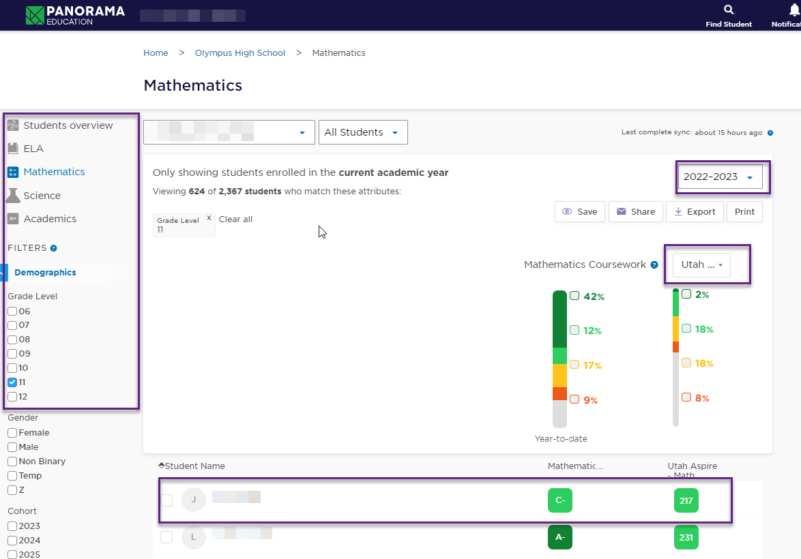
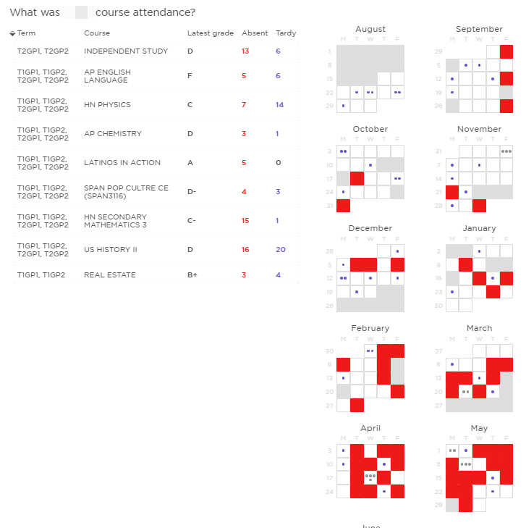
Looking at Multiple Measures: Utah Aspire Plus, PBL grades, Attendance
Digging deeper into Panorama:
Select a grade level from 2022-23.
Select individual grade levels
Student view below allows for a quick overall view too
Or select a student for a visual look at attendance and grades
Notes:
3-5 min Panorama also provides a look at individual students to see progress or to see how closely correlated the students PBL grade is with their Utah Aspire score.
You can also look at individual students to see patterns of attendance, grades at a glance, etc.
We are looking back at 22-23, but as more data is populated for the current year, you will see the year to date information

Slide 31
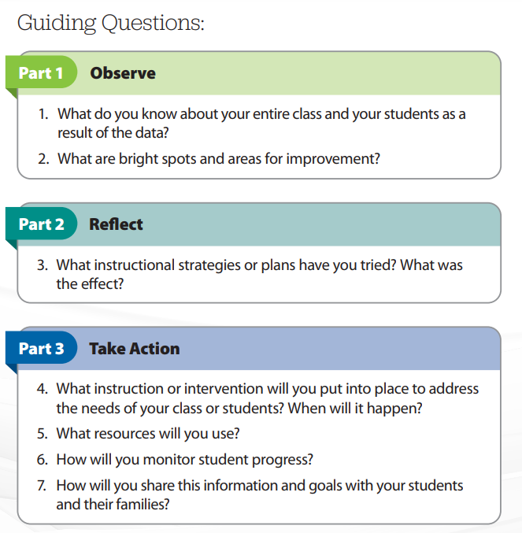
PLC Protocols
Review your data and plan time to meet as a PLC to discuss these guiding questions as a possible protocol

Slide 32
Teacher Observations
HS Benchmarks
School City Proficiency Checks
Derivita Assessments
Utah Aspire Plus Math
Notes:
JB 2 min - As your teachers plan for the year, they also should be developing a plan for their use of Interim Assessments. These could include HS Benchmarks, School City Proficiency Checks, or Derivita Assessments. This type of assessment allows teachers to have periodic checks on how their students are learning standards and how well they are prepared for the summative assessments.

Slide 33

We have the data, now what?
Data is prepared in advance of the meeting to allow time to discuss instruction and necessary changes.
Data is disaggregated by groups for differentiation or response to intervention
Other data includes student work that provides valid and reliable evidence of learning (not just numbers)
Time is allowed for analysis of data
Time Frame for Action with relevant data based on student’s most current needs acted on in a few days
Notes:
R 2 min We have a lot of data and sometimes this is overwhelming. Focusing on what you will do with the data and what you need in order to make instructional decisions can help with a balance. Using the data from assessments or student work samples is what teachers and PLCs should be focused on. Time for analysis and a quick time frame to adjust practice and take action are also important ways that you can think about how you support better use of data.

Slide 34
C. The educator sets goals and makes instructional decisions based on data gathered from multiple sources.
Includes, but not limited to:
•Utilizing data from standardized tests to make adjustments to lesson design and instructional strategies;
•Using data from formal and informal measures to select instructional strategies, materials, and opportunities for review and practice.
If data also informs the selection of instructional strategies in MATH,
what instructional strategies would a teacher select and what would we see in a MATH classroom?
Notes:
R 1 min When teachers use data to make instructional decisions, one of those decisions is the selection of appropriate instructional strategies. As we continue with math as our focus area, consider what instructional strategies you would see in a math classroom.

Slide 35
Turn and Talk: Observation Measures during Instruction as an Additional Data Source
Think about the kinds of instructional tasks a teacher might design during math to reflect their instructional goals.
What would we see the teacher doing during the task?
What would students be doing?
Notes:
R 5 min Tell your neighbor As we review the next slides, think….We have discussed the student data sources our teachers, PLCs and administrators use at the school-wide level to set instructional goals. Other important data we have is observation

Slide 36
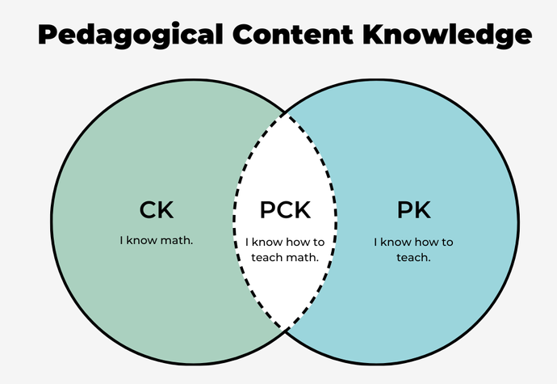
Math Practices During Instruction as a Data Source
Notes:
R 2 min Another math data source/multiple measures

Slide 37
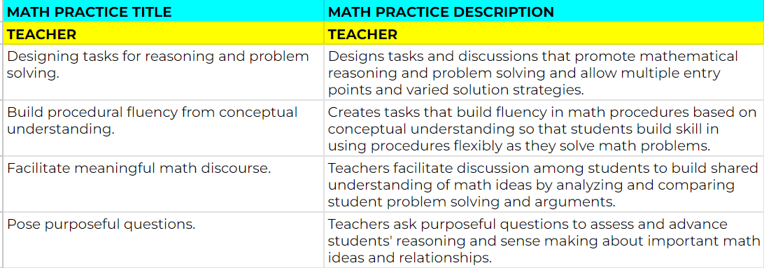
Best Math Practices-What the Teacher Does
Facilitating Meaningful Math Discourse
Notes:
R 3 min Another math data source/multiple measures / nod to the PG&E process, observations, qualitative data-possible i-Ready video here….

Slide 38
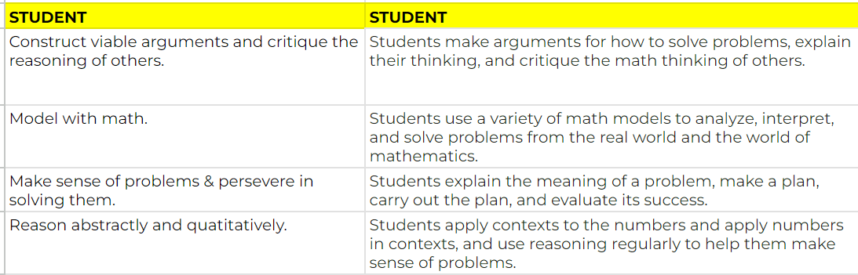
Best Math Practices-What the Student Does
Students Making Sense of the Problem and Persevering in Solving
Notes:
R 3 min Another math data source/multiple measures PG&E process, observations, qualitative data possible i-Ready video

Slide 39
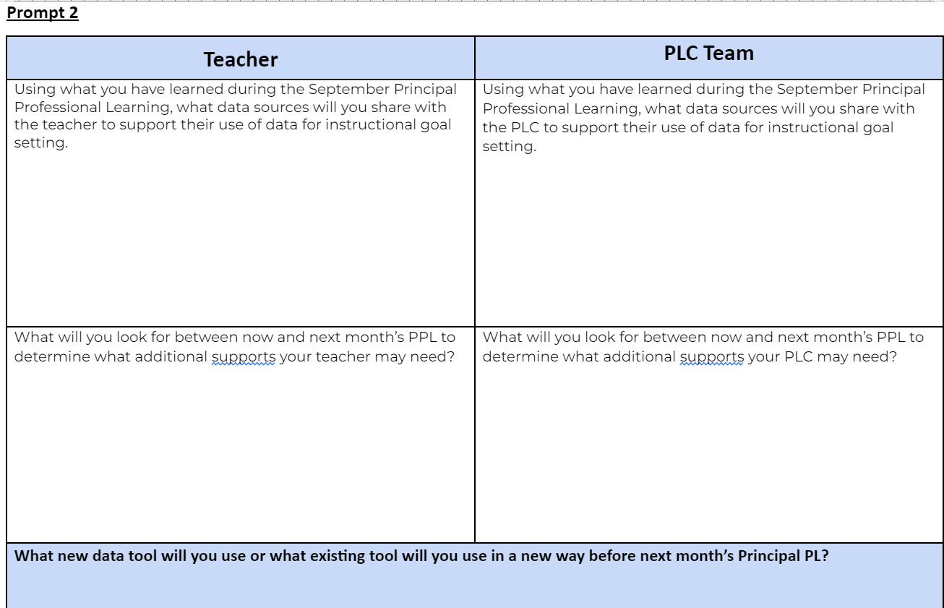
Reflection Journal Time
Notes:
JB 12-15 min You will now have time to complete the remaining prompts in your September Reflection Journal. Keep in mind we will be revisiting your reflections at the start of the October PPL

Slide 40

Principal Professional Learning Survey
Please give us your feedback:
Survey

Slide 41

References
-Buffum, A., Mattos, M., & Malone, J. (2018). Taking Action: A Handbook for RTI at Work, Solution Tree.
-Fisher, D., Frey, N., Amador, O., and Assof, J. (2019) The Teacher Clarity Playbook, Corwin
-Hess, K., Colby, R., & Joseph, J. (2020) Deeper Competency-Based Learning, Corwin
-Hess, K. (2018) A Local assessment Toolkit to Promote Deeper Learning, Corwin
-Schimmer, T., Hillman, G., & Stalets, M. (2018) Standards-Based Learning in Action, Solution Tree
Notes:
Buffum, A., Mattos, M., & Malone, J. (2018) Taking Action A Handbook for RTI at Work, Solution tree

Slide 42

Links to Tools and Resources
Reflection Journal Link
GSD Assessment Model
PLC protocol
Instructional Framework
Lesson Design Model
Lesson Design Website
Lesson Design Guide
Lesson Approaches
Student Learning Stages

