Slide 1

2
0
X
X
REPORT BOOK
PRESENTATION TEMPLATE

Slide 2
1
GOLD
2
SILVER
CONTENTS
3
BRONZE
4
PLATIN

Slide 3

01
GOLD

Slide 4

TITLE HERE
“
We use well-known development methodologies to create a customized approach for each of the projects. This allows us to achieve high quality outcomes and full transparency towards.
”
BAET 01

Slide 5


STEP HERE
We use well-known development methodologies to create a customized approach for each of the projects. This allows us to achieve high quality outcomes and full transparency towards. We use well-known development methodologies to create a customized approach for each of the projects. This allows us to achieve high quality outcomes and full transparency towards.
STEP HERE
BAET 01

Slide 6

STAGE HERE
STAGE HERE
We hope that this template will return to you as a time, money and reputation.
STAGE HERE
We hope that this template will return to you as a time, money and reputation.
STAGE HERE
We hope that this template will return to you as a time, money and reputation.
BAET 01

Slide 7
OPTION HERE
A complex idea can be conveyed with just a single still image, namely making it possible to absorb large amounts of data quickly.
2016
A complex idea can be conveyed with just a single still image, namely making it possible to absorb large amounts of data quickly.
2019
A complex idea can be conveyed with just a single still image, namely making it possible to absorb large amounts of data quickly.
20XX
BAET 01

Slide 8

TITLE HERE
TITLE HERE
A complex idea can be conveyed with just a single still image, namely making it possible to absorb large amounts of data quickly.
A complex idea can be conveyed with just a single still image, namely making it possible to absorb large amounts of data quickly.
BAET 01

Slide 9

02
SILVER

Slide 10

STEP HERE
STEP HERE
STEP HERE
A complex idea can be conveyed with just a single still image, namely making it possible to absorb large amounts of data quickly.
A complex idea can be conveyed with just a single still image, namely making it possible to absorb large amounts of data quickly.
BAET 02

Slide 11
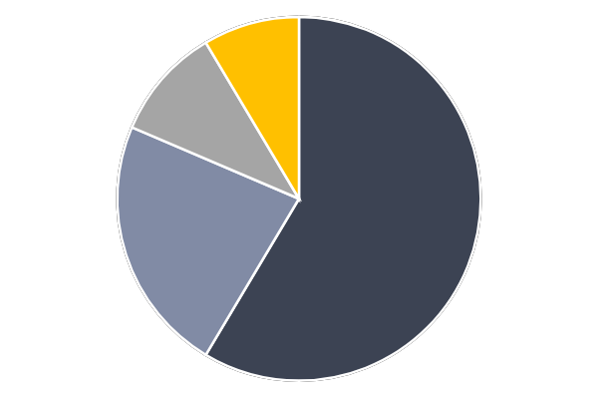
STAGE HERE
STAGE HERE
STAGE HERE
A complex idea can be conveyed with just a single still image, namely making it possible to absorb large amounts of data quickly.
A complex idea can be conveyed with just a single still image, namely making it possible to absorb large amounts of data quickly.
STAGE HERE
STAGE HERE
A complex idea can be conveyed with just a single still image, namely making it possible to absorb large amounts of data quickly.
A complex idea can be conveyed with just a single still image, namely making it possible to absorb large amounts of data quickly.
BAET 02

Slide 12

OPTION HERE
OPTION HERE
A complex idea can be conveyed with just a single still image, namely making it possible to absorb large amounts of data quickly.
BAET 02

Slide 13
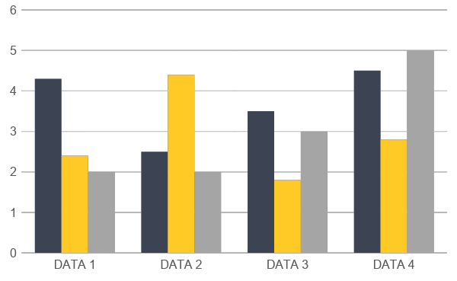
TITLE HERE
TITLE HERE
We hope that this template will return to you as a time, money and reputation.
TITLE HERE
We hope that this template will return to you as a time, money and reputation.
TITLE HERE
We hope that this template will return to you as a time, money and reputation.
BAET 02

Slide 14

03
BRONZE

Slide 15

STEP HERE
STEP HERE
We hope that this template will return to you as a time, money and reputation.
STEP HERE
We hope that this template will return to you as a time, money and reputation.
STEP HERE
We hope that this template will return to you as a time, money and reputation.
BAET 03

Slide 16
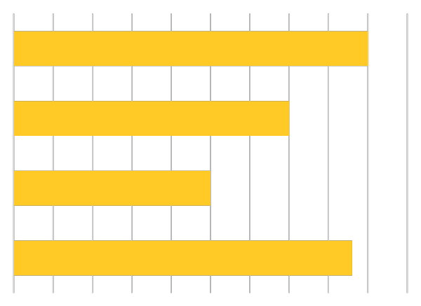
STAGE HERE
STAGE HERE
A complex idea can be conveyed with just a single still image, namely making it possible to absorb large amounts of data quickly.
STAGE HERE
A complex idea can be conveyed with just a single still image, namely making it possible to absorb large amounts of data quickly.
BAET 03

Slide 17

OPTION HERE
OPTION HERE
A complex idea can be conveyed with just a single still image, namely making it possible to absorb large amounts of data quickly.
OPTION HERE
A complex idea can be conveyed with just a single still image, namely making it possible to absorb large amounts of data quickly.
BAET 03

Slide 18
TITLE HERE
TITLE HERE
S
W
TITLE HERE
A complex idea can be conveyed with just a single still image, namely making it possible to absorb large amounts of data quickly.
A complex idea can be conveyed with just a single still image, namely making it possible to absorb large amounts of data quickly.
TITLE HERE
0
T
TITLE HERE
A complex idea can be conveyed with just a single still image, namely making it possible to absorb large amounts of data quickly.
A complex idea can be conveyed with just a single still image, namely making it possible to absorb large amounts of data quickly.
BAET 03

Slide 19


STEP HERE
STEP HERE
A complex idea can be conveyed with just a single still image, namely making it possible to absorb large amounts of data quickly.
STEP HERE
A complex idea can be conveyed with just a single still image, namely making it possible to absorb large amounts of data quickly.
BAET 03

Slide 20

04
PLATIN

Slide 21




STAGE HERE
STAGE HERE
STAGE HERE
A complex idea can be conveyed with just a single still image, namely making it possible to absorb large amounts of data quickly.
A complex idea can be conveyed with just a single still image, namely making it possible to absorb large amounts of data quickly.
STAGE HERE
STAGE HERE
A complex idea can be conveyed with just a single still image, namely making it possible to absorb large amounts of data quickly.
A complex idea can be conveyed with just a single still image, namely making it possible to absorb large amounts of data quickly.
BAET 04

Slide 22



OPTION HERE
A complex idea can be conveyed with just a single still image, namely making it possible to absorb large amounts of data quickly.
A complex idea can be conveyed with just a single still image, namely making it possible to absorb large amounts of data quickly.
A complex idea can be conveyed with just a single still image, namely making it possible to absorb large amounts of data quickly.
BAET 04

Slide 23




TITLE HERE
TITLE HERE
TITLE HERE
A complex idea can be conveyed with just a single still image, namely making it possible to absorb large amounts of data quickly.
A complex idea can be conveyed with just a single still image, namely making it possible to absorb large amounts of data quickly.
TITLE HERE
TITLE HERE
A complex idea can be conveyed with just a single still image, namely making it possible to absorb large amounts of data quickly.
A complex idea can be conveyed with just a single still image, namely making it possible to absorb large amounts of data quickly.
BAET 04

Slide 24
STEP HERE
STEP HERE
STEP HERE
STEP HERE
A complex idea can be conveyed with just a single still image, namely making it possible to absorb large amounts of data quickly.
A complex idea can be conveyed with just a single still image, namely making it possible to absorb large amounts of data quickly.
A complex idea can be conveyed with just a single still image, namely making it possible to absorb large amounts of data quickly.
BAET 04

Slide 25

2
0
X
X
THANK YOU!
Powered by GoogleSlides.org

