Slide 1
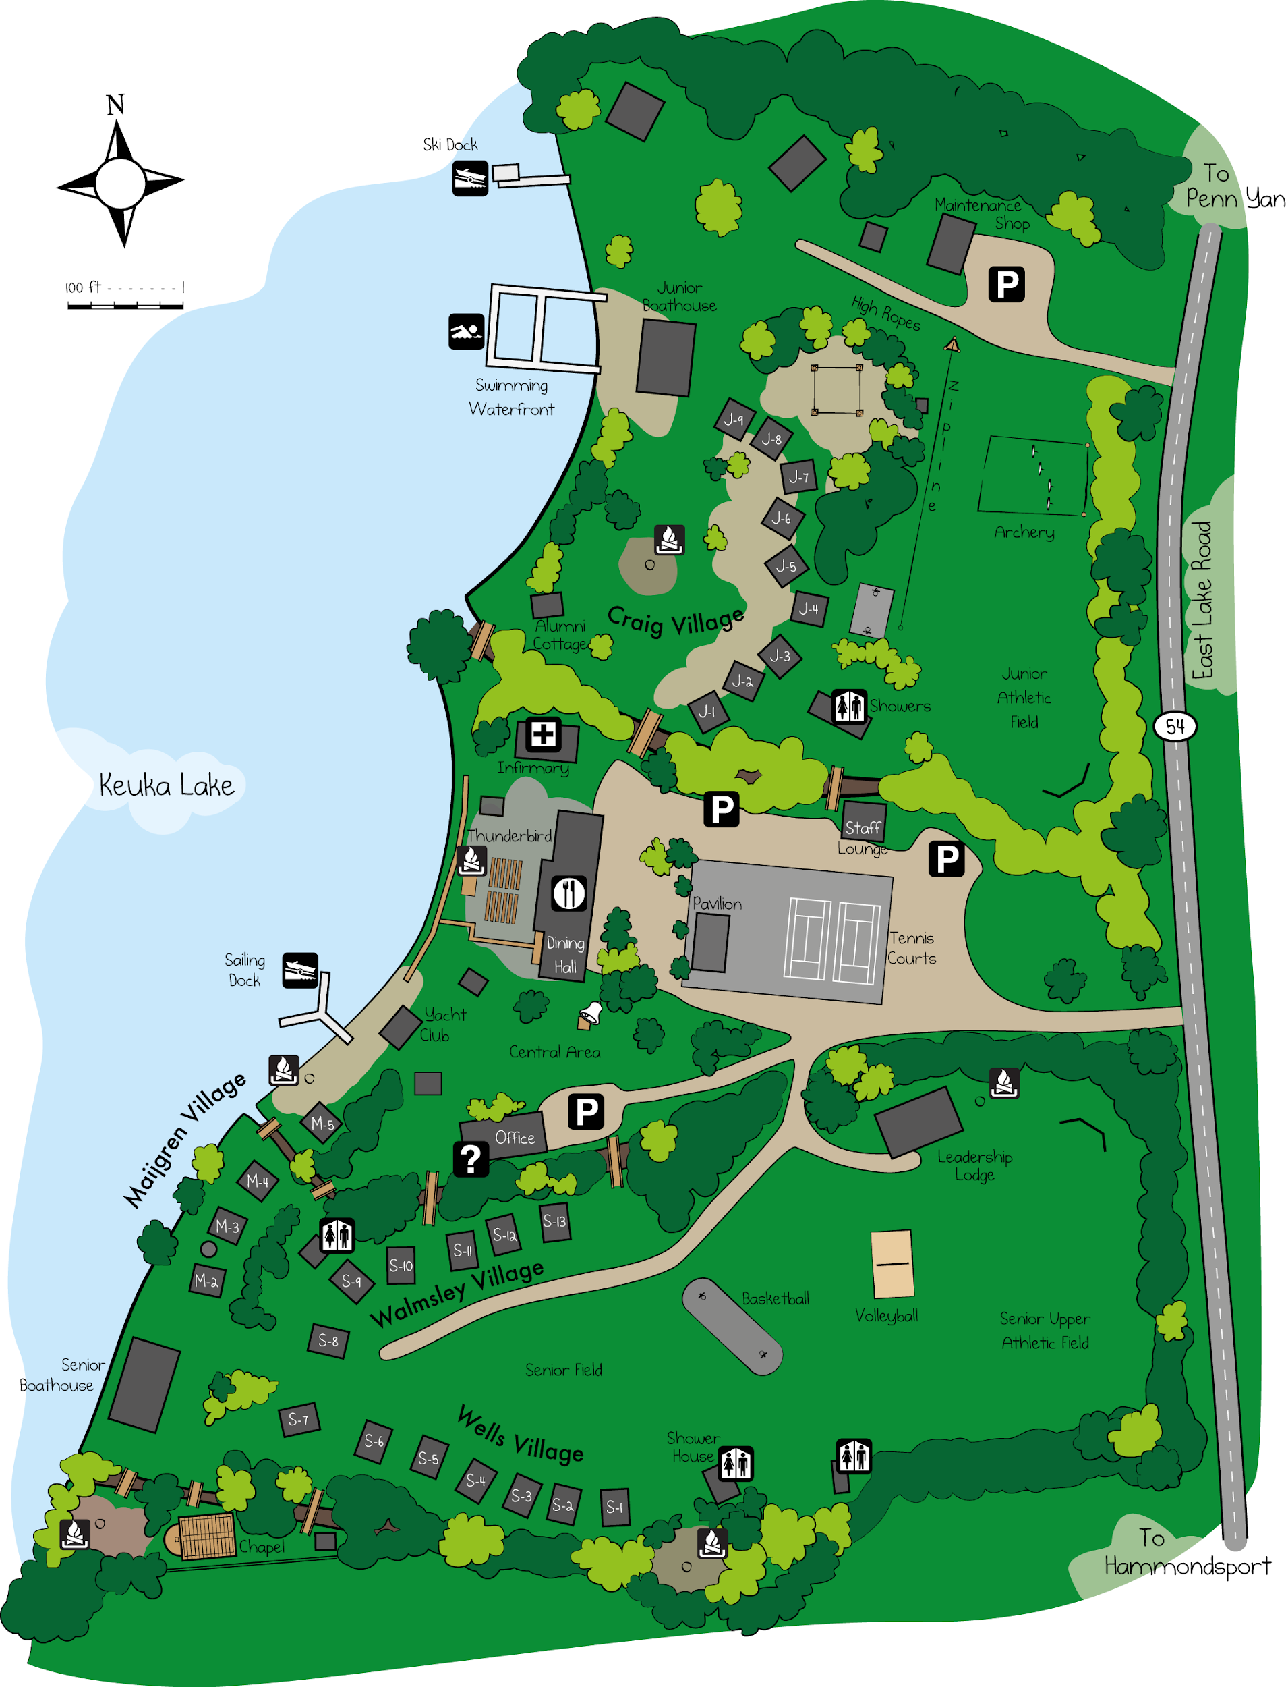
Junior Waterfront
Junior Boathouse
Junior Athletic Field
Craig Fire Circle
Archery Range
High Ropes Shed
Whispering Pines
Thunderbird
Dining Hall
Staff Lounge
Y-Dock
Dining Hall Bell
Tennis Courts
Yacht Club
Wheelhouse
Maijgren Fire Circle
EPO Depot
Totem Pole
Store
Leadership Lodge
Whispering Pines
Senior Waterfront
Basketball Courts
Senior Athletic Field
Senior Boathouse
Wells Fire Circle
Senior Shower House
Walmsley Fire Circle

