Slide 1
How to make informed financial decisions
This session is aimed at Key Stage Three (recommended for Year 7 or 8)

Slide 2
Unit outline
Session 1 | Session 2 | Session 3 | Session 4 | Session 5 | Session 6
How to open a bank account | How to read a bank statement | How to save money | How to use bank cards | How to manage debt | A guide to banking

Slide 3
Having a respectful learning environment
We will listen to each other respectfully
We will avoid making judgements or assumptions about others
We will comment on what has been said, not the person who has said it
We won’t put anyone on the spot and we have the right to pass
We will not share personal stories or ask personal questions

Slide 4
Session 6:
A young person’s
guide to banking

Slide 5
By the end of the session, I will be able to:
Explain key concepts related to banking, saving and spending

Slide 6
What questions could these be answers to?
It’s good to know how much I’ve spent
I’ll earn 3% interest
I found a voucher code
It is needed to open a bank account
Because I didn’t have enough money in my current account
I’d rather save up
No, because I already have 4 of them!
So that I don’t have to carry cash

Slide 7
What questions could these be answers to?
It’s good to know how much I’ve spent
Why do you check your banking app so often?
I’ll earn 3% interest
Why have a savings account?
I found a voucher code
2
How can a person save money when shopping?
1
3
It is needed to open a bank account
Do you have a passport?
Because I didn’t have enough money in my current account
Why were you overdrawn?
I’d rather save up
You can use buy now pay later
4
No, because I already have 4 of them!
7
5
Why don’t you treat yourself to those trainers
So that I don’t have to carry cash
Why have a debit card?
6
8
Notes:
Teacher instruction
Invite students to share their questions
Use animation to display possible questions

Slide 8

What do young people need to know about banking?
During today’s lesson you are going to create a guide that informs young people on the most important things that they need to know about banking.
Take a plain sheet of paper and decide which style of leaflet you are going to use.
Your leaflet will need 4-5 sections covering the five lessons you have had.
We will now recap our learning to help you fill in your booklet. This is a good opportunity for you to make notes on any information that you might have missed.

Slide 9
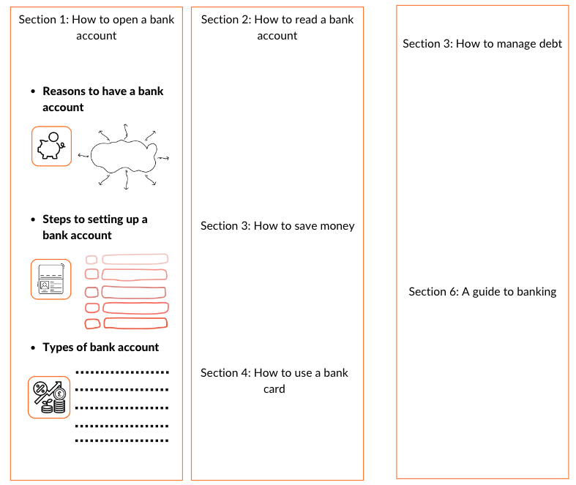
What do young people need to know about banking?
Turn your booklet/worksheet into landscape. Use your notes to complete your leaflet. The first section is an example.

Slide 10
Recap of Module 2 sessions
How to open a bank account
How to save money
How to use a bank card
How to read a bank statement
Notes:
Each box links to the relevant slide: click/tap board to select

Slide 11

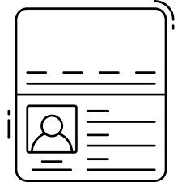


Session 1 recap
How to open a bank account
With your partner, explain how the images below link to opening a bank account
Reasons to have a bank account
Steps to setting up a bank account
Types of bank account

Slide 12
Session 1 recap
How to open a bank account
A way to keep
money safe
A passport is one item needed to open an account
Saving accounts add interest to money in an account

Slide 13
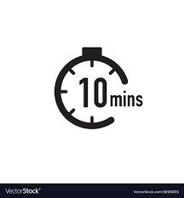
Session 1 recap
How to open a bank account
You have 10 minutes to complete the first section of your guide.
Subtitle: Setting up a bank account
Information to include:
One reasons to have a bank account
Two types of bank account - what is the difference between a current account and a saving account
Three things needed to open a bank account

Slide 14
Recap of Module 2 sessions
How to open a bank account
How to save money
How to use a bank card
How to read a bank statement

Slide 15

Session 3 recap
How to save money
‘Give me 5’... things that we have learnt about saving
What do people save money for?
Name four different ways to save when shopping
What goes into a savings plan?
How does interest work in a savings account?
Bonus: What is compound interest?
Notes:
Teacher instruction
Use following slides to revisit content from lesson 3 and prompt student answers

Slide 16








What do people save money for?
Notes:
Teacher instruction
Possible answers and reasons:
• Paying unexpected bills or for emergencies
• Planning special events (e.g. a wedding)
• Planning to purchase big items (e.g. car, house, holiday, etc.)
• Reducing the need to borrow money
• Saving up for retirement when you’re not working anymore
• It feels good to save, and can reduce stress and anxiety around money
Extended questioning: consider a range of perspectives i.e. differences depending on age
• Which items are more important?
• Which items need a short term savings plan or a longer term saving plan?
• Which items could you delay buying for a while? Are there any benefits of delaying buying these items?
Challenge question: what is the difference between having a budget and saving?

Slide 17
How to save on the things you buy
Use price comparison sites
Find discount codes
Look out for cashback offers
Explore ‘package deals’ e.g. buying a cinema pass rather than one off tickets
Saving when buying
Have a ‘one in,
one out’ policy
when you buy clothes
(and sell or donate
the one you’re
getting rid of)
Delayed gratification
Buy ‘pre-loved’ goods
Notes:
Teacher instruction
Possible answers:
Leave something in your online basket as may then be emailed a discount code
Use buy one get one free offers with a friend and halve the price
Buy in bulk when things are on offer
Look to sell clothes/items no longer need
Shop around for best deals
Spend less
Develop discussion on delayed gratification - why might it be useful to wait before making a purchase

Slide 18


Creating a saving plan
Setting a saving goal, helps keep financial decisions focussed
If the saving goal is large, set some interim goals (and maybe some rewards to stay motivated!)
Find a picture to put as a phone background, in a wallet or displayed on a wall at home as a reminder of the goal

Slide 19


Calculating interest
Lucy is choosing to put some money in a savings account.
She puts money into this account and gains interest on the money that she deposits (puts in).
1. How much interest has she made at the end of the year?
To find 2% of £100, we calculate
0.02 x 100 =£2
2. How much money in total is in her account at the end of the year?
We add up the £100 deposit and the interest she makes.
£100 + £2 = £102
If Lucy deposits £100* earning 2% interest:
How much interest has she made at the end of the year?
How much money in total is in her account at the end of the year?
*Assuming no more money is taken out or deposited over the year
Optional video - watch to learn about compound interest - https://youtu.be/DyXUCEm7VeY
Notes:
Teacher explanation
Adaptive teaching: This example uses simple interest for calculations. For HAPs, compound interest can be introduced.
Compound interest: Instead of finding 2% on the deposit (amount paid in) of £100 each month, we can find 2% on the amount paid in PLUS the extra interest made on the Year before. E.g. in the SECOND YEAR. we find 2% on the amount earned in the FIRST YEAR which is £102. We do 2% on £102 (instead of 2% on £100). 2% on £102 is £102 x 0.02 = £2.04 (bigger than £2). So at the end of Year 2 there will be £102 + £2.04 = £104.04, instead of £104.
Example 2: Instead of finding 5% on the deposit (amount paid in) of £100 each month, we can find 5% on the amount paid in PLUS the extra interest made on the Year before. E.g. in the SECOND YEAR. we find 5% on the amount earned in the FIRST YEAR which is £105. We do 5% on £105 (instead of 5% on £100). 5% on £105 is £105 x 0.05 = £5.25 (bigger than £5). So at the end of Year 2 there will be £105 + £5.25 = £110.25, instead of £110.
Over time compound interest means money in the bank will grow faster than simple interest: watch the video to learn more: https://www.youtube.com/watch?v=8edPzh71RIQ (please note the video has an American context and FLIC will be making a video for the UK context)
https://www.youtube.com/watch?v=vIPhIi9KzAQ
https://www.youtube.com/watch?v=djBJmRH9lDo

Slide 20

Session 3 recap
How to save money
You have 10 minutes to complete the next section of your guide.
Subtitle: Ways to save money
Information to include:
Why do people save?
Name four different ways to save
What goes into a savings plan?
How does interest work in a savings account?
Bonus: What is compound interest?
Notes:
Delivery instructions:

Slide 21
Which lesson would you like to recap?
How to open a bank account
How to save money
How to use a bank card
How to read a bank statement

Slide 22

Session 4 recap
How to use a bank card
With your partner, explain why the statements below are not correct
A credit card is a card used to spend a person’s own money
A person must be 16 to have a credit card.
There is no interest on credit cards
Credit cards are the only way to buy expensive things

Slide 23
Session 4 recap
How to use a bank card
With your partner, explain why the statements below are not correct
A credit card is a card used to spend a person’s own money
A person must be 16 to have a credit card.
There is no interest on credit cards
Credit cards are the only way to buy expensive things

Slide 24
Session 4 recap
How to use a bank card
Money on a credit card comes from the bank – this is borrowing the bank’s money until the credit card statement / bill is paid.
A person must be 18 to have a credit card.
If the money spent is paid back immediately, there may be no interest charged. However, the longer a person takes to pay their credit card bill, the more interest they will be charged.
A person can save their own money buy expensive things. It might take a little longer but they won’t be at risk of being in debt.

Slide 25
Session 4 recap
How to use a bank card
You have 10 minutes to complete the next section of your guide.
Subtitle: What is a credit card?
Information to include:
How a credit card works
Tips for paying off a credit card

Slide 26
Recap of Module 2 sessions
How to open a bank account
How to save money
How to use a bank card
How to read a bank statement

Slide 27
Session 2 recap
How to read a bank statement
Date | Code | Transaction details | Paid in | Paid out | Balance
01/01/01 | D/D | Mobile phone bill |  | £12.79 | £21.47
01/01/01 | D/D | Cloud storage |  | £1.35 | £20.12
03/01/01 | TFR | Present |  | £10.00 | £11.12
03/01/01 | TFR | Birthday meal |  | £16.74 | -£5.62
03/01/01 | DR |  |  | £0.50 | -£6.12
04/01/01 | DR |  |  | £0.50 | -£6.62
05/01/01 | BACS | Speedy Food | £112 |  | £105.38
10/01/01 | S/O | Rugby Club |  | £30 | £75.38
12/01/01 | INT |  | £0.07 |  | £75.45
21/01/01 | ATM | Cash withdrawal |  | £40.00 | £35.45
 | CHG | Account maintenance fee |  | £1.75 | £33.70
23/01/01 | TFR | From AB for Cinema | £11.00 |  | £44.70
29/01/01 | S/O | Phone insurance |  | £3.99 | £40.71
Explain the different transactions on this statement to your partner

Slide 28
Session 2 recap
How to read a bank statement
Abbreviation | What it stands for | What this means
CHG | Charge | A transaction made has incurred an additional charge
D/D | Direct Debit | Regular payment, usually of a changing amount
DR | Account Overdrawn | The account balance is less than zero
CR | Credit | Money going into the account
INT | Interest | The amount earned on your balance or charged on a loan
S/O or STO | Standing Order | Regular payment for a fixed amount
TFR | Transfer | Money has been transferred between accounts

Slide 29
Session 2 recap
How to read a bank statement
You have 10 minutes to complete the next section of your guide.
Subtitle: Understanding a bank statement
Information to include:
Which codes on a bank statement show a deduction of money?
Stretch: What can a person do to avoid these deductions?

Slide 30



Share your guide with the Flic team
Take a picture of your guide
Add to your profile
@ft_flic

Slide 31



Services available for people who have concerns about their personal finances
Citizens Advice – Debt and Money –
Links to advice on a number of topics, including financial difficulties, cost of living and communicating with creditors.
National Debtline – Debt and Money
A debt advice charity run by the Money Advice Trust, offering a free and confidential debt advice service.
Childline Helpline
0800 1111
Talk about anything.
Contact via phone / web
At school, you can speak with an adult you trust.
This could be your form tutor, head of year or the school’s safeguarding officer.

Slide 32
Links to learn more!
Articles to extend learning
Please visit the FT FLIC Learning Hub for further resources
Bank of England: What do Banks Do?
Money Saving Expert: Banking & Savings

