Slide 1



Effective Communication
FREE PRESENTATION TEMPLATE

Slide 2

Welcome
Welcome to the world of fantasy! Join us on a journey to explore the mystical creatures, enchanted lands, and magical wonders that exist beyond our reality. Discover the wonders and secrets of this exciting realm and unlock the power of imagination.

Slide 3
Table of Contents
01
Introduction
02
Encounters
The Extraordinary Realm
Unicorn Sightings
03
Wonders
04
Magic
Wishes Granted
Spellcasting
05
Adventure
06
Conclusion
Happily Ever After
Embrace the Fantasy

Slide 4


Introduction
The Fantasy Realm: Uncovering the Secrets of the Imagination and the Magic that Lies Within

Slide 5
The Realm of the Extraordinary
Welcome to the Fantasy World, a realm of wonder and enchantment where anything is possible. Here, dragons breathe fire, unicorns prance through meadows, and rainbows shine brightly. This world is a place where wishes come true, where potions can be cursed and spells are cast. It's a place of treasure and adventure, where the impossible becomes possible. But the greatest treasure of all is the one that lies within.
The world of fantasy is a reflection of our deepest desires, our fondest dreams, and our wildest imaginations. It's a place where we can let go of the constraints of reality and explore the boundless possibilities of the human mind. In this introduction, we will delve into the mysteries of this realm, uncovering the magic and wonder that lies within. So come with us and let's embark on a journey through the Fantasy World.

Slide 6



Unicorn Sightings
A record of the number of unicorns spotted in the fantasy realm and the beauty and mystery that surrounds these enchanting creatures.
Dragon Taming
A closer look at the art of taming dragons and the brave adventurers who dare to take on these fearsome creatures.

Slide 7






Unicorn Sightings
Dragon Taming
Dragon Taming
A record of the number of unicorns spotted in the fantasy realm and the beauty and mystery.
A closer look at the art of taming dragons and the brave adventurers who take on these creatures.
A closer look at the art of taming dragons and the brave adventurers who take on these creatures.

Slide 8

Fantasy is the gateway to the impossible, the land where the ordinary becomes extraordinary, and the impossible becomes possible. It is the realm of the imagination, where anything can happen and everything is possible.
The Dream Weaver

Slide 9
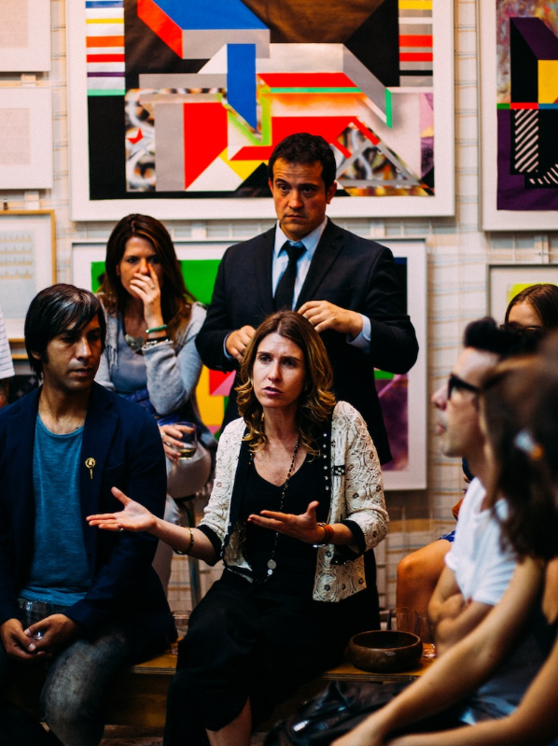

Dragon Taming Technique
A guide to taming and caring for dragons in the realm of magic.
The Art of Unicorn Sighting
Tips and tricks for spotting the elusive unicorns in their natural habitat.

Slide 10

The Magic of Dragons:
A Research
6.7M
4.4M
2.3M

Slide 11




The Elves: A Glimpse into Their World
Elegant inhabitants of enchanted forests, known for their mastery of magic and their close connection to nature. They possess an innate sense of harmony and balance, making them protectors of the natural world.
"The Art of Archery": Discover the intricacies of the Art of Archery as practiced by the graceful and precise elves.
"The Music of the Elves": Immerse yourself in the enchanting music of the elves, whose songs have the power to heal.
"The Life of an Elf": Learn about the customs and daily life of the elves, from their familial structure to their religious beliefs.

Slide 12










Strengths
Weaknesses
Rare event causes unpredictable magic.
S
W
Rare event causes unpredictable magic.
O
T
Opportunities
Threats
Rare event causes unpredictable magic.
Rare event causes unpredictable magic.

Slide 13


Some Data
75%
Enchanted Creatures
possess the ability to cast spells.
Magic-Wielding Individuals
60%
practice the art of illusions.
90%
Spells Cast
are dark magic, foretelling danger.

Slide 14


234,567
UNICORN SIGHTINGS
A tally of the number of unicorns spotted in the fantasy realm.

Slide 15
233 Coins
85%
Treasure Found
Wished Granted
456 Hours
535 Km
Duration of Spell Casting
Journey Distance

Slide 16



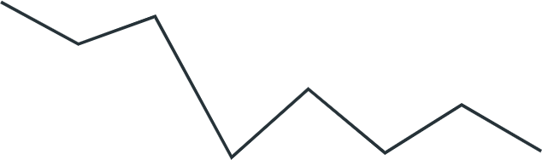

Some Graph
100
90
80
70
60
50
34.574
40
Total
30
20
10
0
1
2
3
4
5
6
7
8
Spellcasting Progress
Treasure Found
A record of the number of spells cast per year
A record of the amount of treasure found per month

Slide 17


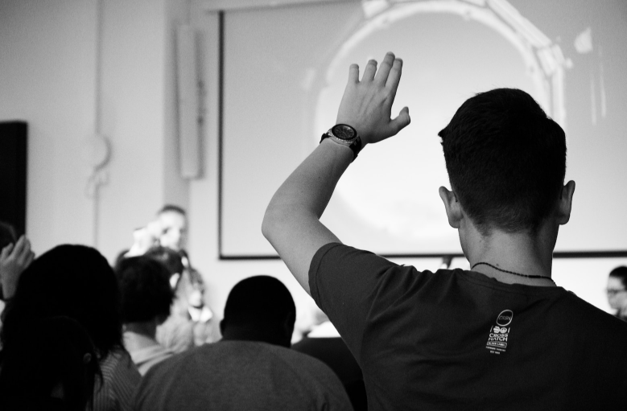
Portal to Adventure
A web application
A web application designed for discovering the world of fantasy

Slide 18



The Future of Fantasy
An mobile app
An app designed for exploring and experiencing the enchanting realm of fantasy
  Explore a magical world
  Experience fantasy firsthand
  Immerse in a realm of magic
  Discover untold wonders
  Live your fantasy dreams

Slide 19

A Magic Picture

Slide 20

The Enchanted Forest
A magical forest filled with talking animals and enchanted creatures.
The Crystal Caves
A network of underground caves filled with precious gems and crystals.
The Dragon's Lair
A dangerous and mysterious place where dragons reside.
Fantasy Realm at a Glance

Slide 21




The Timeline
May
July
Shimmering City, conquest, Unicorn Crystal
Kingdom invaded, betrayal, hero's festival
Eclipse
Quest
Foundation
Transformation
April
June
Eclipse, quest for artifact, volcano disaster
War, curse from artifact, magic discovery

Slide 22



Our Team
Eldruin
The Fire Mage
Lunaria
The Moon Priestess
Elementalen
The Guardian

Slide 23









The Organization
Chloe Ng
The Mage
Valtorin
Aurielle
Theronis
Dariana
The Assassin
The Priestess
The Warrior
The Shaman
Lucian
Elvina
The Conjurer
The Oracle
Cedric
Seraphina
The Timekeeper
The Lightbringer
To download more editable chart, click here

Slide 24
Thank you for choosing EaTemp
We offer free and high-quality slides templates for your presentations. We appreciate you choosing us and hope our templates have been helpful.
As a new website, we rely on your support to grow, so please help us by sharing our site with your friends and colleagues.
Credit | Image: Unsplash

