Slide 1



GRAPHIC DESIGNER
WORK ARCHIEVE
2027 EDITION
FRANCOIS MERCER
VOL. 02
CREATIVE PORTFOLIO

Slide 2

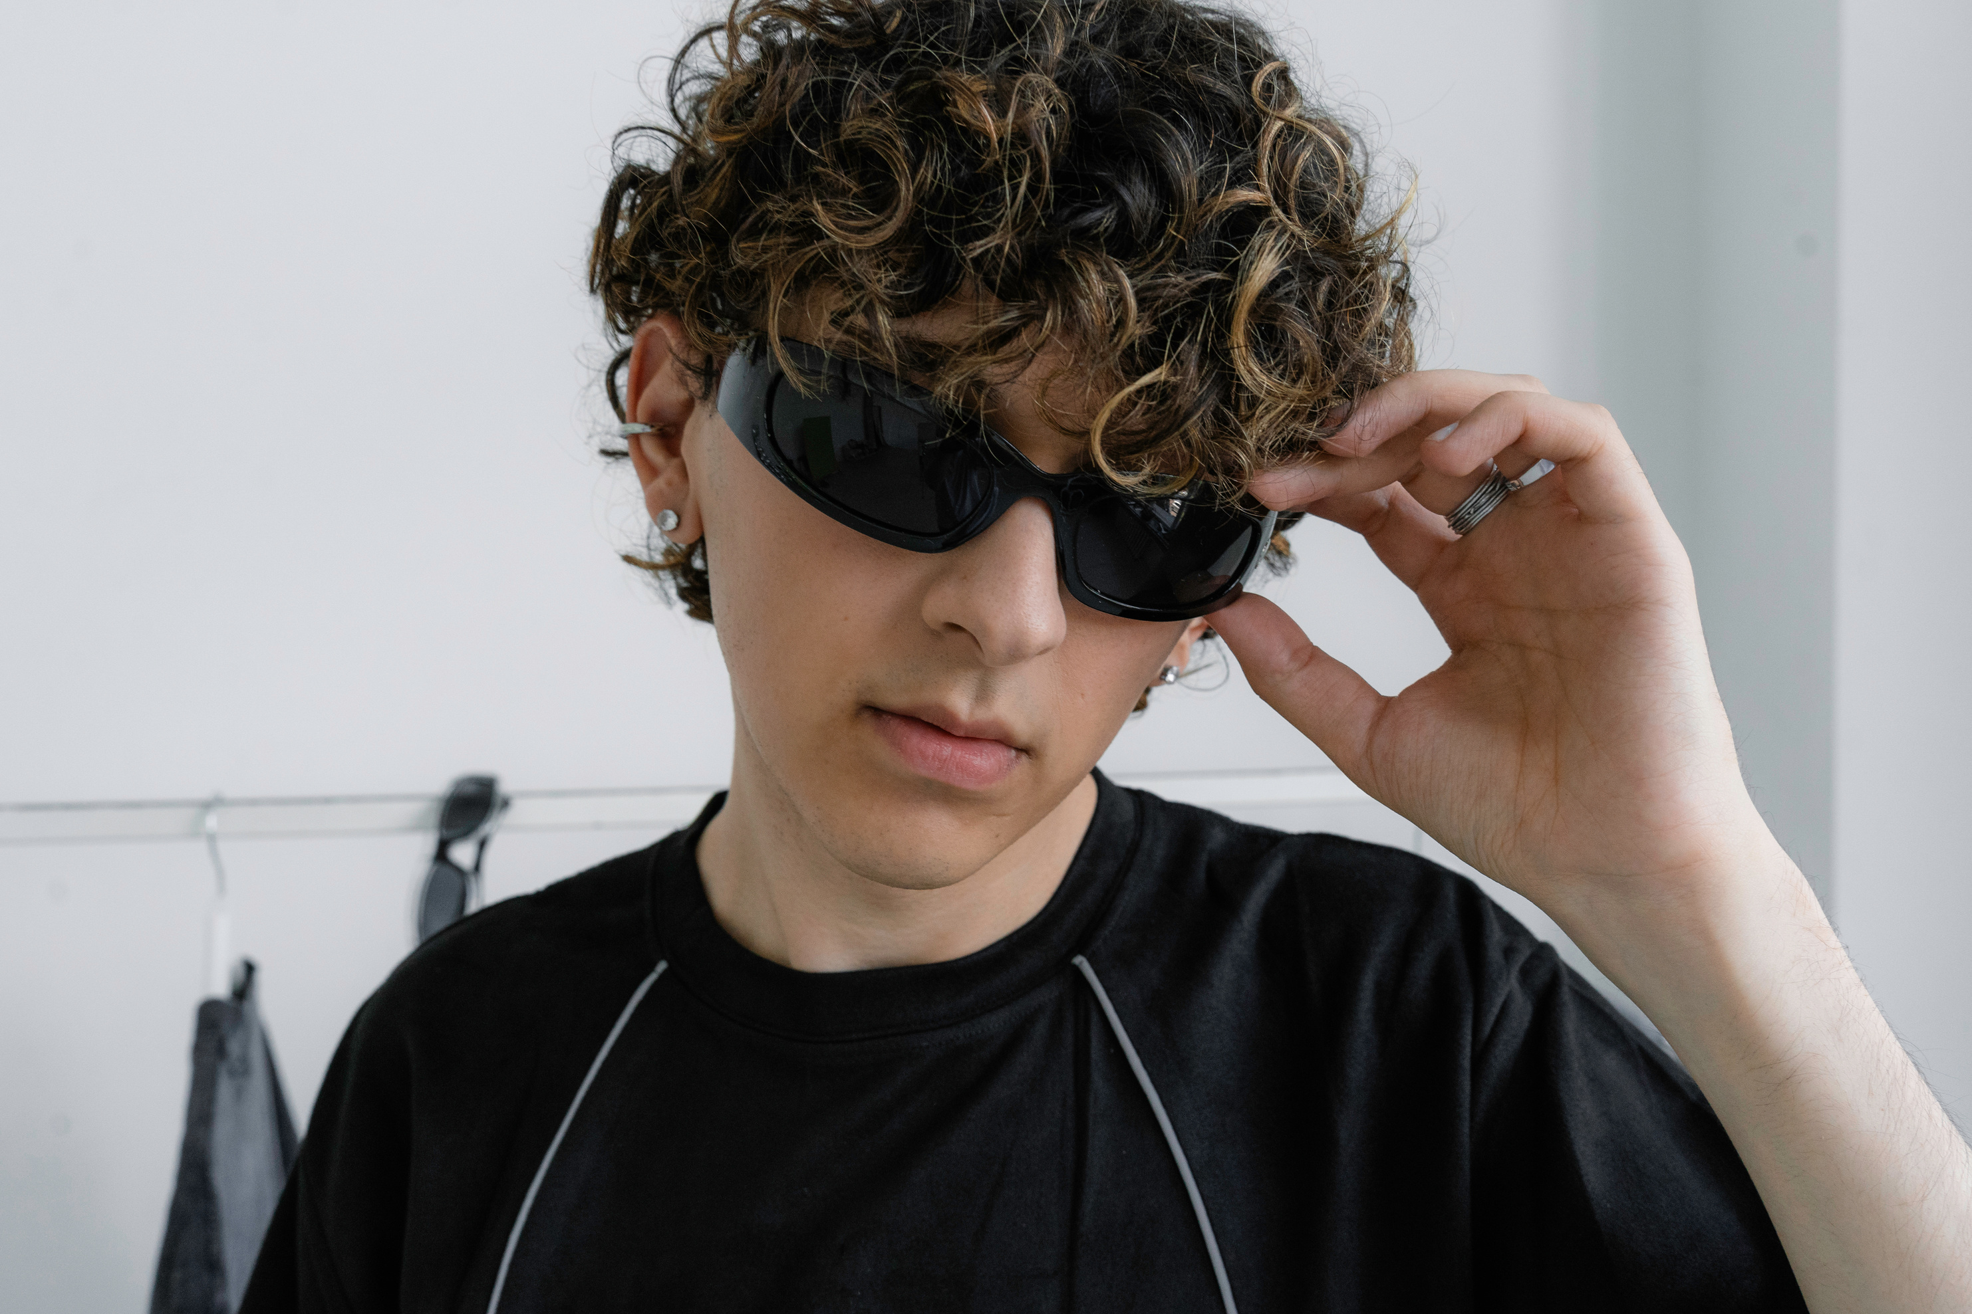
FRANCOIS MERCER
PORTFOLIO VOL.2
01
INTRODUCE
I bring ideas to life through visual storytelling, purposeful design, and innovative thinking. With a strong foundation in design principles and an eye for detail, I turn concepts into meaningful experiences across digital and print media.

Slide 3

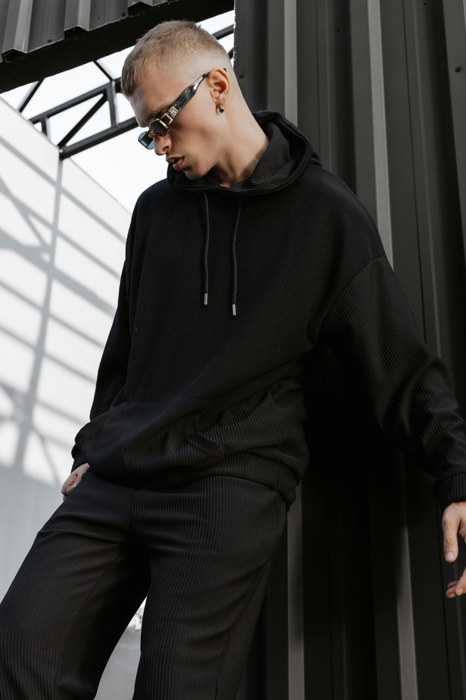
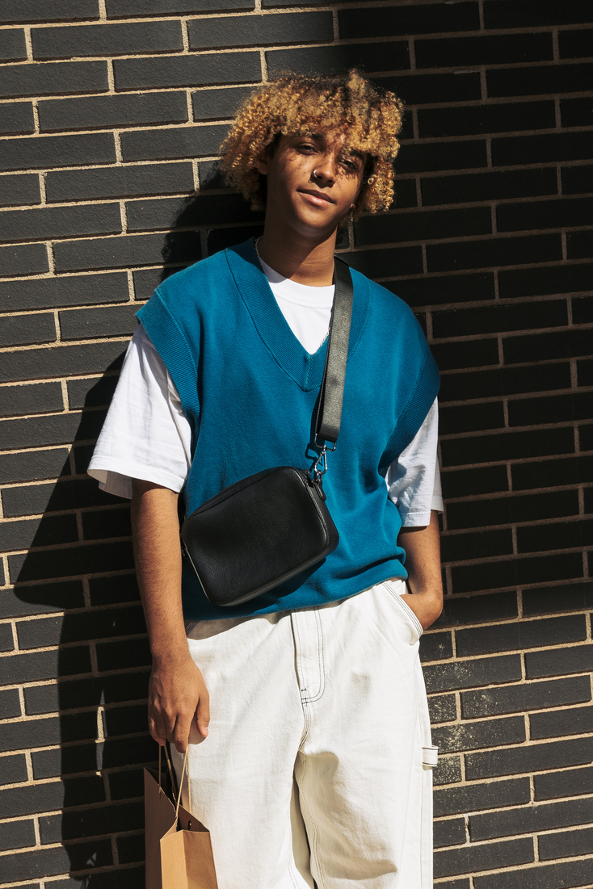
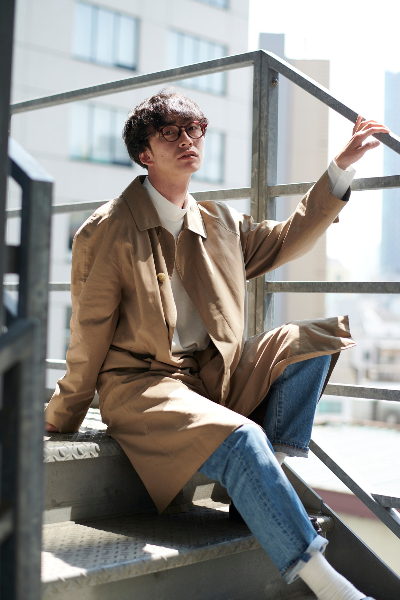
PORTFOLIO VOL.2
WORK ARCHIEVE
CREATIVE DESIGNER
ABOUT ME
02
CREATIVE BY NATURE. STRATEGIC BY MIND.
With over 9 years of experience, I specialize in branding, digital content, and visual communication. My work blends aesthetics with clarity to help brands connect with their audiences. I thrive in both collaborative and independent environments, always striving to craft design solutions that are not just beautiful — but effective.

Slide 4
PORTFOLIO VOL.2
WORK ARCHIEVE
CREATIVE DESIGNER
CORE SKILL
03
BRANDING & IDENTITY DESIGN
CREATIVE DIRECTION
DIGITAL & PRINT DESIGN
SOCIAL MEDIA VISUALS

Slide 5

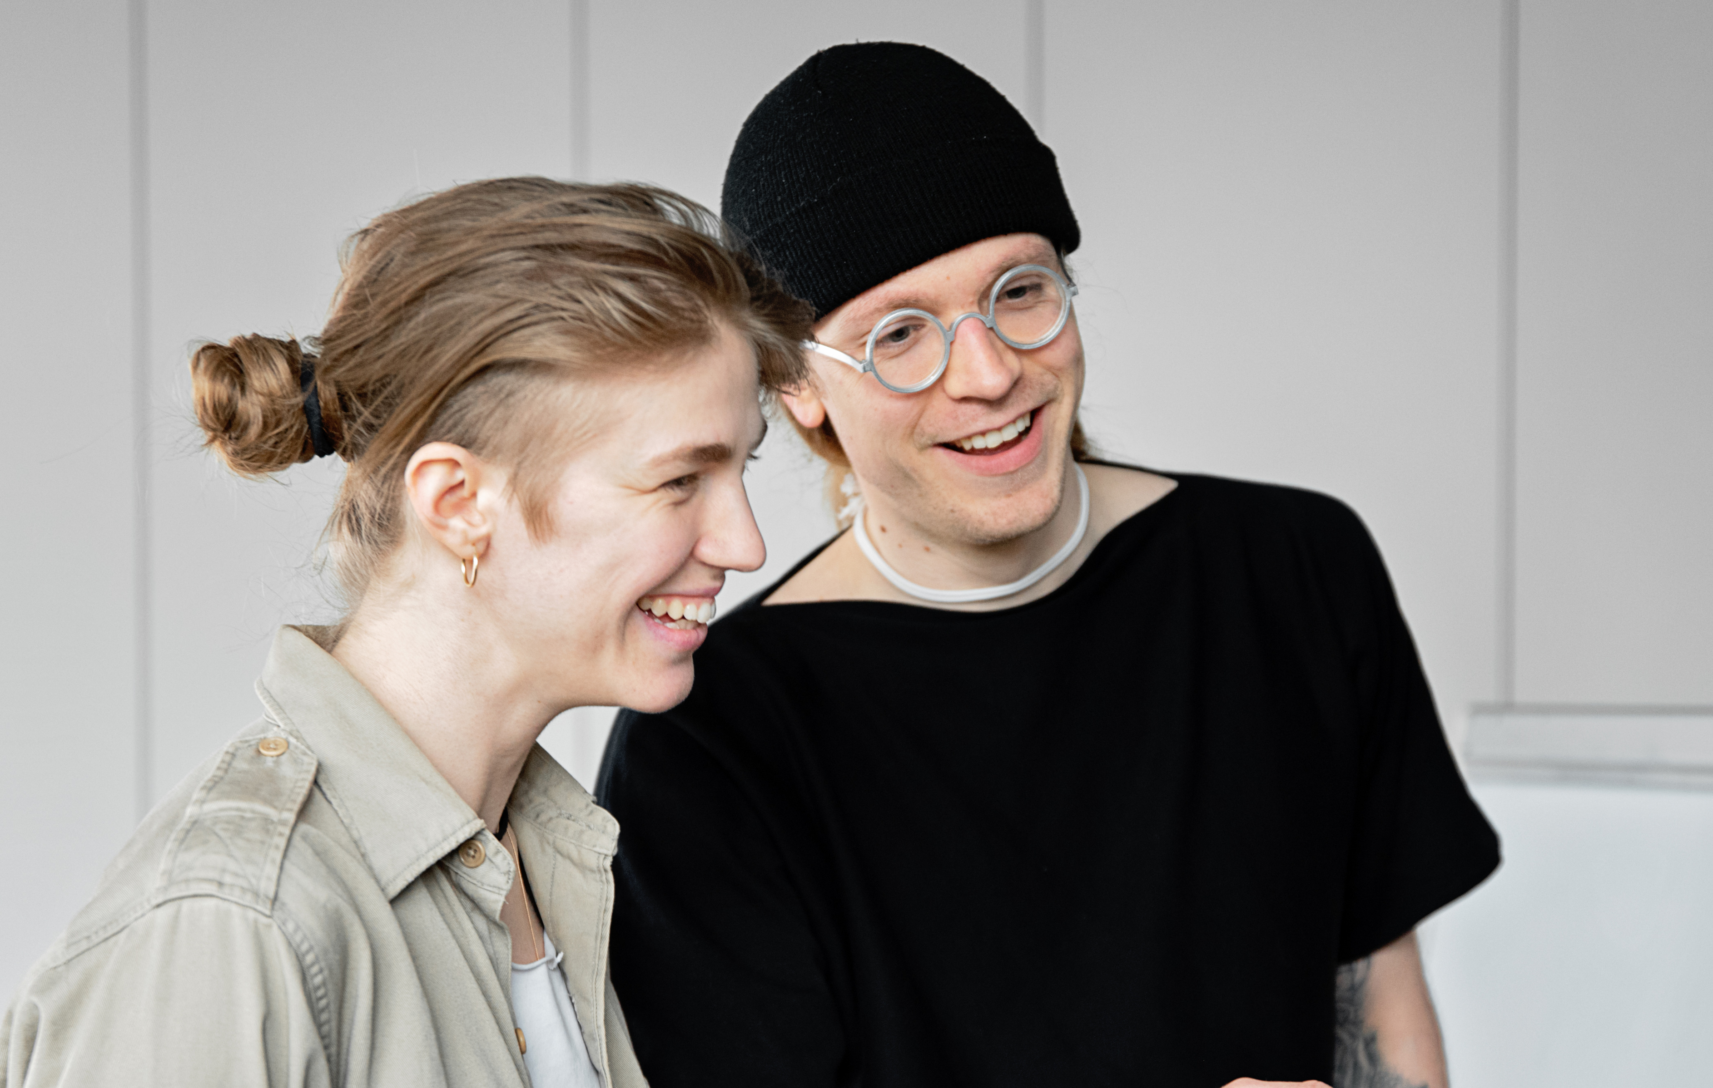
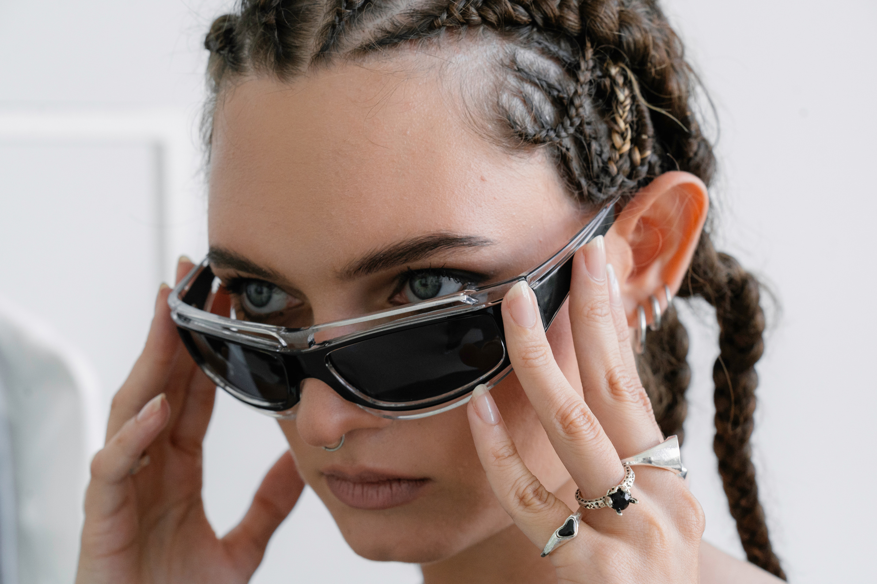

PROCESS
MY CREATIVE
DISCOVERY
RESEARCH
IDEATION
Understand the brand, goals, and audience
Market trends and visual benchmarking
Brainstorming concepts and creative directions
04
DESIGN
FEEDBACK
DELIVERY
Bringing ideas to life with tools
Refining based on collaboration
High-quality files, ready-to-use assets, and documentation

Slide 6

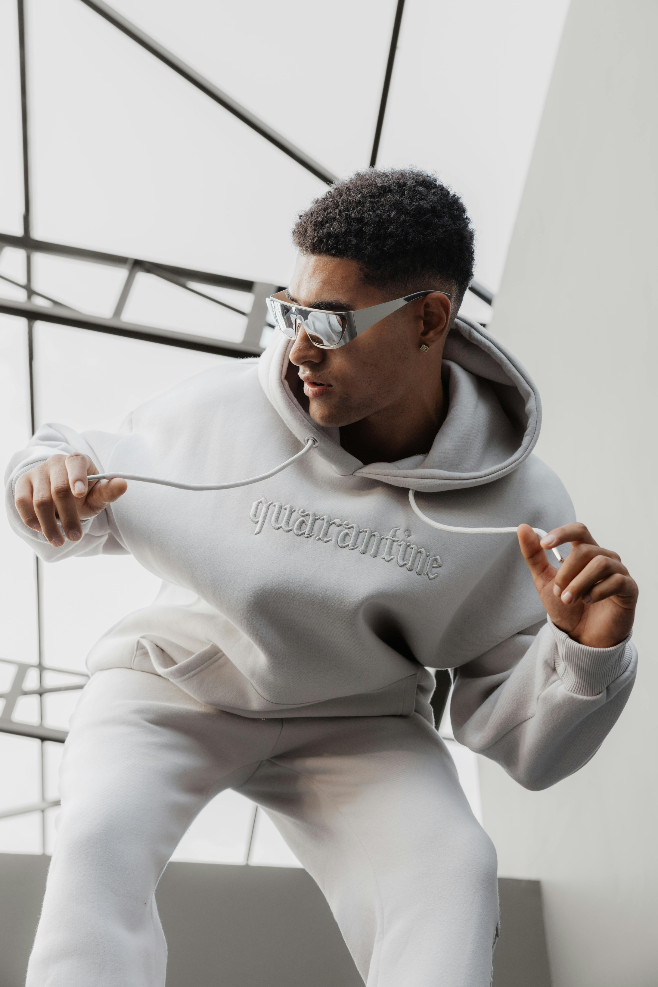
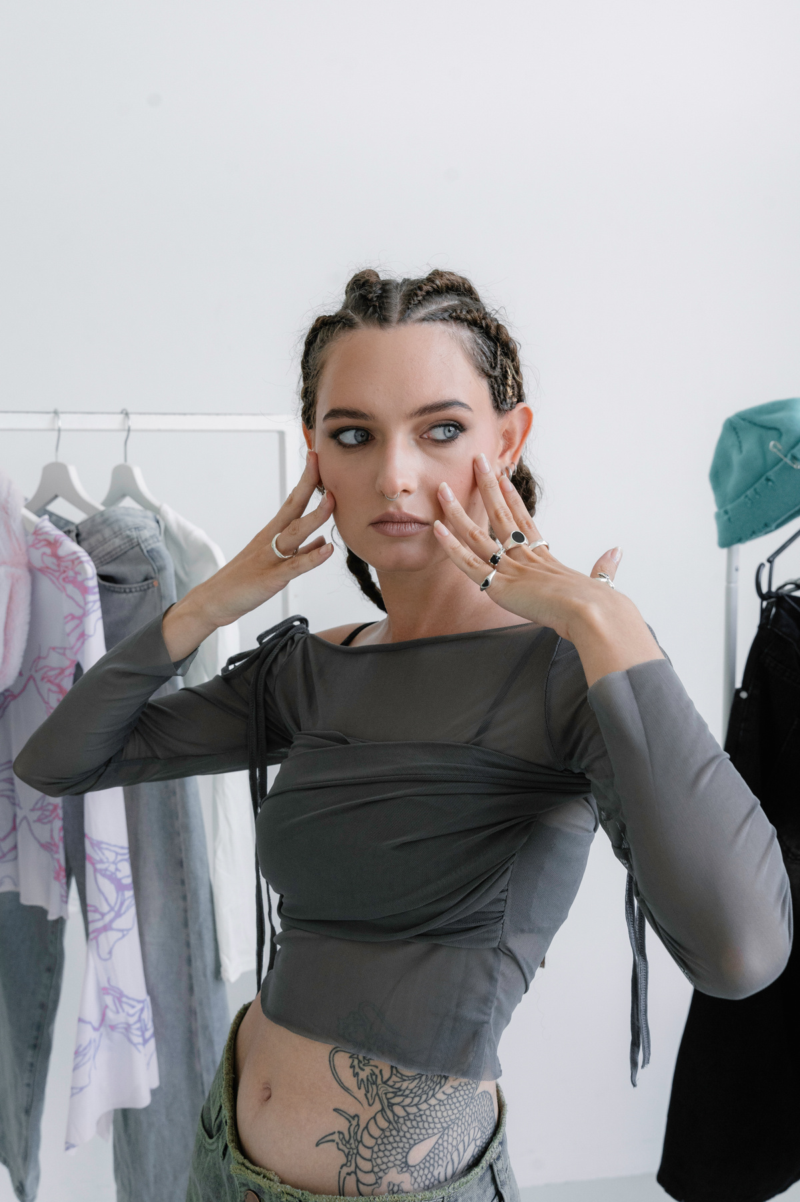
PORTFOLIO VOL.2
WORK ARCHIEVE
CREATIVE DESIGNER
DESIGN IS NOT JUST WHAT IT LOOKS LIKE AND FEELS LIKE. DESIGN IS HOW IT WORKS.
DESIGN PHILOSOPHY
I believe good design is more than visuals — it’s about solving problems, enhancing experiences, and creating impact.
05

Slide 7
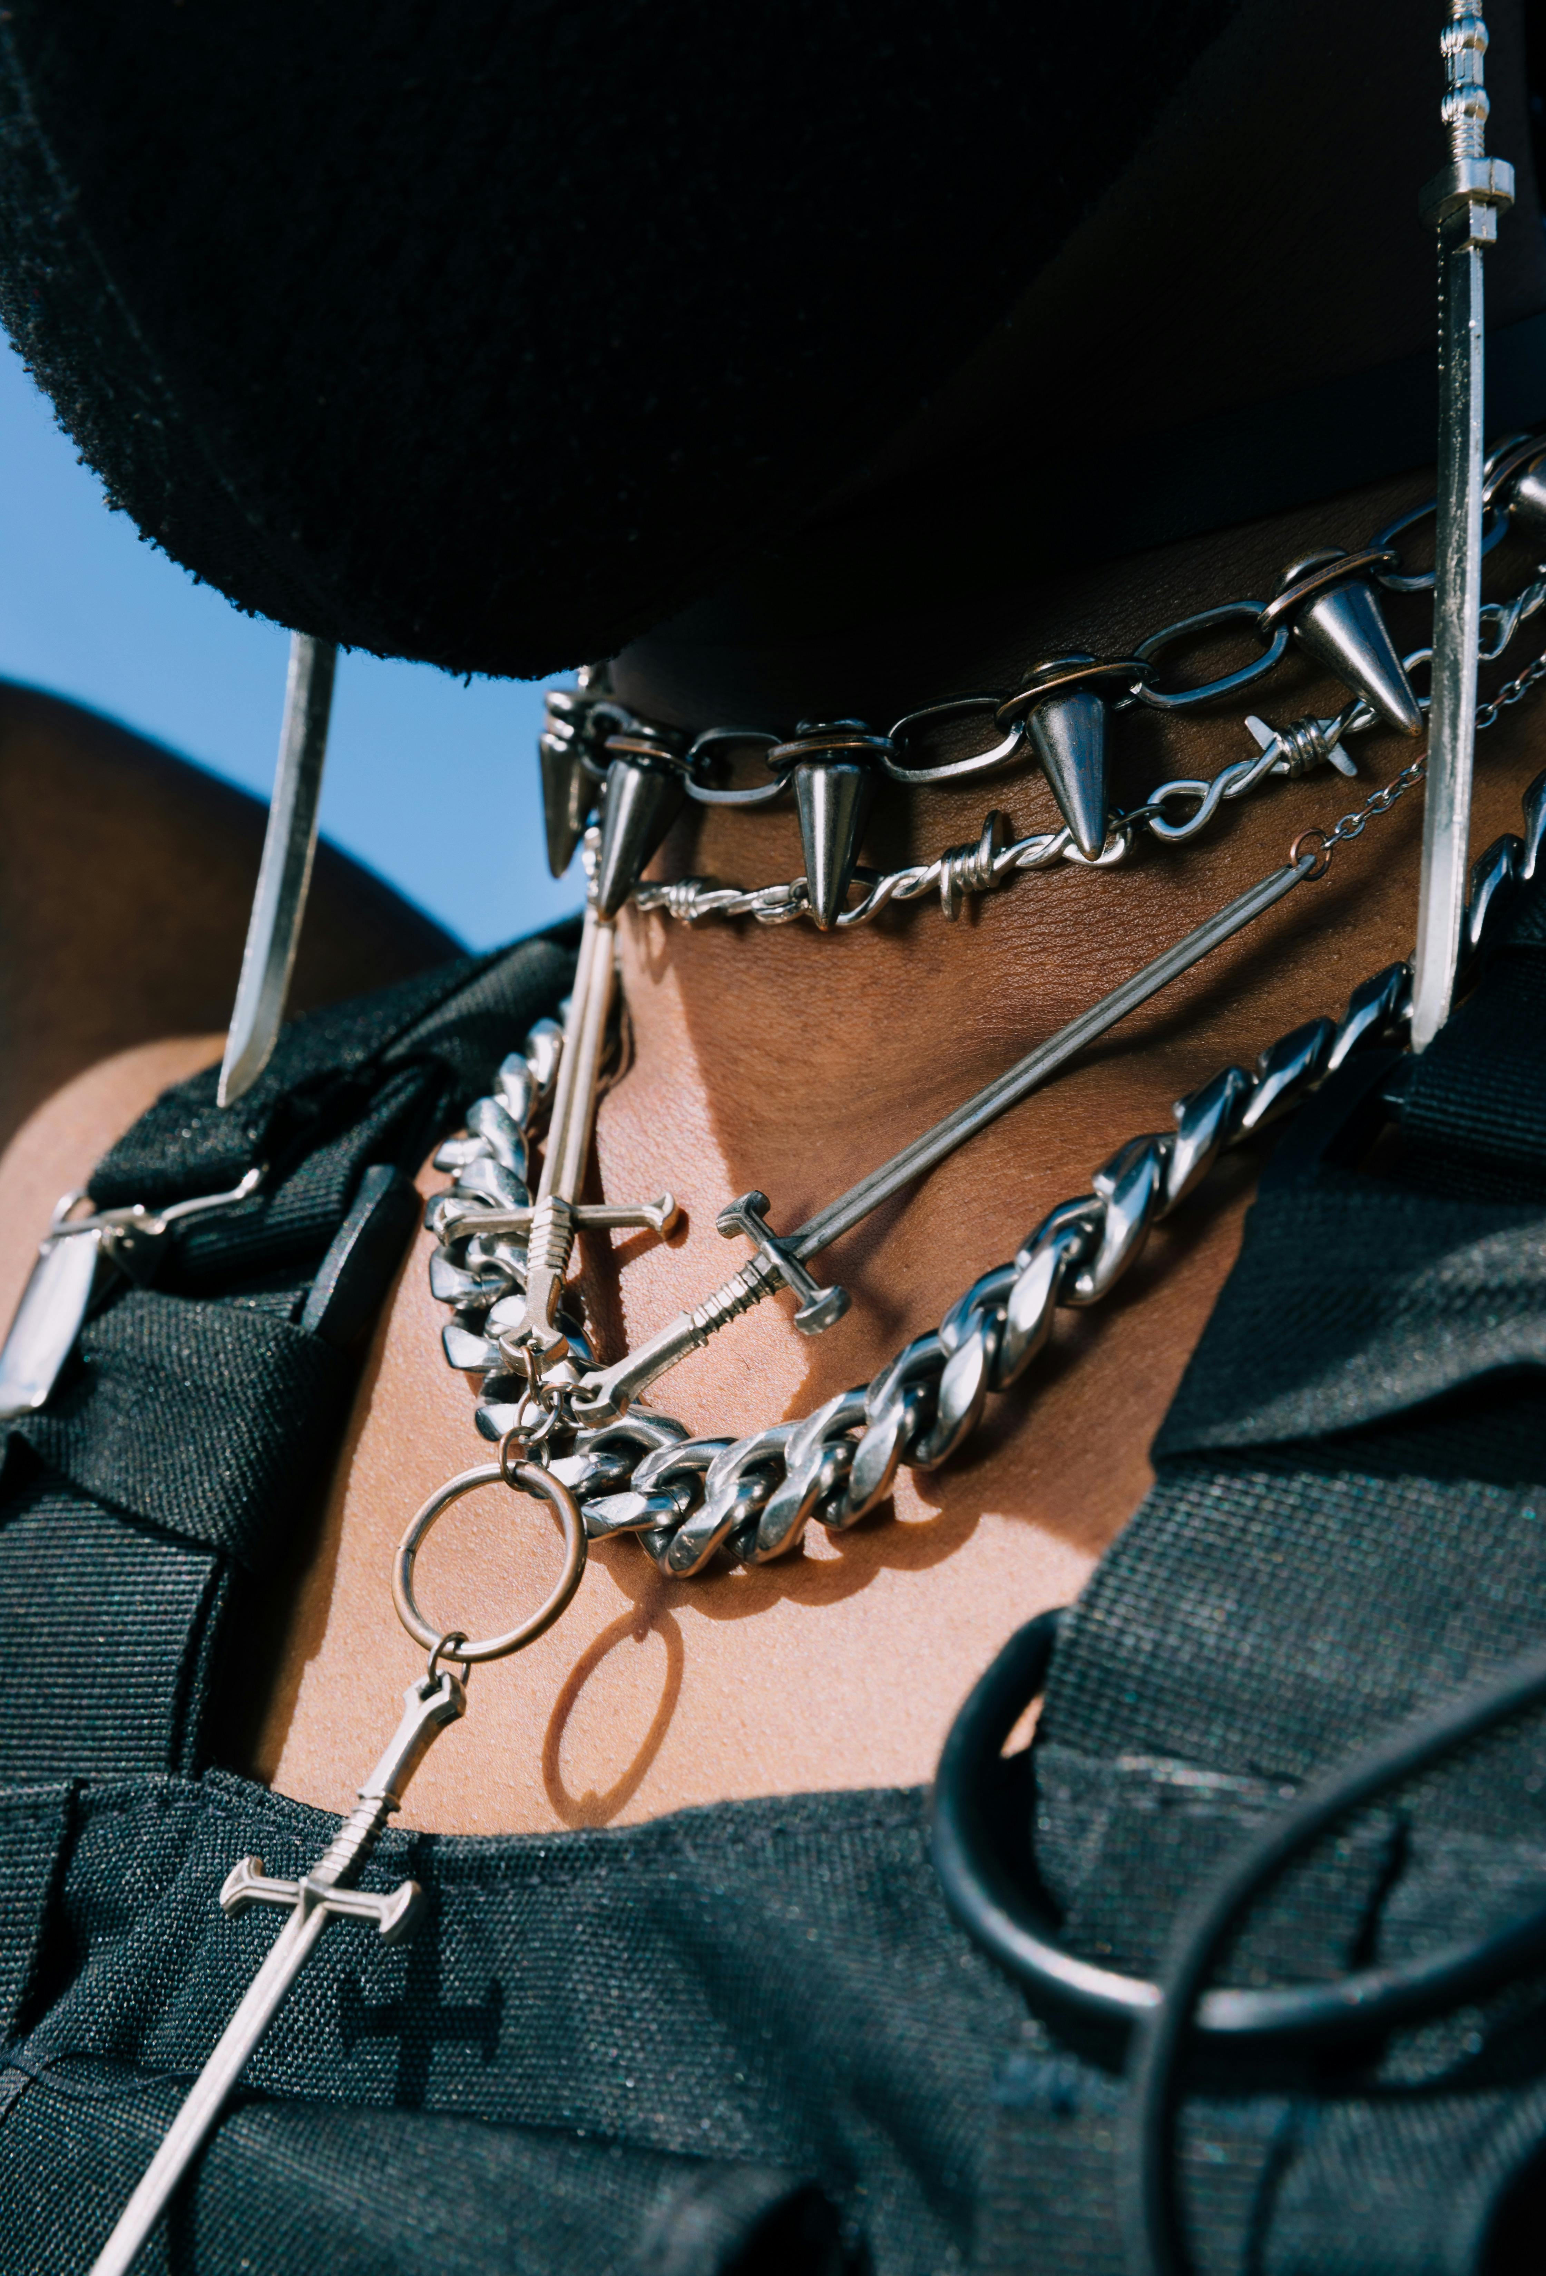
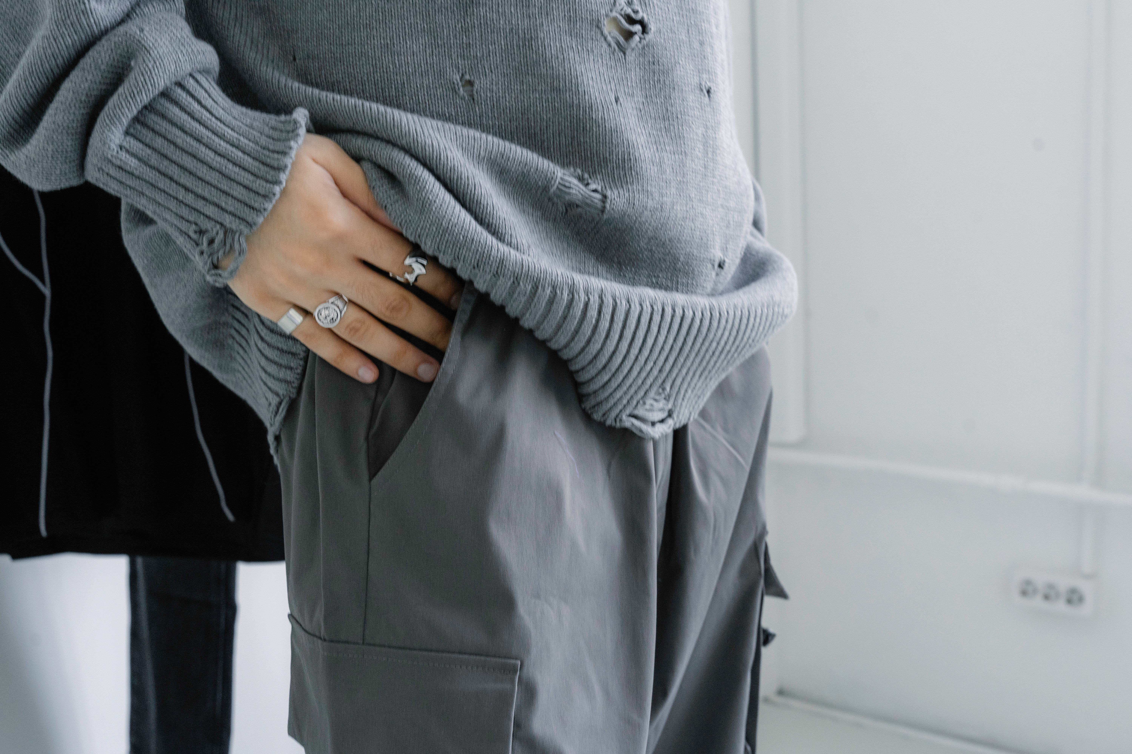
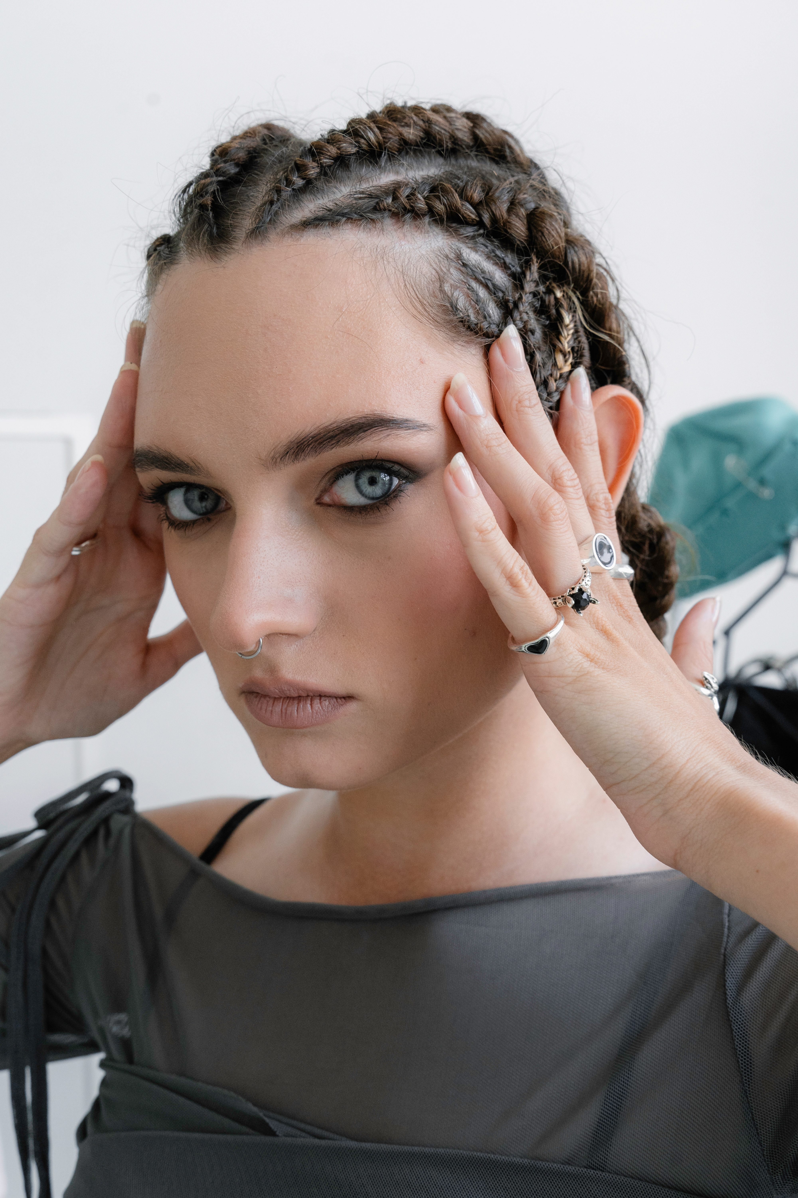
SELECTED WORKS
PORTFOLIO VOL.2
WORK ARCHIEVE

Slide 8

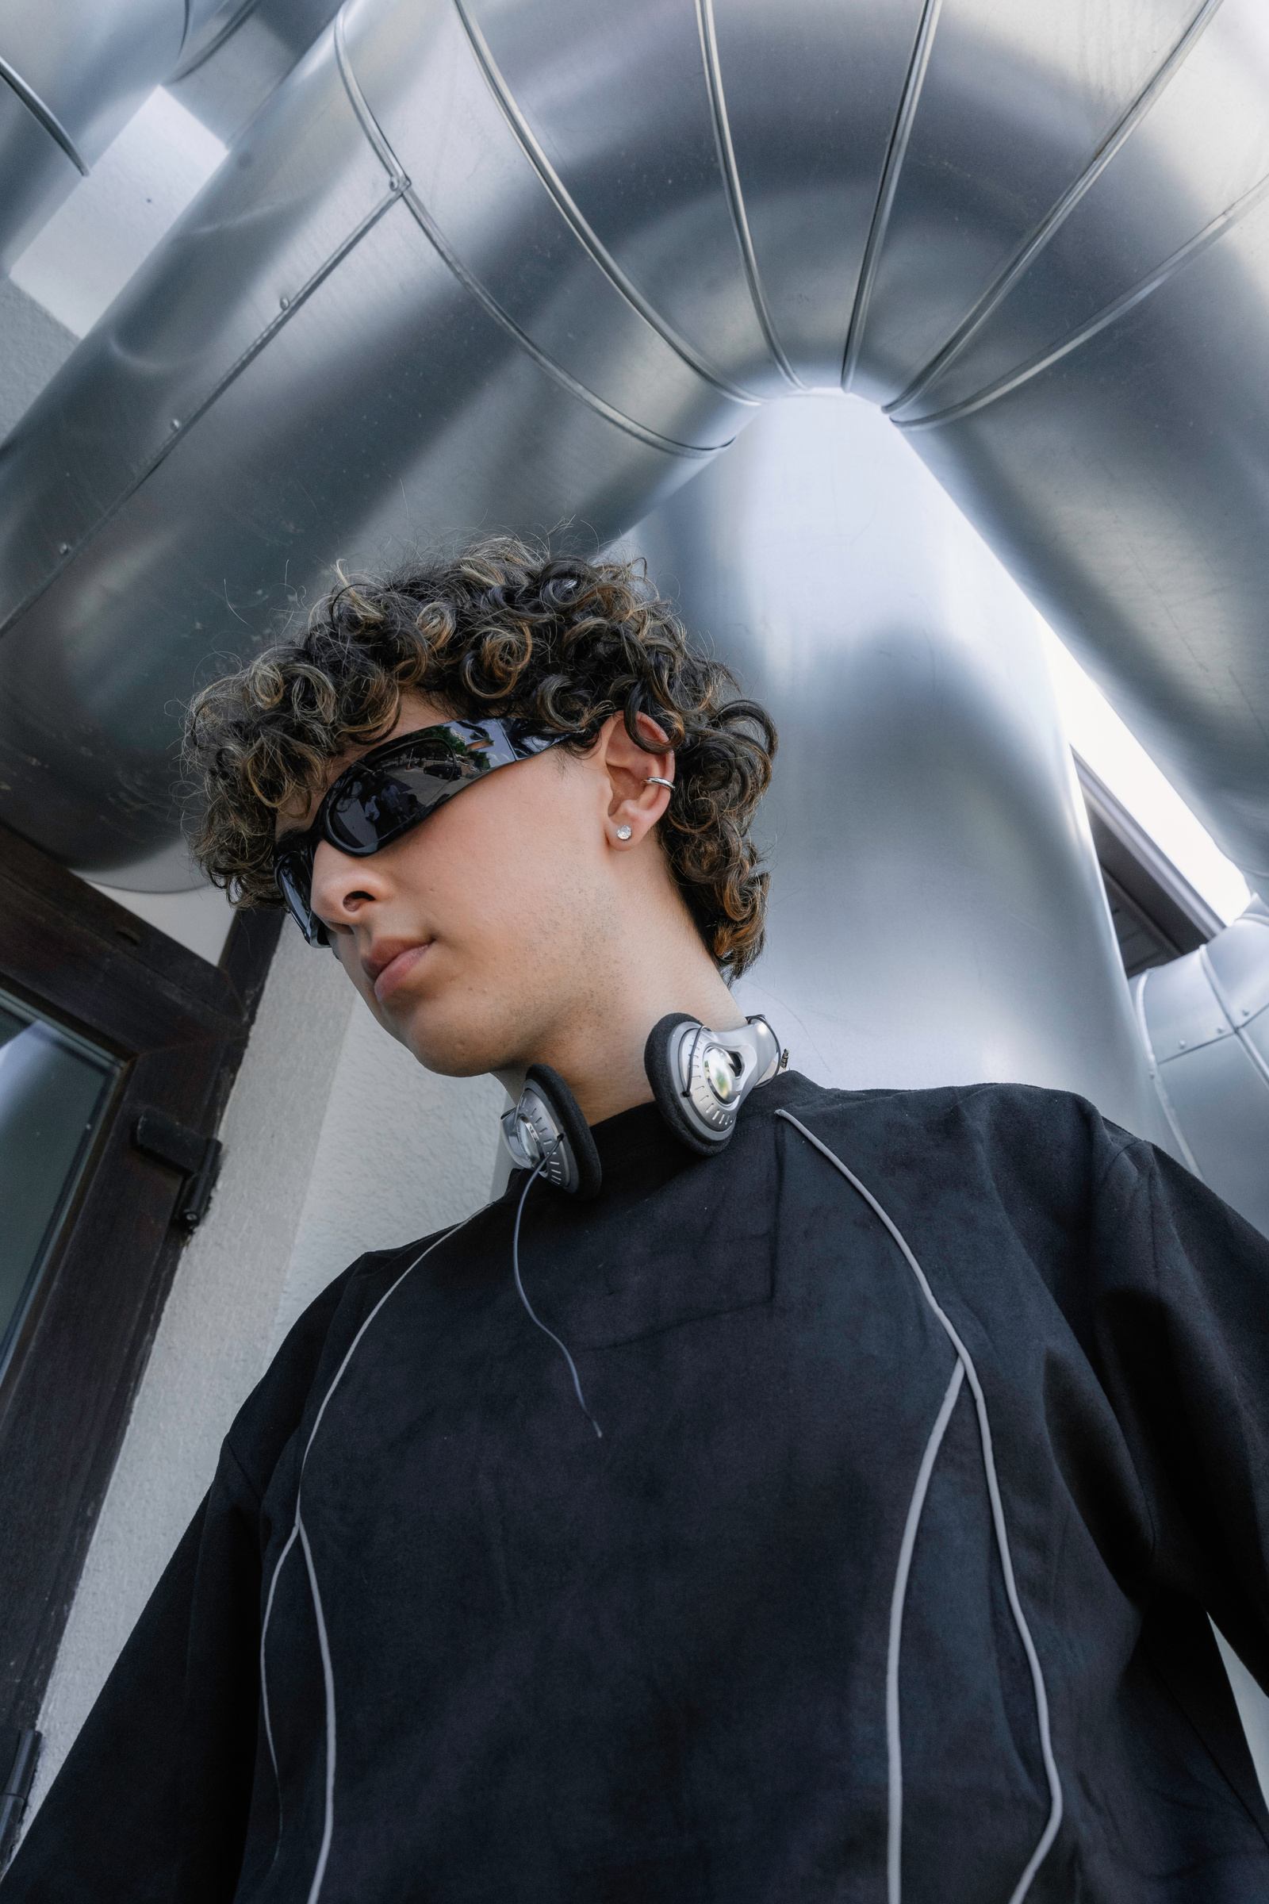
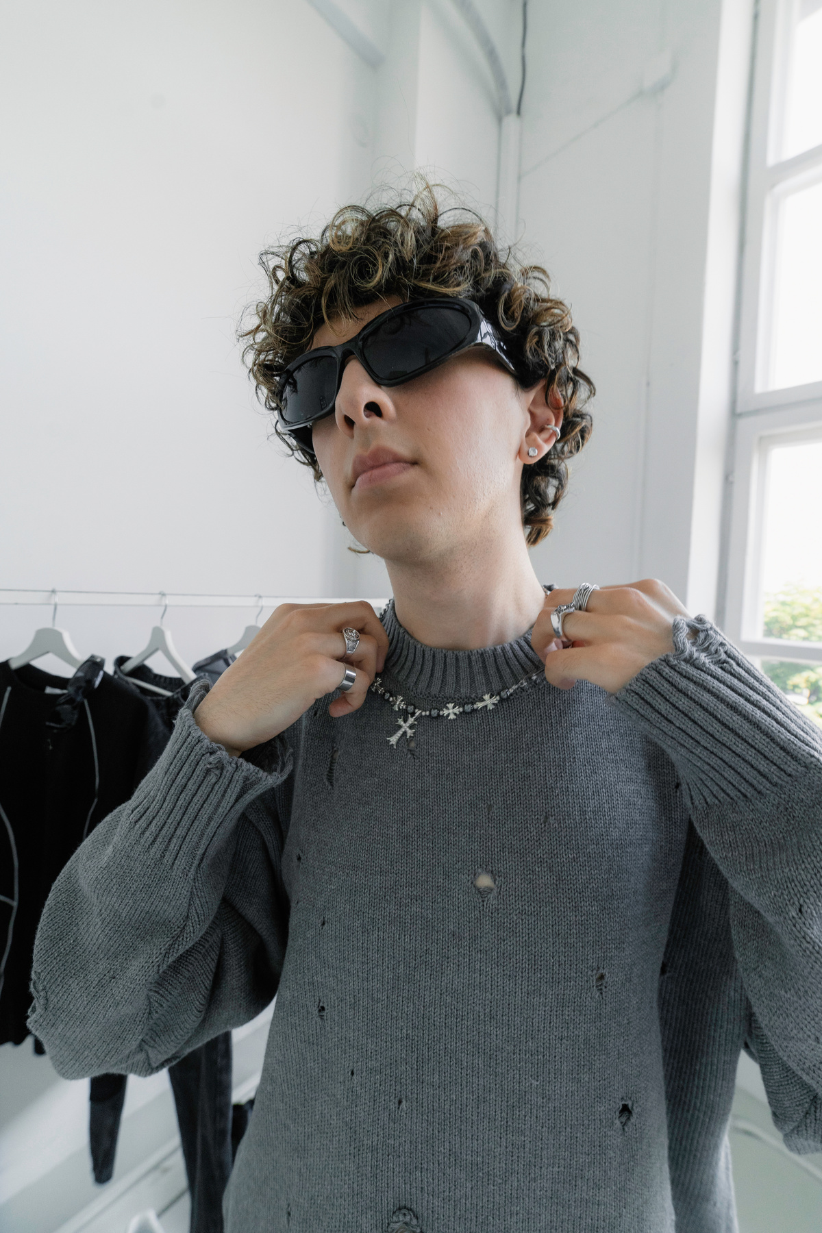
PORTFOLIO VOL.2
WORK ARCHIEVE
CREATIVE DESIGNER
CLIENTS & COLLABORATIONS
07
I’ve worked with startups, agencies, and independent brands from various industries including fashion, tech, hospitality, and education. Some clients include:
STARTUPS, AGENCIES, AND INDEPENDENT BRANDS

Slide 9
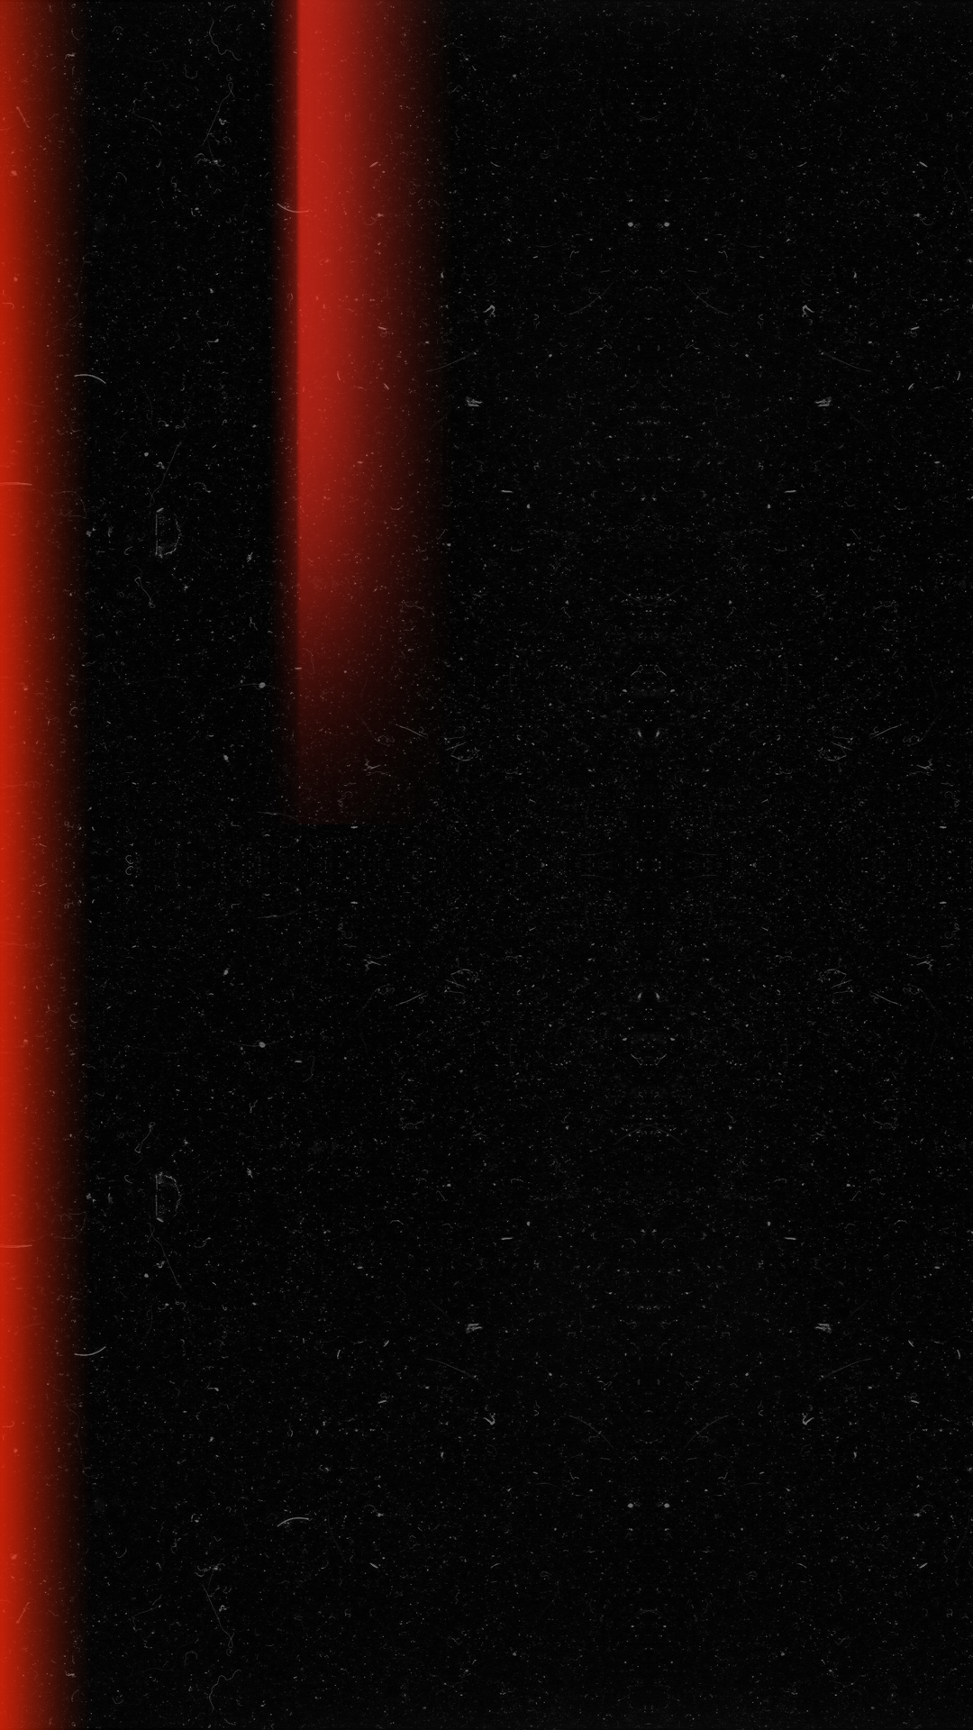
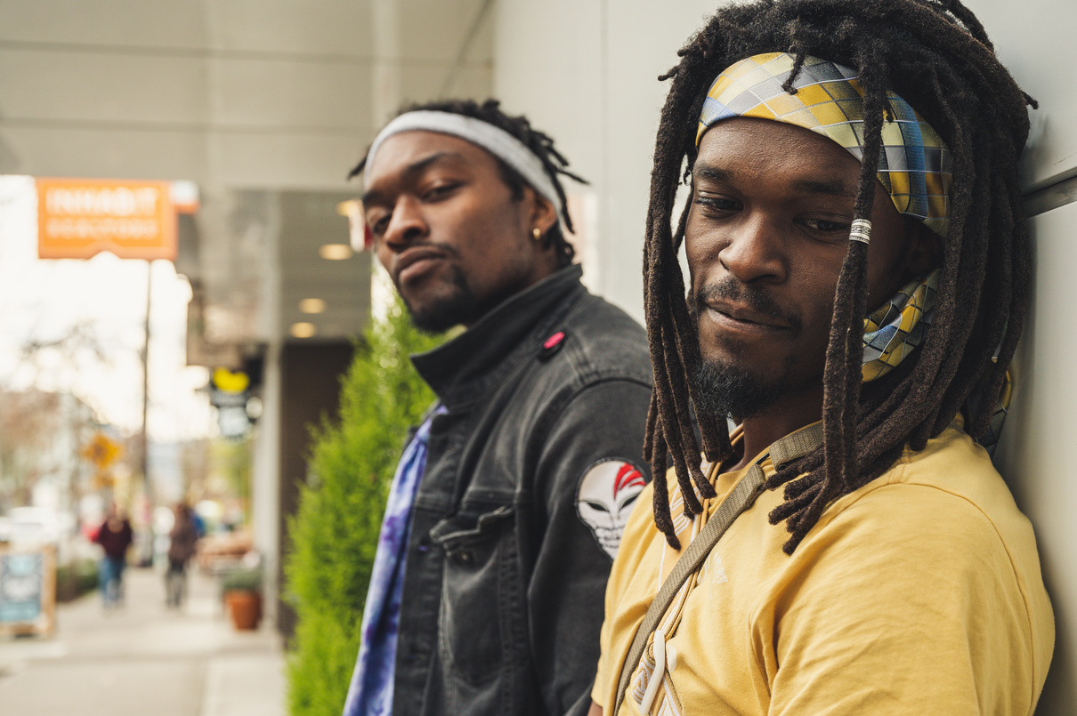
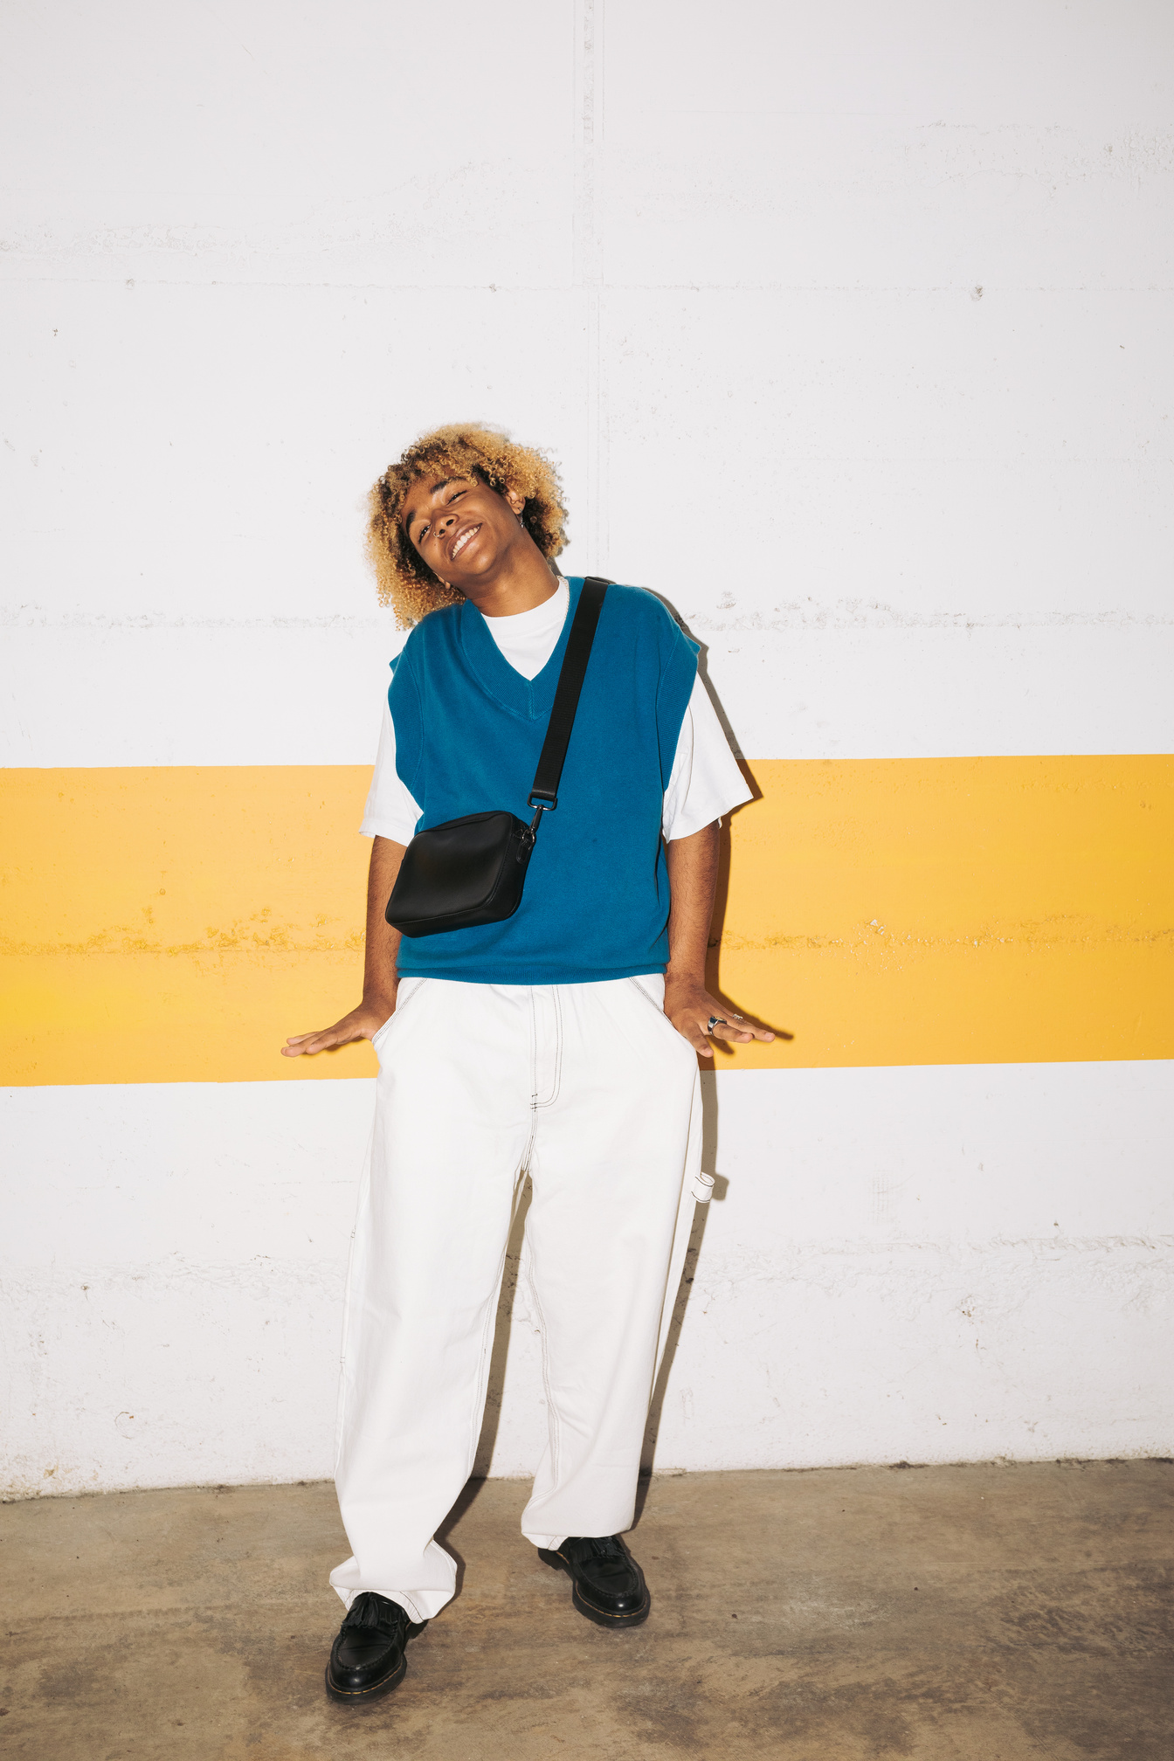
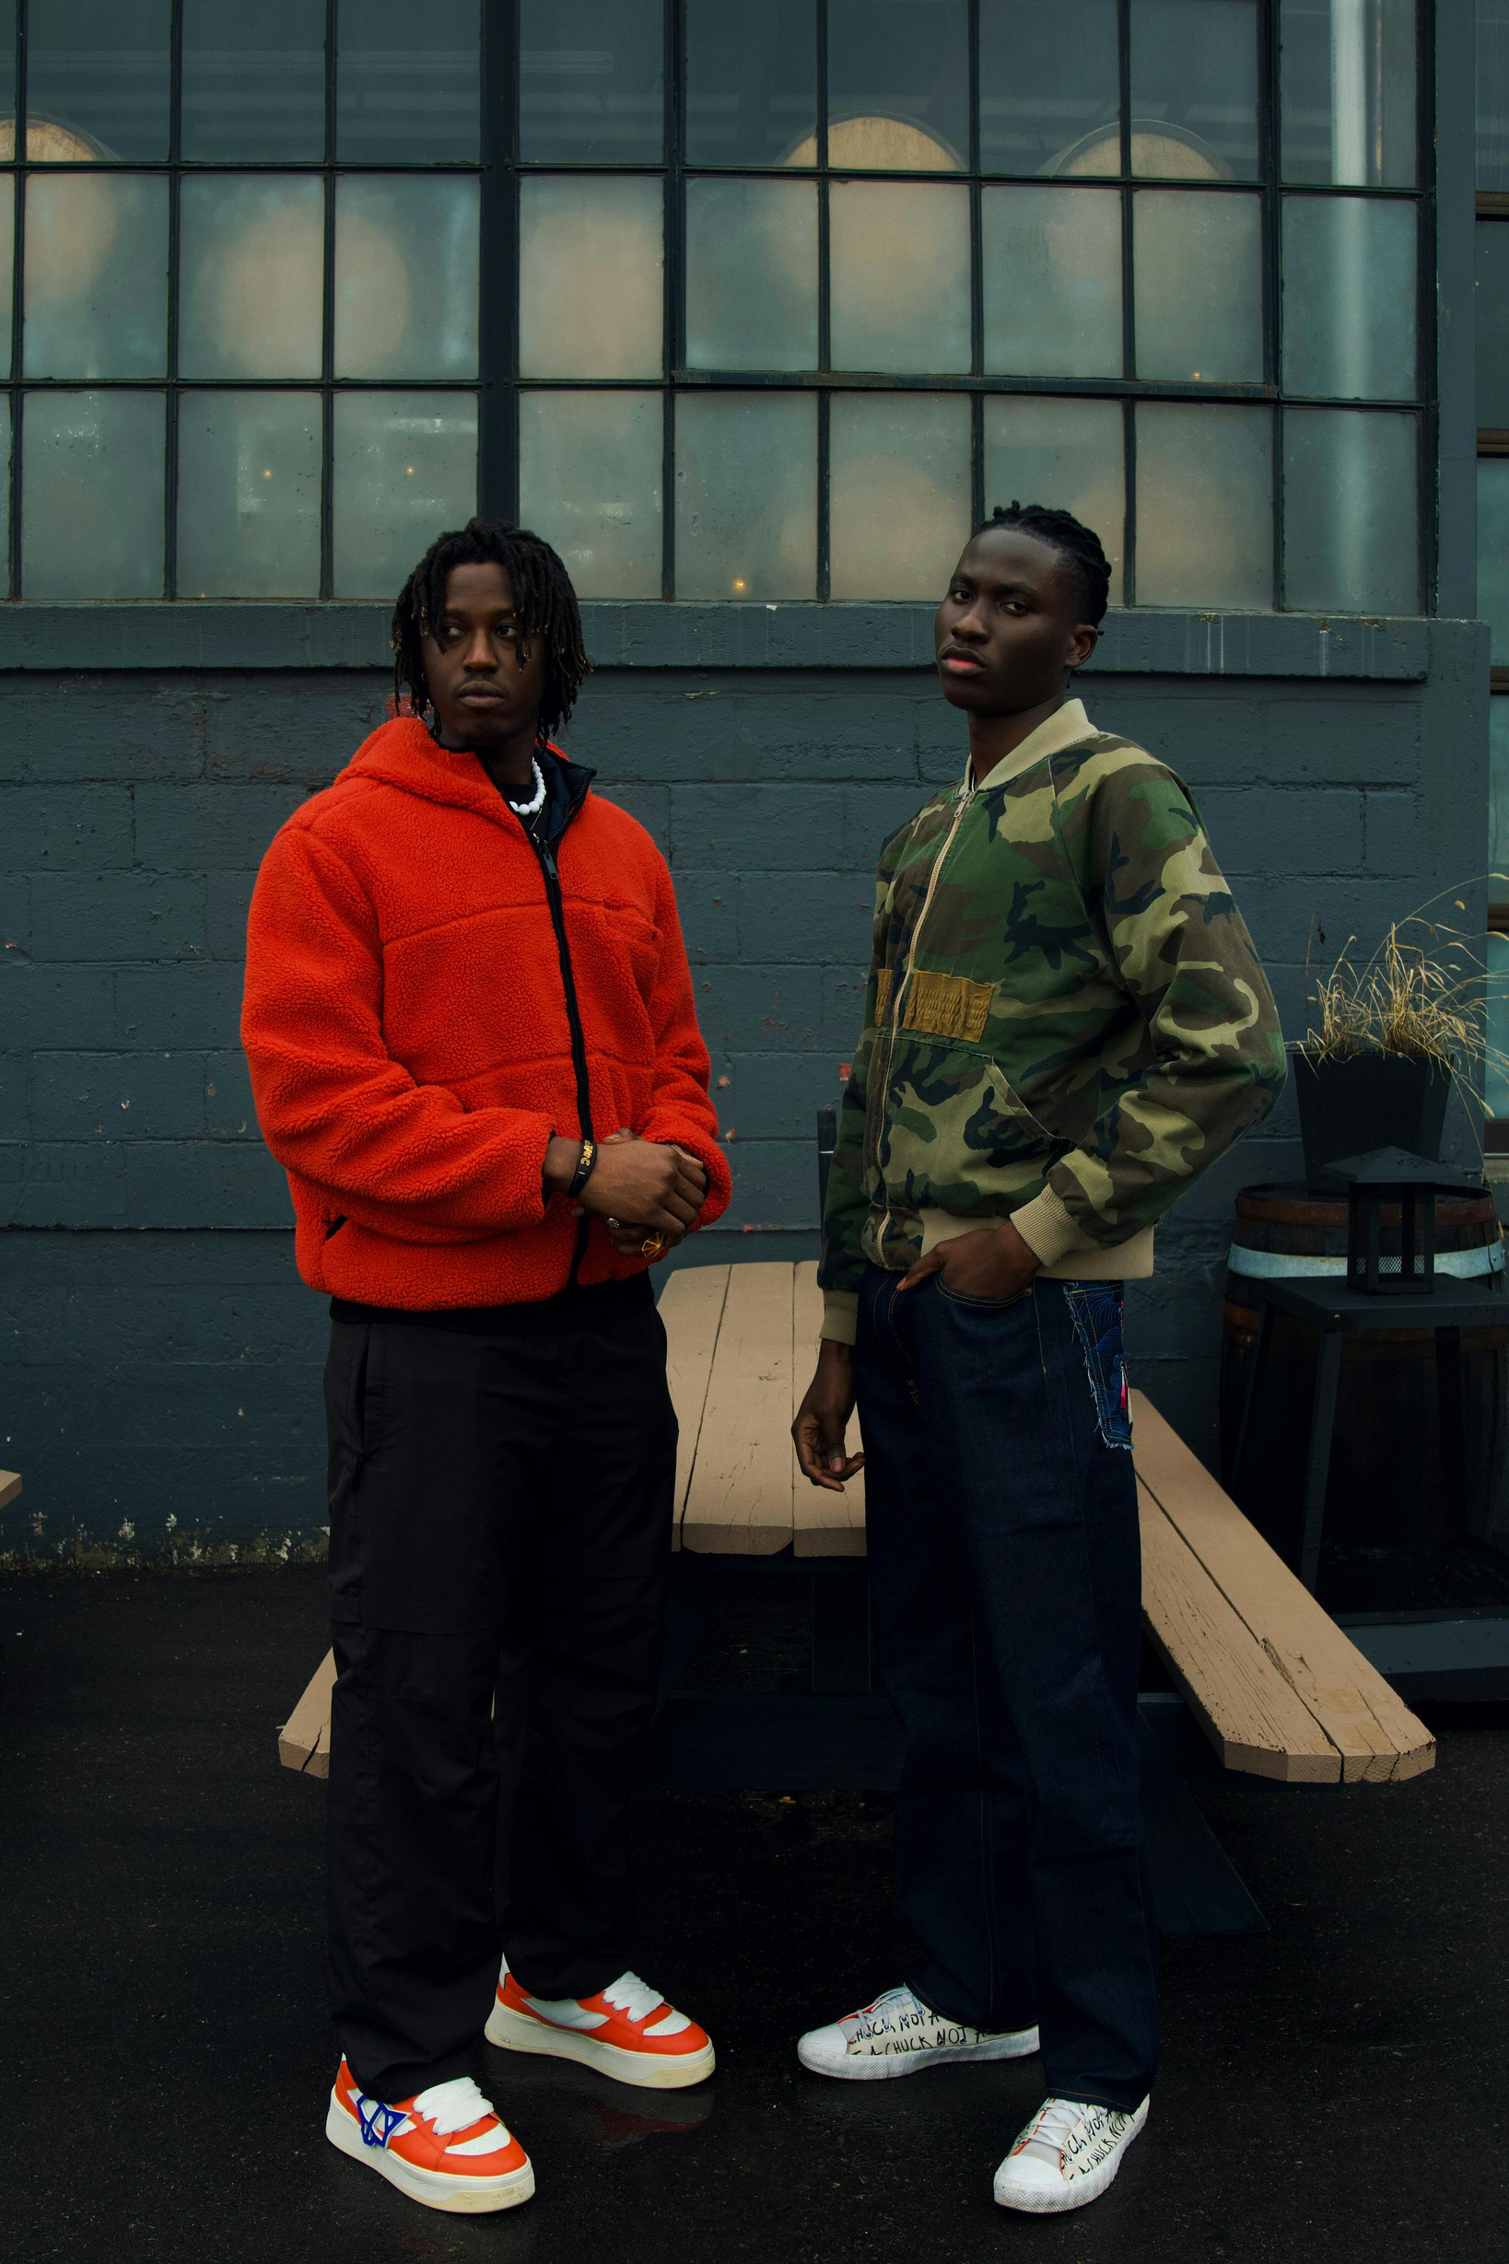
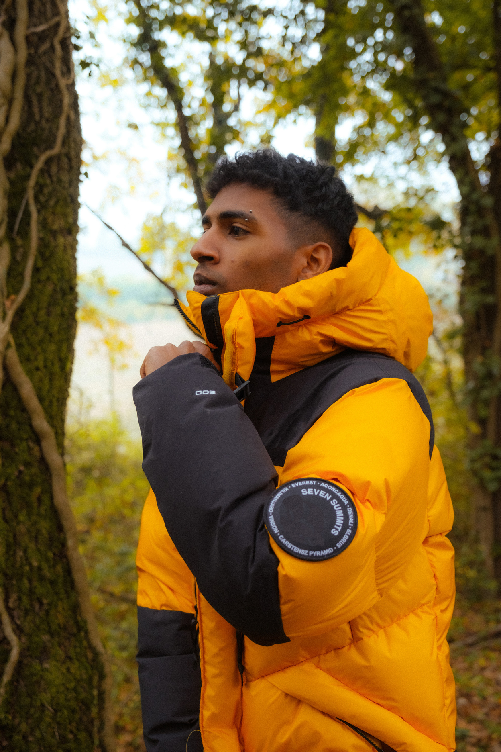
IMPACT
01
DELIVERED DESIGN ASSETS THAT SUPPORTED 3 SUCCESSFUL PRODUCT LAUNCHES
02
CREATED OVER 100+ VISUAL CONTENT PIECES FOR SOCIAL CAMPAIGNS
03
INCREASED USER ENGAGEMENT BY 40% THROUGH REDESIGNED INTERFACE
& RESULTS
04
IMPROVED BRAND RECOGNITION WITH COHESIVE VISUAL IDENTITY

Slide 10

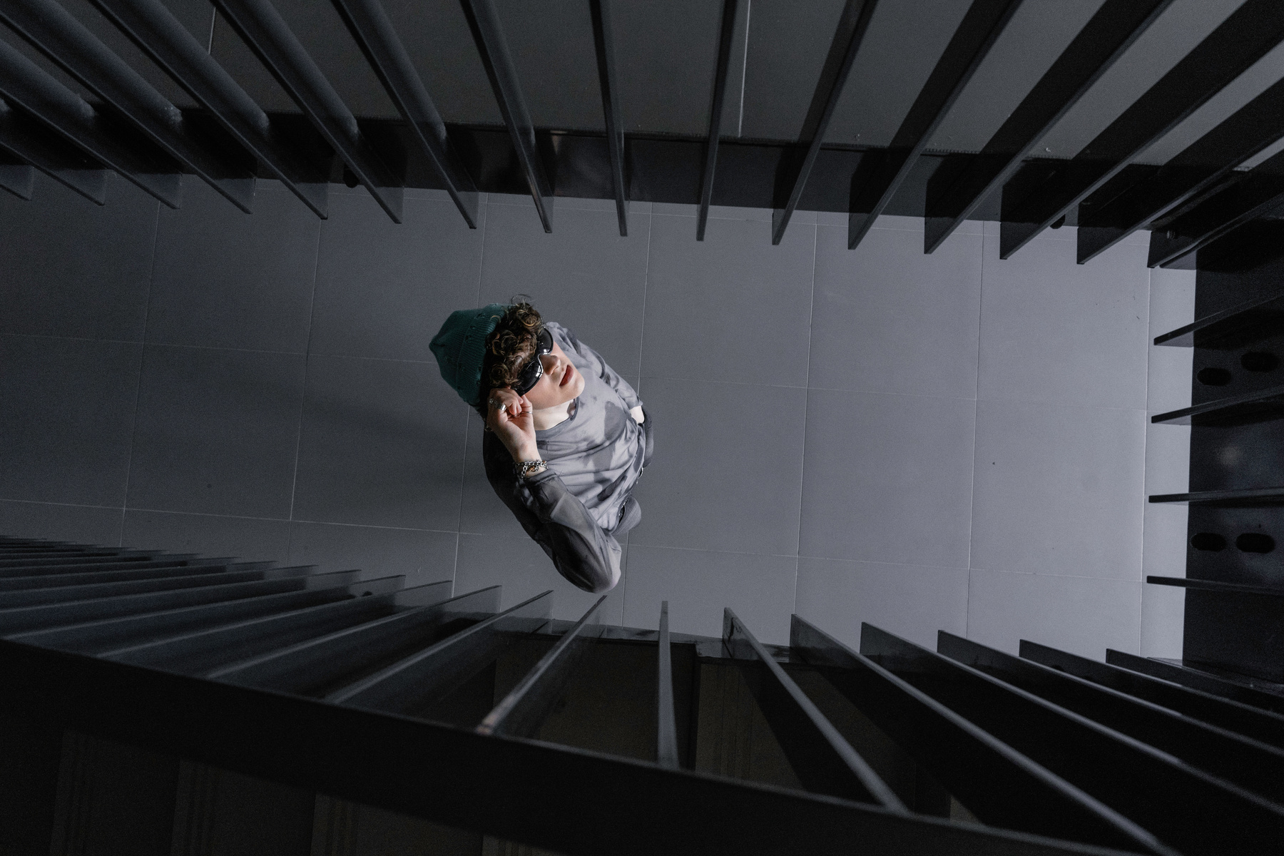
FRANCOIS MERCER
LET’S WORK TOGETHER
GET IN TOUCH
I’VE WORKED WITH STARTUPS, AGENCIES, AND INDEPENDENT BRANDS FROM VARIOUS INDUSTRIES INCLUDING FASHION, TECH, HOSPITALITY, AND EDUCATION. SOME CLIENTS INCLUDE:
+123-456-7890
HELLO@REALLYGREATSITE.COM

