Slide 1

ABAI
Seattle 2012
Principals as Agents of Change
Jack States
The Wing Institute

Slide 2
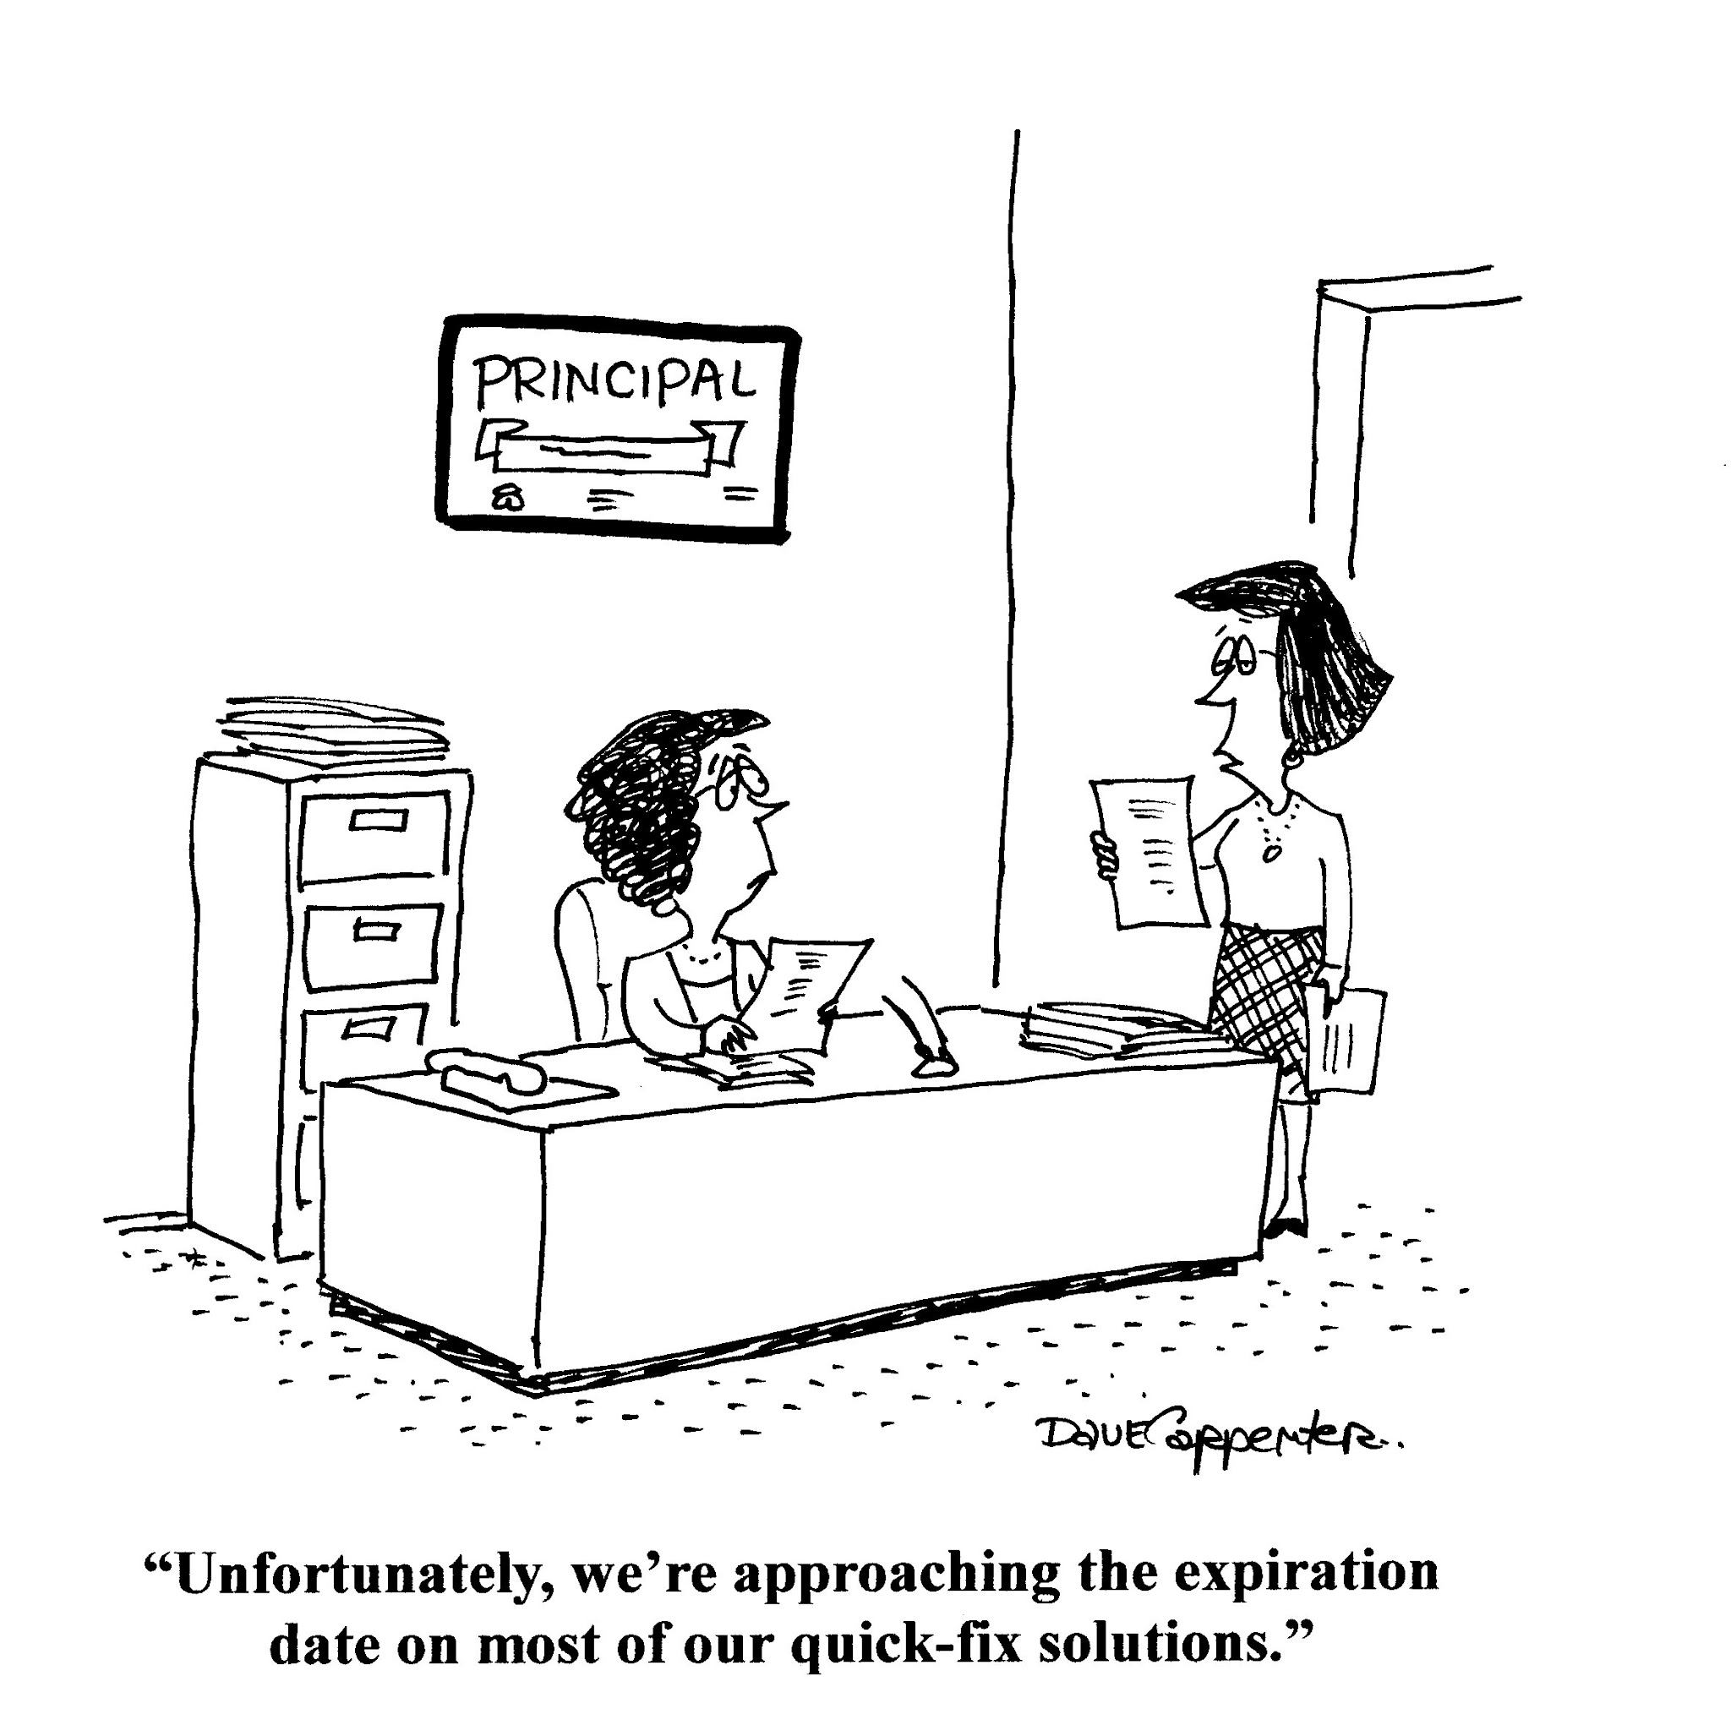
How Important Are Principals?
Notes:
Anecdotally – running schools – quick fixes
Neglected field of study - 1975 and 2002 on 296 studies only 27% were empirical quantitative

Slide 3
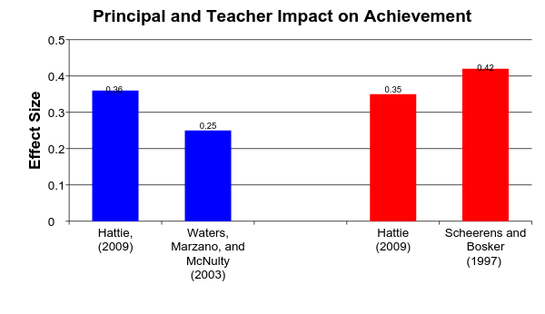
Principals Impact on Student Achievement
0.5 = Medium effect size
Principals
Teachers
Notes:
Principals rank 2nd to teachers in impact (Leithwood, 2007)

Slide 4
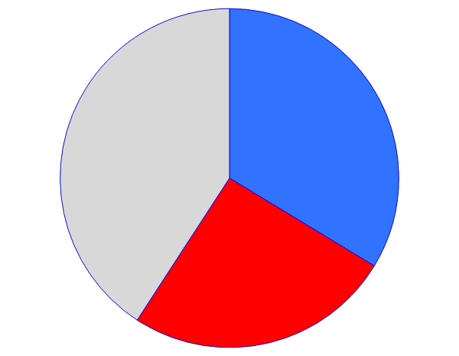
Principals Impact on Student Achievement
Factors Effecting
Achievement
33% Teacher
Impact
Other Factors
25% Principal
Impact
Marzano, Waters, and McNulty, 2005
Notes:
Principals rank 2nd to teachers in impact (Leithwood, 2007)

Slide 5
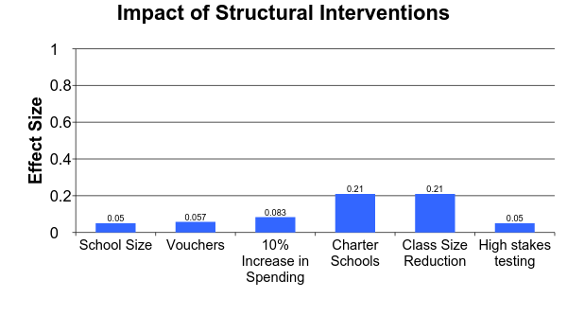
How Effective Are Structural Interventions
Large Effect
Impact on student achievement has been small
Small Effect
Yeh, 2007 and Hattie, 2009
Notes:
Being in a high performing schools is 2 ½ times more powerful than class size

Slide 6
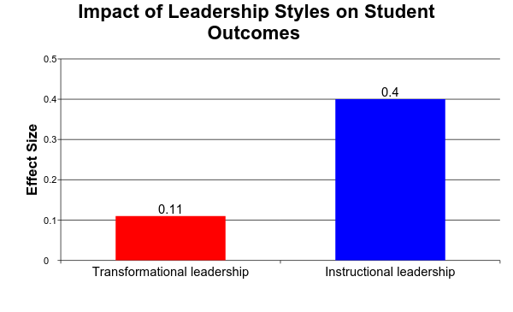
Do Leadership Styles Make a Difference?
Medium
Small
Robinson, Lloyd, and Rowe, 2008
Notes:
Instructional leadership: an approach in which the principal encourages educational achievement by making instructional quality the top priority of the school.
Transformational leadership: an approach in which the principal provides motivation through inspiration

Slide 7
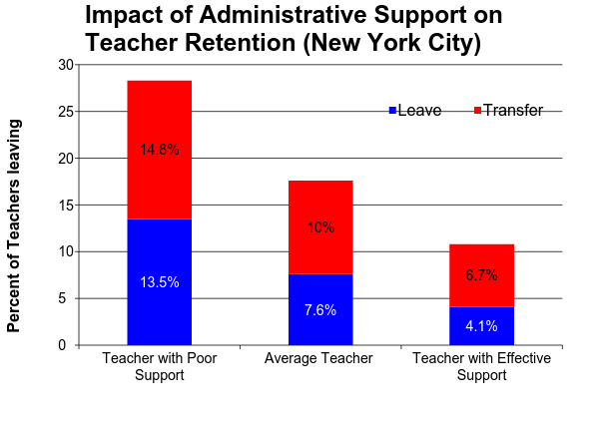
Administrators Impact on Turnover
28.3%
17.6%
10.8%
Boyd et al., 2009
Notes:
Ineffective leadership is primary reason for teachers leaving, North Carolina Teacher Working Conditions Survey, (2008)
Of all the factors, teachers perception of school administration has the greatest influence on teachers retention, Boyd, et al., (2009)
Principals at effective schools measured by value-added analysis are more likely to retain effective teachers and remove less effective teachers, Loeb, (2009)

Slide 8
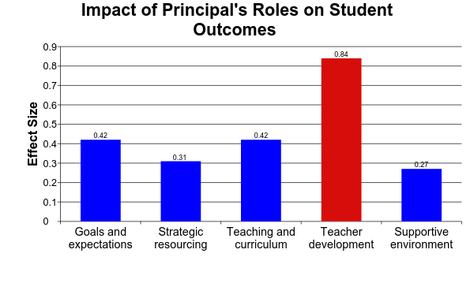
What Principals Do Makes a Difference
Large Effect Size
Robinson, Lloyd, and Rowe, 2008
Notes:
Strategic resourcing: Securing resources that are aligned with instructional purposes rather than securing resources generally for a school.

Slide 9
Leadership
Roles
Technical
(law, finance, facilities, data, and research)
Managing Personnel
(hire, evaluation, develop, firing, conflict)
Norms and Values
(pedagogy and ed philosophies)
Instructional
External Leadership
(community and parents)
Managing for Results
(quality control, and improvement)
Cultural Leadership
(vision, leadership styles, and values)
Hess and Kelly, 2002
Notes:
Points: Principals are overwhelmed – need to time manage – Boat go faster –

Slide 10
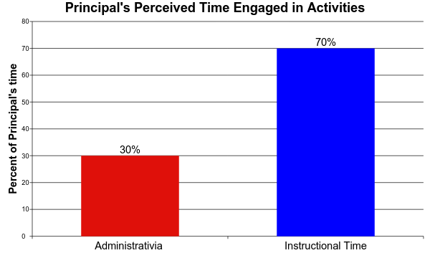
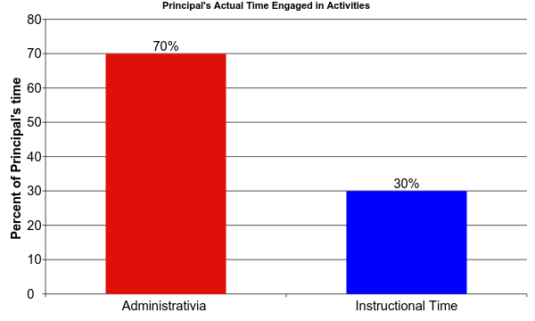
How Principals Spend Time
Turnbull, et al., 2009

Slide 11
How Principals Currently Assess Teachers
Summative process: questionnaires, surveys, interviews, observations, and formal evaluation
Walk-through: brief unscheduled visits
Student achievement data
Portfolio’s
Peer reviews
National Board Certification
School improvement participation
Ponticell, 2004
Notes:
New Teachers Project, 2009 - 98% of teachers evaluations satisfactory or better (12 districts)
Principals 80% reported at least one teacher should not be teaching

Slide 12
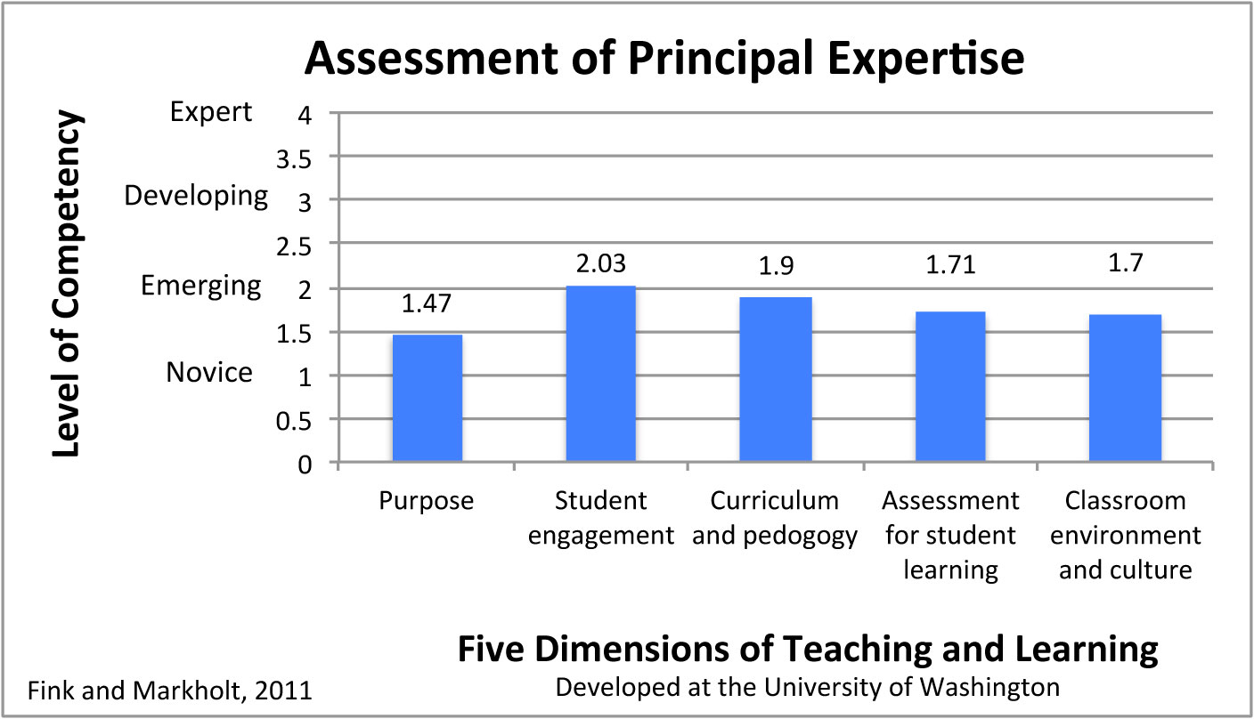
How Effective Are Principals at Identifying Valued Teachers
Notes:
Purpose: How lessons connect with external standards and The learning goals that are expected of a lesson

Slide 13



How Do We Change This Picture?
Curriculum
Graduation
Teaching
Input
Process
Outcomes
Feedback
Loop
Rummler and Brache, 1990
Notes:
Systems approach - Geary Rummler is credited along w/other of founding Six Sigma TQM
Post WWII Japan where the American statistician W. Edwards Demings
Focusing on quality and cost effective
Auto and electronics met quality standards
great success story of late 20th century

Slide 14
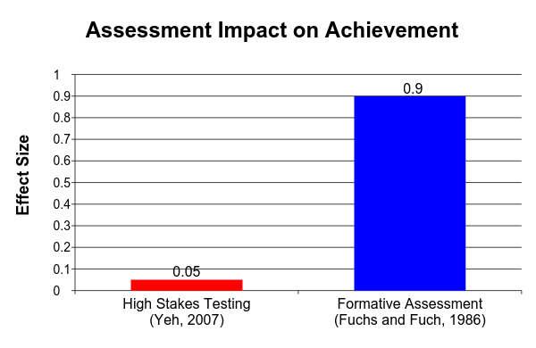
Promote Practices That
Work For Students
Large Effect Size

Slide 15
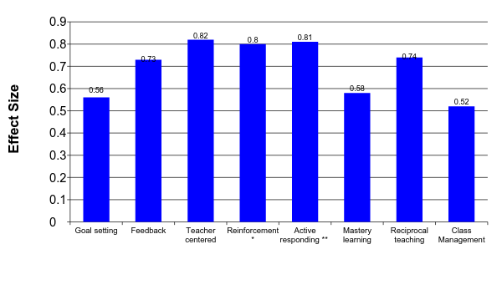
Impact of Instructional Strategies on Student Achievement
Large Effect Size
Hattie, 2009, Marzano, 2003 *, and White, 1998 **

Slide 16
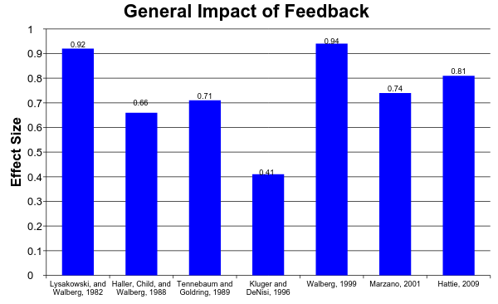
Promote Practices That
Work For Teachers
0.5 = Medium Effect

Slide 17
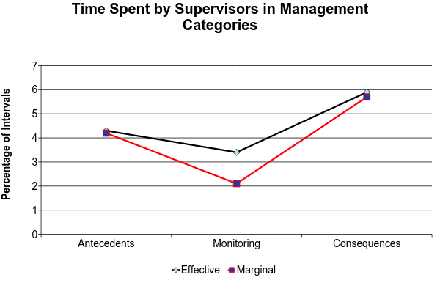
Effective and Marginal Supervisors
Categories From the Operant Supervisory Taxonomy and Index
Komaki, 1986

Slide 18
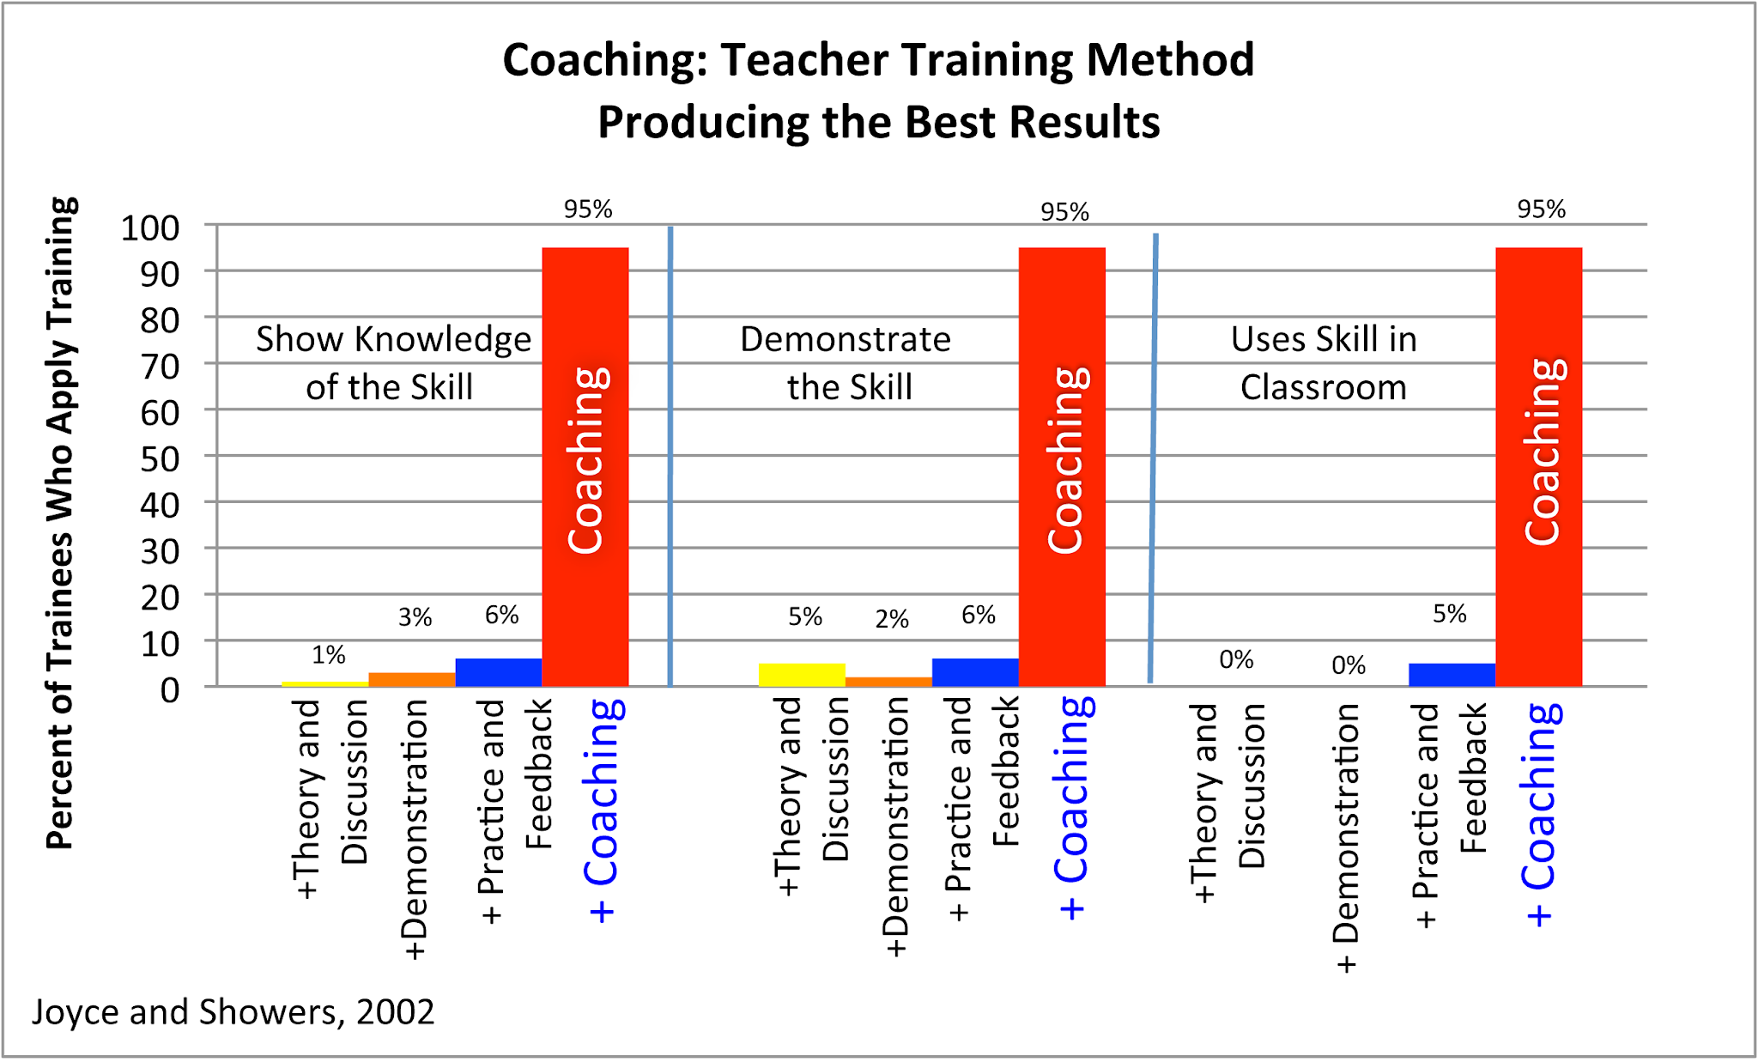
What Staff Development Methods Produce Best Results?
Notes:
Effect Size .22 - .43 over 3 years – value added study of coaching and student literacy
Joyce and Showers 2002
Theory and discussion, demonstrate skills, practice and feedback, coaching
Biancarosa, Bryk, and Dexter (2010)

Slide 19
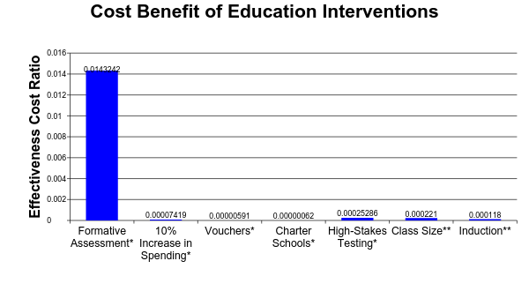
Promote Practices That
Are Cost Effective
Effectiveness cost ratio =
effect size/cost per student
Yeh, 2007*; Wing Institute, 2011**
Notes:
Fixsen and Blasé (Big E) (2004) Reorganization, Reassignment, or Accountability pennies on the $
Staff Competency development + Organization change + Leadership = $1 input = $8 - $12 output

Slide 20
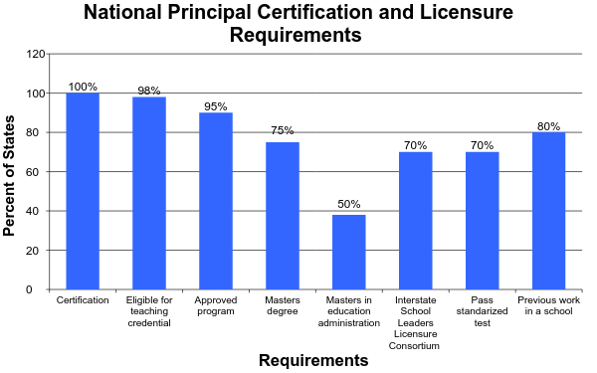
Principal Licensure and Certification
LeTendre and Roberts, 2005
Notes:
- 600 admin programs
- 67% Report programs to be out of touch (Farkas , 2003)
- 89% found programs do not adequately prepare them, (Levine, 2005)

Slide 21
Principal Licensure and Certification
Curriculum is in disarray
Low admissions and graduation standards
Weak faculty
Inadequate clinical instruction
Confusing assortment of degrees
Poor research
Arthur Levine, Principal Survey, 2005

Slide 22
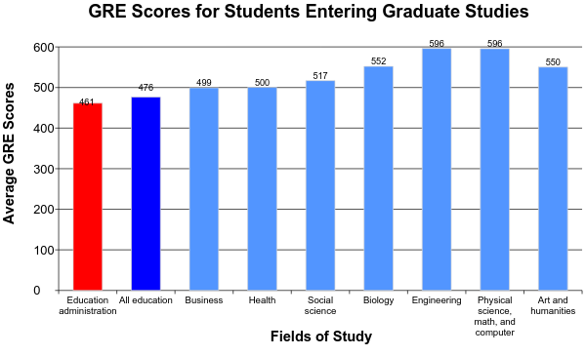
Principal Preparation Qualifications
Keedy, 1999
Notes:
Graduate Record Exam

Slide 23
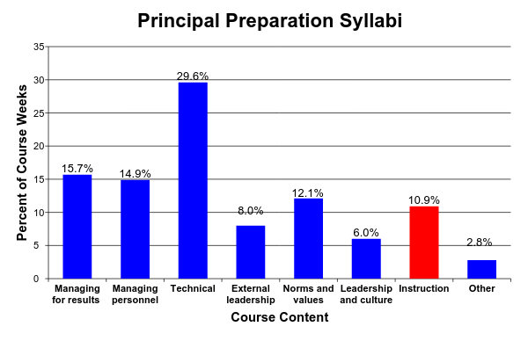
What Do Principal Preparation Programs Teach?
31 Preparation Programs
Hess and Kelly, 2002
Notes:
If equal each 14%
Technical: law, finance, facilities, data, and research

