Slide 1

DoViewPlanning.Org
Illustrative only not endorsed
Children Suspended From School (12 or Younger) DoView
Final Outcomes
Governance, Capability & Resourcing (Internal)
Prevention in Primary Years (Tiered Supports)
Re-entry & Wraparound Support
Data & Continuous Improvement
Fair Incident Response & Student Rights
Equity, Te Tiriti, & Monitoring
Not endorsed/verified. Information only obtained by AI DoView Drawing Prompt (ChatGPT) looking up the internet. DoViewPlanning.Org Dr Paul Duignan /a061 – 2025-08-19

Slide 2
Back to Overview
DoViewPlanning.Org
Illustrative only not endorsed
Final Outcomes
Children aged (12 or younger) remain engaged in schooling and learning
Use of stand-downs/suspensions for (12 or younger) minimised and lawful when used
Inequities in disciplinary responses reduced
Successful re-entry sustained; long-term harms mitigated
Not endorsed/verified. Information only obtained by AI DoView Drawing Prompt (ChatGPT) looking up the internet. DoViewPlanning.Org Dr Paul Duignan – 2025-08-19

Slide 3
Back to Overview
DoViewPlanning.Org
Illustrative only not endorsed
Prevention in Primary Years (Tiered Supports)
Tiered PB4L School-Wide system adopted
At-risk learners identified early (class & school data)
Targeted classroom strategies embedded (evidence-based)
School-wide expectations co-designed & taught
Consistent classroom routines implemented
Learning-support needs assessed (He Pikorua/RTLB)
Challenging behaviours reduced
Culturally responsive practice embedded
Parenting/teacher programmes accessed (e.g., IY)
Whānau engagement approaches strengthened
LSC coordination activated with staff/whānau
Use of stand-downs/suspensions minimised (last resort)
Teacher capability strengthened (Incredible Years Teacher)
Intensive supports accessed when needed (IWS Years 0–10)
Behaviour data practices used (good practice)
Whānau strengths & goals agreed
Not endorsed/verified. Information only obtained by AI DoView Drawing Prompt (ChatGPT) looking up the internet. DoViewPlanning.Org Dr Paul Duignan – 2025-08-19

Slide 4
Back to Overview
DoViewPlanning.Org
Illustrative only not endorsed
Fair Incident Response & Student Rights
Incident investigated fairly & promptly
Whānau informed & engaged
Guidance & counselling provided
Stand-down/suspension enacted lawfully (definitions/limits)
Procedurally fair, transparent response delivered
Principal’s decision made on evidence
Student voice considered
Educational programme provided during suspension
Board process convened where required
Safety maintained without over-reliance on exclusion
Alternatives to stand-down considered & recorded
Rights & information provided to parents
Conditions set appropriately, transparently documented
Records entered in ENROL per process
Not endorsed/verified. Information only obtained by AI DoView Drawing Prompt (ChatGPT) looking up the internet. DoViewPlanning.Org Dr Paul Duignan – 2025-08-19

Slide 5
Back to Overview
DoViewPlanning.Org
Illustrative only not endorsed
Re-entry & Wraparound Support
Re-entry plan & supports co-designed
RTLB & LSC roles aligned
Targeted interventions implemented (e.g., IY)
Student successfully re-integrated
Return-to-learn actions sequenced
IWS engaged for complex needs (Years 0–10)
Attendance & engagement monitored
Repeat incidents/stand-downs reduced
Review dates & responsibilities set
ORS and other supports leveraged where eligible
Adjustments made from data & feedback
Not endorsed/verified. Information only obtained by AI DoView Drawing Prompt (ChatGPT) looking up the internet. DoViewPlanning.Org Dr Paul Duignan – 2025-08-19

Slide 6
Back to Overview
DoViewPlanning.Org
DoViewPlanning.Org
Illustrative only not endorsed
Illustrative only not endorsed
Equity, Te Tiriti, & Monitoring
Ethnic & decile disparities monitored (age-standardised rates)
Whānau/iwi partnerships strengthened
Equity goals integrated into behaviour policy
Inequities in disciplinary responses reduced
Māori stand-down/suspension rates tracked
Restorative approaches embedded (mana-affirming)
Regular equity reviews inform actions
All groups experience fair, effective supports
Regional patterns reviewed to focus support
Staff capability built for responsive practice
Not endorsed/verified. Information only obtained by AI DoView Drawing Prompt (ChatGPT) looking up the internet. DoViewPlanning.Org Dr Paul Duignan – 2025-08-19

Slide 7
Back to Overview
DoViewPlanning.Org
Illustrative only not endorsed
Data & Continuous Improvement
ENROL/Suspension processes consistently applied
≤12 stand-down/suspension counts reviewed
Stand-downs/suspensions for (12 or younger) tracked & reduced over time
Practice & supports adapted from findings
Age-standardised measures understood & used
Trends & hotspots identified (school/region)
Resourcing redirected to prevention
Practice quality continuously improved
ERO guidance used to interpret behaviour data
Findings shared with staff/whānau
Not endorsed/verified. Information only obtained by AI DoView Drawing Prompt (ChatGPT) looking up the internet. DoViewPlanning.Org Dr Paul Duignan – 2025-08-19

Slide 8
Back to Overview
DoViewPlanning.Org
Illustrative only not endorsed
Governance, Capability & Resourcing (Internal)
Behaviour & SEEE policies current & aligned to guidance
Staff trained in PB4L School-Wide & restorative practice
RTLB referrals used appropriately (Years 1–10)
School system enables prevention-first responses
Clear procedures for investigation & decisions
Teachers supported with IY Teacher programme
LSC role embedded to coordinate supports
Decisions consistent, lawful, and well-supported
Complaints/documentation processes maintained
De-escalation & trauma-informed skills strengthened
IWS/ORS accessed for eligible learners
Not endorsed/verified. Information only obtained by AI DoView Drawing Prompt (ChatGPT) looking up the internet. DoViewPlanning.Org Dr Paul Duignan – 2025-08-19

Slide 9
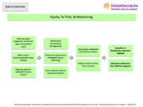
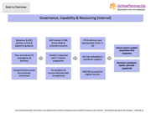
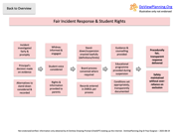
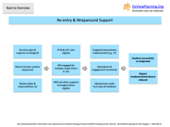

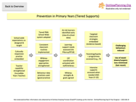
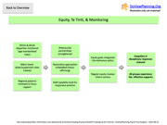
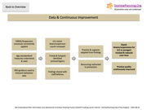
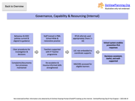
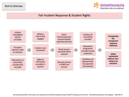
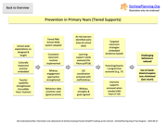
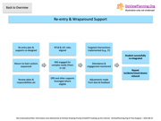
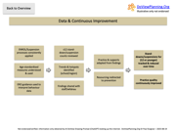

Back to Overview
Children Suspended From School
(12 or Younger) DoView
Illustrative only not endorsed
DoViewPlanning.Org
Not endorsed/verified. Information only obtained by AI DoView Drawing Prompt (ChatGPT) looking up the internet. DoViewPlanning.Org Dr Paul Duignan – 2025-08-19

Slide 10
Back to Overview
DoViewPlanning.Org
Illustrative only not endorsed
What is a DoView?
A DoView is a new type of diagram used to clarify the underlying ‘This-Then’ logic behind any issue. For example, in strategy and planning, all planning approaches are based on assumptions such as: if we do THIS, THEN that will happen.
A DoView makes these assumptions explicit, allowing them to be examined, evaluated and used to make better strategic decisions. A DoView works as a shared thinking tool, helping teams align their mental models about objectives. In planning, DoViews assist with prioritizing outcomes, placing indicators next to the boxes they measure, aligning activities with outcomes, measuring performance, evaluating impact, and guiding improvement efforts.
DoViews can also analyze any document that is being used to think strategically about taking action—it surfaces the implicit ‘This-Then’ claims. For example, a DoView of a scientific paper reveals its 'This-Then' claims. Find how to use DoViews at DoViewPlanning.Org/Method. DoViewing a document highlights its implications for action.
To generate a DoView about anything, visit DoViewPlanning.Org for the free AI DoView Drawing Prompt (ChatGPT). DoViews are powerful for summarizing any complex content and accelerating understanding prior to taking any type of action in the world.
Not endorsed by organization or by DoViewPlanning. Made from public web/user info via AI prompt. Dr Paul Duignan Use at own risk re IP & accuracy. 2025-12-24 12:57

