Slide 1
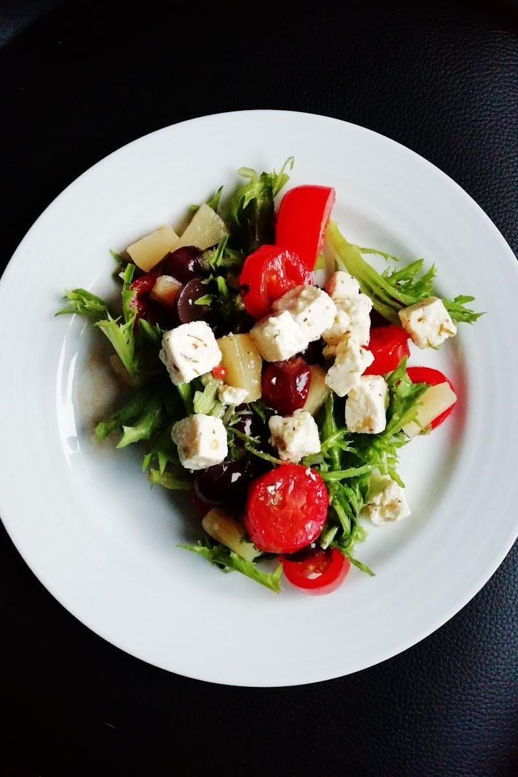
Making Healthy Choices When Eating Out
Look for restaurants that offer healthier menu options or allow customization of your meals to suit dietary needs.
Be mindful of portion sizes when dining out, as restaurant servings can often be larger than necessary.
Consider sharing dishes with friends or ordering smaller plates to avoid overeating while still enjoying the meal.

Slide 2

Understanding Eating In vs. Eating Out
Eating in usually refers to preparing meals at home, which can be healthier and more cost-effective.
Eating out involves dining at restaurants or cafes, offering convenience and a variety of cuisines.
Both options have unique benefits and drawbacks that can affect our lifestyle and health.

Slide 3

Advantages of Eating Out
Dining out can save time and effort, making it a convenient option for busy schedules and social gatherings.
It provides an opportunity to try diverse cuisines and dishes that may not be possible to cook at home.
Eating out can be an enjoyable experience, offering a chance to socialize and relax in a different environment.

Slide 4
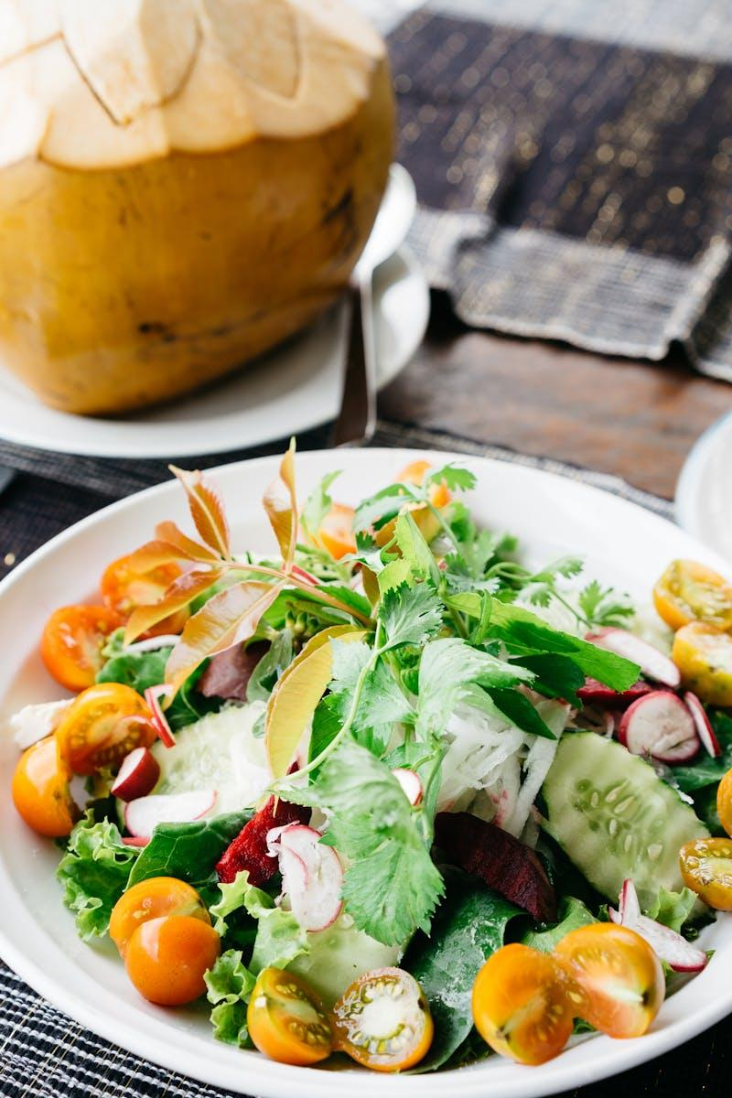
Balancing Eating In and Out
Finding a balance between eating in and eating out can enhance both your culinary skills and dining experiences.
Plan a mix of home-cooked meals and restaurant visits to maintain a varied and exciting diet.
Being mindful of your eating habits can lead to a healthier lifestyle and greater enjoyment of food.

Slide 5
Benefits of Eating In
Preparing meals at home allows for greater control over ingredients and portion sizes, promoting healthier eating habits.
Home-cooked meals often result in lower food costs compared to dining out regularly or frequently.
Cooking at home can be a fun and social activity, encouraging family bonding and creativity in the kitchen.

