Slide 1

KINDERGARTEN
Distance Learning Guide
Our recommendations for adapting Mystery Science lessons for socially distant classrooms and online distance learning.
We’ve assigned each lesson one of these labels:
Ready to Teach
These lessons have activities that only need minor modifications to eliminate partner work or shared supplies. For these activities, you can have students work solo without preparing extra supplies.
Jump to a section:
Plant & Animal Secrets
6 lessons
Wild Weather
3 lessons
Circle of Seasons
3 lessons
Sunny Skies
3 lessons
Force Olympics
6 lessons
Guide FAQs
Using Your Mystery Pack
Adjust Supplies
These lessons also have activities that need small changes so students can work solo, but you’ll need to adjust the supply quantities. We suggest how to adjust the supplies.
Demo Activity
These lessons have activities that require coordinated partner work or messy materials, so we suggest demonstrating the activity for students. Students can make detailed observations.
Substitute Activity
These lessons have activities that require specialized materials or adult help. We suggest an alternative activity to do instead.
1

Slide 2

GRADE K
UNIT Plant & Animal Secrets
View this unit here. | Teaching in the classroom | Teaching online
Lesson 1 Why do woodpeckers peck wood? | Have students do the activity solo. No supplies needed. | Have students do the activity solo. No supplies needed.
Lesson 2 Where do animals live? | Have students do the activity solo. No supplies needed. | Have students do the activity solo. No supplies needed.
Lesson 3 How can you find animals in the woods? | Have students do the activity solo. No supplies needed. | Have students do the activity solo. No supplies needed.
Lesson 4 How do animals make their homes in the forest? | Have students do the activity solo. No supplies needed. | Have students do the activity solo. No supplies needed.
Ready to Teach
Ready to Teach
Ready to Teach
Ready to Teach
2

Slide 3
GRADE K
UNIT Plant & Animal Secrets
View this unit here. | Teaching in the classroom | Teaching online
Lesson 5 How do plants and trees grow? | Set up a few cups with soil and seeds for the entire class to observe and monitor. We also suggest watching this sped-up video and leading a discussion with students. | Set up a few cups with soil and seeds and demo over video conference with your students so they can make observations. We also suggest watching this sped-up video and leading a discussion with students.
Lesson 6 Why would you want an old log in your backyard? | Have students do the activity solo. No supplies needed. | Have students do the activity solo. No supplies needed.
Demo Activity
Ready to Teach
3

Slide 4
GRADE K
UNIT Wild Weather
View this unit here. | Teaching in the classroom | Teaching online
Lesson 1 How can you get ready for a big storm? | Have students do the activity solo. No supply adjustments. | Have students do the activity at home. All supplies are digital.
Lesson 2 Have you ever watched a storm? | Have students do the activity solo. No supply adjustments. | Have students do the activity at home. Send each student home with an index card, pipe cleaner, crepe paper streamer (4-ft), and 4 stickers.
Lesson 3 How many different kinds of weather are there? | Have students do the activity solo. No supply adjustments. | Have students do the activity at home. Send each student home with a copy of the Weather Drawing printout (or assign the digital version).
Ready to Teach
Ready to Teach
Ready to Teach
4

Slide 5
GRADE K
UNIT Circle of Seasons
View this unit here. | Teaching in the classroom | Teaching online
Lesson 1 How do you know what to wear for the weather? | Have students do the activity solo. No supply adjustments. | Have students do the activity at home. Send each student home with a copy of the Weather Window printout (or assign the digital version).
Lesson 2 What will the weather be like on your birthday? | Have students do the activity solo. Print out 2x as many Seasons Sorting Cards so that each student has a copy. | Have students do the activity at home. Send each student home with a copy of the Seasons Sorting Cards (the digital version will not work).
Lesson 3 Why do birds lay eggs in the spring? | Have students do the activity solo. No supply adjustments. | Have students do the activity at home. Send each student home with a paper bag and some soft materials such as tissue, cotton balls, or paper towels.
Ready to Teach
Adjust Supplies
Ready to Teach
5

Slide 6
GRADE K
UNIT Sunny Skies
View this unit here. | Teaching in the classroom | Teaching online
Lesson 1 How could you walk barefoot across hot pavement without burning your feet? | Have students do the activity solo. No supply adjustments. | Have students do the activity at home. All supplies are digital.
Lesson 2 How could you warm up a frozen playground? | Have students do the activity solo. You will need 2x as many supplies as the supply list indicates. | Send each student home with an envelope containing: 1 piece of aluminum foil, 1 sheet of construction paper, 1 plastic report cover, 1 index card and 2 dot stickers. Each student will a also need a copy of the Chill City and Draw Chill City printouts.
Lesson 3 Why does it get cold in winter? | Have students do the activity solo. No supply adjustments. | Have students do the activity at home. All supplies are digital.
Ready to Teach
Adjust Supplies
Ready to Teach
6

Slide 7
GRADE K
UNIT Force Olympics
View this unit here. | Teaching in the classroom | Teaching online
Lesson 1 What’s the biggest excavator? | Have students do the activity solo. No supply adjustments. | Have students do the activity solo. No supply adjustments.
Lesson 2 Why do builders need so many big machines? | Have students do the activity solo. No supply adjustments. | Have students do the activity solo. No supply adjustments.
Lesson 3 How can you knock down a wall made of concrete? | Set up one Game Station so that you can demonstrate the activity. Walk through the activity with students and have them make observations. | Set up the activity and demo over video conference with your students. Prompt students to make observations as you demonstrate.
Lesson 4 How can you knock down the most bowling pins? | We suggest you play Balloon Bounce with your students. You will need to inflate balloons and provide a paper plate paddle for your students. Play the game with each student at a safe distance from one another. | We suggest you assign Balloon Bounce to your students. Send home a balloon and a paper plate paddle with each student. Students will need a partner to help inflate their balloon and play the game.
Ready to Teach
Ready to Teach
Demo Activity
Substitute Activity
7

Slide 8
GRADE K
UNIT Force Olympics
View this unit here. | Teaching in the classroom | Teaching online
Lesson 5 How can we protect a mountain town from falling rocks? | Set up one Game Station so that you can demonstrate the activity. Guide students through the activity. Have them make decisions about where the pushpins should go in order to protect the town. | Set up the activity and demo over video conference with your students. Have students make decisions about where the pushpins should go in order to protect the town.
Lesson 6 How could you invent a trap? | Have students do the activity solo. No supplies needed. | Have students do the activity solo. No supplies needed.
Demo Activity
Ready to Teach
8

Slide 9
KINDERGARTEN
Guide FAQs
Additional recommendations for using this guide to adapt Mystery Science for socially distant classrooms and online distance learning.
Where should I start?
Plant & Animal Secrets is the easiest Kindergarten unit to adapt for distance learning, so we recommend starting with that unit.
What does it mean when this guide says students can work “solo”?
Our lessons are designed to get students talking and working together, but group work and sharing supplies is not advised at present. So, when we mention students working “solo,” we mean that students can work independently at home or in the classroom, without partners or sharing supplies.
Where can I find all of the printouts for the Kindergarten units?
If you would like to easily make packets of printouts for students, you can find all the printouts for each grade level here.
What if I skip some of the lessons in a unit?
If you omit lessons, we recommend reviewing the Kindergarten Planning Guide to see the concepts and standards covered in those lessons.
Will students need any additional supplies for the activities?
This guide lists the specialized supplies students need for each activity, but general classroom supplies (such as pencils, scissors, crayons, markers, and rulers) are not listed. We suggest checking the lesson supply lists to know which general supplies students will need.
9

Slide 10
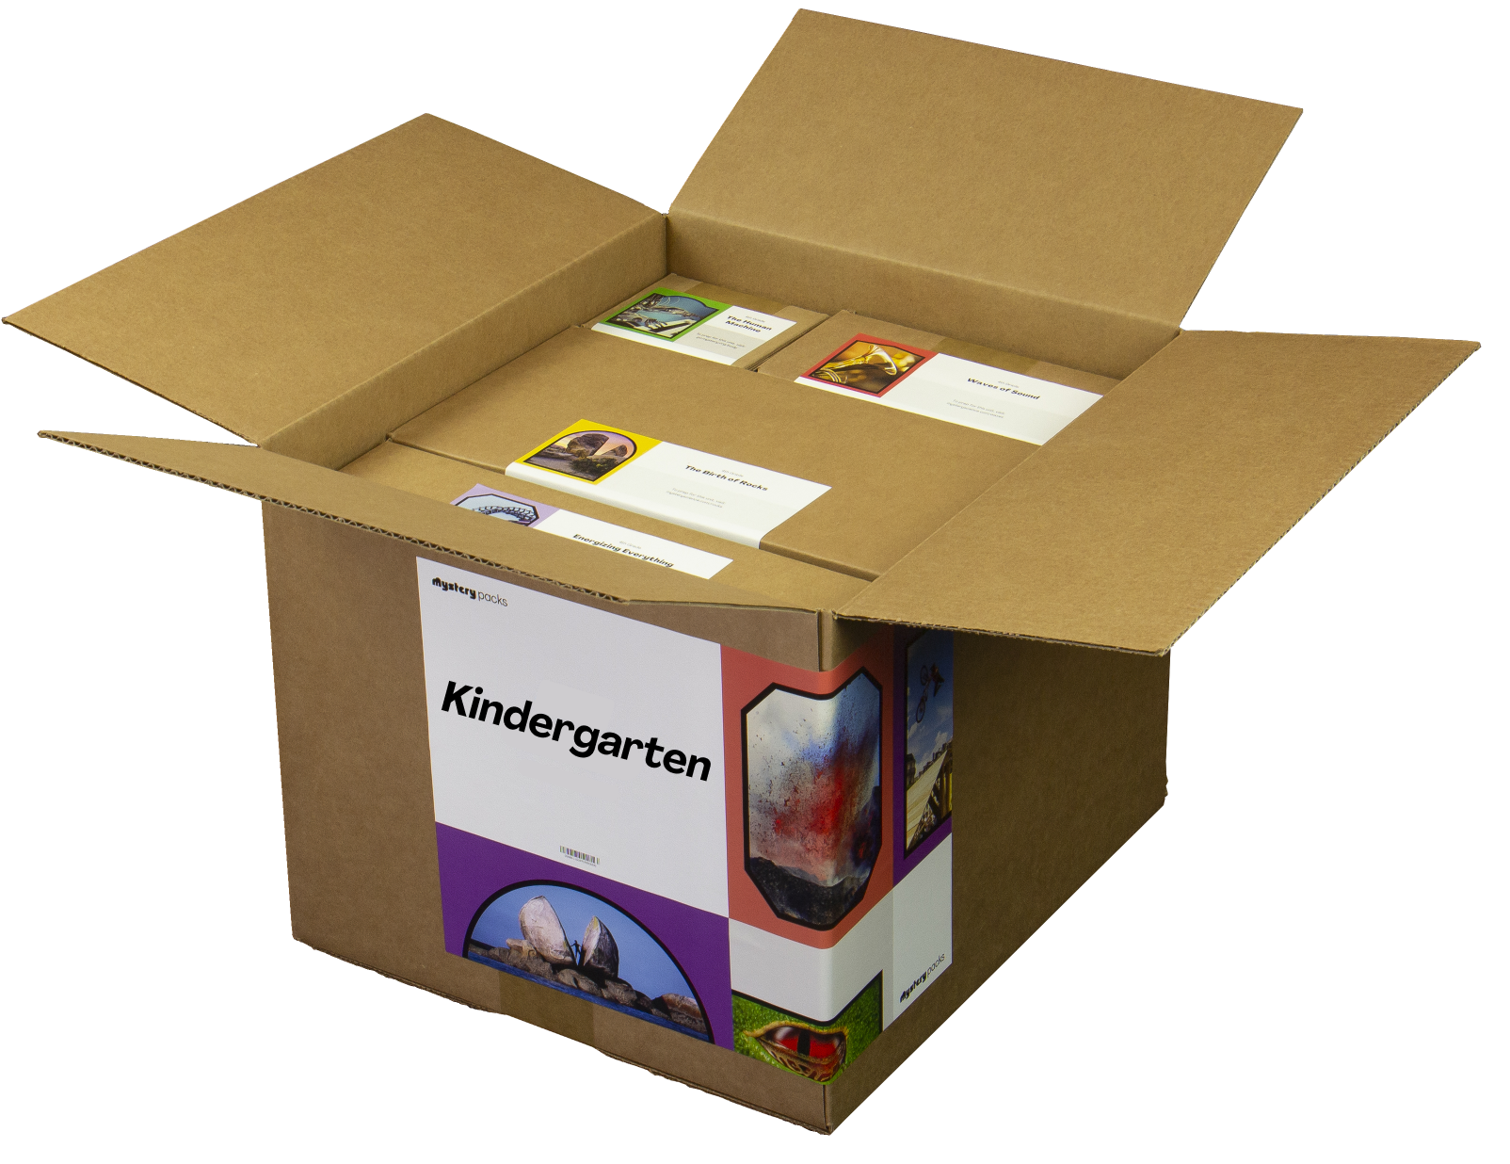
KINDERGARTEN
Using Your Mystery Pack
Mystery Packs are supply kits that contain all the materials needed to teach Mystery Science for the entire year. Each box contains supplies for a class of 30 students.
Does my Mystery Pack contain enough supplies to send home?
For activities labeled Ready to Teach, there are enough supplies in your box for each student to have their own materials. For activities labeled Adjust Supplies, you’ll need some extra materials so that students can work on their own without sharing supplies.
What if I can’t send supplies home to students?
If students don’t have access to supplies, you can turn some activities into demonstrations and share via video conference. Students can participate by recording their observations.
What if I don’t use all of my supplies this year?
Don’t worry! You can still use your Mystery Pack next school year. You’ll just need to refill any supplies that you do use this year.
I don’t have a Mystery Pack. Can I still order one?
Yes! Packs are still available for purchase. You can learn more about Mystery Packs and how to get them here.
10

