Slide 1


A Systems Approach to Feedback:
What You Need to Know and Who Needs to Know it
Jack States
The Wing Institute

Slide 2
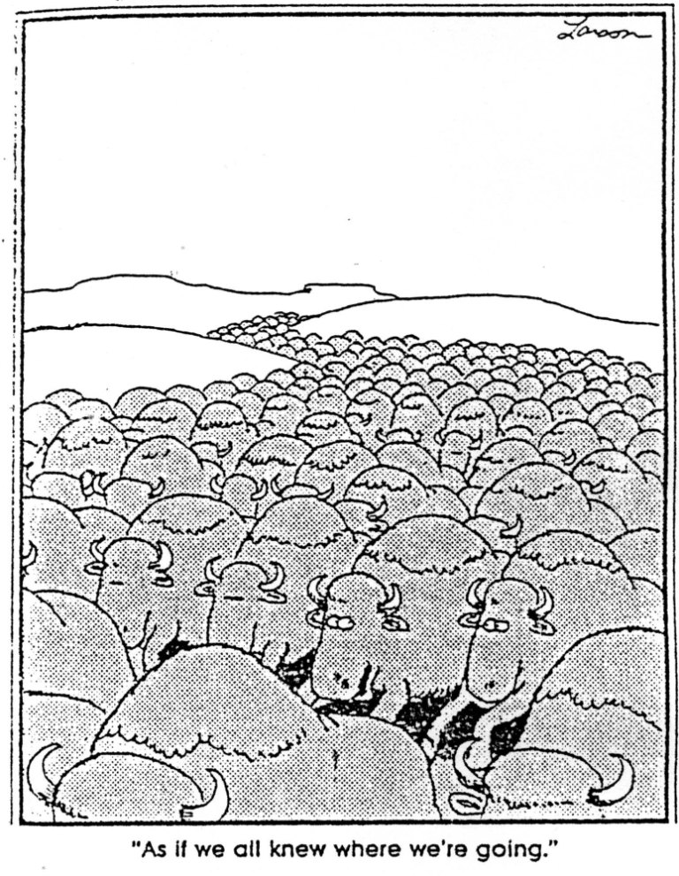
It’s
Hard to
Get Where
You’re
Going
Without
Feedback
Notes:
Intuitively feedback, it dominates our lives, without effective feedback we would flounder
Coloring within the lines as a child
Driving – over steering
Feedback systems are all around
- customer surveys
- reports cards
- flight attendant seat belt
What works, What type of feedback produces best results, feedback to maintain performance, develop system wide feedback so that large systems meet expectations

Slide 3
Intermountain Health Care (IHC)
Group of 30 hospitals and clinics Utah and Idaho
Exemplar for patient care and reduced costs
Medicine excels at evidence-based selection but implementation relying on professional judgment alone decreases outcomes
Professional judgment:
  Professional judgment combined with feedback produces better outcomes
IHC established a key Indicator system
  Best practice guidelines and goals established
  System tracks Doctor outcomes against standards
  Performance reviewed and feedback provided
Notes:
Social significance

Slide 4
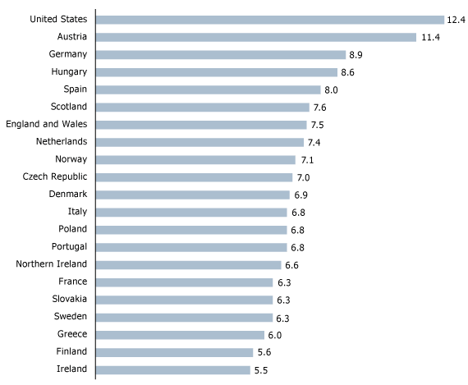
IHC Outcome: Child Mortality
US Ranked: 42nd
Reduce Premature Births
Infant mortality reduced by 13%
IHC - 2001
30% of births induced
IHC - 2009
2% of births induced
Notes:
1. Voluntary induced labors contributor
2. 1998 guidelines set to limit
3. In 2001 Intermountain – 30% of births induced before 39 weeks
4. Setting goals, monitoring doctors performance, and provide
feedback
5. 2009 dropped to 2%
Social significance

Slide 5
What is Feedback?
What it is:
“…Information about performance that allows individuals to adjust his or her performance. Feedback shows a performer where current performance is in relation to past performance and usually some goal.”
(Daniels, A., 1994, Bringing Out the Best In People)
What it is not:
General information
Notes:
Data Based: Objective, reliable, measurable, and specific

Slide 6
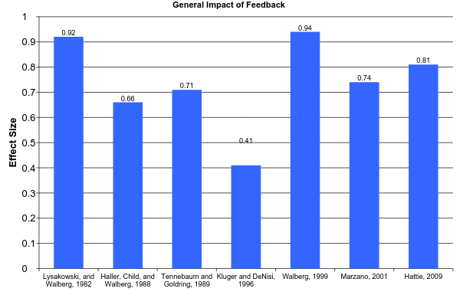
How Powerful is Feedback?
0.5 = Medium Effect
Notes:
1/3 of studies had negative results out of 607 – if focus on the task +, focus on the person
Feedback is powerful, but we need to consider how we use feedback

Slide 7
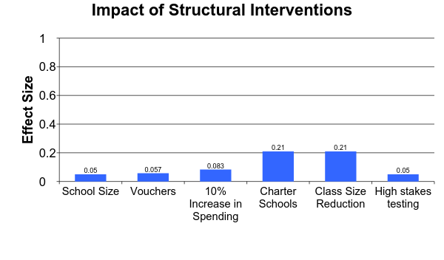
How Effective Are Structural Interventions
Large Effect
Impact on student achievement has been small
Small Effect
Yeh, 2007 and Hattie, 2009

Slide 8
Who is the Focus of Feedback
Student
System
Teacher
Notes:
Locus of the feedback – who is the feedback about who is delivering the feedback

Slide 9
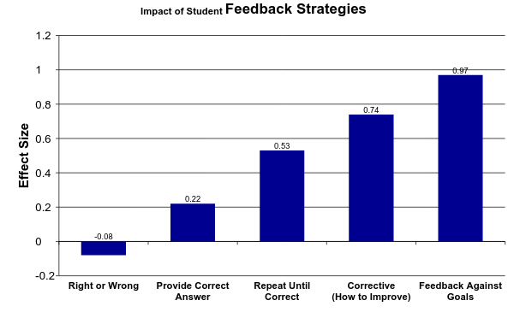
Student Own Performance
Student Focus
How You Provide Feedback to Students Makes a Difference
Marzano, 2005
Notes:
Feedback is complex and we need to address how we are going to use feedback

Slide 10
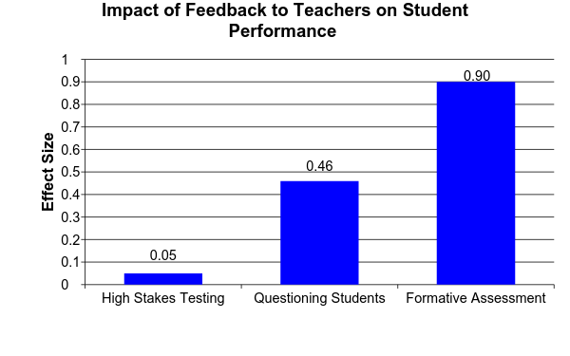
Teacher Feedback on Student Performance
Yeh, 2007, Hattie, 2009, & Fuchs and Fuchs, 1986

Slide 11
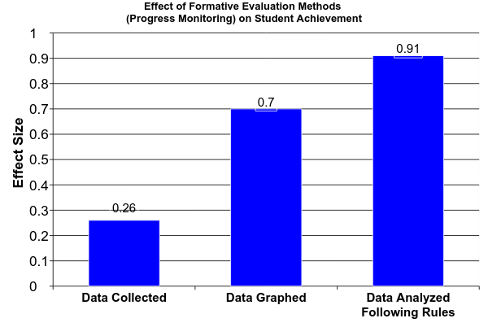
Teacher Feedback on Student Performance
Effects of Systematic Formative Evaluation: A Meta-Analysis, Fuchs & Fuchs, 1986

Slide 12
Effect of Feedback for Supervisors
Monitoring improves performance even when there are no consequences (Larson & Callahan, 1990)
Contingent consequences result in significant improvement in performance when compared to non-contingent (Cherrington, Reitz, & Scott, 1973; Komaki, Waddell, & Pearce, 1977; Orpen, 1974; and Pierce & Risley, 1974)
Monitoring results in leaders providing more consequences (Komaki & Citera, 1990)
Monitoring improves works satisfaction (Millenson, 1967)

Slide 13
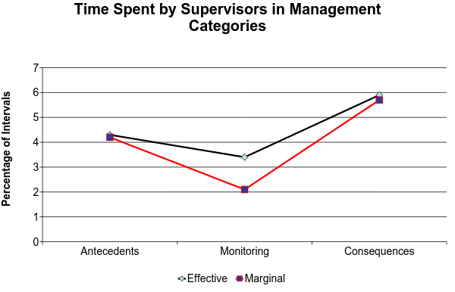
Effective and Marginal Supervisors
Categories From the Operant Supervisory Taxonomy and Index
Komaki, 1986
Notes:
7 categories
Monitoring leads to more consequences and improved performance

Slide 14
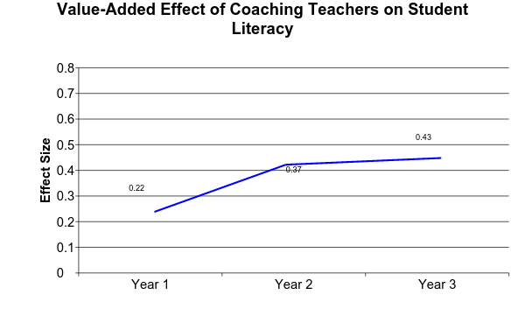
Coaching as Feedback
Large
Small
Medium
Biancarosa, Bryk, and Dexter (2010)
Notes:
Literacy Collaborative - School reform model K-2nd grade
Student Literacy – reading and writing
assessed 2 X year DIBELS and Terra Nova
Joyce and Showers 2002
Theory and discussion, demonstrate skills, practice and feedback, coaching

Slide 15
Temporal Dimensions of Feedback
(Frequency and Immediacy)
Feedback increases maintenance of education interventions, Codding, et al., 2005, O’Reilly et al., 1994
Targeted teaching behaviors acquired more quickly when feedback was immediate, O’Reilly et al., 1994, Coulter and Grossen, 1997
Immediate feedback in applied studies achieved best results 0.28 Effect size, Kulik, J., and Kulik, C., 1988
Notes:
sustainability

Slide 16
Features of Effective Feedback
Performance measures must be reliable and valid.
Teachers need to know the variables being measured
Skills must be identified to attain the measures
Feedback necessary to assure treatment integrity
Feedback should trigger and guide effecting coaching.

Slide 17



What Models Have Worked
Curriculum
Graduation
Teaching
Input
Process
Outcomes
Feedback
Loop
Rummler & Brache, (1990)
Improving Performance
Notes:
Post WWII Japan where the American statistician W. Edwards Demings
Focusing on quality and cost effective
Auto and electronics met quality standards
Geary Rummler is credited along w/other of founding Six Sigma TQM features Feedback
great success story of late 20th century

Slide 18
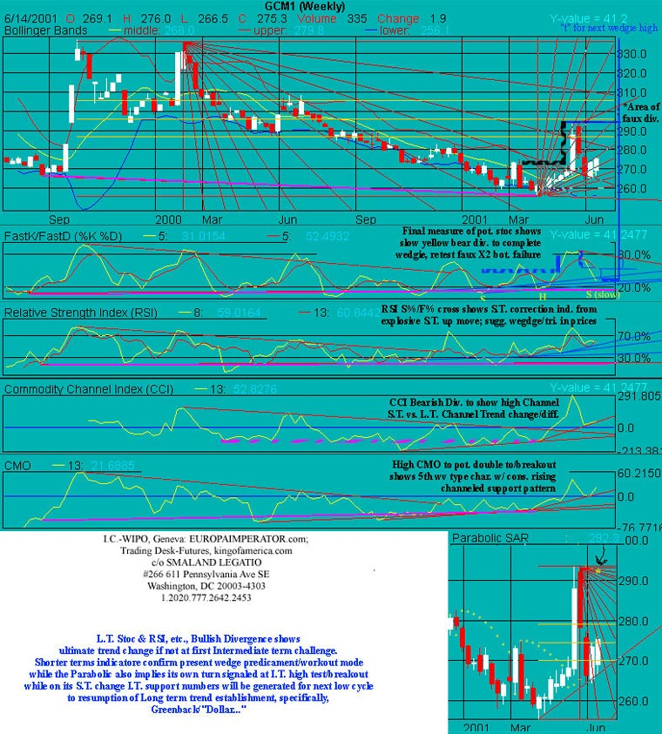
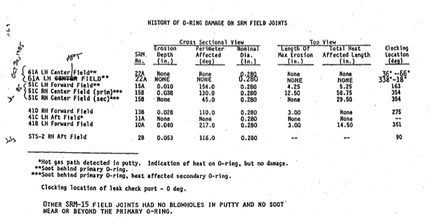
How vs
What
Too much data!
Over-reliance on tables
Notes:
Night before Challenger 1986
13 charts and tables to NASA
No go - Over-ruled
Displays hid the message
Engineers had theory and data, but Message lost
7 people died
Edward Tufte and Howard Wainer

Slide 19
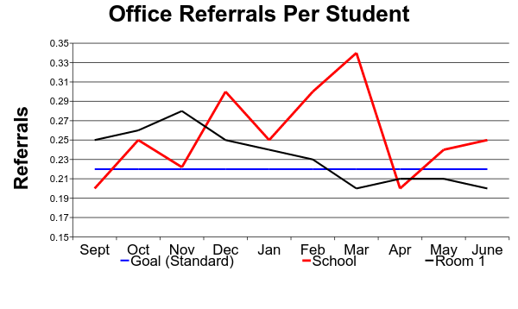
Key Indicator Reports
Providing relative performance feedback improves individual performance, Murthy and Schafer (2011)
Outcome data alone produces minimum results, Kludger and DeNisi (1996)
Outcome data combined with process data produces best results, Leung and Trotman (2005)
Positive and negative feedback can increase performance, Murthy and Schafer (2011)
Status, Trend, and Standard
Notes:
Performance compared to others
Outcome and process data - Rummler and Demmings

Slide 20
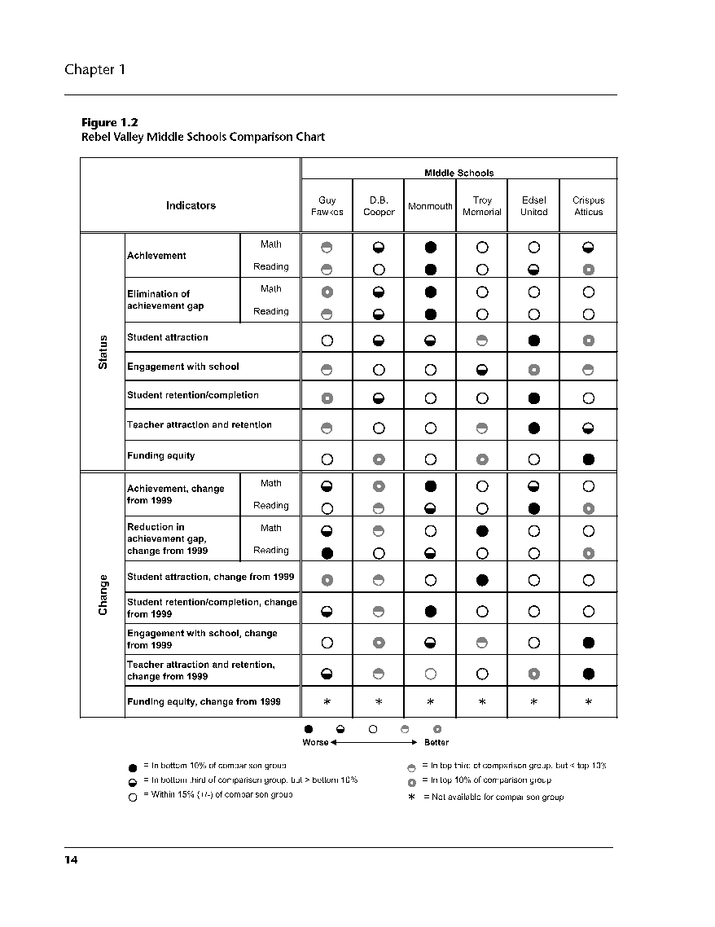
Indicator
Report
(Sample)
Achievement
GAP
Student Attraction
Engagement
Retention
Teacher Retention
Funding Equity
Celio,B. and Harvey, J. (2005)
Buried Treasure
Notes:
9th graders fail classes are risk for drop out
Unfortunately, data isn’t enough
Professional judgment cannot supersede good judgment
James Harvey

Slide 21
Take Home Message
Feedback is a powerful tool for improving student achievement
To be effective you need to know what about feedback works and what doesn’t
Implementation is complex
Notes:
1. It is complex, if implemented incorrectly it’s impact compromised

Slide 22
Indicator Selections
Student Performance | Teacher Performance | System Performance
Achievement | Teaching/Treatment Integrity | Staff Attraction & Retention
Summative | Training | Parent Satisfaction & Participation
Formative |  | Resources & Funding
Retention/Completion |  | Standards & Curriculum
Graduation/Drop out |  | Business Operations
Conduct/Safety |  | Compliance w/Laws and Regulations

