Slide 1


Standards Alignment Guide
Genre Units
List of All Genre Units 5th Grade Units 4th Grade Units 3rd Grade Units 2nd Grade Units
Essential Skill + Practice Lessons
Grades 2-3 Grades 4-5
Genre Intro Lessons
Grades 2-5
Writing Community Lessons
Grades 2-5
Independent Writing Prompts
Grades 2-5
Updated October 2025

Slide 2

List of All Genre Units
Genre Units contain 5-6 lessons that guide students through the writing process to produce a final piece of writing. Units also include pre- and post-assessments.
5th Grade
Narrative Realistic Fiction: Australian Adventures Fictional Story: Magical Objects NEW! | Opinion Persuasive Essay: Skatepark Literary Essay: Storyteller Con Persuasive Essay: Town Fair Informative Research Paper: Investigating Asteroids Research Paper: Bioluminescence
4th Grade
Narrative Realistic Fiction: Amusement Park New Unit Coming in the 2025-26 School Year Opinion Opinion Essay: Would You Rather Response to Reading: Detective Series New Unit Coming in the 2025-26 School Year Informative Informative Text: Travel to Seoul Informative Text: England Expeditions NEW! |
Back to Table of Contents

Slide 3
List of All Genre Units
Genre Units contain 5-6 lessons that guide students through the writing process to produce a final piece of writing. Units also include pre- and post-assessments.
3rd Grade
Narrative Fictional Story: Constellation Stories New Unit Coming in the 2025-26 School Year Opinion Opinion Paragraphs: Festivals New Unit Coming in the 2025-26 School Year Informative Informative Paragraphs: Saving Sea Turtles New Unit Coming in the 2025-26 School Year COMING SOON! |
2nd Grade
Narrative Personal Narrative: Goat Escape Fictional Story: Campsite Bandit Opinion Opinion Sentences: Pizza Quest New Unit Coming in the 2025-26 School Year COMING SOON! | Informative Informative Paragraph: Project Treehouse NEW! | Informative Paragraph: Amani’s Animal Rescue
Back to Table of Contents

Slide 4



5th Grade | Narrative Writing
Narrative Writing | 5th Grade
Unit 1: Australian Adventures
Students write a realistic fiction text with character desires, minor events, and a climax. Along the way, they bring their story to life with character details, reactions, and sensory details.
Pre-
Assessment
Lesson 1
Lesson 2
Lesson 3
Pre-Assessment
Picnic Adventure
30 mins
Planning
Create Your Character
50 minutes
Leads
Begin Your Adventure
40 minutes
Drafting
Add Some Drama
40 minutes
Lesson 4
Lesson 5
Post-
Assessment
Drafting & Revising
Make It Thrilling
40 minutes
Endings & Editing
End Your Adventure
45 minutes
Post-Assessment
Pet Store Adventure
30 minutes
Standards
W.5.3 | Write narratives to develop real or imagined experiences or events using effective technique, descriptive details, and clear event sequences.
W.5.3.a | Orient the reader by establishing a situation and introducing a narrator and/or characters; organize an event sequence that unfolds naturally.
W.5.3.b | Use narrative techniques, such as dialogue, description, and pacing to develop experiences and events or show the responses of characters to situations.
W.5.3.c | Use a variety of transitional words, phrases, and clauses to manage the sequence of events.
W.5.3.d | Use concrete words and phrases and sensory details to convey experiences and events precisely.
W.5.3.e | Provide a conclusion that follows from the narrated experiences or events.
W.5.4 | Produce clear and coherent writing in which the development and organization are appropriate to task, purpose, and audience.
W.5.5 | With guidance and support from peers and adults, develop and strengthen writing as needed by planning, revising, editing, rewriting, or trying a new approach.
‹#›
Back to Table of Contents

Slide 5


5th Grade | Narrative Writing
Narrative Writing | 5th Grade
Unit 3: Magical Objects |INDEPENDENT WRITING UNIT |
Students write a fictional story about a character who discovers a magical object. Students are guided through the writing process but independently brainstorm, make a story plan, create a draft, and revise their writing.
Lesson 1
Lesson 2
Lesson 3
Lesson 4
Brainstorming
Imagine the Magic
30 mins
Planning
Build Your Character
35 minutes
Drafting
Drafting the Impossible
35 minutes
Revising
Make it Sparkle
35 minutes
Post-
Assessment
Post-Assessment
Something’s Broken
30 minutes
Standards
W.5.3 | Write narratives to develop real or imagined experiences or events using effective technique, descriptive details, and clear event sequences.
W.5.3.a | Orient the reader by establishing a situation and introducing a narrator and/or characters; organize an event sequence that unfolds naturally.
W.5.3.b | Use narrative techniques, such as dialogue, description, and pacing to develop experiences and events or show the responses of characters to situations.
W.5.3.c | Use a variety of transitional words, phrases, and clauses to manage the sequence of events.
W.5.3.d | Use concrete words and phrases and sensory details to convey experiences and events precisely.
W.5.3.e | Provide a conclusion that follows from the narrated experiences or events.
W.5.4 | Produce clear and coherent writing in which the development and organization are appropriate to task, purpose, and audience.
W.5.5 | With guidance and support from peers and adults, develop and strengthen writing as needed by planning, revising, editing, rewriting, or trying a new approach.
W.5.10 | Write routinely over extended time frames (time for research, reflection, and revision) and shorter time frames (a single sitting or a day or two) for a range of discipline-specific tasks, purposes, and audiences.
‹#›
Back to Table of Contents

Slide 6


Opinion Writing | 5th Grade
Unit 1: Skatepark
Students write a persuasive letter to convince the mayor to transform an abandoned pool into a skatepark for their community. They read two sources and take notes before organizing the information into a letter.
Pre-
Assessment
Lesson 1
Lesson 2
Lesson 3
Pre-Assessment
Class Pet
30 mins
Planning
A Skatepark for Everyone
40 minutes
Drafting
Convince the Mayor
40 minutes
Drafting
Quote the Experts
40 minutes
Lesson 4
Lesson 5
Post-
Assessment
Intro & Conclusion
Stick the Landing
40 minutes
Endings & Editing
Ramp Up Your Writing
35 minutes
Post-Assessment
Pet Store Adventure
30 minutes
Standards
W.5.1 | Write opinion pieces on topics or texts, supporting a point of view with reasons and information.
W.5.1.a | Introduce a topic or text clearly, state an opinion, and create an organizational structure in which ideas are logically grouped to support the writer’s purpose.
W.5.1.b | Provide logically ordered reasons that are supported by facts and details.
W.5.1.d | Provide a concluding statement or section related to the opinion presented.
W.5.5 | With guidance and support from peers and adults, develop and strengthen writing as needed by planning, revising, editing, rewriting, or trying a new approach.
W.5.8 | Recall relevant information from experiences or gather relevant information from print and digital sources; summarize or paraphrase information in notes and finished work, and provide a list of sources.
L.5.2 | Demonstrate command of the conventions of standard English capitalization, punctuation, and spelling when writing.
‹#›
Back to Table of Contents

Slide 7


Opinion Writing | 5th Grade
Unit 2: Storyteller Con
Students write a four-paragraph literary essay about a theme from a story. Students develop a thesis statement, use story events as reasons, and back their thinking up with evidence and explanations.
Pre-
Assessment
Lesson 1
Lesson 2
Lesson 3
Pre-Assessment
No More Ants
30 mins
Exploring Mentor Texts
Welcome to Storyteller Con
50 minutes
Planning
Plan Your Fanzine
50 minutes
Drafting
Add Your Evidence
50 minutes
Lesson 4
Lesson 5
Lesson 6
Post-
Assessment
Drafting & Revising
Explain Your Evidence
50 minutes
Intro & Conclusion
Introduce Your Fanzine
50 minutes
Editing & Publishing
Design Your Fanzine
35 minutes
Post-Assessment
Shaken Up
30 minutes
Standards
W.5.9 | Draw evidence from literary or informational texts to support analysis, reflection, and research.
W.5.9.a | Apply Grade 5 Reading standards to literature drawing on specific details in the text.
W.5.1 | Write opinion pieces on topics or texts, supporting a point of view with reasons and information.
W.5.1.a | Introduce a topic or text clearly, state an opinion, and create an organizational structure in which ideas are logically grouped to support the writer’s purpose.
W.5.1.b | Provide logically ordered reasons that are supported by facts and details.
W.5.1.c | Link opinion and reasons using words, phrases, and clauses (e.g., consequently, specifically).
W.5.1.d | Provide a concluding statement or section related to the opinion presented.
W.5.4 | Produce clear and coherent writing in which the development and organization are appropriate to task, purpose, and audience.
W.5.5 | With guidance and support from peers and adults, develop and strengthen writing as needed by planning, revising, editing, rewriting, or trying a new approach.
RL.5.1 | Quote accurately from a text when explaining what the text says explicitly and when drawing inferences from the text.
RL.5.2 | Determine a theme of a story, drama, or poem from details in the text, including how characters in a story or drama respond to challenges or how the speaker in a poem reflects upon a topic; summarize the text.
L.5.2 | Demonstrate command of the conventions of standard English capitalization, punctuation, and spelling when writing.
‹#›
Back to Table of Contents

Slide 8


Opinion Writing | 5th Grade
Unit 3: Town Fair |INDEPENDENT WRITING UNIT |
Students write a persuasive essay in the form of a flyer encouraging local residents to hold a town fair. Students are guided through the writing process but independently take notes, create an outline, write a draft, and revise their writing.
Lesson 1
Lesson 2
Lesson 3
Lesson 4
Gathering Information
Explore Town Fairs
35 mins
Outlining
Plan Your Flyer
35 minutes
Drafting
Convince Your Reader to Vote Yes
15 minutes
Revision
Share Your Flyer
35 minutes
Post-
Assessment
Post-Assessment
Science Museum
30 minutes
Standards
W.5.1 | Write opinion pieces on topics or texts, supporting a point of view with reasons and information.
W.5.1.a | Introduce a topic or text clearly, state an opinion, and create an organizational structure in which ideas are logically grouped to support the writer’s purpose.
W.5.1.b | Provide logically ordered reasons that are supported by facts and details.
W.5.1.c | Link opinion and reasons using words, phrases, and clauses (e.g., consequently, specifically).
W.5.1.d | Provide a concluding statement or section related to the opinion presented.
W.5.4 | Produce clear and coherent writing in which the development and organization are appropriate to task, purpose, and audience.
W.5.5 | With guidance and support from peers and adults, develop and strengthen writing as needed by planning, revising, editing, rewriting, or trying a new approach.
W.5.8 | Recall relevant information from experiences or gather relevant information from print and digital sources; summarize or paraphrase information in notes and finished work, and provide a list of sources.
W.5.10 | Write routinely over extended time frames (time for research, reflection, and revision) and shorter time frames (a single sitting or a day or two) for a range of discipline-specific tasks, purposes, and audiences.
‹#›
Back to Table of Contents

Slide 9


Informative Writing | 5th Grade
Unit 1: Investigating Asteroids
Students write a four-paragraph research paper about asteroids. Students research information using multiple sources, organize their notes into subtopics, use expert quotes, and create a bibliography.
Pre-
Assessment
Lesson 1
Lesson 2
Lesson 3
Pre-Assessment
Helpful Insects
30 mins
Gathering Information
Launch Your Research
40 minutes
Research
Meet the Scientists
40 minutes
Organizing Information
Mission to Sort
40 minutes
Lesson 4
Lesson 5
Lesson 6
Post-
Assessment
Drafting
3, 2, 1…Draft!
40 minutes
Intro & Conclusion
Hook Your Reader
40 minutes
Editing & Revising
Prepare to Share
35 minutes
Post-Assessment
Dolphin Smarts
30 minutes
Standards
W.5.2 | Write informative/explanatory texts to examine a topic and convey ideas and information clearly.
W.5.2.a | Introduce a topic clearly, provide a general observation and focus, and group related information logically; include formatting (e.g., headings), illustrations, and multimedia when useful to aid comprehension.
W.5.2.b | Develop the topic with facts, definitions, concrete details, quotations, or other information and examples related to the topic.
W.5.2.d | Use precise language and domain-specific vocabulary to inform about or explain the topic.
W.5.2.e | Provide a concluding statement or section related to the information or explanation presented.
W.5.4 | Produce clear and coherent writing in which the development and organization are appropriate to task, purpose, and audience.
W.5.5 | With guidance and support from peers and adults, develop and strengthen writing as needed by planning, revising, editing, rewriting, or trying a new approach.
W.5.7 | Conduct short research projects that use several sources to build knowledge through investigation of different aspects of a topic.
W.5.8 | Recall relevant information from experiences or gather relevant information from print & digital sources; summarize or paraphrase information in notes & finished work, & provide a list of sources.
L.5.2 | Demonstrate command of the conventions of standard English capitalization, punctuation, and spelling when writing.
‹#›
Back to Table of Contents

Slide 10
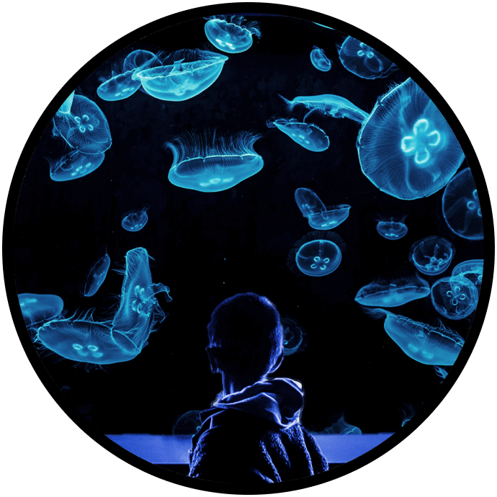

Informative Writing | 5th Grade
Unit 3: Bioluminescence |INDEPENDENT WRITING UNIT |
Students write a five-paragraph research paper on bioluminescence. Students are guided through the writing process but independently take notes, create an outline, write and revise a draft, and create a bibliography.
Lesson 1
Lesson 2
Lesson 3
Lesson 4
Gathering Information
Enter the Deep Ocean
35 mins
Gathering Information
Quote the Ocean Experts
35 minutes
Outlining
Plan Your Poster
35 minutes
Drafting
Overcome the Blank Page
45 minutes
Lesson 5
Post-
Assessment
Revising & Publishing
Design Your Aquarium Poster
45 minutes
Post-Assessment
Carnivorous Plants
30 minutes
Standards
W.5.2 | Write informative/explanatory texts to examine a topic and convey ideas and information clearly.
W.5.2.a | Introduce a topic clearly, provide a general observation and focus, and group related information logically; include formatting (e.g., headings), illustrations, and multimedia when useful to aid comprehension.
W.5.2.b | Develop the topic with facts, definitions, concrete details, quotations, or other information and examples related to the topic.
W.5.2.c | Link ideas within and across categories of information using words, phrases, and clauses (e.g., in contrast, especially).
W.5.2.d | Use precise language and domain-specific vocabulary to inform about or explain the topic.
W.5.2.e | Provide a concluding statement or section related to the information or explanation presented.
W.5.5 | With guidance and support from peers and adults, develop and strengthen writing as needed by planning, revising, editing, rewriting, or trying a new approach.
W.5.7 | Conduct short research projects that use several sources to build knowledge through investigation of different aspects of a topic.
W.5.8 | Recall relevant information from experiences or gather relevant information from print and digital sources; summarize or paraphrase information in notes and finished work; provide a list of sources.
W.5.10 | Write routinely over extended time frames (time for research, reflection, revision) and shorter time frames (single sitting or a day or two) for a range of discipline-specific tasks, purposes, & audiences.
‹#›
Back to Table of Contents

Slide 11
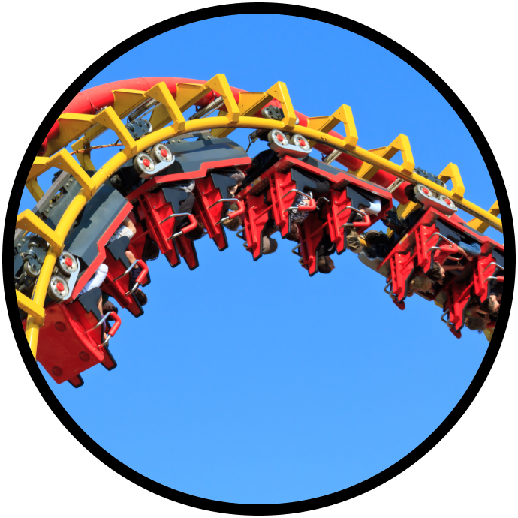

Narrative Writing | 4th Grade
Unit 1: Amusement Park
Students write a realistic fiction text for a classroom short story festival. They plan using a story arc, and draft the story using dialogue, action, emotions, and transition words. Lastly, they edit their writing and share with their classmates.
Pre-
Assessment
Lesson 1
Lesson 2
Lesson 3
Pre-Assessment
Playground Stories
30 mins
Story Planning
Plan Your Story
45 minutes
Beginning a Story
Set the Stage
40 minutes
Transition Words & Phrases
Add Some SPEED
50 minutes
Lesson 4
Lesson 5
Post-
Assessment
Story Endings
Wrap It Up
40 minutes
Editing & Sharing
Share Your Story
45 minutes
Post-Assessment
Sports Stories
30 minutes
Standards
W.4.3 | Write narratives to develop real or imagined experiences or events using effective technique, descriptive details, and clear event sequences.
W.4.3.a | Orient the reader by establishing a situation and introducing a narrator and/or characters; organize an event sequence that unfolds naturally.
W.4.3.b | Use dialogue and description to develop experiences and events or show the responses of characters to situations.
W.4.3.c | Use a variety of transitional words and phrases to manage the sequence of events.
W.4.3.e | Provide a conclusion that follows from the narrated experiences or events.
W.4.4 | Produce clear and coherent writing in which the development and organization are appropriate to task, purpose, and audience.
W.4.5 | With guidance and support from peers and adults, develop and strengthen writing as needed by planning, revising, and editing.
L.4.2.b | Use commas and quotation marks to mark direct speech and quotations from a text.
‹#›
Back to Table of Contents

Slide 12


Opinion Writing | 4th Grade
Unit 1: Would You Rather
Students write an opinion essay and act as guests on a “would you rather”-style podcast. Each student crafts a four-paragraph text with a thesis, two reasons, and examples. Lastly, students present their podcast with a partner.
Pre-
Assessment
Lesson 1
Lesson 2
Lesson 3
Pre-Assessment
Which Class?
30 mins
Gathering Information
Either/Or Explorers
40 minutes
Planning
Plan Your Podcast
40 minutes
Drafting
Start Your Script
40 minutes
Lesson 4
Lesson 5
Post-
Assessment
Drafting & Revising
Add Some POWER
40 minutes
Editing & Sharing
Get Ready to Present
45 minutes
Post-Assessment
Which Job?
30 minutes
Standards
W.4.1 | Write opinion pieces on topics or texts, supporting a point of view with reasons and information.
W.4.1.a | Introduce a topic or text clearly, state an opinion, and create an organizational structure in which related ideas are grouped to support the writer’s purpose.
W.4.1.b | Provide reasons that are supported by facts and details.
W.4.1.c | Link opinion and reasons using words and phrases (e.g., for instance, in order to, in addition).
W.4.1.d | Provide a concluding statement or section related to the opinion presented.
W.4.4 | Produce clear and coherent writing in which the development and organization are appropriate to task, purpose, and audience.
W.4.5 | With guidance and support from peers and adults, develop and strengthen writing as needed by planning, revising, and editing.
W.4.8 | Recall relevant information from experiences or gather relevant information from print and digital sources; take notes and categorize information, and provide a list of sources.
W.4.10 | Write routinely over extended time frames (time for research, reflection, and revision) and shorter time frames (a single sitting or a day or two) for a range of discipline-specific tasks, purposes, and audiences.
‹#›
Back to Table of Contents

Slide 13


Opinion Writing | 4th Grade
Unit 2: Detective Series
Students learn how to write a response to reading. Students begin by writing complete-sentence answers to questions about a text, and by the end of the unit write complete-paragraph responses with text evidence and analysis.
Pre-
Assessment
Lesson 1
Lesson 2
Lesson 3
Pre-Assessment
Stay Cool
30 mins
Answering in a Complete Sentence
Case of the Missing Grandpa
30 minutes
Adding Evidence
Find the Evidence
35 minutes
Elaboration
Connect the Clues
30 minutes
Lesson 4
Post-
Assessment
Paragraph Responses
Solve the Mystery
30 minutes
Post-Assessment
Welcome Back
30 minutes
Standards
W.4.4 | Produce clear and coherent writing in which the development and organization are appropriate to task, purpose, and audience.
W.4.5 | With guidance and support from peers and adults, develop and strengthen writing as needed by planning, revising, and editing.
W.4.9 | Draw evidence from literary or informational texts to support analysis, reflection, and research.
W.4.9.a | Apply grade 4 Reading standards to literature (e.g., “Describe in depth a character, setting, or event in a story or drama, drawing on specific details in the text [e.g., a character’s thoughts, words, or actions].”).
W.4.10 | Write routinely over extended time frames (time for research, reflection, and revision) and shorter time frames (a single sitting or a day or two) for a range of discipline-specific tasks, purposes, and audiences.
RL.4.1 | Refer to details and examples in a text when explaining what the text says explicitly and when drawing inferences from the text.
‹#›
Back to Table of Contents

Slide 14


Informative Writing | 4th Grade
Unit 1: Travel to Seoul
Students write a three-paragraph informative text in the form of a blog post about Seoul, South Korea. After sorting information about destinations in Seoul, they select two to include in their blog and add an introduction. Finally, they edit and revise to create a final daft.
Pre-
Assessment
Lesson 1
Lesson 2
Lesson 3
Pre-Assessment
Ready for the Moon
30 mins
Gathering Information
Explore the City
40 minutes
Organizing Information & Drafting
Find Your Facts
35 minutes
Drafting
Match It Up
40 minutes
Lesson 4
Lesson 5
Lesson 6
Post-
Assessment
Write an Introduction
Excite Your Reader
40 minutes
Write a Conclusion
Make It Memorable
40 minutes
Editing
Prepare to Post
35 minutes
Post-Assessment
Useful Robots
30 minutes
Standards
W.4.2 | Write informative/explanatory texts to examine a topic and convey ideas and information clearly.
W.4.2.a | Introduce a topic clearly and group related information in paragraphs and sections; include formatting (e.g., headings), illustrations, and multimedia when useful to aiding comprehension.
W.4.2.b | Develop the topic with facts, definitions, concrete details, quotations, or other information and examples related to the topic.
W.4.2.c | Link ideas within categories of information using words and phrases (e.g., another, for example, also, because).
W.4.2.e | Provide a concluding statement or section related to the information or explanation presented.
W.4.5 | With guidance and support from peers and adults, develop and strengthen writing as needed by planning, revising, and editing.
W.4.7 | Conduct short research projects that build knowledge through investigation of different aspects of a topic.
W.4.8 | Recall relevant information from experiences or gather relevant information from print and digital sources; take notes and categorize information, and provide a list of sources.
‹#›
Back to Table of Contents

Slide 15


Informative Writing | 4th Grade
Unit 3: England Expeditions |INDEPENDENT WRITING UNIT|
Students write a four-paragraph informative script about London and Cornwall, England. Students are guided through the writing process but will independently take notes, create an outline, draft, revise, and list their sources.
Lesson 1
Lesson 2
Lesson 3
Lesson 4
Gathering Information
Explore London
35 mins
Gathering Information
Discover Cornwall
35 minutes
Outlining
Map Out Your Script
35 minutes
Drafting
All About London and Cornwall
45 minutes
Lesson 5
Post-
Assessment
Lesson 6
Post-
Assessment
Revising & Editing
Show Off Your Script
45 minutes
Post-Assessment
Secrets of the Brain
30 minutes
Standards
W.4.2 | Write informative/explanatory texts to examine a topic and convey ideas and information clearly.
W.4.2.a | Introduce a topic clearly and group related information in paragraphs and sections; include formatting (e.g., headings), illustrations, and multimedia when useful to aiding comprehension.
W.4.2.b | Develop the topic with facts, definitions, concrete details, quotations, or other information and examples related to the topic.
W.4.2.c | Link ideas within categories of information using words and phrases (e.g., another, for example, also, because).
W.4.2.d | Use precise language and domain-specific vocabulary to inform about or explain the topic.
W.4.2.e | Provide a concluding statement or section related to the information or explanation presented.
W.4.4 | Produce clear and coherent writing in which the development and organization are appropriate to task, purpose, and audience.
W.4.5 | With guidance and support from peers and adults, develop and strengthen writing as needed by planning, revising, and editing.
W.4.7 | Conduct short research projects that build knowledge through investigation of different aspects of a topic.
W.4.8 | Recall relevant information from experiences or gather relevant information from print and digital sources; take notes and categorize information, and provide a list of sources.
‹#›
Back to Table of Contents

Slide 16


Narrative Writing | 3rd Grade
Unit 1: Constellation Stories
Students write a fictional story about a character seen in a constellation. They plan using a story plan, and draft the story using descriptions, character thoughts, and character actions. Lastly, they edit their writing and share with their classmates.
Pre-
Assessment
Lesson 1
Lesson 2
Lesson 3
Pre-Assessment
Pond Stories
30 mins
Planning Your Story
Constellation Creation
45 minutes
Brainstorming a Solution
Stellar Solutions
50 minutes
Drafting a Lead
Strap Into Your Story
50 minutes
Lesson 4
Lesson 5
Post-
Assessment
Drafting with Character Thoughts
Thought-full Characters
55 minutes
Revising & Editing
Share Your Story
45 minutes
Post-Assessment
Nocturnal Creatures Story
30 minutes
Standards
W.3.3 | Write narratives to develop real or imagined experiences or events using effective technique, descriptive details, and clear event sequences.
W.3.3.a | Establish a situation and introduce a narrator and/or characters; organize an event sequence that unfolds naturally.
W.3.3.b | Use dialogue and descriptions of actions, thoughts, and feelings to develop experiences and events or show the response of characters to situations.
W.3.3.d | Provide a sense of closure.
W.3.4 | With guidance and support from adults, produce writing in which the development and organization are appropriate to task and purpose.
W.3.5 | With guidance and support from peers and adults, develop and strengthen writing as needed by planning, revising, and editing.
W.3.10 | Write routinely over extended time frames (time for research, reflection, and revision) and shorter time frames (a single sitting, or a day or two) for a range of discipline-specific tasks, purposes, and audiences.
L.3.2.c | Use commas and quotation marks in dialogue.
L.3.3.a | Choose words and phrases for effect.
L.3.5 | Demonstrate understanding of word relationships and nuances in word meanings (figurative language).
‹#›
Back to Table of Contents

Slide 17


Opinion Writing | 3rd Grade
Unit 1: Festivals
Students write a short opinion essay in the form of a message to a traveling filmmaker. They write a three-paragraph text that includes an opinion sentence, two reasons, and examples. Students will share their message with the class at the end of the unit.
Pre-
Assessment
Lesson 1
Lesson 2
Lesson 3
Pre-Assessment
Choice Day
30 mins
Planning
Pick Your Festival!
40 minutes
Drafting
Tell Tariq Why
35 minutes
Drafting & Elaboration
Help Tariq Picture It
40 minutes
Lesson 4
Lesson 5
Post-
Assessment
Introduction & Conclusion
Opening and Final Acts
50 minutes
Editing & Publishing
Festival Showcase
45 minutes
Post-Assessment
National Day
30 minutes
Standards
W.3.1 | Write opinion pieces on topics or texts, supporting a point of view with reasons.
W.3.1.a | Introduce the topic or text they are writing about, state an opinion, and create an organizational structure that lists reasons.
W.3.1.b | Provide reasons that support the opinion.
W.3.1.c | Use linking words and phrases (e.g., because, therefore, since, for example) to connect opinion and reasons.
W.3.1.d | Provide a concluding statement or section.
W.3.4 | With guidance and support from adults, produce writing in which the development and organization are appropriate to task and purpose.
W.3.5 | With guidance and support from peers and adults, develop and strengthen writing as needed by planning, revising, editing, rewriting, or trying a new approach.
W.3.8 | Recall information from experiences or gather information from print and digital sources; take brief notes on sources and sort evidence into provided categories.
L.3.3.a | Choose words and phrases for effect.
‹#›
Back to Table of Contents

Slide 18

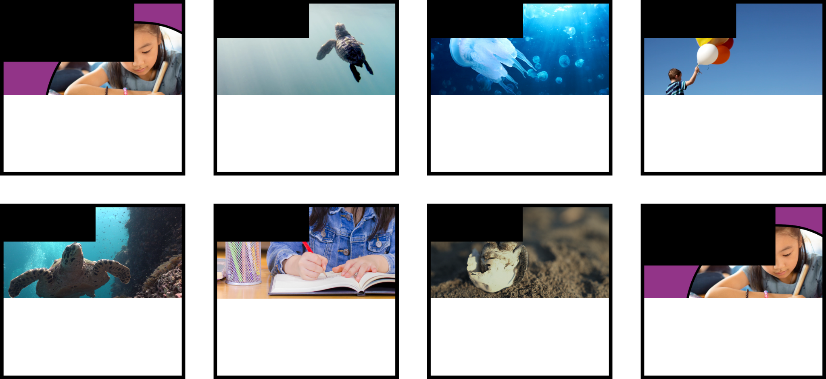
Informative Writing | 3rd Grade
Unit 1: Saving Sea Turtles
Students write informative paragraphs in a booklet with two sections about how to help protect sea turtles. They gather information from experts, write drafts using complex sentences, elaborate on their ideas, and include headings for each section.
Pre-
Assessment
Lesson 1
Lesson 2
Lesson 3
Pre-Assessment
Free Saturday
30 mins
Gathering Information
Shelly’s Beach Needs You
40 minutes
Drafting with Complex Sentences
Make Your Guidebook
40 minutes
Elaboration
Be the Turtle Expert
50 minutes
Lesson 4
Lesson 5
Lesson 6
Post-
Assessment
Titles & Headings
Create Exciting Turtle Titles
40 minutes
Editing
Fix It Up!
35 minutes
Give Feedback
Show Off Your Guidebook
35 minutes
Post-Assessment
New Student
30 minutes
Standards
W.3.2 | Write informative/explanatory texts to examine a topic and convey ideas and information clearly.
W.3.2.a | Introduce a topic and group related information together; include illustrations when useful to aiding comprehension.
W.3.2.b | Develop the topic with facts, definitions, and details.
W.3.2.c | Use linking words and phrases (e.g., because, therefore, since, for example) to connect opinion and reasons.
W.3.4 | With guidance and support from adults, produce writing in which the development and organization are appropriate to task and purpose.
W.3.5 | With guidance and support from peers and adults, develop and strengthen writing as needed by planning, revising, and editing.
W.3.7 | Conduct short research projects that build knowledge about a topic.
W.3.8 | Recall information from experiences or gather information from print and digital sources; take brief notes on sources and sort evidence into provided categories.
‹#›
Back to Table of Contents

Slide 19
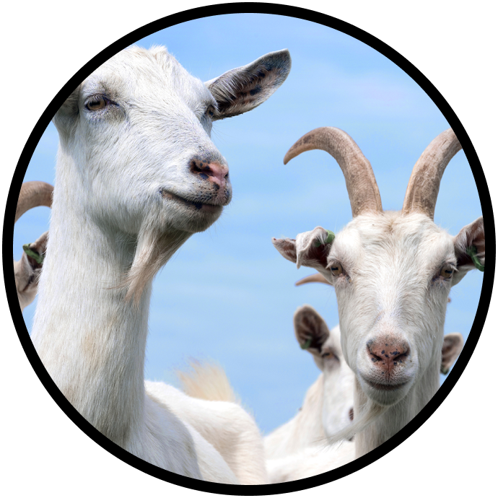

Narrative Writing | 2nd Grade
Unit 1: Goat Escape
Students write a personal narrative about witnessing a breaking-news report about goats taking over a neighborhood. They use a story plan and create a draft using details and feelings. Lastly, they edit their writing and share it with their classmates.
Pre-
Assessment
Lesson 1
Lesson 2
Lesson 3
Pre-Assessment
Something New
30 mins
Planning & Drafting the Beginning
Breaking News!
35 minutes
Planning & Drafting the Middle
Goat Takeover
35 minutes
Planning & Drafting the End
Goodbye, Goats
35 minutes
Post-
Assessment
Post-Assessment
Waiting Isn’t Easy
30 minutes
Standards
W.2.3 | Write narratives in which they recount a well-elaborated event or short sequence of events, include details to describe actions, thoughts, and feelings, use temporal words to signal event order, and provide a sense of closure.
W.2.5 | With guidance and support from adults and peers, focus on a topic and strengthen writing as needed by revising and editing.
SL.2.4 | Tell a story or recount an experience with appropriate facts and relevant, descriptive details, speaking clearly at an understandable pace.
‹#›
Back to Table of Contents

Slide 20


Narrative Writing | 2nd Grade
Unit 2: Campsite Bandit
Students write a fictional story as a character who takes marshmallows from a crowded campsite. They use a story plan and draft the story using descriptions, character feelings, and character actions. Lastly, they edit their draft and share with their classmates.
Pre-
Assessment
Lesson 1
Lesson 2
Lesson 3
Pre-Assessment
The Garage Sale Bandit
30 mins
Planning
The Marshmallow Mystery
40 minutes
Drafting the Beginning
Be the Bandit
40 minutes
Drafting the Middle
The Bandit Strikes!
50 minutes
Lesson 4
Lesson 5
Post-
Assessment
Drafting the Ending
The Sweet Escape
40 minutes
Editing
Classroom Campfire
45 minutes
Post-Assessment
The Beach Bandit
30 minutes
Standards
W.2.3 | Write narratives in which they recount a well-elaborated event or short sequence of events, include details to describe actions, thoughts, and feelings, use temporal words to signal event order, and provide a sense of closure.
W.2.5 | With guidance and support from adults and peers, focus on a topic and strengthen writing as needed by revising and editing.
W.2.6 | With guidance and support from adults, use a variety of digital tools to produce and publish writing, including in collaboration with peers.
‹#›
Back to Table of Contents

Slide 21


Opinion Writing | 2nd Grade
Unit 1: Pizza Quest
Students write opinion sentences in the form of a message to a team of video-game designers. They write sentences with an opinion, a reason, and a connecting word. Then, students share their message with the class.
Pre-
Assessment
Lesson 1
Lesson 2
Lesson 3
Pre-Assessment
Travel Through Moab
30 mins
Drafting & Revising
Mount Mozzarella
45 minutes
Drafting & Revising
Marinara Bay
35 minutes
Write a Conclusion
Deep Dish Glacier
35 minutes
Lesson 4
Post-
Assessment
Write an Introduction
To the Game Designers
45 minutes
Post-Assessment
Explore La Fortuna
30 minutes
Standards
W.2.1 | Write opinion pieces in which they introduce the topic or book they are writing about, state an opinion, supply reasons that support the opinion, use linking words (e.g., because, and, also) to connect opinion and reasons, and provide a concluding statement or section.
W.2.5 | With guidance and support from adults and peers, focus on a topic and strengthen writing as needed by revising and editing.
L.2.1 | Demonstrate command of the conventions of standard English grammar and usage when writing or speaking.
L.2.2 | Demonstrate command of the conventions of standard English capitalization, punctuation, and spelling when writing.
‹#›
Back to Table of Contents

Slide 22


Informative Writing | 2nd Grade
Unit 1: Project Treehouse
Students write an informative paragraph and create a design plan for a treehouse. After gathering information and taking notes on a diagram, they write a body paragraph. Then, they add an intro and conclusion, revise their writing, and edit to complete a final draft.
Pre-
Assessment
Lesson 1
Lesson 2
Lesson 3
Pre-Assessment
Fish Tank Designer
30 mins
Gathering Information
Welcome to Project Treehouse!
35 minutes
Planning
Meet the Clients
35 minutes
Drafting & Editing
Build It with Words
35 minutes
Lesson 4
Post-
Assessment
Drafting & Editing
The Treehouse Reveal
25 minutes
Post-Assessment
Playground Designer
40 minutes
Standards
W.2.2 | Write informative/explanatory texts in which they introduce a topic, use facts and definitions to develop points, and provide a concluding statement or section.
W.2.5 | With guidance and support from adults and peers, focus on a topic and strengthen writing as needed by revising and editing.
L.2.1 | Demonstrate command of the conventions of standard English grammar and usage when writing or speaking.
L.2.2 | Demonstrate command of the conventions of standard English capitalization, punctuation, and spelling when writing.
‹#›
Back to Table of Contents

Slide 23


Informative Writing | 2nd Grade
Unit 2: Amani’s Animal Rescue
Students write an informative paragraph about an animal. After gathering information and taking notes from two sources, they write a draft that includes an introduction and conclusion. Lastly, they revise and edit their writing to create a final draft.
Pre-
Assessment
Lesson 1
Lesson 2
Lesson 3
Pre-Assessment
Spider Monkeys
30 mins
Gathering Information
Amani’s Animal Rescue Needs You!
30 minutes
Begin Drafting
Be the Animal Expert
35 minutes
Beginnings & Endings
Introduce Your Arrival
35 minutes
Lesson 4
Lesson 5
Post-
Assessment
Revision
Wow Your Reader
40 minutes
Editing
Fix It Up!
40 minutes
Post-Assessment
Mossy Frogs
30 minutes
Standards
W.2.2 | Write informative/explanatory texts in which they introduce a topic, use facts and definitions to develop points, and provide a concluding statement or section.
W.2.5 | With guidance and support from adults and peers, focus on a topic and strengthen writing as needed by revising and editing.
W.2.7 | Participate in shared research and writing projects (e.g., read a number of books on a single topic to produce a report; record science observations).
W.2.8 | Recall information from experiences or gather information from provided sources to answer a question.
‹#›
Back to Table of Contents

Slide 24
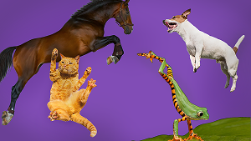
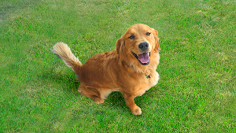
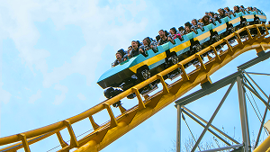

Essential Skill Lessons | 2nd-3rd Grade
Skill | Lesson | Grades | Related Genres | Standards
Adding Details | It Jumped (30 mins) Practice Lessons: It Leaped (15 mins) It Climbed (15 mins) It Fell (15 mins) | 2-3 | Narrative Opinion Informative | L.2.1.e | Use adjectives and adverbs, and choose between them depending on what is to be modified.
 |  |  |  | L.3.1.a | Explain the function of nouns, pronouns, verbs, adjectives, and adverbs in general and their functions in particular sentences.
 |  |  |  | L.3.1.l | Produce simple, compound, and complex sentences.
 |  |  |  | W.2.3 | Write narratives in which they recount a well-elaborated event or short sequence of events, include details to describe actions, thoughts, and feelings, use temporal words to signal event order, and provide a sense of closure.
Connecting Words | Pet Contest (30 mins) Practice Lessons: Because (15 mins) But (15 mins) So (15 mins) | 2-3 | Narrative Opinion Informative | W.2.1 | Write opinion pieces that introduce the topic or book they are writing about, state an opinion, supply reasons that support the opinion, use linking words (e.g., because, and, also) to connect opinion and reasons, and provide a concluding statement or section.
 |  |  |  | W.3.1.c | Use linking words and phrases (e.g., because, therefore, since, for example) to connect opinion and reasons.
Elaborating with Feelings | Roller Coaster Ride (30 mins) Practice Lessons: Kayak (15 mins) BMX (15 mins) Zip Line (15 mins) | 2-3 | Narrative | L.3.1.a | Explain the function of nouns, pronouns, verbs, adjectives, and adverbs in general and their functions in particular sentences.
 |  |  |  | W.2.3 | Write narratives in which they recount a well-elaborated event or short sequence of events, include details to describe actions, thoughts, and feelings, use temporal words to signal event order, and provide a sense of closure.
 |  |  |  | W.3.3 | Write narratives to develop real or imagined experiences or events using effective technique, descriptive details, and clear event sequences.
“How” Adverbs | The Dog Walker (30 mins) Practice Lessons: Dog Obstacle Course (15 mins) Roller Dancing (15 mins) Robot Gymnastics (15 mins) | 2-3 | Narrative Opinion Informative | L.2.1 | Demonstrate command of the conventions of standard English grammar and usage when writing or speaking.
 |  |  |  | L.2.1.e | Write narratives in which they recount a well-elaborated event or short sequence of events, include details to describe actions, thoughts, and feelings, use temporal words to signal event order, and provide a sense of closure.
 |  |  |  | L.2.1.f | Use adjectives and adverbs, and choose between them depending on what is to be modified.
 |  |  |  | L.3.1 | Demonstrate command of the conventions of standard English grammar and usage when writing or speaking.
 |  |  |  | L.3.1.a | Explain the function of nouns, pronouns, verbs, adjectives, and adverbs in general and their functions in particular sentences.
 |  |  |  | L.3.3.b | Recognize and observe differences between the conventions of spoken and written standard English.
‹#›
Back to Table of Contents

Slide 25
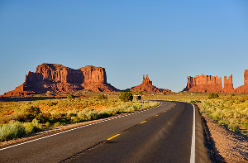
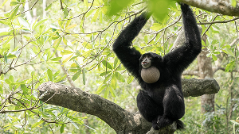
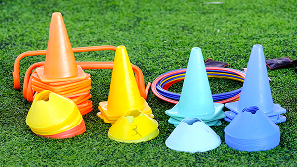
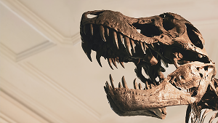
Essential Skill Lessons | 2nd-3rd Grade
Skill | Lesson | Grades | Related Genres | Standards
Hyperbole | Best Trip Ever! (30 mins) Practice Lessons: Ski Trip (15 mins) State Fair (15 mins) Water Park (15 mins) | 2-3 | Narrative | L.2.5 | Demonstrate understanding of word relationships and nuances in word meanings.
 |  |  |  | L.3.3.a | Choose words and phrases for effect.
 |  |  |  | L.3.5 | Demonstrate understanding of word relationships and nuances in word meanings.
 |  |  |  | L.3.5.a | Distinguish the literal and nonliteral meanings of words and phrases in context (e.g., take steps).
 |  |  |  | RL.3.4 | Determine the meaning of words and phrases as they are used in a text, distinguishing literal from nonliteral language.
Onomatopoeia | Jungle Sounds (30 mins) Practice Lessons: Pinball Game (15 mins) Steam Train (15 mins) Floating Dog (15 mins) | 2-3 | Narrative | L.3.3.a | Choose words and phrases for effect.
 |  |  |  | L.3.5 | Demonstrate understanding of word relationships and nuances in word meanings.
 |  |  |  | L.3.5.a | Distinguish the literal and nonliteral meanings of words and phrases in context (e.g., take steps).
 |  |  |  | RL.3.4 | Determine the meaning of words and phrases as they are used in a text, distinguishing literal from nonliteral language.
Sorting Information | Field Day Games (30 mins) Practice Lessons: Making Pancakes (15 mins) Making Spaghetti (15 mins) Making S’mores (15 mins) | 2-3 | Opinion Informative | W.2.2 | Write informative/explanatory texts in which they introduce a topic, use facts and definitions to develop points, and provide a concluding statement or section.
 |  |  |  | W.3.2 | Write informative/explanatory texts to examine a topic and convey ideas and information clearly.
Topic Sentences | People and Their Jobs (30 mins) Practice Lessons: Elevator Mechanic (15 mins) Pastry Chef (15 mins) Flight Attendant (15 mins) | 2-3 | Opinion Informative | W.2.2 | Write informative/explanatory texts in which they introduce a topic, use facts and definitions to develop points, and provide a concluding statement or section.
 |  |  |  | W.3.2.a | Introduce a topic and group related information together; include illustrations when useful to aiding comprehension.
 |  |  |  | W.4.2.a | Introduce a topic clearly and group related information in paragraphs and sections; include formatting (e.g., headings), illustrations, and multimedia when useful to aiding comprehension.
 |  |  |  | W.5.2.a | Introduce a topic clearly, provide a general observation and focus, and group related information logically; include formatting (e.g., headings), illustrations, and multimedia when useful to aiding comprehension.
‹#›
Back to Table of Contents

Slide 26
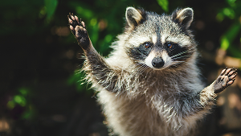

Essential Skill Lessons | 2nd-3rd Grade
Skill | Lesson | Grades | Related Genres | Standards
Using “And” | Racoon Day Poster (30 mins) Practice Lessons: Candy Store (15 mins) Water Playground (15 mins) House (15 mins) | 2-3 | Narrative Opinion Informative | L.2.1.f | Produce, expand, and rearrange complete simple and compound sentences (e.g., The boy watched the movie; The little boy watched the movie; The action movie was watched by the little boy).
 |  |  |  | L.3.1.l | Produce simple, compound, and complex sentences.
“When” Adverbs | The World’s Fair (30 mins) Practice Lessons: Baking Cookies (15 mins) Swim-Bike-Run (15 mins) Snow Day Fun! (15 mins) | 2-3 | Narrative Opinion Informative | L.2.1 | Demonstrate command of the conventions of standard English grammar and usage when writing or speaking.
 |  |  |  | L.2.6 | Use words and phrases acquired through conversations, reading and being read to, and responding to texts, including using adjectives and adverbs to describe (e.g., When other kids are happy, that makes me happy).
 |  |  |  | L.3.1 | Demonstrate command of the conventions of standard English grammar and usage when writing or speaking.
 |  |  |  | L.3.6 | Acquire and use accurately grade-appropriate conversational, general academic, and domain-specific words and phrases, including those that signal spatial and temporal relationships (e.g., After dinner that night we went looking for them).
 |  |  |  | RI.3.3 | Describe the relationship between a series of historical events, scientific ideas or concepts, or steps in technical procedures in a text, using language that pertains to time, sequence, and cause/effect.
 |  |  |  | W.2.3 | Write narratives in which they recount a well-elaborated event or short sequence of events, include details to describe actions, thoughts, and feelings, use temporal words to signal event order, and provide a sense of closure.
 |  |  |  | W.3.3 | Write narratives to develop real or imagined experiences or events using effective technique, descriptive details, and clear event sequences.
 |  |  |  | W.3.3.c | Use temporal words and phrases to signal event order.
‹#›
Back to Table of Contents

Slide 27
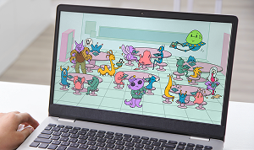
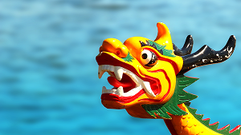
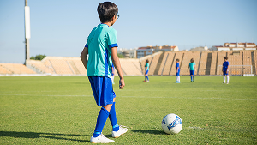

Essential Skill Lessons | 4th-5th Grade
Skill | Lesson | Grades | Related Genres | Standards
Character Traits | Alex the Alien (30 mins) Practice Lessons: Darla (15 mins) Pablo (15 mins) William (15 mins) | 4-5 | Narrative | W.4.3.b | Use dialogue and description to develop experiences and events or show the responses of characters to situations.
 |  |  |  | W.5.3.b | Use narrative techniques, such as dialogue, description, and pacing to develop experiences and events or show the responses of characters to situations.
 |  |  |  | RL.4.3 | Describe in depth a character, setting, or event in a story or drama, drawing on specific details in the text (e.g., a character’s thoughts, words, or actions).
 |  |  |  | RL.5.2 | Determine a theme of a story, drama, or poem from details in the text, including how characters in a story or drama respond to challenges.
Complex Sentences | Dragon Boat Race (30 mins) Practice Lessons: Games (15 mins) Art Activity (15 mins) Summer Activity (15 mins) | 4-5 | Narrative Opinion Informative | L.4.1 | Demonstrate command of the conventions of standard English grammar and usage when writing or speaking.
 |  |  |  | L.4.1.f | Produce complete sentences, recognizing and correcting inappropriate fragments and run-ons.
 |  |  |  | L.5.1 | Demonstrate command of the conventions of standard English grammar and usage when writing or speaking.
 |  |  |  | L.5.3.a | Expand, combine, and reduce sentences for meaning, reader/listener interest, and style.
Direct Quotations | Quote the Coach (30 mins) Practice Lessons: Astronaut (15 mins) Robots (15 mins) Marine Biologist (15 mins) | 4-5 | Opinion Informative | W.4.2.b | Develop the topic with facts, definitions, concrete details, quotations, or other information and examples related to the topic.
 |  |  |  | W.5.2.b | Develop the topic with facts, definitions, concrete details, quotations, or other information and examples related to the topic.
Domain- Specific Vocabulary | Kite Fest (30 mins) Practice Lessons: Tent Building (15 mins) Rock Climbing (15 mins) Scuba Diving (15 mins) | 4-5 | Opinion Informative | W.4.2.d | Use precise language and domain-specific vocabulary to inform about or explain the topic.
 |  |  |  | W.5.2.d | Use precise language and domain-specific vocabulary to inform about or explain the topic.
‹#›
Back to Table of Contents

Slide 28


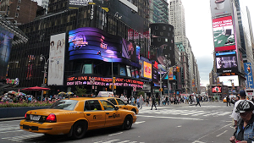
Essential Skill Lessons | 4th-5th Grade
Skill | Lesson | Grades | Related Genres | Standards
Expanding Sentences | Expand the Caption (30 mins) Practice Lessons: At the Park (15 mins) After the Rain (15 mins) At the Library (15 mins) | 4-5 | Narrative Opinion Informative | L.4.1 | Demonstrate command of the conventions of standard English grammar and usage when writing or speaking.
 |  |  |  | L.4.3a | Choose words and phrases to convey ideas precisely.
 |  |  |  | L.4.1.f | Produce complete sentences, recognizing and correcting inappropriate fragments and run-ons.
 |  |  |  | L.5.1 | Demonstrate command of the conventions of standard English grammar and usage when writing or speaking.
Paragraph Structure | Tardigrades in Space (30 mins) Practice Lessons: Underwater Stalactites (15 mins) The Iris (15 mins) The Bridge (15 mins) | 4-5 | Opinion Informative | W.4.2 | Write informative/explanatory texts to examine a topic and convey ideas and information clearly.
 |  |  |  | W.4.2.a | Introduce a topic clearly and group related information in paragraphs and sections; include formatting (e.g., headings), illustrations, and multimedia when useful to aid comprehension.
 |  |  |  | W.5.2 | Write informative/explanatory texts to examine a topic and convey ideas and information clearly.
 |  |  |  | W.5.2.a | Introduce a topic clearly, provide a general observation and focus, and group related information logically; include formatting (e.g., headings), illustrations, and multimedia when useful to aid comprehension.
Personification | A Weekend in the City (30 mins) Practice Lessons: Amusement Park (15 mins) Fountain (15 mins) Car Wash (15 mins) | 4-5 | Narrative Opinion Informative | L.4.5 | Demonstrate understanding of figurative language, word relationships, and nuances in word meanings.
 |  |  |  | L.5.5 | Demonstrate understanding of figurative language, word relationships, and nuances in word meanings.
‹#›
Back to Table of Contents

Slide 29
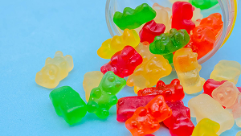


Essential Skill Lessons | 4th-5th Grade
Skill | Lesson | Grades | Related Genres | Standards
Prompt Analysis | Candy Factory (30 mins) Practice Lessons: Donut Factory (15 mins) Splash Park (15 mins) Reptile Petting Zoo (15 mins) | 4-5 | Narrative Opinion Informative | RI.4.1 | Refer to details and examples in a text when explaining what the text says explicitly and when drawing inferences from the text.
 |  |  |  | RI.5.1 | Quote accurately from a text when explaining what the text says explicitly and when drawing inferences from the text
 |  |  |  | W.4.4 | Produce clear and coherent writing in which the development and organization are appropriate to task, purpose, and audience.
 |  |  |  | W.5.4 | Produce clear and coherent writing in which the development and organization are appropriate to task, purpose, and audience.
Revising Words | Curious Collections (30 mins) Practice Lessons: Landscape Art (15 mins) Tiny Worlds (15 mins) Pet Portraits (15 mins) | 4-5 | Narrative Opinion Informative | L.4.3.a | Choose words and phrases to convey ideas precisely.
 |  |  |  | W.4.5 | With guidance and support from peers and adults, develop and strengthen writing as needed by planning, revising, and editing.
 |  |  |  | W.5.5 | With guidance and support from peers and adults, develop and strengthen writing as needed by planning, revising, editing, rewriting, or trying a new approach.
Similes | Sea Monster (30 mins) Practice Lessons: Hammerhead Shark (15 mins) Walrus (15 mins) Blowfish (15 mins) | 4-5 | Narrative Opinion Informative | L.4.5 | Demonstrate understanding of figurative language, word relationships, and nuances in word meanings.
 |  |  |  | L.4.5.a | Explain the meaning of simple similes and metaphors (e.g., as pretty as a picture) in context.
 |  |  |  | L.5.5 | Demonstrate understanding of figurative language, word relationships, and nuances in word meanings.
 |  |  |  | L.5.5.a | Interpret figurative language, including similes and metaphors, in context.
‹#›
Back to Table of Contents

Slide 30



Genre Intro Lessons | 2nd-5th Grade
Skill | Lesson | Grades | Related Genres | Standards
Intro to Narrative | Parts of a Story (30 mins) Practice Lessons: Ice Cream (15 mins) Football (15 mins) Lost Dog (15 mins) | 2-5 | Narrative | W.3.3 | Write narratives to develop real or imagined experiences or events using effective technique, descriptive details, and clear event sequences.
 |  |  |  | W.4.3 | Write narratives to develop real or imagined experiences or events using effective technique, descriptive details, and clear event sequences.
 |  |  |  | W.5.3 | Write narratives to develop real or imagined experiences or events using effective technique, descriptive details, and clear event sequences.
Intro to Opinion | This or That (30 mins) Practice Lessons: Recess (15 mins) Field Trip (15 mins) New Pet (15 mins) | 2-5 | Opinion | W.2.1 | Write opinion pieces in which they introduce the topic or book they are writing about, state an opinion, supply reasons that support the opinion, use linking words (e.g., because, and, also) to connect opinion and reasons, and provide a concluding statement or section.
 |  |  |  | W.3.1 | Write opinion pieces on topics or texts, supporting a point of view with reasons.
 |  |  |  | W.4.1 | Write opinion pieces on topics or texts, supporting a point of view with reasons and information.
 |  |  |  | W.5.1 | Write opinion pieces on topics or texts, supporting a point of view with reasons and information.
Intro to Informative | Animal Clues (30 mins) Practice Lessons: Vehicles (15 mins) Sports (15 mins) Places (15 mins) | 2-5 | Informative | W.2.2 | Write informative/explanatory texts in which they introduce a topic, use facts and definitions to develop points, and provide a concluding statement or section.
 |  |  |  | W.3.2 | Write informative/explanatory texts to examine a topic and convey ideas and information clearly.
 |  |  |  | W.4.2 | Write informative/explanatory texts to examine a topic and convey ideas and information clearly.
 |  |  |  | W.5.2 | Write informative/explanatory texts to examine a topic and convey ideas and information clearly.
‹#›
Back to Table of Contents

Slide 31



Writing Community Lessons | 2nd-5th Grade
Skill | Lesson | Grades | Related Genres | Standards
Setting Writing Goals | My Writing Journey (30 mins) Practice Lessons: Goal Check-in #1 (15 mins) Goal Check-in #2 (15 mins) Goal Check-in #3 (15 mins) | 2-5 | Narrative Opinion Informative | W.3.10 | Write routinely over extended time frames (time for research, reflection, and revision) and shorter time frames (a single sitting or a day or two) for a range of discipline-specific tasks, purposes, and audiences.
 |  |  |  | W.4.10 | Write routinely over extended time frames (time for research, reflection, and revision) and shorter time frames (a single sitting or a day or two) for a range of discipline-specific tasks, purposes, and audiences.
 |  |  |  | W.5.10 | Write routinely over extended time frames (time for research, reflection, and revision) and shorter time frames (a single sitting or a day or two) for a range of discipline-specific tasks, purposes, and audiences.
Partnering | Balloon Crew (30 mins) Practice Lessons: Billboard Crew (15 mins) Building Crew (15 mins) Garden Club (15 mins) | 2-3 | Narrative Opinion Informative | SL.2.1 | Participate in collaborative conversations with diverse partners about grade 2 topics and texts with peers and adults in small and larger groups.
 |  |  |  | SL.3.1 | Engage effectively in a range of collaborative discussions (one-on-one, in groups, and teacher-led) with diverse partners on grade 3 topics and texts, building on others’ ideas and expressing their own clearly.
Peer Feedback | Skateboard Story (30 mins) Practice Lessons: The Painter (15 mins) Maybe Tomorrow (15 mins) Above the Clouds (15 mins) | 4-5 | Narrative Opinion Informative | SL.4.1 | Engage effectively in a range of collaborative discussions (one-on-one, in groups, and teacher-led) with diverse partners on grade 4 topics and texts, building on others’ ideas and expressing their own clearly.
 |  |  |  | SL.5.1 | Engage effectively in a range of collaborative discussions (one-on-one, in groups, and teacher-led) with diverse partners on grade 5 topics and texts, building on others’ ideas and expressing their own clearly.
 |  |  |  | W.4.5 | With guidance and support from peers and adults, develop and strengthen writing as needed by planning, revising, and editing.
 |  |  |  | W.5.5 | With guidance and support from peers and adults, develop and strengthen writing as needed by planning, revising, editing, rewriting, or trying a new approach.
‹#›
Back to Table of Contents

Slide 32




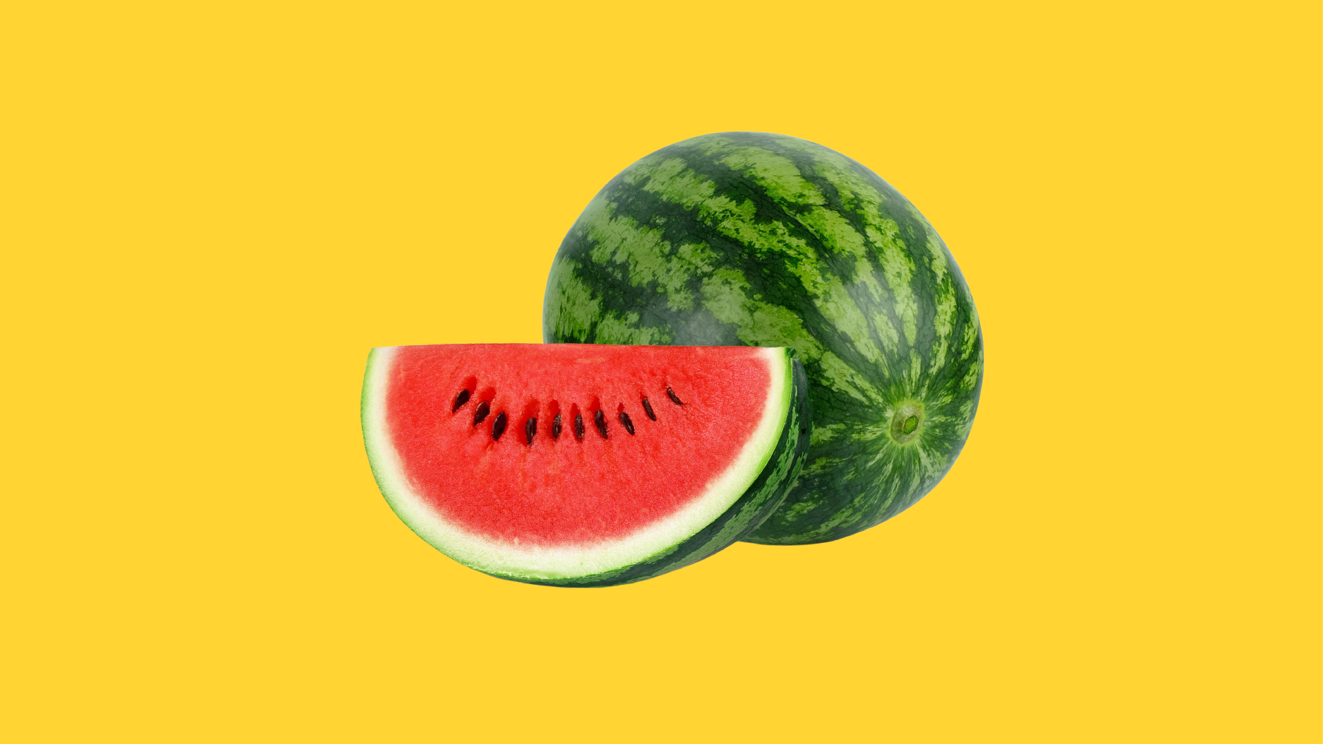
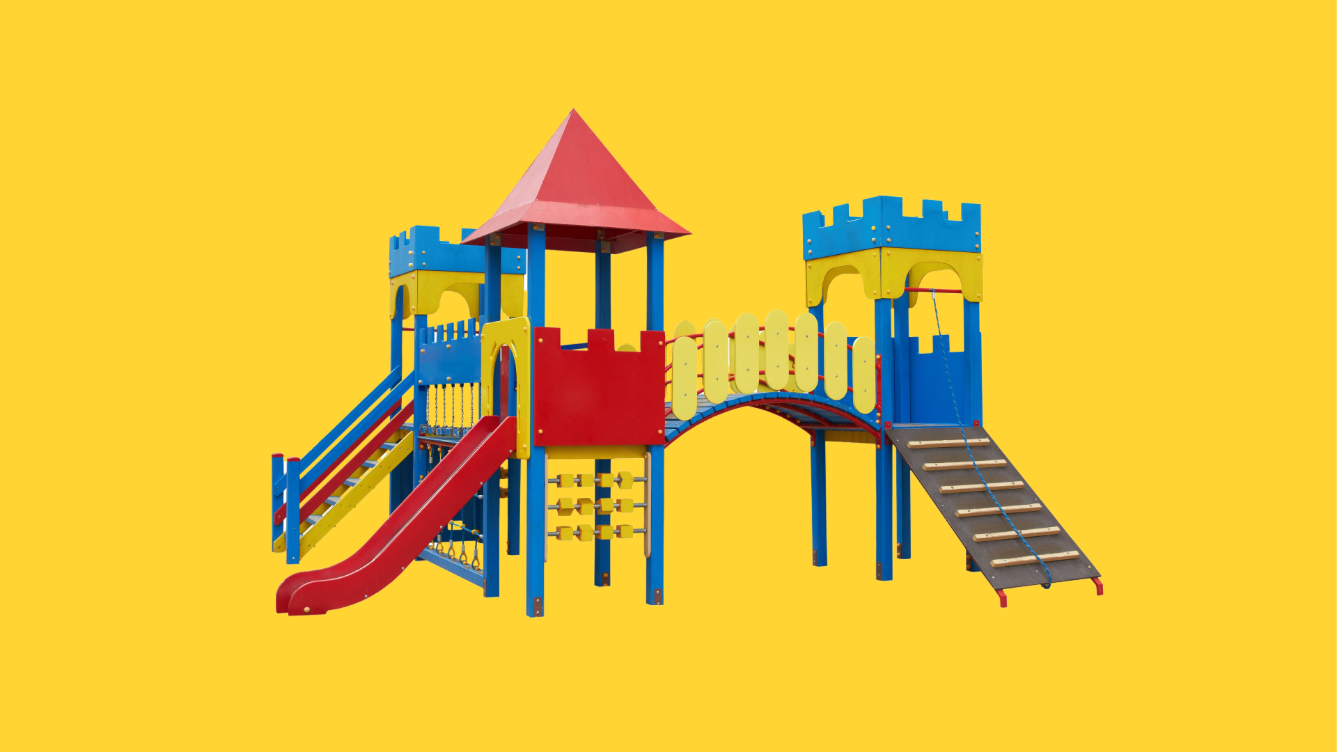
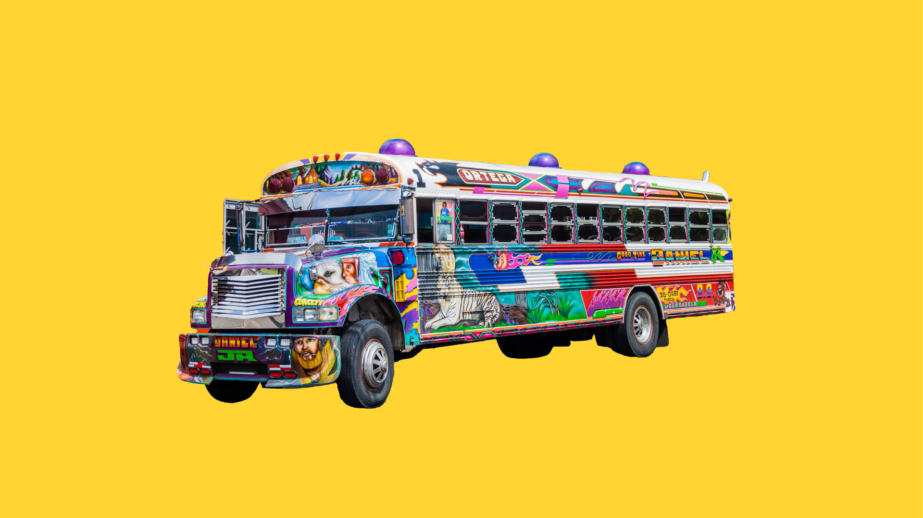

Independent Writing Prompts | 2nd-5th Grade
Independent Writing Prompt | Grades | Related Genres | Focus Area
Pick a Puppy | 2-5 | Narrative Opinion Informative | Description Similarities and Differences
Make a Monster! | 2-5 | Narrative | Description
The Unexpected Guest | 2-5 | Narrative | Sequence
The Backpack Monster | 2-5 | Narrative | Elaboration
Watermelon-ventions | 2-5 | Informative | Problem-Solution
Build Your Own Playground | 2-5 | Opinion | Personal Opinion
Beautiful Busses | 2-5 | Opinion | Persuasive Letter
The City of Ice | 2-5 | Informative | Observation and Description
‹#›
Back to Table of Contents

Slide 33

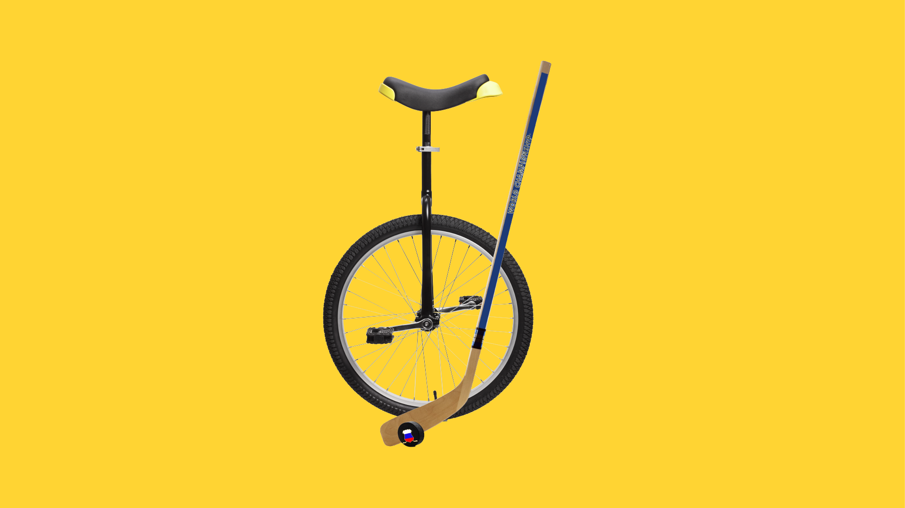


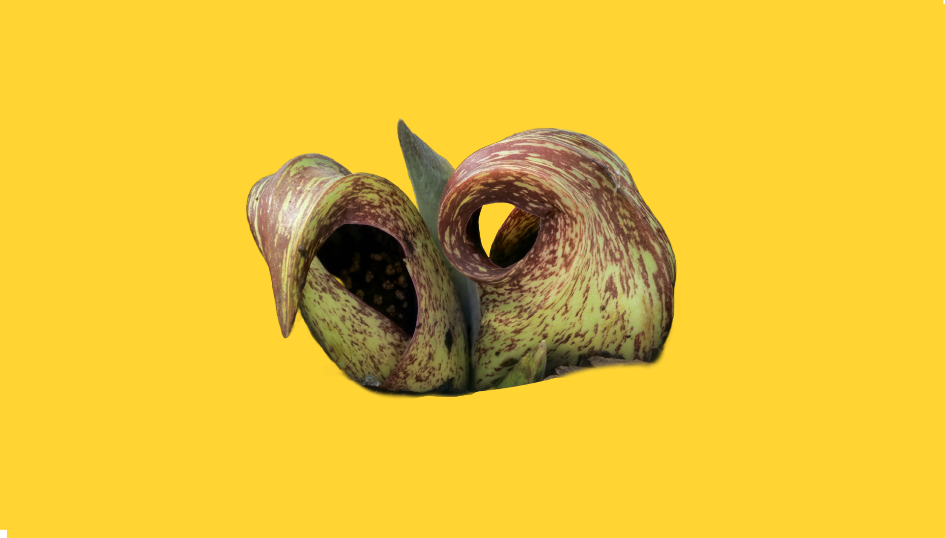



Independent Writing Prompts | 2nd-5th Grade
Independent Writing Prompt | Grades | Related Genres | Focus Area
The Water’s Fine | 2-5 | Opinion | Reasoning
Challenging Combinations | 2-5 | Narrative Opinion Informative | Transition Word “While”
Sensational Smells | 2-5 | Narrative Opinion Informative | Sensory Details
The Great Pumpkin Paddle | 2-5 | Narrative Opinion Informative | Description
Plantimals | 2-5 | Narrative Opinion Informative | Prediction Context Clues
Spring Homonyms | 2-5 | Narrative Opinion Informative | Homonyms
The Oxford Shark | 2-5 | Narrative Opinion Informative | Description Reasons Emotion Words
Gotham City Surprise | 2-5 | Narrative Opinion Informative | Transition Phrases
‹#›
Back to Table of Contents

