Slide 1

HAPPY FAMILY
Presentation Template
www.freepptbackgrounds.net

Slide 2
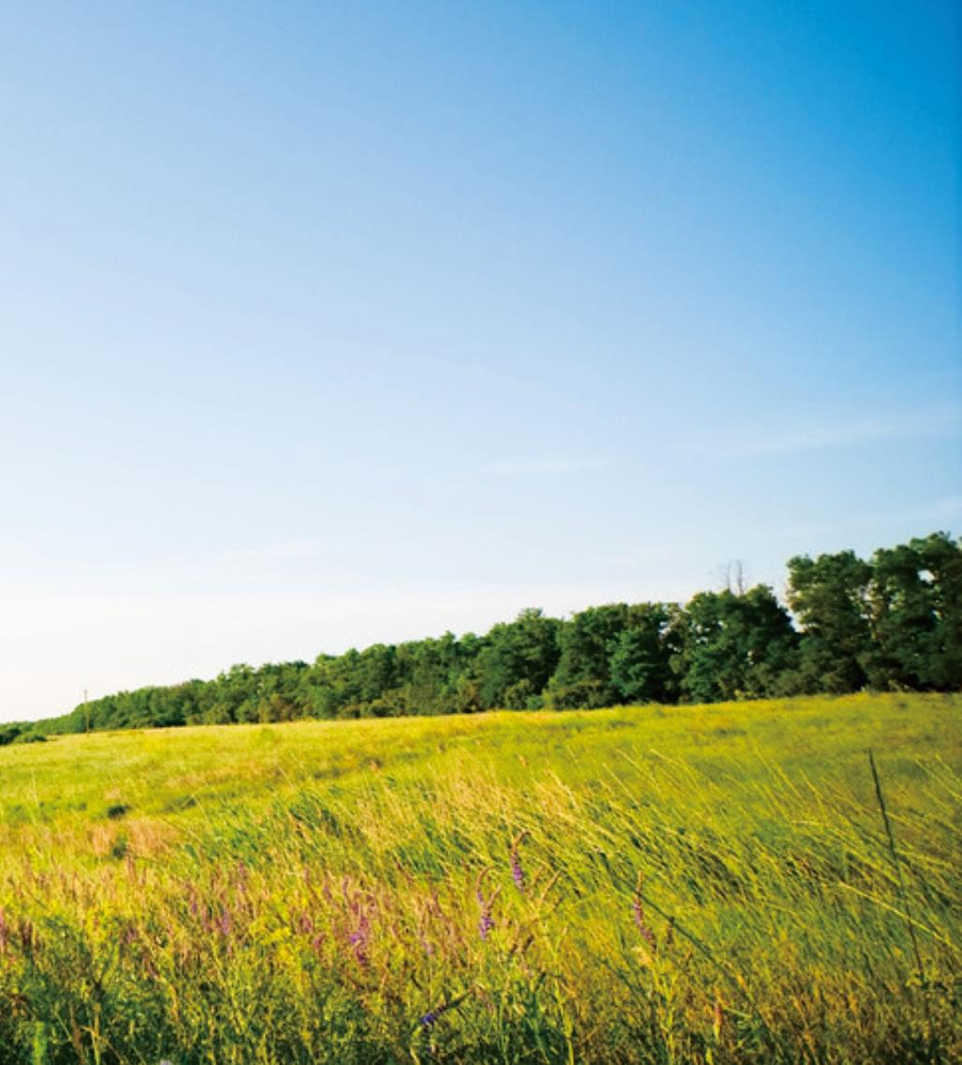
01
Solution
02
Content
03
Direction
04
Visual

Slide 3
01
SOLUTION

Slide 4
Layouts
36%
Impress
28%
Invectors
10%
Editable
Raise
16%
Money
10%

Slide 5

Company
Grow
2020
Business
2015
Models
2009
Base
2005
Business
2001
Enterprise

Slide 6
YEAR3
YEAR4
YEAR2
User
Focused
YEAR4
Strategy
Defined
YEAR1
Customer Acquisition

Slide 7
I hope and I believe that this Template will your Time, Money and Reputation.
Show and explain your web, app or software projects using these gadget templates
I hope and I believe that this Template will your Time, Money and Reputation.
Show and explain your web, app or software projects using these gadget templates
Partnerships
Conferences
Events
Campaign
Get a modern PowerPoint Presentation
Easy to change
colors, photos and Text.
Get a modern PowerPoint Presentation
Easy to change
colors, photos and Text.

Slide 8
You have to be signed in to your Google account.
You have to be signed in to your Google account.
Our
Easy to change colors, photos and Text.
You will get a copy of this document on your
35%
50%
Service
Get a modern PowerPoint Presentation that is beautifully designed.
25%

Slide 9
02
CONTENT

Slide 10
1
2
You have to be signed
in to your Google
account.
Click on the button
under the
presentation
Powerpoint
3
4
Click on the button
under the
presentation
You have to be signed
in to your Google
account.

Slide 11
Add or delete slides. You have to be signed
Remember to download and install the fonts used in
Is the color of gold, butter and ripe lemons.
Add or delete slides. You have to be signed
Remember to download and install the fonts used in

Slide 12
A
Keynote
Is the color of gold, butter and ripe lemons. In the spectrum of visible light, yellow is found between green and orange.
B
Web Design
We use well-known development methodologies to create a customized approach for each of the projects.

Slide 13
Circle
This allows us to achieve
high quality outcomes and full
transparency towards.
Development
We press play on
your digital story.

Slide 14
Simple & Smooth, exactly how
purchasing experiences should be.
Infographic
Think
We create a solid user-product relationship,
one that's long and fruitful.
Circle
Moving from creative ideas to solid
strategy and execution,
we help your target market resonate

Slide 15
03
DIRECTION

Slide 16
Meet our Team
Solutions
The user can demonstrate on a projector or computer, or print the
Web Design
The user can make a presentation on a projector or computer, or print out the

Slide 17
Overview
Infographics
Opening
Introduction
1
2
3
4
5
6
7
Devices
Cerenomy
Speakers

Slide 18
Opening
01
02
Time
Free
75%
Vision
Mission
Values
About us
25%
Values
Mission
Vision
Free
Time

Slide 19
Timeline
The user can make a presentation
Services
The user can demonstrate on a projector or computer
Timeline
Services
Future
Forum
Future
The user can
demonstrate on a
projector or computer
Forum
The user can make a presentation
Pricing
Pricing

Slide 20
Meeting
What we do?
Enter the comprehensive
description of the above
chart here
It is a very sad thing that
nowadays there is so little
useless information.
Suggest
Annual
Enter the comprehensive
description of the above
chart here
It is a very sad thing that
nowadays there is so little
useless information.

Slide 21
04
VISUAL

Slide 22


Skills
Split
Success
It is a very sad thing that
nowadays there is so little
useless information.
We certainly do not
forget you as soon as
you forget us.
It is a very sad thing that
nowadays there is so little
useless information.

Slide 23
Signature
Share
Send
We cannot help ourselves.
We cannot help ourselves.
I believe that people would

Slide 24
2013
2014
2018
2019
2020
The time is now,
the place is here
Genius hath electric
power which earth
I believe that
people would be alive
The time is now,
the place is here
I believe that
people would be alive
Schedule
Lanage
Lower
Occupation
The time is now, the place
is here. Stay in the present.

Slide 25
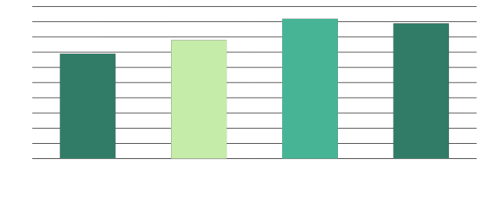
I feel very strongly that change is good
because it stirs up the system. Ann Richards

Slide 26
A large income is the best recipe for happiness I ever heard of. Mansfield Park
A large income is the best recipe for happiness I ever heard of. Mansfield Park A large income is the best recipe for happiness I ever heard of. Mansfield Park
80%
5%
10%
Agenda
Advise
Add
Apply
Bill
Approve
Brand
Authorize
Bill
Brand
Budget
173
258
178
382
01
02
03
04
05
06

Slide 27
THANK
YOU !
Happy Family
Powerpoint Template
www.freepptbackgrounds.net

