Slide 1
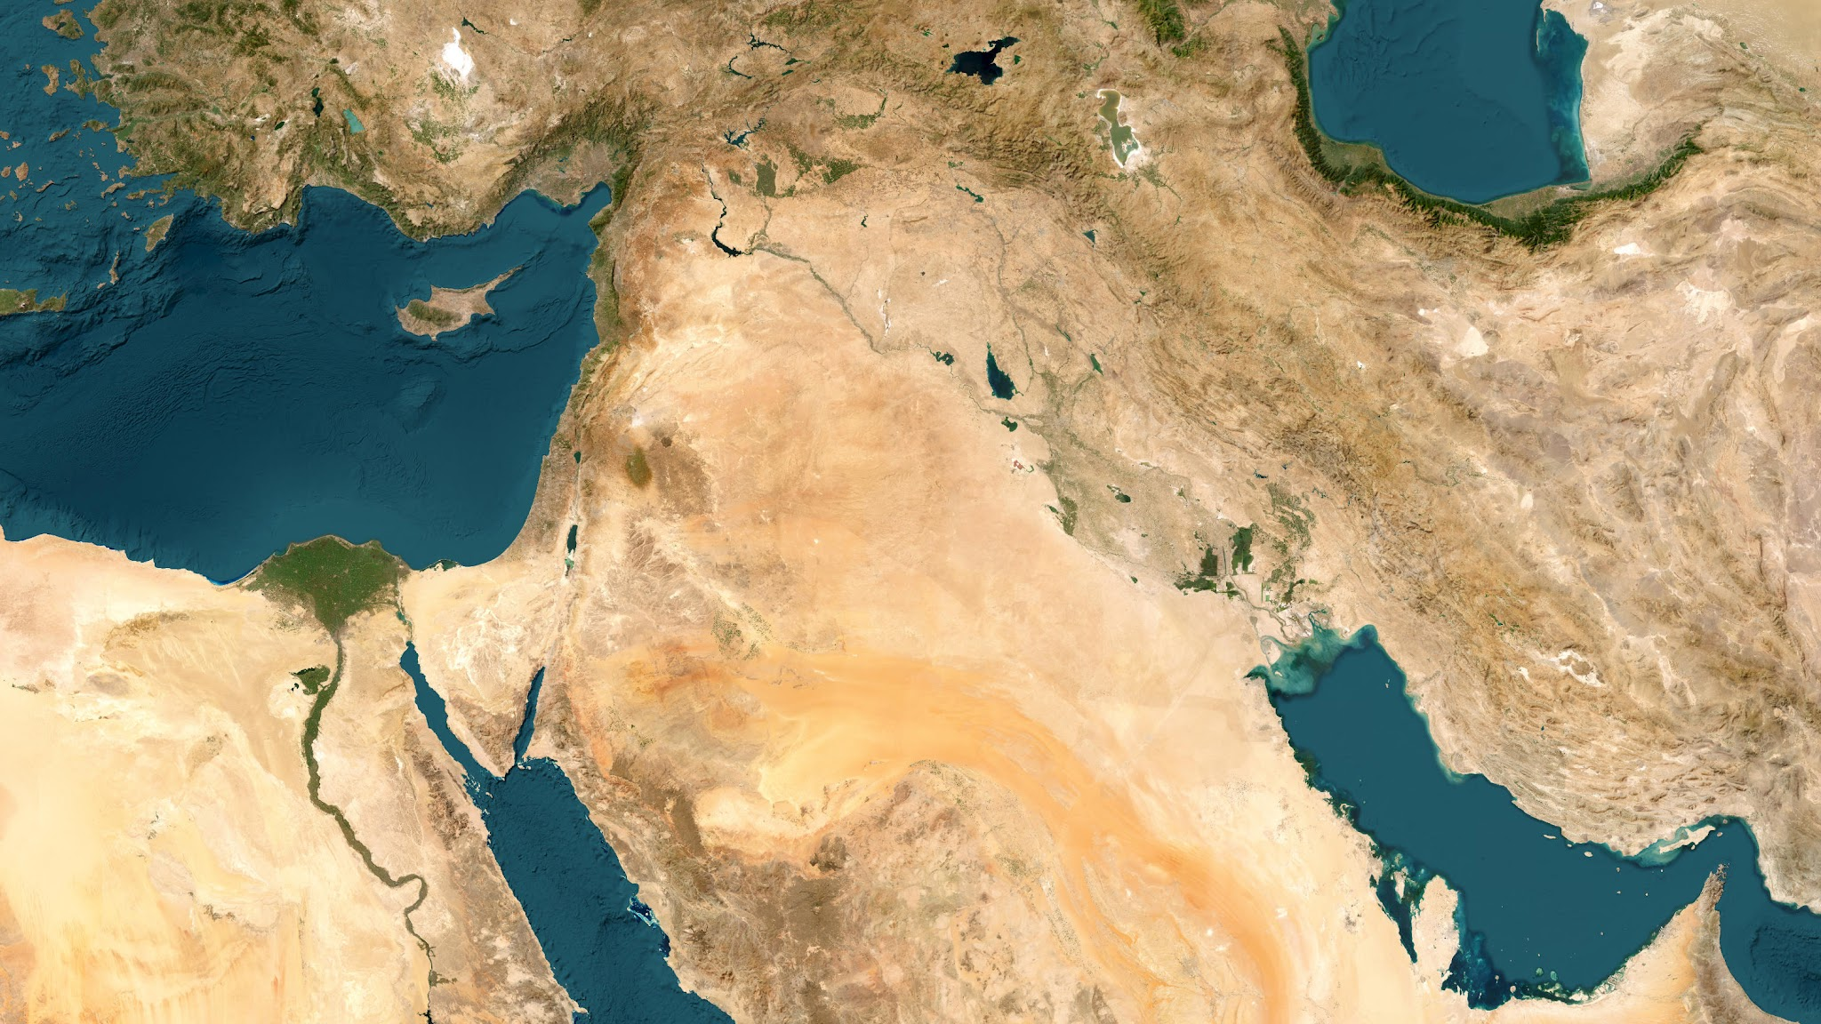

Slide 2
Instructions
On your map, using page 333 of The Essence of the Old Testament as a guide, mark the following locations:
Regions
Urartu
Assyria
Aram
Media
Judah
Arabian Desert
Babylonia
Elam
Egypt
Sinai
Euphrates River
Tigris River
Cities
No-amon (Thebes)
Noph (Memphis)
Jerusalem
Samaria
Tyre
Sidon
Damascus
Riblah
Hamath
Aleppo
Tarsus
Carchemish
Haran
Rezeph
Nineveh
Asshur
Babylon
Ur
Susa
Ecbatana
When you are done, draw an arrow that replicates the red line on the map, tracing the route of the Judeans as they were carried into exile by the Babylonians.

Slide 3
Customize Your Map
Additional Tips
Color Coding and Consistency:
Use consistent colors and styles for different types of features.
Zoom and Positioning:
Ensure your map image is large enough and centrally positioned for easy editing. Zoom in on specific areas if necessary to improve accuracy.
Layering:
Place regions and rivers first as they’re often larger, then add cities and landmarks last for clearer positioning.
Regions, Nations, or Large Bodies of Water
  Labeling: Add a text box over the correct area. For names of regions use a black font. For names of nations use a green font. For names of bodies of water use a white font.
Cities or Landmarks
  Use the Icon or Shape Tool for Markers:
    You can use a circle, square, or other small shape to mark the exact location of a city or landmark.
    Color Code: Choose a distinct color to differentiate cities from other elements.
  Add a Label: Insert a text box next to the marker with the name of the city or landmark in red.
Rivers
  Use the Line Tool: Select the "Line" or "Scribble" tool to draw the path of the river.
  Adjust Line Style:
    Line Color: Choose a blue color to represent water.
    Line Thickness: Increase the line thickness to make the river clearly visible.
    Transparency: Add transparency if needed to match the aesthetic of your map.
  Add a Label: Place a small text box near the line with the river’s name in blue.
Map Image Source: NOAA Data Access Viewer (https://coast.noaa.gov/dataviewer)

