Slide 1
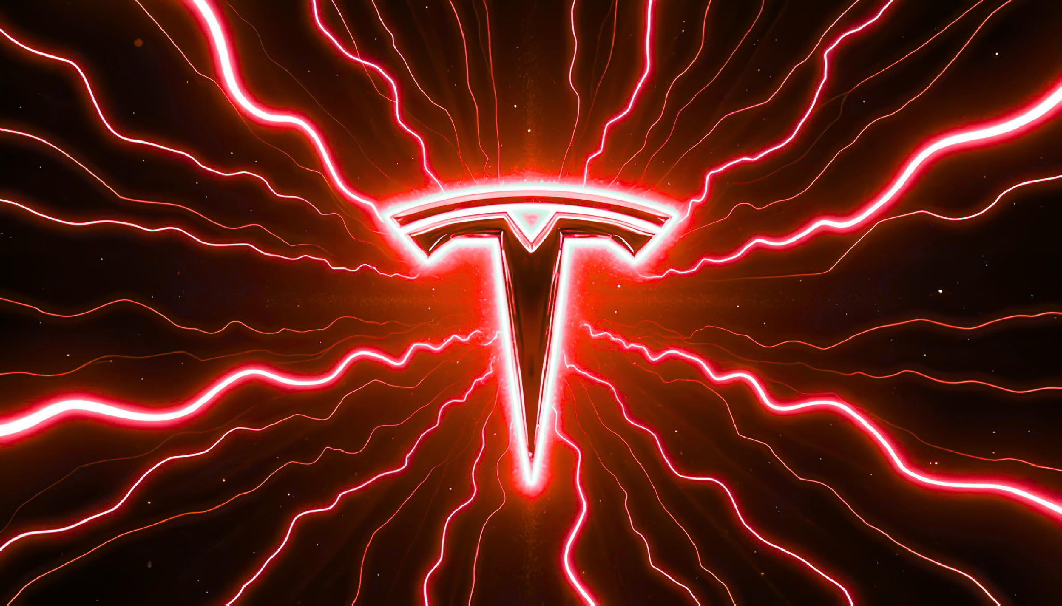
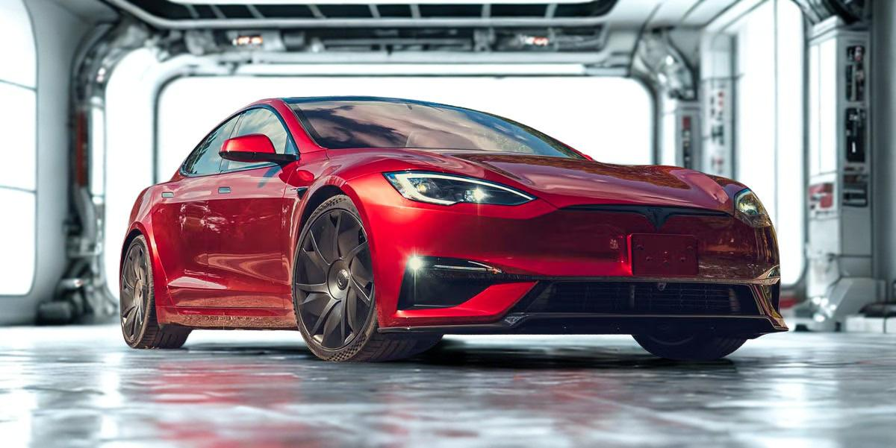

Tesla Inc. Strategic Battle Card
Platform vs Product Strategy

Slide 2

Executive Summary
Tesla should not try to beat BYD at the cheapest EV on earth. It should make the cheapest EV look strategically incomplete.
01
02
03
Regional Games
Pentagon Model
Platform vs Product
Tesla faces four distinct regional games with unique rivals and pricing dynamics
Pentagon Model frames Tesla's strategic focus: where to attack, defend, avoid
Real contest is platform vs product, not car vs car—ecosystem integration wins

Slide 3
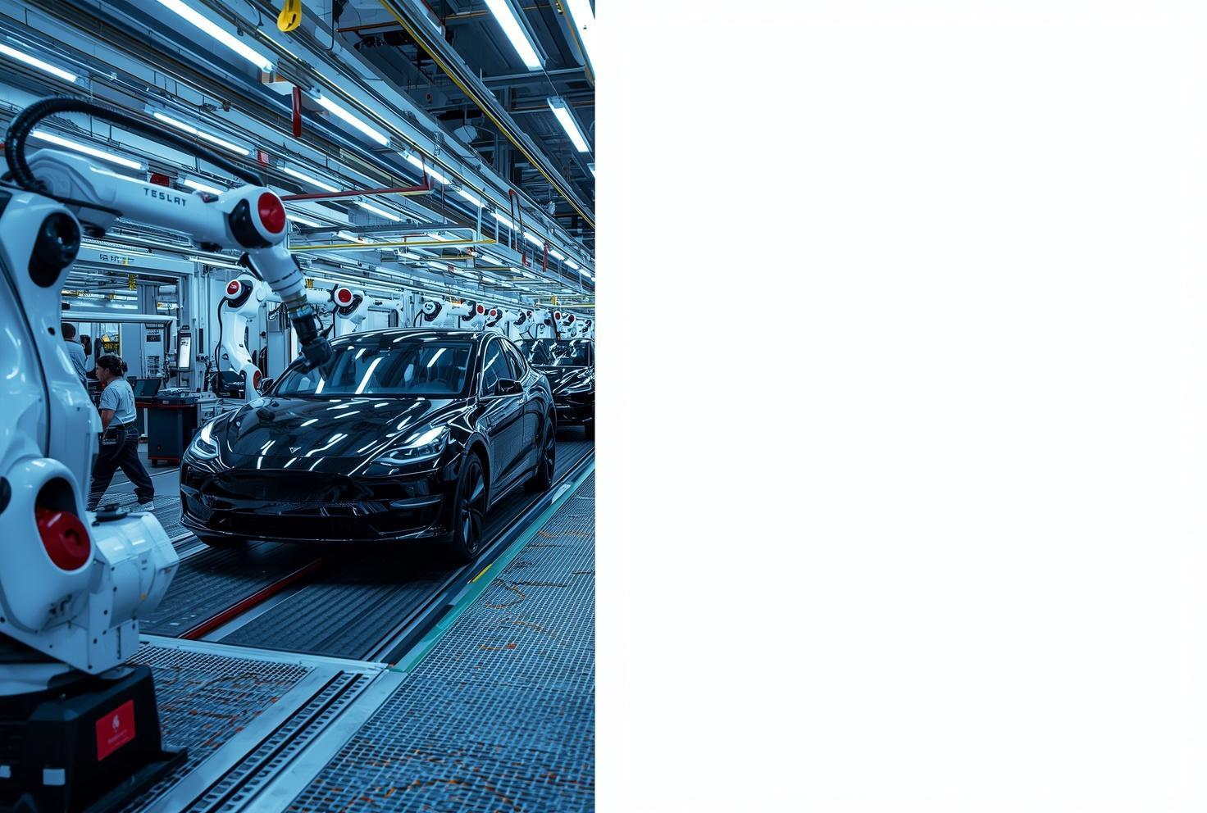
1 in 4
new cars sold worldwide is now electric
Industry Dynamics and Macro Forces
20M+
Global EV Sales in 2025
The market remains highly fragmented with distinct regional battles shaping competitive dynamics and Tesla's strategic positioning.

Slide 4

Three Macro Forces Shaping the Industry
01
02
03
AI and Autonomy
The Eastern Ascent
The Green Reckoning
Tesla's 10B+ real-world miles of FSD data, Waymo's commercial validation, and surging AI grid demands
Chinese dominance with BYD's Blade battery technology and geopolitical supply chain realities
Energy infrastructure as the critical battleground where Tesla's unique platform position shines

Slide 5

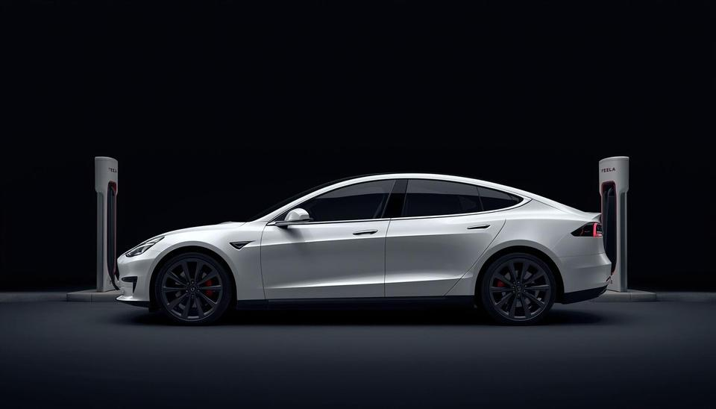
Tesla Beats BYD in Platform and Brand where BYD leads in Cost
Tesla Strengths
Broad platform portfolio spanning vehicles, energy, and AI. Premium global brand with integrated ecosystem including FSD, Supercharger network, and energy products.
BYD Strengths
Cost leadership through vertical integration and Blade battery technology. Dominant scale in China with superior low-cost manufacturing capabilities.

Slide 6
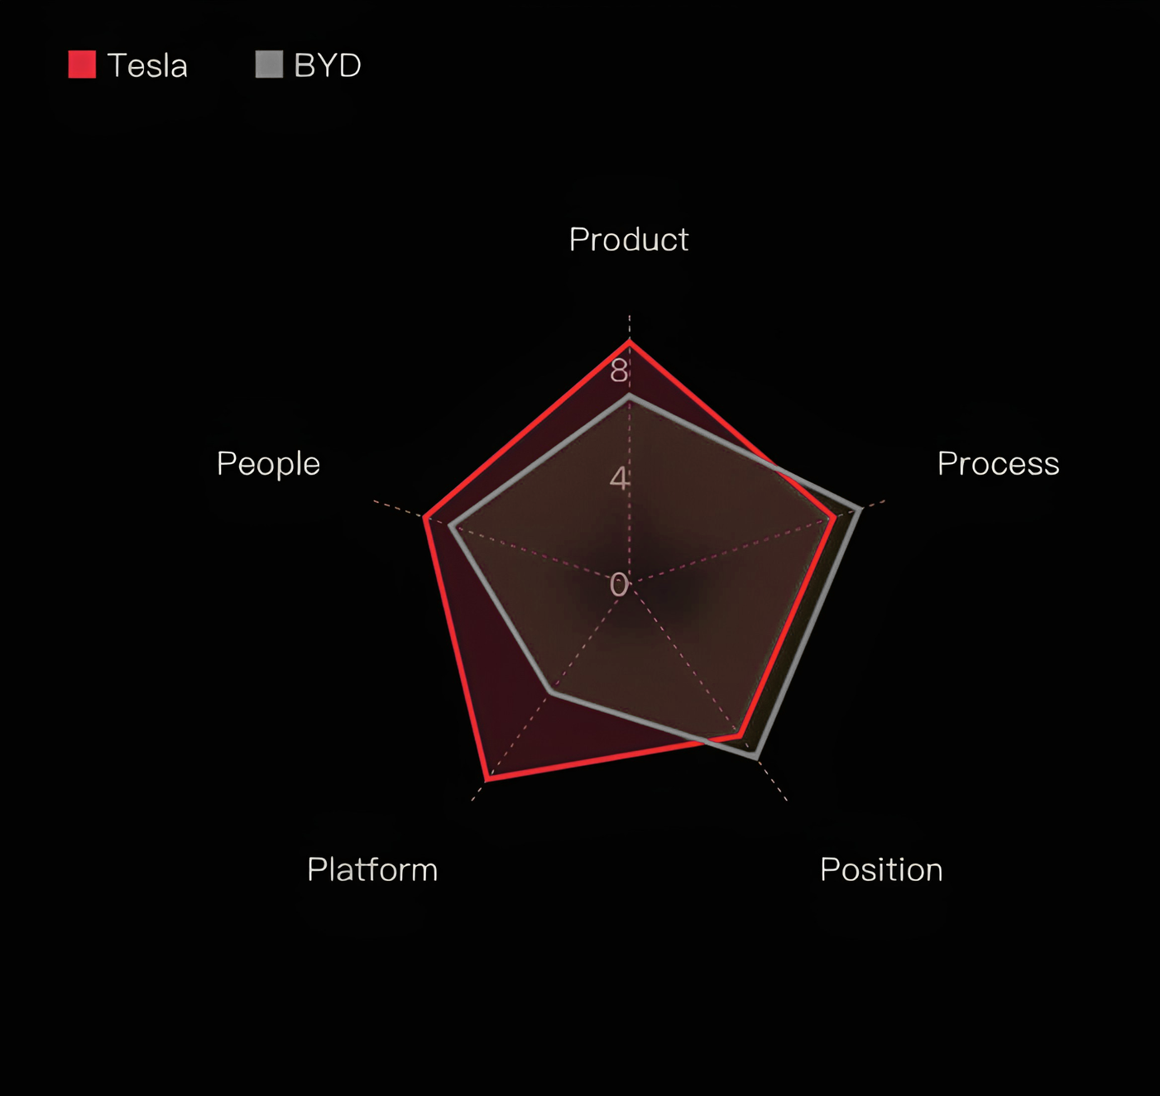
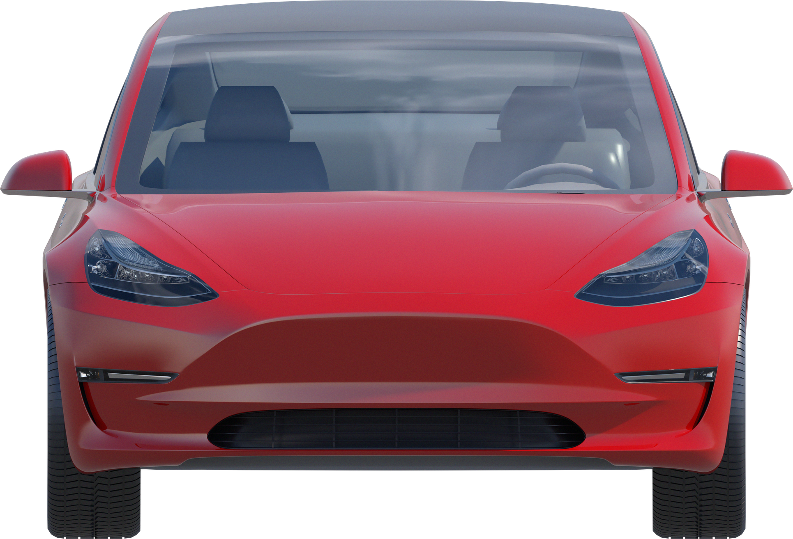
Where to attack, defend, and avoid fighting

Slide 7
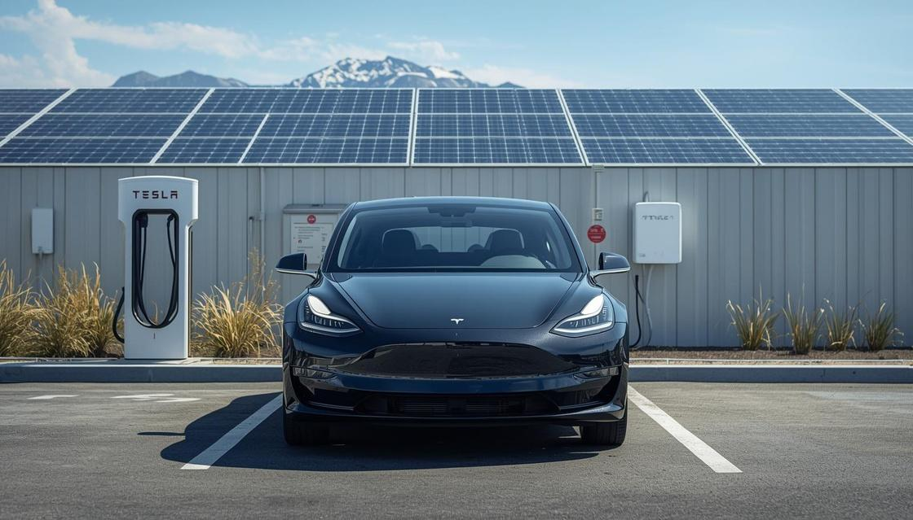

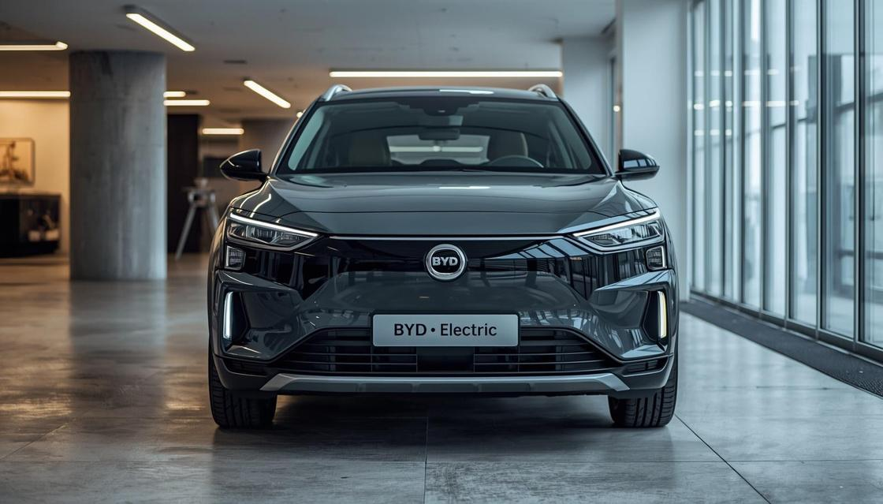

Product Dimension
Tesla Ecosystem
Tesla offers a broad ecosystem: Vehicles, FSD, Megapack, Powerwall, Solar Roof, and Optimus robotics, creating multiple revenue streams beyond car sales.
BYD Focus
BYD excels with a strong EV lineup and battery-backed value at competitive prices, but lacks Tesla's diversified non-vehicle portfolio.

Slide 8
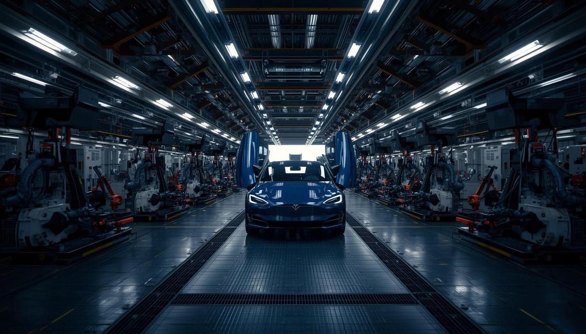



Process Dimension
Tesla Process
Gigacasting innovation reduces parts and assembly time. 4680 battery cells for improved energy density. Over-the-air updates enable continuous improvement. Vertically integrated supply chain for control.
BYD Process
Superior low-cost manufacturing at scale. Significant battery cost advantage through vertical integration. Blade battery technology reduces production complexity. Strategy: 4680 matters only if it enables $25-30K vehicle.

Slide 9
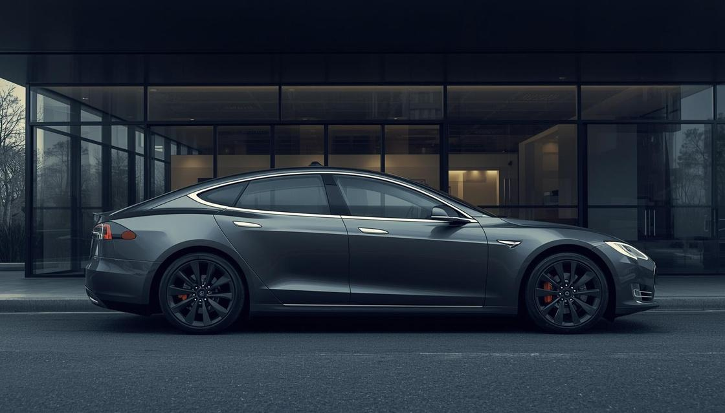
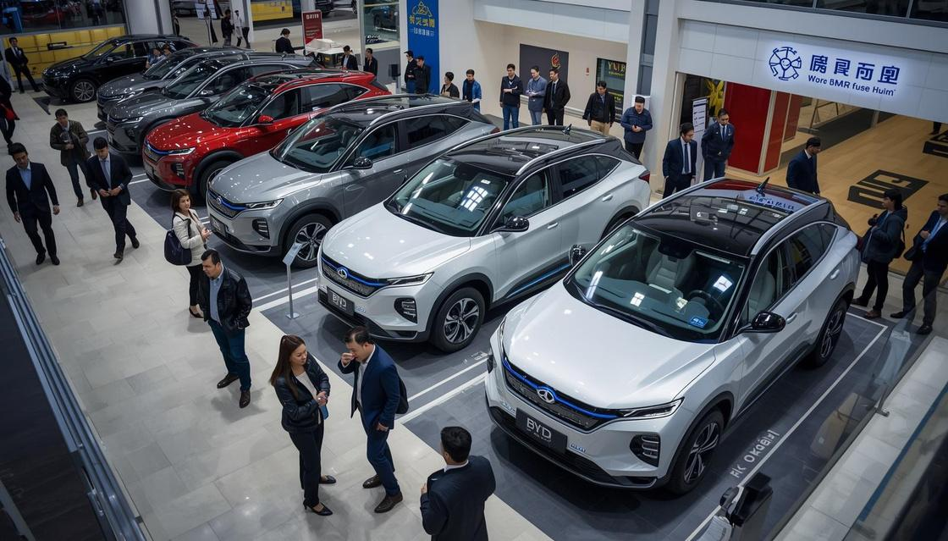
Position Dimension
Tesla Position
Premium global brand with strong recognition, but facing uneven regional traction and brand strain in Europe and US markets due to founder controversies.
BYD Position
Scale-driven positioning with dominant home market stronghold in China. Strategy: Abandon one-size-fits-all global approach; adopt region-specific postures.

Slide 10
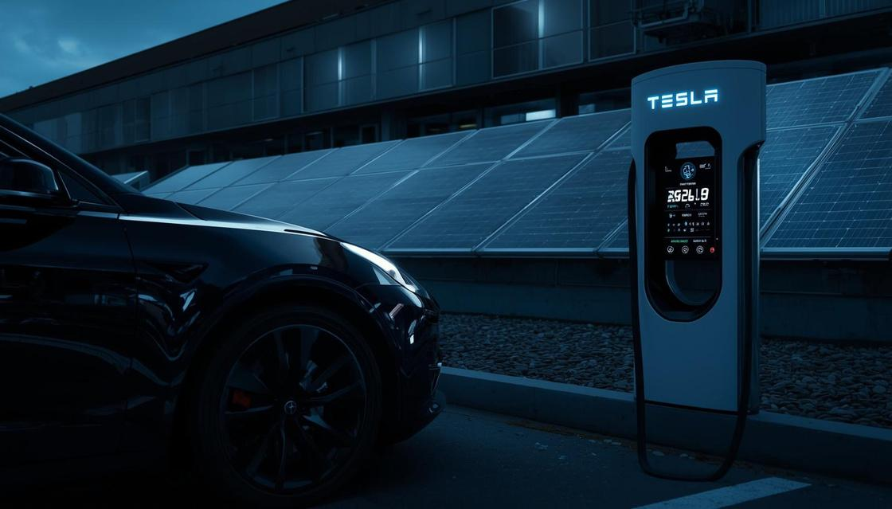

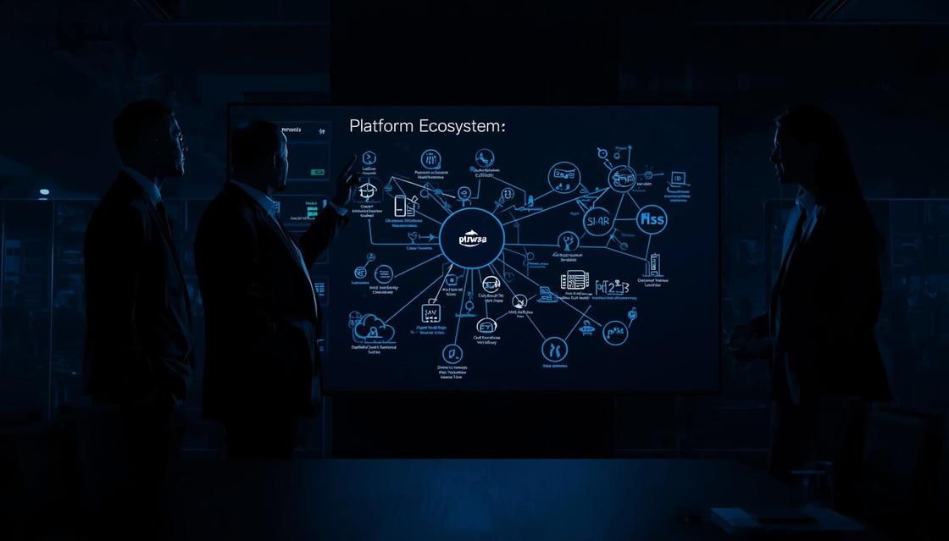

Platform Dimension
Tesla Platform
Deep integration across mobility, charging network, software ecosystem, AI capabilities, and energy solutions creates unmatched platform synergy.
BYD Platform
Strong battery-vehicle integration but weaker lifestyle and energy ecosystem limits cross-selling and customer lock-in opportunities.

Slide 11


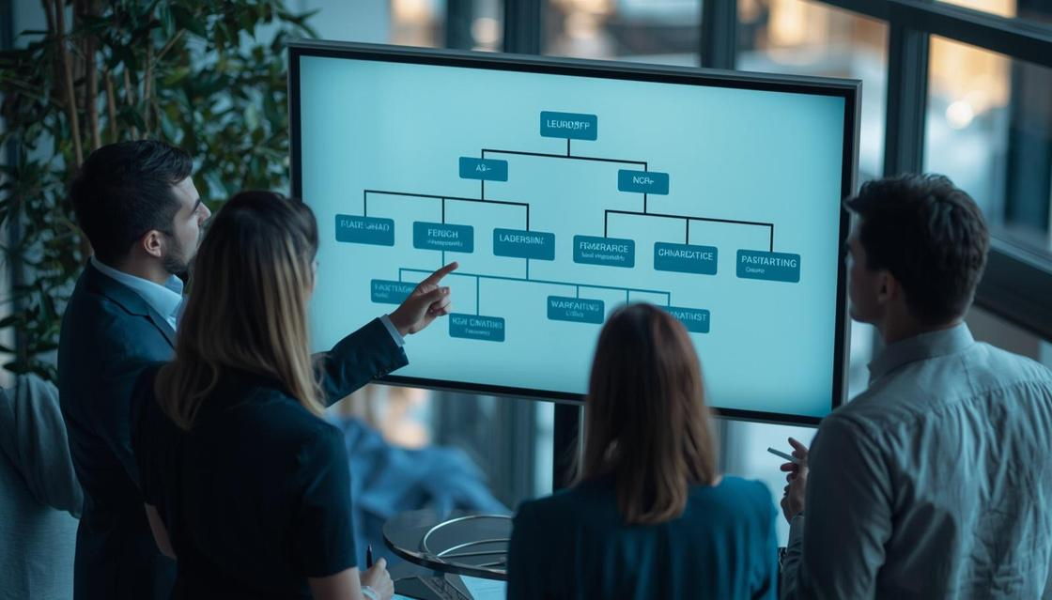
People Dimension
Tesla Culture
Elite engineering talent and innovation culture, but significant brand volatility tied to Elon Musk's public persona and controversial statements.
BYD Culture
Lower founder risk with Wang Chuanfu maintaining steady leadership. Strategy: Strengthen brand governance and build commercial independence from founder risk.

Slide 12

The Continental Gameboard
Four Regional Games with Distinct Strategies

Slide 13

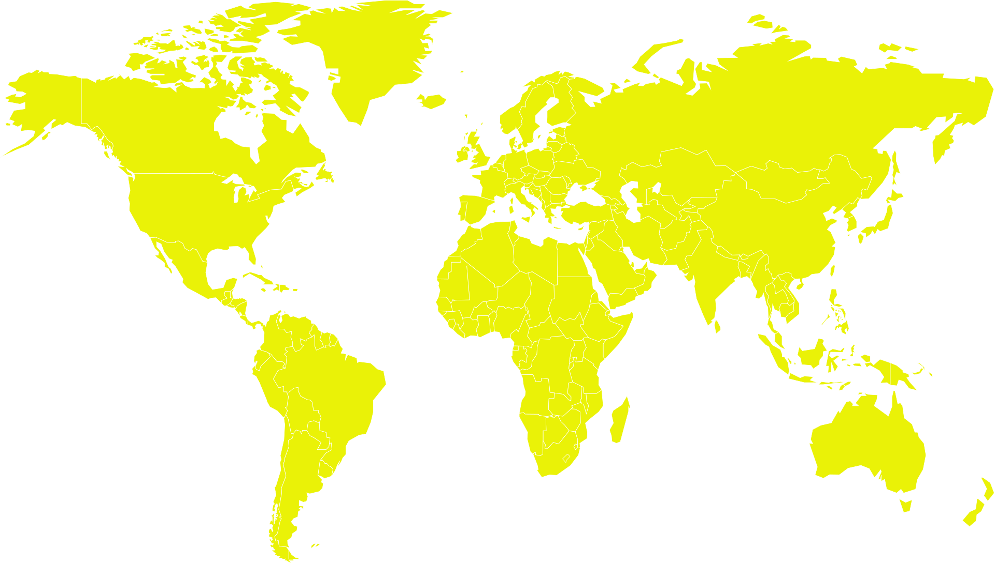




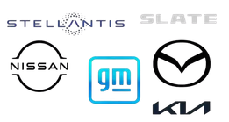






Competitor are taking over the regional markets

Slide 14

Regional Game 1: North America
Ecosystem control
  Game focuses on ecosystem control.
  Involves autonomous leadership.
  Centers on charging network dominance.
  Includes brand repair efforts.
  Rivals include GM, Hyundai-Kia, and Waymo.
Legacy OEMs are entering the EV market.
Full-Stack Strategy
Avoid price wars; pursue full-stack platform approach to maximize revenue per customer through integrated services.

Slide 15

Regional Game 2: Europe
Refreshed models, Marketing reset, Selective energy partnerships.
Avoid assuming supply solves brand issues. Focus on trust repair and rebuilding credibility with European consumers and regulators.
Game: Brand recovery, localized positioning, and regulatory fit. Rivals include BYD, Stellantis, VW, Renault, and Hyundai-Kia.
Trust Repair

Slide 16

Regional Games 3 & 4
China Strategy
Emerging Markets Strategy
Game: Premium differentiation, urban tech, software prestige. Rivals: BYD, Xiaomi, Geely, Huawei EVs. Focus on margin and prestige positioning.
Game: Affordability, modular infrastructure, ecosystem seeding. Rivals: BYD, Tata Motors, local EV makers. Affordability as entry; ecosystem as optional upgrade.
Focus on margin and prestige positioning.
Affordability as entry; ecosystem as optional upgrade
People’s
Tesla
Avoid entering premium-only and expecting the brand to carry adoption.

Slide 17
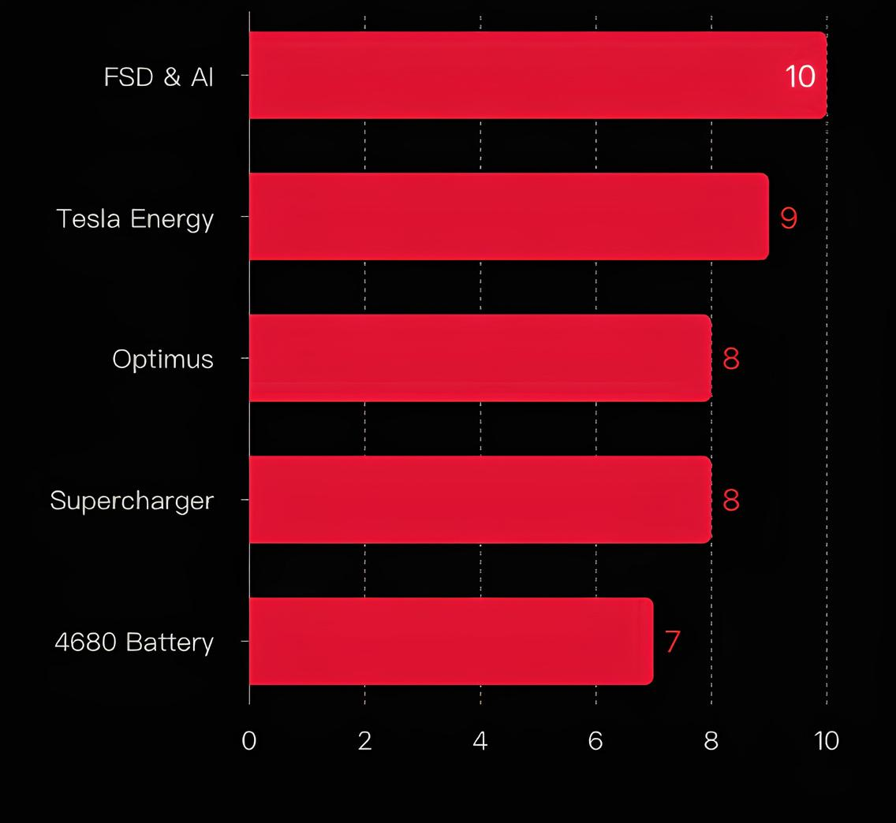
Technology Bets: FSD & AI Today , Energy & Optimus Tomorrow

Slide 18
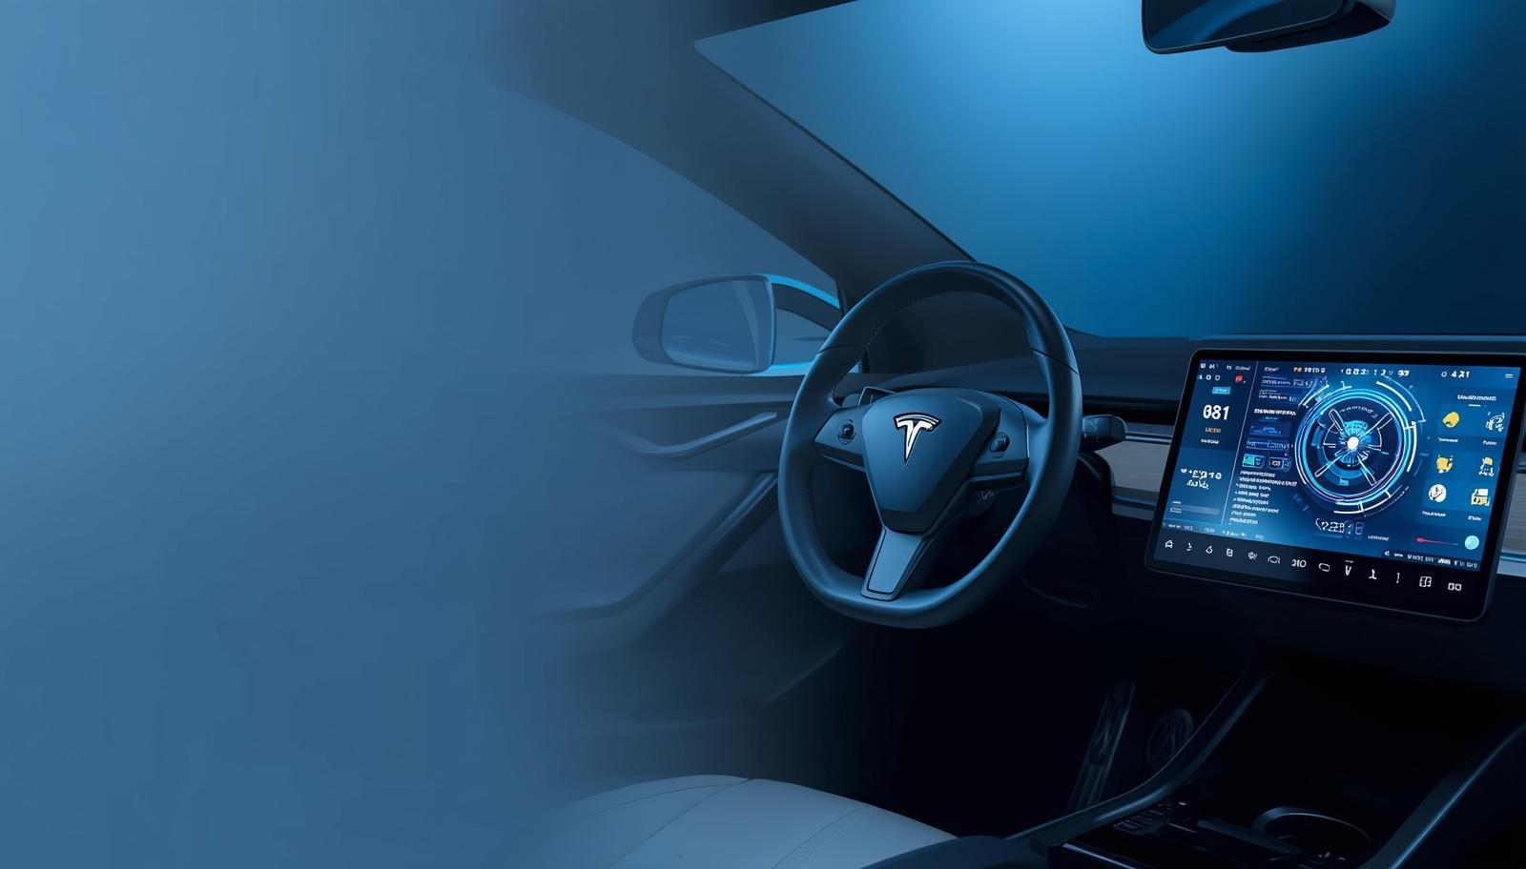

Strategy
Technology
Technology Bet 1: FSD and Autonomous AI
Platform Revenue Model
Cybercab Expansion
FSD shifts Tesla from product to recurring platform revenue via data and subscriptions. Waymo validates the commercial model; regulatory speed is the key uncertainty.
Cybercab deployments extend Tesla's model beyond vehicle sales, creating new revenue streams through autonomous ride-hailing services.

Slide 19


Strategy
Analysis
Technology Bet 2: 4680 Battery Program
Business-Driven Evaluation
Strategic Criteria
4680 battery technology matters only if it enables a $25-30K vehicle or significantly improves Megapack unit economics.
Evaluate by measurable business outcomes—cost reduction, margin improvement—not engineering symbolism or technical milestones.

Slide 20

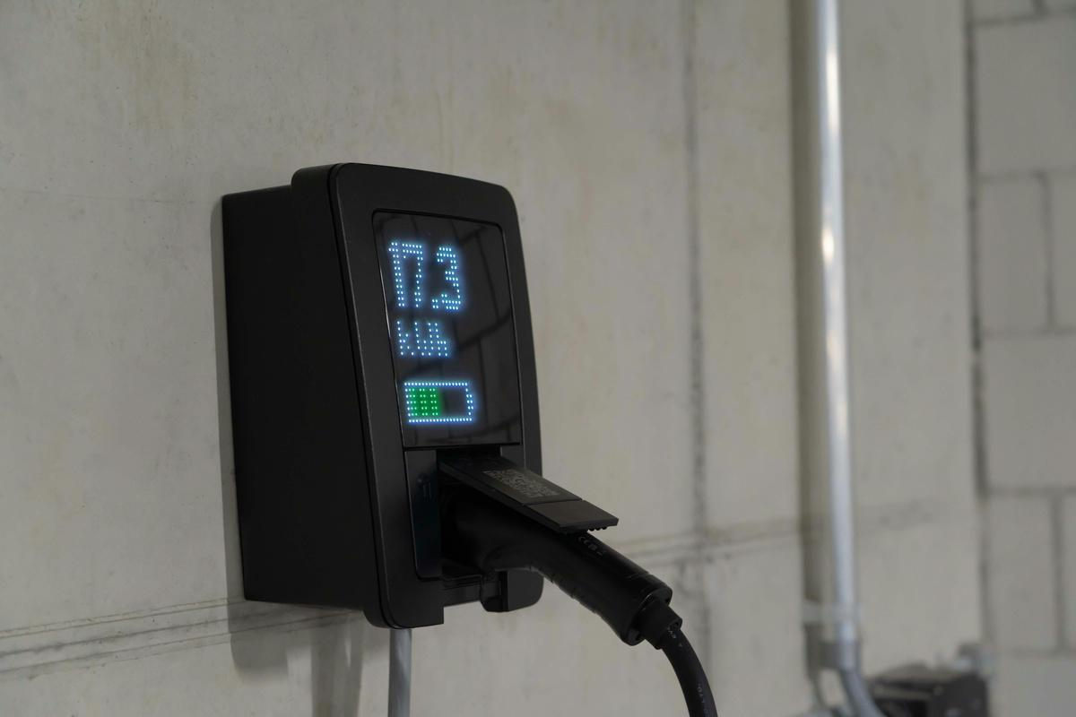
Strategy
Analysis
Technology Bet 3: Supercharger Network
75,000+ NACS Stations
Network-as-a-Service Revenue
Tesla's Supercharger network has become the North American standard with NACS adoption by major OEMs, creating infrastructure dominance.
Dynamic pricing and OEM access fees generate recurring margin even from competitors, transforming infrastructure into profit center.

Slide 21
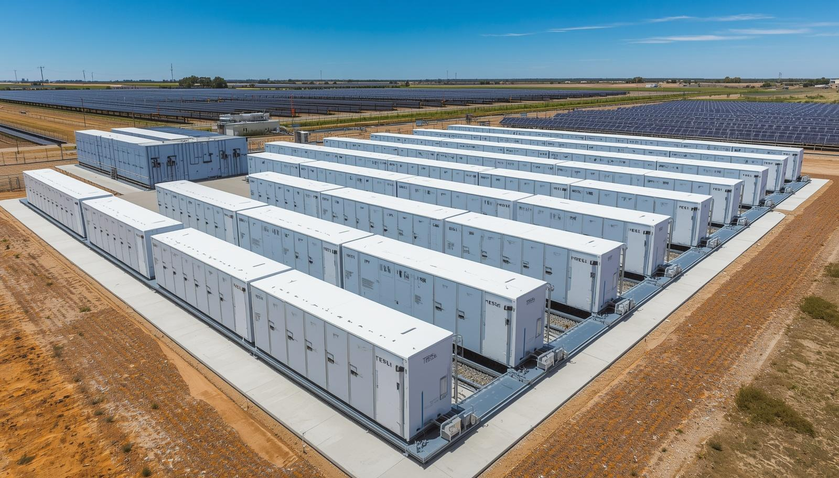
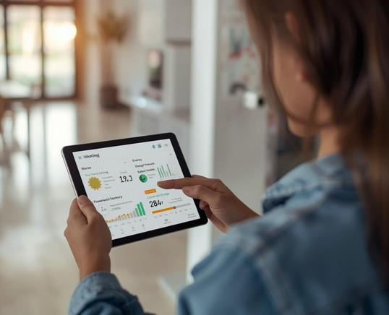
Products
Strategy
Technology Bet 4: Megapack, Powerwall & Solar
Grid-Scale Energy Solutions
Residential Lock-In Strategy
Megapack directly addresses the AI data center grid strain opportunity, positioning Tesla in the rapidly growing utility-scale storage market.
Powerwall and Solar Roof create powerful customer lock-in when bundled as the Tesla Home system, with different revenue cycles than vehicles.

Slide 22
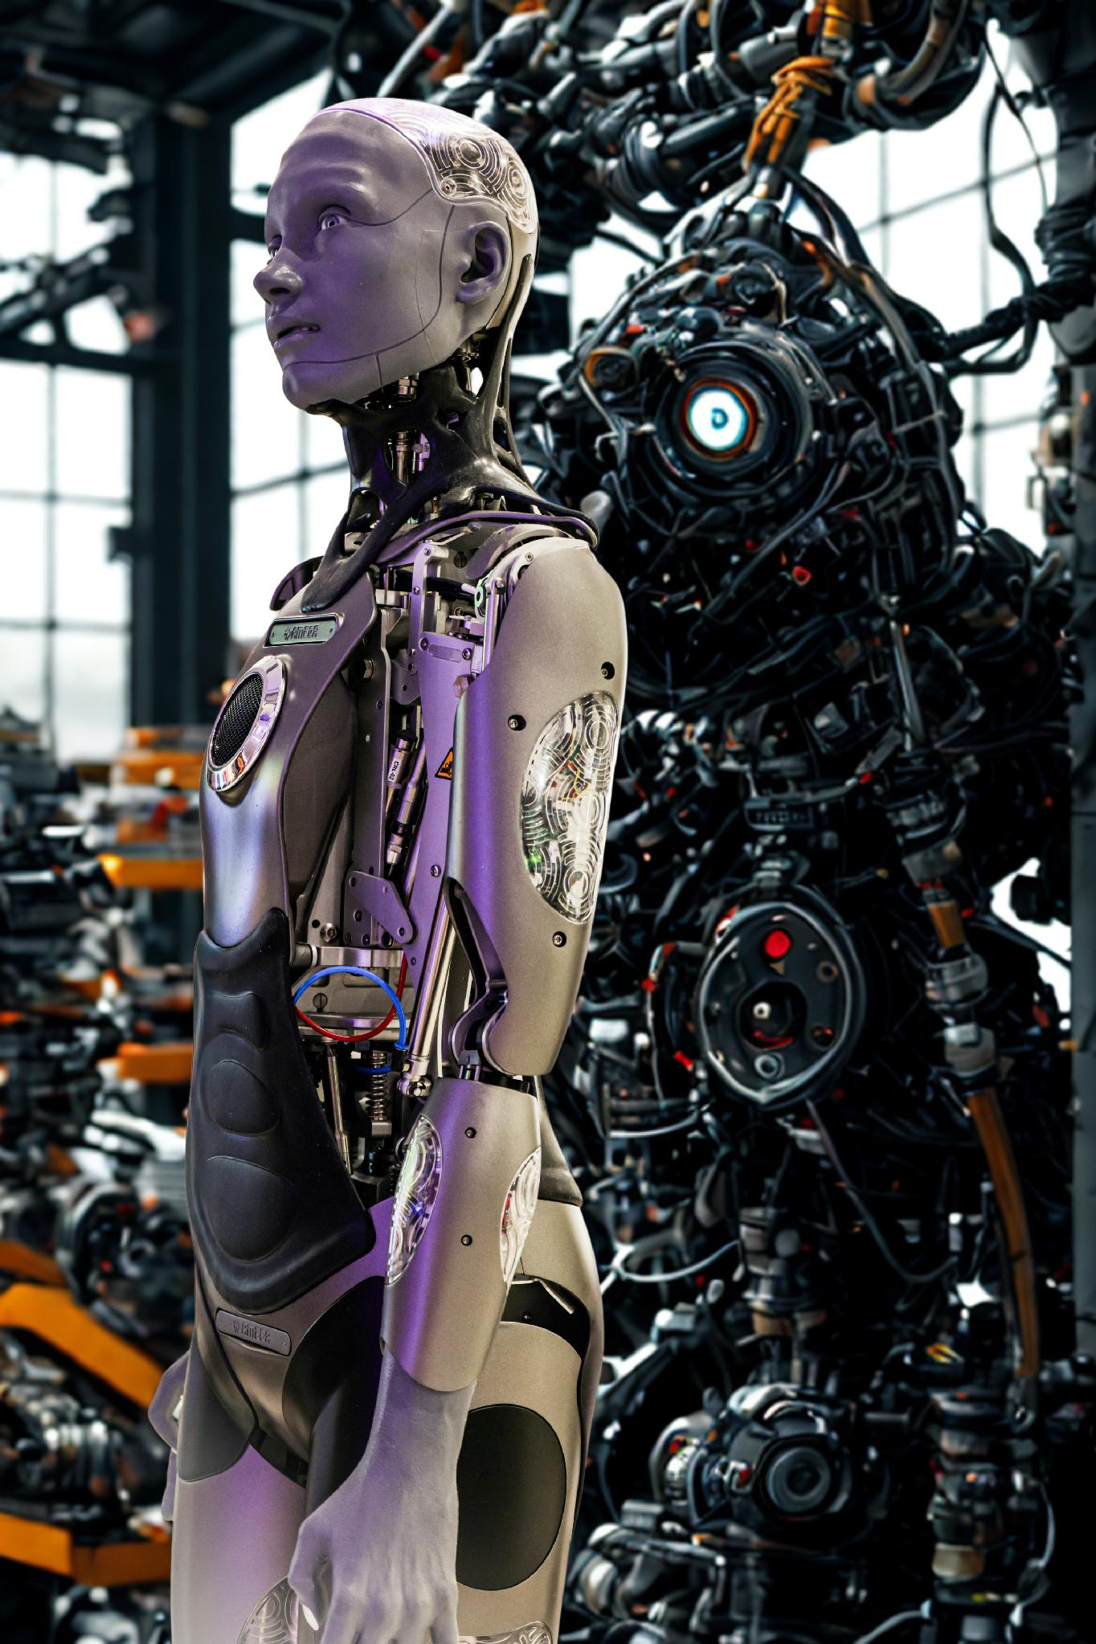

Technology Bet 5: Optimus
Factory Deployment Value
Strategic Approach
Near-term Optimus value lies in internal gigafactory deployment, improving manufacturing cost and throughput before external commercialization.
Robotics-as-a-service model follows after internal validation. Avoid premature consumer product framing—prove industrial value first.

Slide 23
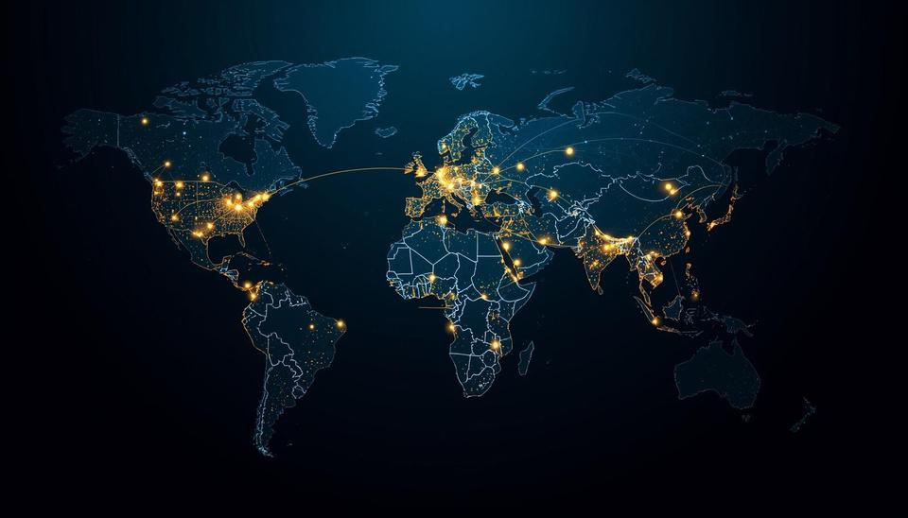


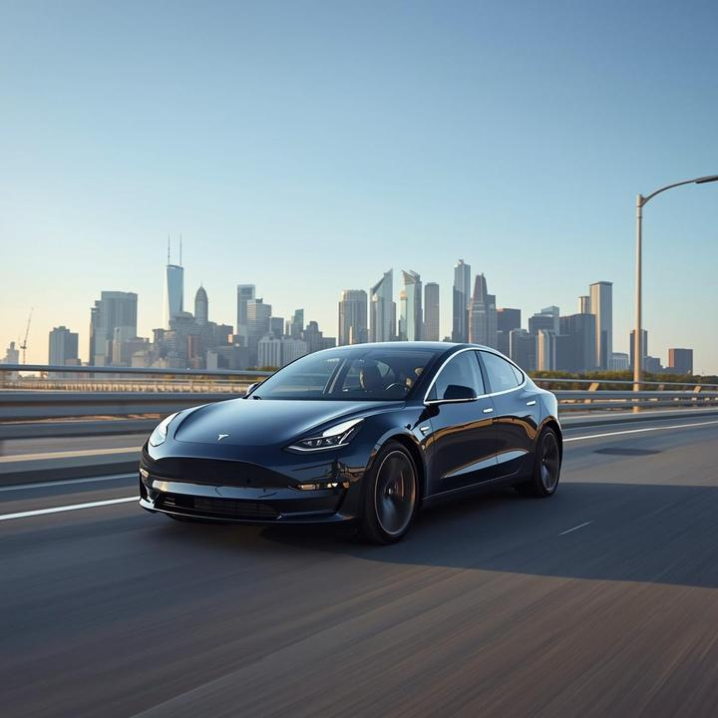
Key Takeaways
Regional Games
Strategic Clarity
Platform Gap
Urgent
The real contest is system vs product. Tesla has a credible path to platform leadership if it executes with discipline and regional focus.

Slide 24
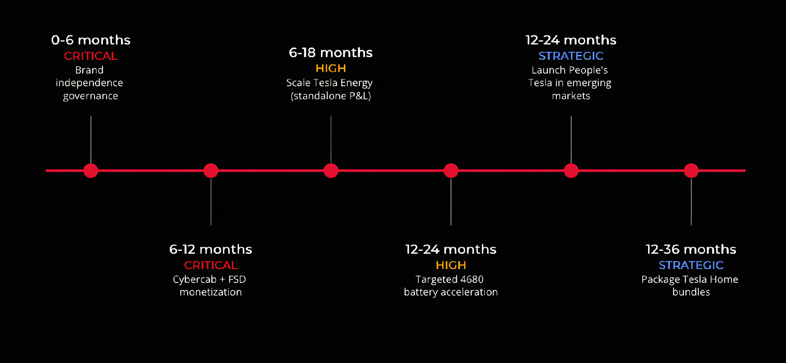
Prioritized Strategic Pathways

Slide 25

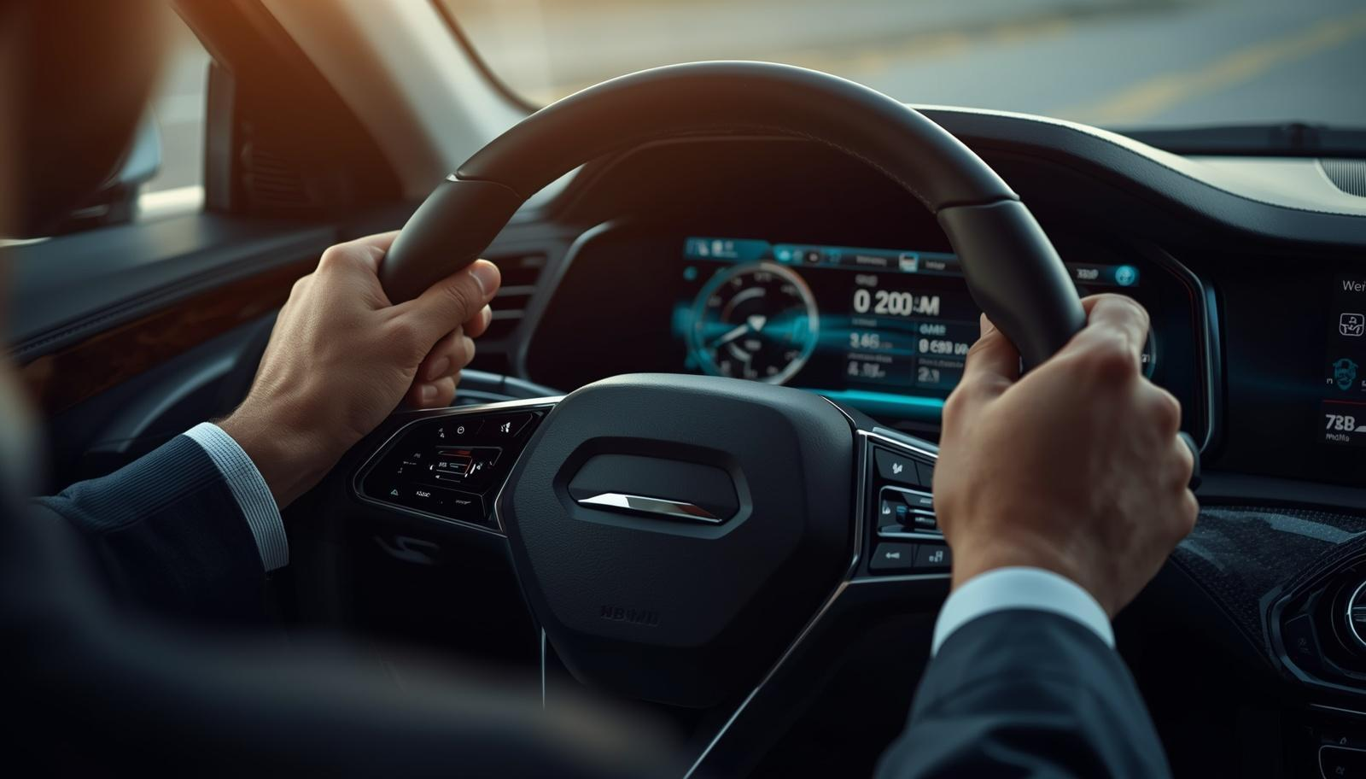
Strategic Crossroads
Tesla's challenge extends beyond EV sales volume to defining company identity amid regional rivalries and integration value.
Regional Focus
System vs Product
Stop treating the world as one market; prioritize Pentagon advantages regionally.
The real contest is system vs product; Tesla's credible path requires discipline and focus.

Slide 26
References
  Brand Finance (2026). Global 500 2026 Report. brandfinance.com
  CleanTechnica (2026). Tesla Had 46% of US EV Market in 2025. cleantechnica.com
  Cox Automotive / CarEdge (2026). Electric Vehicle Sales and Market Share. caredge.com
  Grand View Research (2026). Global Electric Vehicle Market Size & Forecast, 2025–2030.
  IEA (2025). Global EV Outlook 2025: Trends in Electric Car Markets. iea.org
  InsideEVs (2026). Tesla’s U.S. Sales in Q1 2026. insideevs.com
  MarketsandMarkets (2025). EV Market worth USD 620.3 billion by 2030. globenewswire.com
  Statista (2025). AI Market Size & Growth 2020–2030.
  WEF (2025). Future of Jobs Report 2025. weforum.org
  Yale / NBER (2025). Musk’s Political Activities and Tesla Sales Impact.
  Counterpoint Research (2026). Global Electric Vehicle Market Share: Quarterly.
  BIS (2024). Triennial Central Bank Survey: Foreign Exchange Turnover.
  IMF COFER Database (2025). Currency Composition of Official Foreign Exchange Reserves.
  Researched from Gemini, above resources and Tesla official website, Written by the team and refined/ polished by Perplexity.

