Slide 1

KEYWORD RESEARCH
Cheyenne Throckmorton | Founder, Massive Reach
@cheyennejack cheyenne@massivereach.com @massivereach

Slide 2
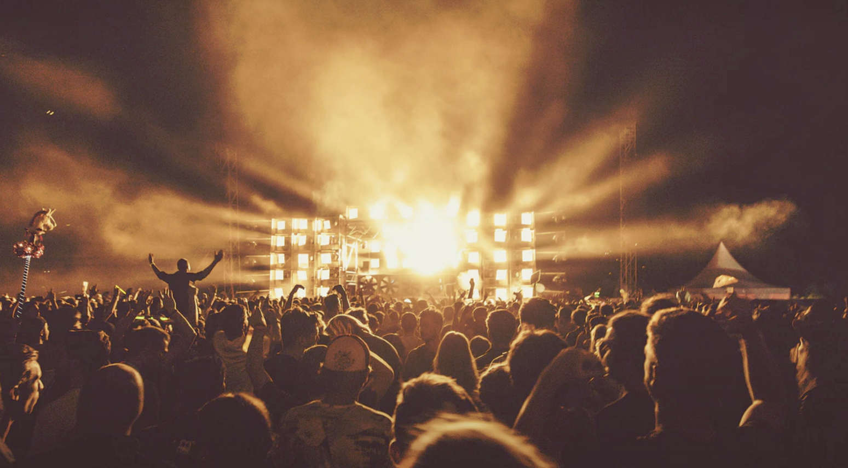
Know Your Audience
Make Them Happy

Slide 3
User Personas
Build personas for specific people
Easier to identify with “one” person than audience
Daily Activity - What do they do each hour?
Fears / Joys - What motivates them?
Trusted Brands - Who else do they like?
Quote - You should be there when they say “X”

Slide 4
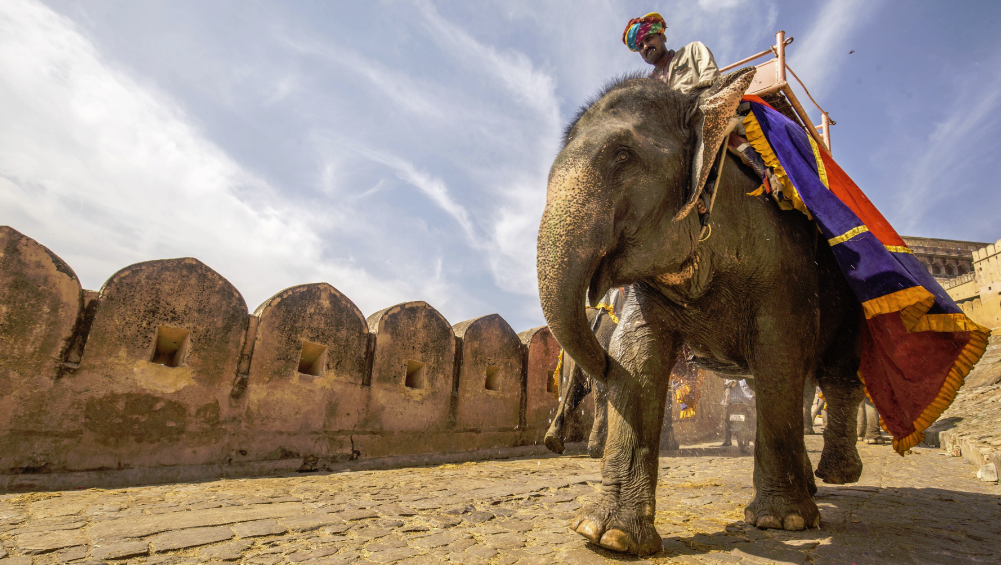
Find Great Keywords
Search Frequency
Relevance To Your Site
Competitiveness

Slide 5
Longer Keyword Phrases
Tend to have less competition
Tend to be easier to get higher rankings
Tend to have less traffic
Tend to have more intentional & converting traffic

Slide 6
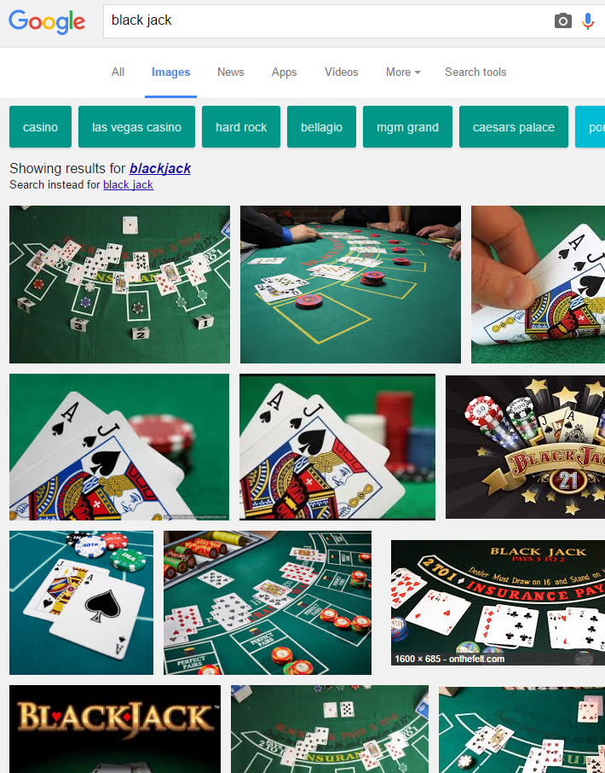
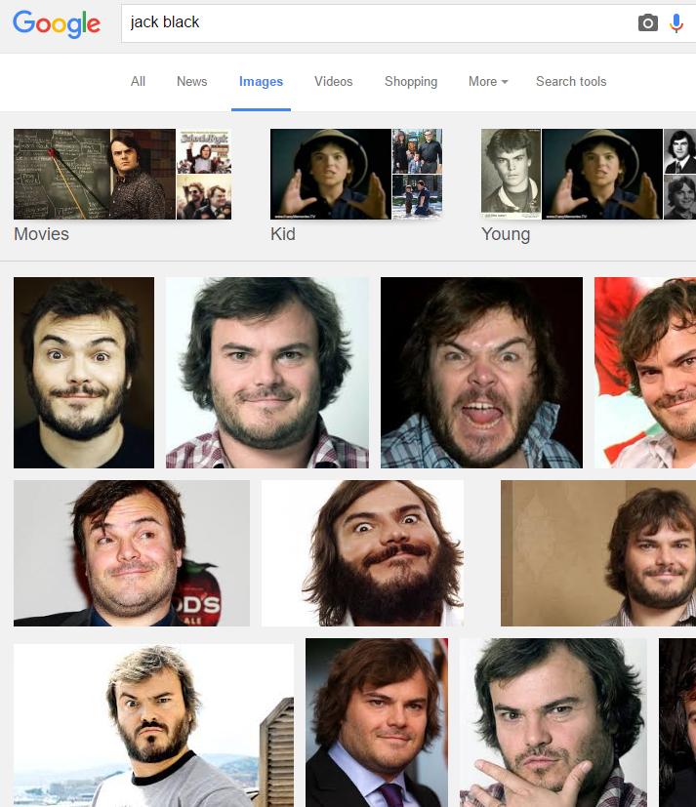
KEYWORD ORDER MATTERS

Slide 7
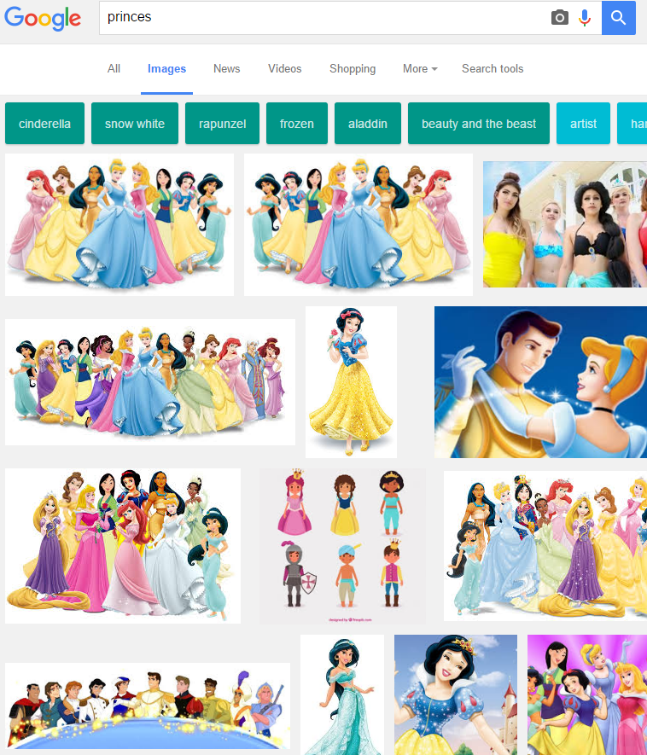
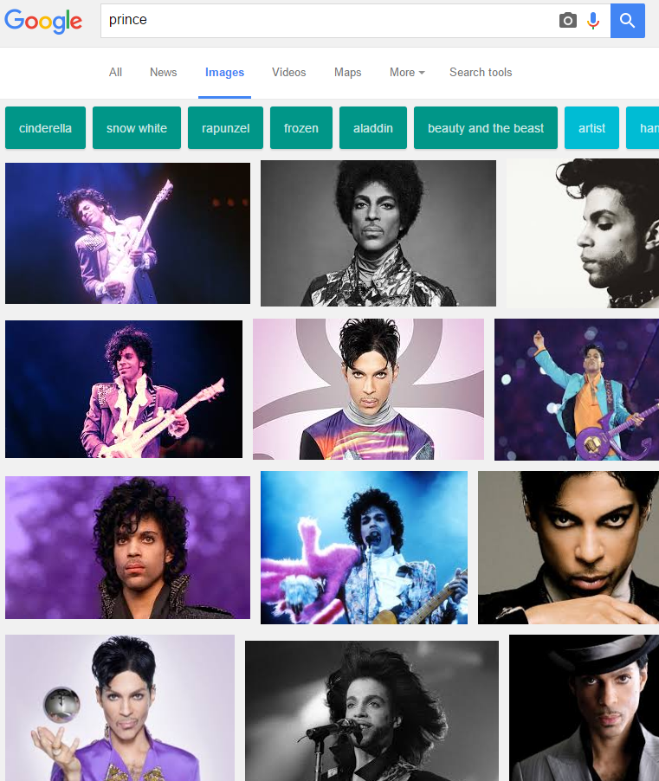
PLURALIZATION MATTERS

Slide 8
Intent in Keywords
Awareness / Informational
- How to, Best way, What is, Ways to, Why
Interest / Desire
- Review, Top, Compare vs, Brand/Product (Dell)
Action
- Buy, Deal, Coupon, Discount, Now, Subscribe

Slide 9
Keyword Strategies
Mix and Match Keywords + Intent to target personas at different stages
Best way to dunk, Top Dunking Shoes, Buy NK34X
- Create 3 pages / strategies

Slide 10
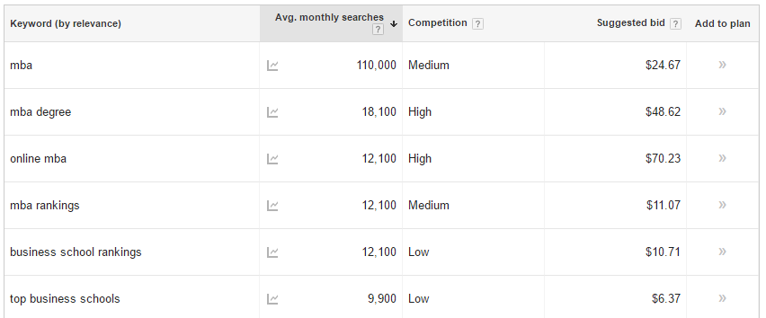
Keyword Planner (Adwords)

Slide 11
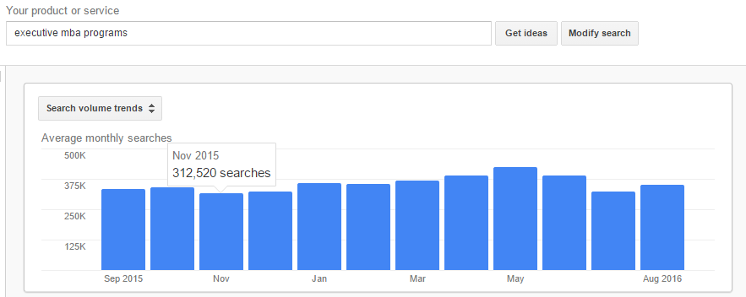
Keyword Planner (Adwords)

Slide 12
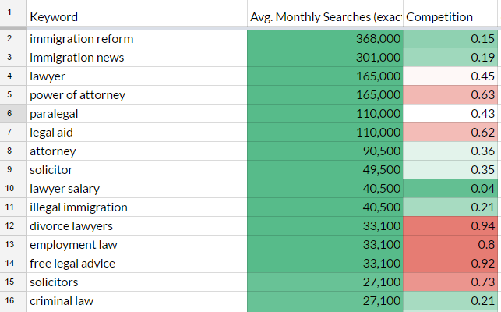
Google Sheets - Conditional Formatting

Slide 13
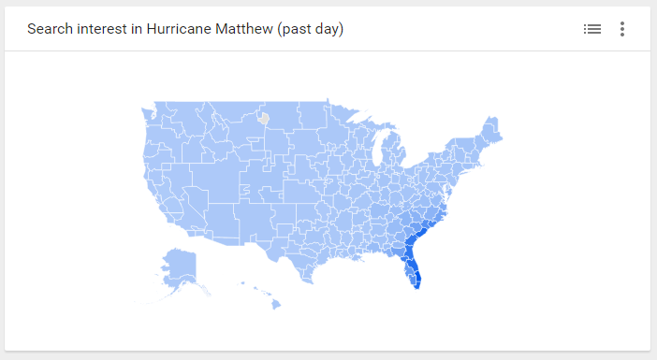
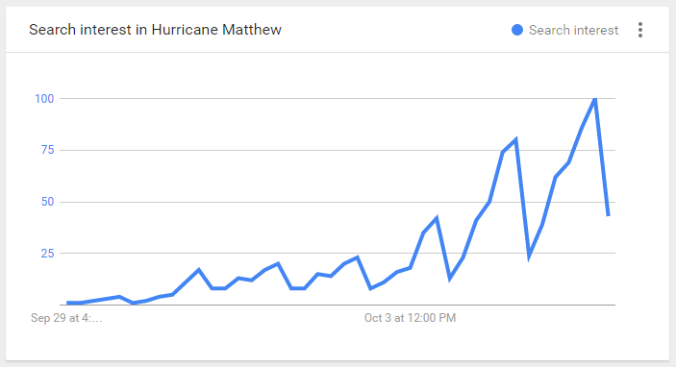
Google Trends - Search Interest

Slide 14
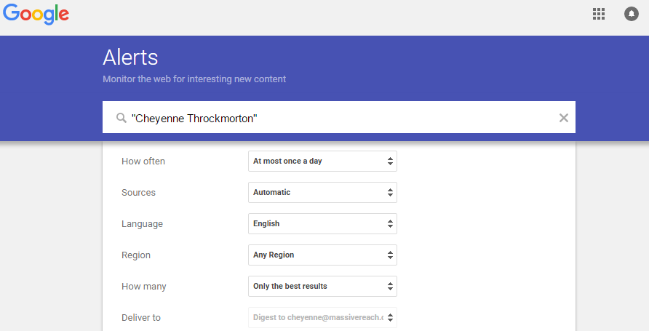
Google Alerts

Slide 15
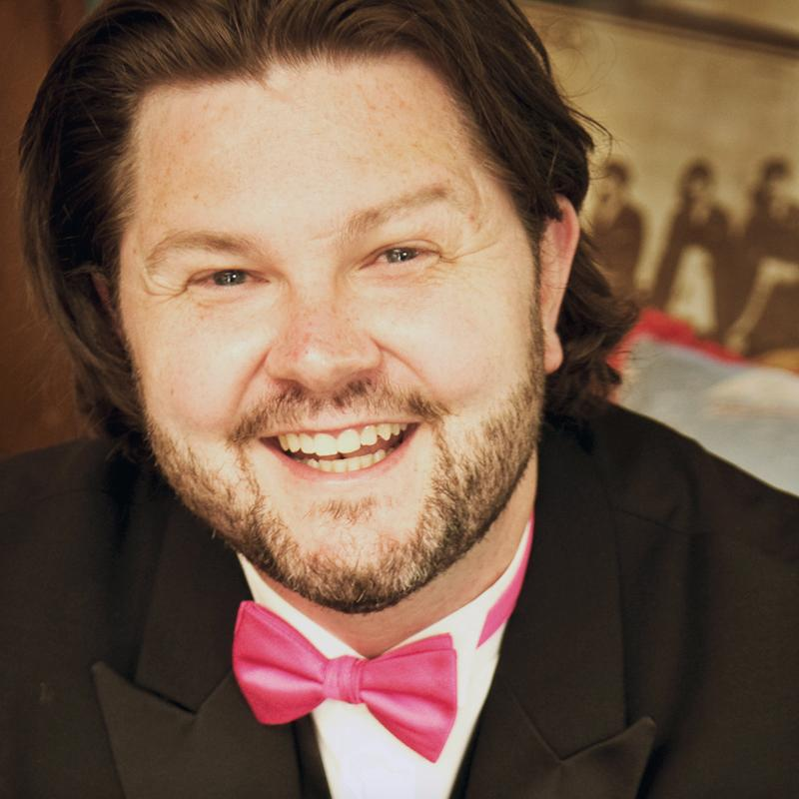






Contact & Resources
cheyenne@massivereach.com
@cheyennejack @massivereach
/in/cheyennejack
/massivereachcom
google.com/+massivereach
Other Resources
https://www.google.com/trends
https://www.google.com/alerts
https://www.massivereach.com/seo-tools
www.massivereach.com

