Slide 1

FREELANCE TRANSLATOR
Presentation Template
www.freepptbackgrounds.net

Slide 2
1 Social
Media 2
3 Slideshare
Campaign 4

Slide 3
1
SOCIAL

Slide 4

TITLE HERE
01
TITLE HERE
We hope that this template will return to you as a time, money and reputation.
START

Slide 5
TITLE HERE
A complex idea can be conveyed with just a single still image, namely making it possible to absorb large amounts of data quickly.
WRITE HERE
WRITE HERE
WRITE HERE
A complex idea can be conveyed with just a single still image, namely making it possible to absorb large amounts of data quickly.
A complex idea can be conveyed with just a single still image, namely making it possible to absorb large amounts of data quickly.
A complex idea can be conveyed with just a single still image, namely making it possible to absorb large amounts of data quickly.

Slide 6
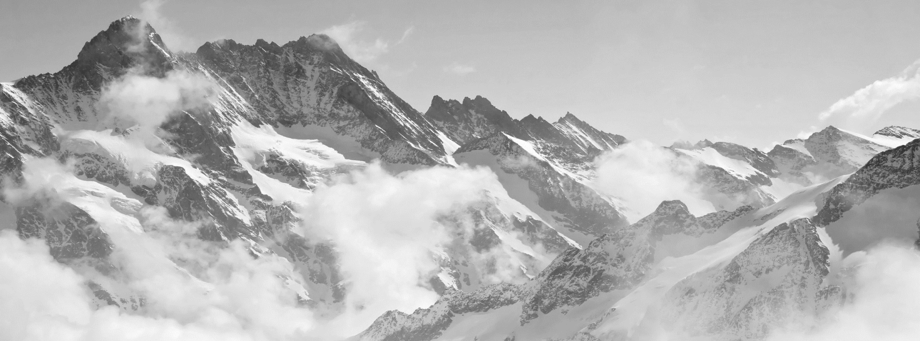
TITLE HERE
A complex idea can be conveyed with just a single still image, namely making it possible to absorb large amounts of data quickly.

Slide 7

TITLE HERE
”
We hope that this template will return to you as a time, money and reputation.
TITLE
We hope that this template will return to you as a time, money and reputation.
Click to add a title
We hope that this template will return to you as a time, money and reputation.

Slide 8
TITLE HERE
STEP HERE
Click to add a title
We hope that this template will return to you as a time, money and reputation.
We hope that this template will return to you as a time, money and reputation.
NOTE HERE

Slide 9
2
MEDIA

Slide 10


TITLE HERE
We hope that this template will return to you as a time, money and reputation.
We hope that this template will return to you as a time, money and reputation.

Slide 11
TITLE HERE
OPTION HERE
OPTION HERE
OPTION HERE
OPTION HERE
OPTION HERE
We use well-known development methodologies to create a customized approach for each of the.
We use well-known development methodologies to create a customized approach for each of the.
We use well-known development methodologies to create a customized approach for each of the.
We use well-known development methodologies to create a customized approach for each of the.
We use well-known development methodologies to create a customized approach for each of the.

Slide 12

TITLE HERE
STAGE HERE
Click to add a title
A complex idea can be conveyed with just a single still image, namely making it possible to absorb large amounts of data quickly.
A complex idea can be conveyed with just a single still image, namely making it possible to absorb large amounts of data quickly.

Slide 13
TITLE HERE
DESCRIPTION HERE
Click to add a title
A complex idea can be conveyed with just a single still image, namely making it possible to absorb large amounts of data quickly.
“
”
A complex idea can be conveyed with just a single still image, namely making it possible to absorb large amounts of data quickly.
A complex idea can be conveyed with just a single still image, namely making it possible to absorb large amounts of data quickly.

Slide 14
TITLE HERE
TITLE HERE
We hope that this template will return to you as a time, money and reputation.
Go ahead and replace it with your own text.
TITLE HERE
We hope that this template will return to you as a time, money and reputation.
Go ahead and replace it with your own text.
Go ahead and replace it with your own text.
TITLE HERE
We hope that this template will return to you as a time, money and reputation.

Slide 15



TITLE HERE
NOTE HERE
NOTE HERE
NOTE HERE
A complex idea can be conveyed with just a single still image, namely making it possible to absorb large amounts of data quickly.
A complex idea can be conveyed with just a single still image, namely making it possible to absorb large amounts of data quickly.
A complex idea can be conveyed with just a single still image, namely making it possible to absorb large amounts of data quickly.

Slide 16
3
SLIDESHARE

Slide 17
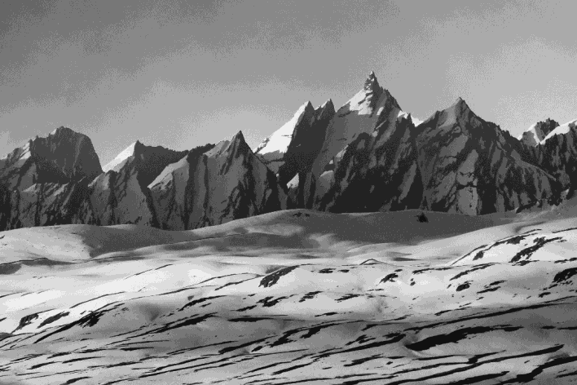
TITLE HERE
01
02
NOTE HERE
NOTE HERE
A complex idea can be conveyed with just a single still image, namely making it possible to absorb large amounts of data quickly.
A complex idea can be conveyed with just a single still image, namely making it possible to absorb large amounts of data quickly.
NOTE HERE

Slide 18
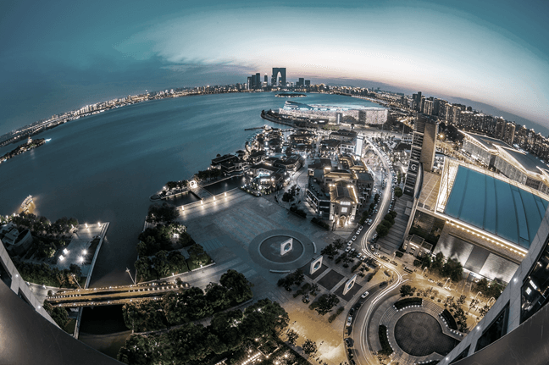



TITLE HERE
We hope that this template will return to you as a time, money and reputation.
We hope that this template will return to you as a time, money and reputation.
We hope that this template will return to you as a time, money and reputation.

Slide 19
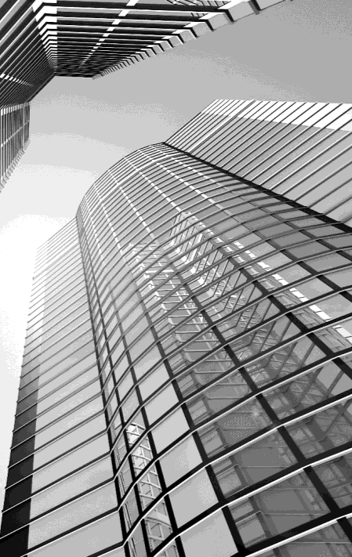
TITLE HERE
NOTE HERE
Click to add a title
A complex idea can be conveyed with just a single still image, namely making it possible to absorb large amounts of data quickly.
A complex idea can be conveyed with just a single still image, namely making it possible to absorb large amounts of data quickly.
A complex idea can be conveyed with just a single still image, namely making it possible to absorb large amounts of data quickly.

Slide 20

TITLE HERE
TITLE
Click to add a title
A complex idea can be conveyed with just a single still image, namely making it possible to absorb large amounts of data quickly.
A complex idea can be conveyed with just a single still image, namely making it possible to absorb large amounts of data quickly.
A complex idea can be conveyed with just a single still image, namely making it possible to absorb large amounts of data quickly.

Slide 21
4
CAMPAIGN

Slide 22

TITLE HERE
STEP HERE
Go ahead and replace it with your own text.
We hope that this template will return to you as a time, money and reputation.
We hope that this template will return to you as a time, money and reputation.

Slide 23
TITLE HERE
1
TITLE HERE
4
TITLE HERE
We hope that this template will return to you as a time, money and reputation.
We hope that this template will return to you as a time, money and reputation.
2
5
TITLE HERE
TITLE HERE
We hope that this template will return to you as a time, money and reputation.
We hope that this template will return to you as a time, money and reputation.
3
6
TITLE HERE
TITLE HERE
We hope that this template will return to you as a time, money and reputation.
We hope that this template will return to you as a time, money and reputation.

Slide 24
TITLE HERE
60%
35%
70%
90%
NOTE HERE
NOTE HERE
NOTE HERE
NOTE HERE
We hope that this template will return to you as a time, money and reputation.
We hope that this template will return to you as a time, money and reputation.
We hope that this template will return to you as a time, money and reputation.
We hope that this template will return to you as a time, money and reputation.

Slide 25

TITLE HERE
A complex idea can be conveyed with just a single still image, namely making it possible to absorb large amounts of data quickly.
A complex idea can be conveyed with just a single still image, namely making it possible to absorb large amounts of data quickly.
A complex idea can be conveyed with just a single still image, namely making it possible to absorb large amounts of data quickly.

Slide 26
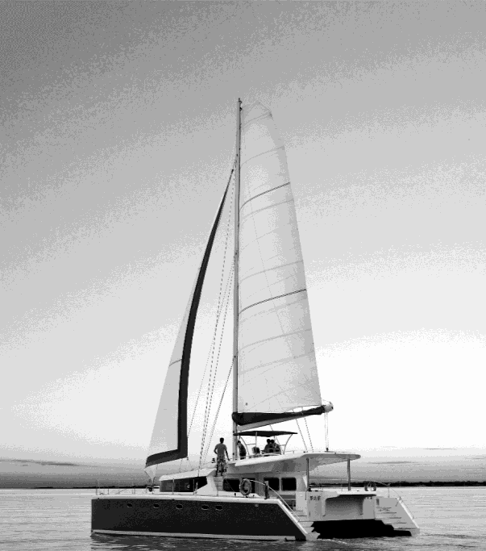
TITLE HERE
NOTE HERE
Click to add a title
A complex idea can be conveyed with just a single still image, namely making it possible to absorb large amounts of data quickly.
A complex idea can be conveyed with just a single still image, namely making it possible to absorb large amounts of data quickly.
A complex idea can be conveyed with just a single still image, namely making it possible to absorb large amounts of data quickly.

Slide 27
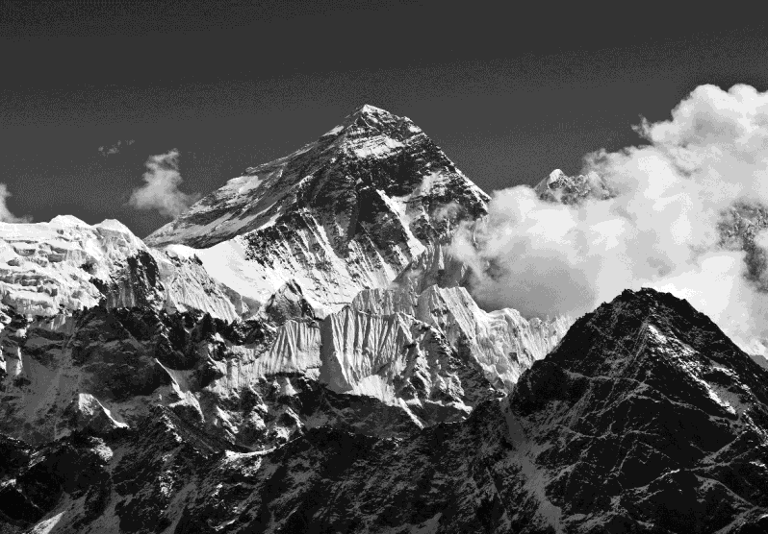
DESCRIPTION HERE
Click to add a title
A complex idea can be conveyed with just a single still image, namely making it possible to absorb large amounts of data quickly.
A complex idea can be conveyed with just a single still image, namely making it possible to absorb large amounts of data quickly.
START

Slide 28
THANK YOU !
Freelance Transtor
Powerpoint Template
www.freepptbackgrounds.net

