Slide 1
Call Recording
July 2022

Slide 2
Introduction
App Solutioning
User guide
App Integrations

Slide 3
Product Introduction

Slide 4
What is the Call Recording Application?
Call Recording automatically allows you to record and store all incoming and outgoing calls from BizPhone, SIP, Virtual Line and Direct Line, providing you insight into every voice interaction to ensure standard adherence or assist in resolving disputes.
The Call Recording application is usually one of the element or service that customers interact with in the following solutions:
Cloud PBX
Call Centre Solution

Slide 5
Features
Recording with superior quality.
Downloadable records of all incoming and outgoing calls.
User and access rights management.
Unlimited cloud storage.
Navigating capability to quickly locate all records.
Other apps integration:
SIP, Virtual Line, Direct Line: based on number of concurrent calls
Bizphone: based on number of extensions

Slide 6
App Solutioning

Slide 7
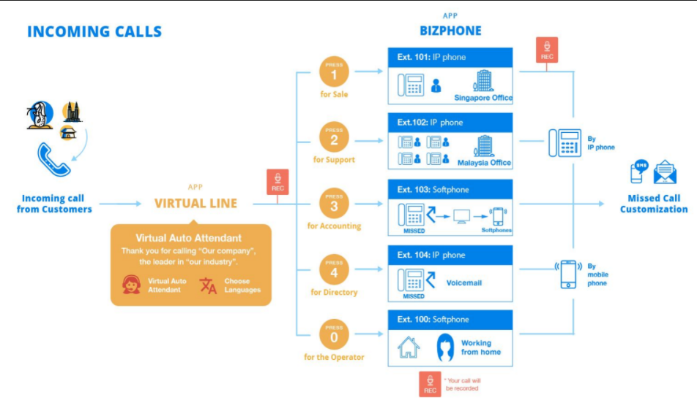
Cloud PBX
In order to build a simple Cloud PBX Solution, the Call Recording can be integrated to work with the following applications:
Virtual Line
BizPhone
Global DNC (Optional)
Inbound calls to Virtual Line and outbound call via Bizphone will be recorded. This solution is enough to replace a traditional PABX system.

Slide 8
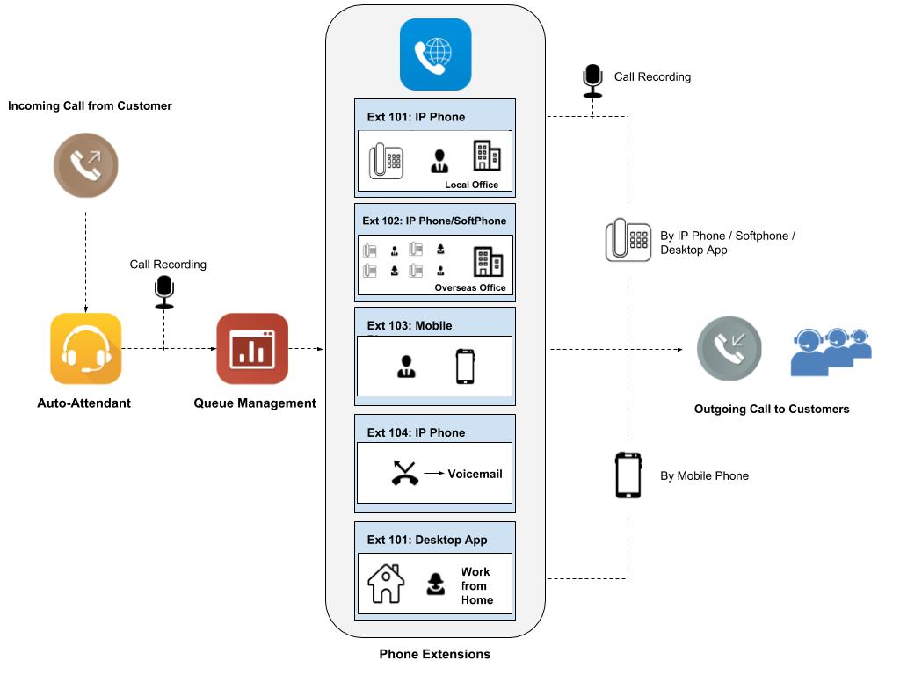
Call Centre
Building a full cloud Call Centre Solution is also possible when Call Recording is integrated with the following applications:
Wallboard
Virtual Line
BizPhone
Global DNC (Optional)
Inbound calls to Virtual Line and outbound call via Bizphone will be recorded

Slide 9
User Guide

Slide 10
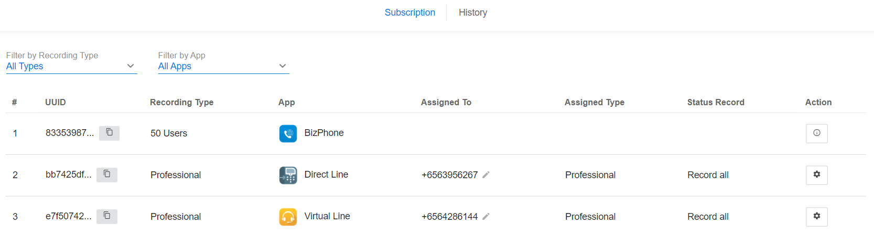
Subscription Window
Upon opening the application, a list of different integrated applications is visible at a glance for easier workflow management.

Slide 11
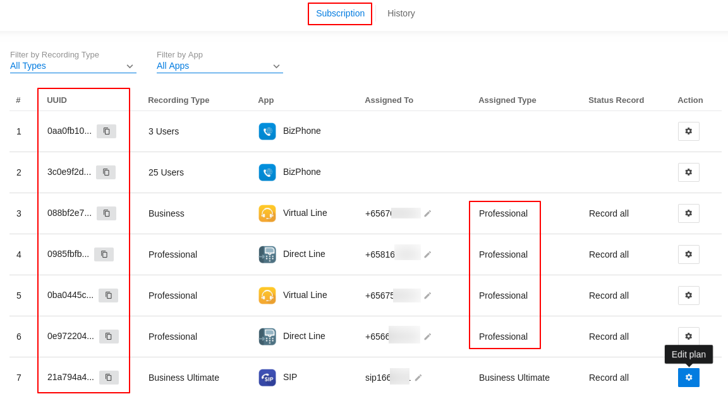
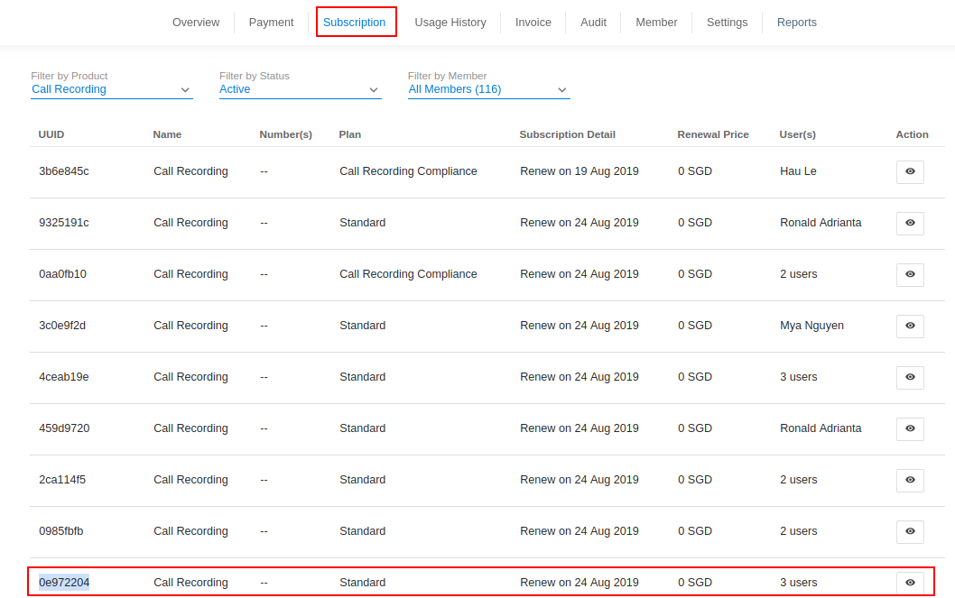
Distinguish the CR subscriptions
1 Call Recording App can record 1 specific app only
If you need to unsubscribe / terminate CR of the any app, use the UUID chain to identify
Go to Call Recording App
Find the CR and copy its UUID (0e972204...)
Match it with the UUID in subscription page and proceed to unsubscribe / terminate

Slide 12
Secure your CR logs
 | Normal | Encrypted | SFTP support
View the file name on portal | Everyone has access to CR app | Everyone has access to CR app | Everyone has access to CR app
Listen online | Any user can click the Play icon and listen to the file | Do not support | Do not support
Download file from portal | Any user can download and open the files. | Any user can download. Password is required to play the file. | Restricted users can download and open the file at restricted location. Require add-ons: SFTP browser and downloader
If your Call recording has a Compliance flag, all its records will be stored and reconciled.
For security purpose, we provide users with two advanced types of Call recording logs:
The CR files are encrypted and cached on our cloud: specific users have the credential can open the files.
The CR files are encrypted and sent to local server for enhanced security: all the files are only stored and accessed from your site.
SFTP - SSH File Transfer Protocol: is a network protocol that provides file access, file transfer, and file management over any reliable data stream

Slide 13
App Integrations

Slide 14
Integrate Call Recording with SIP

Slide 15
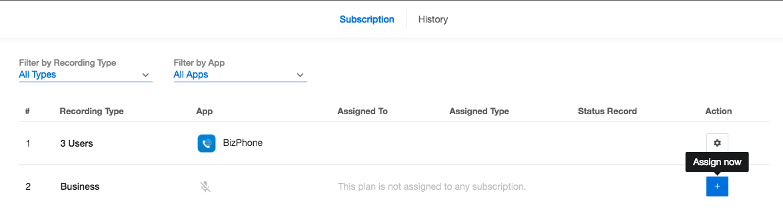
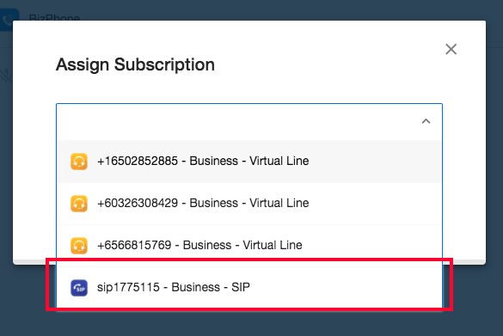
Integrate CR with SIP
Click Assign now
Select the SIP subscription to be recorded
Save

Slide 16
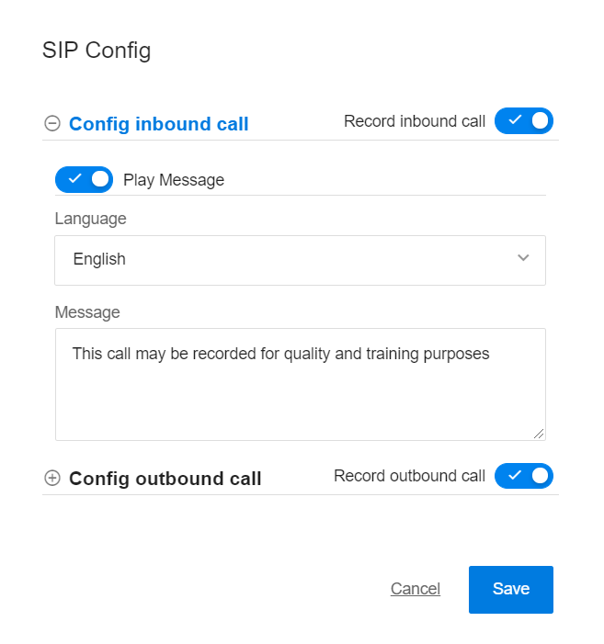
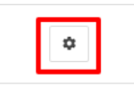
Integrate CR with SIP (cont’d)
You can toggle to record inbound and/or outbound call.
Turn on/off message - the message played before the call is recorded.
Choose language
Key in the message
Save

Slide 17
Integrate Call Recording with
Direct Line / Virtual Line

Slide 18
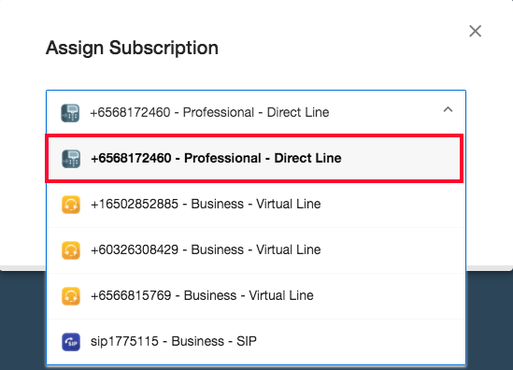
Integrate CR with DL / VL
Click Assign now
Select the Direct Line / Virtual Line to be recorded
Save

Slide 19
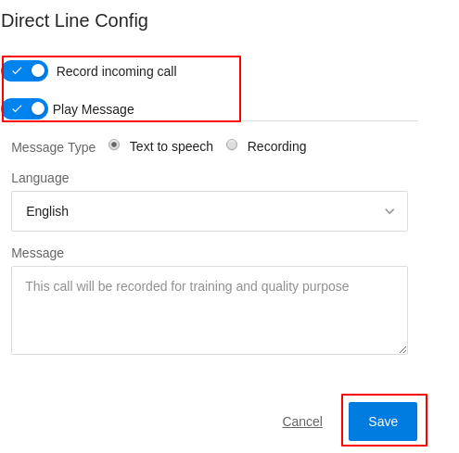
Integrate CR with DL / VL (cont’d)
You can toggle to record inbound calls.
Turn on/off message - the message played before the call is recorded.
Choose language
Key in the message
Save

Slide 20
Integrate Call Recording with Bizphone

Slide 21
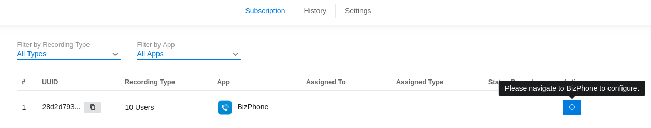
Integrate CR with Bizphone
To record BizPhone, make sure that you have 1 Call Recording subscription with Bizphone Extension addon.
If you purchase correctly, the Call Recording will be auto assigned to the Bizphone subscription.

Slide 22
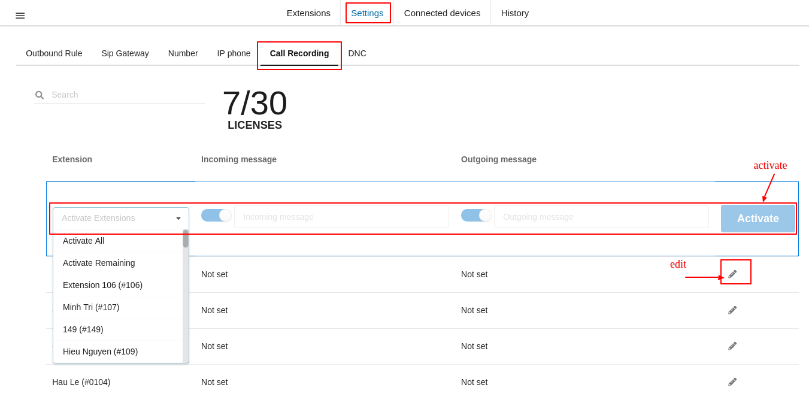
Integrate CR with Bizphone (cont’d)
Configure Call Recording at Bizphone
Go to Bizphone
Settings > Call recording
Select the extension
Turn on/off message for incoming/outgoing
Activate

