Slide 1

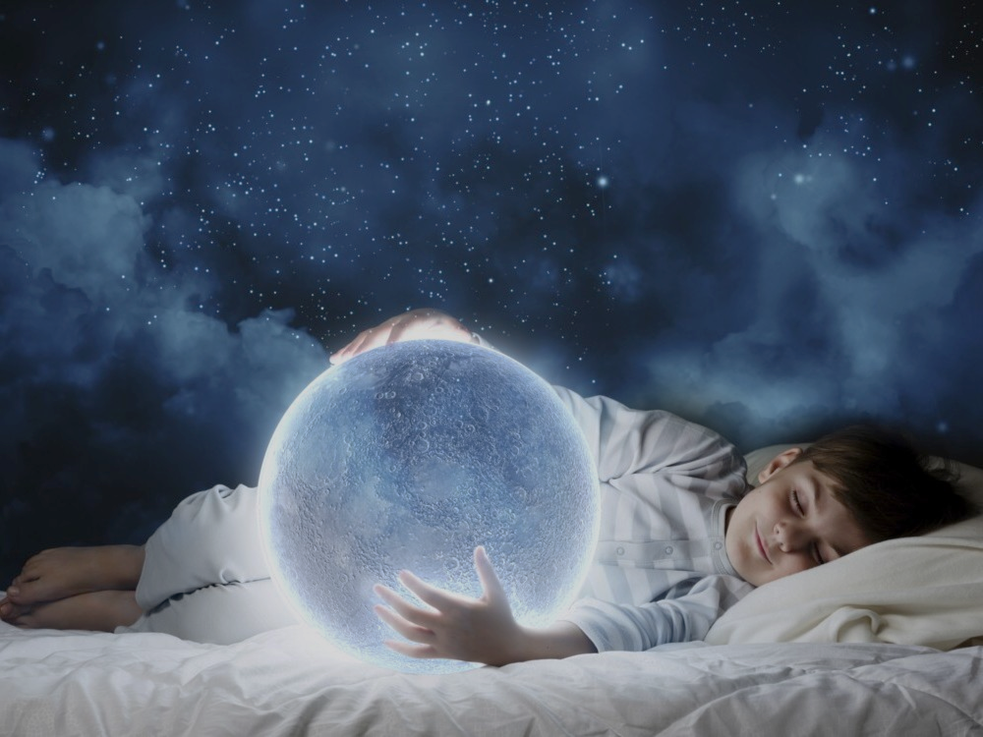
DREAMS
Free Template
Here is where your presentation begins
https://plantillaspowerpoint.org/
Notes:
plantillaspower-point.com

Slide 2


Table of contents
01
02
03
About the patient
Discussion
Diagnosis
04
05
Treatment
Patient monitoring
You can describe the topic of the section here
You can describe the topic of the section here
You can describe the topic of the section here
You can describe the topic of the section here
You can describe the topic of the section here
Notes:
plantillaspower-point.com

Slide 3

Introduction
You can give a brief description of the topic you want to talk about here. For example, if you want to talk about Mercury, you can say that it’s the smallest planet in the entire Solar System
Notes:
plantillaspower-point.com

Slide 4
01
About the patient
You can enter a subtitle here if you need it

Slide 5
Identifying information
Mercury
Venus
Mars
It’s the closest planet to the Sun and the smallest in the Solar System
Venus has a beautiful name and is the second planet from the Sun
Despite being red, Mars is actually a cold place. It’s full of iron oxide dust
Notes:
plantillaspower-point.com

Slide 6


THE SLIDE TITLE GOES HERE!
Do you know what helps you make your point clear? Lists like this one:
They’re simple
You can organize your ideas clearly
You’ll never forget to buy milk!
And the most important thing: the audience won’t miss the point of your presentation

Slide 7

Patient’s medical history
2022
Venus has a beautiful name and very high temperatures
Age | 30
Gender | Male
Diseases | None
Location | Spain
Despite being red, Mars is a cold place full of iron oxide dust
2021

Slide 8
Review of systems
Do you know what helps you make your point crystal clear?
Lists like this one:
They’re simple
You can organize your ideas clearly
You’ll never forget to buy milk!
And the most important thing: the audience won’t miss the point of your presentation
Notes:
plantillaspower-point.com

Slide 9
Physical examination
Venus
Venus has extremely high temperatures
Mercury
Mercury is the smallest planet of them all
Jupiter
Jupiter is a gas giant and the biggest planet

Slide 10

MAYBE YOU NEED TO
DIVIDE THE TEXT
MERCURY
VENUS
Venus has a beautiful name and is the second planet from the Sun. It’s terribly hot, even hotter than Mercury
Venus has a beautiful name and is the second planet from the Sun. It’s terribly hot, even hotter than Mercury
Notes:
plantillaspower-point.com

Slide 11
Discussion
Dr. Sara James
Dr. Mike Jones
Dr. John Lee
Dr. Mary Doe
Venus has a beautiful name and high temperatures
Jupiter is the biggest planet in the Solar System
Despite being red, Mars is a very cold planet
Saturn is composed mostly of hydrogen and helium

Slide 12
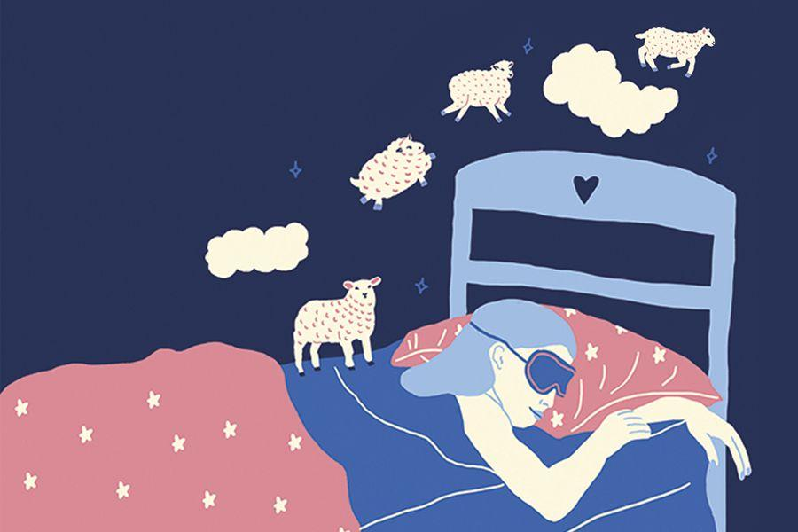
THE SLIDE TITLE GOES HERE!
Do you know what helps you make your point clear? Lists like this one:
They’re simple
You can organize your ideas clearly
You’ll never forget to buy milk!
And the most important thing: the audience won’t miss the point of your presentation
Notes:
plantillaspower-point.com

Slide 13
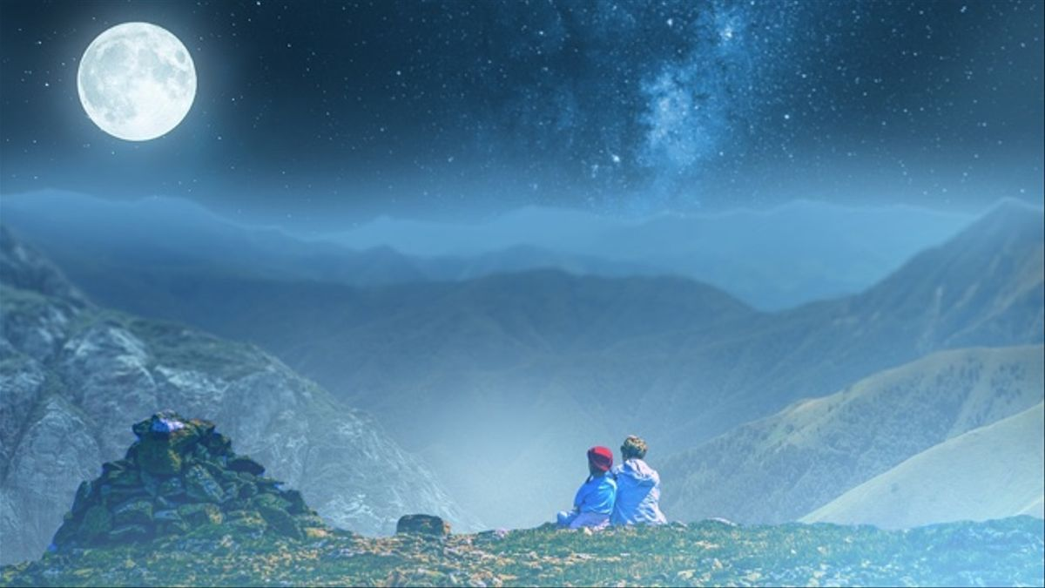

Slide 14
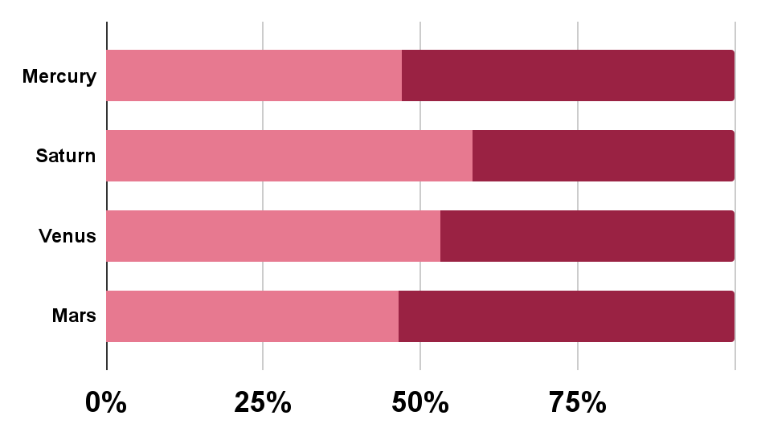
Findings
Evolution
Prevalence
45%
55%
Despite being red, Mars is a cold place
Saturn is a gas giant and has several rings
200,000,000
Follow the link in the graph to modify its data and then paste the new one here. For more info, click here
Neptune

Slide 15
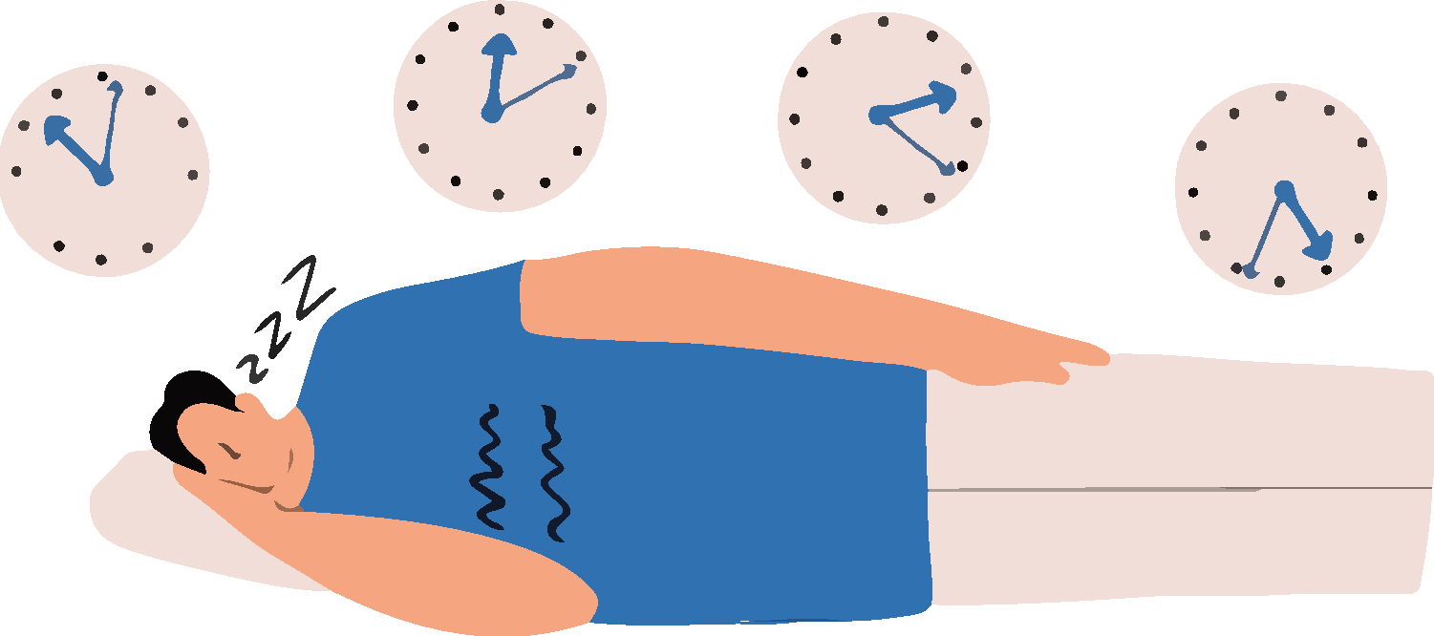
SOME PERCENTAGES
Neptune is the farthest planet from the Sun
Mercury is the closest planet to the Sun
33%
45%
Despite being red, Mars is actually a cold place
22%
Notes:
plantillaspower-point.com

Slide 16


—SOMEONE FAMOUS
“This is a quote, words full of wisdom that someone important said and can make the reader get inspired.”
Notes:
plantillaspower-point.com

Slide 17

Discussion summary
Images reveal large amounts of data, so remember: use an image instead of a long text. Your audience will appreciate it
Notes:
plantillaspower-point.com

Slide 18
DREAMS
Free Template
Here is where your presentation begins
Notes:
plantillaspower-point.com

Slide 19

Awesome words

Slide 20
146M
Number of people that celebrate Saint Patrick’s Day in the US
Notes:
plantillaspower-point.com

Slide 21


A PICTURE ALWAYS REINFORCES THE CONCEPT
Images reveal large amounts of data, so remember: use an image instead of a long text. Your audience will appreciate that

Slide 22

Diagnosis
Mercury
Venus
Mars
Jupiter
Saturn
It’s the closest planet to the Sun
Venus is the second planet from the Sun
Mars is actually a very cold place
Jupiter is the biggest planet of them all
It’s composed of hydrogen and helium

Slide 23

—Someone Famous
“This is a quote, words full of wisdom that someone important said and can make the reader get inspired.”
Notes:
plantillaspower-point.com

Slide 24
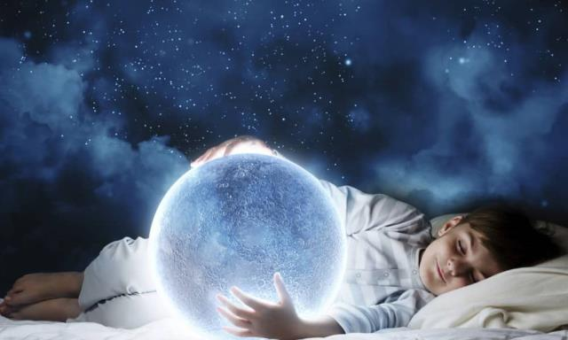
A PICTURE IS WORTH A THOUSAND WORDS

Slide 25

Treatment
Call your doctor
Reach out to a friend
Mercury is the closest planet to the Sun and the smallest of them all—it’s only a bit larger than the Moon
Venus has a beautiful name and is the second planet from the Sun. It’s hot and has a poisonous atmosphere
Notes:
plantillaspower-point.com

Slide 26
Patient monitoring
Week 1
Week 2
Week 3
Jupiter is the biggest planet of them all
Saturn is the only planet with rings
Despite being red, Mars is cold
Mood | Sad
Energy | 10%
Mood | Sad
Energy | 20%
Mood | Calm
Energy | 70%

Slide 27

A picture always reinforces the concept
Images reveal large amounts of data, so remember: use an image instead of long texts
Images reveal large amounts of data, so remember: use an image instead of long texts
Images reveal large amounts of data, so remember: use an image instead of long texts

Slide 28


A picture is worth a thousand words

Slide 29
Contraindications & indications
What to do
What not to do
You can describe the treatment indication here
You can describe the treatment indication here
You can describe the treatment indication here
You can describe a reason to stop the treatment here
You can describe a reason to stop the treatment here
You can describe a reason to stop the treatment here

Slide 30
Post-prevention
Herbal treatment
Therapy
Antidepressants
Venus has a beautiful name and is the second planet from the Sun
Mercury is the closest planet from the Sun and the smallest one
Despite being red, Mars is a very cold planet full of iron oxide dust

Slide 31
AWESOME
WORDS
You can simply impress your audience and add a unique zing and appeal to your Presentations. Get a modern PowerPoint Presentation that is beautifully designed. I hope and I believe that this Template will your Time, Money and Reputation.

Slide 32
A TIMELINE ALWAYS WORKS WELL
Bathroom saving
Saving money
Despite being red, Mars is cold
Jupiter is a gas giant and the biggest planet
Water quality
Drought reduction
Venus has a beautiful name, but it’s hot
Mercury is the closest planet to the Sun

Slide 33
Infographic Style
Content Here
You can simply impress your audience and add a unique zing and appeal to your Presentations.
99%
Content Here
You can simply impress your audience and add a unique zing and appeal to your Presentations.
85%
Content Here
You can simply impress your audience and add a unique zing and appeal to your Presentations.
67%
Notes:
plantillaspower-point.com

Slide 34
Case timeline
Earth is the third planet from the Sun
Venus is the second planet from the Sun
Day 1
Day 3
Day 2
Day 4
Jupiter is the fifth planet from the Sun
Mercury is the smallest planet

Slide 35
150,000
Big numbers catch your audience’s attention

Slide 36

9h 55m 23s
333,000
386,000 km
Is Jupiter's rotation period
Earths is the Sun’s mass
Is the distance between Earth and the Moon

Slide 37
Higher incidence
10%
25%
35%
30%
Jupiter
Earth
Mars
Venus
It’s a big planet
We all live here
Mars is a cold place
It is a hot planet

Slide 38



Conclusions
Earth is the third planet from the Sun and the only one that harbors life in the Solar System. This is where we all live

Slide 39
References
AUTHOR (YEAR). Title of the publication. Publisher
AUTHOR (YEAR). Title of the publication. Publisher
AUTHOR (YEAR). Title of the publication. Publisher
AUTHOR (YEAR). Title of the publication. Publisher
AUTHOR (YEAR). Title of the publication. Publisher
AUTHOR (YEAR). Title of the publication. Publisher
AUTHOR (YEAR). Title of the publication. Publisher
AUTHOR (YEAR). Title of the publication. Publisher
AUTHOR (YEAR). Title of the publication. Publisher
AUTHOR (YEAR). Title of the publication. Publisher
Notes:
plantillaspower-point.com

Slide 40

Social media
You can replace the image on the screen with your own work. Just right-click on it and select “Replace image”

Slide 41
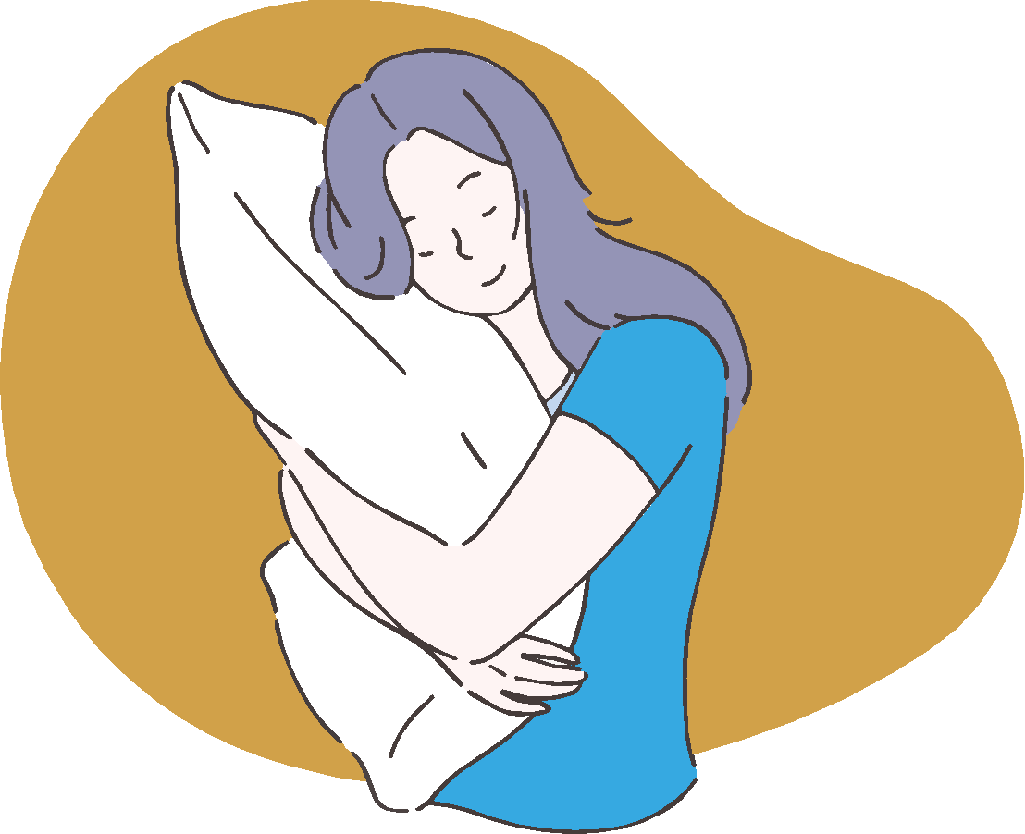
Our team
Jenna Doe
Mike Bones
You can speak a bit about this person here
You can speak a bit about this person here

Slide 42
Thanks!
Do you have any questions?
Earth is the third planet from the Sun and the only one that harbors life in the Solar System. This is where we all live
Please keep this slide for attribution
www.plantillaspower-point.com

Slide 43
www.plantillaspower-point.com
Notes:
plantillaspower-point.com

Slide 44


ALTERNATIVE RESOURCES
Here’s an assortment of alternative resources whose style fits that of this template

Slide 45


ALTERNATIVE RESOURCES
Here’s an assortment of alternative resources whose style fits that of this template

Slide 46

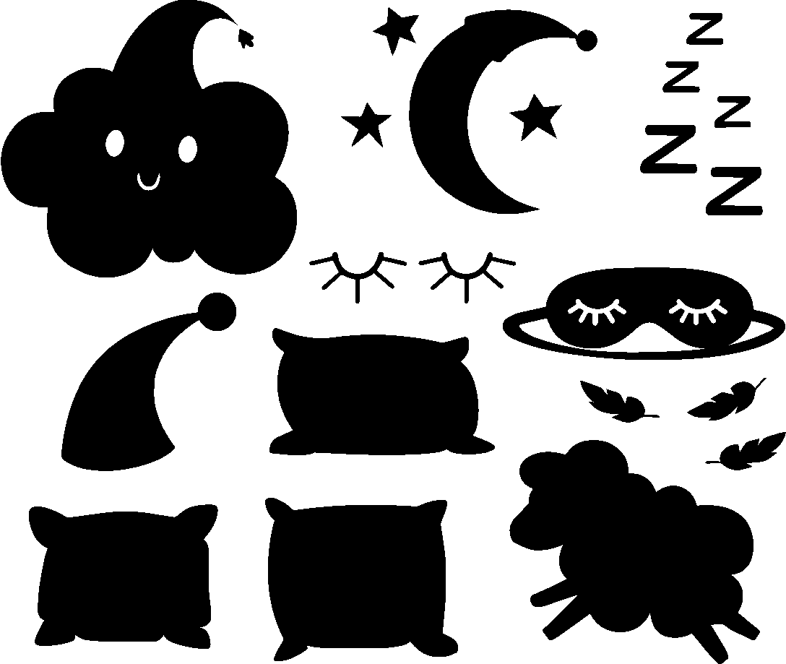
ALTERNATIVE RESOURCES
Here’s an assortment of alternative resources whose style fits that of this template
www.plantillaspower-point.com
Notes:
plantillaspower-point.com

Slide 47
...and our sets of editable icons
www.plantillaspower-point.com

Slide 48
Educational Icons
Medical Icons
www.plantillaspower-point.com

