Slide 1
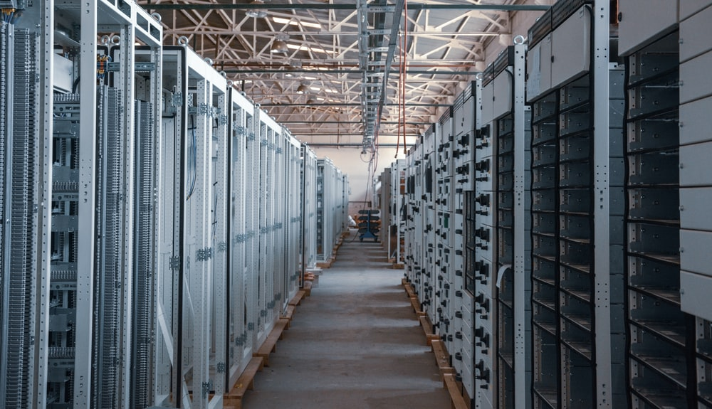
DOCUMENTS IN THE CLOUD
Free Template

Slide 2
TABLE OF CONTENTS
01
02
OBJECTIVES
METHODOLOGY
You can describe the topic of the section here
You can describe the topic of the section here
03
04
RESULTS ANALYSIS
CONCLUSIONS
You can describe the topic of the section here
You can describe the topic of the section here

Slide 3
Whoa!
It could be the part of the presentation where you can introduce yourself. Keep it short and go straight to the point. Your audience will appreciate that

Slide 4
Isometric Clouds Infographics
01
Jupiter
Mercury
02
Jupiter is a gas giant and the biggest object in the Solar System
Mercury is the closest planet to the Sun and the smallest one
03
Mars
Saturn
04
Despite being red, Mars is actually a very cold place
It is the ringed planet. It is composed of hydrogen and helium

Slide 5
Isometric Clouds Infographics
1
2
Mercury
Venus
It’s the smallest and innermost planet in the entire Solar System
It’s the second planet from the Sun. It was named after a goddess
3
4
Saturn
Jupiter
It is the sixth planet from the Sun and the second-largest
It’s the fifth planet from the Sun and the largest in the Solar System

Slide 6
Isometric Clouds Infographics
01
02
03
Neptune
Mercury
Mars
Neptune is the farthest planet from the Sun
Mercury is the closest planet to the Sun
Despite being red, Mars is actually a cold place

Slide 7

A picture is worth a thousand words

Slide 8
Isometric Clouds Infographics
Mercury
Jupiter
1
Mercury is the closest planet to the Sun and the smallest one
Jupiter is a gas giant and the biggest planet in the Solar System
2
Venus
Mars
3
It has a beautiful name and is the second planet from the Sun
Despite being red, it is actually a cold place full of iron oxide dust
4

Slide 9
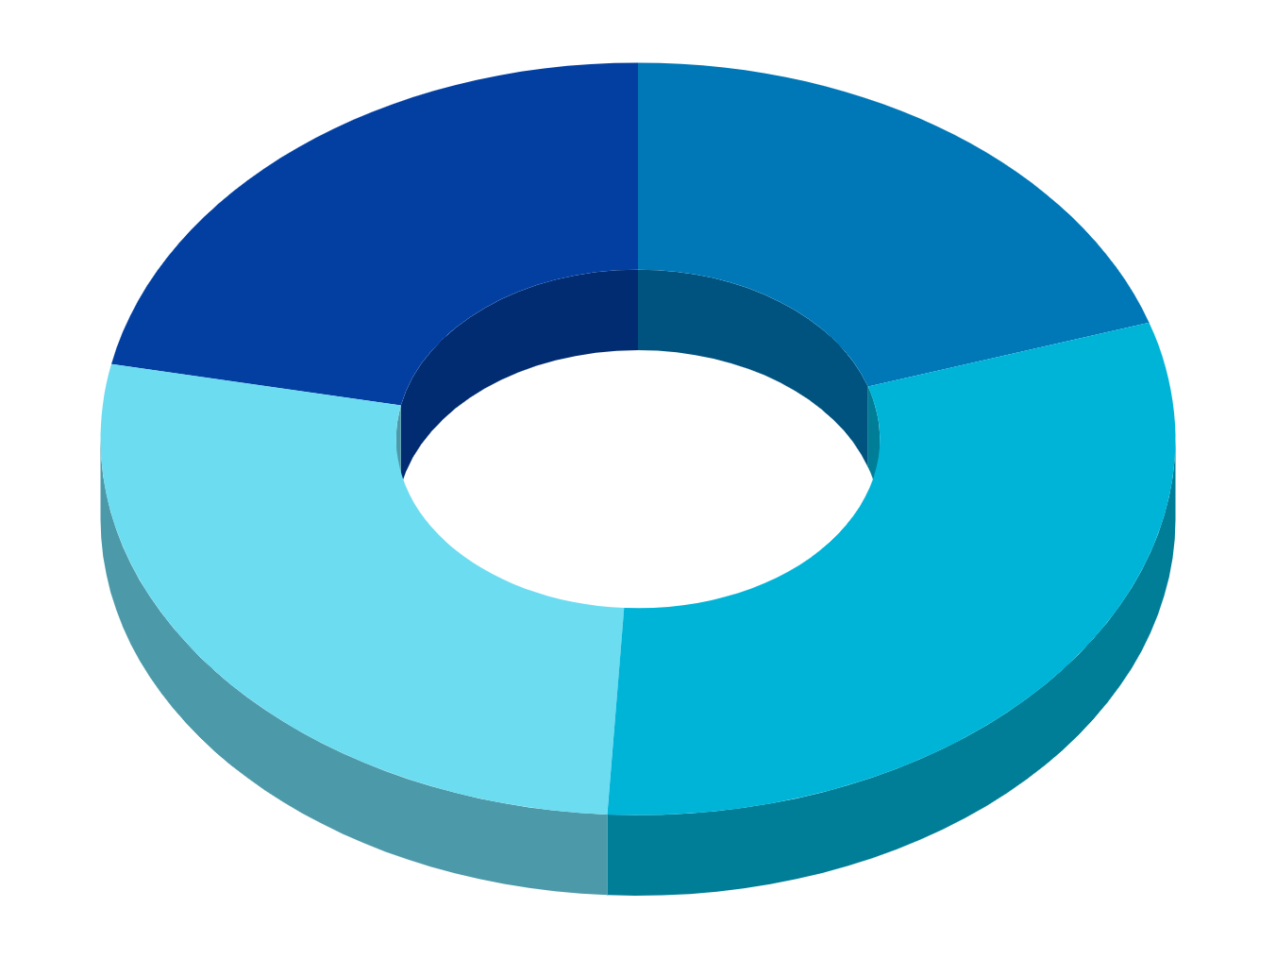
Isometric Clouds Infographics
01
02
Saturn
Mars
It’s composed mostly of hydrogen and helium
Despite being red, Mars is a cold place
03
04
Jupiter
Mercury
The fifth planet from the Sun and the largest one
It is the smallest and innermost planet

Slide 10
Isometric Clouds Infographics
Mars
01
Despite being red, Mars is a cold place. It’s full of iron oxide dust
Mercury
02
Mercury is the closest planet to the Sun and the smallest one
Venus
03
Venus has a beautiful name and is the second planet from the Sun

Slide 11
Isometric Clouds Infographics
Jupiter
1
2
Saturn
Jupiter is the biggest planet
Saturn is the ringed planet
Venus
3
4
Neptune
Venus has a beautiful name
Neptune is the farthest planet

Slide 12
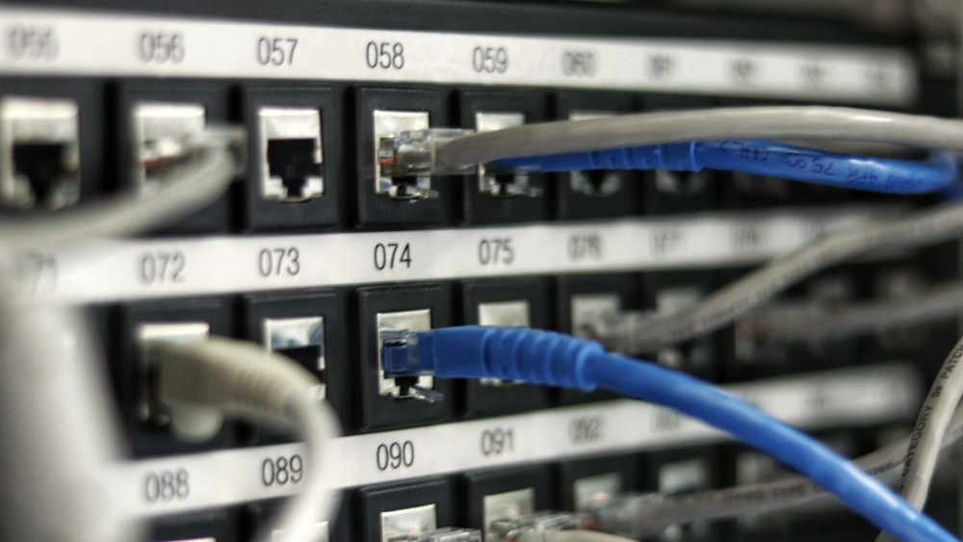
Awesome words
Because key words are great for catching your audience’s attention

Slide 13
Isometric Clouds Infographics
01
02
Mercury
Saturn
Mercury is the closest planet to the Sun and the smallest one
It is the ringed planet. It is composed of hydrogen and helium
03
04
Jupiter
Mars
Jupiter is a gas giant and the biggest object in the Solar System
Despite being red, Mars is actually a very cold place

Slide 14
Isometric Clouds Infographics
Venus
Venus has a beautiful name and is the second planet from the Sun
Mars
Despite being red, Mars is actually a cold place full of iron oxide dust
Mercury
Mercury is the closest planet to the Sun and the smallest one

Slide 15
Isometric Clouds Infographics
60%
75%
Mars
Neptune
Despite being red, Mars is a cold place
It’s a gas giant and the biggest planet
53%
61%
Mercury
Venus
Mercury is the closest planet to the Sun
Venus is the second planet from the Sun

Slide 16
Isometric Clouds Infographics
Jupiter is the biggest planet
1
2
It’s a gas giant and has several rings
Despite being
red, Mars is cold
3
4
Mercury is the smallest planet
Venus has a beautiful name
5
6
Neptune is the farthest planet

Slide 17
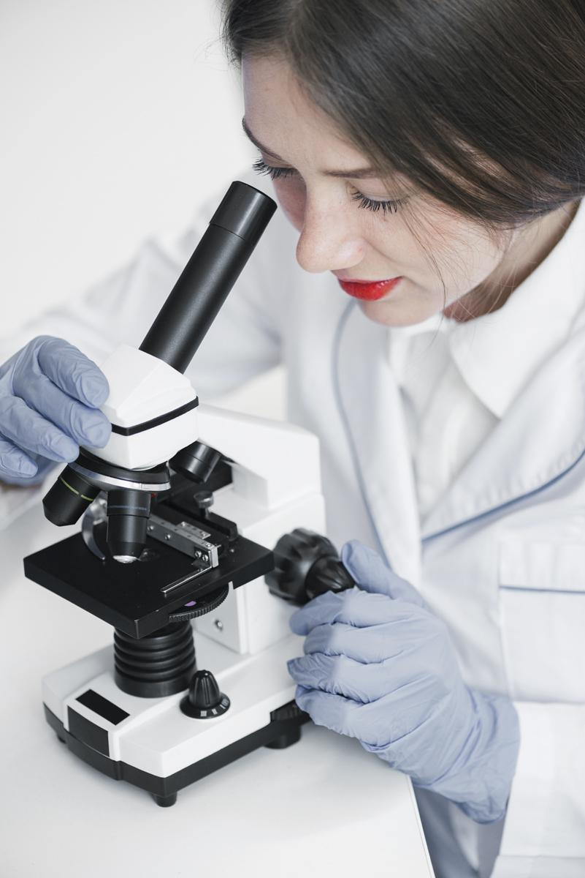
CONCLUSIONS
Saturn is a gas giant. It is made up of 94% hydrogen, 6% helium and small amounts of methane and ammonia. Hydrogen and helium are what most stars are made of

Slide 18
Isometric Clouds Infographics
Jupiter
Mercury
Jupiter is a gas giant and also the biggest planet
Mercury is the closest planet to the Sun
Mars
Venus
Despite being red, Mars is a cold place
Venus is the second planet from the Sun
Neptune
Earth
Neptune is the farthest planet from the Sun
Earth is the only planet that harbors life

Slide 19
Isometric Clouds Infographics
Mercury
Mercury is the closest planet to the Sun
Mars
Despite being red, Mars is a cold place
Venus
Venus is the second planet from the Sun
Neptune
Neptune is the farthest planet from the Sun

Slide 20
Isometric Clouds Infographics
Mercury
Neptune
Mercury is the closest planet to the Sun and the smallest one in the Solar System
Neptune is the farthest planet from the Sun and also the fourth-largest of them all
Mars
Saturn
Despite being red, Mars is a very cold place. The planet is full of iron oxide dust
Earth is the third planet from the Sun and, apparently, the only one that harbors life

Slide 21
Isometric Clouds Infographics
Mercury
Neptune
Mercury is the closest planet to the Sun and the smallest one in the Solar System
Neptune is the farthest planet from the Sun and also the fourth-largest of them all
Mars
Saturn
Despite being red, Mars is a very cold place. The planet is full of iron oxide dust
Earth is the third planet from the Sun and, apparently, the only one that harbors life

Slide 22
Isometric Clouds Infographics
Mars
Despite being red, Mars is a cold place. The planet is full of iron oxide dust
Saturn
Neptune
Saturn is the ringed one. It’s composed mostly of hydrogen and helium
The reason why Neptune is blue is due to the presence of gas methane

Slide 23

TENDENCY
Mercury is the closest planet to the Sun and the smallest one in the Solar System. The planet’s name has nothing to do with the liquid metal, since it was named after the Roman messenger god
To modify this graph, click on it, follow the link, change the data and paste the new graph here

Slide 24
Isometric Clouds Infographics
Venus
Venus has a beautiful name and is the second planet from the Sun
Mercury
Mercury is the closest to the Sun and the smallest of them all
Mars
Despite being red, it’s a cold place full of iron oxide dust
Jupiter
Jupiter is a gas giant and the biggest planet in the Solar System

Slide 25
Isometric Clouds Infographics
01
Mercury is the closest planet to the Sun
Mercury
02
Venus is the second planet from the Sun
Venus
03
Big Data
Jupiter is a gas giant and the biggest planet
Jupiter
04
Yes, this is the ringed one. It’s a gas giant
Saturn

Slide 26
Isometric Clouds Infographics
01
Venus has a beautiful name and is the second one from the Sun
02
Mercury is the closest planet to the Sun and the smallest one
03
Despite being red, Mars is a cold place full of iron oxide dust
Venus
50%
Mercury
70%
04
Mars
70%
Jupiter
40%
It’s a gas giant and the biggest planet in the Solar System

Slide 27
Isometric Clouds Infographics
Mars
Saturn
Despite being red, Mars is a cold place
It’s a gas giant and the biggest planet
Mercury
Venus
Mercury is the closest planet to the Sun
Venus is the second planet from the Sun

Slide 28
Isometric Clouds Infographics
Venus is a planet that has a really beautiful name and is the second planet from the Sun
Mars is a cold desert world. It is half the size of Earth. Mars is sometimes called the Red Planet
Jupiter is the biggest planet in our solar system. It's similar to a star, but it never got big enough
Saturn isn’t the only planet to have rings, but it definitely has the most beautiful ones

Slide 29
THANKS
Do you have any questions?
+91 620 421 838
Domain.com
Free Template

Slide 30
FUENTE
ELABORADO POR : plantillaspowerpoint.org
IMAGES :
unsplash.com
pixabay.com
flickr.com
FONTS :
Quicksand

Slide 31
RESOURCES
Notes:
<!-- Generator: Adobe Illustrator 24.0.2, SVG Export Plug-In -->
<svg version="1.1" xmlns="http://www.w3.org/2000/svg" xmlns:xlink="http://www.w3.org/1999/xlink" x="0px" y="0px"
width="125.93px" height="312.84px" viewBox="0 0 125.93 312.84" style="enable-background:new 0 0 125.93 312.84;"
xml:space="preserve">
<style type="text/css">
.st0{fill:#45A4DC;}
.st1{fill:#2C52A0;}
.st2{fill:#61C5E2;}
.st3{fill:#2F5CA8;}
.st4{fill:#1C3F92;}
.st5{fill:#283778;}
.st6{fill:#45A0D9;}
.st7{fill:#336CB4;}
.st8{fill:#26387D;}
.st9{fill:#3C87C8;}
.st10{fill:#346EB5;}
.st11{fill:#3E8CCB;}
.st12{fill:#3F90CE;}
</style>
<defs>
</defs>
<path class="st0" d="M63.4,66.12c-14.69,0.01-29.38,0.03-44.06,0.03c-1.42,0-2.86-0.03-4.2-0.64c1.26-0.62,2.19-1.63,3.16-2.6
C28.61,52.6,38.92,42.29,49.23,31.98c5.53-5.53,11.05-11.07,16.62-16.56c3.08-2.62,5.79-5.62,8.64-8.47
c3.27-3.26,7.1-5.47,11.63-6.44c14.74-3.15,28.43,8.71,27.38,23.75c-0.11,1.57-0.33,3.15-0.89,4.65c-0.31,1.34-1.33,1.43-2.38,1.27
c-4.26-0.63-8.2,0.28-11.95,2.32c-1.42,0.77-2.59,1.85-3.7,2.95c-4.43,4.37-8.84,8.77-13.23,13.19c-4.21,4.23-8.53,8.37-12.64,12.71
c-1.33,1.41-2.87,2.61-4.13,4.1C64.26,65.81,63.8,65.91,63.4,66.12z"/>
<path class="st1" d="M76.05,312.77c-15.15,0.02-30.29,0.03-45.44,0.05c-0.2,0-0.41-0.04-0.61-0.06c-0.05-0.43,0.3-0.5,0.58-0.55
c5.64-1.01,9.92-4.05,13.07-8.77c1.65-2.92,2.44-6.05,2.42-9.4c-0.03-3.89,0.02-7.78-0.02-11.66c-0.01-0.45-0.13-0.93,0.24-1.31
c0.74-1.06,0.53-2.34,0.82-3.51c2.94-11.89,10.31-19.65,22.2-22.3c11.83-2.65,21.83,1.17,29.45,10.68
c3.47,4.33,5.39,9.36,5.89,14.91c0.19,0.39,0.06,0.81,0.12,1.21c0.15,1.04-0.42,1.38-1.33,1.38c-1.03,0-2.04,0.14-3.05,0.35
c-6.87,1.41-11.62,7.22-11.64,14.26c0,0.97,0.03,1.95-0.03,2.92c-0.33,5.33-3.14,8.9-7.85,11.19
C79.29,312.9,77.64,312.47,76.05,312.77z"/>
<path class="st2" d="M63.4,66.12c4.76-4.84,9.58-9.63,14.41-14.41c2.54-2.52,5.1-5.05,7.56-7.66c2.92-3.09,5.93-6.08,9-9.01
c3.08-2.94,6.65-4.89,11.03-5.26c1.63-0.14,3.22-0.33,4.84,0.03c0.93,0.2,1.83,0.07,2.37-0.9c-0.11,0.87,0.2,1.35,1.1,1.69
c3.5,1.33,6.53,3.39,8.75,6.46c5.69,7.84,4.24,19.24-3.28,25.2c-3.8,3.01-8.14,4.08-12.83,4.09c-13.71,0.02-27.42,0.01-41.13,0.01
C64.6,66.35,63.98,66.38,63.4,66.12z"/>
<path class="st3" d="M65.84,15.42c0.06,0.69-0.52,0.96-0.9,1.34c-4.5,4.39-9,8.79-13.39,13.28C40.13,41.69,28.46,53.09,17.02,64.71
c-0.55,0.56-1.12,0.84-1.88,0.8c-6.38-1.74-10.96-5.54-13.49-11.7c0.02-0.66,0.37-1.14,0.82-1.58c7.92-7.74,15.71-15.62,23.52-23.48
c0.52-0.52,1.09-0.89,1.79-1.09c2.85-2.42,5.3-5.24,8-7.81c2.18-2.08,4.1-4.43,6.54-6.23C49.49,8.32,59.86,9.12,65.84,15.42z"/>
<path class="st4" d="M46.28,281.06c0.3,0.89,0.24,1.81,0.24,2.72c0,3.77,0.07,7.54-0.02,11.31c-0.08,3.18-0.85,6.19-2.74,8.84
c-0.6,0.13-1.21,0.16-1.82,0.16c-9.03-0.01-18.07-0.06-27.1,0.04c-2.17,0.02-3.54-0.59-4.39-2.67c-0.38-0.94-0.66-2.02-1.44-2.79
c-2.9-7.03-0.63-16.29,5.36-21.88c9.35-8.73,24.26-7.09,31.48,3.48C46.03,280.51,46.14,280.79,46.28,281.06z"/>
<path class="st0" d="M44.7,195.43c-6.01-0.06-12.09,0.76-17.97-1.2c-8.87-2.95-15.1-8.73-18.03-17.65
c-3.33-10.16-1.14-19.38,5.91-27.24c4.66-5.19,10.71-8.11,17.77-8.65c0.67-0.05,1.33-0.11,1.87-0.56c3.84,0,7.45,1.27,11.16,1.99
c2.73,1.44,5.43,2.93,7.75,4.99c0.72,0.64,1.74,1.12,1.72,2.33c-0.21,0.33-0.56,0.57-0.9,0.45c-1.47-0.53-1.69,0.44-1.98,1.49
c-0.24,0.89-0.6,1.74-1.24,2.43c-0.47,0.51-0.7,1.1-0.8,1.78c-0.18,1.25-0.91,2-2.2,2.16c-0.57-0.17-0.98-0.56-1.36-0.97
c-5.24-5.75-15.43-6.71-21.92-1.26c-8.15,6.84-7.69,19.14,0.42,25.24c3.16,2.38,6.75,3.5,10.75,3.5c20.13-0.04,40.25-0.03,60.38,0
c0.83,0,1.87-0.44,2.44,0.66c-0.63,0.72-1.49,0.56-2.28,0.56c-4.47,0.01-8.94,0.04-13.41-0.02c-6.66,0.04-13.32,0.07-19.98-0.01
c-5.37-0.04-10.74,0.01-16.11-0.03c-0.96-0.01-1.64,0.17-2.08,1.13c-0.32,0.71-1.03,1.2-1.76,1.41c-1.51,0.43-2,1.42-2.25,2.88
c-0.4,2.33-1.53,3.39-3.59,3.85c-0.2,0.01,0,0.33-0.07,0.14c-0.01-0.02,0.03-0.04,0.13-0.05c2.14-0.2,4.29-0.09,6.44-0.05
C43.99,194.75,44.61,194.71,44.7,195.43z"/>
<path class="st0" d="M76.05,312.77c2.07-0.24,4.12-0.45,5.94-1.64c3.13-2.06,5.44-4.6,6.1-8.49c0.45-2.64-0.02-5.29,0.54-7.91
c1.33-6.3,7.2-11.39,13.64-11.69c2.24-0.1,2.24-0.1,2.37-2.2c0.01,1.75,0.99,2.29,2.62,2.75c6.03,1.72,9.67,5.89,10.66,12.01
c0.94,5.82-1.14,10.66-5.83,14.29c-2.69,2.08-5.78,2.97-9.17,2.96C93.96,312.81,85,312.79,76.05,312.77z"/>
<path class="st3" d="M82.79,185.01c4.68-0.02,9.36-0.03,14.05-0.06c0.54,0,1.13,0.17,1.62-0.22c0.53-0.58,1.31-0.53,1.97-0.74
c3.7-1.16,6.01-3.66,6.78-7.41c0.78-3.81-0.62-6.91-3.65-9.29c-0.4-0.31-0.84-0.59-1.2-0.96c-0.59-0.67-0.38-1.46-0.27-2.2
c0.41-2.63,0.69-5.26,0.67-7.93c0-0.62,0.01-1.32,0.99-1.07c9.39,2.84,15.18,11.18,14.72,21.19c-0.41,8.86-7.48,16.86-16.55,18.71
c-0.5,0.1-1.01,0.1-1.52,0.15c-3.57,0.26-7.15,0.05-10.73,0.11c-1.79,0.03-3.58,0.01-5.37,0c-1.77,0-3.2-1.3-3.08-3.04
c0.1-1.52,0.31-3.11,1.96-3.89c0.7-0.33,0.6-0.8,0.36-1.39C83.28,186.32,82.69,185.8,82.79,185.01z"/>
<path class="st5" d="M27.78,27.66c-7.66,7.63-15.32,15.25-22.97,22.88c-1.07,1.07-2.29,2.01-3.16,3.27
c-4.58-9.9,0.8-22.61,11.21-26.4C17.85,25.58,22.84,25.52,27.78,27.66z"/>
<path class="st3" d="M45.58,142.3c-0.78,0.71-1.59,0.16-2.28-0.09c-2.65-0.94-5.36-1.48-8.17-1.48c-0.43,0-0.83-0.04-0.87-0.6
c5.28-9.45,13.13-15.59,23.64-18.24c1.78-0.45,3.65-0.56,5.48-0.83c1.97-0.21,3.94-0.21,5.92,0l0.02-0.01
c-0.06,0.86-0.84,0.74-1.34,0.92c-1.2,0.42-2.09,0.98-2.53,2.34c-0.51,1.58-1.37,3.04-1.5,4.74c-0.05,0.68-0.72,0.94-1,1.44
c0.28,0.51,1.18,0.28,1.15,1.06c-1.1,0.89-2.51,0.79-3.77,1.11c-5.5,1.41-9.97,4.36-13.59,8.68
C46.4,141.74,46.15,142.22,45.58,142.3z"/>
<path class="st6" d="M103.76,155.13c-0.3,0.09-0.66,0.18-0.62,0.56c0.32,3.27-0.31,6.46-0.79,9.66c-0.07,0.46,0.21,0.63,0.38,0.91
c-0.46,1.73-0.97,3.45-1.63,5.11c-0.44,1.12-1.15,1.48-2.29,0.95c-1.25-0.59-2.55-1.06-3.79-1.68c-3.04-1.51-4.09-3.69-3.59-7.04
c0.43-2.87,1.11-5.74,0.52-8.68c-0.08-0.4-0.02-0.82,0.22-1.18c0.21-0.24,0.72,0.32,0.82-0.49c0.24-1.96,0.59-3.91,1.03-5.84
c0.32-1.39,0.43-2.82,1.64-3.82c0.19-0.16,0.34-0.41,0.36-0.66c0.15-1.64,1.35-2.53,2.45-3.5c2.64,4.21,3.94,8.87,4.61,13.74
C103.19,153.87,103.2,154.59,103.76,155.13z"/>
<path class="st7" d="M82.79,185.01c0.86,0.61,0.97,1.72,1.63,2.49c0.43,0.5,0.11,0.92-0.48,1.16c-2.32,0.96-2.58,3.07-1.61,5.2
c0.78,1.71,1.81,1.25,2.87,1.26c5.07,0.06,10.14,0.05,15.21,0.06c-0.44,0.36-0.98,0.26-1.47,0.26c-8.56,0-17.11-0.01-25.67-0.02
c-3.76-0.29-7.53-0.05-11.3-0.12c-0.51-0.01-1.02,0.01-1.53,0c-1.41-0.03-2.02-1-1.27-2.23c0.5-0.83,0.75-1.65,0.78-2.59
c0.01-0.2,0-0.44,0.11-0.6c1.07-1.49,1.4-3.36,2.48-4.85C69.28,185.02,76.04,185.01,82.79,185.01z"/>
<path class="st8" d="M9.01,298.66c0.08-0.19,0.15-0.65,0.36-0.08c0.53,1.46,1.57,2.65,2.1,4.13c0.31,0.85,1.2,0.93,2.08,0.92
c9.44-0.03,18.88-0.02,28.32-0.01c0.63,0,1.34-0.25,1.89,0.3c-2.49,3.89-6.01,6.4-10.31,8.04c-1.16,0.44-2.35,0.38-3.46,0.79
c-10.03,0.6-17.99-5.75-20.8-13.36C9.11,299.16,9.07,298.9,9.01,298.66z"/>
<path class="st9" d="M62.52,185.02c-0.42,1.39-0.32,2.97-1.65,4.02c-0.49,0.38-0.54,1.07-0.52,1.7c0.03,0.96,0.18,1.93-0.94,2.52
c-0.5,0.27-0.14,0.81-0.02,1.25c0.18,0.7,0.72,0.61,1.22,0.61c3.68,0.01,7.36,0,11.04,0.02c0.54,0,1.13-0.18,1.61,0.26
c-6.72,0.02-13.44,0.05-20.17,0.06c-2.8,0-5.6-0.03-8.4-0.04c-0.79-0.57-1.68-0.25-2.53-0.27c-2.15-0.05-4.31-0.02-6.54-0.02
c0.17-0.52,0.41-0.56,0.67-0.61c2.6-0.49,3.92-1.89,4.05-4.57c0.06-1.2,0.41-1.78,1.64-2.14c1.19-0.34,2.56-0.77,2.64-2.5
c0.03-0.56,0.67-0.29,1.03-0.29C51.28,185.01,56.9,185.02,62.52,185.02z"/>
<path class="st10" d="M64.04,131.56c-0.51-0.59-1.53-0.22-1.98-1.13c2.24-0.54,1.62-2.73,2.13-4.15c0.92-2.57,1.86-4.7,4.9-5.03
c0.08-0.01,0.15-0.13,0.22-0.2c5.62,0.1,10.72,1.99,15.57,4.66c0.25,0.14,0.43,0.41,0.65,0.61c-0.28,1.83-1.39,3.34-2.04,5.03
c-0.54,1.42-1.44,2.67-0.41,4.26c0.37,0.56,0.05,1.2-0.76,1.33c-0.69-0.07-1.21-0.5-1.77-0.85c-4.33-2.72-9.04-4.14-14.17-4.14
C65.59,131.95,64.74,132.16,64.04,131.56z"/>
<path class="st11" d="M82.38,136.79c0.43-0.27,0.83-0.82,0.42-1.1c-1.65-1.13-0.62-2.63-0.17-3.5c1-1.94,1.52-4.12,2.9-5.87
c1.99,0.63,3.47,2.04,4.99,3.35c3.22,2.78,5.96,5.98,7.97,9.76c-0.02,0.2,0.02,0.55-0.07,0.59c-2,0.85-1.44,3.45-3.11,4.52
c-0.35,0.22-0.48,0.65-0.53,1.07c-0.29,2.42-1.08,4.74-1.27,7.18c-0.04,0.53-0.38,1.04-0.6,1.62c-0.24-0.31-0.41-0.54-0.59-0.77
c-0.66-0.4-0.64-1.12-0.79-1.75c-1.26-5.31-3.86-9.81-7.98-13.41C83.04,138.03,82.39,137.62,82.38,136.79z"/>
<path class="st10" d="M69.29,121.07c-1.97,0-3.94,0-5.92,0C65.34,120.72,67.32,120.67,69.29,121.07z"/>
<path class="st12" d="M54.77,149.4c4.65,4.77,6.96,10.54,7.46,17.13c0.1,1.3-0.31,1.71-1.59,1.61c-1.37-0.11-2.75-0.01-4.13-0.03
c-2.65-0.03-4.59-1.37-5.43-3.9c-0.76-2.29-1.67-4.48-3.07-6.46c0.89-0.87,1.73-1.63,1.72-3.14c-0.01-0.95,1.48-1.47,1.65-2.63
c0.03-0.24,0.25-0.46,0.29-0.7c0.24-1.36,0.33-2.88,2.4-1.68C54.21,149.69,54.53,149.47,54.77,149.4z"/>
</svg>

Slide 32
RESOURCES

Slide 33
RESOURCES

Slide 34
Fully Editable Icon Sets: A

Slide 35
Fully Editable Icon Sets: B

Slide 36
Fully Editable Icon Sets: C

