Slide 1

Payments, Virtual
Solutions, and
Innovation
Avid Modjtabai
Senior Executive
Vice
President
May 11, 2017
© 2017 Wells Fargo & Company. All rights reserved.

Slide 2


Business Overview
Payments, Virtual Solutions, and Innovation

Slide 3
PVSI
was
formed
in
4Q16
Deposit Products Group
_{Ed Kadletz}
▪ Consumer checking and savings
▪ Debit card
▪ Small business checking
Cards and Retail Services
_{Beverly Anderson} ⁽¹⁾
▪ General purpose credit card
▪ Co-branded credit card
▪ Private label credit card
▪ Loyalty/rewards programs
Treasury, Merchant, and Payment Solutions Danny Peltz
▪ Treasury management
▪ Merchant services (card acceptance)
▪ CEO digital portal
▪ Wells Fargo Gateway
Virtual Channels
_{Jim Smith}
▪ Online and mobile banking
▪ 24/7 contact center
▪ E-mail, chat, and social media
Operations
_{Titi Cole}
▪ Payment clearing and settlement
▪ Risk and fraud operations
▪ Electronic and commercial services
▪ Enterprise utilities
▪ Document processing
Innovation
_{Steve Ellis}
▪ Emerging technologies research and development
▪ Artificial intelligence
▪ Innovation labs
▪ Wells Fargo Accelerator
(1) Interim head.
Wells Fargo 2017 Investor Day
Payments, Virtual Solutions, and Innovation 2

Slide 4
Strong
positions
in
payments
and
digital
Payments
_{Leadership}
▪ #1 in Retail deposits ⁽¹⁾
▪ #1 in Debit card transaction and purchase volume ⁽²⁾
▪ #1 in Treasury management ⁽³⁾
▪ #1 in ACH originations ⁽⁴⁾
▪ #2 in e-Commerce as merchant acquirer ⁽⁵⁾
Digital
_{Leadership}
▪ #1 in Consumer mobile banking ⁽⁶⁾
▪ #1 in Consumer online money movement e-delivery ⁽⁷⁾
▪ #1 in Small business in digital ⁽⁸⁾
▪ #1 in Corporate/Institutional mobile banking, integrated corporate banking site, and website design ⁽⁹⁾
(1) FDIC data, SNL Financial, as of June 2016. Retail deposit data is pro forma for acquisitions and caps deposits at $1 billion in a single banking branch and excludes
credit union deposits.(2) Nilson report, April 2017; total 2016 debit and prepaid transaction volume for consumer and small business. (3) Ernst & Young: 2016 Cash Management Survey of fee-equivalent revenues in the U.S. (4) NACHA, Largest Financial Institution Originators of Automated Clearing House Payments, Year 2016. (5) The Nilson Report, March 2017. (6) Q1 2017 Keynote #1 in mobile overall. (7) 2016 Forrester US Online Banking Functionality Benchmark. (8) 2016 Keynote Small Business Scorecard. (9) World’s Best Corporate/Institutional Digital Banks - North America 2016, Global Finance magazine.
Wells Fargo 2017 Investor Day
Payments, Virtual Solutions, and Innovation 3

Slide 5
Digitally
engaged
consumer
and
wholesale customers
Consumer
Wholesale
Consumer Mobile and Online Secure Session
(# of sessions)
Wholesale Mobile Sessions
_{(# of sessions, in thousands)}
Average Monthly Sessions per active user
2014 4.1B 13
2015 5.0B 16
2016 5.6B 17
3.5x
1,320
370
2014 2015 2016
914
90-day Active Digital Payment Consumers ⁽¹⁾
_{(# in millions)}
Wholesale Mobile Money Movement
_{($ in billions)}
+7%
_{12.7} 13.6
1Q16 1Q17
+37%
_{7.0} 9.6
1Q16 1Q17
(1) Customers who in the last 90 days transacted with one or more of the following: bill pay, person to person, wires, asset to credit account transfers (on and off-us),
global remittance, and small business e-payments.
Wells Fargo 2017 Investor Day
Payments, Virtual Solutions, and Innovation 4

Slide 6
Progress on credit card,
despite softer account opens
Win New Cards and Customers
Deepen Engagement
▪ Increased retail bank household
penetration from 43.3% to 45.5%
▪
Refreshed Go Far Rewards; average redeemer spend is 4X non-redeemers
Launched multi-card offers for existing customers
Executing early months on book, spend, and upgrade campaigns
Optimizing credit lines by customer segment
▪ ~30% of 2016 net new accounts from
non-deposit WF households; increased
(1)
▪
penetration from 10.1% to 11.2%
(1)
▪
▪ Grew affluent balances by 10% YoY
(1)(2)
▪ Launched third American Express Propel
_{product and Visa Cash Wise}
▪
POS-active Credit Cards
(#, in millions)
Credit Card Transactions
(#, in millions)
Credit Card Outstandings
($, in billions)
+4%
_{7.4} 7.7
1Q16 1Q17
+6%
₂₅₅ 270
1Q16 1Q17
+7%
_{25.1} 26.9
1Q16 1Q17
All charts reference general purpose credit card only. All data is period-end. (1) From 1Q16 to 1Q17. (2) Affluent defined as >$25k in total wallet.
Wells Fargo 2017 Investor Day
Payments, Virtual Solutions, and Innovation
5

Slide 7

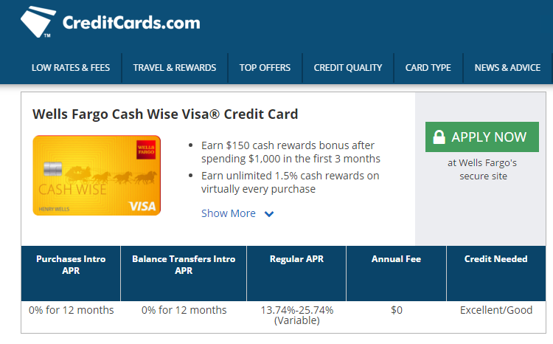
Growing digital distribution
for
credit
card
Expand Distribution & Capabilities
Credit Card Account Opens
_{(by channel)}
2%
8%
Off-us
digital
▪ Building out digital acquisition
_{capabilities:}
12%
15%
7%
WF.com
-
Developing custom underwriting
Scorecards for non-deposit customers and prospects
6%
7%
22%
7%
Phone
4%
75%
69%
Direct mail
-
Growing affiliate relationships
(e.g., creditcards.com, zappos.com)
16%
50%
Branch
-
Leveraging advanced fraud and
Digital data analytics tools
Payments, Virtual Solutions, and Innovati
-
Optimizing digital marketing
assets
▪ Refreshed credit card digital
_{“shopping” experience}
▪ Opened wellsfargo.com to prospect
_{applicants}
Wells Fargo 2017 Investor Day
on 6

Slide 8
Accelerating our
Payments, Virtual Solutions and Innovation
growth

Slide 9
Our opportunities
Our unique opportunities to accelerate growth across Wells Fargo:
▪ Accelerate digital account acquisition with experiences that are simple and fast, end-to- end
▪ Provide best-in-class digital payments for
_{every customer we serve}
▪ Deliver personalized advice at scale to help customers reach their financial goals
▪ Expand and integrate our distribution to
reach our customers wherever they are
▪ Build a platform for innovation to re-shape our infrastructure and deliver greater speed
and flexibility for customers and team members
PVSI brings together:
▪ Broad consumer
_{reach}
▪ Deep business
_{relationships}
▪ Leading positions in
consumer and wholesale payments
▪ Robust digital
_{presence}
Wells Fargo 2017 Investor Day
Payments, Virtual Solutions, and Innovation 8

Slide 10
Our
roadmap
Accelerate digital account acquisition
Provide best-in-class digital payments
Deliver personalized advice at scale
Expand and integrate Wells Fargo distribution
Build a platform for innovation
Wells Fargo 2017 Investor Day
Payments, Virtual Solutions, and Innovation 9

Slide 11
Accelerate digital account
acquisition
Despite growth, digital sales are
_{<10% of new account opens}
Simple, fast, end-to-end digital
Account open experience
Product Functionality Status
Student Loan
End-to-end digital loans
✓
Digital Account Opens
(1)
Personal Loan & Loans
End-to-end digital loans and lines
✓
15%
CAGR
Small Business
FastFlex fast-decision loans funded next day
✓
Mortgage
Digital mortgage application
In pilot
Small Business
FastFlex line of credit
In pilot
Brokerage
Intuitive investor hybrid rono-advisor offering
In pilot
Deposits
Express mobile account open and use
2Q17
Consumer Credit ⁽²⁾
Multi-product credit decisioning and offer
Expected
2H17
Merchant Services
Online application, approval, and setup
1Q15
1Q16
1Q17
SBA Loans
Online application and prequalification (phase 1)
(1) Includes all products available for online applications in the following categories: consumer DDA, general purpose credit card, student loans, home equity,
personal loans, personal lines, WellsTrade, and business deposits and credit. (2) General purpose credit card and personal Loans and lines.
Wells Fargo 2017 Investor Day
Payments, Virtual Solutions, and Innovation 10

Slide 12




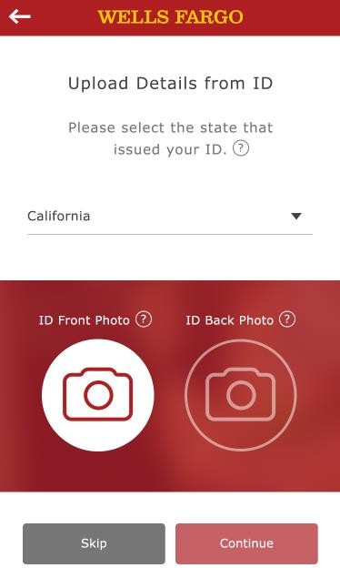
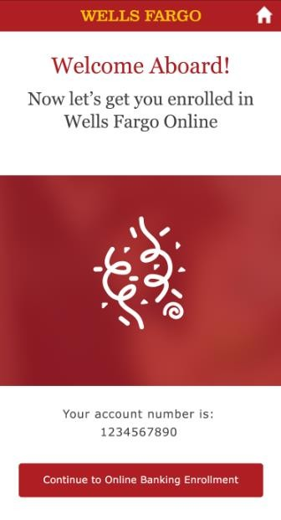
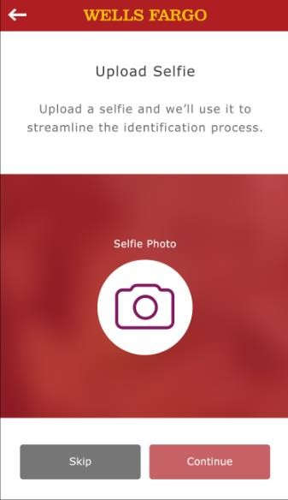
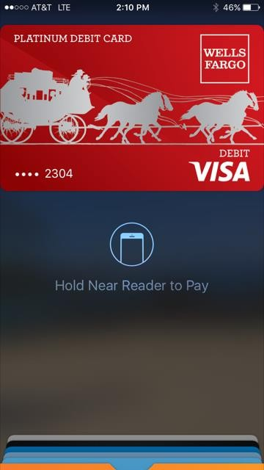
From prospect to
making
a
purchase
in
5
minutes
Launching
May
2017
^{Expected 2H17}
▪ Verify new-to-bank customers with a “selfie”
▪ Immediate use of digital debit card
▪ Use a picture of an official ID to fill in
Application details
▪ Real-time account funding
▪ Instant access to Wells Fargo Mobile Banking
Wells Fargo 2017 Investor Day
Payments, Virtual Solutions, and Innovation
11

Slide 13

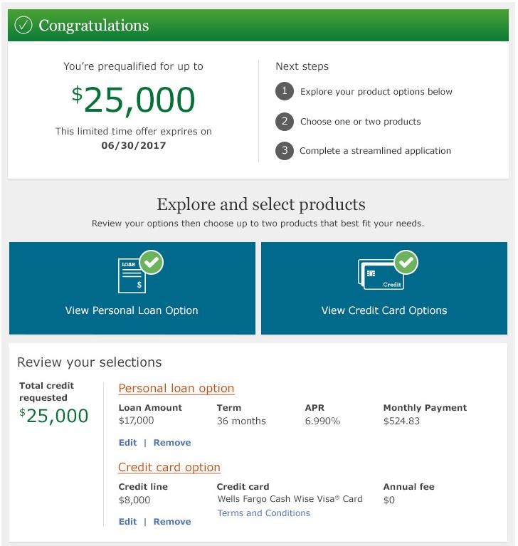
Maximize customer
choice
with
multi-product offers
Expected
2H17
▪
One application,
multiple product approvals
▪
Shifting offers from product-centric to customer-centric
▪
Customer chooses how
to allocate credit limit among products
▪
100% end-to-end
digital, pre-filled and pre-qualified
Wells Fargo 2017 Investor Day
Payments, Virtual Solutions, and Innovation
12

Slide 14
Building
robust
capabilities
for
digital
acquisition
Easy and Simple, End-to-end
Differentiated Value
Expanded Reach
▪ Use system of record data to provide existing Wells Fargo customers with streamlined digital experiences
▪ Leverage trusted source data to provide simpler applications for prospects
▪ Enable instant provisioning of new products (e.g., instant digital debit card)
▪ Provide tailored offers for every customer, leveraging insights and behavior
▪ Underwrite customers holistically (vs. at product level)
▪ Deliver compelling value propositions to attract new customers
▪ Drive broader reach and awareness through strategic partnerships (e.g., affiliates, co-brand, sponsorships)
▪ Embed offers and real- time fulfillment in relevant off-us environments (e.g., cards in online shopping checkout, IRAs in tax software)
Secure data exchange
Enhanced authentication
Digital product issuance
Customer-level
_{behavioral analytics}
AI-driven underwriting
API capabilities
Digital and social marketing
Key Capabilities
Wells Fargo 2017 Investor Day
Payments, Virtual Solutions, and Innovation
13

Slide 15
Our
roadmap
Accelerate digital account acquisition
Provide best-in-class digital payments
Deliver personalized advice at scale
Expand and integrate Wells Fargo distribution
Build a platform for innovation
Wells Fargo 2017 Investor Day
Payments, Virtual Solutions, and Innovation 14

Slide 16
Continue
to lead across
the payments
value chain
Payments
segment
Consumer
Small Business
Corporate
Our Leadership Position
▪ #1 retail deposit ▪ #1 small business ^{▪ #1 Treasury}
▪ #1 debit card ▪ #1 SBA 7(a) lender (5) ▪ #1 ACH originator (8)
market share
(1)
lender
(4)
Management
(7)
transaction and
purchase volume
▪ #1 in small business
▪ #2 merchant acquirer for
(2)
e-commerce companies ⁽⁹⁾
▪ #1 online money movement experience ⁽³⁾
▪ #1 in small business digital ⁽⁶⁾
▪ Best Bank for Payments and Collections ⁽¹⁰⁾
Wells Fargo processed ~$145T in payments in 2016
Our
_{Opportunities}
▪ Put real-time payments in our customers’ hands
▪ Make business payments easier and more flexible
▪ Be the premier payments provider for digital ecosystems
(1) FDIC data, SNL Financial, as of June 2016. Retail deposit data is pro forma for acquisitions and caps deposits at $1 billion in a single banking branch and
excludes credit union deposits. (2) Nilson report, April 2017; total 2016 debit and prepaid transaction volume for consumer and small business. (3) 2016 Forrester US Online Banking Functionality Benchmark. (4) U.S. in dollars, loans <$1MM, 2015 Community Reinvestment Act government data. (5) In dollars and units, internal analysis of U.S. SBA fiscal year-end data, 2016. (6) 2016 Keynote Small Business Banker Scorecard (7) Ernst & Young: 2016 Cash Management Survey of fee-equivalent revenues in the U.S (8) NACHA, Largest Financial Institution Originators of Automated Clearing House Payments, Year 2016. (9) The Nilson Report, March 2017. (10) Global Finance Magazine: World’s Best Treasury & Cash Management Providers 2016. North America.
Wells Fargo 2017 Investor Day
Payments, Virtual Solutions, and Innovation 15

Slide 17
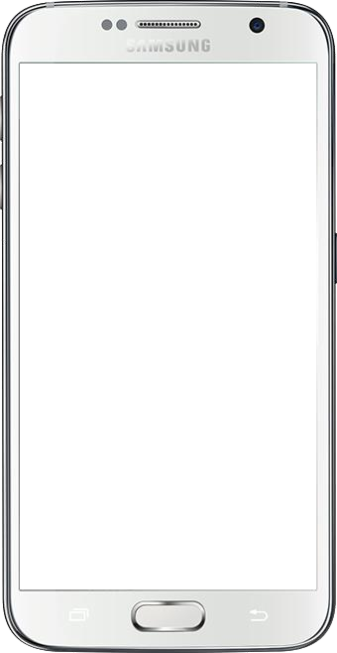
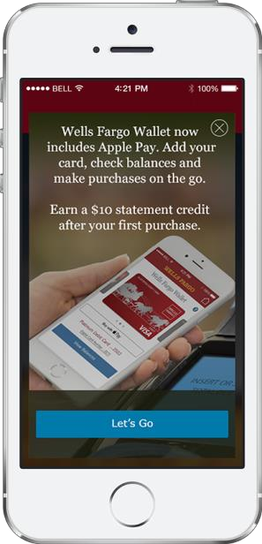
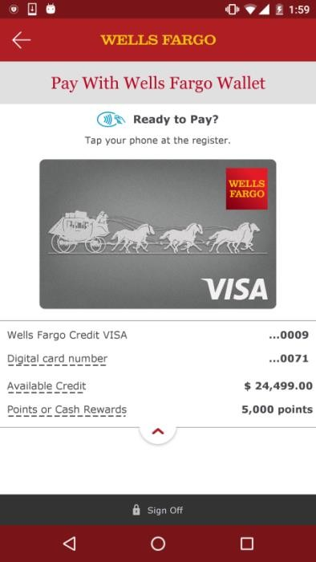
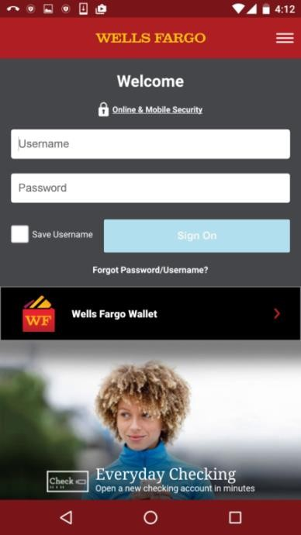
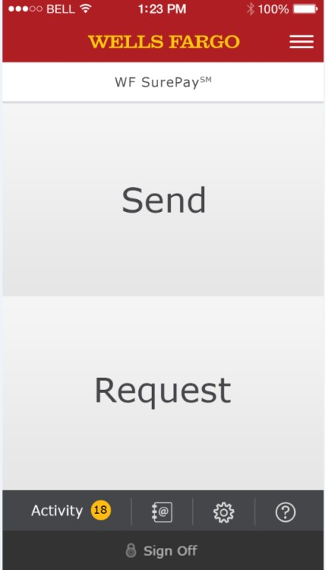
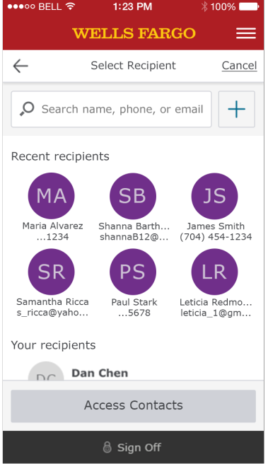
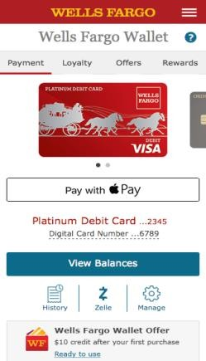
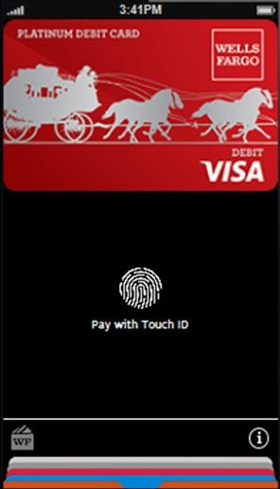
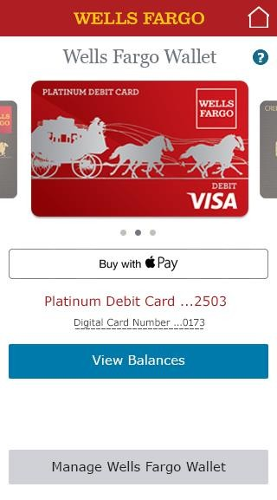
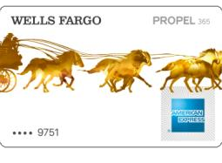





Put
real-time payments
in
our
customers’ hands
Digital
Cards
Zelle
(WF
SurePay)
Rewards Credit Card
Updated experience expected 3Q17
First bank to deliver Zelle
additional features June 2017
experience in mobile app;
Wells Fargo 2017 Investor Day
Payments, Virtual Solutions, and Innovation
16

Slide 18



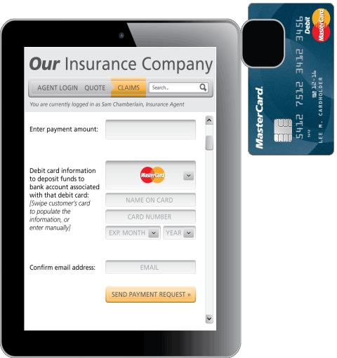
Make business payments
easier and more flexible
Push-to-card
_{Disbursement}
Embedded services through
APIs
and
SDKs
▪ Reach consumer payees using just a debit card number
▪
APIs to enable integration of Wells Fargo into our customers business tools
▪ Funds delivered in 30 minutes
▪
Software Development Kit (SDK) embeds WF
payment options within merchants’ mobile apps (coming soon)
▪ Broad use cases (e.g., benefits payments, insurance claims)
Launched 4Q16
v2.0 expected 2H17
Wells Fargo 2017 Investor Day
Payments, Virtual Solutions, and Innovation 17

Slide 19



Uniquely positioned to serve digital ecosystems
▪ Industry leader in commercial tech banking
▪ A payments provider for eCommerce leaders (e.g., Stripe, Paypal)
▪ Mass customization and integration enabled by API capabilities
▪ Broad consumer scale and reach
▪ Highly engaged digital customer base
Our
_{Strengths}
For platforms
▪ Robust payments processing capabilities
▪ Best-in-class risk and fraud management tools
▪ Seamless integration with digital properties
▪ Co-brand capabilities
For hosted businesses
▪ Financial products relevant to eco-system (e.g., rental property finance)
▪ Streamlined payment acceptance
▪ Small business financial products and advice
For consumers
▪ Cross promotion and integration with WF products
▪ Differentiated value and experiences for WF consumers (e.g., pay with points)
▪ Convenient embedded payment capabilities
Wells Fargo 2017 Investor Day
Payments, Virtual Solutions, and Innovation 18

Slide 20
Our
roadmap
Accelerate digital account acquisition
Provide best-in-class digital payments
Deliver personalized advice at scale
Expand and integrate Wells Fargo distribution
Build a platform for innovation
Wells Fargo 2017 Investor Day
Payments, Virtual Solutions, and Innovation 19

Slide 21








Deliver personalized
advice
at
scale
“How can I manage
_{my day-to-day}
_{budgeting?”}
“How can I build
my
credit for
_{future?”}
the
“How can I develop
_{a regular savings}
_{habit?”}
“How do we create
_{an investment}
_{strategy?”}
Wells Fargo 2017 Investor Day
Payments, Virtual Solutions, and Innovation
20

Slide 22

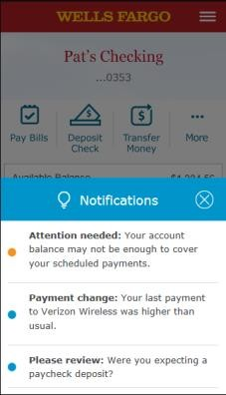
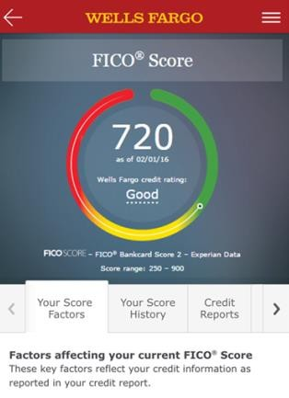
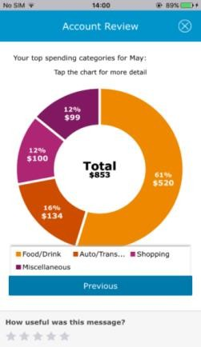



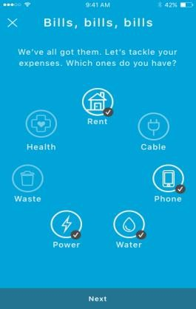
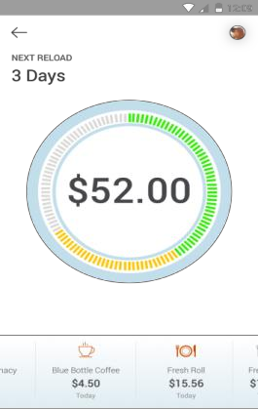


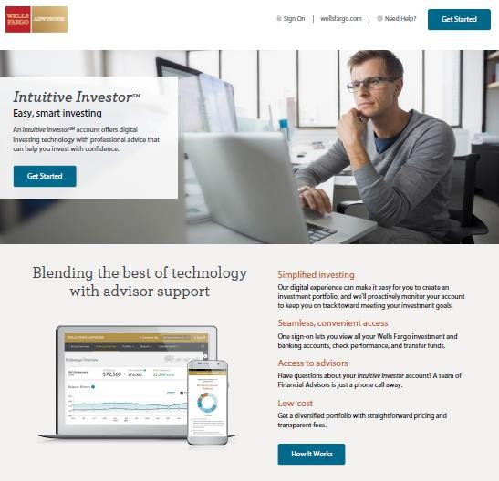


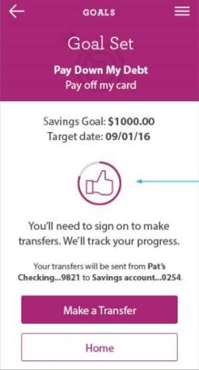
Helping customers
reach their
goals
_{w}
Predictive
_{Banking}
_{Launched 2Q17}
FICO Score
_{Launched 2016}
Spend
Borr
Save
Invest
Consumer Cash
_{Management}
_{Expected 2H17}
Intuitive
_{Investor}
_{Expected 2H17}
Daily Change
_{Launched 4Q16}
Wells Fargo 2017 Investor Day
Payments, Virtual Solutions, and Innovation 21

Slide 23
Our
roadmap
Accelerate digital account acquisition
Provide best-in-class digital payments
Deliver personalized advice at scale
Expand and integrate Wells Fargo distribution
Build a platform for innovation
Wells Fargo 2017 Investor Day
Payments, Virtual Solutions, and Innovation 22

Slide 24


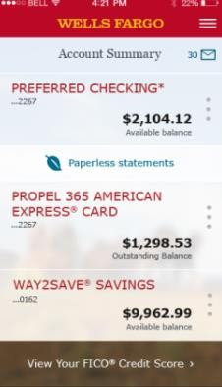
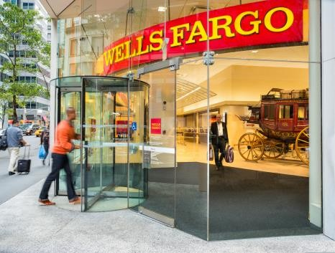


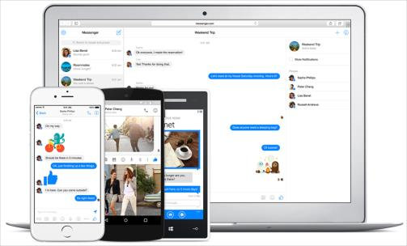




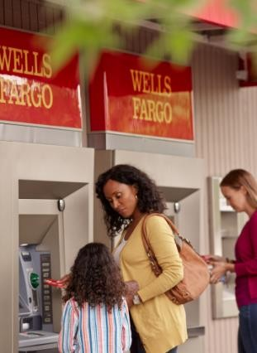
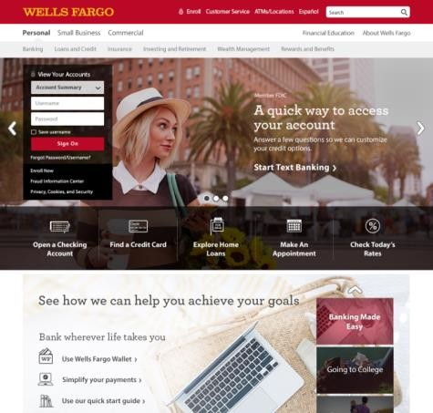



Evolving
with
our
customers’
preferences
3.4B+⁽¹⁾ mobile
600MM+ teller
440MM+
Social
_{media}
transactions
phone calls
secure sessions
Traditional
WF Distribution
2.2B+⁽¹⁾ online
Emerging
900MM+ ATM
_{transactions}
Off-WF websites
Internet of Things
secure sessions
2016. (1) Based on annualized 1Q17 actuals.
All figures represent full year 2016.
Unless noted, all figures represent full year
Wells Fargo 2017 Investor Day
Payments, Virtual Solutions, and Innovation
23

Slide 25


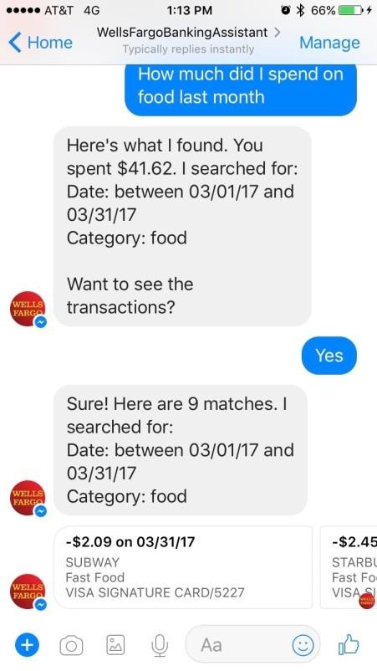
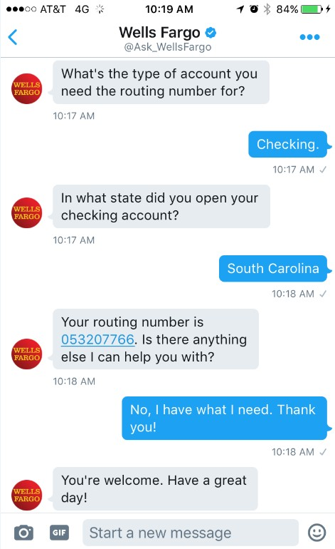


Serving
our
customers in their channel
of
choice
Social
Media
Chatbots
Powered by Kasisto
_{(WF Startup Accelerator)}
Proprietary Bot (WF Labs)
Providing secure access to
_{services on customers’}
_{digital platforms of choice}
Testing hand-offs
between chatbots and messaging service
In pilot
In pilot
Wells Fargo 2017 Investor Day
Payments, Virtual Solutions, and Innovation
24

Slide 26




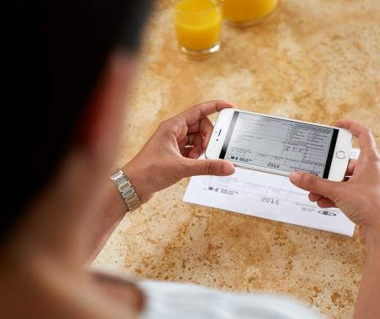



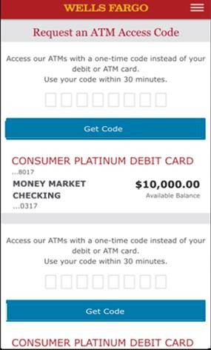
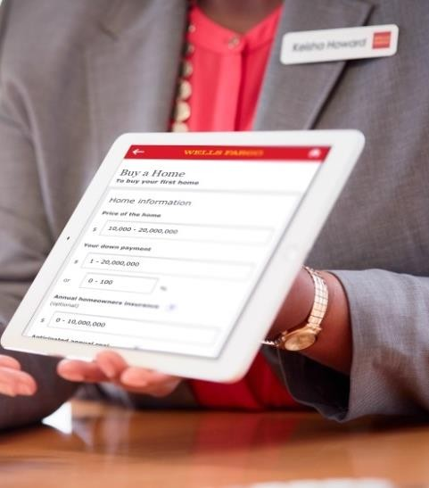

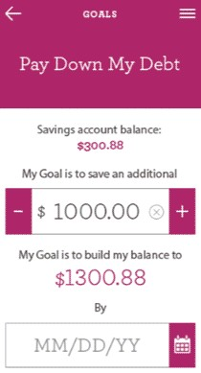

Seamless cross-channel customer experiences
Streamlined digital
_{application}
Digital advocates help create a more
efficient experience in-branch and at home
Mobile document
_{capture}
Faster
_{account open}
Digital
_{self-service}
NFC/Mobile
Digital branch
Financial health phone
_{conversations}
Financial health
_{digital tools}
_{ls Fargo 2017 Investor Day}
Authentication
Advice
Wel
Payments, Virtual Solutions, and Innovation
25

Slide 27
Our
roadmap
Accelerate digital account acquisition
Provide best-in-class digital payments
Deliver personalized advice at scale
Expand and integrate Wells Fargo distribution
Build a platform for innovation
Wells Fargo 2017 Investor Day
Payments, Virtual Solutions, and Innovation 26

Slide 28
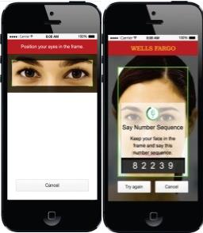
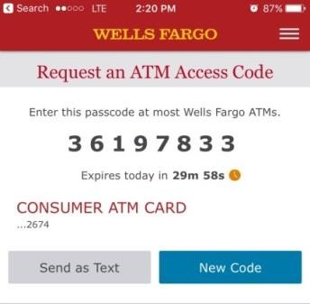

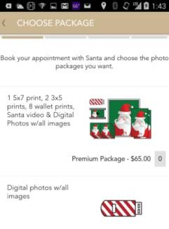


Building enterprise capabilities and
platforms
Capability Key Business Results Examples
▪
Deployed one-time passcodes across
_{channels (e.g., card-free ATM)}
Launched suite of biometric capabilities (e.g., fingerprint, voice, and eye verification)
Introducing new prospect verification capabilities (e.g., selfie technology) and passive authentication (e.g., real time mobile identity services)
One-time passcode
▪
Advanced
_{Authentication}
CEO eyeprint
_{authentication}
▪
▪
8 business solution APIs deployed to
_{date supporting 4 LOBs}
Launched developer portal
20 additional APIs and SDKs planned for deployment by the end of 2017
Payments
APIs and
_{Developer}
_{Gateway}
▪
▪
Push-to-card
_{disbursement}
acceptance kit
▪
Piloted predictive banking capability
(provides insights based on customer behavior)
Delivering financial services information through virtual assistants and chatbots
Chatbot
Banking
Artificial
Intelligence/ Speech and Messaging
▪
Wells Fargo
Predictive
Wells Fargo 2017 Investor Day
Payments, Virtual Solutions, and Innovation 27

Slide 29



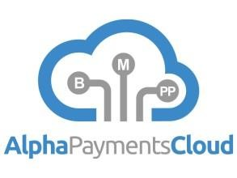










Collaborating to deliver for
our
customers
Startup Accelerator
Recent Collaborative
_{Relationships}
(Launched
2014)
Wells Fargo 2017 Investor Day
Payments, Virtual Solutions, and Innovation
28

Slide 30
Summary
Our Opportunities:
▪ Accelerate digital account acquisition
▪ Provide best-in-class
_{digital payments}
▪ Deliver personalized advice at scale
▪ Expand and integrate our
_{distribution}
▪ Build a platform for innovation
Our Strengths:
✓
Market leadership, scale,
_{and deep relationships}
✓
Strong market positioning
✓
Long track record of
_{innovation}
✓
Focused strategy and
_{aligned team}
✓
Clear mandate to drive
_{change on behalf of the}
_{enterprise}
Wells Fargo 2017 Investor Day
Payments, Virtual Solutions, and Innovation 29

Slide 31
Biography

Slide 32
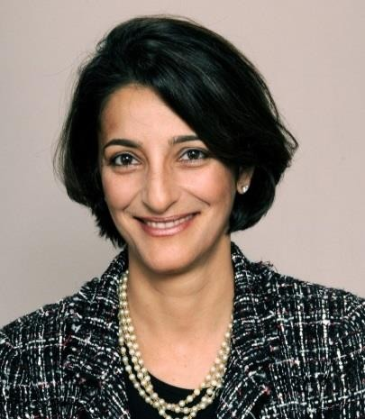
Avid Modjtabai
Senior Executive Vice President,
Payments, Virtual Solutions, and Innovation
▪
Avid Modjtabai is responsible for Wells Fargo’s Payments, Virtual Solutions and
Innovation (PVSI) group, and leads approximately 35,000 team members. The PVSI group brings together the company’s robust payments platforms, digital capabilities, online, mobile and phone channels and innovation teams. PVSI includes Deposits, Card and Retail Services, Treasury Management, Merchant Services, Virtual Channels, Operations, and the Enterprise Innovation Group.
A 24-year veteran of Wells Fargo, Modjtabai has served in a number of senior leadership roles prior to leading PVSI including: head of the Consumer Lending Group and enterprise-wide Operations, head of the Technology and Operations Group and Chief Information Office, head of Human Resources, and head of the Internet Services Group.
Modjtabai has been named as one of the “Most Powerful Women in Banking” by American Banker. Additionally, she received the “Ellis Island Medal of Honor,” awarded for her outstanding personal and professional achievements, coupled with preserving the richness of her heritage.
As an active member of the community, she serves on the board of trustees for The Marine Mammal Center and on the board of directors for Avnet, Inc., a leading global technology distributor.
She earned a Bachelor’s degree in industrial engineering from Stanford
University and an MBA in finance from Columbia University.
▪
▪
▪
▪
Wells Fargo 2017 Investor Day
Payments, Virtual Solutions, and Innovation 31

