Slide 1
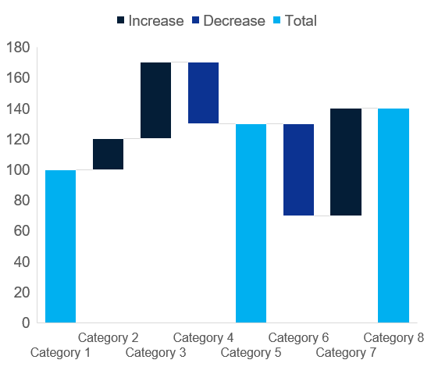
Doughnut / Waterfall
Click to edit Header text styles
Click to edit Header text styles
Source: Complete if required

