Slide 2
The Sustainability Tracking, Assessment & Rating System™ (STARS) is a transparent, self-reporting framework for colleges and universities to measure their sustainability performance.

Slide 3
Gain international recognition for your sustainability efforts.
Join the hundreds of higher education institutions around the world that have already earned a STARS Rating.
Rated institutions are featured in AASHE’s annual Sustainable Campus Index (SCI), which highlights best practices and top performers by impact area and institution type, and are included in the STARS Benchmarking Tool, which allows AASHE members to compare institutions on their sustainability performance.
Create a baseline for continuous improvement.
STARS will allow you to comprehensively measure your institution’s current sustainability performance and assess your progress, both internally and in comparison to peer institutions.
The STARS rating gave our institution something to celebrate, and the credits provided both food for thought in terms of what goals are achievable in our current context and what we might try to achieve in the long term.
We now have more of a common vocabulary to talk about STARS-related topics. We also know where we need to go to improve in each of the categories. And because we are working with STARS, we have greater validity with others to get some of these other improvements developed and implemented.

Slide 4
Generate new ideas.
Whether your institution is just starting out or an established leader in sustainability, STARS will help you identify best practices that you can implement locally.
The biggest benefit of STARS was that it has generated new ideas. Given that STARS is so widely used, the credits we were not able to attain are looked at as suggestions that we hope to implement in the future.
Inform strategic planning and budgeting.
STARS can serve as a framework to help integrate sustainability into your institution’s planning and development efforts. Participants have used STARS as the basis for their sustainability reports and strategic sustainability plans. In addition, your STARS rating or score can be incorporated into your institution’s overall strategic plan as an indicator of progress toward sustainability.
Due to administrative changes at the institution, it was very difficult to generate momentum and interest, however, the results of the data collection will be used to draft a Sustainability Strategic Plan which will fulfill the requirements of the College Strategic Plan.

Slide 5
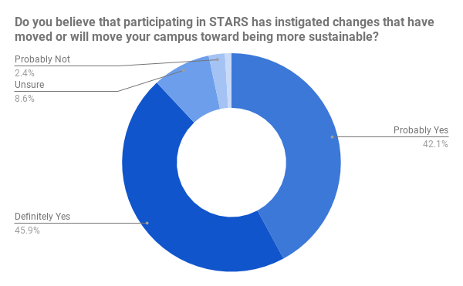
Make real progress towards sustainability.
Nine out of ten participants report that STARS has instigated changes that have moved or will move their institutions toward being more sustainable.

Slide 6
How does it work?
Eligibility
Any college or university in the world may participate in STARS. Other educational institutions are also welcome.
There are two levels of access available:
Basic Access - Free
Full Access - Required to submit a scored, rated Report

Slide 7
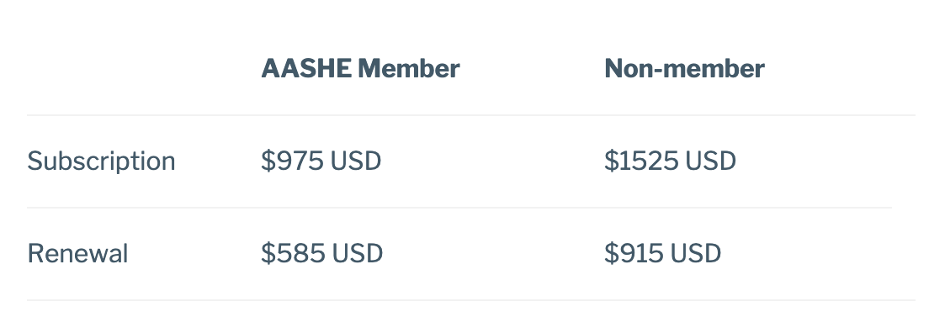
Full Access Fees
40% renewal discount (within 90 days of expiration)
Additional discounts for institutions outside the OECD

Slide 8
Categories
AC
EN
Academics
Engagement
OP
PA
Operations
Planning & Administration
IN
Innovation & Leadership

Slide 9
Subcategories
AC
Curriculum
Research
EN
Campus Engagement
Public Engagement
OP
Air & Climate
Buildings
Energy
Food & Dining
Grounds
Purchasing
Transportation
Waste
Water
PA
Coordination & Planning
Diversity & Affordability
Investment & Finance
Wellbeing & Work
IN
Exemplary Practice
Innovation

Slide 10
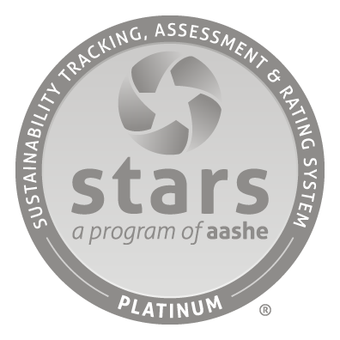
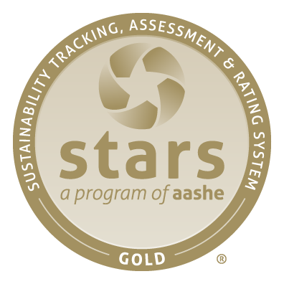
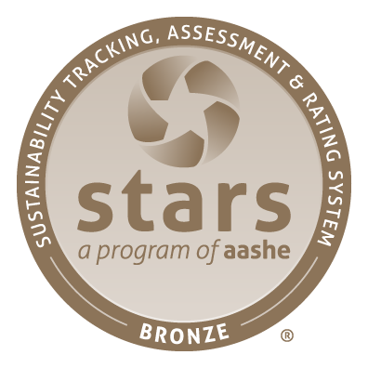
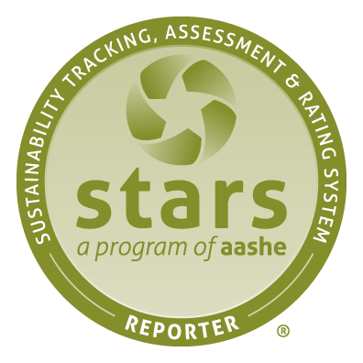
Public Recognition

Slide 11
Scoring
Percentage Score
(% of points earned)
Score
85 +
65 - 84
45 - 64
25 - 44
----
Recognition Level
Platinum
Gold
Silver
Bronze
Reporter
+
Innovation & Leadership pts
=
Overall STARS Score

Slide 12
Timeframes
Each STARS report and rating is valid for up to 3 years.
A report may be submitted as often as once per year.
Each full access subscription is valid for 12 months.
Annual deadlines exist for:
AASHE’s Sustainable Campus Index
Princeton Review’s annual green rankings

Slide 13
Reporting Process
Basic access
Full access
Complete credits
Monitor score
Submit report (and executive letter)
Collaborative review and revision
Report published as Reporter
Rating awarded

Slide 14
Resources
Data Collection:
Benchmarking:
Technical Manual
Help Center
Forms & Templates
Data Collection tab
Data Displays
Benchmarking Tool

Slide 15
Please contact us at:
stars@aashe.org

